Slide 1

Status and roadmap of the AlFa Framework
Mohammad Al-Turany
GSI-IT/CERN-PH-AIP

Slide 2
Just to remind you what is “AlFa”
Will rely on a data-flow based model (Message Queues).
It will contain
  Transport layer (based on: ZeroMQ, NanoMSG)
  Configuration, building and testing tools (infrastructure)
  Management and monitoring tools
Provide unified access to configuration parameters and databases.
It will include support for a heterogeneous and distributed computing system.
Incorporate common data processing components

Slide 3
And What is NOT in Alfa
Monte-Carlo simulation (Transport)
  AlFa will use the output of the Monte-Carlo simulation for developing the re-construction
GRID
  AlFa Should be seen as an application which could run in any distributed system Grid or what ever will be there in 2018

Slide 4
Where we are now?
We can choose between two transport layers and we could add new options if needed
  ZeroMQ
  Nanomsg

Slide 5
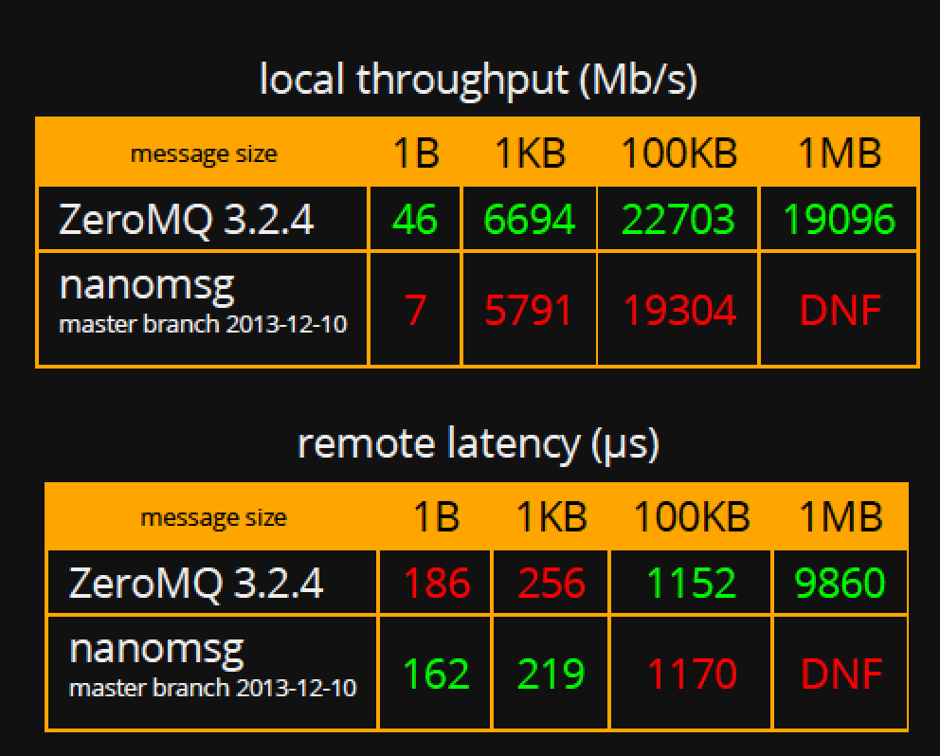
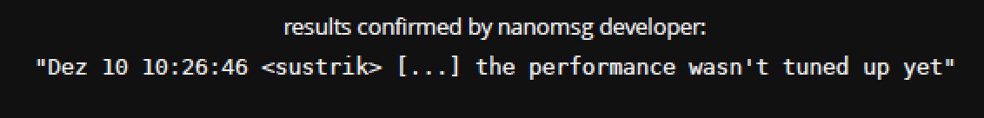
ZeroMQ vs. nanomsg
Alexey Rybalchenko
https://github.com/nanomsg/nanomsg/issues/206

Slide 6
Protocol buffers
Alexey Rybalchenko
Google Protocol Buffers support is now implemented
  Example in Tutorial 3 in FairRoot.
To use protobuf, run cmake as follows:
  cmake -DUSE_PROTOBUF=1

Slide 7
Boost serialization
Nicolas Winckler
Code portability - depend only on ANSI C++ facilities.
Code economy - exploit features of C++ such as RTTI, templates, and multiple inheritance, etc. where appropriate to make code shorter and simpler to use.
Independent versioning for each class definition. That is, when a class definition changed, older files can still be imported to the new version of the class.
Deep pointer save and restore. That is, save and restore of pointers saves and restores the data pointed to.
….
http://www.boost.org/doc/libs/1_55_0/libs/serialization/doc/index.html
This is used already by the CBM Online group in Frankfurt and to we need
it to communicate with them!

Slide 8
Protobuf, Boost or Manual serialization?
Nicolas Winckler
Alexey Rybalchenko
Boost:
  we are generic in the tasks but intrusive in the data class (digi, hit, timestamp)
Manual and Protobuf
  we are generic in the class but intrusive in the tasks (need to fill/access payloads from class with set/get x, y, z etc ).
Manual method is still the fastest, protobuf is 20% slower and boost is 30% slower.
preliminary

Slide 9
Dynamic Deployment System
Deploy executables
Use (utilize) any RMS (Slurm, Grid Engine, … ),
Secure execution of nodes (watchdog),
Support different topologies and user process dependencies,
Support a central log engine
….
Anar Manafov
Andrey Lebedev
See talk by Anar today

Slide 10
Templated Digi-loader and File-sink are under development
This is the interface between the simulation data driven framework.
Data is read from ROOT files, converted to raw data format (if necessary) and then send as messages over the network.
(de)serialise of digis and/or hits
It can use manual serialization of messages, boost serialization and/or protobuf
Nicolas Winckler

Slide 11

New Proto-Type for ALICE
Use the existing geometry of the ITS and TPC detectors
Port the stepping managers to FairRoot
Make a simple simulation of ALICE detector that can be used with the generic digi-loader as a first step for developing algorithms in AlFa later.
Charalampos Kouzinopoulos

Slide 12
FAIR: Next steps
  Testing the full reconstruction chain with the First Level Event Selector cluster (FLES) of the CBM experiment
  Integrate the GPU triplet finder (CUDA code) of PANDA experiment into the Framework

Slide 13

ALICE: Next steps
Continue developing the simulation proto type (see talk by Charis today)
Implement (port) the TPC and ITS digitization to the proto type and adapt them to the pile up simulation in FairRoot
Use the generic loaders (data samplers) on the time frames generated by the proto type

