Slide 1


ALICE Grid operations: last year and perspectives
(+ some general remarks)
ALICE T1/T2 workshop
Tsukuba
5 March 2014
Latchezar Betev
Updated for the ALICE week 20/03/2014

Slide 2
On the T1/T2 workshop
Fourth workshop in this series
  CERN – May 2009 (pre-data-taking) - ~45 participants
  KIT – January 2012 – 47 participants counted
  CCIN2P3 – June 2013 – 46 registered (45 counted)
  Tsukuba* - March 2014 – ~45 participants (Grid sites)
Main venue for discussions on ALICE-specific Grid operations, past and future
  Site experts+Grid software developers
  Throughout the year - communication by e-mail
  …and tickets (the most de-humanizing system)
*-the only city without a computing centre for ALICE

Slide 3
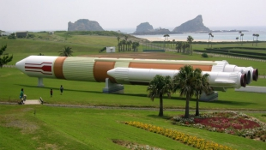

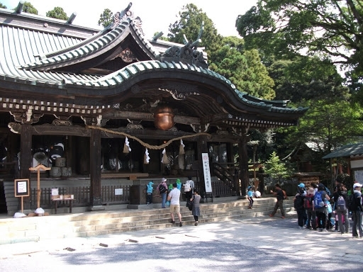
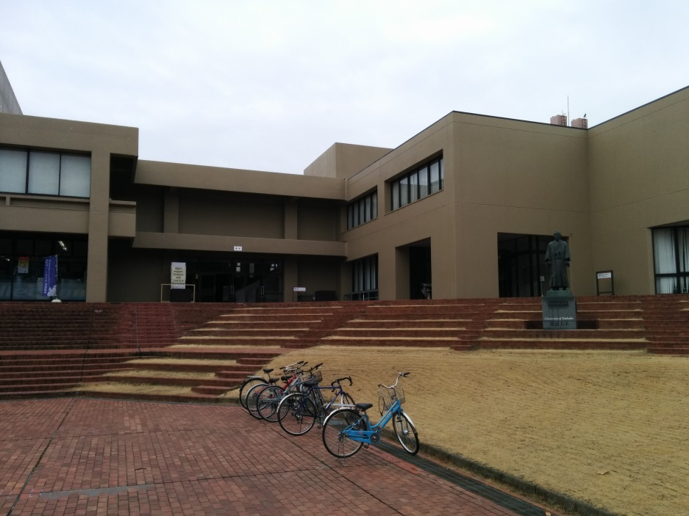
On the T1/T22 workshop (2)

Slide 4
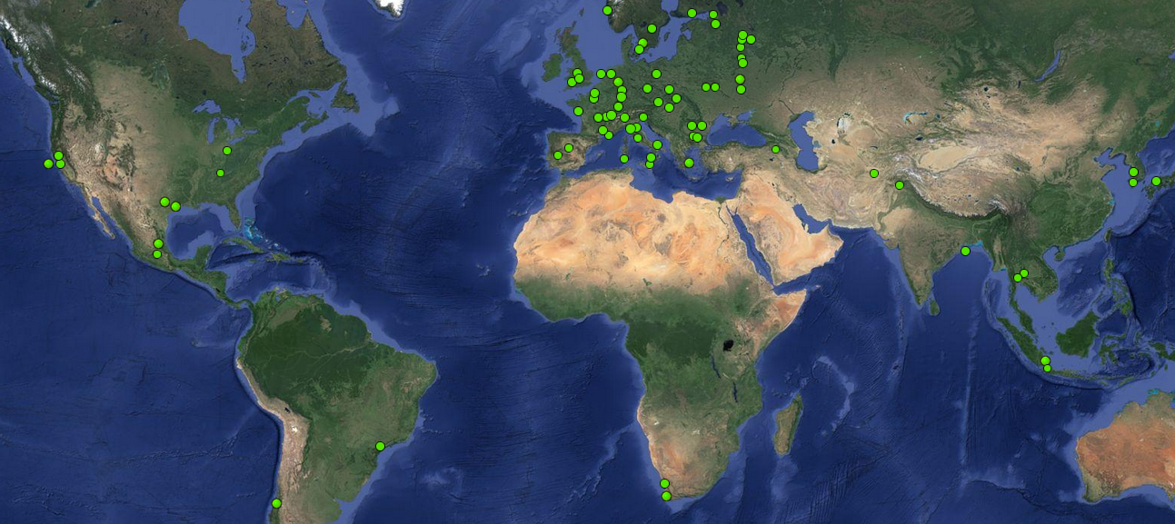
The ALICE Grid
8 in North America
4 operational
4 future + 1 past
53 in Europe
10 in Aisa
8 operational
2 future
2 in Africa
1 operational
1 future
2 in South America
1 operational
1 future

Slide 5
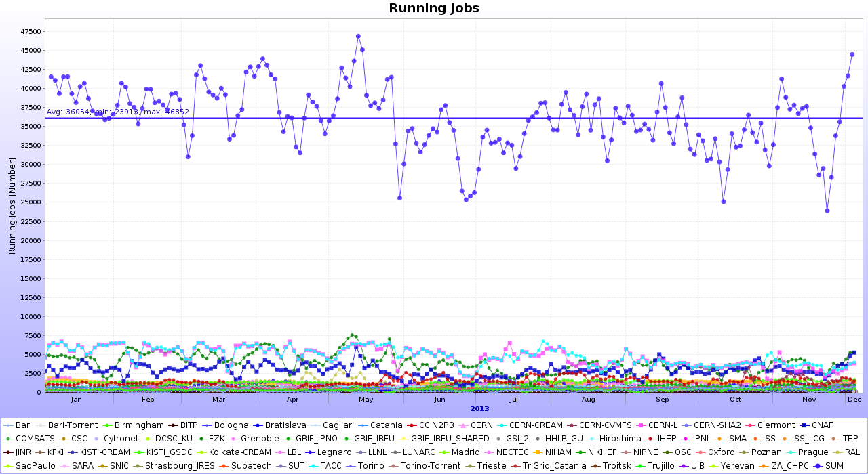
Grid job profile in 2013
Average 36K jobs
Steady state, later on what we did with all this power

Slide 6
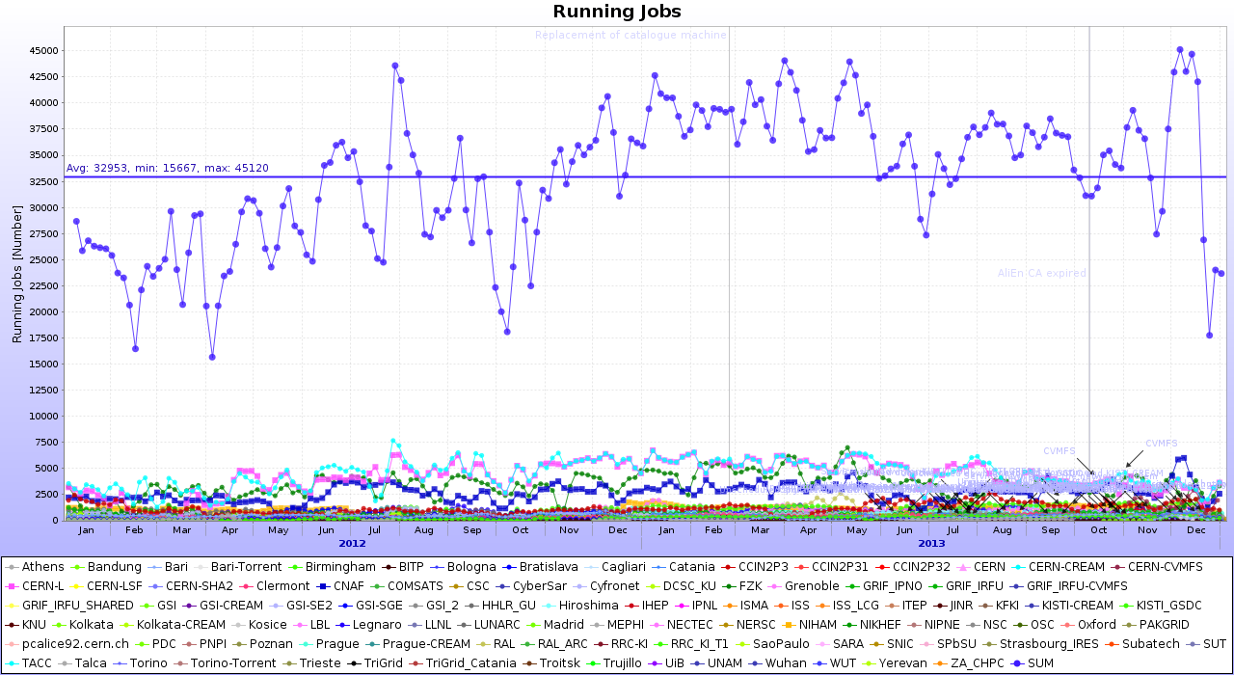
The GRID job profile in 2012
Average 33K jobs
Installation of new resources
through the year visible

Slide 7
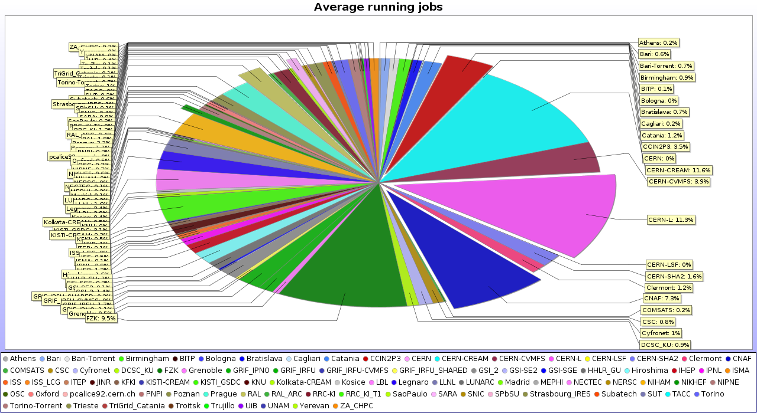
Resources delivery distribution
The remarkable 50/50 share T1/T2 is still alive
and well

Slide 8
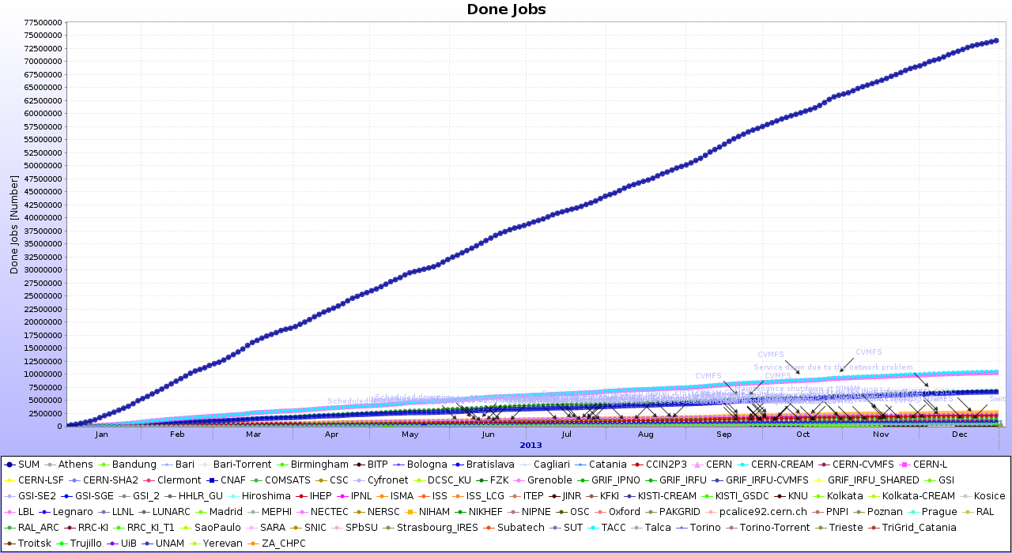
Done jobs
~250K job per day, no slope change, i.e. mixture of jobs is steady
(for comparison, ATLAS has in average 850K completed jobs/day)

Slide 9
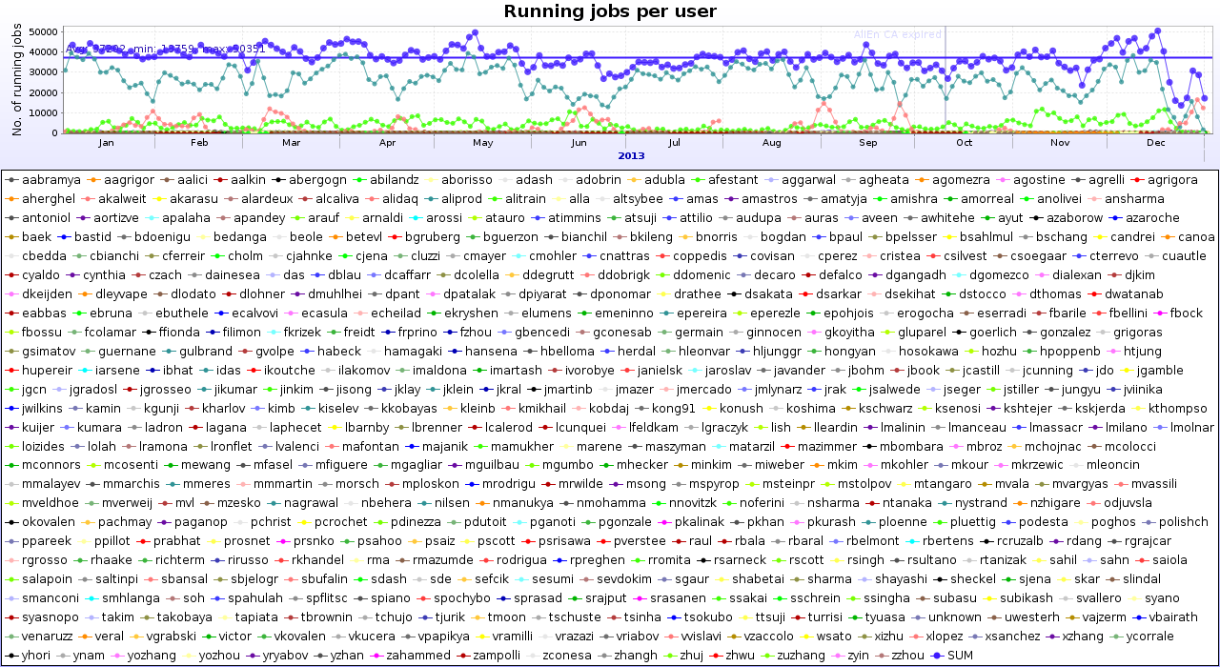
Job mixture
69% MC, 8% RAW, 11% LEGO, 12% individual, 447 individual users

Slide 10
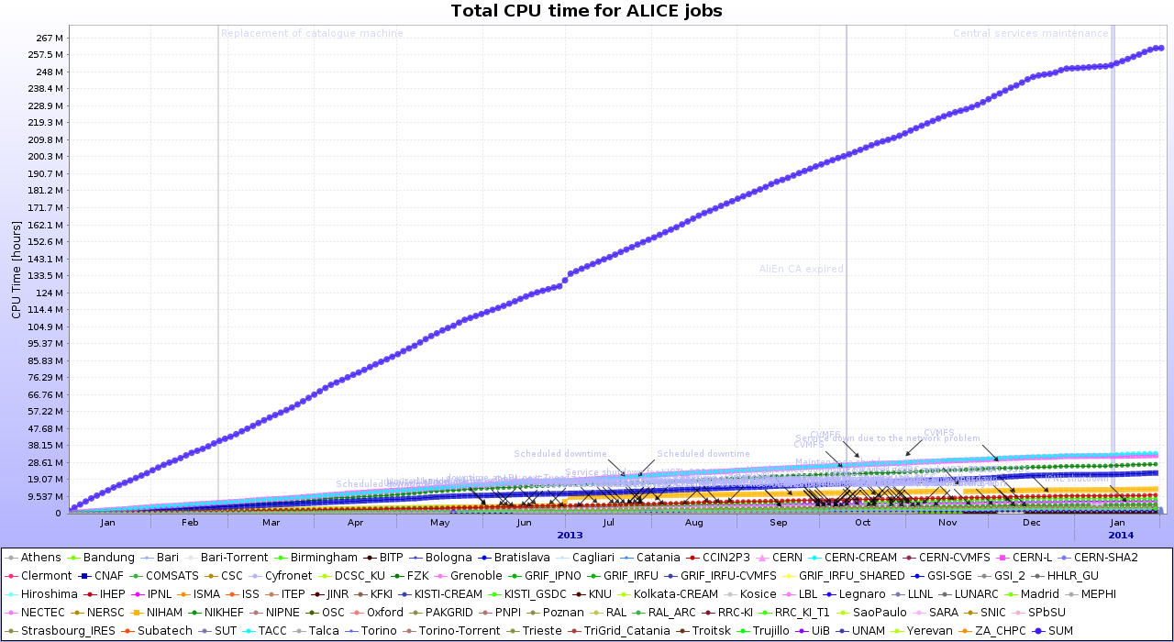
CPU and Wall time
262M CPU hours, 324M Wall => 81% global efficiency

Slide 11
Year 2013 in brief
‘Flat’ CPU and storage resources
  However we had 8% more job slots in average in 2013 than in (second half) of 2012
  Mostly due to Asian (KISTI) sites increasing their CPU capacity, some additional capacity installed at few European sites
  Storage capacity has increased by 5%
Stable performance of the Grid in general
  The productions and analysis unaffected by upgrade stops at many sites

Slide 12
Production cycles MC
93 production cycles from beginning of the calendar year
  For comparison – 123 cycles in 2012; 639,597,409 events
767,433,329 events
  All types – p+p, p+A, A+A
  Anchored to all data-taking years – from 2010 to 2013

Slide 13
AOD re-filtering
46 cycles
  From MC and RAW, from 2010 to 2013
Most of the RAW data cycles have been ‘refiltered’
Same for the main MC cycles
This method is fast and reduces the need for RAW data reprocessing

Slide 14
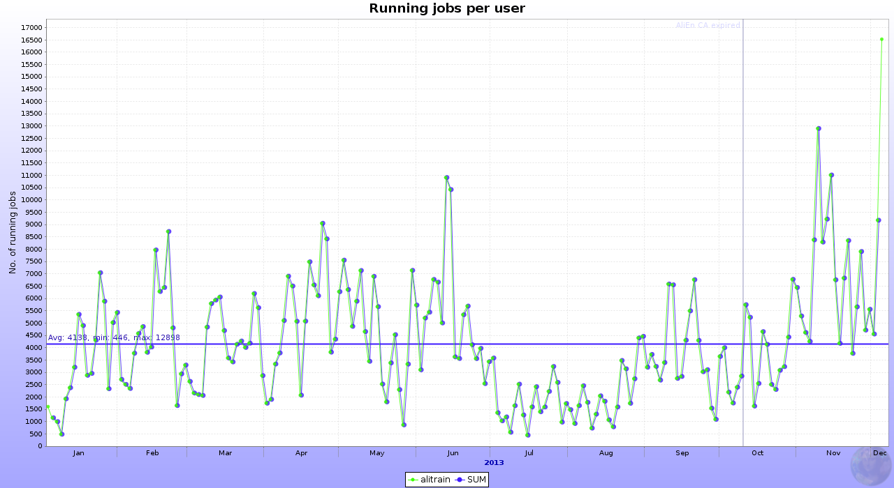
Analysis Train
More active in specific periods, increase in the past months (QM)
4100 jobs, 11% of Grid resources
75 train sets for the 8 ALICE PWGs
1400 train departure/arrivals in 49 weeks => 28 trains per week…

Slide 15
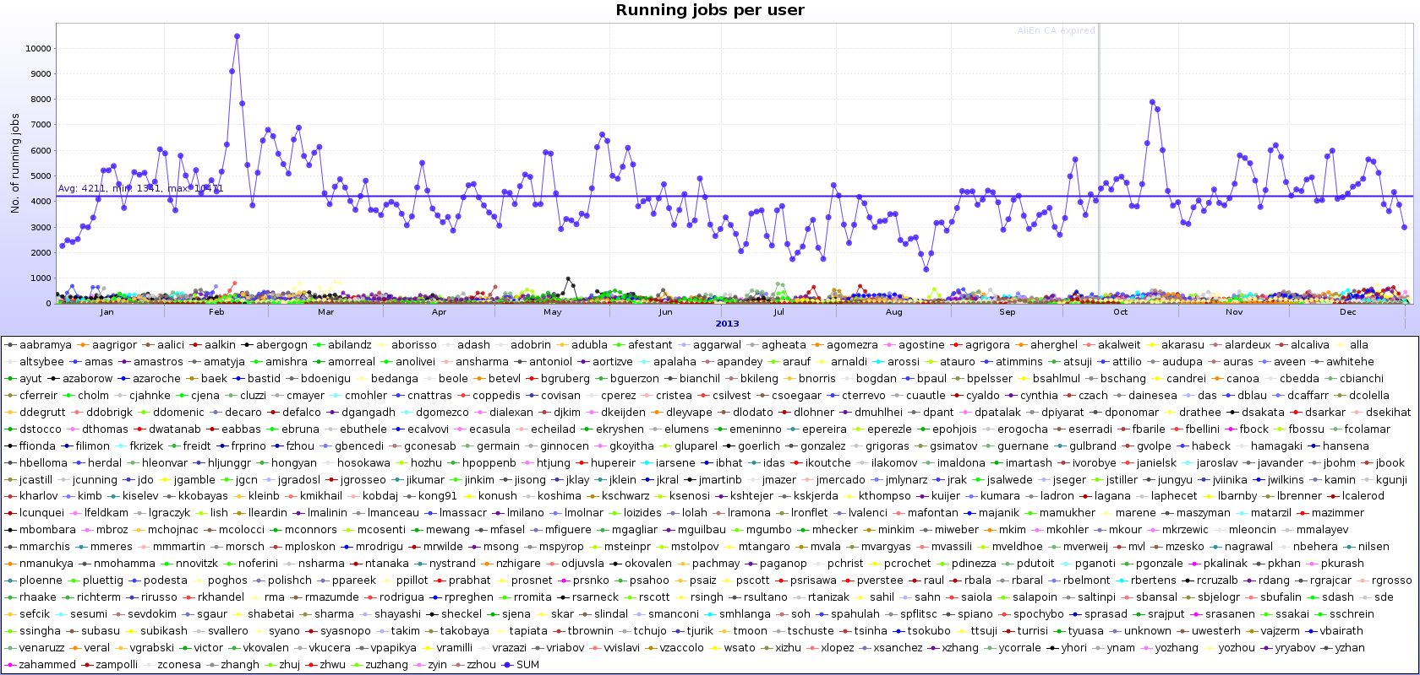
Summary on resources utilization
The above activities use up to 88% if the total resources made available to ALICE
The remaining 12% is individual user analysis
447 individual users

Slide 16
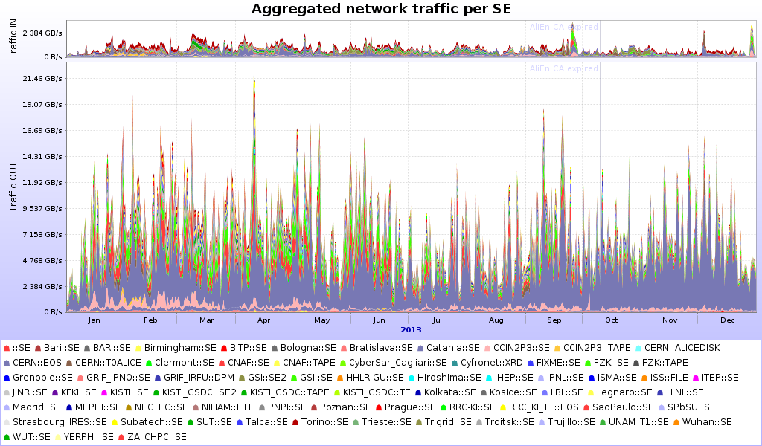
Access to data (disk SEs)
69 SEs, 29PB in, 240PB out, ~10/1 read/write

Slide 17
Data access 2
99% of the data read are input (ESDs/AODs) to analysis jobs, the remaining 1% are configurations and macros
From LEGO train statistics, ~93% of the data is read locally
  The job is sent to the data
The 7% is file cannot be accessed locally (either server not returning it or file missing)
  In all such cases, the file is read remotely
  Or the job has waited for too long and is allowed to run anywhere to complete the train (last train jobs)
Eliminating some of the remote access (not all possible) will increase the global efficiency by few percent
  This is not a showstopper at all, especially with better network

Slide 18
Storage availability
More important question – availability of storage
ALICE computing model – 2 replicas => if SE is down, we lose efficiency and may overload the remaining SE
  The CPU resources must access data remotely, otherwise there will be not enough to satisfy the demand
In the future, we may be forced to go to one replica
  Cannot be done for popular data

Slide 19
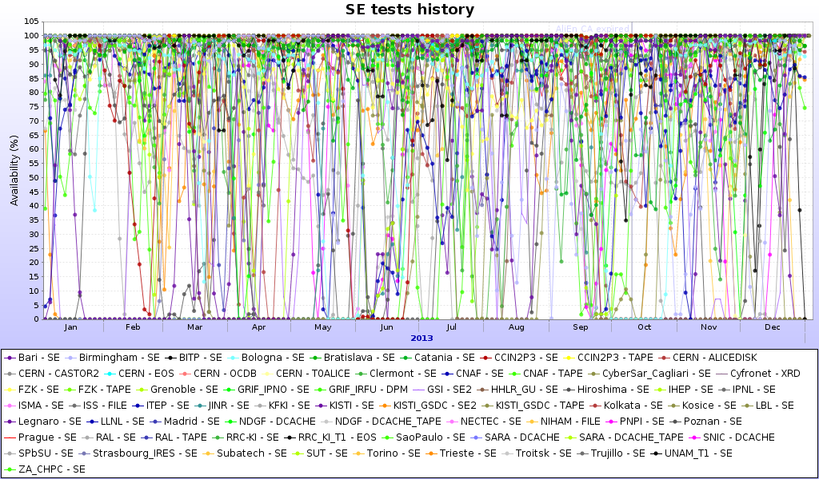
Storage availability (2)
Average SE availability in the last year: 86%

Slide 20
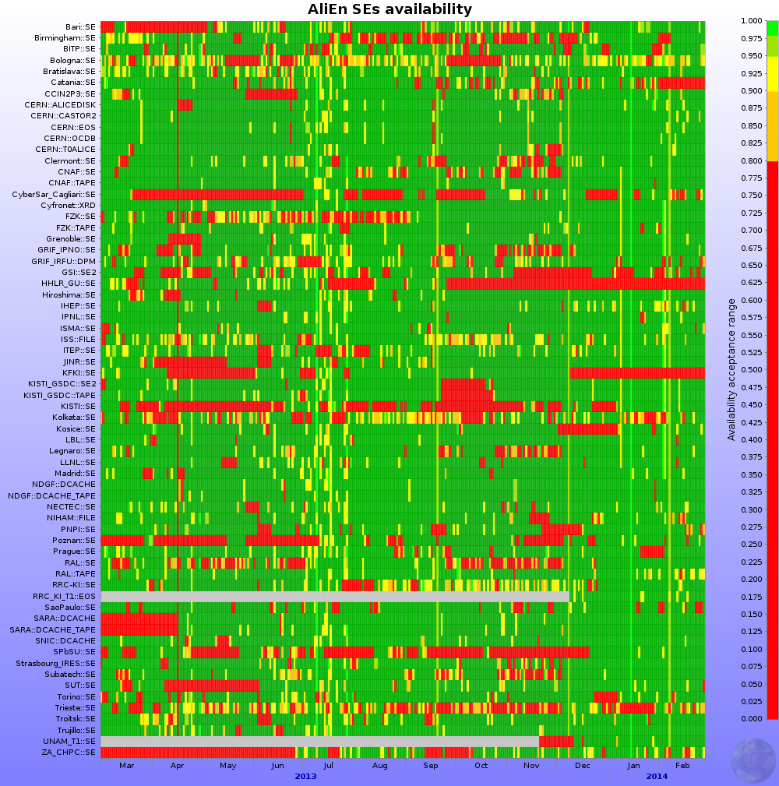
Alternative representation
Green – good
Red – bad
Yellow/orange - bad
Some SEs do have
extended ‘repair’
times…
Oscillating ‘availa-
bility’ is also well
visible

Slide 21
Storage availability
Extensive ‘repair’, upgrade times, down times
  Tolerated due to the existing second replica for all files
Troubles with underlying FS
  Some SEs – xrootd gateways over GPFS/Lustre/Other
  Fast file access and multiple open files are is not always supported well
  Issues with tuning of xrootd parameters
  Limited number of gateways (traffic routing), can hurt the site performance
  xrootd works best over a simple Linux FS
How to solve this – storage session on Thursday
Goal for SE availability >95%

Slide 22
Other services
Nothing special to report
  Services are mature and stable
  Operators are well aware of what is to be done and where
  Ample monitoring is available for every service (more on this will be reported throughout the workshop)
  Personal reminders needed from time to time
  Several services updates were done in 2013…

Slide 23
Major upgrade events
xrootd version – smooth, but not yet done at all sites
  Purpose – more stable server performance, rehearsal for xrootd v.4 (IPv6-compliant)
EMI2/3 (including new VO-box) – mostly smooth – more in Maarten’s talk
SL(C)5 (or equivalent) ->SL(C)6 (or equivalent) – smooth, for some reason not yet complete…
Torrent->CVMFS – quite smooth, two (small) sites remaining

Slide 24
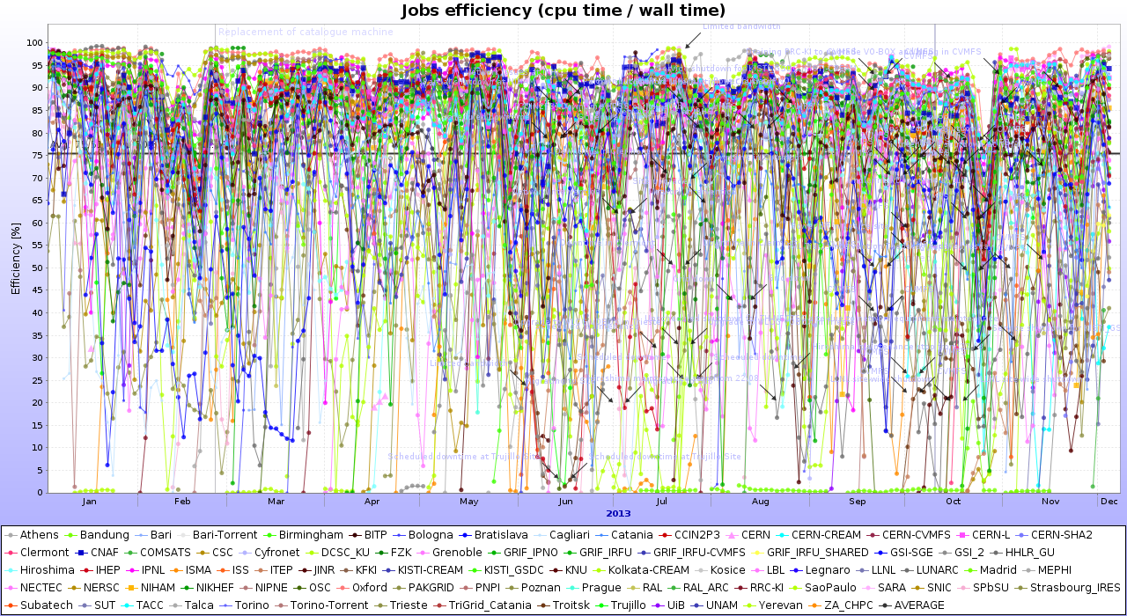
The Efficiency
Average of all sites: 75% (unweighted)

Slide 25
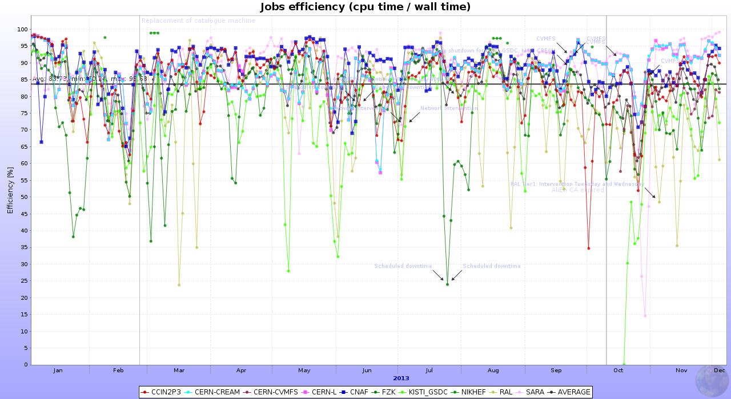
Closer look – T0/T1s
Average – 85% (unweighted)

Slide 26
Summary on efficiency
Stable throughout the year
T2s efficiencies are not much below T0/T1s
  It is possible to equalize all, it is in the storage and networking
Biggest gains through
  Inter-sites network improvement (LHCONE); networking session on Friday
  Storage – keep it simple – xrootd works best directly on a Linux FS and on generic storage boxes

Slide 27
What’s in store for 2014
Production and analysis will not stop – know how to handle these, nothing to worry about
  Some of the RAW data production is left over from 2013
Another ‘flat’ resources year – no increase in requirements
Year 2015
  Start of LHC RUN2 - higher luminosity, higher energy
  Upgraded ALICE detector/DAQ – higher data taking rate; basically 2x the RUN1 rate

Slide 28
What’s in store for 2014 - sites
We should finish with the largest upgrades before March 2015
  Storage – new xrootd/EOS
  Services updates
  Network – IPv6, LHCONE
  New sites installation – Indonesia, US, Mexico, South Africa
  Build and validate new T1s – UNAM, RRC-KI (already on the way)

Slide 29
Ramp up to 2015
Some (cosmics trigger) data taking will start June-October 2014
  This concerns the Offline team – nothing specific for the sites
Depending on the ‘intensity’ of this data taking, or how many thing got broken in the past 2 years
  The central team may be a bit less responsive for site queries

Slide 30
Last trimester of 2014
ALICE will start standard shifts
Technical, calibration and cosmics trigger runs
Test of new DAQ cluster – high throughput data transfers to CERN T0
  Does not affect T1s… since we do data transfer continuously
Reconstruction of calibration/cosmics trigger data will be done
Expected start of data taking – spring 2015

Slide 31
Summary
Stable and productive Grid operations in 2013
Resources fully used
Software updates successfully completed
MC productions completed according to requests and planning
  Next year – continue with RAW data reprocessing and associated MC
Analysis – OK
2014 - focus on SE consolidation, resources ramp-up for 2015 (where applicable), networking, new sites installation and validation

Slide 32
A big Thank You to all sites providing resources for ALICE and their ever-vigilant administrators
A big Thank You to the Tsukuba organizing committee for hosting this workshop

Slide 33
Summary of the workshop
63 participants (first day – common session)
54 participants next days
Record participation!

Slide 34
General Themes
Wednesday – Grid operations, computing model, AliEn development, WLCG development, resources
  Two very interesting external presentations on Tokyo T2 and Belle II experiment – we thank the presenters for sharing their experiences and ideas
Thursday – Storage and monitoring
Friday - Networking

Slide 35
Site themes
17 regional presentations
2 site-specific presentations
News on Indonesia, US and China

Slide 36
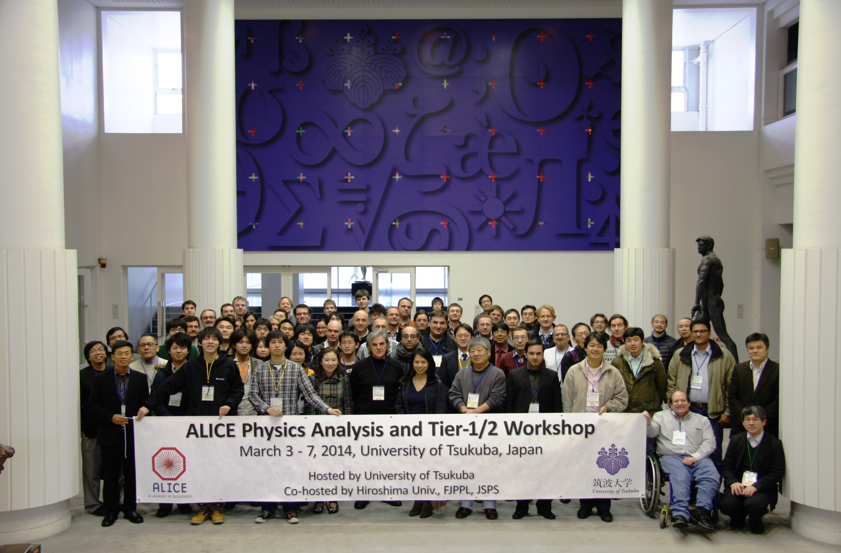
Finally… the group photo

