Slide 1
Results (and Problems) of PHIN Run Summer 2013
Christoph Hessler, Eric Chevallay, Steffen Doebert, Valentin Fedosseev, Irene Martini, Mikhail Martyanov
CLIC/CTF3 experimental verification meeting
04.03.2014

Slide 2
Problems (and Results) of PHIN Run Summer 2013
Christoph Hessler, Eric Chevallay, Steffen Doebert, Valentin Fedosseev, Irene Martini, Mikhail Martyanov
CLIC/CTF3 experimental verification meeting
04.03.2014

Slide 3
Original Plans
Lifetime studies with Cs₃Sb cathode and green light
  Under improved vacuum conditions (new NEG pump)
  With 5 µs (2.5 µs) long pulse trains
  With 5 Hz operation
Feedback stability tests
Dark current studies
  Measurements with Cs₃Sb and Cu cathodes
  Try to see field emission spots with camera looking into the gun

Slide 4
Original Plans
Lifetime studies with Cs₃Sb cathode and green light
  Under improved vacuum conditions (new NEG pump)
  With 5 µs (2.5 µs) long pulse trains
  With 5 Hz operation
Feedback stability tests
Dark current studies
  Measurements with Cs₃Sb and Cu cathodes
  Try to see field emission spots with camera looking into the gun

Slide 5
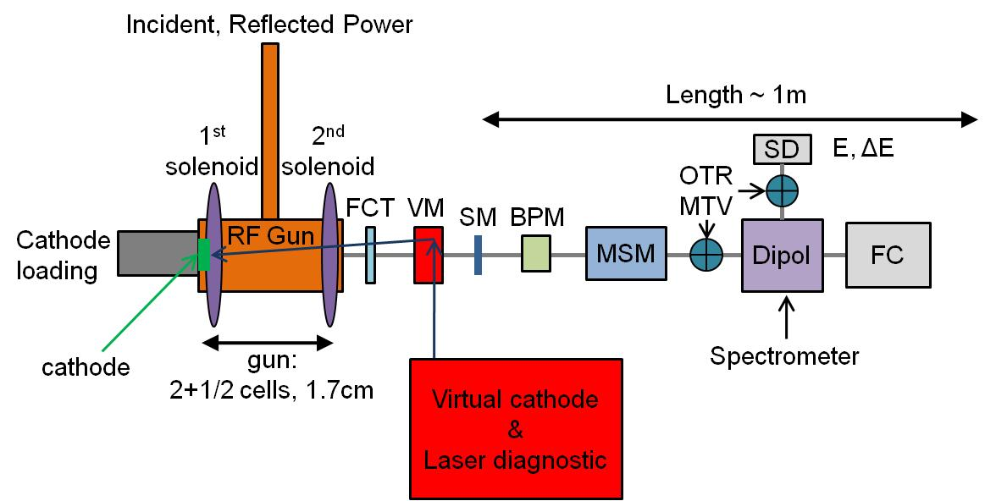
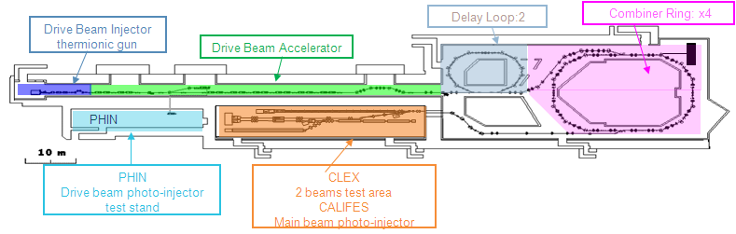
Layout of PHIN
FCT: Fast current transformer
VM: Vacuum mirror
SM: Steering magnet
BPM: Beam position monitor
MSM: Multi-slit Mask
OTR: Optical transition radiation screen
MTV: Gated cameras
SD: Segmented dump
FC: Faraday cup

Slide 6
Available Beam Instrumentation (1)
For the long-pulse tests, the Faraday cup (FC) was separated from the vacuum system and operated in air. A vacuum window was installed.
As a consequence the FC was no longer 50 Ω terminated.
During the preparation works a leak at the insulator glass tube, needed for the fast current transformer (FCT), was detected.
As a consequence the FCT has been replaced by an old wall current monitor (WCM) with different bandwidth.
⇒ Only “unknown” instruments for current / charge
measurement were available!

Slide 7
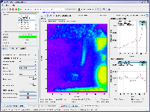
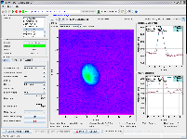
Available Beam Instrumentation (2)
BTV screen CT.MTV0265 was “blind” during PHIN run 2012 due to residual green laser light, back reflected from the cathode.
To solve this issue a notch filter for 532 nm was installed in front of the Proxitronic camera:
Some residual green light was also visible on screen CT.MTV0305 for high intensities, but this was less critical.
Installation of notch filter for 2nd screen for next PHIN run.
without notch filter
with notch filter

Slide 8
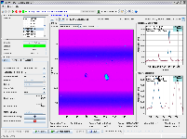
Virtual Cathode Camera
Camera has been replaced at the beginning by one, which was directly placed in the image plane.
However, the field of view was to small for the range in which the beam position can move.
It has then be replaced again by the old camera in the old configuration (focused to the image plane).
However, the old camera shows
strange horizontal lines and
should be replaced for the next run:

Slide 9
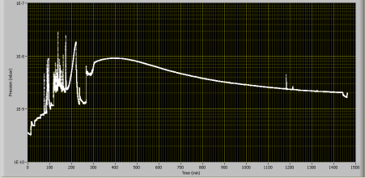
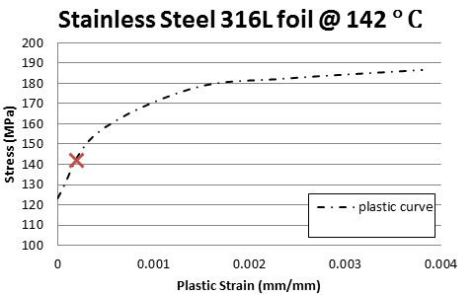
Vacuum Window and Protection (1)
In 2012 strong pressure increase due to
Faraday cup heating was observed for
relatively high beam intensity.
Maximum achievable beam intensity:
5 µs long pulse trains with 2.7 nC/bunch
(limited by klystron power)
→ 1.3E14 electrons/train
→ 500 W maximum beam power
Intensity too high for uncooled Faraday cup!
Operation of FC in air, separated by exit window from beam line.
Fluka studies showed, that only Beryllium
can withstand maximum beam intensity at minimum achievable beam size.
(Thanks to M. Brugger and M. Delonca)
Cathode #189 (PHIN run 2012)
Pressure increase to 2e-7 mbar
Courtesy:
M. Delonca

Slide 10
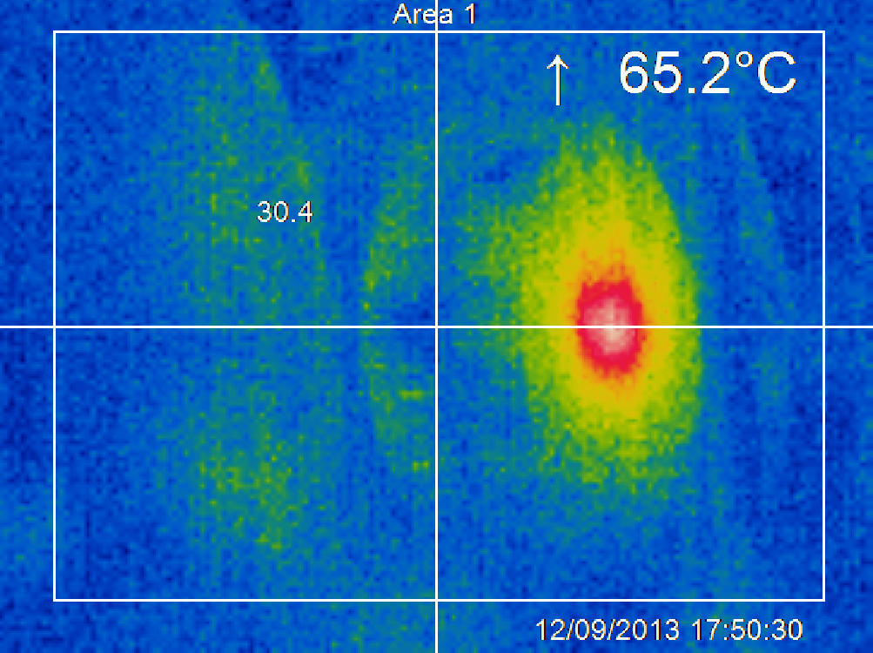
Vacuum Window and Protection (2)
Disadvantages of Beryllium:
  Toxicity
  Long lead times
  Carbon-composite support plate required with unknown and potentially harmful effect (?) on Cs₃Sb cathodes. To be investigated more in detail.
  ↔ In conflict with actions to improve vacuum level.
Therefore, a stainless steel window
was chosen for this PHIN run, which
requires a reduced beam intensity.
Supervision of window temperature
with infrared camera.
Bunch charge 2.3 nC
Train length 1000 ns

Slide 11
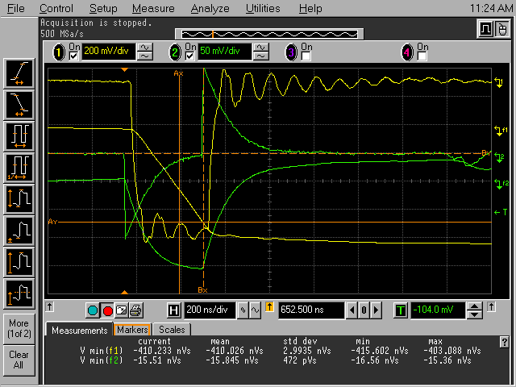
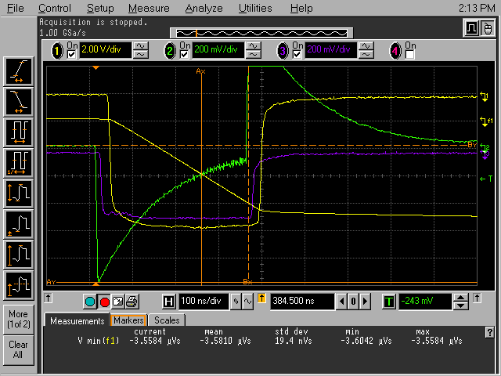
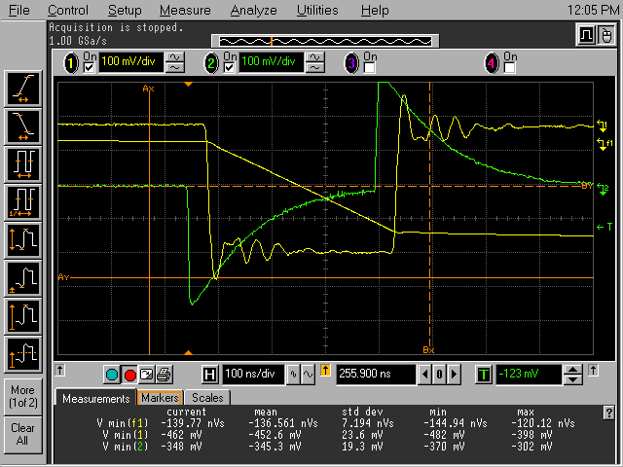
FC Measurements
Problems:
  Ringing on the FC signal: Due to separation from the vacuum system FC is not 50 Ω terminated anymore.
  Poor transmission WCM -> FC, especially for higher bunch charges
Trials to improve the signal:
  Add flange with a hole at the entrance of FC
  FC moved as close as possible to window (loss of temperature control with IR camera)
  Connection of FC to beam line with cable and Cu foil
  Replacement of FC with Cu plate
Conclusion: No solution without ringing and good transmission found and simultaneous measurement of the window temperature.
FC signal
Initial situation 24.7.
FC signal
FC moved 25.7.
FC signal
Cu plate 8.8.2013

Slide 12
FC: Possible Solutions?
Possible explanations for the poor transmission:
  Original FC in air: Scattering of electrons in the window might increase the size of the beam, which then does not fully hit the FC.
  Cu plate: Due to the larger size of the plate more electrons hit the plate, but back scattered and secondary electrons can leave the FC easier.
Possible solutions:
  Built new FC with same geometry as original FC but much bigger size. But will be still difficult (and maybe not possible) to have it in a sufficient distance to be able to observe the window with the IR camera.
  FC with repeller electrode.
  Installation of a second FCT right before or after the window to replace the FC as current measurement device. Effect of back-scattered electrons from the window on FCT?
Solutions to avoid ringing?
→ Maybe we can live with the ringing?

Slide 13
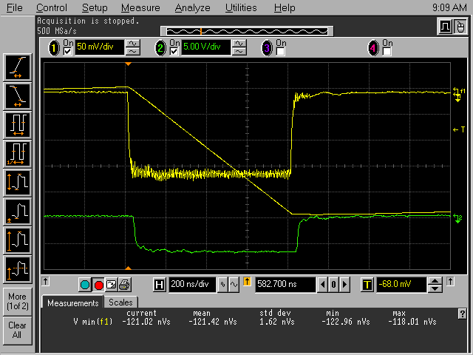
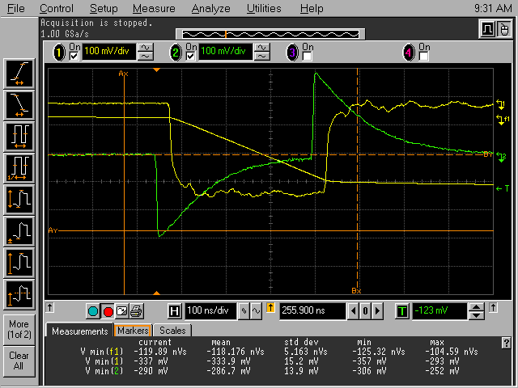
WCM Measurements
In the past an FCT with
1.6 kHz – 1 GHz bandwidth was used and integral of signal was measured.
The WCM used in this PHIN run has a bandwidth of 1 MHz – 10 GHz and is therefore not suitable for measuring long pulses. As a work-around the amplitude was measured instead of the integral.
FCT signal
WCM signal

Slide 14
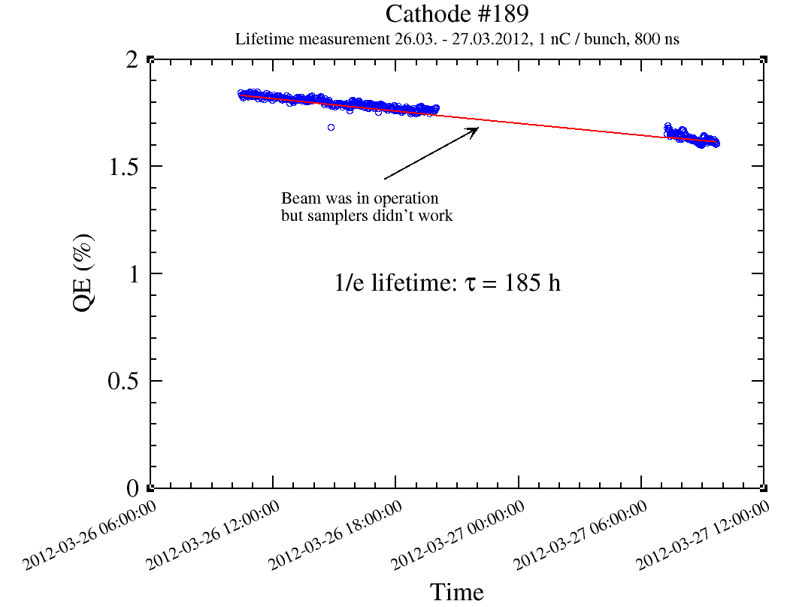
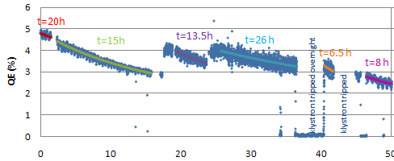
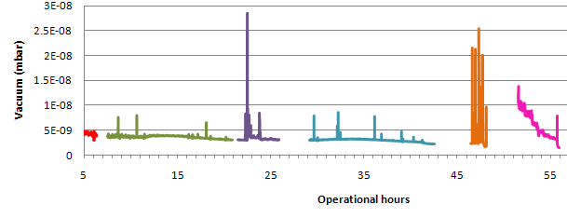
Improvement of Vacuum in PHIN
March 2011
March 2012
July 2013
Dynamic vacuum level:
4e-9 mbar
Static vacuum level:
2.2e-10 mbar
Activation of NEG chamber around gun
Installation of additional NEG pump
7e-10 mbar
1.3e-10 mbar
<2e-10 mbar
2.4e-11 mbar
1/e lifetime 26 h
1/e lifetime 185 h
1/e lifetime n/a
due to different
problems during
PHIN run
1 nC, 800 ns, λ=262 nm, Cs₃Sb
1 nC, 800 ns, λ=524 nm, Cs₃Sb

Slide 15
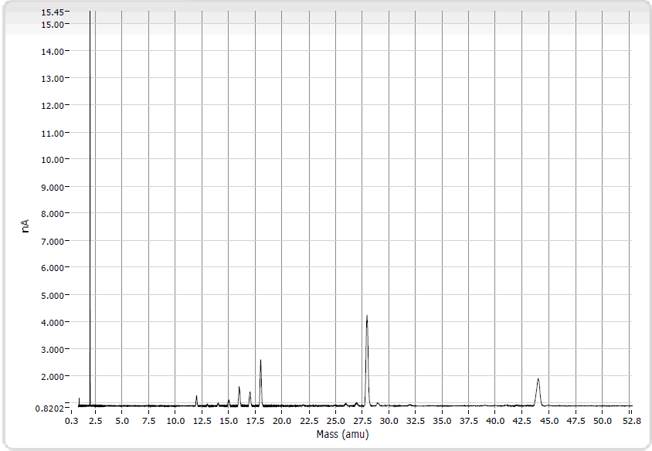
Improvement of Vacuum
New RGA installed
RGA does not work during beam operation due to disturbance caused by the magnetic fields of the solenoids
RGA spectrum

Slide 16
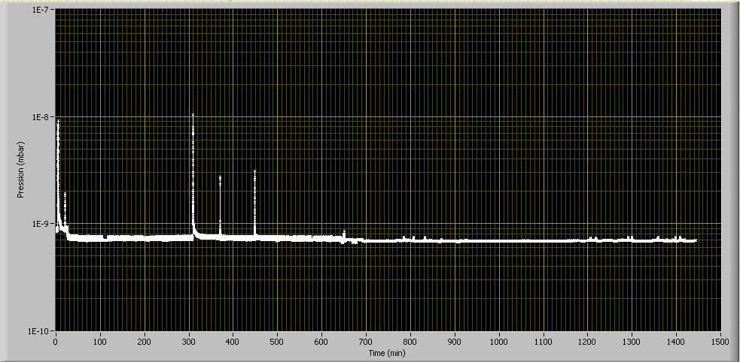
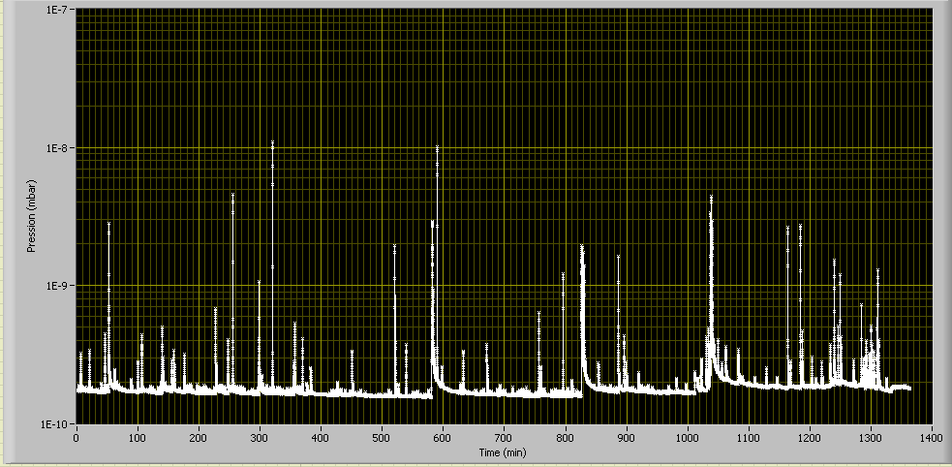
Problems with Lifetime Measurements
Despite good QE in DC gun, photocathodes had low QE on arrival in PHIN gun
Despite good dynamic base vacuum level there were a lot of breakdowns causing desorption spikes:
Rapidly decreasing QE, (partially) recovering during “QE jumps”
24h oscillations on beam current
Frequent loss of synchronization of laser system
Cathode #189 (PHIN run 2012)
Cathode #191 (PHIN run 2013)

Slide 17
Photocathodes Used during PHIN Run
Number | Material | Age | QE in DC gun | QE in PHIN
#188 | Cs₃Sb | Old cathode, previously used for studies in photoemission lab | 0.24% 21.03.2013 | 0.33%
#193 | Cs₃Sb | New cathode, produced 28.02.2013 | 5.8% after preparation | 1%
#191 | Cs₃Sb | New cathode, produced 12.02.2013 | 7.5% after preparation | 1%
#194 | Cs₃Sb | Fresh, new cathode, produced 22.08.2013 on Cu plug previously used for RF conditioning at PHIN. | 4.5% after preparation | 1.3%
#186 | Cs₂Te | Old Cs₂Te cathode, but with good QE | 9.0% 03.05.2013 (QE not uniform) | 6.5%
Number | Material | Age | QE in DC gun
#188 | Cs₃Sb | Old cathode, previously used for studies in photoemission lab | 0.24% 21.03.2013
#193 | Cs₃Sb | New cathode, produced 28.02.2013 | 5.8% after preparation
#191 | Cs₃Sb | New cathode, produced 12.02.2013 | 7.5% after preparation
#194 | Cs₃Sb | Fresh, new cathode, produced 22.08.2013 on Cu plug previously used for RF conditioning at PHIN. | 4.5% after preparation
#186 | Cs₂Te | Old Cs₂Te cathode, but with good QE | 9.0% 03.05.2013 (QE not uniform)

Slide 18
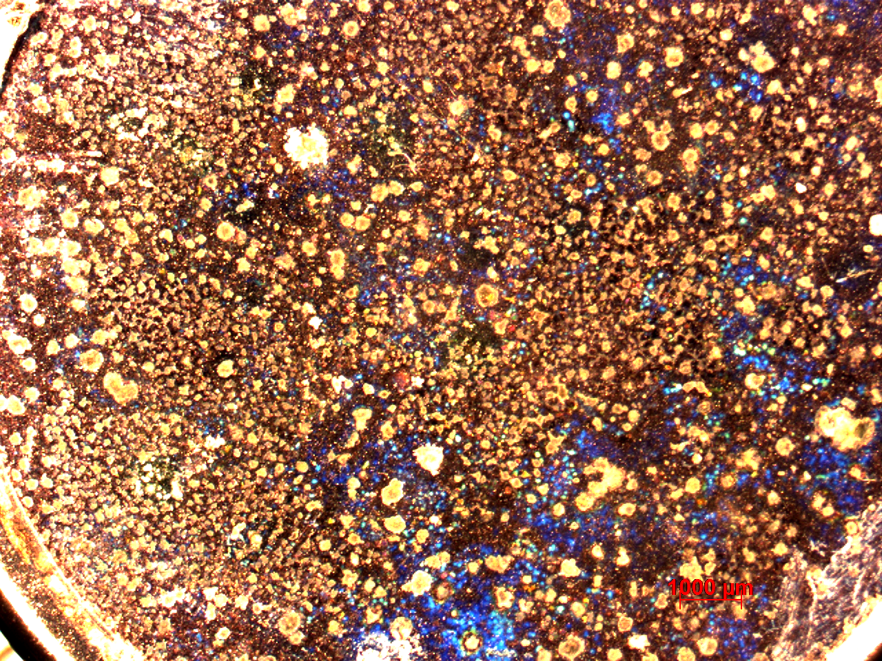
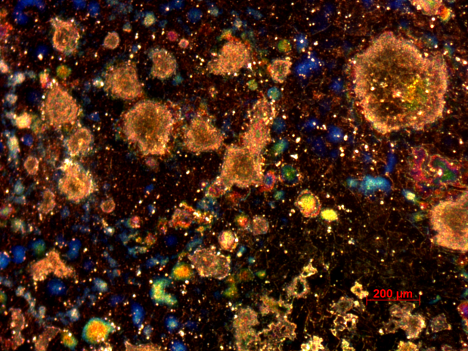
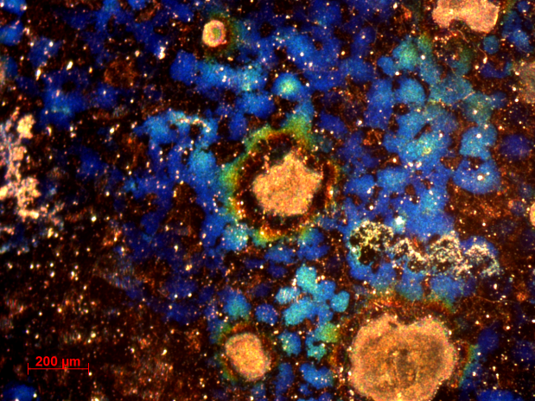
Cathode #188
1st Cathode used during PHIN run 2013.
Surface treatment: Diamond powder polishing.

Slide 19
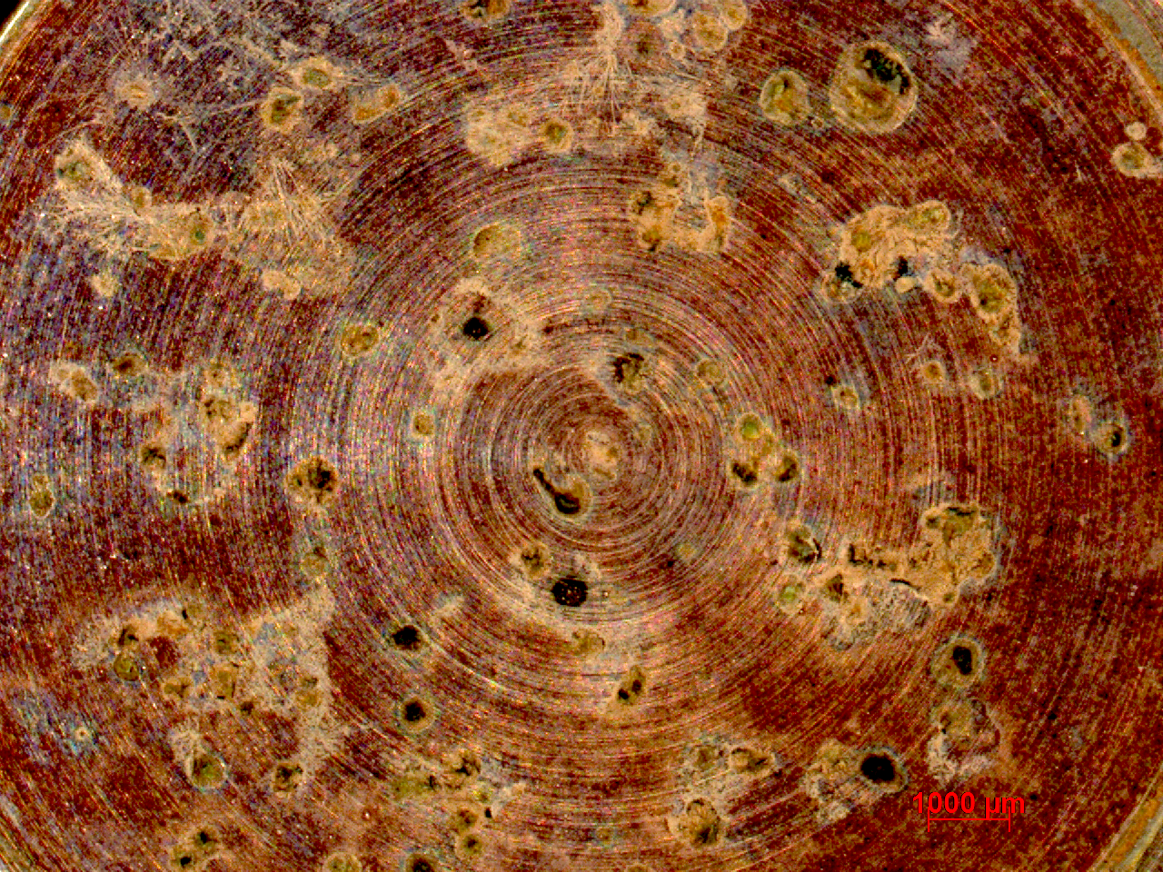
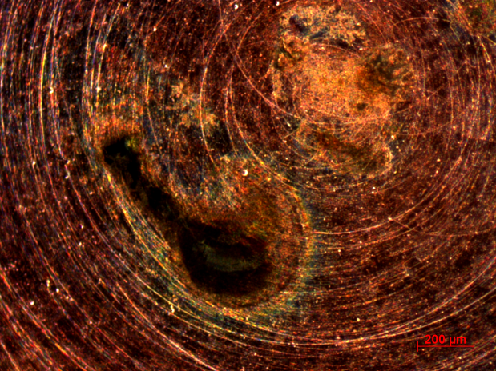
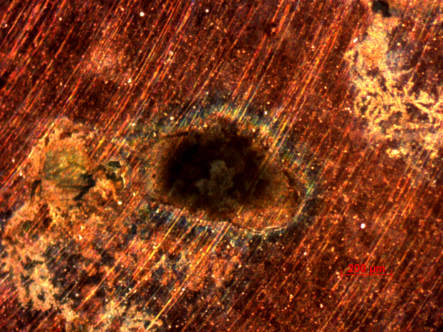
Cathode #193
2nd Cathode used during PHIN run 2013.
Surface treatment: Diamond turning.

Slide 20
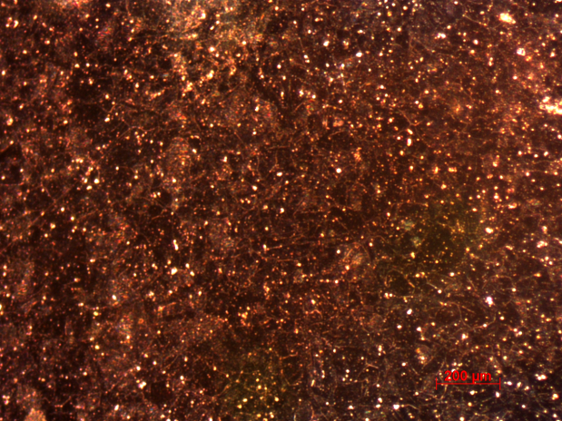
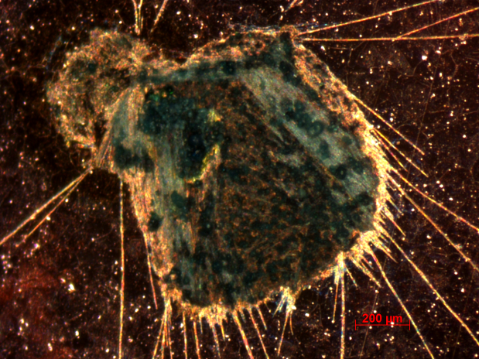
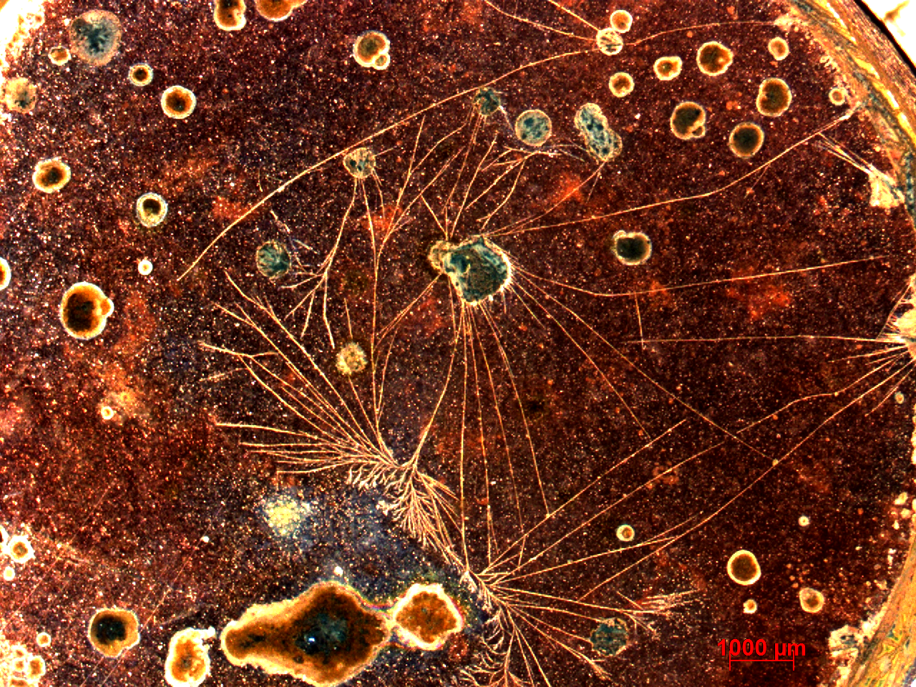
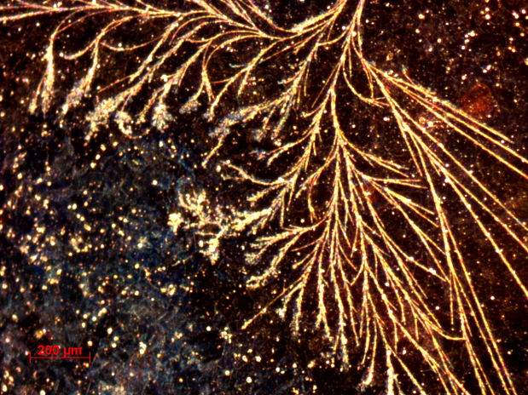
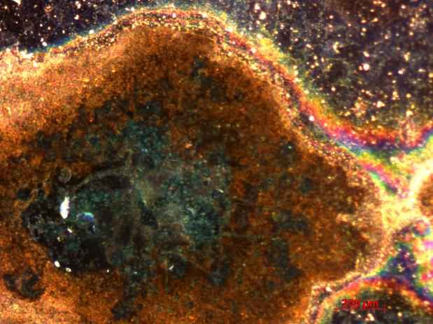
Cathode #189 (PHIN run 2012)
Cathode used during PHIN run 2012 with long lifetime.
Surface treatment: Diamond powder polishing.

Slide 21
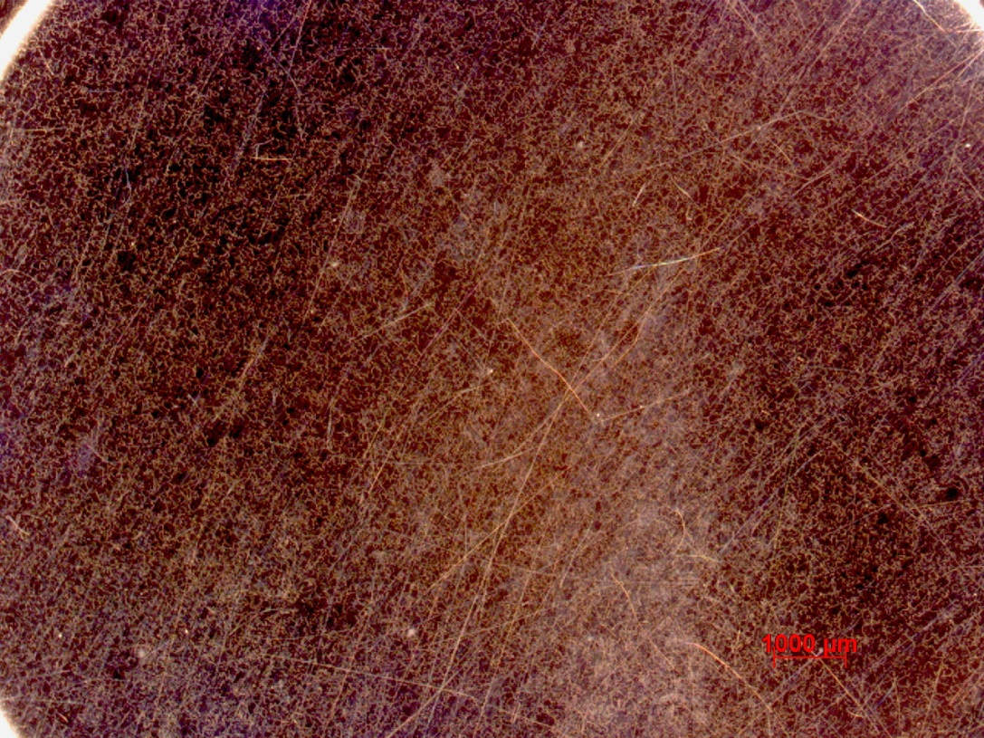
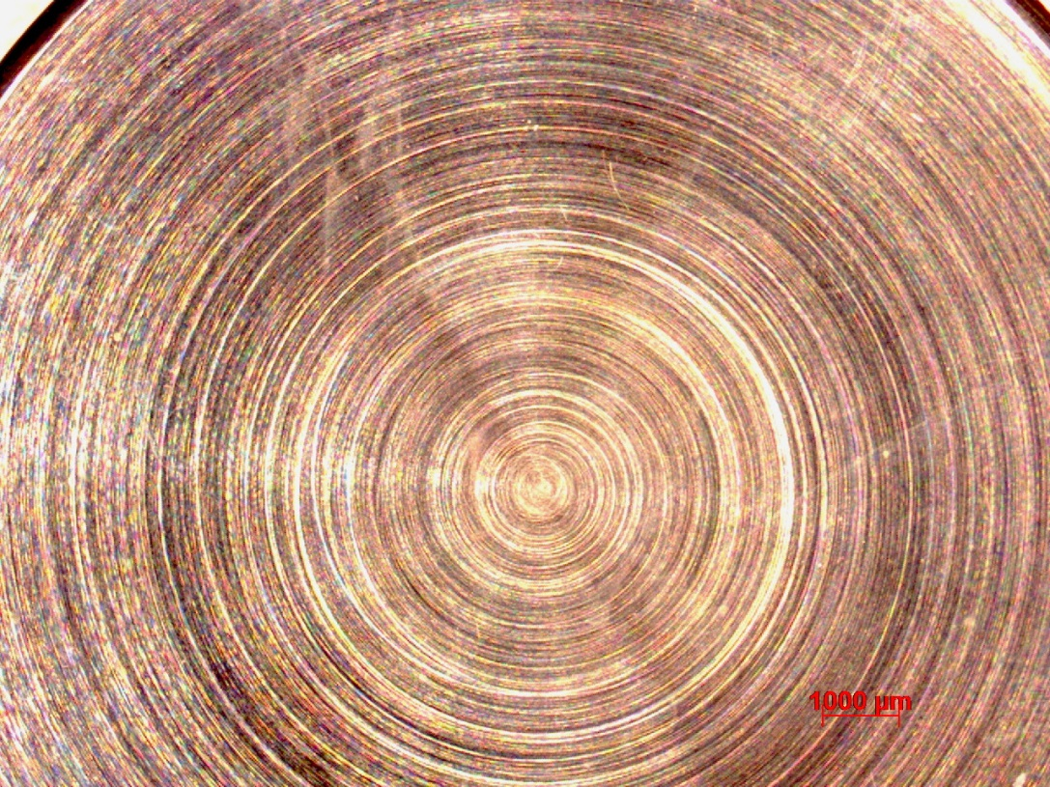
Fresh Copper Plugs
Surface treatment:
Diamond powder polishing.
Surface treatment:
Diamond turned.

Slide 22
Photocathodes Used during PHIN Run
Number | Material | Age | QE in DC gun | QE in PHIN
#188 | Cs₃Sb | Old cathode, previously used for studies in photoemission lab | 0.24% 21.03.2013 | 0.33%
#193 | Cs₃Sb | New cathode, produced 28.02.2013 | 5.8% after preparation | 1%
#191 | Cs₃Sb | New cathode, produced 12.02.2013 | 7.5% after preparation | 1%
#194 | Cs₃Sb | Fresh, new cathode, produced 22.08.2013 on Cu plug previously used for RF conditioning at PHIN. | 4.5% after preparation | 1.3%
#186 | Cs₂Te | Old Cs₂Te cathode, but with good QE | 9.0% 03.05.2013 (QE not uniform) | 6.5%
Number | Material | Age | QE in DC gun | QE in PHIN | Surface treatment
#188 | Cs₃Sb | Old cathode, previously used for studies in photoemission lab | 0.24% 21.03.2013 | 0.33% | Diamond powder polishing
#193 | Cs₃Sb | New cathode, produced 28.02.2013 | 5.8% after preparation | 1% | Diamond turning
#191 | Cs₃Sb | New cathode, produced 12.02.2013 | 7.5% after preparation | 1% | Diamond turning
#194 | Cs₃Sb | Fresh, new cathode, produced 22.08.2013 on Cu plug previously used for RF conditioning at PHIN. | 4.5% after preparation | 1.3% | Diamond powder polishing + RF conditioning
#186 | Cs₂Te | Old Cs₂Te cathode, but with good QE | 9.0% 03.05.2013 (QE not uniform) | 6.5% | Diamond powder polishing
Number | Material | Age | QE in DC gun | QE in PHIN | Surface treatment | Layer thickness
#188 | Cs₃Sb | Old cathode, previously used for studies in photoemission lab | 0.24% 21.03.2013 | 0.33% | Diamond powder polishing | 170 nm
#193 | Cs₃Sb | New cathode, produced 28.02.2013 | 5.8% after preparation | 1% | Diamond turning | 19 nm
#191 | Cs₃Sb | New cathode, produced 12.02.2013 | 7.5% after preparation | 1% | Diamond turning | 171 nm
#194 | Cs₃Sb | Fresh, new cathode, produced 22.08.2013 on Cu plug previously used for RF conditioning at PHIN. | 4.5% after preparation | 1.3% | Diamond powder polishing + RF conditioning | 39 nm
#186 | Cs₂Te | Old Cs₂Te cathode, but with good QE | 9.0% 03.05.2013 (QE not uniform) | 6.5% | Diamond powder polishing | 215 nm
Could be explained by the fact that pumping time of SAS of transport carrier was not sufficient after its reconnection to PHIN

Slide 23
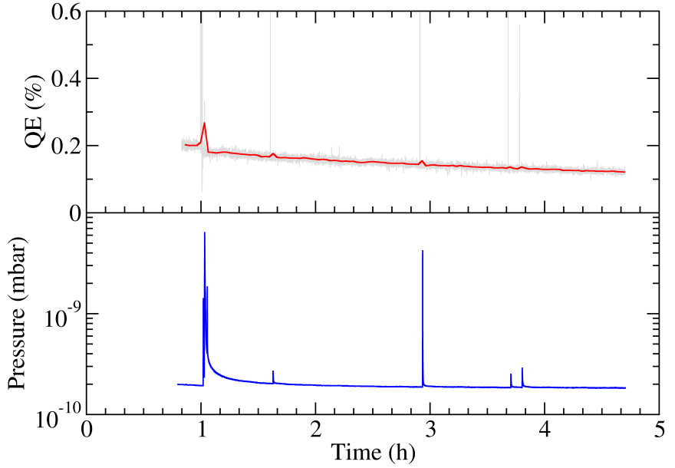
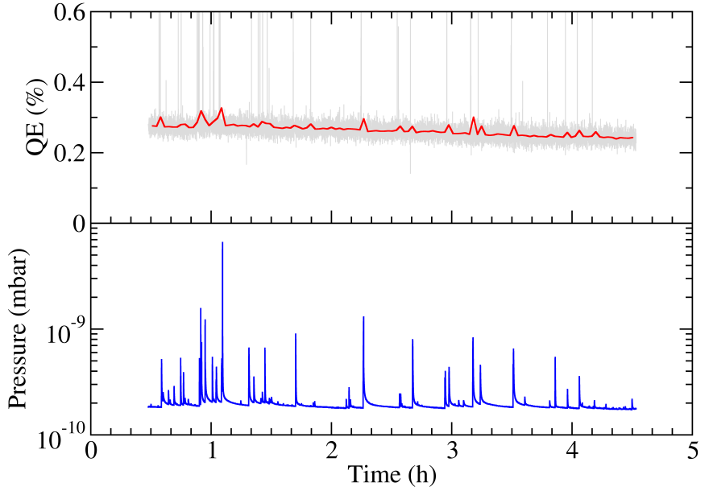
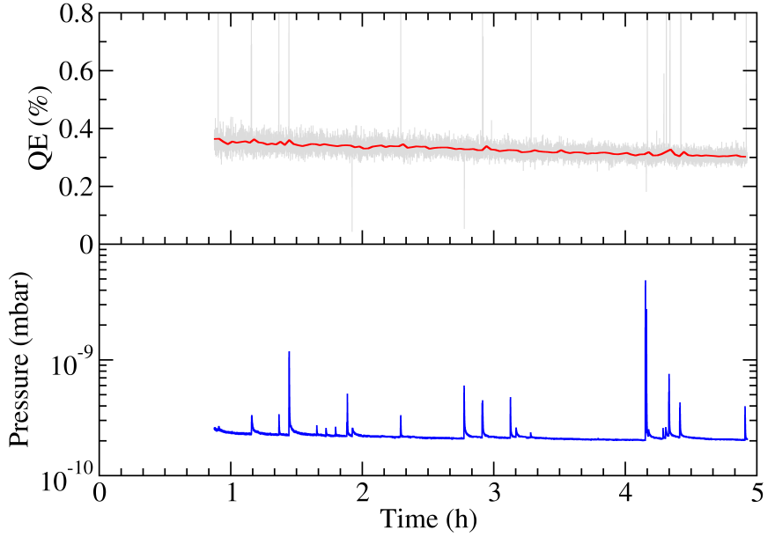
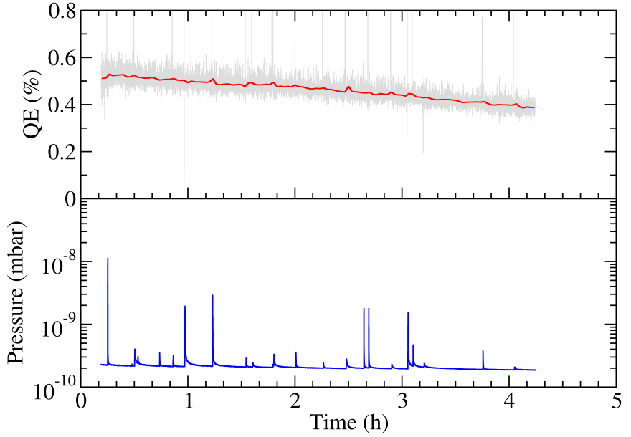
RF Break-downs
#188
#191
2.1 break-downs/h
Significantly less break-downs
10.6 break-downs/h
Diamond
powder
polishing
Diamond
turning
#194
#193
5.2 break-downs/h
5.7 break-downs/h
Diamond
powder
polishing
Diamond
turning

Slide 24
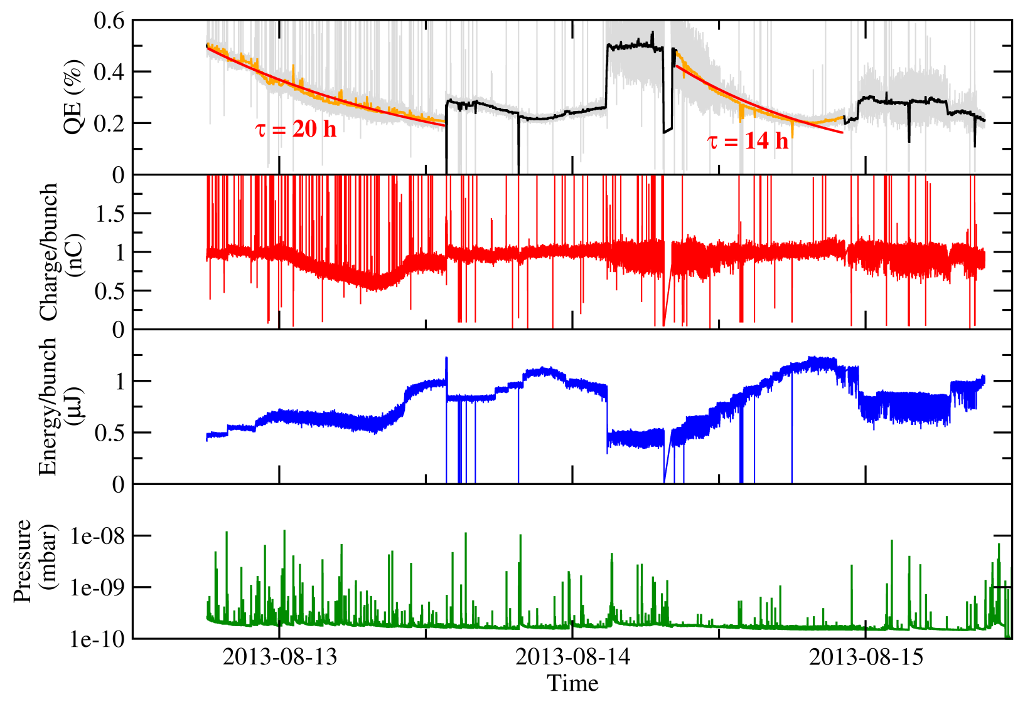
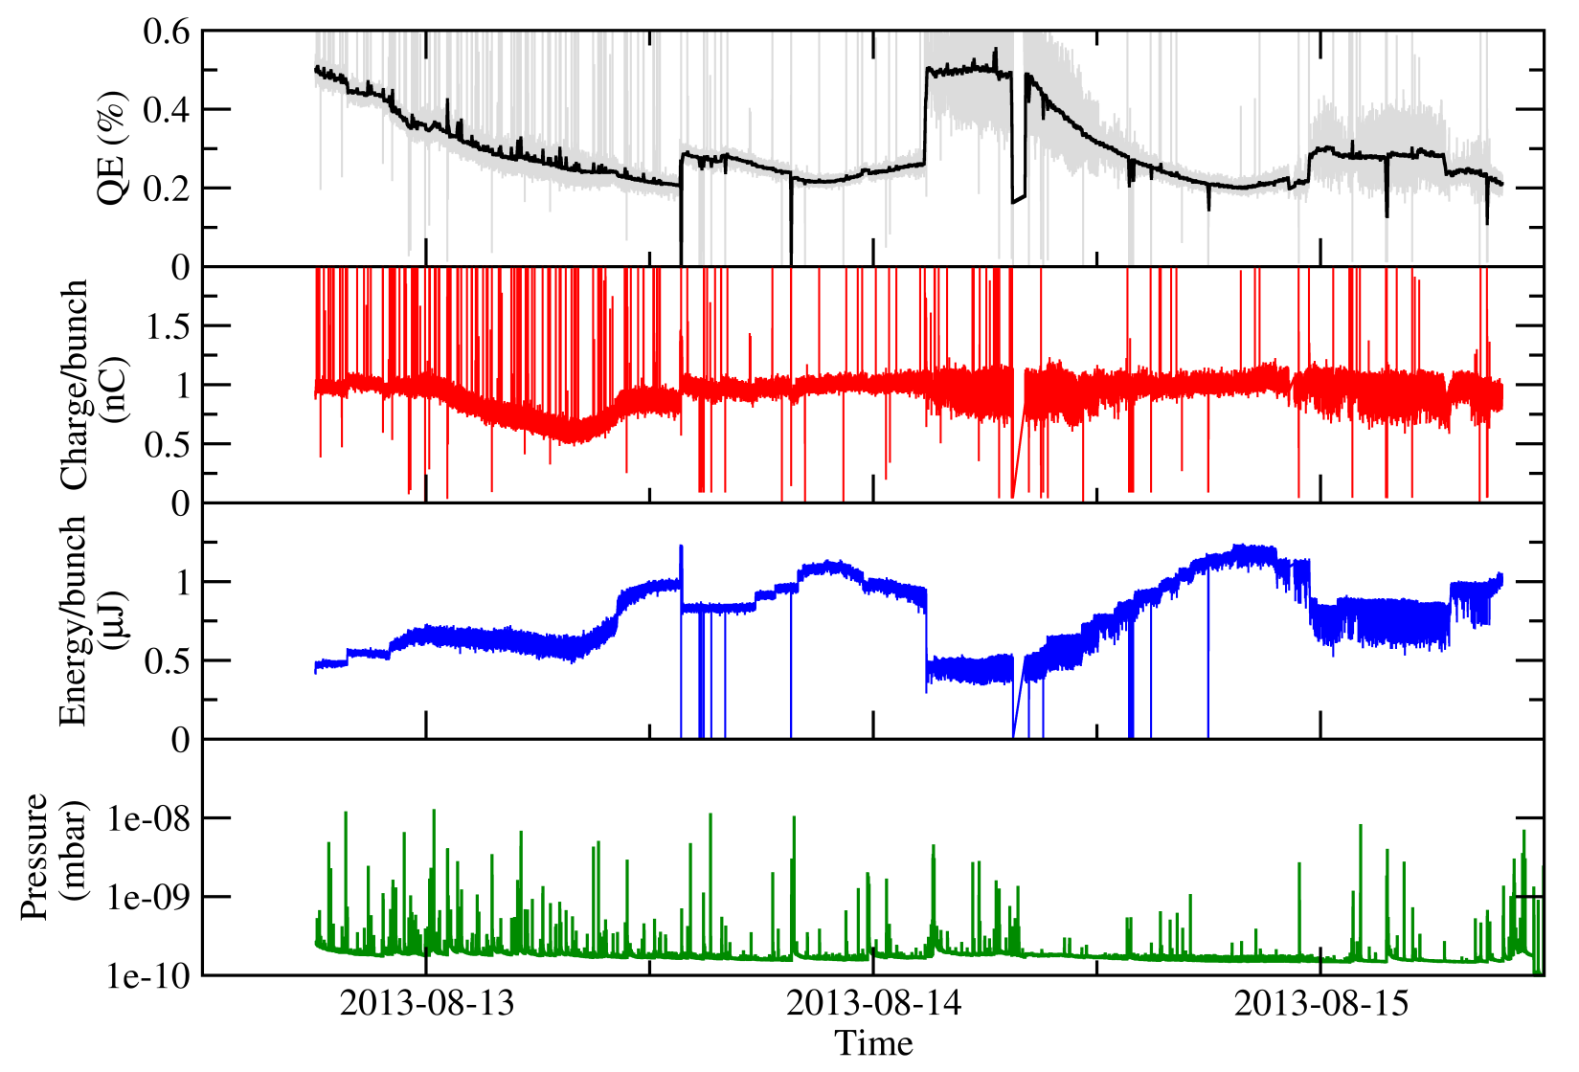
Quantum Efficiency Jumps
Cathode #191, Cs₃Sb, train length 800 ns, bunch charge 1 nC
Sudden improvement of quantum efficiency
(“QE jumps”)
Laser energy was regulated to keep the charge constant at 1 nC
→ Not yet
understood!

Slide 25
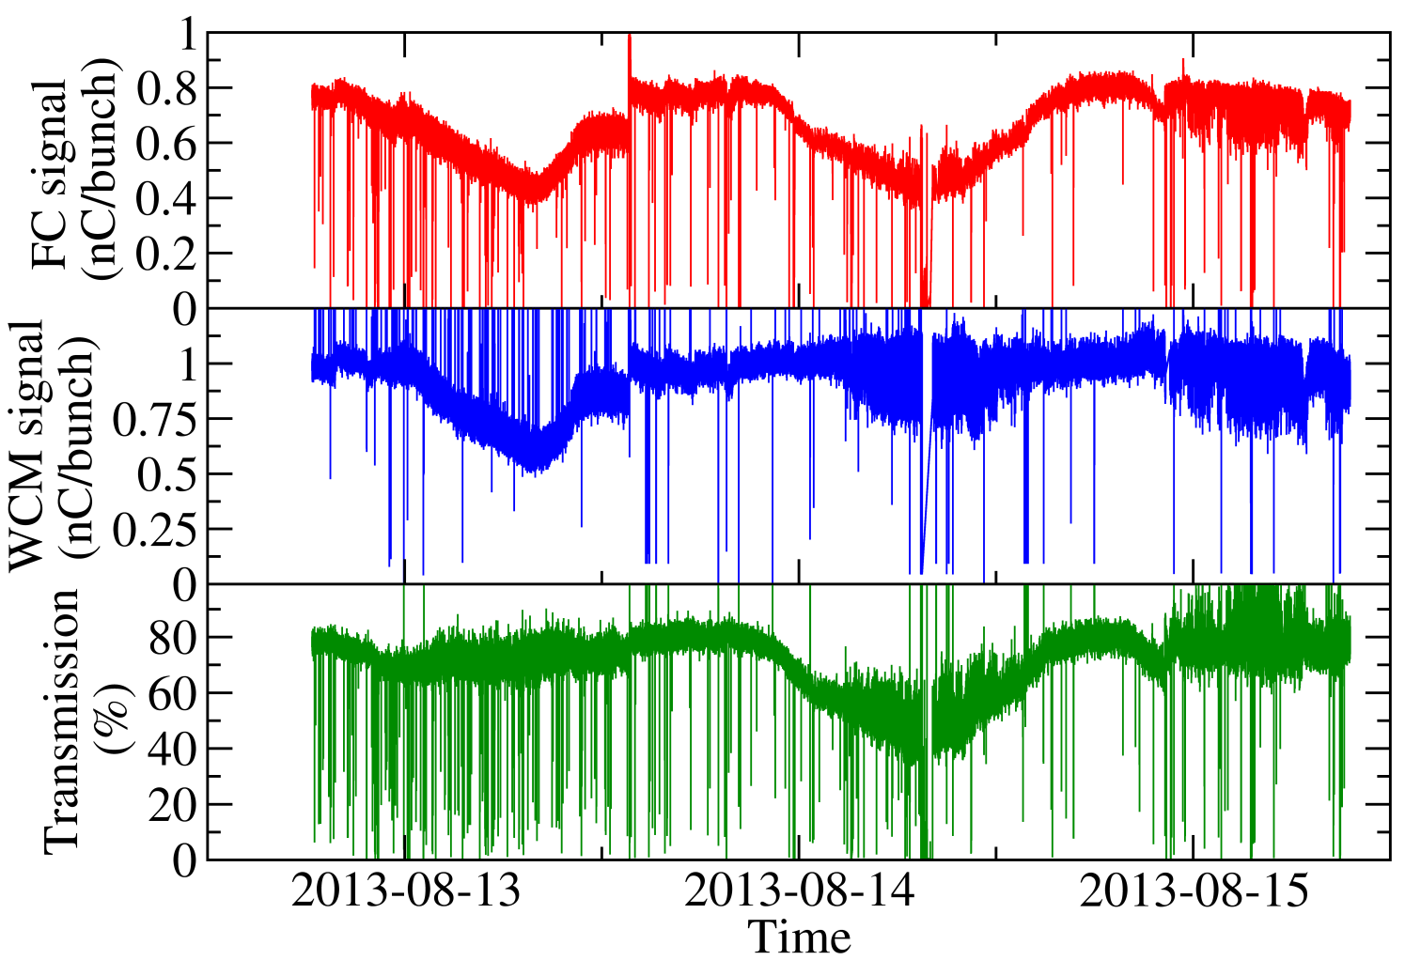
24h Oscillations on Beam Current
Klystron phase was kept constant
24h oscillations probably caused by non-working air-conditioning in klystron gallery:
→ Temperature
variation of RF
reference signal
cable for laser
→ Phase shift of
laser with respect
to klystron
Iris opened, more laser energy available
Laser energy was at its limit and could not be increased further

Slide 26
Loss of Synchronisation of the Laser System
Frequent loss of synchronisation of the laser system at the end of the PHIN run
Incoming RF power for the laser synchronisation unit was outside the recommended range (-20 to 0 dBm). An increase of the RF power to -16 dBm did not help.
Investigations showed that there was a back reflection from a lens after Amp 1, which caused the oscillator to lose the synchronisation

Slide 27
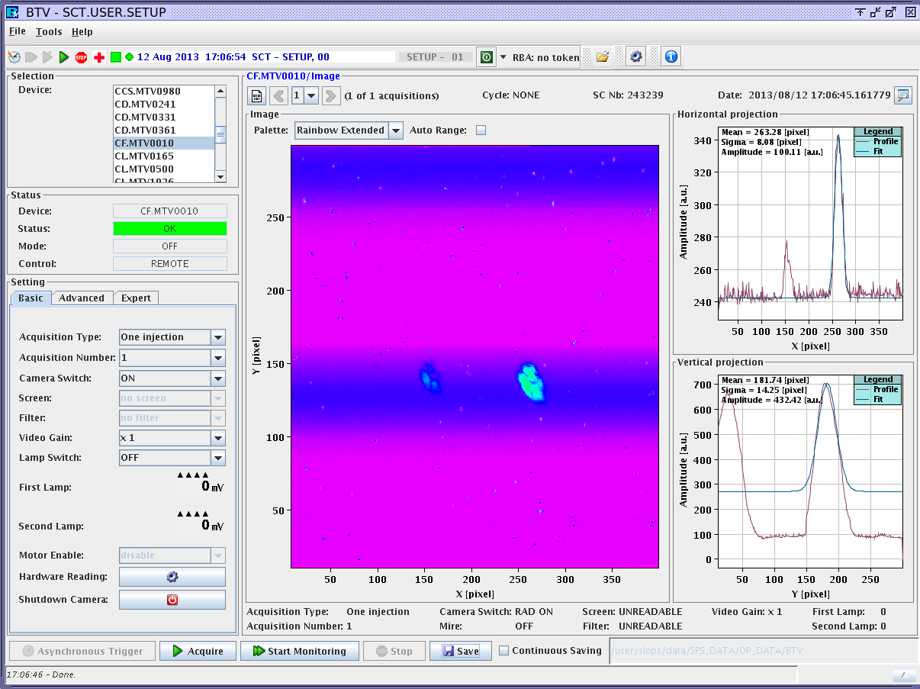
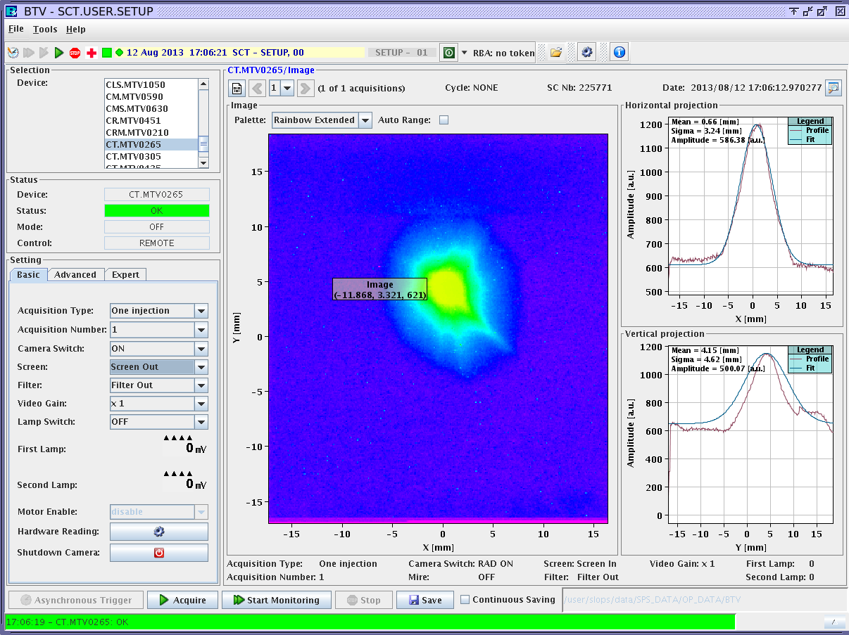
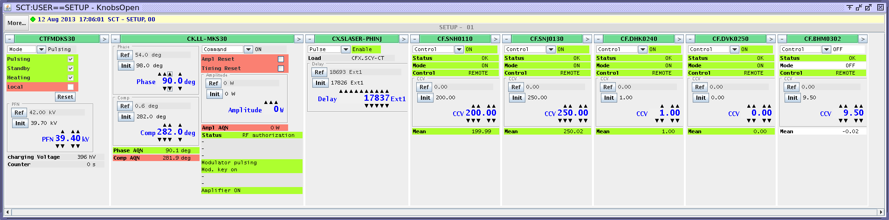
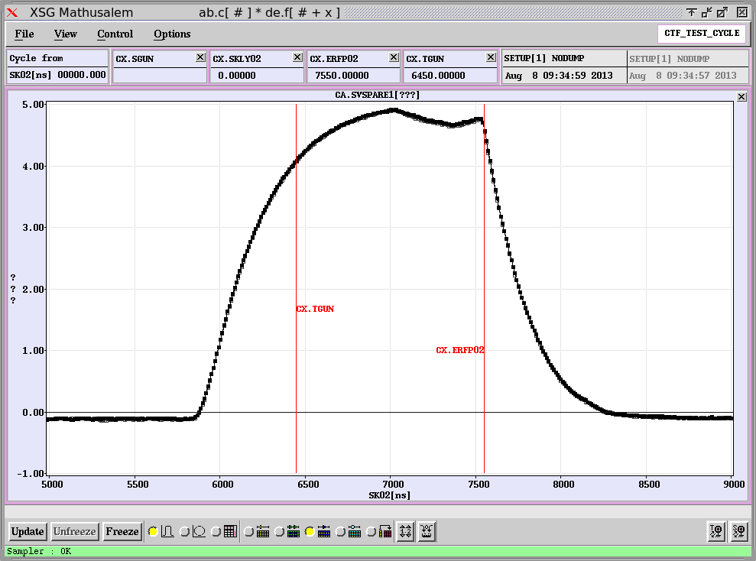
Magnet powering / Beam Focusing
Even with a small laser beam, it was difficult to get a reasonable electron beam size on the OTR screen.
The second solenoid had to be powered almost at its limit.
12.08.2013
200 A
250 A

Slide 28
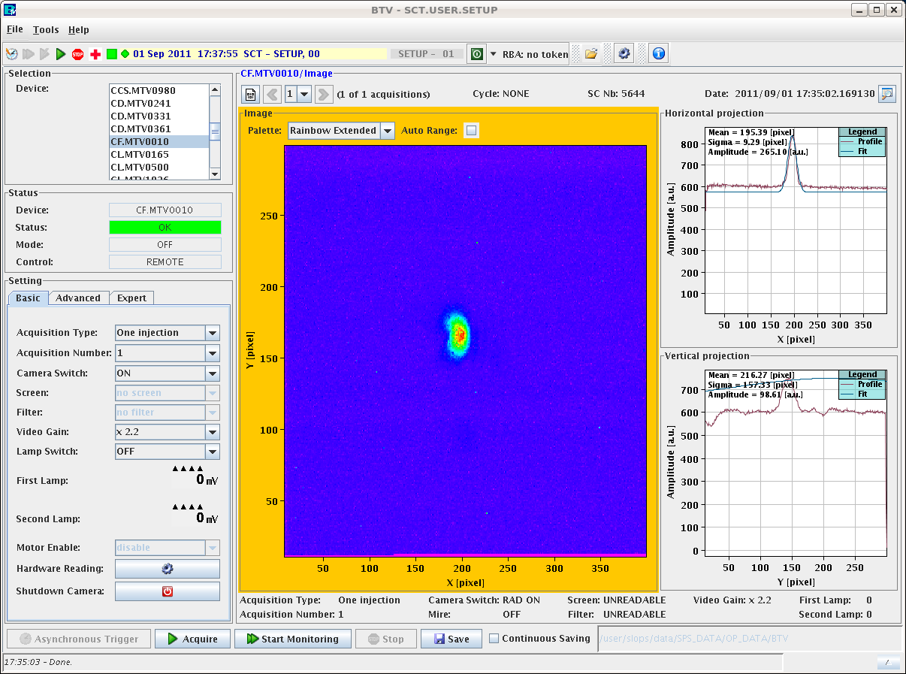
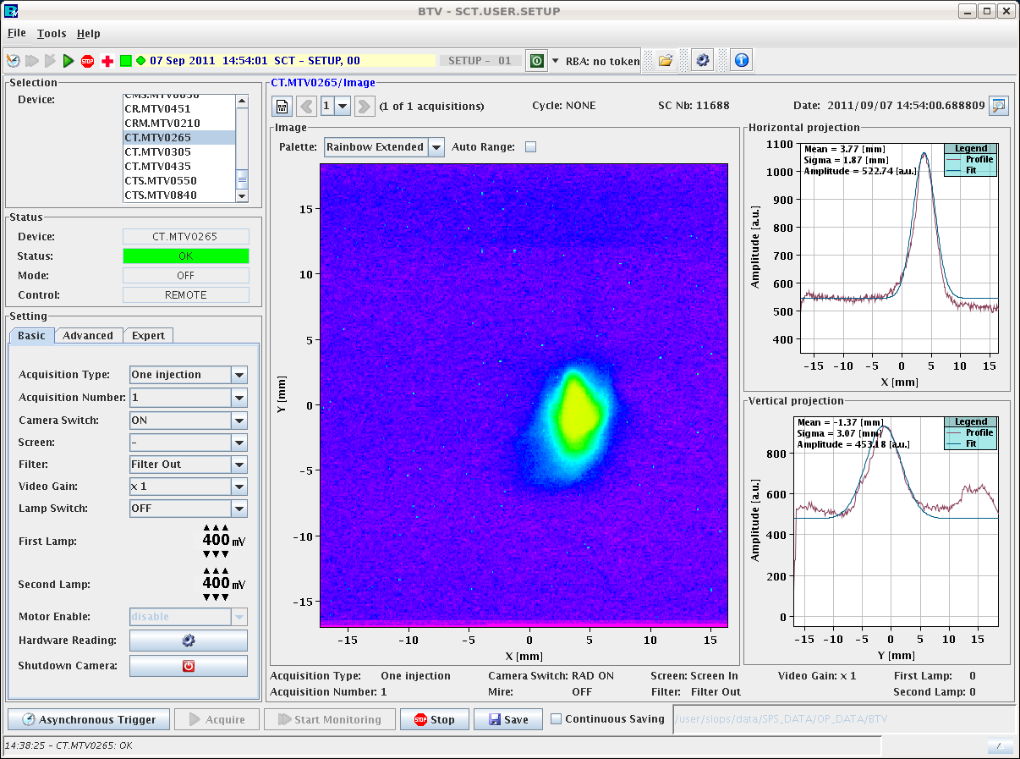
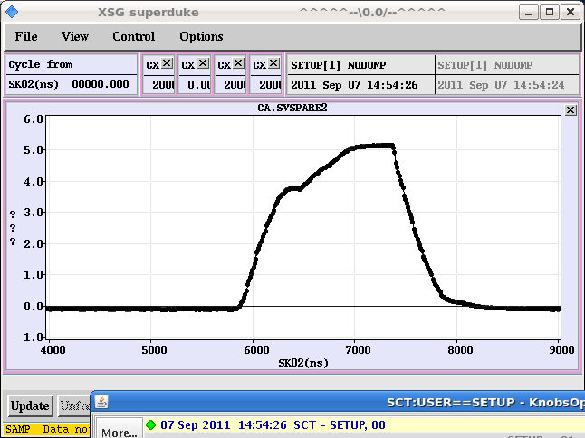
Magnet powering / Beam Focusing
For comparison PHIN run September 2011:
07.09.2011
Parameters:
Phase: 60 deg
CF.SNH0110: 190
CF.SNJ0130: 195
Klystron voltage: 38.50kV

Slide 29
Original Plans
Lifetime studies with Cs₃Sb cathode and green light
  Under improved vacuum conditions (new NEG pump)
  With 5 µs (2.5 µs) long pulse trains
  With 5 Hz operation
Feedback stability tests
Dark current studies
  Measurements with Cs₃Sb and Cu cathodes
  Try to see field emission spots with camera looking into the gun

Slide 30
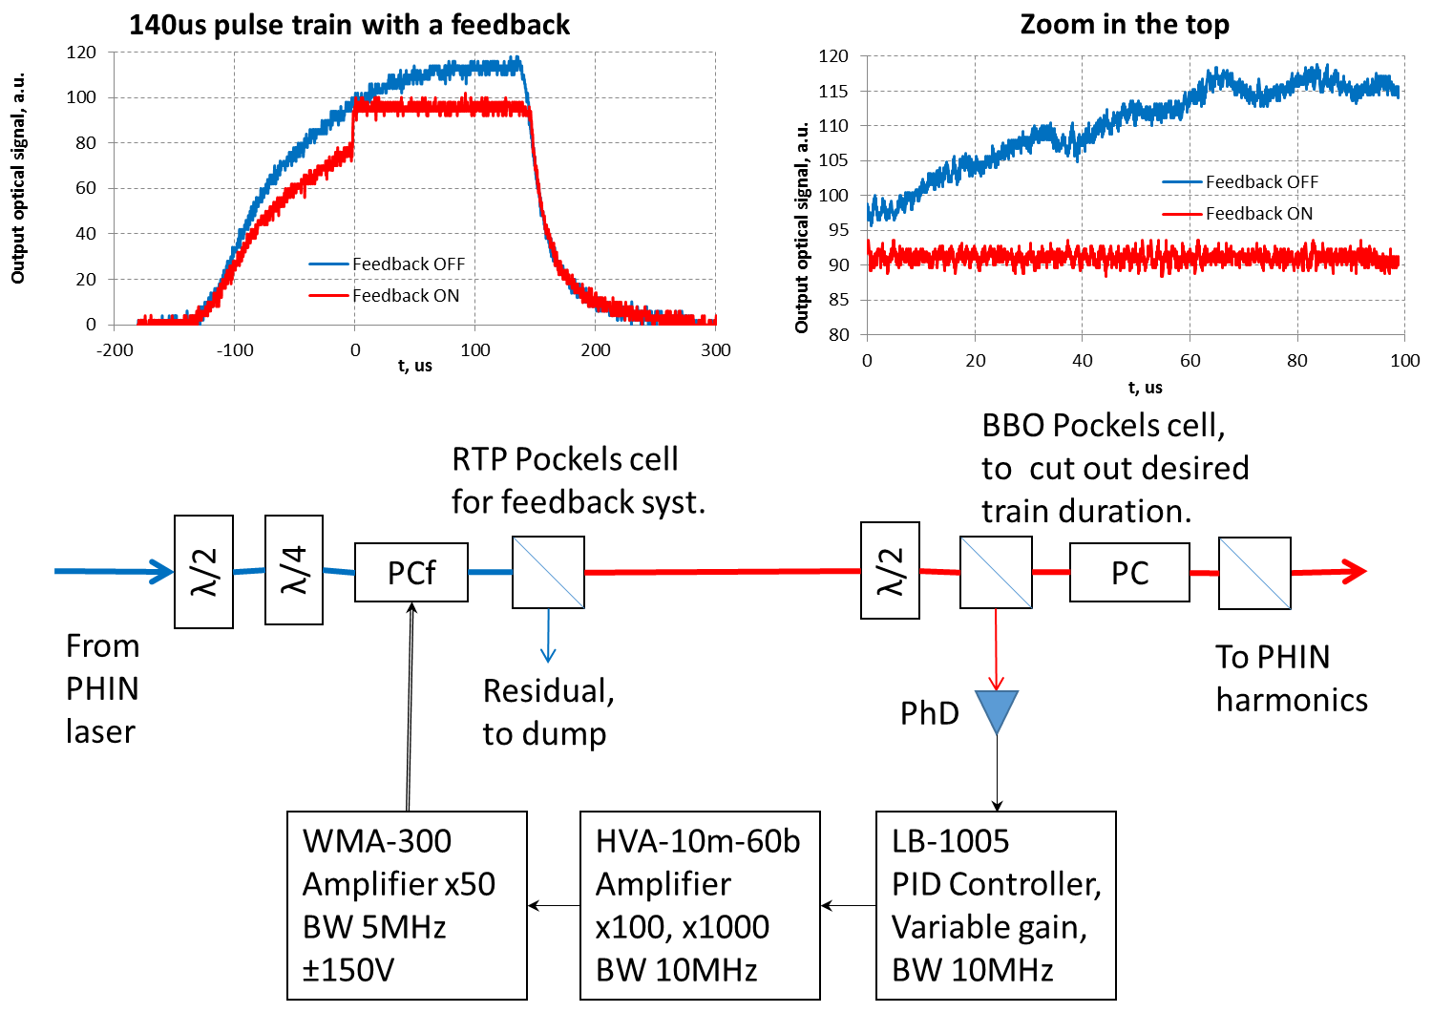
Feedback Stabilisation Scheme

Slide 31
Feedback Stabilisation Tests
Feedback OFF
1.34 % rms
Feedback ON
0.43 % rms
Laser beam
factor 3
improvement !
Cathode #193
Feedback OFF
Cathode #188
Feedback ON
3.03% rms
0.97% rms
Electron beam

Slide 32
Original Plans
Lifetime studies with Cs₃Sb cathode and green light
  Under improved vacuum conditions (new NEG pump)
  With 5 µs (2.5 µs) long pulse trains
  With 5 Hz operation
Feedback stability tests
Dark current studies
  Measurements with Cs₃Sb, Cs₂Te and Cu cathodes
  Try to see field emission spots with camera looking into the gun

Slide 33
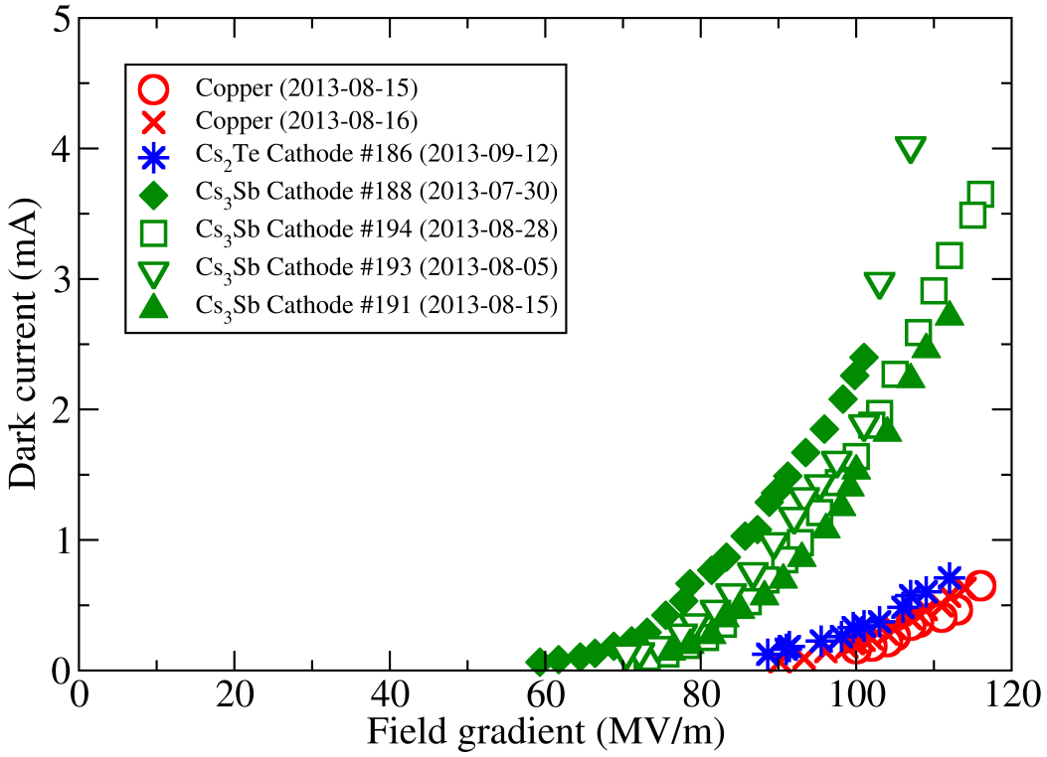
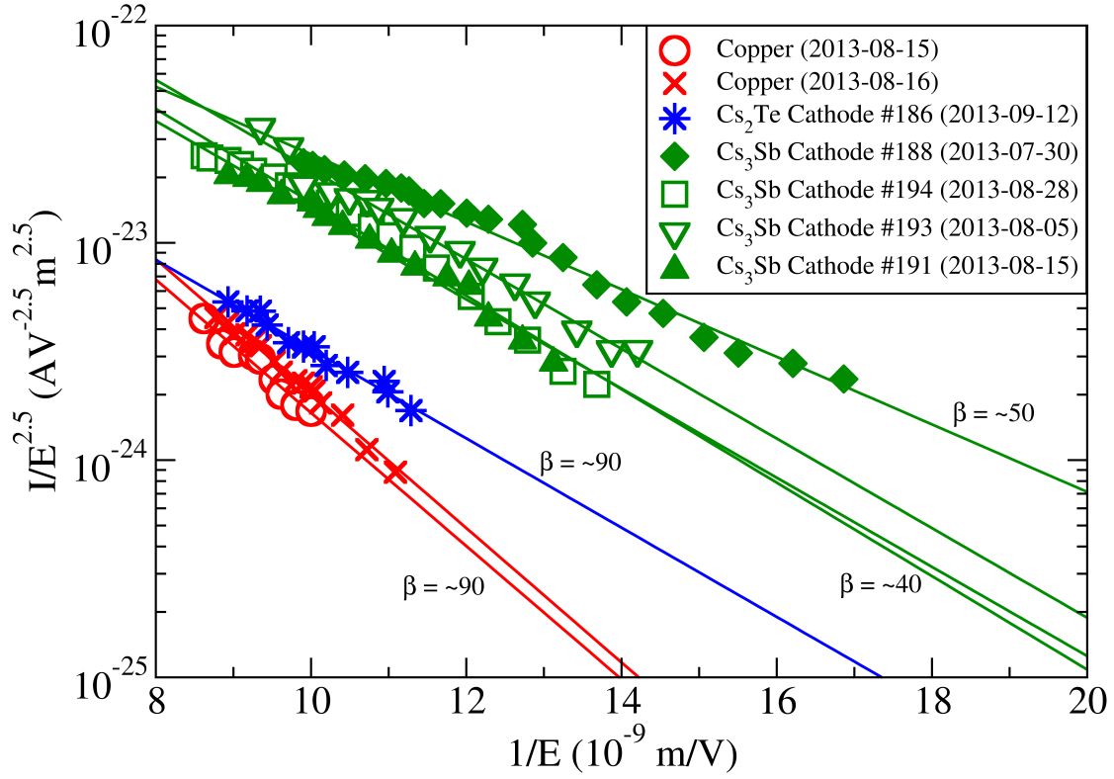
Dark Current Measurements
Measurement performed with a 1.3 µs long klystron pulse
Dark current by a factor ~5 higher in Cs₃Sb than in Cs₂Te
β by factor ~2 smaller for Cs₃Sb than for Cs₂Te or copper

Slide 34
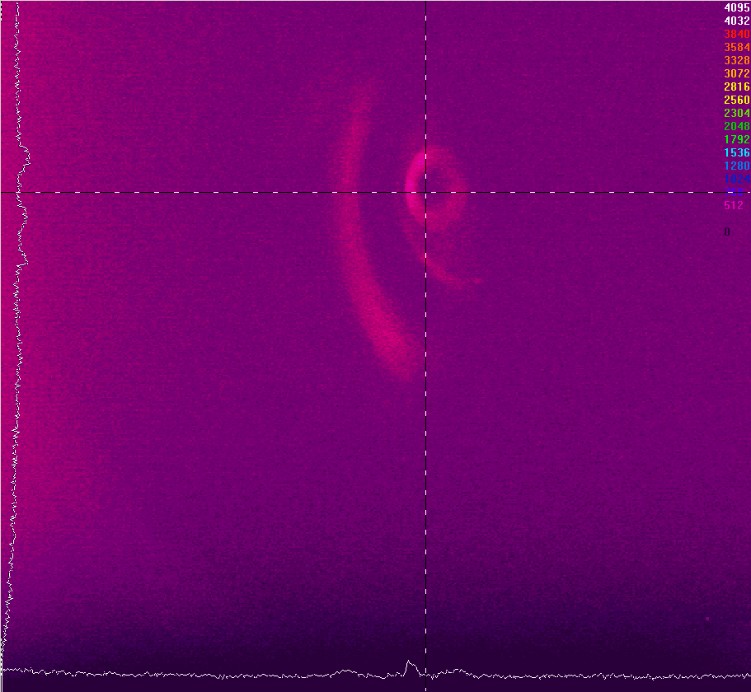
Observation of Field Emission Spots?
RF off

Slide 35

Observation of Field Emission Spots?
RF on
No field emission spots visible, but…

Slide 36

Observation of Field Emission Spots?
Break-downs

Slide 37

Observation of Field Emission Spots?
Break-downs

Slide 38

Observation of Field Emission Spots?
Break-downs

Slide 39

Observation of Field Emission Spots?
Break-downs

Slide 40

Observation of Field Emission Spots?
Break-downs

Slide 41

Observation of Field Emission Spots?
Break-downs

Slide 42

Observation of Field Emission Spots?
Break-downs

Slide 43

Observation of Field Emission Spots?
Break-downs

Slide 44

Observation of Field Emission Spots?
Break-downs

Slide 45

Observation of Field Emission Spots?
Break-downs

Slide 46

Observation of Field Emission Spots?
Break-downs

Slide 47

Observation of Field Emission Spots?
Break-downs

Slide 48
Plans for PHIN, Photoemission Lab and
Laser System
PHIN:
Excellent vacuum conditions have been achieved
→ Lifetime studies under these conditions with Cs₃Sb and Cs₂Te cathodes
Study the effect of surface roughness on cathode lifetime
→ Electro-polished cathode plugs
Continue studies of Cs₃Sb cathodes using a green laser beam
Studies with 5 µs long pulse trains and 5 Hz repetition rate
→ Be window needed → separate PHIN run required
Photoemission lab:
Continue high-charge studies (with different cathode layer thicknesses)
XPS studies
Upgrade of cathode preparation system with load-lock system
Laser:
Study of performance of laser system with CLIC specs (new 500 MHz front end, 50 Hz tests)
Continue stability studies with new front end
PHIN run
2014
PHIN run
2015

Slide 49
Prerequisites for next PHIN Run
Possibility to easily switch to 5 Hz for RF conditioning.
Stable air-conditioning klystron gallery and laser lab
Check of solenoid resistance
Replacement insulator piece of FCT
Installation additional FCT at the end of the beam line
Re-design FC? Or re-connection to beam line for short pulse studies? Add additional ion pump?
Setup for 2D QE scan at PHIN

Slide 50
Acknowledgement
Controls: Sergio Batuca, Mark Butcher, Mathieu Donze, Alessandro Masi, Christophe Mitifiot
Load-lock system: Szymon Sroka
FLUKA simulations: Markus Brugger, Melanie Delonca
Beam instrumentation: Benoit Bolzon, Thibaut Lefevre
Vacuum: Paolo Chiggiato, Berthold Jenninger, Esa Paju
RF: Stephane Curt, Luca Timeo
Wilfrid Farabolini
XPS studies: Holger Neupert, Elise Usureau
Collaborators at LAL and IAP-RAS
… and many others
… and thank you for your attention!

Slide 52

Failure of Air Conditioning in Laser Lab
Air conditioning in laser lab failed on 15.08.2013
No laser operation possible for a couple of days
Temperature evolution:

Slide 53
PHIN and CLIC Parameters
Parameter | PHIN | CLIC
Charge / bunch (nC) | 2.3 | 8.4
Macro pulse length (μs) | 1.2 | 140
Bunch spacing (ns) | 0.66 | 2.0
Bunch rep. rate (GHz) | 1.5 | 0.5
Number of bunches / macro pulse | 1800 | 70000
Macro pulse rep. rate (Hz) | 5 | 50
Charge / macro pulse (μC) | 4.1 | 590
Beam current / macro pulse (A) | 3.4 | 4.2
Bunch length (ps) | 10 | 10
Charge stability | <0.25% | <0.1%
Cathode lifetime (h) at QE > 3% (Cs₂Te) | >50 | >150
Norm. emittance (μm) | <25 | <100

