Slide 1
Nikhef Multicore Experience
Jeff Templon
Multicore TF 2014.04.01

Slide 2
disclaimer
It may be possible to do this with native torque and maui features
  Standing reservations
  Partitions
Couldn’t figure it out
  Docs very poor (cases too simple)
  Nobody answers questions
Hence wrote something; tried to keep it ASAP (as small/simple as possible)

Slide 3
Summary
With a bit of scriptology, working system
Performance is adequate for us
Entropy is important here too : 32 vs 8 cores per node

Slide 4
Contents
Results
How we did it
Why we did it like we did
Random observations and musings

Slide 5
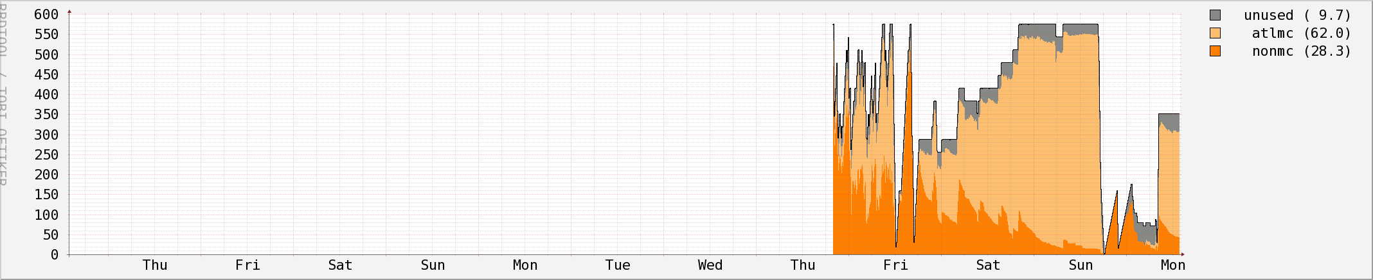
Mc pool performance
Weekend of 29 march 2014
600 cores
500
400
300
200
100

Slide 6
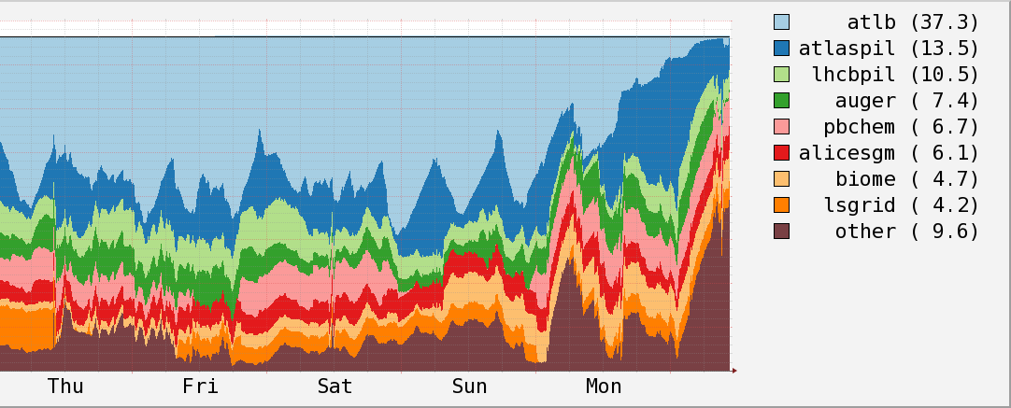
The whole farm
Multicore jobs are ‘atlb’; lots of single core atlb jobs too.
3800 cores
Weekend of 29 march 2014
Empty cores included in “other”
Farm > 98% full with two exceptions

Slide 7
48 h : grabbed all 18 nodes
Kept total farm at 98.5% occupancy
At 48 h point : 528 atlas-mc cores
21 non-mc cores, 27 unused cores
Pool max : 18 32-core boxes
576 cores total
600 cores
Started
here

Slide 8
How we did it
Torque node properties:
  Normal jobs want “el6” property
  Make ATLAS mc jobs look for ‘mc’ property
  Separation done by diff. queue for mc vs rest
Small cron job that observes situation and adjusts node properties as needed

Slide 9
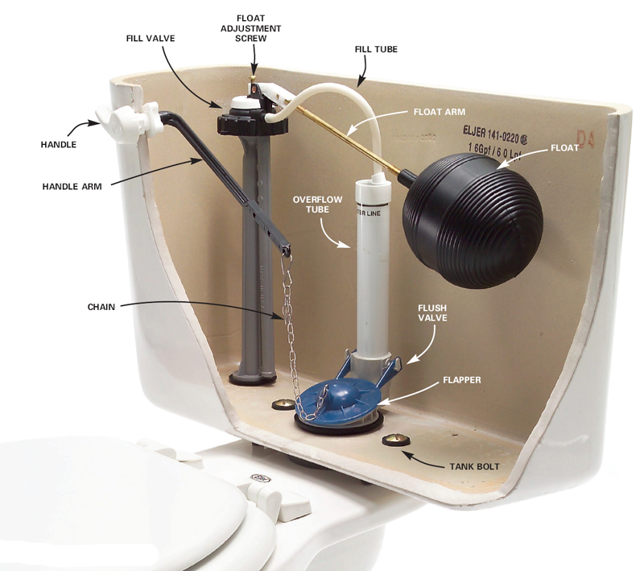
Cron job is a ‘float’ for the mc pool level in the ‘tank’ of our farm

Slide 10
For 32-core nodes
Soft limit of 7 nodes “draining”
Hard limit of 49 unused slots
If below both limits : put another node in pool
Soft exceeded, hard not : do nothing
Hard limit exceeded: put node(s) back in generic pool
Every ten minutes

Slide 11
Node recovery
In case no more atlasmc jobs:
  8(+) slots free on node: check on next run
  10 min later still 8+ free: add to list marked for returning to generic pool
  Put half of marked nodes back in pool, check the other half again on next run
Conservative : protect pool against temporary glitches.
Worst case : 60 minutes until all slots back in generic pool

Slide 12
Mc pool performance
32-core case
Slow ramp as machines become 100% mc
Reached 7 draining nodes
Disabled job starts :
pool “flushed”
Turned on float
600 cores
500
400
300
200
100

Slide 13
For 8-core nodes
Soft limit of 16 nodes “draining”
Hard limit of 49 unused slots
If below both limits : put another node in pool
Soft exceeded, hard not : do nothing
Hard limit exceeded: put node(s) back in generic pool
Every ten minutes

Slide 14
Mc pool performance
8-core case
Give back nodes due to max unused
Stabilize at 10 pool nodes
Peak at 22 nodes / 176 cores
1st mc job : 7 hrs after start
Turned on float
Pool : 72 8-core boxes
576 cores total

Slide 15
10 h : grabbed 10 nodes
Kept same farm inoccupancy (49 core lim)
At 10 h point : 80-core pool subset
24 atlas-mc cores
18 non-mc cores, 38 unused cores
600 cores
Started
here
Pool : 72 8-core boxes = 576 cores total

Slide 16
Why we did it like this
Separate pool : avoid the ‘ops job’ (or other higher prio job) takes 1 of my 8 slots and destroys ‘mc slot’
Floating pool boundary w/ policies for filling and draining the tank:
  Avoid too many empty slots during filling
  Avoid empty slots if supply of mc jobs consistently (10+ minutes) dries up
  Protect against short stops (eg maui server restart!)

Slide 17
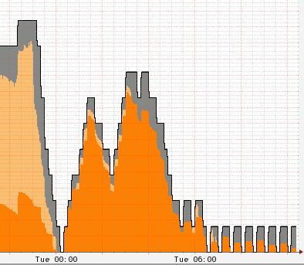
Holding the handle down
No more waiting mc jobs
A handful still get submitted
32-core case
Really no more waiting

Slide 18
32 vs 8 core (I)
8 core case : 1st mc job after 7 hrs
32 core case : 1st mc job after 16 minutes
Not just 4 times faster
Entropic effect
  8 cores: all cores of box must free up
  32 cores : 8 of 32 cores must free up
  Time to free up entire box ~ same 8 or 32
  Much shorter time to free up ¼ of box

Slide 19
32 vs 8 core (II)
8 core case : in 7 hr, 1 mc job (8 cores)
32 core case : in 7 hr, 18 mc jobs (144 cores)
4 times container size
18 times the result

Slide 20
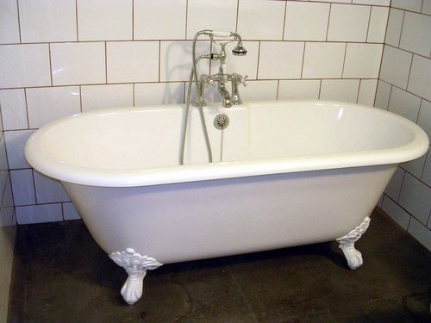
32 vs 8 core
32 core case clearly easier due to entropy
Sites where all machines 8 or fewer cores?
  Review cycle time … much more conservative on giving back a drained node
  Probably more aggressive node acquisition
  Semi-dedicated manual system might be better

Slide 21


vs

Slide 22
Random musings
System is not at all smart
  By design … being smart is really hard, esp with bad information
  Often a simple (passively stable) system has vastly better “poor behavior” and only slightly worse “optimal behavior”
Still some simple tweaks possible
  E.g. give back most recent grabbed node instead of random one

Slide 23
Check your own farm
The MC Question : if I don’t start any new jobs, which current job will end last?
Statistically, same as question : which current job started first? Fully utilized node looks same both directions in time
Can answer 2nd question with maui
showres -n | grep Running | sort -k1 -k6nr
Careful with sort order (not always ok)

Slide 24
8 core nodes
Start to drain all 147 now : 1st start in about 7 hrs
How long ago job started
Of 147 ‘smrt’ class 8-core nodes, the best:
*
*
*

Slide 25
32 core nodes
Whole node takes a day : only need 8 cores to get 1st job
*
*
*

