Slide 1
LHC machine integration experience
PicoSEC-MCNet System Integration Training
26th May 2014 - Julie Coupard

Slide 2
Contents
Introduction to the LHC machine
Installation 1995-2008
First long shutdown 2013-2014
Summary

Slide 3
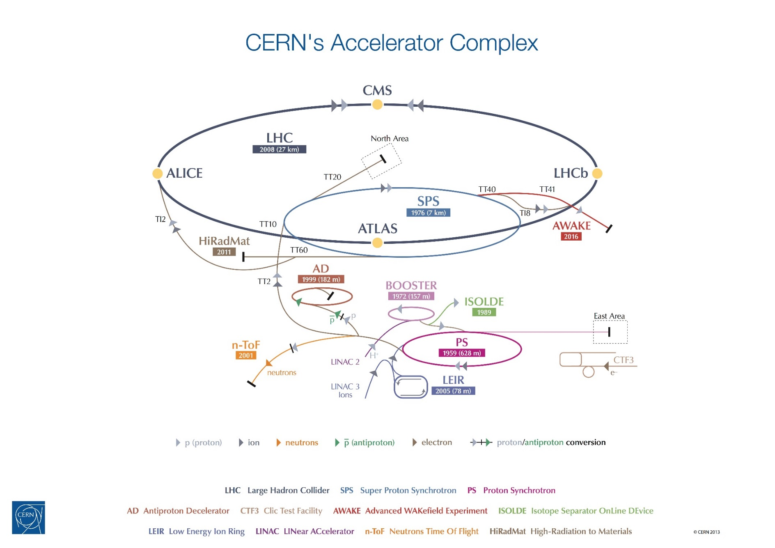
Introduction to the LHC machine

Slide 4
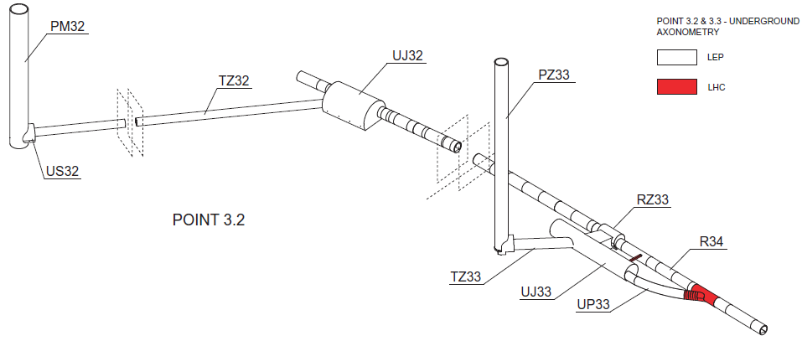
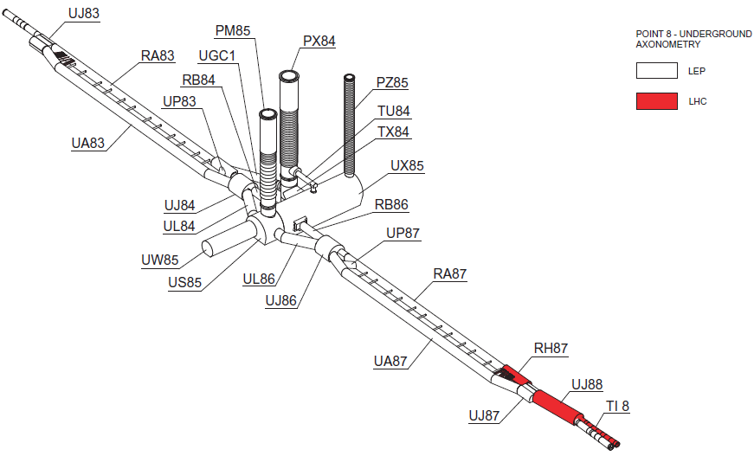
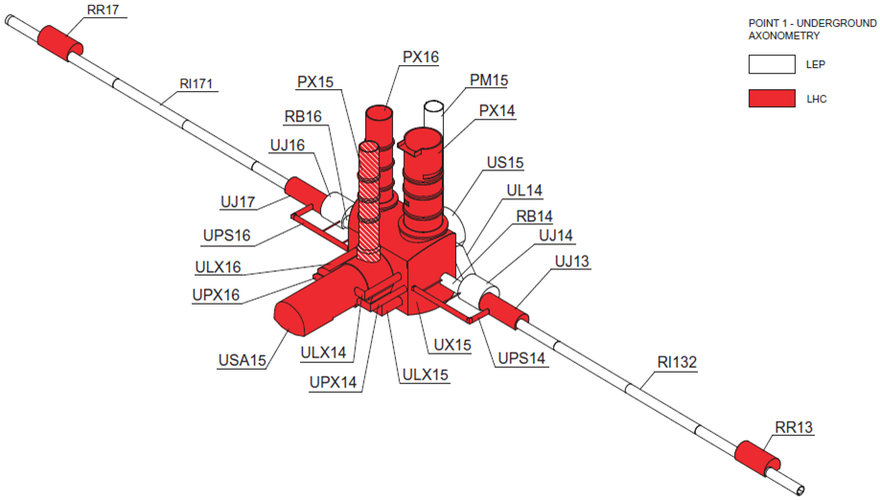
The LHC machine
Introduction to LHC
LEP tunnel

Slide 5
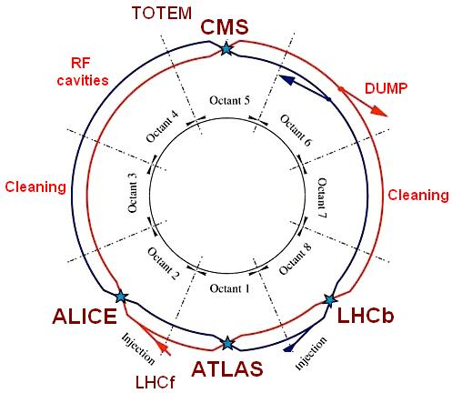
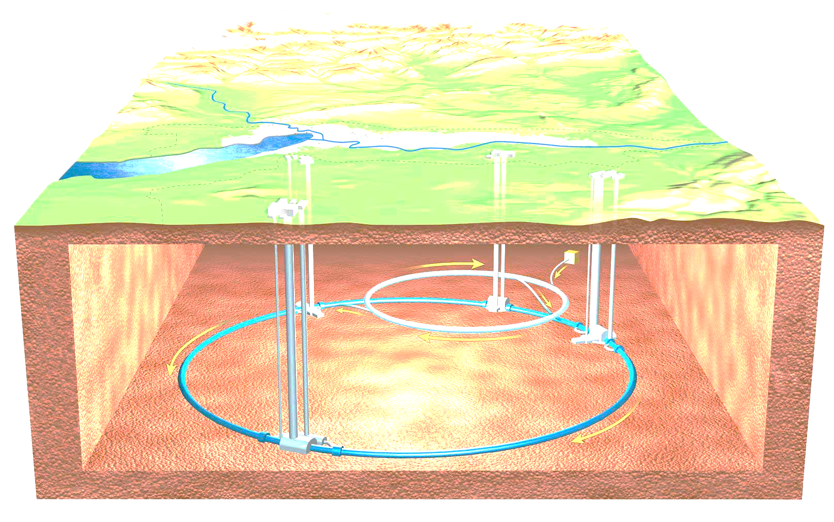
The LHC machine
Introduction to LHC
27km of circumference composed of 8 sectors of ~3,3km
  8 arcs of 2,4km
  8 long straight section of 2x440m
From 50 to 175m underground

Slide 6
Cost structure of the LHC main ring
Introduction to LHC
LHC project: ~ 5 BCHF ₍₂₀₀₈₎
Personnel: ~ 1.2 BCHF
Materials: ~ 3.8 BCHF

Slide 7
Installation
The first idea of the LHC started in the 80s, during the LEP construction.
The Project has been fully approved in December 1994 by the CERN Council.
Between 1994 and 1998
  Tests of prototype
  Publication of the Technical Design Review
  Approval of the Experiments
  Financial contribution of the member States
Construction and Installation from 1998 to 2008

Slide 8
Challenge to carry out a MegaProject
Installation
computing
organizational
construction
training / HR
PROJECTS
industrial plant
events
new product
new service

Slide 9
Challenge to carry out a MegaProject
Installation
Time Horizon
  Multi-years
  Multi-phases
Chain of Command
  Multi-layers organization
  Matrix Structure
High‐degree of Specialization
  Subject Matter Expertise
  Cutting-Edge Technology
Dispersed Teams
  Virtual teams in multiple locations
  Outsourcing to other countries
  Risks had to be properly analyzed
  Responsibilities had to be clear
  Coordination was crucial
  As well as clear and transparent communication
Mega project factors
Impact on the Project

Slide 10
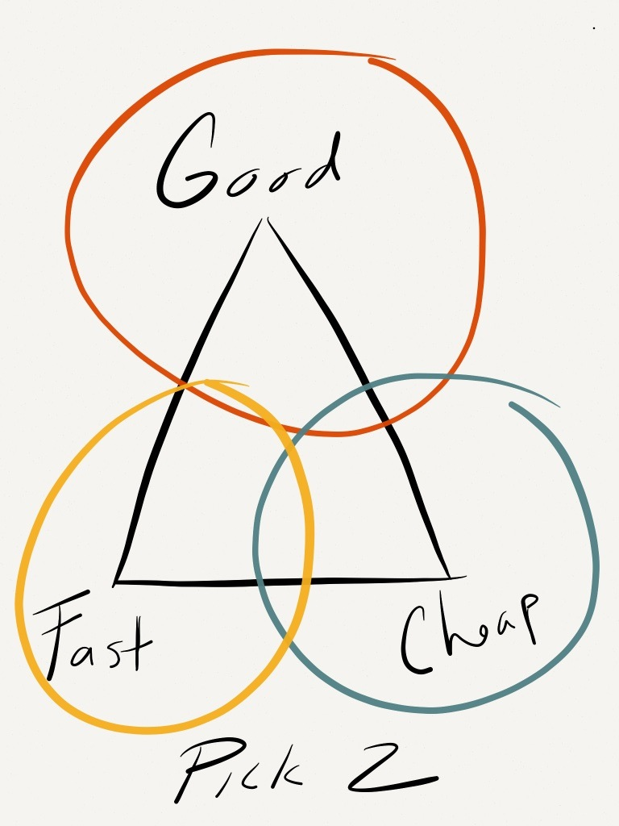
The aspects of the Mega-project
Installation
Project management plan
Organization
  Scheduling and coordination
  Integration studies
  Configuration management
Risks assessment
Issues example

Slide 11
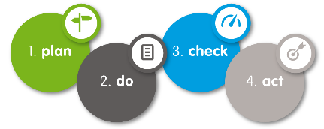






Project management
Installation
Project Assurance Quality (PAQ) put in place in 1995 based on PMBoK
  Project Integration Management
  Project Scope Management
  Project Time Management
  Project Cost Management
  Project Quality Management
  Project Human Resource Management
  Project Communications Management
  Project Risk Management
  Project Procurement Management
  Project Stakeholders Management
with large-scale projects, one PM plan shall not impose a PM methodology.

Slide 12


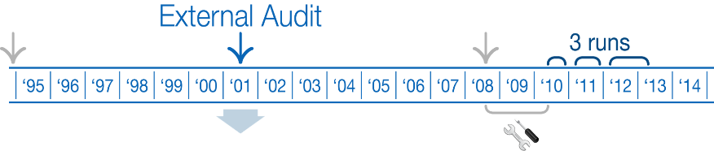

Project management
Installation
Some issues in the PM plan:
  No link between the cost control system (cost packages) and the scheduling system (work packages)
    Technical Coordinator “the project is behind schedule”
    Project Administrator “the project is under-running”
Need an appropriate Project control system

Slide 13
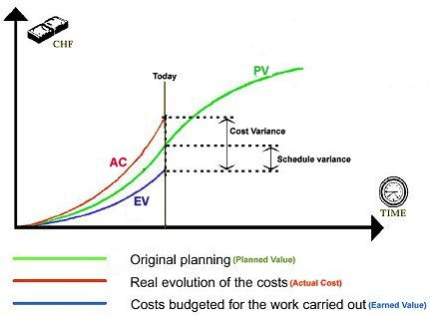
Project management
Installation
Project control 2.0
  Multi-levels planning and scheduling
  Earned Value Management-based
  Interfaced to accounting system: Actual Costs
    Payment milestones of result-oriented contracts refer to effective deliveries
    Finish dates of contract activities are always known!
  Interfaced to contract management system
  Interfaced to human resource management system
  In-kind contributions
  Collaborative and web-based
  Reporting
    Transparency of the physical progress reporting
    A “10 magnets out of 20” physical progress statement
    is more informative than a “50% complete” statement!

Slide 14
Organization
Installation
The project is defined in a Work Breakdown Structure (WBS)
  Organize the people with their roles and responsibilities
  Organize the requirements and the procurements
    Work Unit (WU):
    A Work Unit is synonym with activity, an element of work performed during the course of a project. A Work Unit consists of one or several resource assignments that have a cost estimate or a manpower estimate and one or several deliverables.
    Deliverables (DE):
    Any measurable, tangible, verifiable outcome, result or item that must be produced to complete a project or part of a project.

Slide 15

Organization
Installation
Integration
Studies
Scheduling
Coordination
Safety
Coordination on site
Configuration management
Coordination meetings
Pillars of coordination

Slide 16
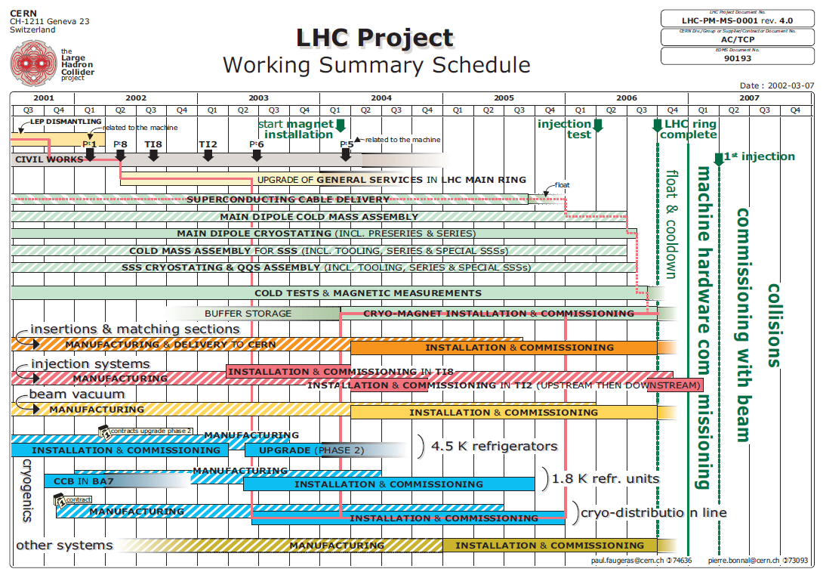
Scheduling and coordination
Installation

Slide 17
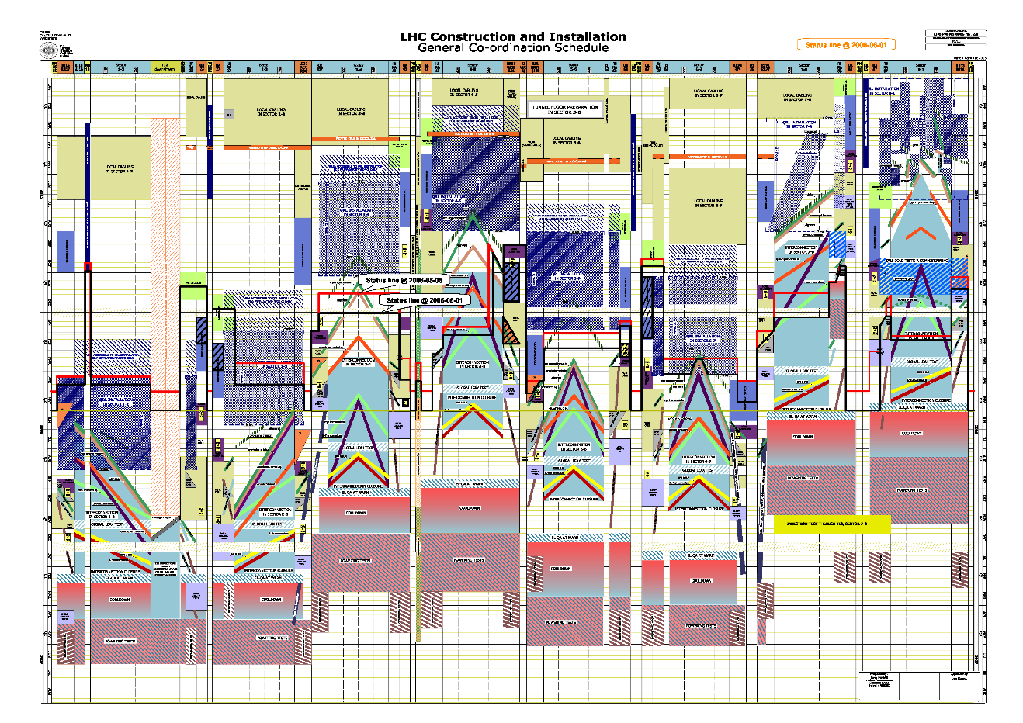
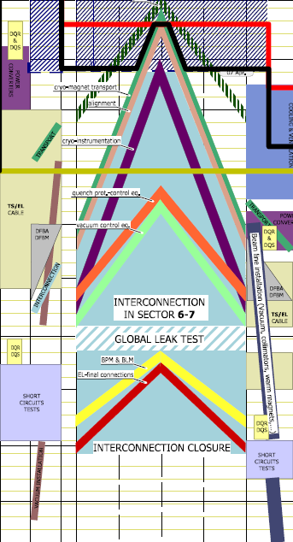
Scheduling and coordination
Installation

Slide 18
Scheduling and coordination
Installation
Multi-level planning
    Have a coherent information up-to-date
    Be able by experience to identify the over/under-estimation
    Contingencies have to be taken into account at one level
Master Schedule
Design schedule
Manufacturing schedule
Installation schedule
Detailed schedule
Detailed schedule
Detailed schedule
Detailed schedule
18

Slide 19
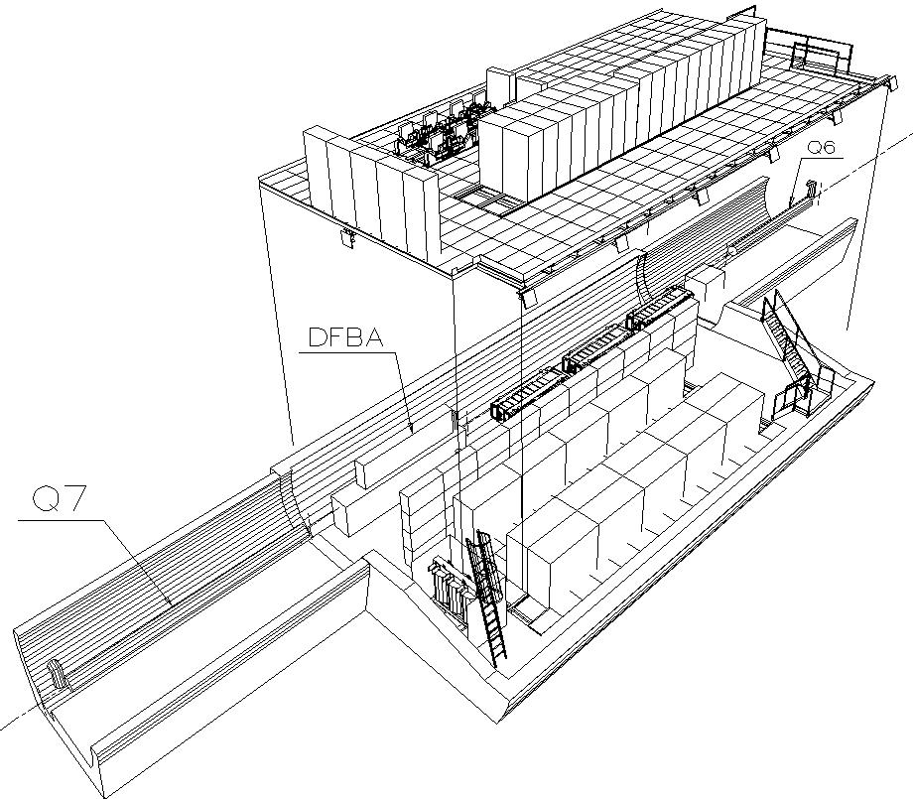
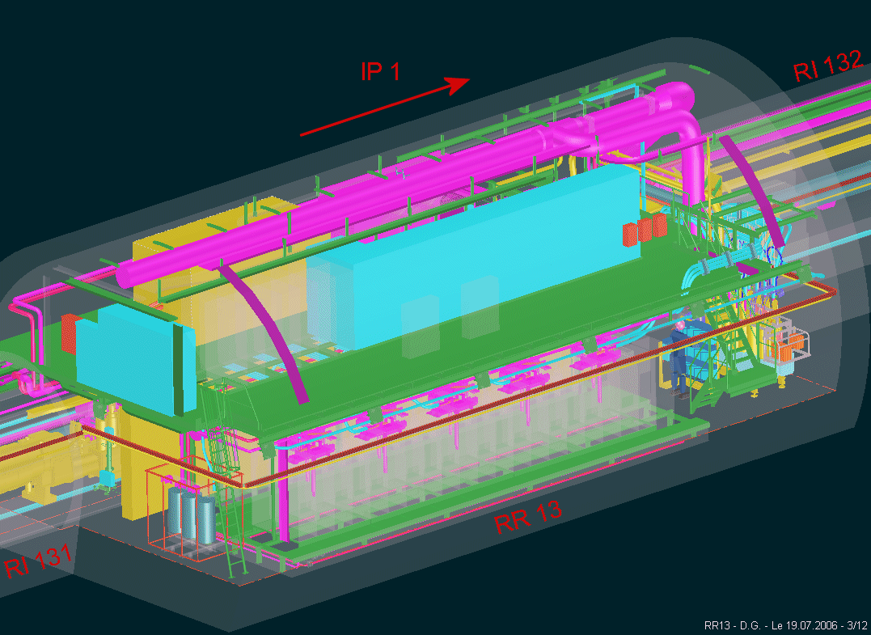
Integration studies
Installation
The integration office designs the first draft and determine the volumes for the design offices = pre-studies

Slide 20



Integration studies
Installation
The design offices provide their 3D models to integration office
  Civil engineering and metallic infrastructure
  General services and power devices
  Machine equipment
The integration office creates the puzzle
  Identification of the interferences with proposal of solution
  Space reservation
Once the integration is approved, the integration team follows-up the installation
  Identification of non-conformities of installation
  Scans
  Update of the 3D models

Slide 21
Integration studies
Installation
Study phase
Installation drawings
Installation
3D models
Critical new study
Critical rework
Installation verification
or
Documentation to update
3D models
No critical
“Use as is”
I.N.C. creation

Slide 22
Integration studies
Installation
Major difficulties
During integration studies
    Volume of transport
    Volume for the survey
Design and Studies
Installation
Machine
Cryogenics
Services
Infrastructure
Civil engineering

Slide 23
Configuration management
Installation
Provides a clear and coherent picture of the status of a project or machine at a given point in time.
In order to achieve this, we use three important tools
  Changes to the machines and transfer lines are documented, circulated and approved in the Hardware Baseline (also known as a Product Breakdown Structure)
  We register the layouts of the accelerators and all changes to them within the Layout Database that has to remain up-to-date.
    Sequence of functional positions = space management
    Integration and Installation Drawings match the recorded layout to ensure that envelopes of reserved space still match the physical equipment dimensions
  Naming is critical throughout the lifecycle of the machines/projects. To store and manage naming, we use the Naming Portal
Keyword is coherence between the tools.

Slide 24
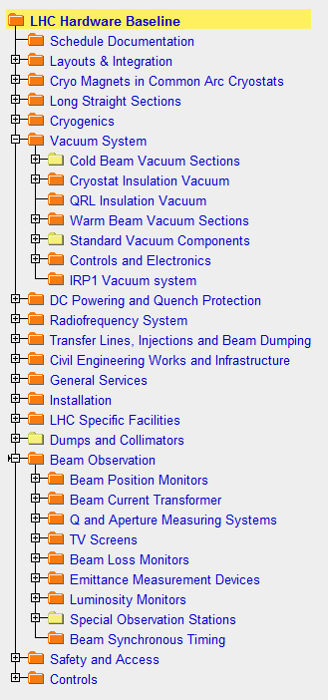
Configuration management
Installation
Hardware Baseline
    …is an EDMS (Electronic Document Management System) based tool.
    The hardware baseline contains all the information needed to re-build the machine, including:
      Engineering Specifications, Drawing Folders, ECR, Procurement Documents
      LHC Baseline was the first to be issued
      SPS and PS Complex Hardware Baselines are in progress
    Logical structure of nodes, based on hardware types and functions
    Documentation can be linked to multiple locations

Slide 25
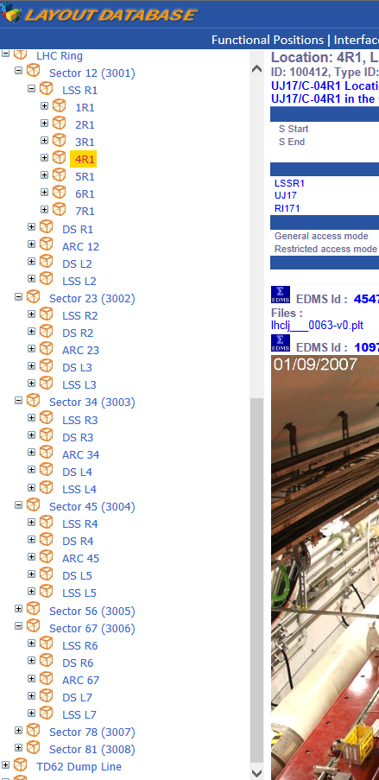
Configuration management
Installation
Layout Database
    Stores the sequence (layout) of accelerator and transfer line components.
    Equipment types and details
    Functional positions for mechanical and electrical layouts
    Asset names – functional position is exported to MTF database and associated to an asset. Layout just shows the result.
    Expert name – optional, alternative functional name

Slide 26
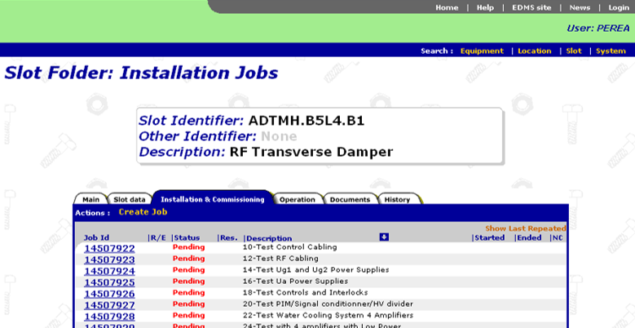
Configuration management
Installation
The link with the manufacturing tool
    The MTF is an integral tool of the CERN EDMS that allows a detailed follow-up of the equipment during the manufacturing and test processes. Predefined workflows with tasks and technical measurements can be logged and followed-up in a fully configurable manner for each type of equipment. The Non-Conformity management is another important module for the manufacturing follow-up, which allows formalized procedures for solving problems discovered during production.
    For the LHC project, over 600.000 components were individually followed up with MTF during the manufacturing and test phases.

Slide 27

Risks assessment
Installation
By definition, risks can occur and the prevention is less control for new machine like LHC which stays a prototype with unique systems.
How we prevent risks
    Anticipation, follow-up, monitoring
    Strict quality control
    Long term analysis schedule
    Flexibility (plan A, plan B)
When a risk occurs
    Dedicated task force: correct expertise and appropriate experts !!
    Being ready for the unexpected and determining your response to it

Slide 28
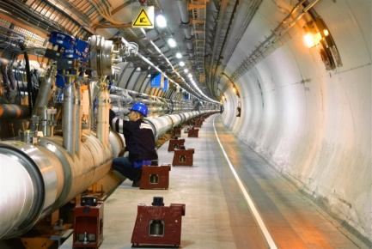
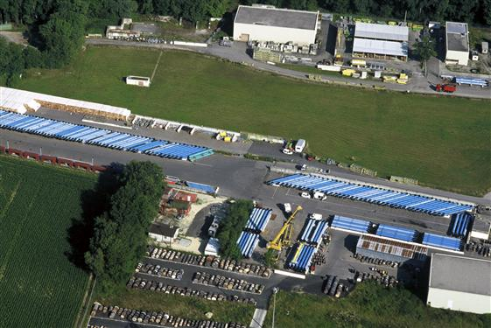
Issues example
Installation
The study and installation of the cryogenics distribution line (QRL)
The situation:
1 unique firm for the study and installation of around 25 km of QRL
The issue:
Design of the supports of the QRL underestimated, the installation of the QRL could not be done properly
Plan B: CERN Task Force
Decided to repair the delivered equipment
Change in the Master Plan
Impacts:
Delay in the installation of the magnets → storage
Logistic of transport of the magnets
99 | 00 | 01 | 02 | 03 | 04 | 05 | 06 | 07 | 08
Notes:
History:
Débuté en juin 03
Après plusieurs mois, de sérieux problèmes techniques et qualitatifs
Chantiers arrêtés en Juillet 04…
Afin d’avancer, le CERN a décidé de réparer et réinstaller des éléments défectueux déjà approvisionnés
Chantiers repris en Novembre 04
Fini en Décembre 06
Impact :
Changement planning :
annulation des tests intermediaires
Changement de sequence dans l’installation
Diminution des temps d’installation machine
Diminution des temps de tests de la machine d’un facteur 2

Slide 29
Issues example
Installation
The installation of the cryomagnets
The situation:
The installation has to be carried-out in parallel of works in the tunnel
The issue:
Co-activities in underground → difficulties with the logistic of transport (only one pits to bring the magnets in underground)
Delay on availability on surface → 1 hour = 1 day
Plan B:
Transports of the magnets during the night
Coordination with the co-activity to allow the transports
Impacts:
Long time window dedicated for the installation
Co-activity on several km of tunnel
99 | 00 | 01 | 02 | 03 | 04 | 05 | 06 | 07 | 08

Slide 30
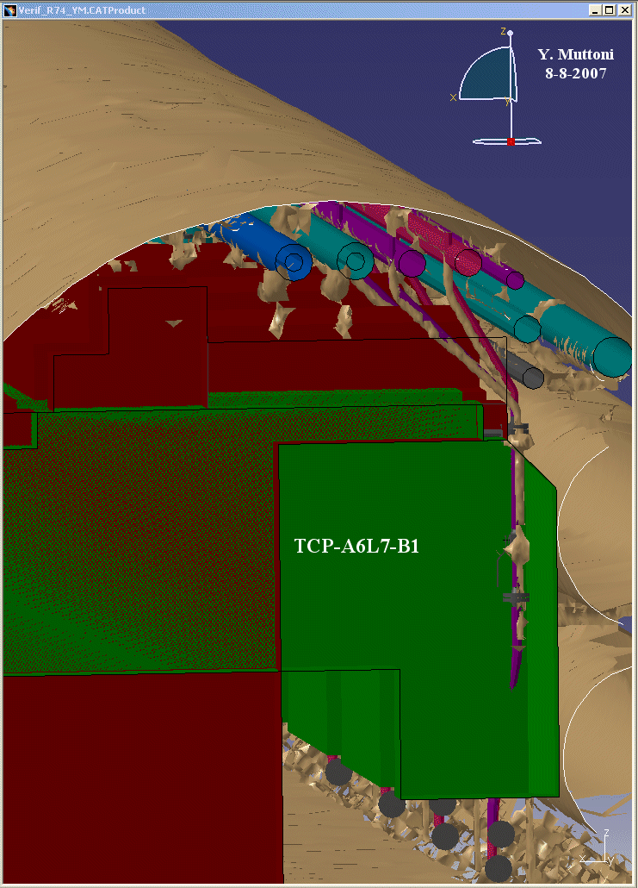
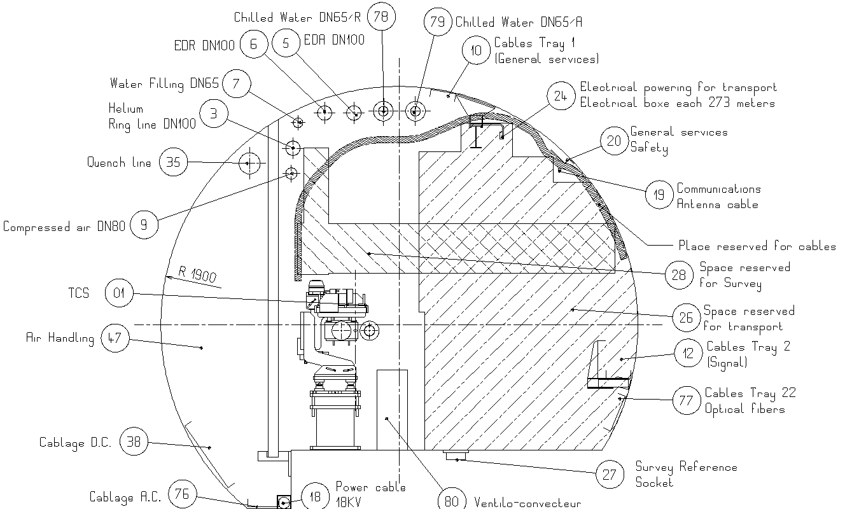
Issues example
Installation
The installation of the collimators
The situation:
The handling volume during installation was not taking into account in time
The issue:
Interference between the cooling system and the handling of the collimators
Plan B:
Modification of the cooling system and cable trays
Impacts:
Storage of the collimators
Additional work for the cooling team
Updating of the drawing and 3D models
99 | 00 | 01 | 02 | 03 | 04 | 05 | 06 | 07 | 08

Slide 31
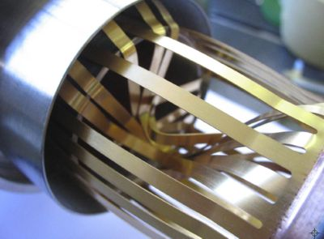
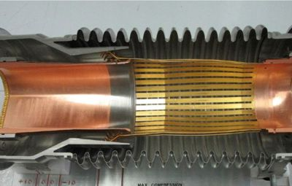
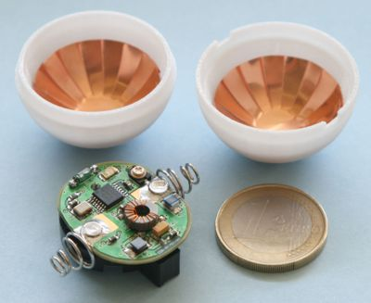
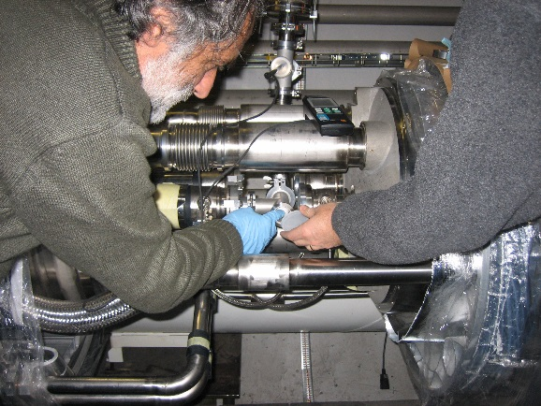
Issues example
Installation
Deformation of the plug-in modules contacts during warm-up
The situation:
PIM contacts did not slide during the magnet warm-up and instead got buckled into the beam pipe aperture
The issue:
The deformation of the plug-in modules would become an obstruction for the circulating beams
Plan B: working group
Send inside the beam pipe a ball equipped with a radio-frequency transmitter in order to identify the defective PIMs to repair.
Impacts:
New task to integer in the schedule after warm-up of a sector
99 | 00 | 01 | 02 | 03 | 04 | 05 | 06 | 07 | 08

Slide 32
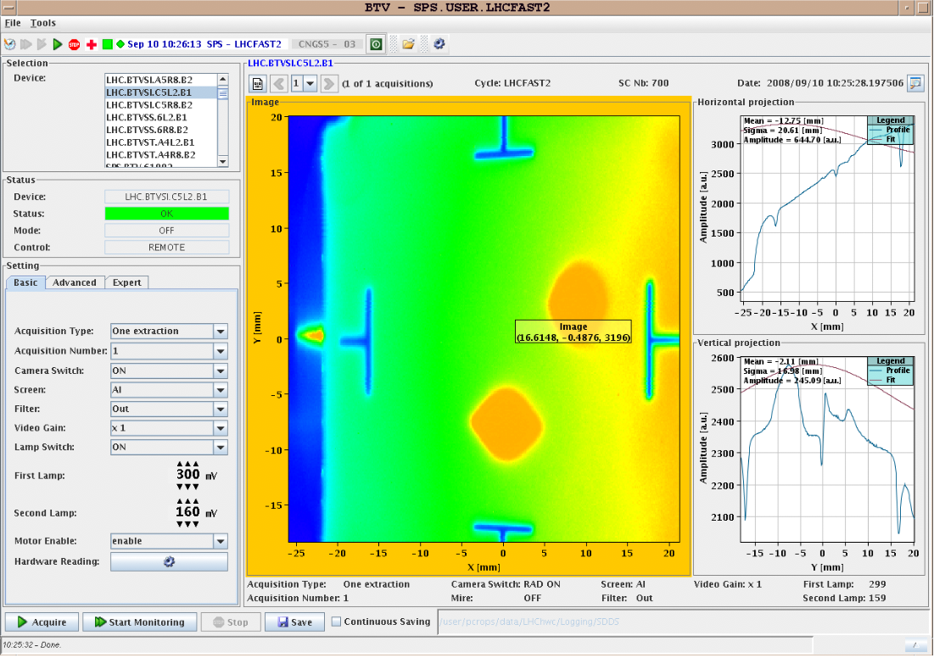
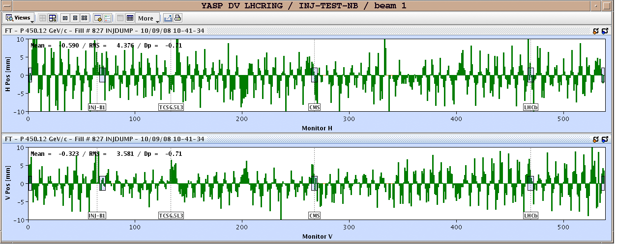
Success – 10th September 2008
Installation
First complete turn of the beam
“It’s a fantastic moment,” said LHC project leader Lyn Evans, “we can now look forward to a new era of understanding about the origins and evolution of the universe.”

Slide 33
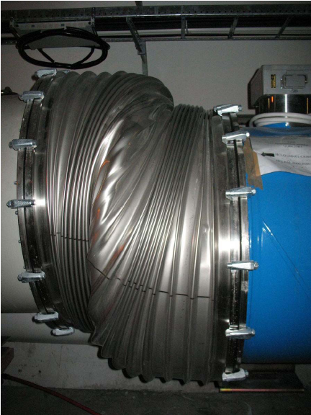
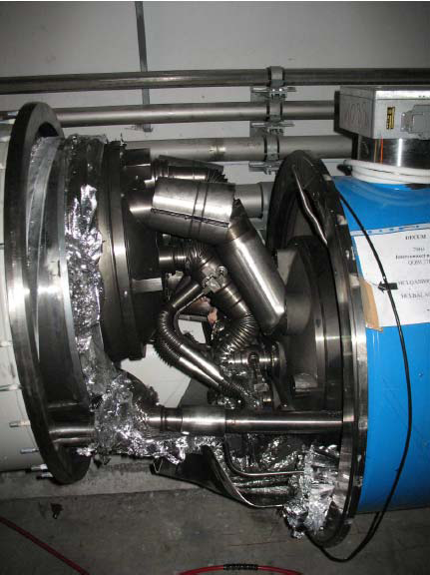
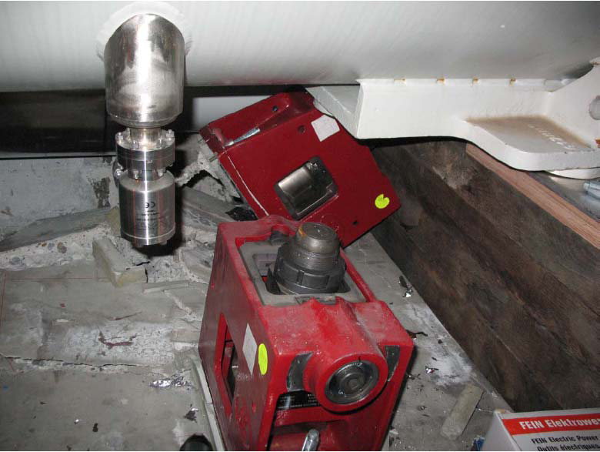
Issues example
Installation
Incident 19th September 2008
The situation:
Last electrical tests at higher Energy (7TeV)
The issue:
Collateral damage due to pressure forces
  Magnets displacement
  Support displacement and rupture of ground anchors
Plan B: CERN Task Force
Dismantle, repair and re-install the whole damaged sector and repeat the hardware commissioning with powering test with limit at 3.5 TeV beam energy.
Impacts:
1 year to repair, consolidate and tests again the machine.
New safety measures put in place.
Studies of the issue for next consolidation.

Slide 34
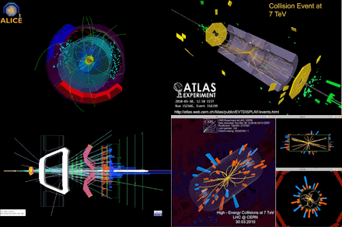
Success – 30th March 2010
Installation
7 TeV collision events seen by the LHC's four major experiments
(clockwise from top-left: ALICE, ATLAS, CMS, LHCb)

Slide 35

Success – 4th July 2012
Installation
The ATLAS and CMS experiments at CERN's Large Hadron Collider announced they had each observed a new particle in the mass region around 126 GeV.

Slide 36
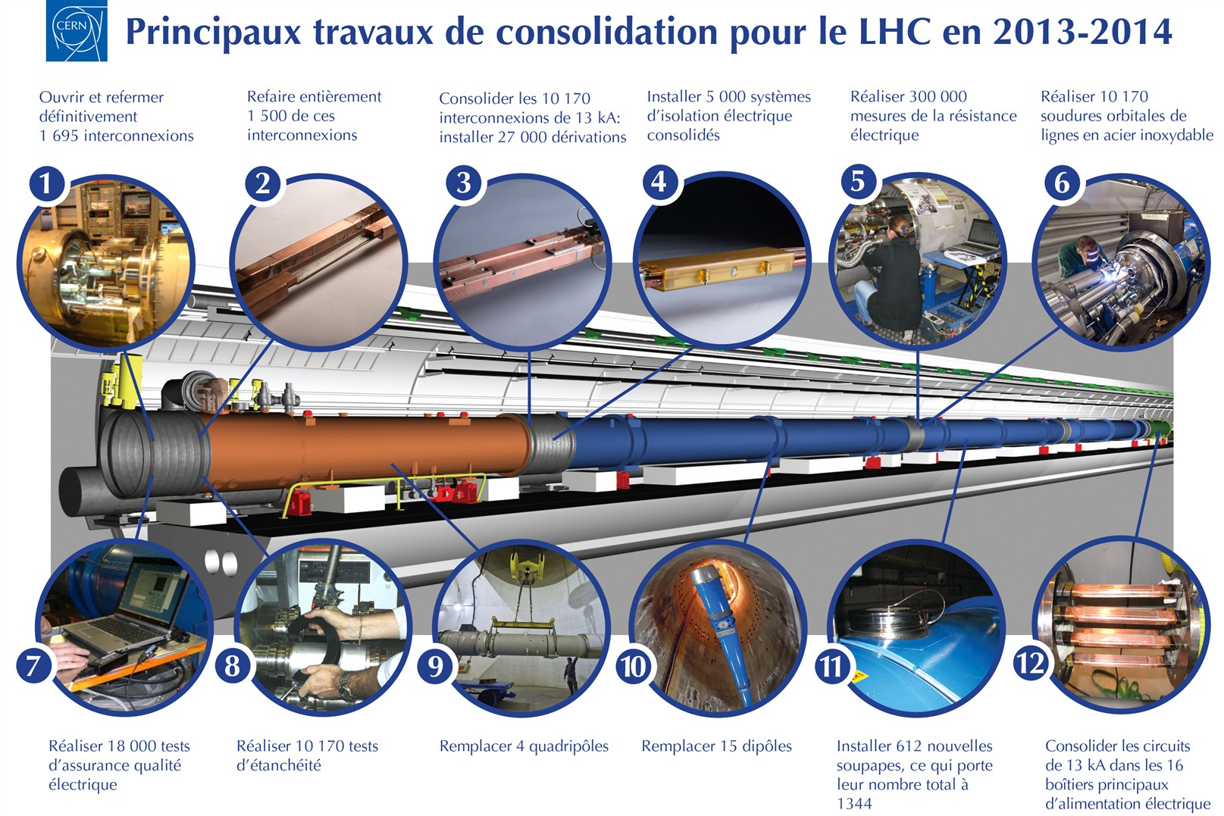
First Long Shutdown
New challenges

Slide 37
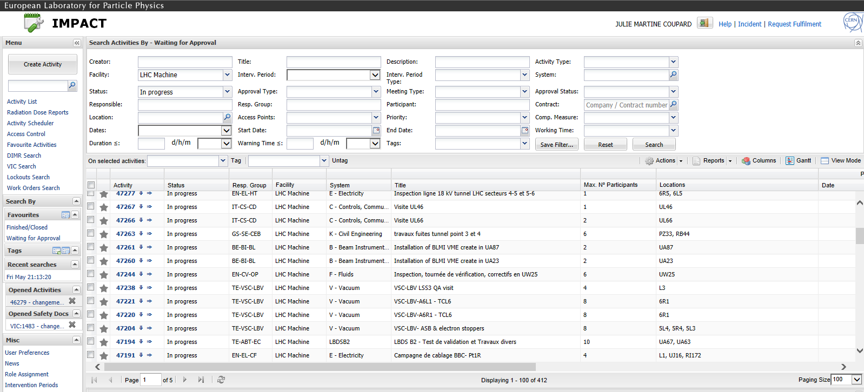
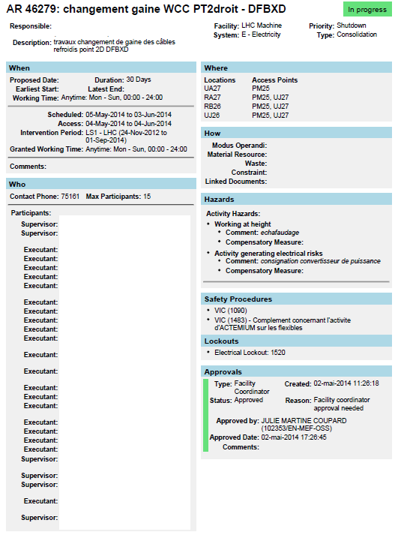
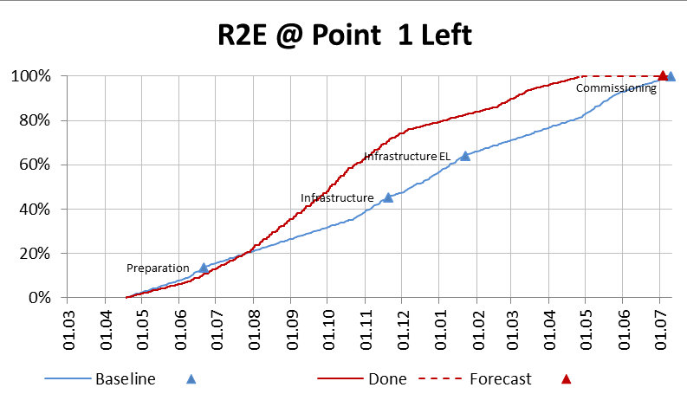
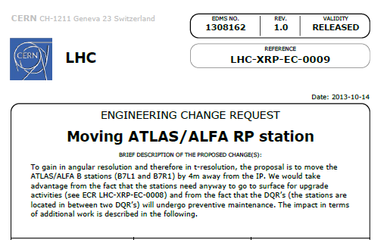
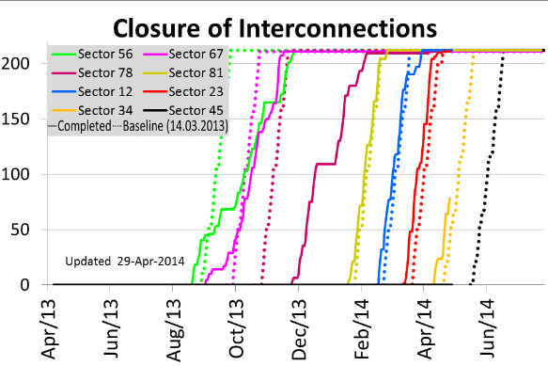
Lessons learnt
First Long Shutdown
Improvements
    Intervention Management Planning & Activity Coordination Tool (IMPACT)
    Engineering Change Request template (ECR)
    Dashboards

Slide 38
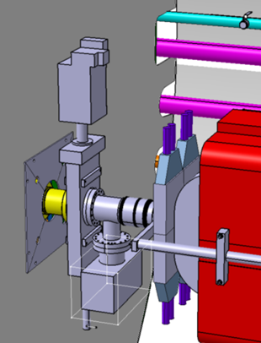
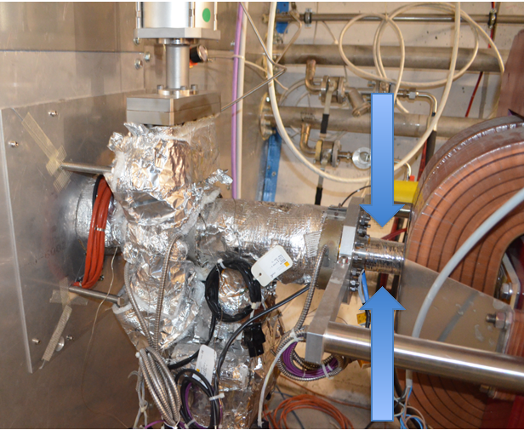
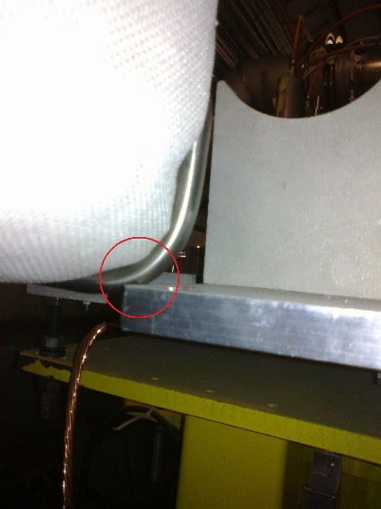
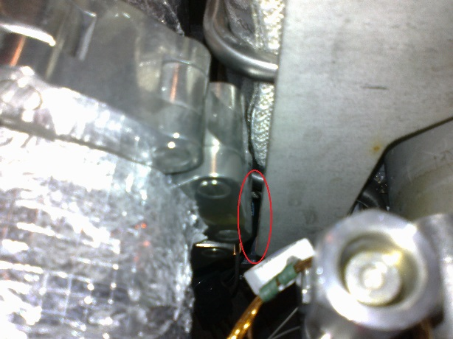
Lessons to come
First Long Shutdown
Remaining difficulties
    Simplified 3D model
    and reality
      Cabling
      Mechanical pieces
      Cooling system
    Communication between meeting of decisions and worker on site
      Information online
      Screen on site giving the important news

Slide 39


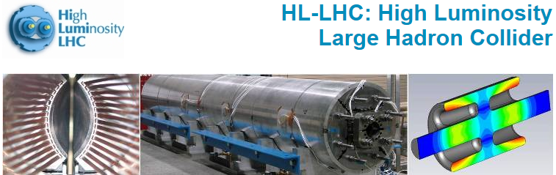

Lessons learnt
First Long Shutdown
New Projects at CERN after LHC

Slide 40
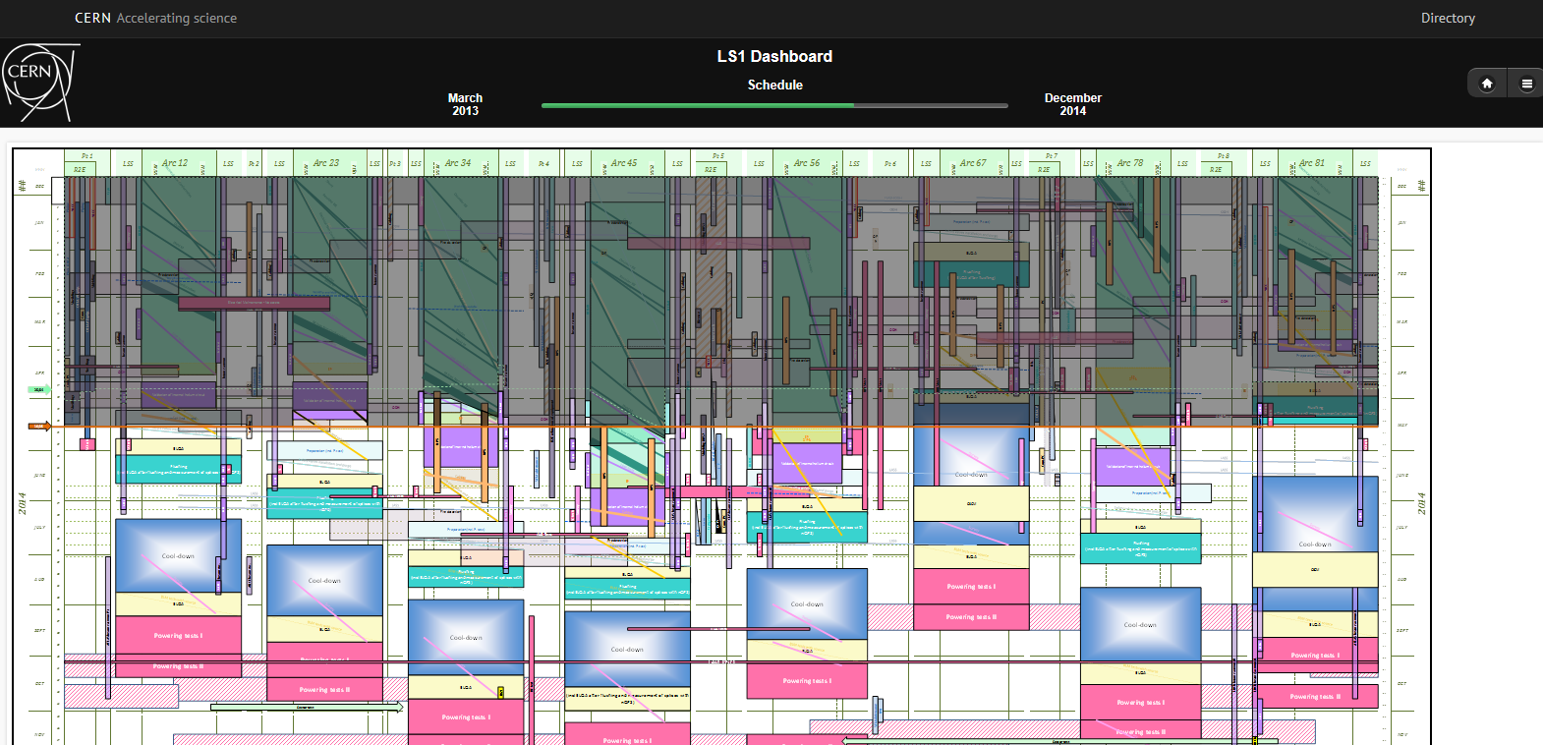
Current situation
First Long Shutdown
http://lhcdashboard.web.cern.ch/lhcdashboard/ls1/
Master schedule in time with forecast

Slide 41
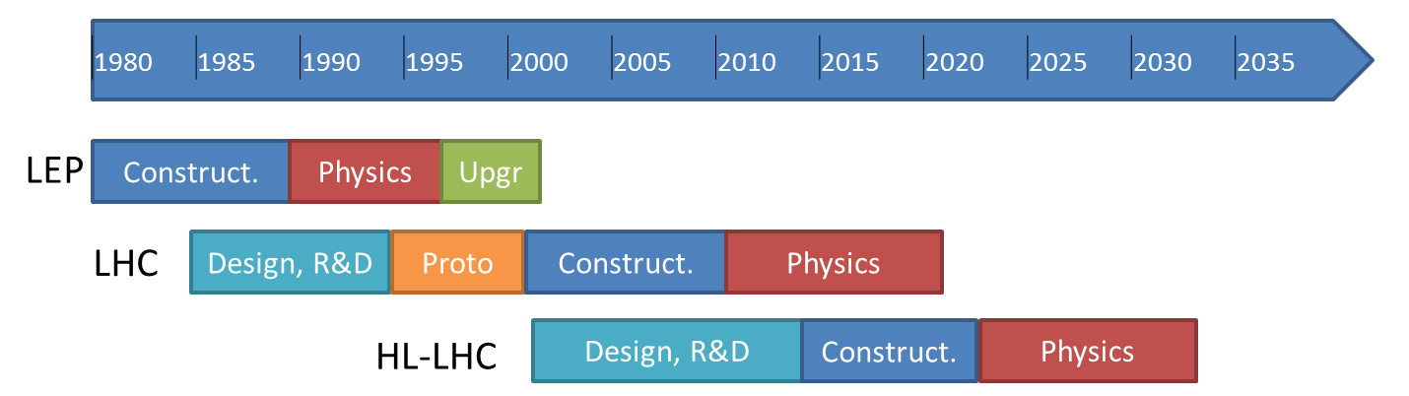



What’s next ?
today
FCC

Slide 42
Summary
Work Breakdown Structure
Cost control system
Reporting
Project Management Plan
Product Breakdown Structure
Risk assessment
Committee
Coordination on site
Scheduling
Coordination
Multi-level
Have a coherent information up-to-date
Be able by experience to identify the over/under-estimation
Clear information
Anticipate the logistic on site
Manage the co-activity
COMMUNICATION
&
COHERENCE
Safety
Integration
Predefinition of the environment
Puzzle of the design office 3D models
Volume of transport
Volume for the survey
Integer from pre-studies
Involve at all stages
Work package description
Visit on site
Configuration Management
Naming convention
Link to quality assurance management tool
Hardware baseline
Layout database

Slide 43
THANK YOU FOR YOUR ATTENTION
Thanks to my colleagues for their contributions:
K. Foraz, Y. Muttoni, S. Chemli, T. Birtwistle, P. Bonnal

