Slide 1
OMD (Open Monitoring Distribution)
Shawn McKee/University of Michigan
USATLAS Facilities Meeting
March 19th, 2014

Slide 2
OMD Overview
I wanted to give everyone a quick look at OMD (Open Monitoring Distribution). http://omdistro.org/start
What is it?
  An easy-to-install monitoring package
  A new way to deploy Nagios and related components into a single package (RPM)
  Provides Nagios like tests, a rule-based system to configure with, automatic graph creation, high-performance (1 minute interval monitoring), customizable alerting and mapping.

Slide 3
Installation
It is pretty easy to install. For CentOS(RHEL,SL) it is available as an RPM.
  Make sure EPEL is installed. rpm -Uvh "http://download.fedoraproject.org/pub/epel/6/x86_64/epel-release-6-8.noarch.rpm"
  Then to get OMD use rpm -Uvh http://labs.consol.de/repo/stable/rhel6/x86_64/labs-consol-stable.rhel6.noarch.rpm
  Finally: ‘yum -y install omd-1.10’
I set up OMD and MaDDash for WLCG perfSONAR monitoring and install details are at:
https://twiki.cern.ch/twiki/bin/view/LCG/MadDashWLCG

Slide 4
Setup OMD
On CentOS 6.x we need to fix a problem in OMD:
  In CentOS 6.4 there is a small issue with pathing in /usr/bin/omd. On line 794 You want to add the following highlighted red text….
  “file(“/etc/fstab”, “a+”).write(“tmpfs /opt%s tmpfs noauto,user,mode=755,uid=%s,gid=%s 0 0\n” % \“
Then we can setup a new ‘site’ in OMD. As ‘root’ you need to run: ‘omd setup’ to prepare OMD.
  Pick a name for your monitoring site. NOTE: this name will be used to create a new user of the same name which must not already exist!: ‘omd create <SITENAME>’
  Start it: ‘omd start <SITENAME>’

Slide 5
Configure OMD
To configure the site you could use the WATO interface on the web or you can login and use command line tools.
  For now, login as root on the new system and ‘su - <SITENAME>’ to become the new site owner/user. The "root" of the site is in /omd/sites/ which is /omd/sites/<SITENAME> in our case.
The easiest way to use/configure OMD is to exploit check_mk. The configuration files are in /omd/sites/<SITENAME>/etc/check_mk and sub-directories. The main file is appropriately called main.mk. Any files ending in .mk will be included. The 'wato' subdirectories are for WATO (Web Administration Tool).

Slide 6
Example Deployment
We have setup OMD for monitoring AGLT2 and have deployed an instance at UM and MSU
  https://omd.aglt2.org/atlas/omd/
  https://omd-msu.aglt2.org/aglt2msu/omd/
  (Login AGLT2-guest/USAtlas)
We additionally have a deployment for the WLCG perfSONAR-PS monitoring at:
  https://maddash.aglt2.org/WLCGperfSONAR/check_mk/index.py?start_url=%2FWLCGperfSONAR%2Fcheck_mk%2Fdashboard.py (User WLCGps, pw given on call)
I will try to provide a “tour” during the call using these

Slide 7
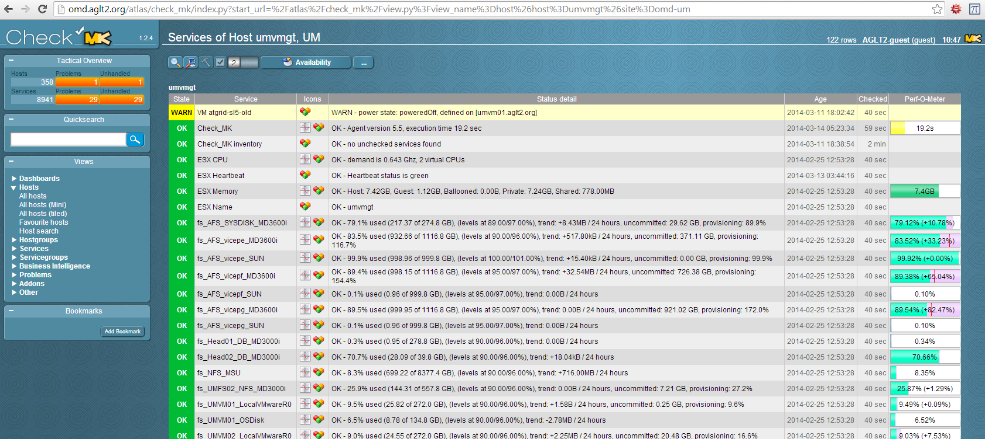
Example Check_MK Monitoring
An example of the type of monitoring is shown below for AGLT2s Vmware management instance.
http://omd.aglt2.org/atlas/check_mk/index.py?start_url=%2Fatlas%2Fcheck_mk%2Fview.py%3Fview_name%3Dhost%26host%3Dumvmgt%26site%3Domd-um

Slide 8
Adding Hosts to Monitor in OMD
Adding hosts to monitor is easy. Just add a line to the ~/etc/check_mk/conf.d/wato/hosts.mk file OR add it via the WATO (Web Adminstration TOolkit) OR add a new file like <hostname>.mk somewhere in the ~/etc/check_mk tree.
    Content example:
    all_hosts += [
    'umvmgt|tcp|lan|um|prod|vmware|vcenter',
    ]
    Note the line starts with a hostname, then “tags” separated by ‘|’
Next just “inventory” the host:
  ‘cmk –I umvmgt’ # This auto-discovers services
Reload CMK to get it in place: ‘cmk -R’
Check your webinterface: http://<hostname>/<SITENAME/check_mk/

Slide 9
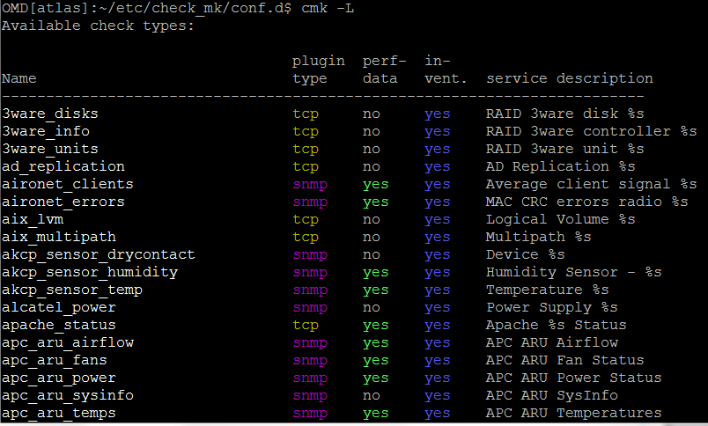
Service Discovery
The ‘check_mk’ rule-based config component of OMD knows an extensive list (520) services to automatically find and configure monitoring for (‘cmk -L’ shows them)
Requires either ‘snmp’ or a check_mk_agent installed…

Slide 10
Tour URLs
Dell OMSA monitoring: http://omd.aglt2.org/atlas/check_mk/index.py?start_url=%2Fatlas%2Fcheck_mk%2Fview.py%3Fview_name%3Dservicedesc%26service%3DDell%2520OMSA
Hostgroups: http://omd.aglt2.org/atlas/check_mk/index.py?start_url=%2Fatlas%2Fcheck_mk%2Fview.py%3Fview_name%3Dhostgroups
Servicegroups: http://omd.aglt2.org/atlas/check_mk/index.py?start_url=%2Fatlas%2Fcheck_mk%2Fview.py%3Fview_name%3Dsvcgroups
Hosts: http://omd.aglt2.org/atlas/check_mk/index.py?start_url=%2Fatlas%2Fcheck_mk%2Fview.py%3Fview_name%3Dallhosts

Slide 11
Discussion/Questions
Questions or Comments?

