Slide 1
Charm nuclear systems with heavy quark symmetry
Tokyo Institute of Technology
S. Yasui
The 3rd Korea-Japan Workshop on Nuclear and Hadron Physics at J-PARC@Inha Univ. 20-21 Mar. 2014

Slide 2
References
HQS doublet/singlet in exotic hadrons and nuclei
S.Y., K.Sudoh, Y.Yamaguchi, S.Ohkoda, A.Hosaka, T.Hyodo, Phys. Lett. B727, 185 (2013)
Y.Yamaguchi, S.Ohkoda, A.Hosaka, T.Hyodo, S.Y., arXiv:1402.5222 [hep-ph]
P⁽*⁾N, P⁽*⁾NN hadronic molecules
S.Y., K.Sudoh, Phys. Rev. D80, 034008 (2009)
Y.Yamaguchi, S.Ohkoda, S.Y., A.Hosaka, Phys. Rev. D84, 014032 (2011)
Y.Yamaguchi, S.Ohkoda, S.Y., A.Hosaka, Phys. Rev. D85, 054003 (2013)
Y.Yamaguchi, S.Y., A.Hosaka, arXiv:1309.4324 [nucl-th]
P⁽*⁾ in nuclear matter, NLO in 1/m_{Q} expansion, Kondo effects
S.Y., K.Sudoh, Phys. Rev. C87, 015202 (2013)
S.Y., K.Sudoh, Phys. Rev. C88, 015201 (2013)
S.Y., K.Sudoh, Phys. Rev. C89, 015201 (2014)
P⁽*⁾N hadronic molecules
Y.Yamaguchi, S.Ohkoda, S.Y., A.Hosaka, Phys. Rev. D87, 074019 (2013)

Slide 3



1. Introduction to charm (bottom) nuclei
D⁽*⁾ (B⁽*⁾) meson in nuclear matter
n
p
D⁽*⁾
1. D⁽*⁾ (B⁽*⁾) meson and nucleon interaction
2. Modifications of D⁽*⁾ (B⁽*⁾) meson properties
- chiral condensate, gluon condensate, ...
3. Modifications of nuclear structure
- glue-like effects?

Slide 4
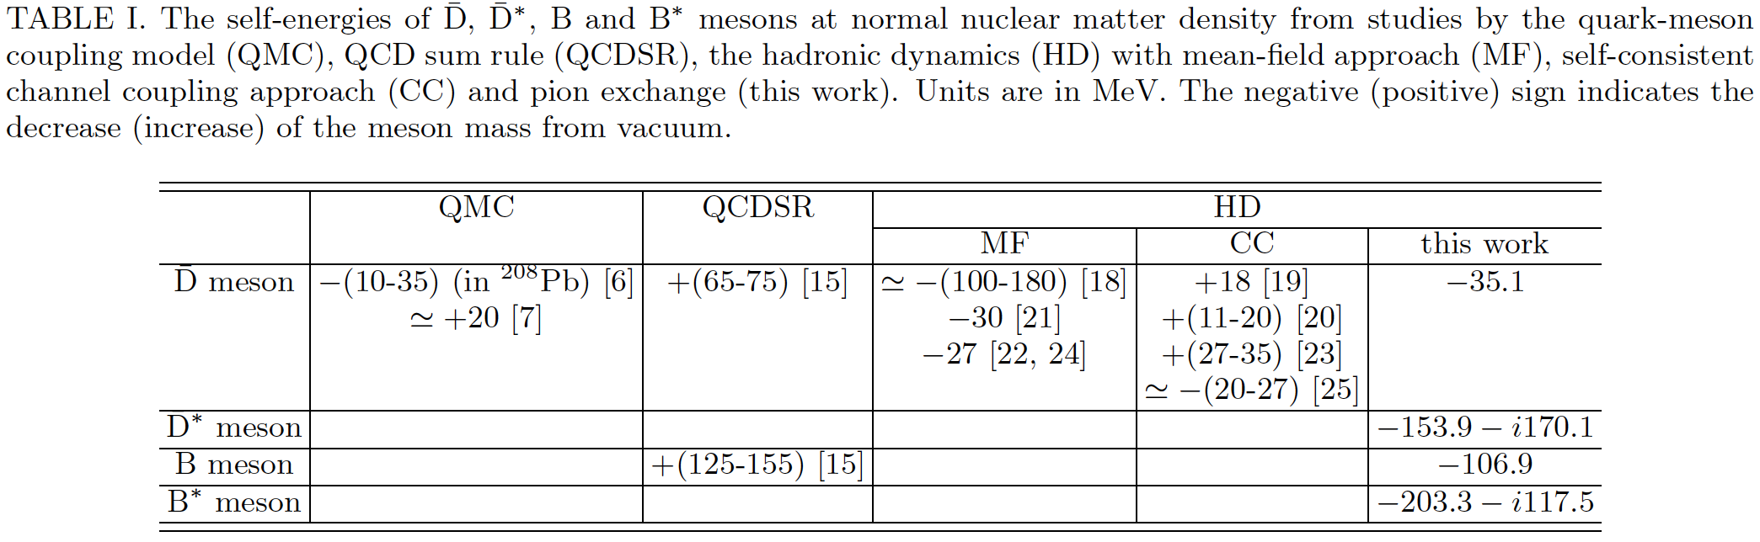
1. Introduction to charm (bottom) nuclei
Binding energy of D⁽*⁾ (B⁽*⁾) meson in nuclear matter (MeV)
Quark-meson coupling model
QCD rum rule
Hadron dynamics
Mean field
WT-type coupling
π exchange
[6] K. Tsushima, D. -H. Lu, A. W. Thomas, K. Saito and R. H. Landau, Phys. Rev. C 59, 2824 (1999).
[7] A. Sibirtsev, K. Tsushima and A. W. Thomas, Eur. Phys. J. A 6, 351 (1999).
[15] T. Hilger, R. Thomas and B. Kampfer, Phys. Rev. C 79, 025202 (2009).
[16] T. Hilger, R. Schulze and B. Kampfer, J. Phys. G G 37, 094054 (2010).
[17] Z. -G. Wang and T. Huang, Phys. Rev. C 84, 048201 (2011).
[18] A. Mishra, E. L. Bratkovskaya, J. Schaffner-Bielich, S. Schramm and H. Stoecker, Phys. Rev. C 69, 015202 (2004).
[19] M. F. M. Lutz and C. L. Korpa, Phys. Lett. B 633, 43 (2006).
[20] L. Tolos, A. Ramos and T. Mizutani, Phys. Rev. C 77, 015207 (2008).
[21] A. Mishra and A. Mazumdar, Phys. Rev. C 79, 024908 (2009).
[22] A. Kumar and A. Mishra, Phys. Rev. C 81, 065204 (2010).
[23] C. E. Jimenez-Tejero, A. Ramos, L. Tolos and I. Vidana, Phys. Rev. C 84, 015208 (2011).
[24] A. Kumar and A. Mishra, Eur. Phys. J. A 47, 164 (2011).
[25] C. Garcia-Recio, J. Nieves, L. L. Salcedo and L. Tolos, Phys. Rev. C 85, 025203 (2012).
* π exchange : S. Yasui, K. Sudoh, Phys. Rev. C87, 015202 (2013).

Slide 5
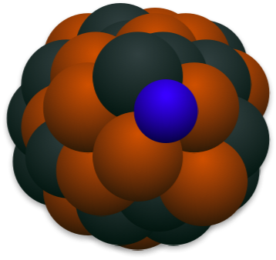
1. Introduction to charm (bottom) nuclei
π exchange in D⁽*⁾N systems
D
S-wave
N
D⁽*⁾(cq)
π
large baryon number
D*
D-wave
N
π
D
S-wave
N
“D-D* mixing”
Charmed nuclei
・ Mass degeneracy for D and D*
M_{D*}-M_{D} = 140 MeV ∝ 1/m_{c}
D⁽*⁾ nuclei
C<0
・ π exchange (tensor force)
S, D-wave mixing (deuteron-like)
Λ_{c}, D⁽*⁾ nuclei
C>0
→ Attraction !!
Cohen and Lebed, PRD72, 074010 (2005)
SY and Sudoh, PRD80, 034008 (2009)
Yamaguchi, Ohkoda, SY, Hosaka, PRD84, 014032 (2011)
Yamaguchi, Ohkoda, SY, Hosaka, PRD85, 054003 (2012)
SY and Sudoh, PRD87, 105202 (2013)

Slide 6
1. Introduction to charm (bottom) nuclei
π exchange in D⁽*⁾N systems
D
S-wave
N
D⁽*⁾(cq)
π
large baryon number
D*
D-wave
N
π
D
S-wave
N
“D-D* mixing”
Charmed nuclei
・ Mass degeneracy for D and D*
M_{D*}-M_{D} = 140 MeV ∝ 1/m_{c}
D⁽*⁾ nuclei
C<0
New!
・ π exchange (tensor force)
S, D-wave mixing (deuteron-like)
Λ_{c}, D⁽*⁾ nuclei
C>0
→ Attraction !!
Cohen and Lebed, PRD72, 074010 (2005)
SY and Sudoh, PRD80, 034008 (2009)
Yamaguchi, Ohkoda, SY, Hosaka, PRD84, 014032 (2011)
Yamaguchi, Ohkoda, SY, Hosaka, PRD85, 054003 (2012)
SY and Sudoh, PRD87, 105202 (2013)

Slide 7
Contents
1. Introduction to charm (bottom) nuclei
2. Heavy hadrons in nuclear matter
- Heavy Quark Symmetry
- 1/m_{Q} expansion LO, LO+NLO
3. Future prospects of charm hadron study
4. Conclusion

Slide 8
Contents
1. Introduction to charm (bottom) nuclei
2. Heavy hadrons in nuclear matter
- Heavy Quark Symmetry
- 1/m_{Q} expansion LO, LO+NLO
3. Future prospects of charm hadron study
4. Conclusion

Slide 9
Contents
1. Introduction to charm (bottom) nuclei
2. Heavy hadrons in nuclear matter
- Heavy Quark Symmetry
- 1/m_{Q} expansion LO, LO+NLO
3. Future prospects of charm hadron study
4. Conclusion
Applicable to any single-heavy-quark hadrons!
(D, D*, Λ_{c}, Σ_{c}, Σ_{c}*, ...)
Cf. Λ_{c}-Σ_{c}-Σ_{c}* charm-hypernuclei (Liu and Oka, Phys. Rev. D85, 014015 (2012))

Slide 10
2. Heavy hadrons in nuclear matter
Heavy Quark Symmetry

Slide 11
2. Heavy hadrons in nuclear matter
Quark
1/m_{Q} expansion
LO

Slide 12
2. Heavy hadrons in nuclear matter
Quark
1/m_{Q} expansion
LO in m_{Q}→∞
HQS = Heavy Quark Symmetry
gluon
Q

Slide 13
2. Heavy hadrons in nuclear matter
Hadron
Qq
P⁽*⁾
P*
P
=
or
1⁻
0⁻
Q=c
Q=b
D*
B*
D
B
mass degeneracy
HQS = Heavy Quark Symmetry
H.Georgi, Phys. Lett. B240, 447 (1990)
A.F.Falk, H.Georgi, B.Grinstein, Nucl. Phys. B343, 1 (1990)

Slide 14
2. Heavy hadrons in nuclear matter
Hadron
Heavy hadron effective theory
LO
Interaction between heavy hadron and pion

Slide 15
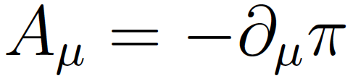
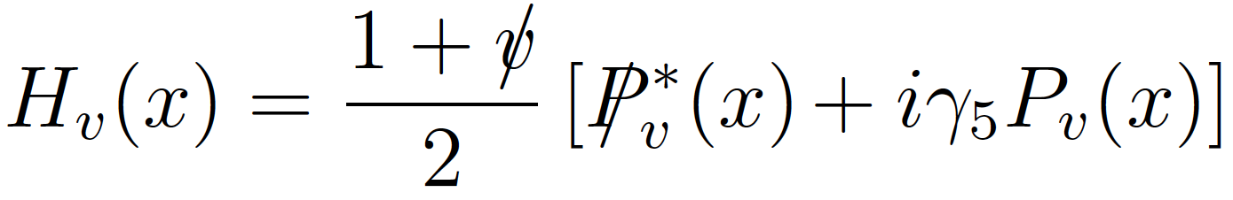

2. Heavy hadrons in nuclear matter
Hadron
Qq
virtual momentum
coupling to axial current (pion)
P*
P
P*
HQS
The Lagrangian is invariant under HQS.
π
π
π
P
P*
P*
H.Georgi, Phys. Lett. B240, 447 (1990)
A.F.Falk, H.Georgi, B.Grinstein, Nucl. Phys. B343, 1 (1990)

Slide 16
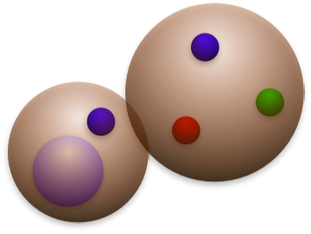
2. Heavy hadrons in nuclear matter
Qq
q
q
No quark-antiquark
annihilation
(very simple system!)
q
q
Q
D⁽*⁾ meson
Nucleon
Hadronic molecule

Slide 17
2. Heavy hadrons in nuclear matter
Qq
=P⁽*⁾
•
•
•
q
P
S-wave
N
q
π
P*
S-wave
N
q
q
π
Q
P*
D-wave
N
D⁽*⁾ meson
Nucleon
π
P
S-wave
N
Hadronic molecule
J^{P}=1/2⁻ case
Tensor force
(changing angular momentum L and L±2)
P-P* mixing is important !
PPπ vertex cannot exist by parity conservation.

Slide 18
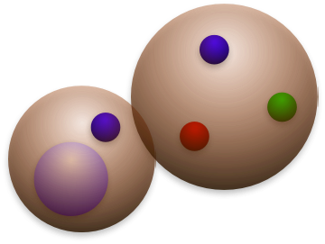
2. Heavy hadrons in nuclear matter
Mass
P⁽*⁾N
D*N
142 MeV
B*N
46 MeV
DN
0 MeV
BN
0 MeV
PN, P*N
0 MeV
Charm
Bottom
m_{Q}→∞

Slide 19
2. Heavy hadrons in nuclear matter
Mass
P⁽*⁾N
Predictions
3/2⁻
1/2⁻
Charm
Bottom
m_{Q}→∞

Slide 20
2. Heavy hadrons in nuclear matter
Mass
P⁽*⁾N
Predictions
D⁽*⁾N
3/2⁻
B⁽*⁾N
3/2⁻
1/2⁻
1/2⁻
HQS doublet
3/2⁻
1/2⁻
Charm
Bottom
m_{Q}→∞

Slide 21
2. Heavy hadrons in nuclear matter
Mass
P⁽*⁾N
Predictions
D⁽*⁾N
3/2⁺
3/2⁻
B⁽*⁾N
3/2⁺
1/2⁺
3/2⁻
1/2⁻
1/2⁺
3/2⁺
1/2⁺
1/2⁻
HQS doublet
3/2⁻
1/2⁻
Charm
Bottom
m_{Q}→∞

Slide 22
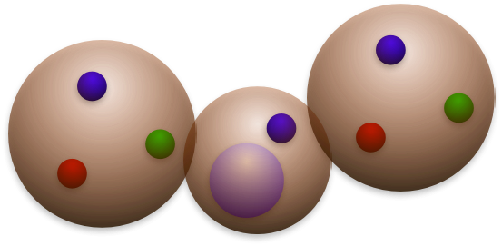
2. Heavy hadrons in nuclear matter
Mass
P⁽*⁾NN
Predictions
D⁽*⁾NN
Argonne v₈’ pot.
(with tensor force)
1⁻
B⁽*⁾NN
1⁻
0⁻
0⁻
1⁻
0⁻
HQS doublet
Charm
Bottom
m_{Q}→∞

Slide 23
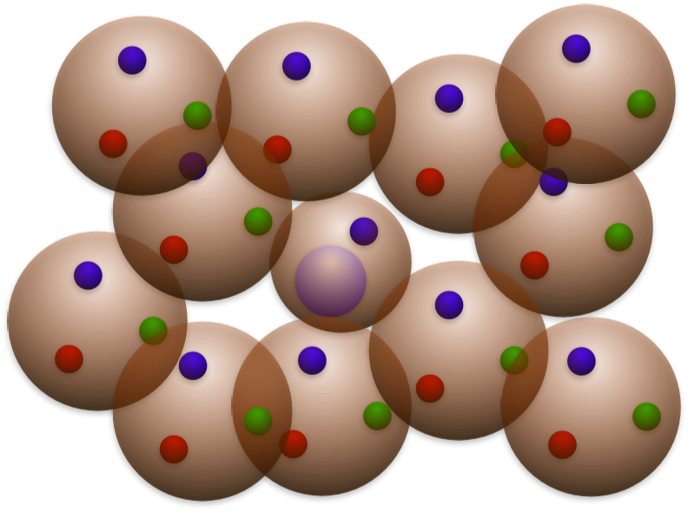
2. Heavy hadrons in nuclear matter
P⁽*⁾ in nuclear matter
D⁽*⁾ meson

Slide 24
2. Heavy hadrons in nuclear matter
P⁽*⁾ in nuclear matter
P* self-energy
P self-energy
P*
P*
P
P
P*
P*
+
particle-hole
NN⁻¹
P*
P*
P

Slide 25
2. Heavy hadrons in nuclear matter
P⁽*⁾ in nuclear matter
P* self-energy
=
P self-energy
1
P*
2
P*
P
3
P
P*
=
P*
+
particle-hole NN⁻¹
P*
P*
P
HQS doublet

Slide 26



2. Heavy hadrons in nuclear matter
Spin degeneracy
=
+
Q
Q
light quarks
+ gluons
light quarks
+ gluons
Brown muck
Decoupled !
HQS doublet/singlet

Slide 27
2. Heavy hadrons in nuclear matter
Spin degeneracy
Hadronic molecule

Slide 28

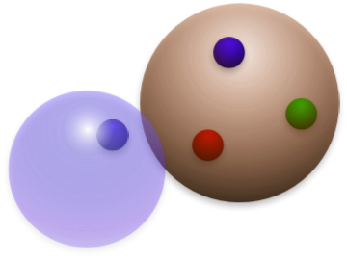


2. Heavy hadrons in nuclear matter
Spin degeneracy
=
+
Light quarks
+ gluons
Light
hadron(s)
Hadronic molecule
Heavy quark
Brown muck
“Light spin-complex”
Decoupled !
HQS doublet/singlet

Slide 29
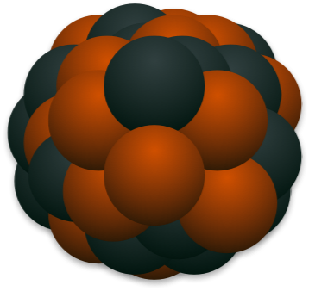
2. Heavy hadrons in nuclear matter
Spin degeneracy
Heavy hadron

Slide 30
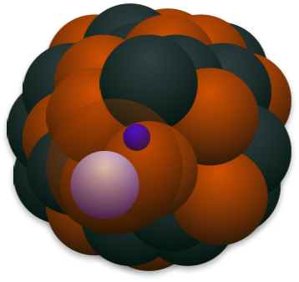
2. Heavy hadrons in nuclear matter
Spin degeneracy
Exotic nucleus

Slide 31
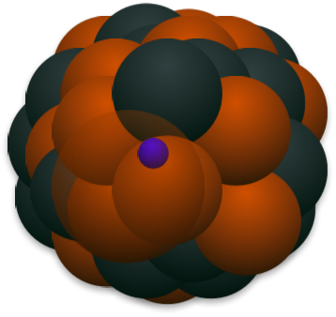

2. Heavy hadrons in nuclear matter
Spin degeneracy
=
+
Light quarks
+ gluons
Nucleus
Exotic nucleus
Heavy quark
Brown muck
“Light spin-complex”
Decoupled !
HQS doublet/singlet

Slide 32
2. Heavy hadrons in nuclear matter
1/m_{Q} expansion
LO
+
NLO

Slide 33
2. Heavy hadrons in nuclear matter
1/m_{Q} expansion
LO
+
NLO

Slide 34
2. Heavy hadrons in nuclear matter
Heavy hadron mass (in nuclear matter density ρ)
1/m_{Q} expansion
at NLO
HQS symmetry broken (NLO)
M.Neubert, Phys. Lett.
B322, 419 (1994)
Color electric gluon
spin-flip
1/m_{Q}
gluon
Color magnetic gluon
Q

Slide 35
2. Heavy hadrons in nuclear matter
Heavy hadron effective theory
LO + NLO

Slide 36
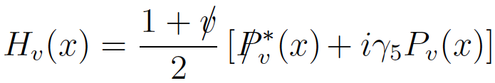



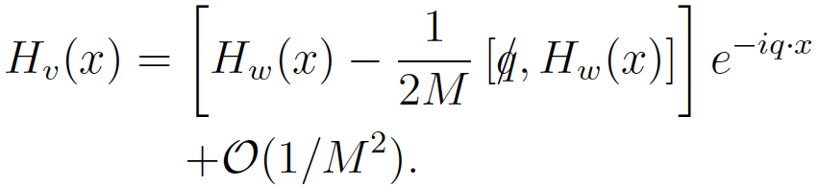
2. Heavy hadrons in nuclear matter
Heavy meson effective theory with 1/M corrections
Heavy-meson effective field and separation of momentum
P⁽*⁾=(Qq)_{spin 0 (1)}
vector meson pseudoscalar meson
Spin degeneracy at LO
on-shell + off-shell
1/M correction (NLO) : uncertainty of four-velocity or residual momentum
(change of frame with v to frame with w=v-q/M)
Lorentz transformation for frame (“Velocity rearrangement”)
H_{v}(x)
v
p/M
↑ Additional term
w=v-q/M
H_{w}(x)
Luke, Manohar, PLB286, 348 (1992), Kitazawa, Kurimoto, PLB323, 65 (1994)

Slide 37
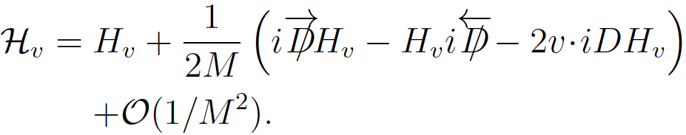

2. Heavy hadrons in nuclear matter
Heavy meson effective theory with 1/M corrections
Heavy-meson effective field and separation of momentum
P⁽*⁾=(Qq)_{spin 0 (1)}
vector meson pseudoscalar meson
Spin degeneracy at LO
on-shell + off-shell
1/M correction (NLO) : uncertainty of four-velocity or residual momentum
(change of frame with v to frame with w=v-q/M)
Effective field defined in fame with four-velocity p/M
H_{v}(x)
v
p/M
w=v-q/M
Only a phase appears under
velocity-rearrangement!
H_{w}(x)
Luke, Manohar, PLB286, 348 (1992), Kitazawa, Kurimoto, PLB323, 65 (1994)

Slide 38
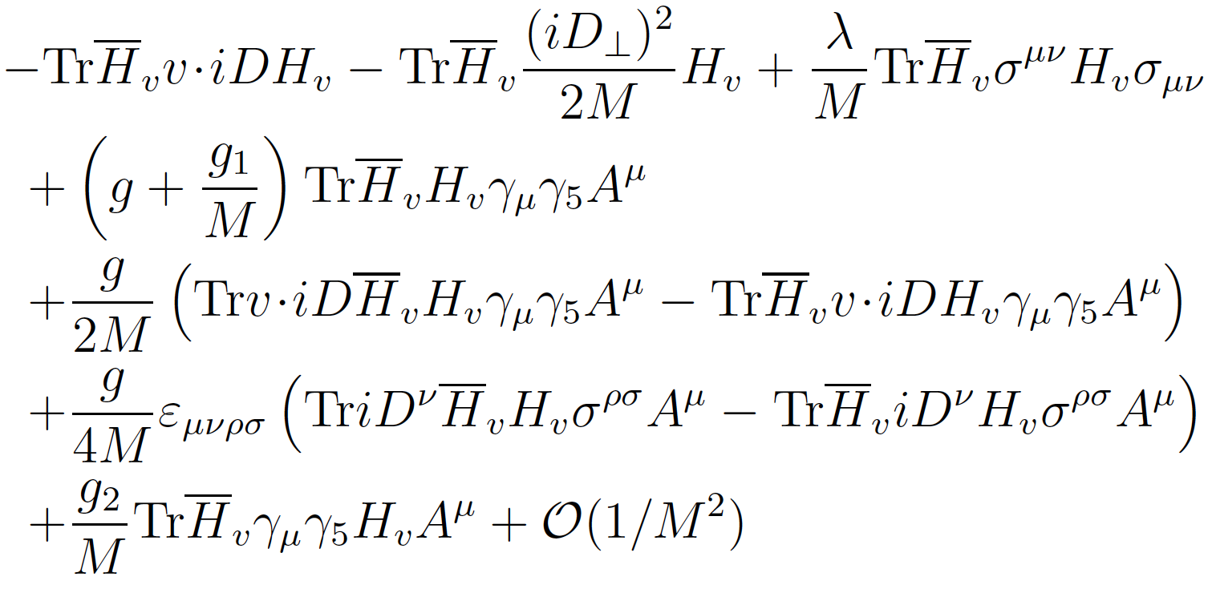
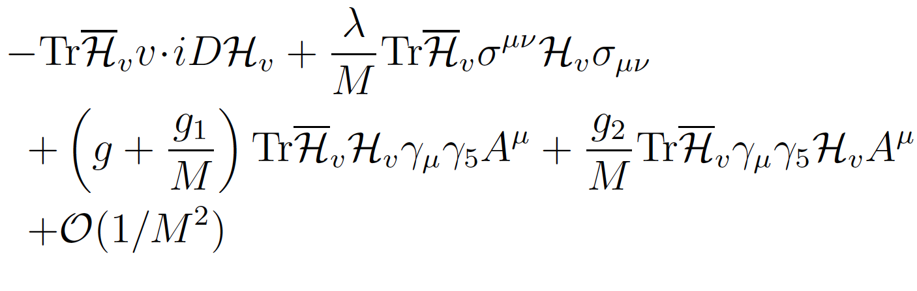

2. Heavy hadrons in nuclear matter
Heavy meson effective theory with 1/M corrections
1/m_{Q} terms
spin-flip
Kitazawa, Kurimoto, PLB323, 65 (1994)

Slide 39
2. Heavy hadrons in nuclear matter
P⁽*⁾ in nuclear matter
Breaking of HQS
g_{P*P*π} = g + (g₁+g₂)/M
≠ g_{P*Pπ} = g + (g₁-g₂)/M
P⁽*⁾
M_{P*} = M-2λ/M
≠ M_{P} = M+6λ/M
P⁽*⁾
particle-hole
NN⁻¹
P⁽*⁾

Slide 40
2. Heavy hadrons in nuclear matter
λ₁(ρ)
Color electric gluon enhanced
λ₂(ρ,m_{c})
Color magnetic gluon suppressed
λ₂(ρ,m_{b})
vacuum
normal nuclear matter

Slide 42
3. Future prospects for charm hadron study
Charm baryons
Qqq

Slide 43
3. Future prospects for charm hadron study
Charm baryons
Qqq
Diquark
(brown muck)
Note
In this definition, λ and ρ modes are not separated.

Slide 44
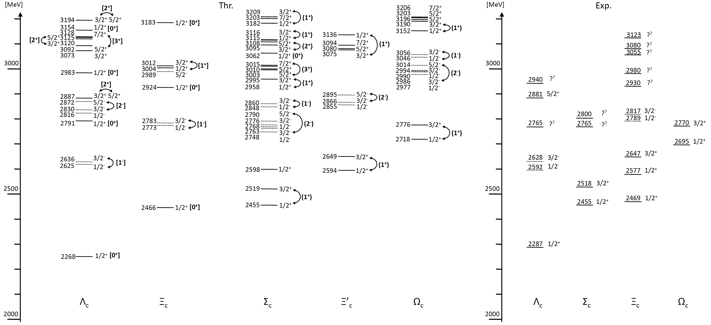
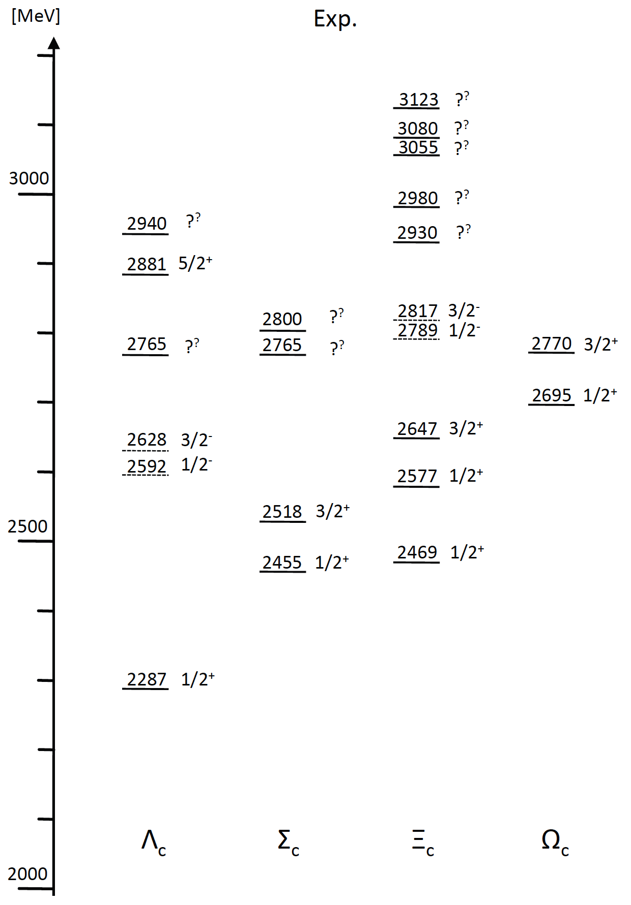
3. Future prospects for charm hadron study
J-PARC
Diquark
(brown muck)
Quark model
W.Roberts, M.Pervin, Int. J. Mod. Phys. A23, 19 (2008);
Y.Yamaguchi, S.Ohkoda, A.Hosaka, T.Hyodo, S.Y., arXiv:1402.5222 [hep-ph]

Slide 45
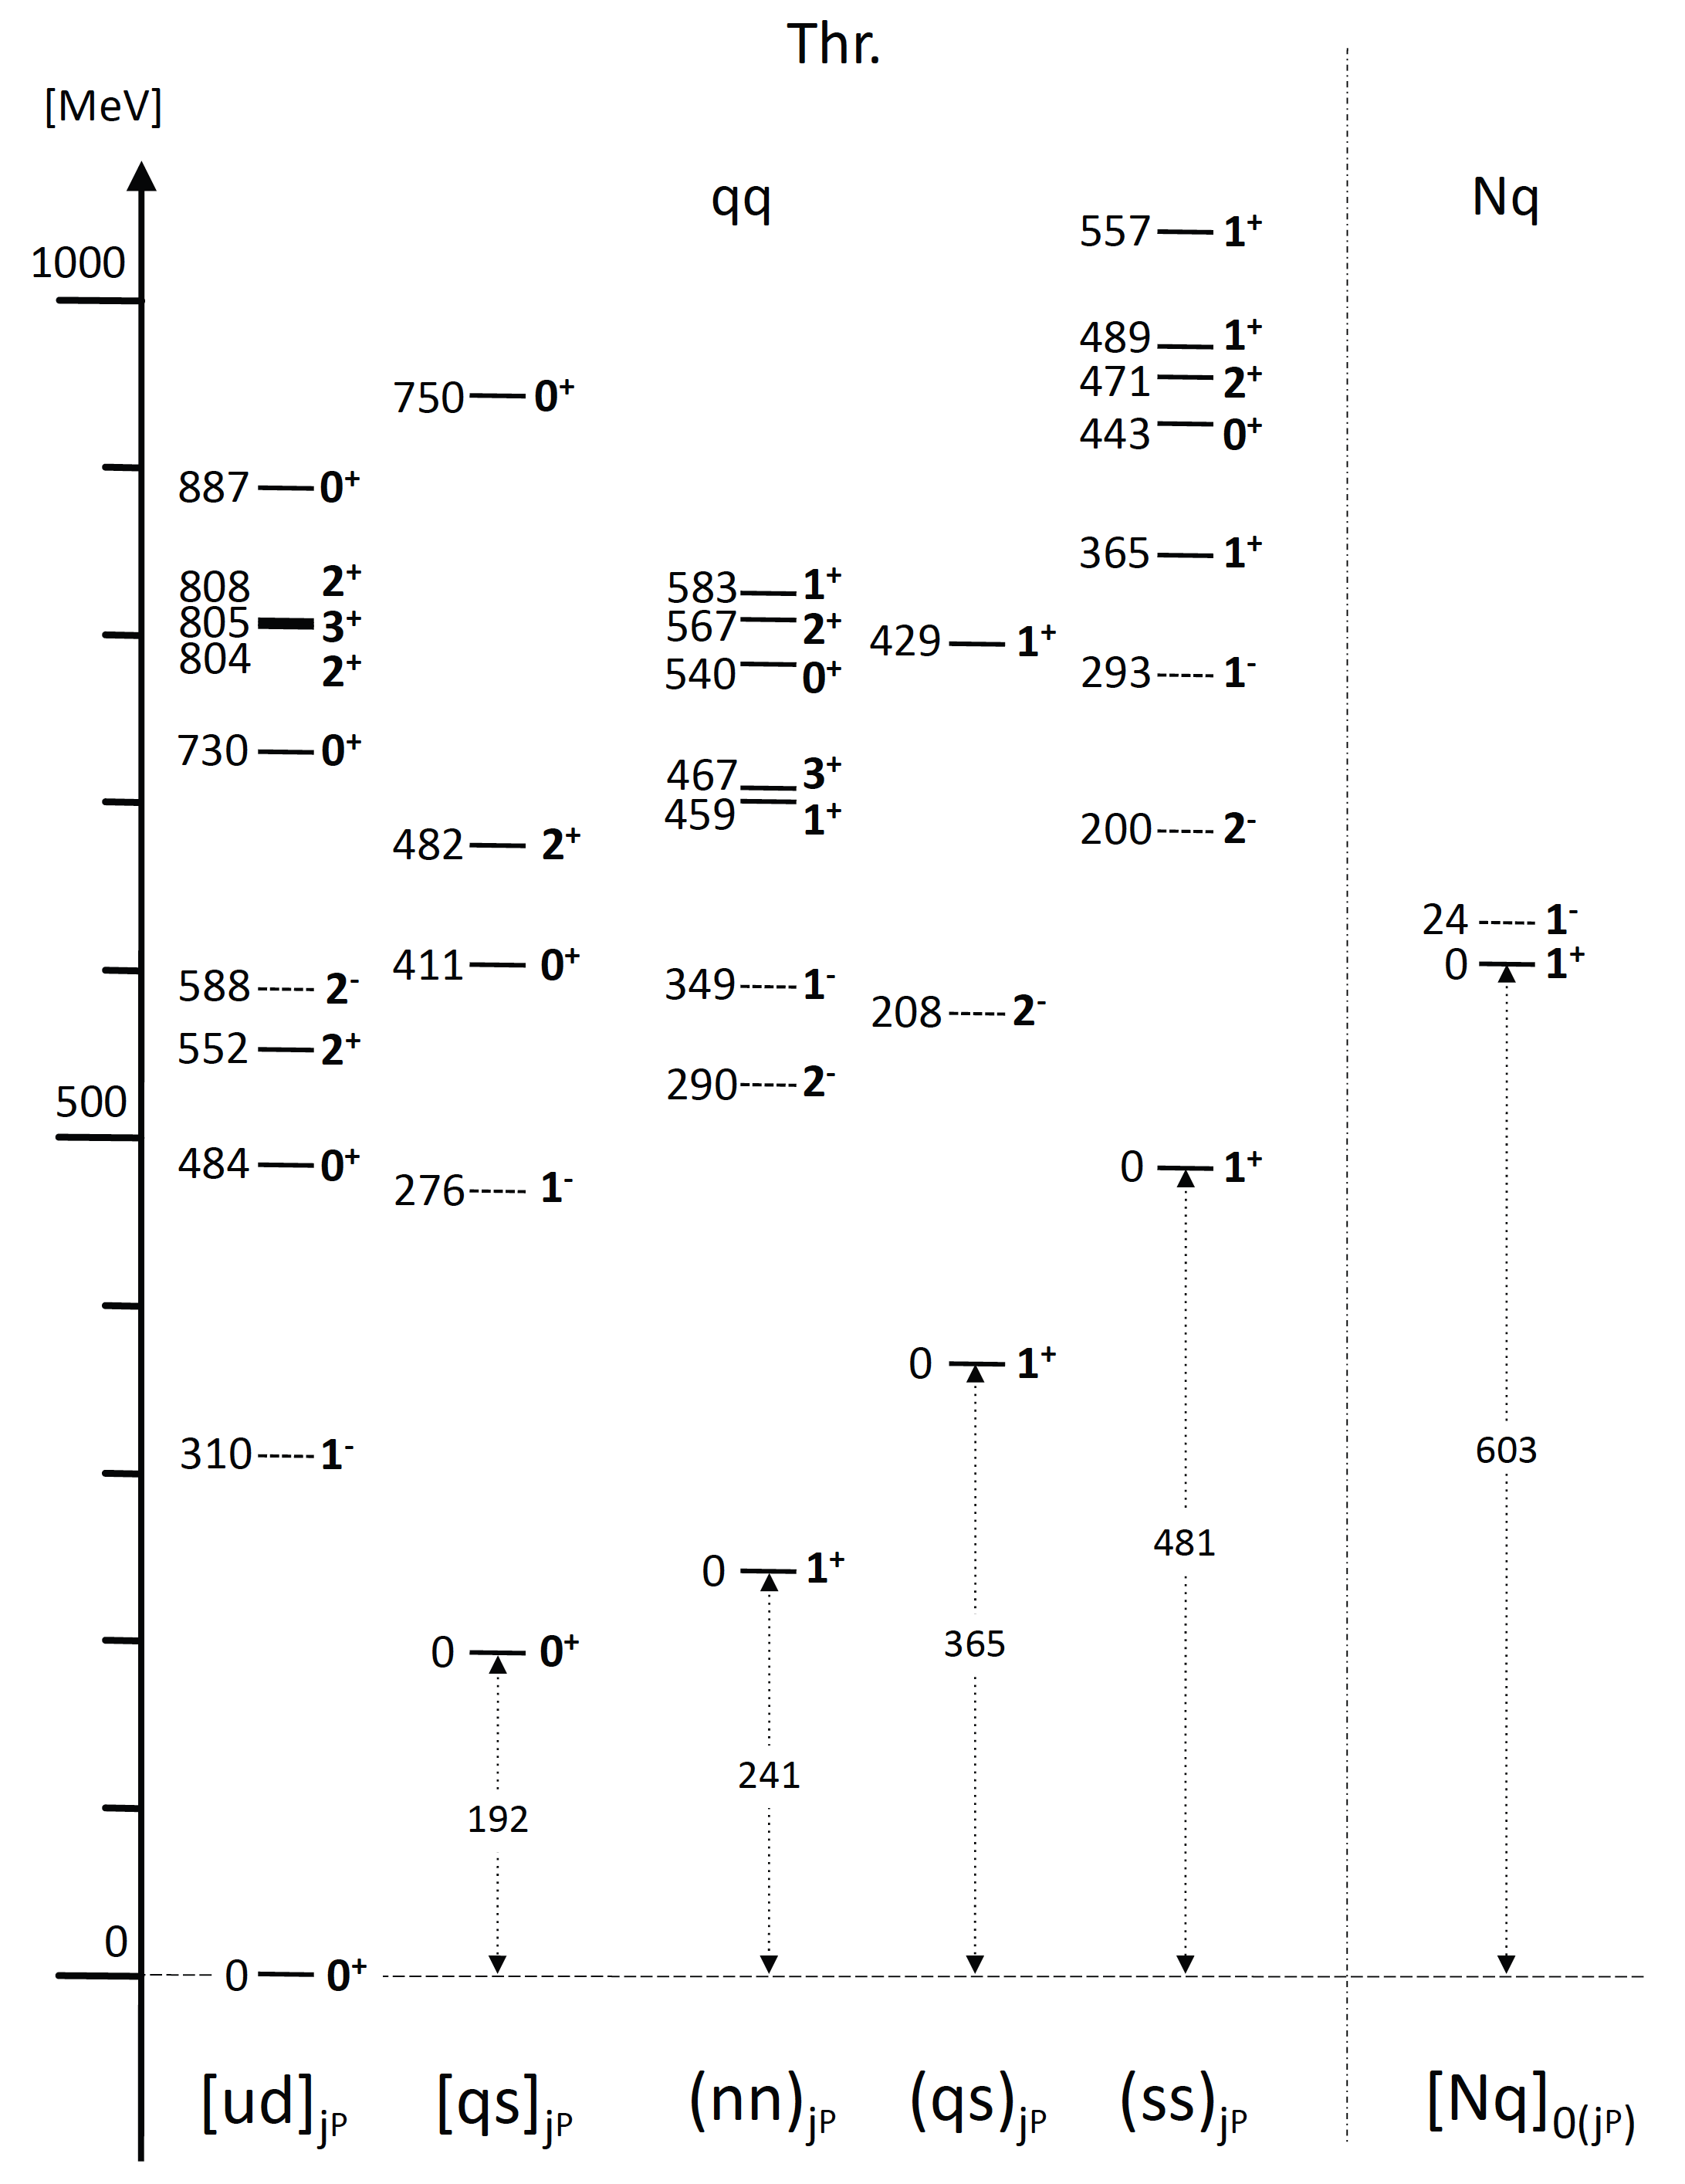
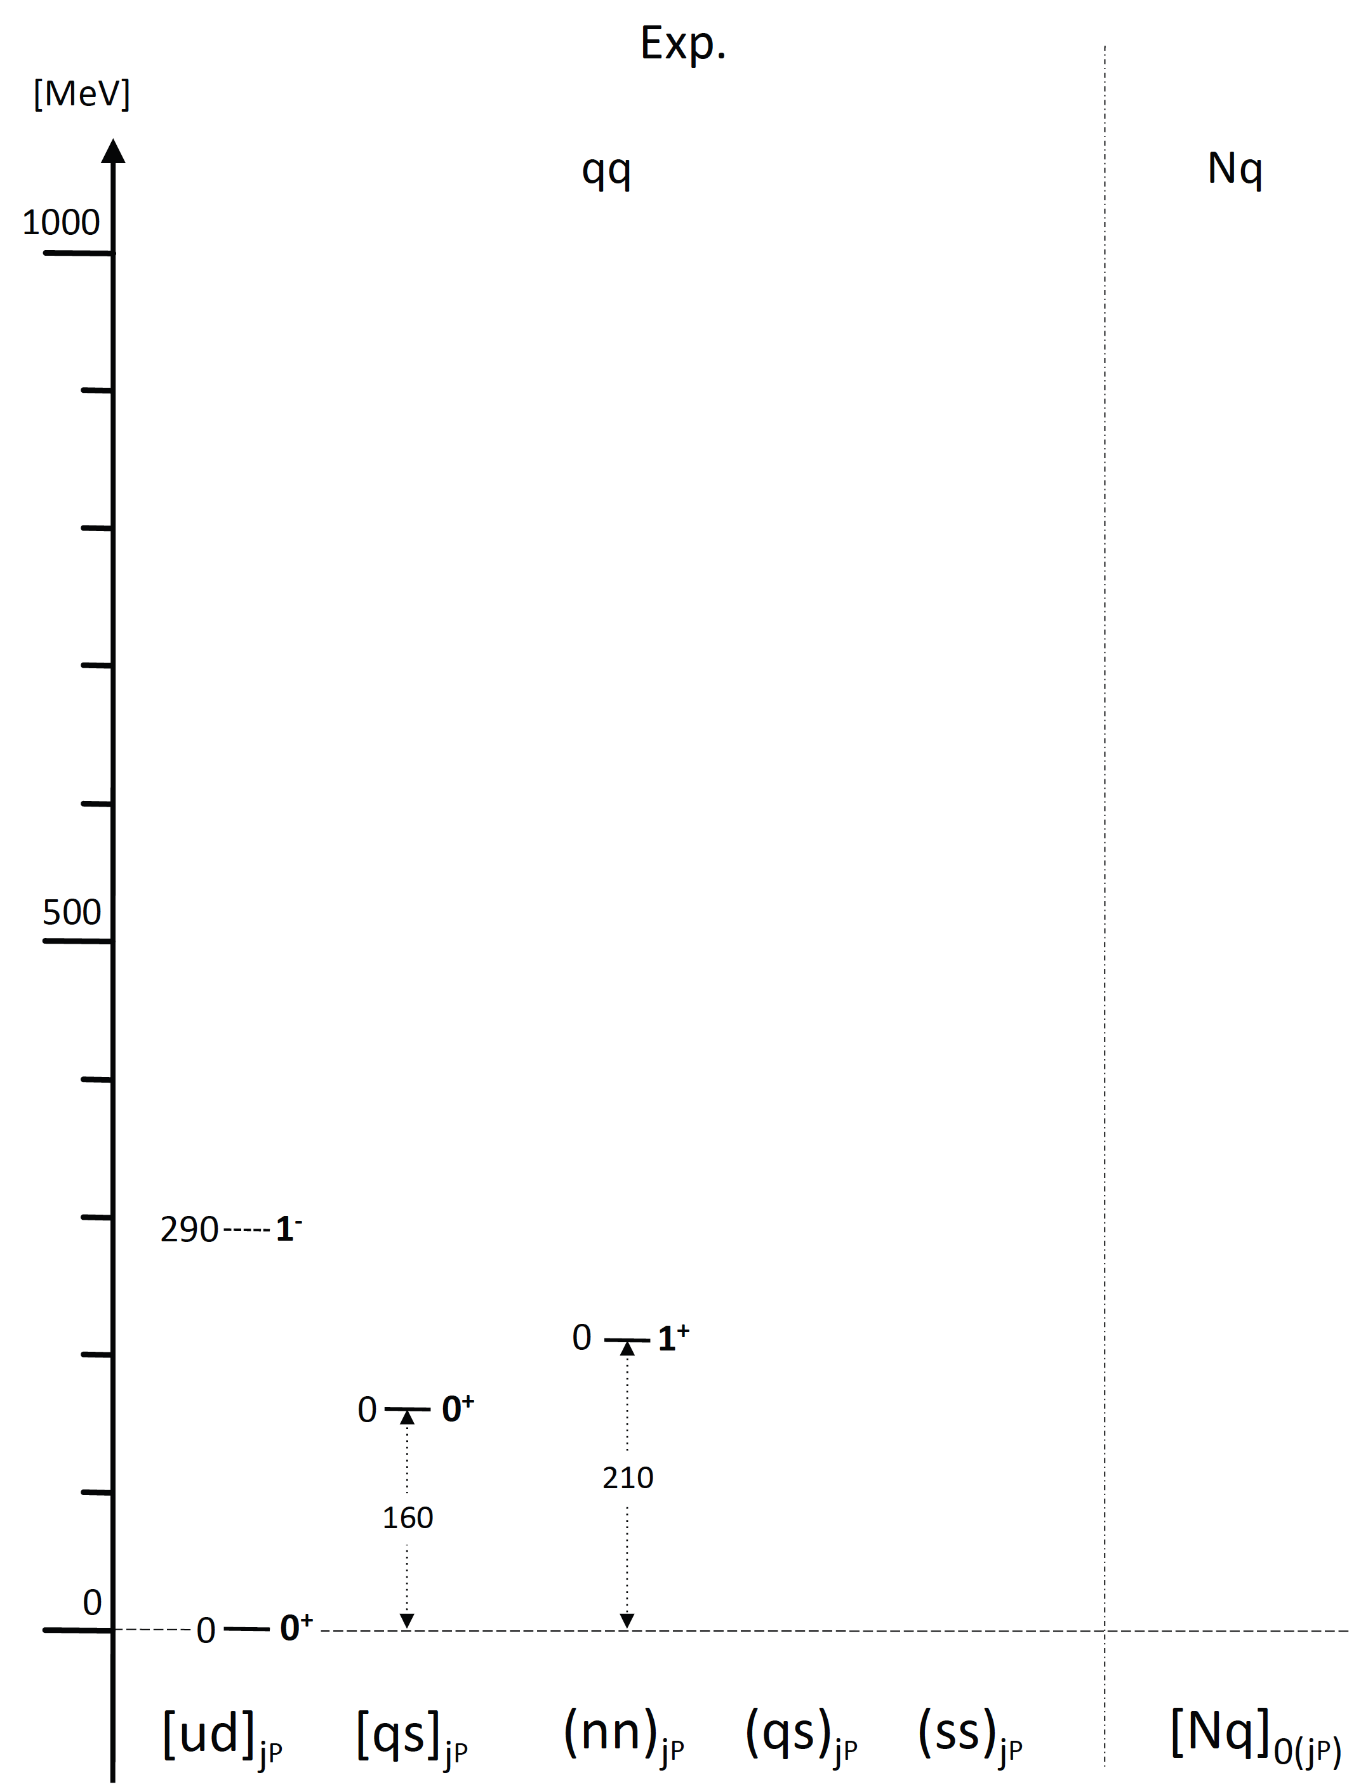
3. Future prospects for charm hadron study
Diquark
(brown muck)
W.Roberts, M.Pervin, Int. J. Mod. Phys. A23, 19 (2008);
Y.Yamaguchi, S.Ohkoda, A.Hosaka, T.Hyodo, S.Y., arXiv:1402.5222 [hep-ph]

Slide 47
4. Conclusion
1. We discussed heavy quark symmetry (HQS)
at LO in 1/m_{Q} expansion from QCD.
2. HQS gives doublet/singlet in mass spectrum
in exotic heavy hadrons and nuclei.
3. If one state is found in experiments, there should
exist a paired state nearby (HQS doublet).
4. Gluon dynamics is probed in heavy hadron
mass spectra at NLO in 1/m_{Q} expansion.
5. Toward charm-nuclear physics at J-PARC!!

Slide 49
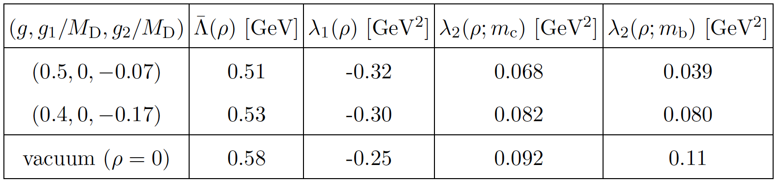
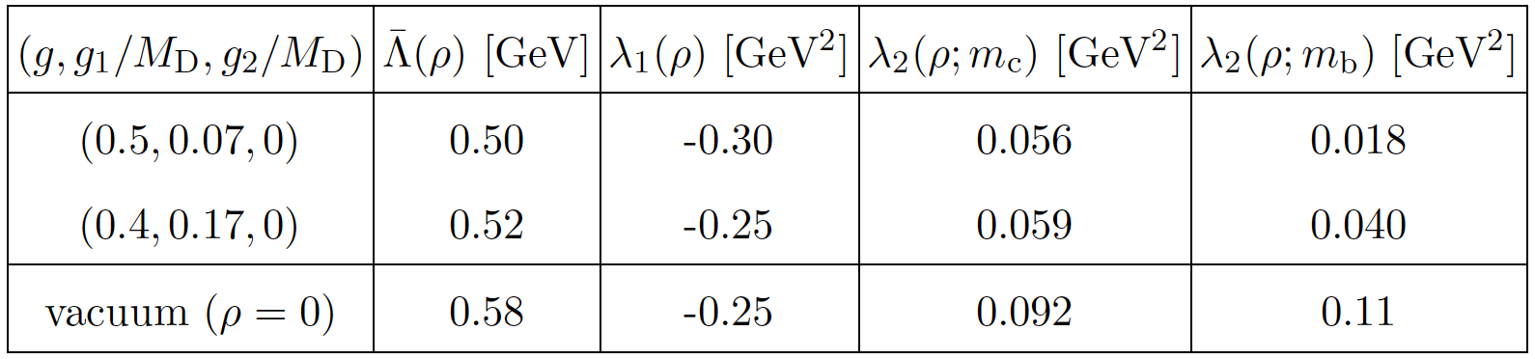

Slide 50
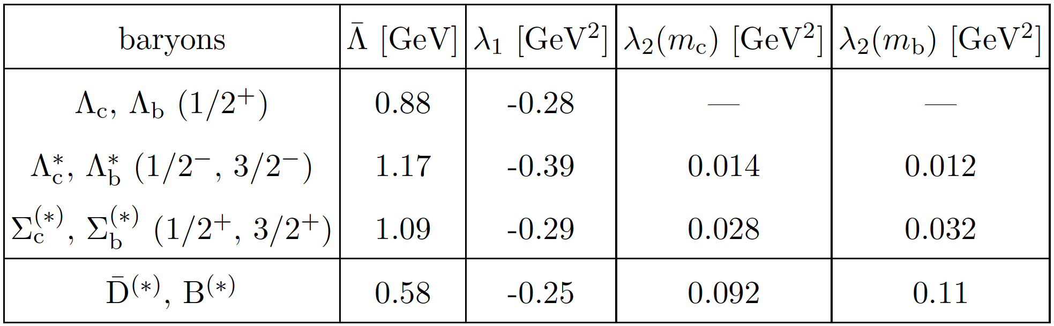

Slide 51
What is D/D-nucleon interaction ?
D and nucleon
D and nucleon
different
D*+N (2947 MeV)
D*+N (2947 MeV)
D+N (2803 MeV)
D+N (2803 MeV)
Only DN and D*N channel
Σc(2800) 1(??)
π+Σc* (2658 MeV)
C<0
Λc(2625) 0(3/2⁻)
C>0
Λc(2595) 0(1/2⁻)
π+Σc (2593 MeV)
`Exotic channel‘
`Normal channel‘
cqqqq
cqqqq
SY and Sudoh, PRD80, 034008 (2009)
Yamaguchi, Ohkoda, SY, Hosaka, PRD84, 014032 (2011)
Yamaguchi, Ohkoda, SY, Hosaka, PRD85, 054003 (2012)
Yamaguchi, Ohkoda, SY, Hosaka, arXiv:1301.4557 [hep-ph]

Slide 52
What is D/D-nucleon interaction ?
D and nucleon
D and nucleon
different
D*+N (2947 MeV)
D*+N (2947 MeV)
D+N (2803 MeV)
D+N (2803 MeV)
Only DN and D*N channel
Σc(2800) 1(??)
π+Σc* (2658 MeV)
C<0
C>0
Λc(2625) 0(3/2⁻)
Λc(2595) 0(1/2⁻)
π+Σc (2593 MeV)
`Exotic channel‘
`Normal channel‘
cqqqq
cqqqq
SY and Sudoh, PRD80, 034008 (2009)
Yamaguchi, Ohkoda, SY, Hosaka, PRD84, 014032 (2011)
Yamaguchi, Ohkoda, SY, Hosaka, PRD85, 054003 (2012)
Yamaguchi, Ohkoda, SY, Hosaka, arXiv:1301.4557 [hep-ph]

