Slide 1
K⁻pp studied with coupled-channel Complex Scaling Method + Feshbach method
Akinobu Doté (KEK Theory Center / IPNS / J-PARC branch)
Takashi Inoue (Nihon university)
Takayuki Myo (Osaka Institute of Technology)
Introduction
Channel elimination by “Feshbach method with coupled-channel Complex Scaling Method”
Result of “K⁻pp” calculated with ccCSM+Feshbach method
Summary and future plan
The 3rd Korea-Japan on
Nuclear and Hadron Physics at J-PARC,
21.Mar.’14 @ Inha university, Incheon, Korea

Slide 2
1. Introduction

Slide 3
“Prototype of kaonic nuclei”
K⁻
Λ(1405)
“Building block of kaonic nuclei”
Proton
well described with a meson-baryon molecule picture
Determine K^{bar}N interaction
K⁻pp
K⁻
P
P
The simplest kaonic nucleus
Nuclear many-body system with K⁻
Doorway to dense matter†
→ Chiral symmetry restoration in dense matter
Interesting structure†
Neutron star
³HeK⁻, pppK⁻,
⁴HeK⁻, pppnK⁻,
…, ⁸BeK⁻,…
† A. D., H. Horiuchi, Y. Akaishi and T. Yamazaki, PRC70, 044313 (2004)

Slide 4
“Prototype of kaonic nuclei”
K⁻
Λ(1405)
“Building block of kaonic nuclei”
Proton
well described with a meson-baryon molecule picture
Determine K^{bar}N interaction
K⁻pp
K⁻
P
P
The simplest kaonic nucleus
Nuclear many-body system with K⁻
Doorway to dense matter†
→ Chiral symmetry restoration in dense matter
Interesting structure†
Neutron star
³HeK⁻, pppK⁻,
⁴HeK⁻, pppnK⁻,
…, ⁸BeK⁻,…
† A. D., H. Horiuchi, Y. Akaishi and T. Yamazaki, PRC70, 044313 (2004)

Slide 5
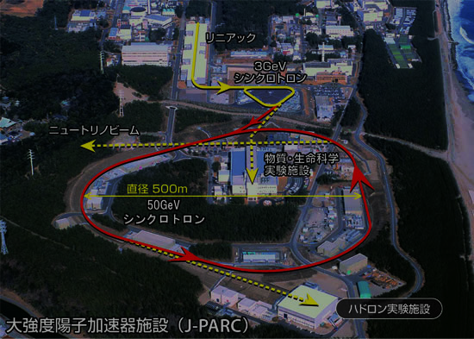
Kaonic nuclei
P
K⁻
P
Prototype system = K⁻ pp
at J-PARC

Slide 6
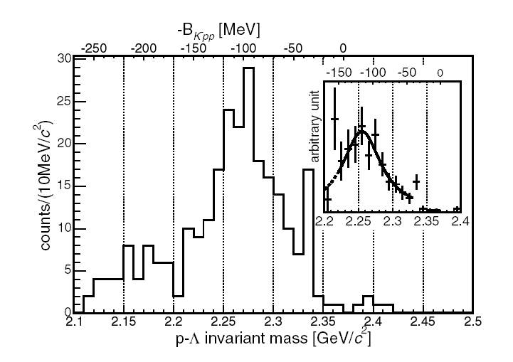
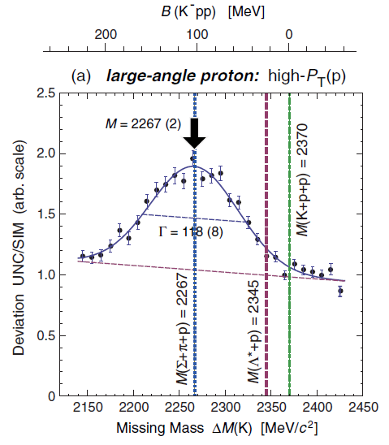
Current situation of K⁻pp study
 | Dote-Hyodo-Weise | Akaishi-Yamazaki | Barnea-Gal-Liverts | Ikeda-Sato | Shevchenko-Gal-Mares
B(K⁻pp) | 20±3 | 47 | 16 | 60 ~ 95 | 50 ~ 70
Width Γ | 40 ~ 70 | 61 | 41 | 45 ~ 80 | 90 ~ 110
Method | Variational (Gauss) | Variational (Gauss) | Variational (HH) | Faddeev-AGS | Faddeev-AGS
Potential | Chiral (E-dep.) | Pheno. | Chiral (E-dep.) | Chiral (E-indep.) | Pheno.
Kinematics | Non-rel. | Non-rel. | Non-rel. | Rel. | Non-rel.
Theory
Experiments
B(K⁻pp) = 116 MeV
Γ = 67 MeV
if it is K⁻pp
B(K⁻pp) = 103 MeV
Γ = 118 MeV
if it is K⁻pp
J-PARC E15
(Preliminary)
J-PARC E27
(Preliminary)
FINUDA
DISTO

Slide 7
Current situation of K⁻pp study
 | Dote-Hyodo-Weise | Akaishi-Yamazaki | Barnea-Gal-Liverts | Ikeda-Sato | Shevchenko-Gal-Mares
B(K⁻pp) | 20±3 | 47 | 16 | 60 ~ 95 | 50 ~ 70
Width Γ | 40 ~ 70 | 61 | 41 | 45 ~ 80 | 90 ~ 110
Method | Variational (Gauss) | Variational (Gauss) | Variational (HH) | Faddeev-AGS | Faddeev-AGS
Potential | Chiral (E-dep.) | Pheno. | Chiral (E-dep.) | Chiral (E-indep.) | Pheno.
Kinematics | Non-rel. | Non-rel. | Non-rel. | Rel. | Non-rel.
Theory
From theoretical viewpoint,
K⁻pp exists above π-Σ-N threshold!
(100 MeV below K^{bar}-N-N threshold)
K⁻pp = Resonance state of a K^{bar}NN-πYN coupled system
Experiments
K^{bar} + N + N
Consider a coupled-channel problem
Treat resonant states adequately
Get the wave function to analyze the state
Confirmed that CSM works well on many-body systems
“K^{bar} N N”
π + Σ + N
B(K⁻pp) = 116MeV
Γ = 67 MeV
if it is K⁻pp
B(K⁻pp) = 103MeV
Γ = 118 MeV
if it is K⁻pp
“coupled-channel Complex Scaling Method”
J-PARC E15
(Preliminary)
J-PARC E27
(Preliminary)
FINUDA
DISTO

Slide 8
Complex Scaling Method for Resonance
Complex rotation of coordinate (Complex scaling)
Diagonalize H_{θ} with Gaussian base,
we can obtain resonant states, in the same way as bound states!
S. Aoyama, T. Myo, K. Kato
and K. Ikeda, PTP116, 1 (2006)
† J. Aguilar and J. M. Combes, Commun. Math. Phys. 22 (1971),269.
E. Balslev and J. M. Combes, Commun. Math. Phys. 22 (1971),280
Continuum state appears on 2θ line.
Resonance pole is off from 2θ line, and independent of θ. (ABC theorem†)

Slide 9
2. Channel elimination by
“Feshbach method with ccCSM”
Reduce the coupled-channel problem
to a single channel problem

Slide 10
Formalism of ccCSM + Feshbach method
Elimination of channels by Feshbash method
Schrödinger eq.
in model space “P” and out of model space “Q”
Schrödinger eq. in P-space :
Effective potential for P-space
Q-space Green function:
Extended Closure Relation in Complex Scaling Method
Diagonalize H^{θ}_{QQ} with Gaussian base,
Well approximated
T. Myo, A. Ohnishi and K. Kato, PTP99, 801 (1998)
Express the G_{Q}(E) with Gaussian base using ECR
: expanded with Gaussian base.

Slide 11
Remark on U^{Eff}_{P}
Non-local
and E-dep.
Due to the energy dependence …
Schrödinger eq. in P space :
Self-consistency for the energy should be taken into account,
when bound and resonant states are considered.

Slide 12
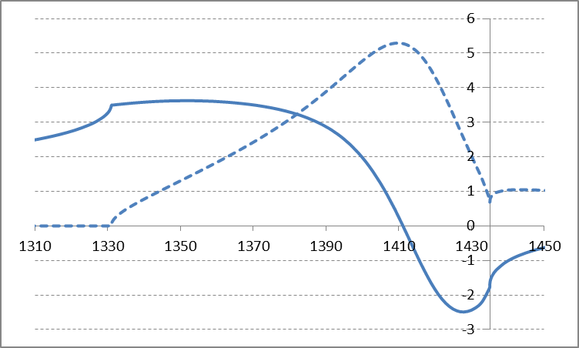
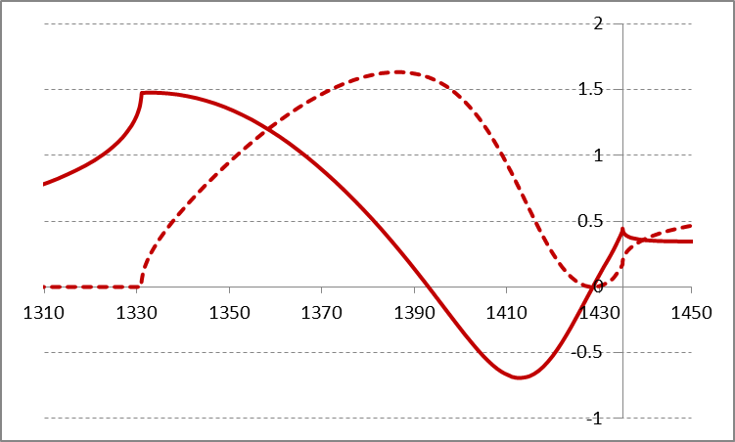
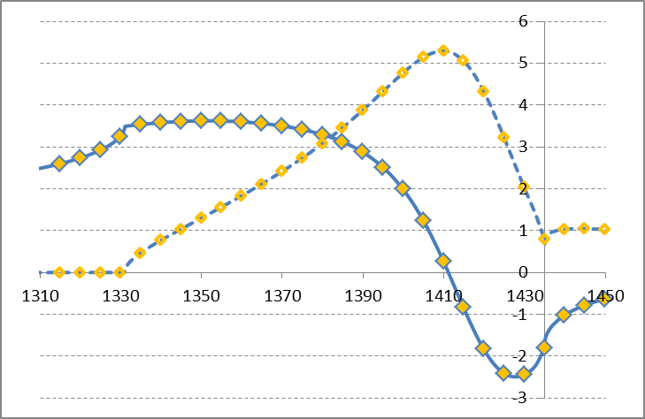
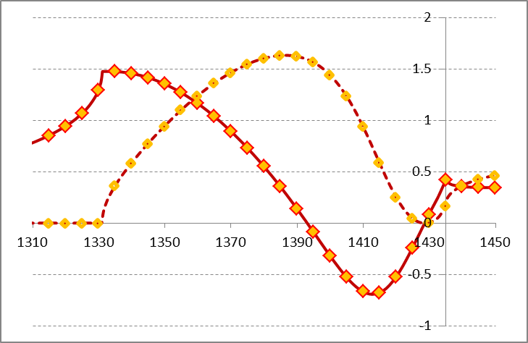
Test of ccCSM+Feshbach on 2-body system
Scattering problem
Chiral SU(3)-based potential
(KSW-type potential)
A. D., T. Inoue, T. Myo, Nucl. Phys. A 912, 66 (2013)
Scattering amplitude (I=0 channel; K^{bar}N-πΣ)
Re
Im
K^{bar}N → K^{bar}N
πΣ → πΣ
KSW – SR-A (I=0), f_{π}=110 MeV

Slide 13
Test of ccCSM+Feshbach on 2-body system
Resonance state
Schrödinger eq. in P space :
Resonance → Self-consistency for complex energy “Z”
AY potential (Non-rela. / E-indep.)
†Y. Akaishi and T. Yamazaki,
PRC 52 (2002) 044005
Feshbach+ccCSM

Slide 14
Chiral SU(3) potential (E-dep.)
NRv2
(Non-rela. / E-dep.)
SR-A
(Semi-rela. / E-dep.)
Feshbach+ccCSM
Feshbach+ccCSM
Even when the original interaction has
energy dependence, a self-consistent solution
with complex energy can be obtained.

Slide 15
3. Result of K⁻pp calculated with
ccCSM + Feshbach method

Slide 16
Apply ccCSM + Feshbach method to K⁻pp
“K⁻pp” … K^{bar}NN - πΣN - πΛN (J^{π}=0⁻, T=1/2)
“K⁻pp” … K^{bar}NN - πΣN - πΛN (J^{π}=0⁻, T=1/2)
For the two-body system, P = K^{bar}N, Q = πY
Feshbach + ccCSM
Schrödinger eq. for K^{bar}NN channel :
Trial wave function
Ch. 1: K^{bar}NN, NN:¹E
Ch. 2: K^{bar}NN, NN:¹O
Basis function ＝ Correlated Gaussian
…including 3-types Jacobi-coordinates

Slide 17
Apply ccCSM + Feshbach method to K⁻pp
“K⁻pp” … K^{bar}NN - πΣN - πΛN (J^{π}=0⁻, T=1/2)
Chiral SU(3) potential
… Pseudopotential derived from an effective chiral SU(3) Lagrangian
N. Kaiser, P. B. Siegel and W. Weise, NPA 594, 325 (1995)
A. D., T. Inoue, T. Myo, Nucl. Phys. A 912, 66 (2013)
Weinberg-Tomozawa term,
r-space, Gaussian form
Semi-rela. / Non-rela.
Based on Chiral SU(3) theory
→ Energy dependence
A non-relativistic potential (NRv2)
Constrained by K^{bar}N scattering length
a_{KN(I=0)} = -1.70+i0.67fm, a_{KN(I=1)} = 0.37+i0.60fm
A. D. Martin, NPB179, 33(1979)

Slide 18
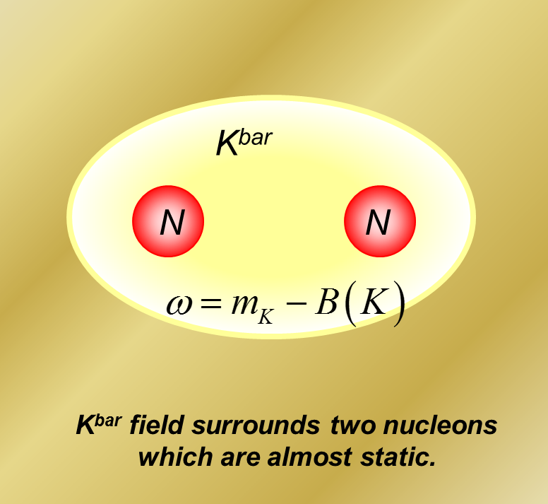
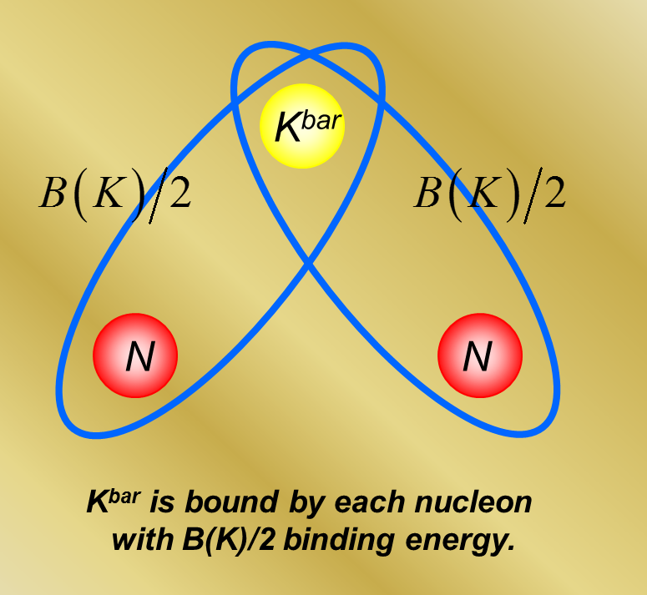
Apply ccCSM + Feshbach method to K⁻pp
“K⁻pp” … K^{bar}NN - πΣN - πΛN (J^{π}=0⁻, T=1/2)
Self-consistency for complex K^{bar}N energy
A. D., T. Hyodo, W. Weise,
PRC79, 014003 (2009)
How to determine the two-body energy in the three-body system?… Similarly to the DHW study
1. Kaon’s binding energy:
: Hamiltonian of two nucleons
2. Define a K^{bar}N-bond energy in two ways
: Field picture
: Particle picture

Slide 19
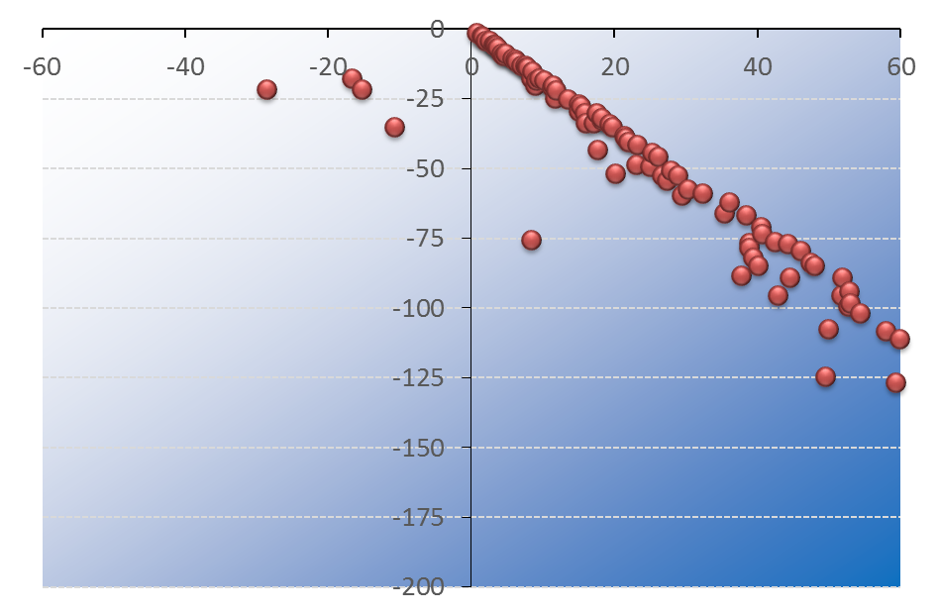
Result: NRv2 potential (f_{π}=110MeV)
NN potential : Av18 (Central + spin-spin)
Fix the K^{bar}N energy at Λ*. (self-consistent at Λ* in free space)
K^{bar}-N-N
E_{KNN} [MeV]
“K⁻pp”
(-28.6, -21.6) MeV
K^{bar}-N-N
continuum
Λ*-N continuum
-Γ/2 [MeV]
θ = 30 deg.

Slide 20
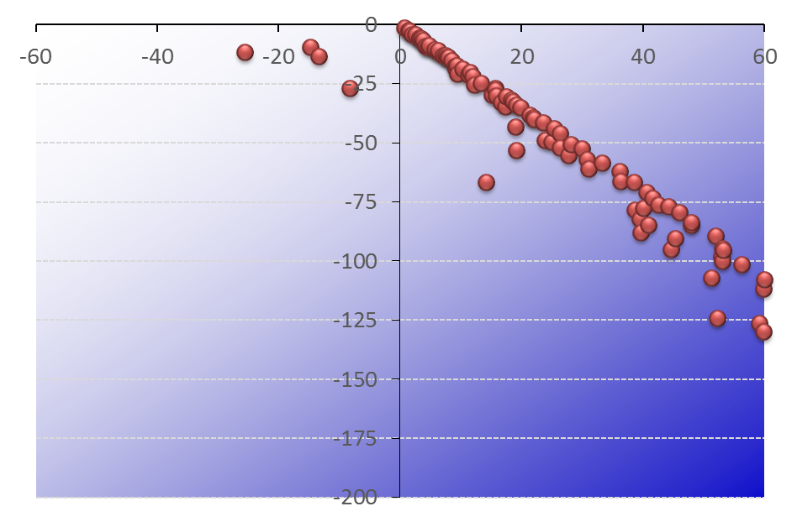
Result: NRv2 potential (f_{π}=110MeV)
NN potential : Av18 (Central + spin-spin)
K^{bar}N energy is self-consistent at K⁻pp. (“Field picture”)
K^{bar}-N-N
E_{KNN} [MeV]
“K⁻pp”
(-25.6, -11.6) MeV
K^{bar}-N-N
continuum
K^{bar}
1.5 - i 0.2 fm
N
N
2.2 - i 0.2 fm
Λ*-N continuum
-Γ/2 [MeV]
θ = 30 deg.

Slide 21
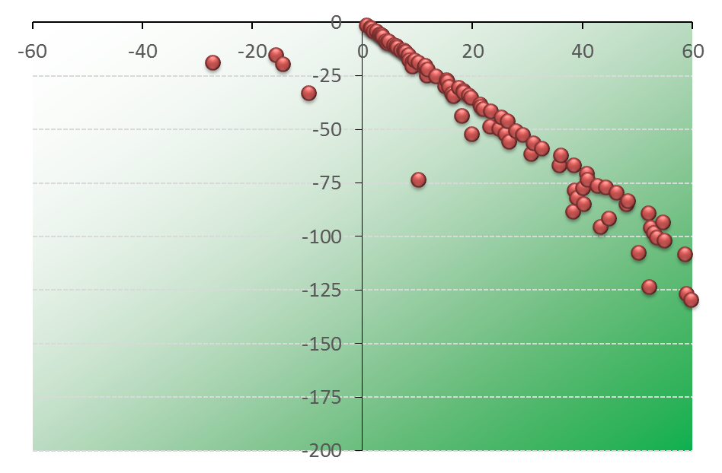
Result: NRv2 potential (f_{π}=110MeV)
NN potential : Av18 (Central + spin-spin)
K^{bar}N energy is self-consistent at K⁻pp. (“Particle picture”)
K^{bar}-N-N
E_{KNN} [MeV]
“K⁻pp”
(-27.3, -18.9) MeV
K^{bar}-N-N
continuum
K^{bar}
1.4 - i 0.2 fm
N
N
2.1 - i 0.3 fm
Λ*-N continuum
-Γ/2 [MeV]
θ = 30 deg.

Slide 22
Result: NRv2 potential
NN potential : Av18 (Central + spin-spin)
f_{π}=90~120MeV / “Field picture” or “Particle picture”
“Field”
“Particle”
“Field pict.”: (B, Γ/2) = (21~36, 9~30)
“Particle pict.”: (B, Γ/2) = (25~30, 15~32)

Slide 23
4. Summary
and future plans

Slide 24
4. Summary and future plans
A prototype of K^{bar} nuclei “K⁻pp” = Resonance state of K^{bar}NN-πYN coupled system
“coupled-channel Complex Scaling Method + Feshbach method”
… Represent the Q-space Green function with the Extended Complete Set
well approximated by Gaussian base
⇒ Eliminate πＹ channels to reduce the problem to a K^{bar}NN single channel problem.
K⁻pp studied with ccCSM+Feshbch method
Used a Chiral SU(3)-based potential
(Gaussian form in r-space)
Self-consistency for kaon’s complex energy
NRv2 potential case
(B, Γ/2) = (21~36, 9~30) MeV : “Field picture”
(25~30, 15~32) MeV : “Particle pict.”
Mean NN distance ~ 2.2 fm → Normal density
Future plans
Further study of K⁻pp
… Other version of K^{bar}N potential, semi-relativistic kinematics
Detailed analysis of the structure
Full-coupled channel calculation of K⁻pp
Construct K^{bar}N potential, based on the latest data of SIDDAHRTA

