Slide 1
Injector magnet considerations
Attilio Milanese
14 Feb. 2014

Slide 2
Foreword
Injector magnet considerations
magnet = bending magnet
(combined function might be interesting too)
injector = High Energy Booster (HEB), taking proton beams at 450 GeV (or lower) from existing LHC injector chain up to injection energy of collider ring
(only injector for collider ring, or also parallel physics?)
assumption: no dedicated new tunnel for HEB

Slide 3
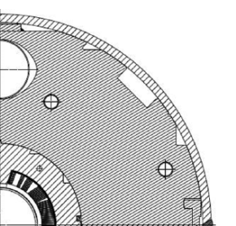
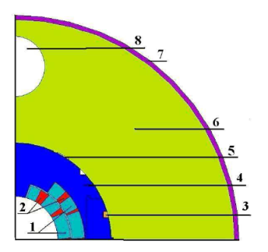
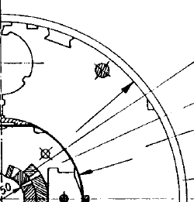


HEB magnets in the SPS tunnel
top field HEB [T] | 4.5 | 6.0 | 8.0 | 11.0
technology | Nb-Ti, 4.2 K | Nb-Ti, 4.2 K | Nb-Ti, 1.9 K | Nb₃Sn, 1.9 / 4.2 K
top energy HEB [TeV] | 1.0 | 1.3 | 1.8 | 2.4
injection energy HEB [TeV] | 0.450 | 0.450 | 0.450 | 0.450
injection field 100 km collider [T] | 0.3 | 0.4 | 0.5 | 0.8
ramp time [s] | 5-10 | 5-10 | 30-60 | 300-600
applicable for parallel physics | yes | yes | yes | ?
FAIR SIS-300
prototypes
LHC-like, design optimized for faster ramp, one aperture
2-layers cos-θ
[MSUT @ UniTwente,
HFD @ FNAL,
11 T @ CERN / FNAL]

Slide 4
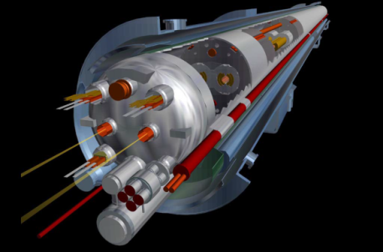
HEB magnets in the LEP/LHC tunnel
jhgj
top field HEB [T] | 1.8 | 1.8 | 5.0
technology | resistive | superferric | LHC magnets (faster)
top energy HEB [TeV] | 1.5 | 1.5 | 4.2
injection energy HEB [TeV] | 0.450 | 0.450 | 0.450
injection field 100 km collider [T] | 0.5 | 0.5 | 1.3
ramp time [s] | 2-5 | 2-5 | 140-200
applicable for parallel physics | ? (consumption?) | yes | ?
To ramp in 2.5 minutes (50 A/s instead of 10 A/s):
diode: ok, limit at 60 A/s
cryogenic load: to be fully checked
premature quench: not an issue
quench protection: not an issue (for main circuits)
impact on (faster) correctors: to be checked, also for quench protection
powering: splitting each circuit in 2 likely, power converters to be changed anyway
field quality: dynamic effects at injection can be handled with same scheme used now (if correctors follow)
machine modification / decommissioning: to be evaluated in detail

Slide 5
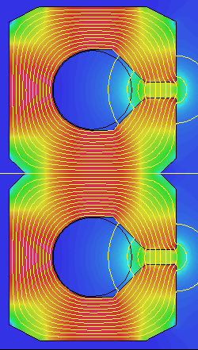
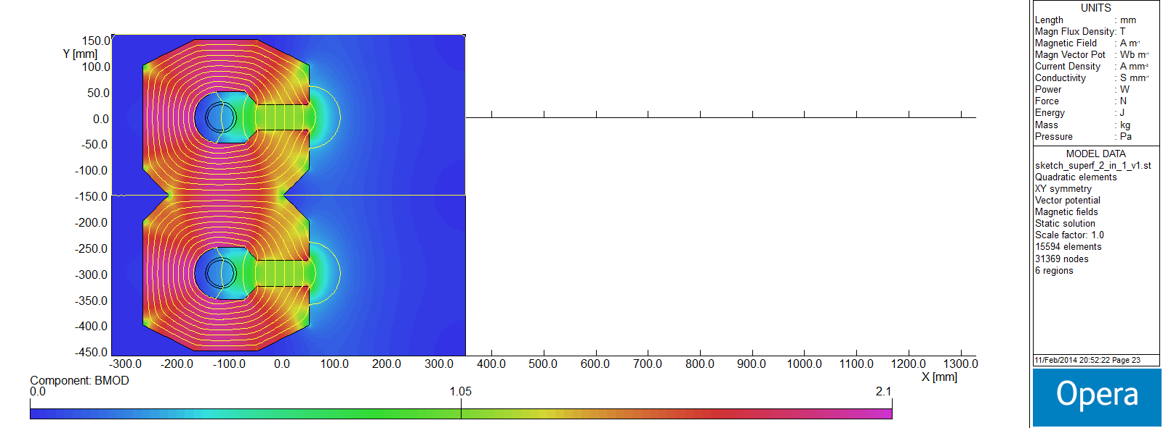
HEB magnets in a 100 km tunnel
top field HEB [T] | 1.1 | 1.1
technology | resistive | superferric
top energy HEB [TeV] | 3.4 | 3.4
injection energy HEB [TeV] | 0.450 | 0.450
injection field 100 km collider [T] | 1.1 | 1.1
ramp time [s] | 2-5 | 2-5
applicable for parallel physics | ? (consumption) | yes
peak power (in magnets only) of 100 MW with coil operating at low current density (1 A/mm²)
overall size 54 x 108 cm
45 kA for 1.1 T in bore
overall size 32 x 60 cm
50 kA for 1.1 T in bore
cryogenic power to be evaluated, function of cycle (ramp rate and frequency), superconducting material and operating temperature

Slide 6
HEB magnets in a 100 km tunnel
“transmission line”, iron dominated, superferric, 2-in-1 dipole
tentative parameters:
  vertical full gap 50 mm
  good field region of the order of ±20 mm
  overall diameter of “super-cable”, including cryostat, 100 mm
  type and amount of superconductor to be defined
50 kA for 1.1 T (3.4 TeV), at injection could be filled by the SPS at 0.45 TeV (0.14 T)
the field in the second aperture comes for free with the return cable
1-turn design: bus-bar coils (à la LEP, but superconducting), with minimum inductive voltage for given dB/dt and volume
at much lower current (resistive? different cable?), the apertures could be used in bipolar operation as a lepton booster
conceptual sketch, for discussion only
∙
×
0.0 T
2.1 T

Slide 7
A tentative rating
tunnel circumference | 7 km SPS | 27 km LEP/LHC | 100 km
resistive | n. a. |  | 
superferric | n. a. |  | 
Nb-Ti, low field |  | ● | ●
Nb-Ti, high field |  |  | ●
Nb₃Sn |  | ● | ●
●
don’t even think about it looks more attractive

The rating depends highly on the relative weights that are given to the various arguments, also not directly magnet related.
discussion time

Slide 8
Thanks in particular to L. Bottura, B. Goddard, L. Rossi, D. Tommasini, A. Verweij.
Thank you.

