Slide 1

Opening
Yannis PAPAPHILIPPOU
CERN

Slide 2
Low Emittance Rings network
Bring together scientific communities of synchrotron light sources’ storage rings, damping rings for linear colliders and e+/e- ring colliders in order to communicate, identify and promote common work on topics affecting the design of low emittance electron and positron rings
The series of workshops specifically aims at strengthening the collaborations within the low emittance rings' community, including the LOWεRING collaboration network and the Ultimate Storage Rings workshop series
This is the 1st workshop on Low Emittance Rings Technology after the three general ones (CERN 2010, Heraklion 2011, Oxford 2013) and one topical on instabilities (Paris 2014)
For more info see https://espace.cern.ch/EuCARD2-Low-Emittance-Rings/default.aspx

Slide 3
Network coordination
Coordinators:
  R. Bartolini (UOXF)
  S. Guiducci (INFN-LNF)
  Y. Papaphilippou (CERN)
Formed collaboration board, representing the Low Emittance Rings community (including non-EU members)
  B. Hettel (SLAC)
  Q. Qin (IHEP)
  D. Rubin (Cornell)
  J. Urakawa (KEK)
  Task coordinators: M. Böge (PSI), R. Nagaoka (Soleil), H. Schmickler (CERN)
Organize Low Emittance Rings’ general and topical workshops (low emittance ring lattice design, collective effects and technology)
Each one representing community of X-ray storage rings of e+/e- colliders and damping rings
Representing “Ultimate-storage ring” community and damping ring test facilities

Slide 4
ALERT 2014 - Scope
Gather scientists but also industrial partners who are designing and building hardware for low emittance rings
Emphasis on studies and experimental programs in existing rings and facilities.
Specifically address impact of targeting and reaching ultra-low emittances to the design of technical systems in an environment dominated by synchrotron radiation
  Operational issues
  Manufacturing tolerances
  Calibration and stability/repeatability problems

Slide 5
ALERT 2014 - Organisation
Two full days
22 presentations (20-25 minutes)
15-minutes of fame talks on Monday afternoon
Subjects treated
  Insertion devices, magnets and alignment
    SC wigglers
  Beam Instrumentation
  Kicker systems
  RF system design, including low-level RF systems
  Vacuum design
  Feedback systems
Podium discussion on Tuesday afternoon
Happy hour on Monday evening
Presenters’ guidelines
  Upload your presentations to indico ASAP (contact us for help)
  Leave time for discussions (3-5 minutes)

Slide 6
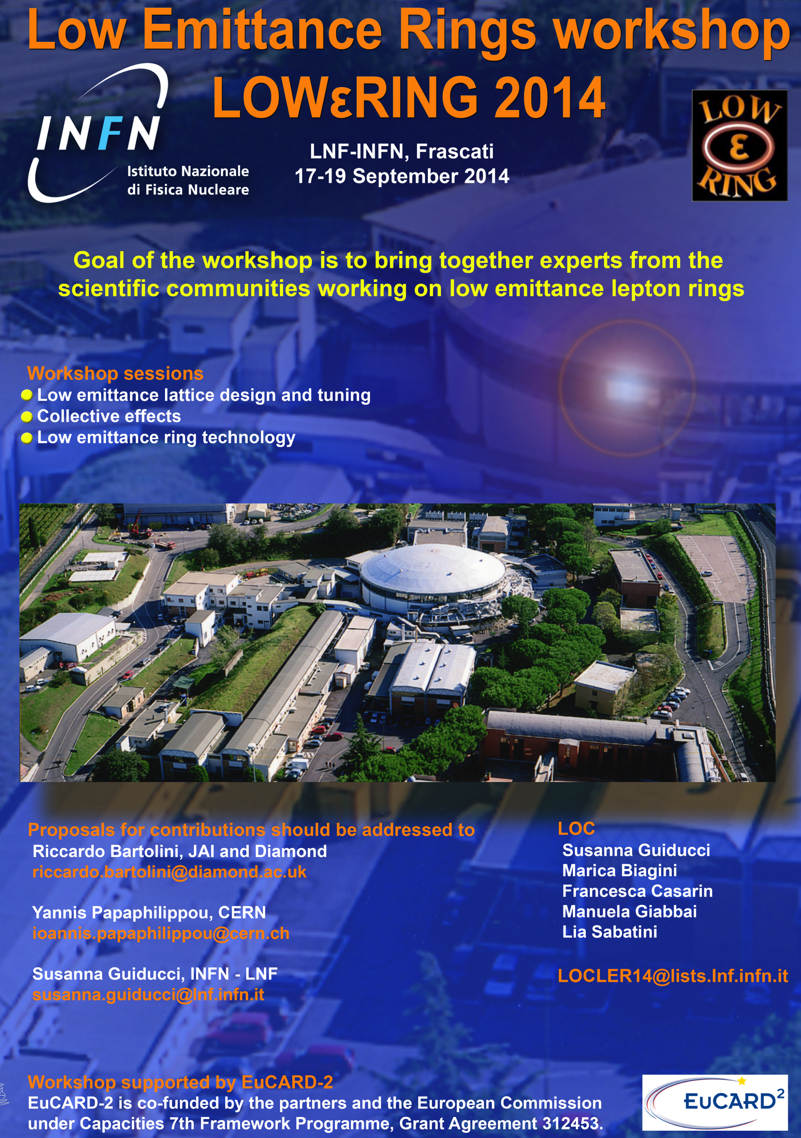
General workshop 2014
Time: 17-19 September 2014
Place: INFN-LNF, Frascatti
Organizing committee: R. Bartolini, S. Guiducci, Y. Papaphilippou, B. Hettel, Q. Qin, D. Rubin, J. Urakawa
Registration deadline July 2014
Accommodation deadline 31st of May 2014
For more info:
  https://agenda.infn.it/conferenceDisplay.py?confId=7766

Slide 7
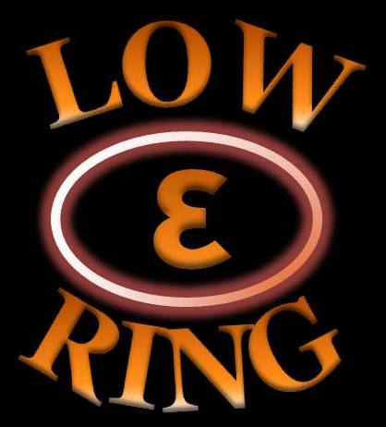
Enjoy the workshop!

