Slide 1


Methods for sub-micron beam size measurements in circular accelerators
Enrico Bravin
CERN
ALERT 2014, May 5-6, IFIC, Valencia, Spain

Slide 2
Introduction
Interceptive methods
  Wire scanner
  Screen imaging (OTR, YAG etc.)
  Screen interferometry
Non intercepting
  Synchrotron radiation imaging
  Synchrotron radiation interferometry
  Diffraction radiation
  Laser wire scanner

Slide 3
Wire scanner
Used as reference in many particle accelerators
Few microns resolution achieved (SLC, ATF) on LINAC or transfer line [1]
Difficult to use in rings due to wire damage
  Ex.: for a 4 μm carbon wire moving at 1 m/s in a ring with rev. time of 1 μs and beam of σ_{x,y} of 10 μm
  the limit is around 10⁹ particles [2]

Slide 4
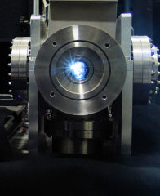
Synchrotron radiation
Widely used for online monitoring of beam parameters in electron/positron rings
Radiation generated in all bending magnets
Need only an extraction viewport and an adequate optical system to obtain the image of the beam
In most rings however the emitted radiation is diffraction limited

Slide 5


Synchrotron radiation imaging
X-Ray data booklet
Diffraction limit
For E= 2 GeV (γ∼ 4000) λ= 400 nm and ρ= 10 m
E_{cr}=1.7 keV
resolution is around 25 μm (240 μm using 1/γ)

Slide 6
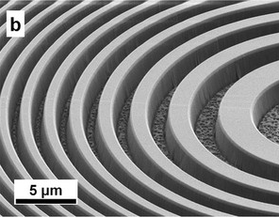
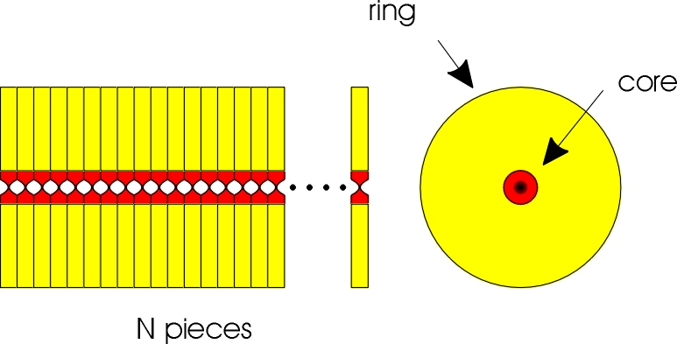
X-rays imaging
Reducing the wavelength we can improve the diffraction limit
For E= 2GeV (γ= 4000) ρ= 10 m and λ= 0.4 nm (3 keV) the diffraction limit is around 0.5 μm
Still need an optical system for X-rays with very good optical properties
Fresnel plates
Compound refractive lenses
Pin-hole

Slide 7
SR imaging using FZP at ATF [3]

Slide 8
SR imaging at ESRF [4]
Vertical beam profile obtained with 12.5 keV photons and 5 Al lenses οf 49μm curvature radius
29 lenses are used at 45.6 keV for a focal length of 3.3 m

Slide 9
SR imaging at CeSR-TA [5]
Pin-hole camera
  Single slit 50-1000 μm
  Coded aperture
1 keV to 10 keV photons
Measured beam of 12 μm with 0.5 μm error
Complex deconvolution of PRF
Can do single turn single bunch acquisitions
array of 32 InGaAs photodiodes with 50 μm pitch

Slide 10
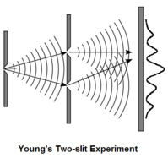
SR interferometry
Alternative to imaging
Interference fringes produced by SR passing trough two slits (Young’s interferometer)
Visibility of fringes depends on source (beam) size

Slide 11

SR interferometer at KEK [6]
Developed by Toshi Mitsuhashi at the KEK Photon Factory. Works at 500 nm
Very small beams can be measured assuming Gaussian profiles
σ= 14.7 ± 0.6 μm
σ= 39 ± 1 μm

Slide 12
Another slit solution [7]
Solution implemented at the Australian synchroton
No mechanical limit on the distance between slits
Designed for 532 nm
Demonstrated pin-hole measurement 15 ±2 μm

Slide 13
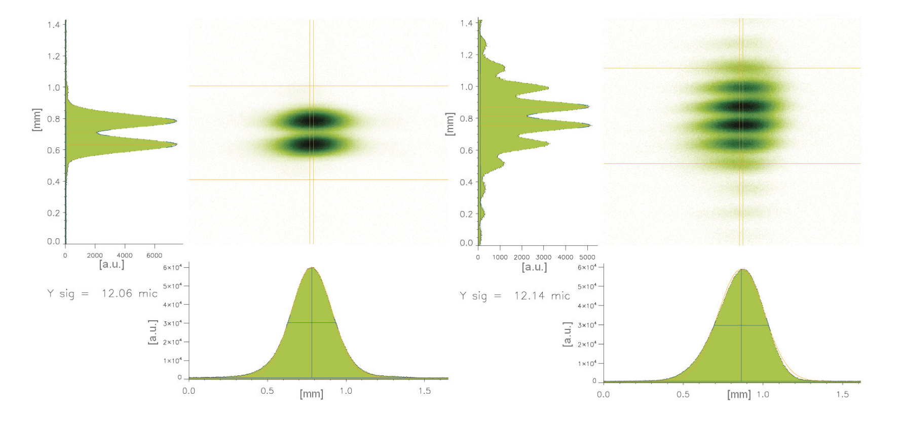
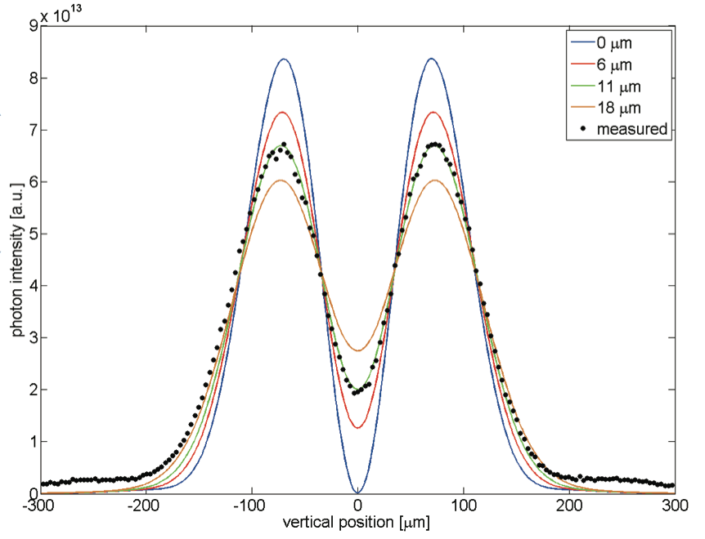
Alternative interferometry at SLS [8]
Uses the two lobes of the π polarization to create a “natural” interferometer
Possible to insert a mask between the lobes to increase the visibility
Measured 3.6 ± 0.6 μm

Slide 14
Diffraction radiation [9]
Based on the analysis the angular distribution of the “vertical” polarization of the optical diffraction radiation
ATF: E=1.28 GeV, λ= 550 nm

Slide 15
Laser wire scanner
Scan a collimated laser beam across the electron beam and observe the X-Rays/γ-Rays produced in the inverse Compton scattering process
Difficult to measure small beams with high aspect ratio (Rayleigh range)

Slide 16
LWS at ATF [10]
1.28 GeV beam on extraction line of ATF
Vertical beam size around 1μm
Horizontal size 100μm
Laser 532 nm focused to 1μm
Fit data with complex model

Slide 17
Conclusions
A selection of methods presented with relative examples
Measuring small (microns) beams is possible
Measuring small (microns) beams is difficult
For circular machines methods based on synchrotron radiation are the most indicated
But … if you really need to measure sub-micron beams
T. Shintake et al.,
“EXPERIMENTS OF NANOMETER SPOT SIZE MONITOR AT FFTB USING LASER INTERFEROMETRY”

Slide 18
References
M. Sapinski et al., “Carbon Fiber Damage in Accelerator Beam”, CERN-BE-2009-028 BI
H. Hayano, “WIRE SCANNERS FOR SMALL EMITTANCE BEAM MEASUREMENT IN ATF”, 20th International Linear Accelerator Conference, Monterey, CA, USA, 21 - 25 Aug 2000, pp.e-proc. MOC01
H. Sakai et al., “MEASUREMENT OF THE BEAM PROFILES WITH THE IMPROVED FRESNEL ZONE PLATE MONITOR”, EPAC 2006, Edimburgh, Scotland, THOBFI02
F. Ewald et al., “CHARACTERISATION OF Al-COMPOUND REFRACTIVE LENSES FOR X-RAYS”, IBIC 2013, Oxford, UK, WEPF12
J. P. Alexander et al., “Vertical beam size measurement in the CESR-TA e⁺e⁻ storage ring using x-rays from synchrotron radiation”, http://arxiv.org/abs/1311.6769
T. Mitsuhashi, “MEASUREMENT OF SMALL TRANSVERSE BEAM SIZE USING INTERFEROMETRY”, DIPAC 2001, Grenoble, France, IT06
K.P. Wootton et al., “A NOVEL SYNCHROTRON RADIATION INTERFEROMETER FOR THE AUSTRALIAN SYNCHROTRON”, IPAC’10, Kyoto, Japan, MOPD079
A. Saa Hernandez et al., “THE NEW SLS BEAM SIZE MONITOR, FIRST RESULTS”, IPAC2013, Shanghai, China, MOPWA041
T. Muto et al., “DEVELOPMENT OF THE NON-INVASIVE BEAM SIZE MONITOR USING ODR”, EPAC 2004, Lucerne, Switzerland, THOALH02
L. J. Nevay et al., “Laserwire at the Accelerator Test Facility 2 with Sub-Micrometre Resolution”, http://arxiv.org/abs/1404.0294

