Slide 1

Harmonic RF System Technology for Electron Storage Rings
Lawrence Berkeley National Laboratory
John Byrd
Workshop on Advanced Low Emittance Rings Technology
17 May 5-62014

Slide 2
Acknowledgements
Stefano De Santis
Matthias Georgsson (Ph.D. thesis)
Jorn Jacob
Vincent Serriere (Ph.D. thesis)
Giuseppe Penco
Michele Svandrlik
ALS Physics Group

Slide 3
Motivation for Harmonic RF
Old: emittance is small enough that beam density gives lifetime dominated by large-angle intrabeam (Touschek) scattering. Most low-energy 3GLS have implemented or considered 3HCs.
New: Modern lattice designs reduce horizontal emittance by ~2 orders of magnitude, bunch charge densities are high enough that the equilibrium 3-d emittance increases from small-angle intrabeam scattering.
How to address this problem with the RF system?
  High RF frequency with many small bunches?
  Low RF frequency with few large long bunches?
  Multiple RF systems with variable length bunches?

Slide 4
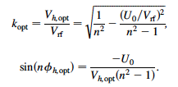
Physics of harmonic RF systems
Typical storage ring RF systems typically provide beam power and enough longitudinal focussing to give desired bunch length.
By adding harmonic voltage(s), we can shape the bunch longitudinally, useful for a variety of applications.
Focusing is cancelled at the bunch center
For large overvoltage, k_{opt}~1/n and optimum phase is close to 90 deg.

Slide 5
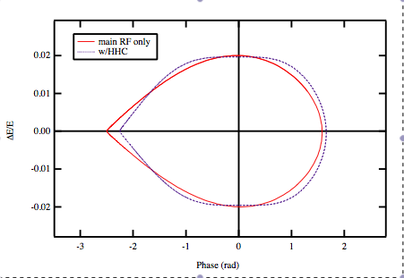
Harmonic RF systems (cont.)
The bunch shape can be calculated from the resulting distortion of the potential well.
In the bunch lengthening case, the single particle motion is highly nonlinear and a large tune spread is introduced.
bunch distribution
potential
potential and bunch distribution for optimal lengthening.
RF bucket height slightly lower

Slide 6
Harmonic RF systems (cont.)
Bunch lengthening effects very sensitive to phase of HC when focusing is gone.
±5 deg phase offset
Example for ALS2

Slide 7
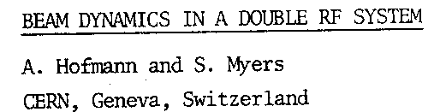
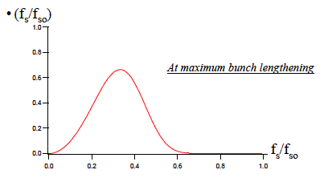
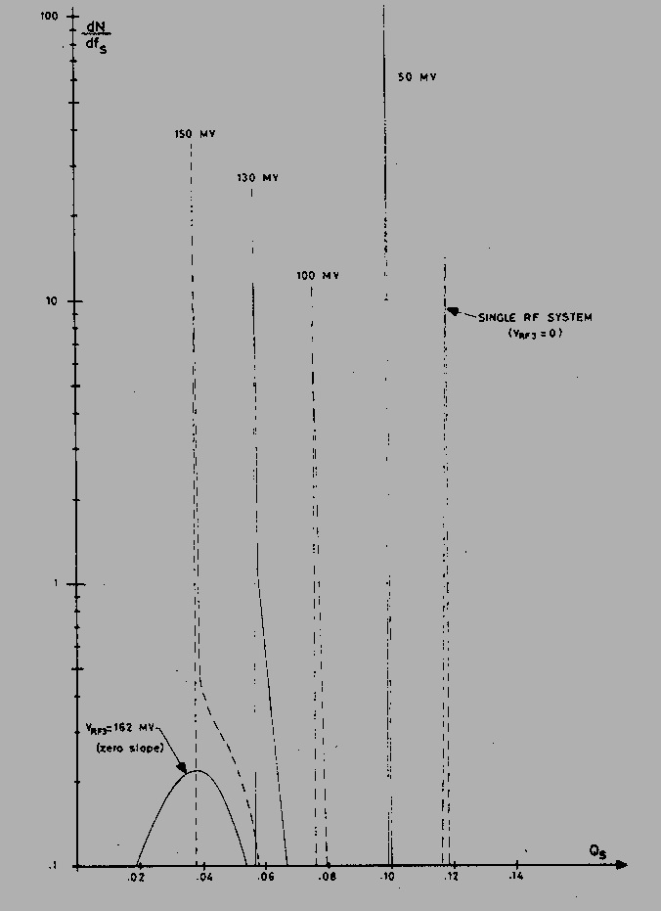
Harmonic RF systems (cont.)
Flattening of potential well induces large synchrotron frequency spread, providing large Landau damping.
ΔQ_{s}~0.3
Tune spread ranges from 0.01 (no HC) to 0.3 at optimal bunch lengthening. This should be strong enough to damp all HOM driven instabilities.

Slide 8
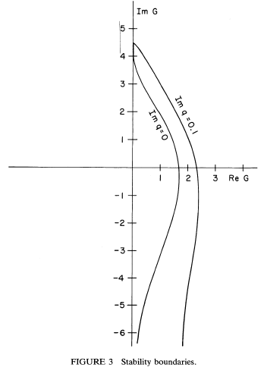
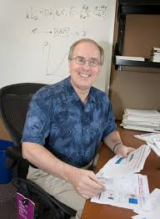
Landau Damping Theory
Much work done in 1980’s. Example Krinsky and Wang, Particle Accelerators 17 (1985).
Landau damping rate is approximately half of (angular) frequency spread.

Slide 9
Bunch shortening using HCs
The harmonic voltage can be phased to add the focussing of the main RF.
Since the focussing is reactive, a passive (i.e. idling) cavity can be used to generate the voltage.
Very economical method for reaching short bunches.
Increased focusing gives higher SB and MB instability threshold.

Slide 10
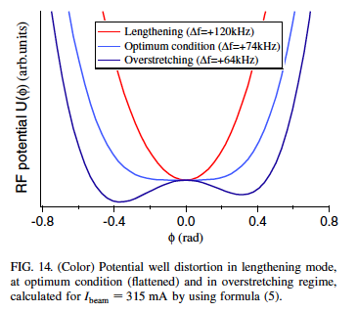
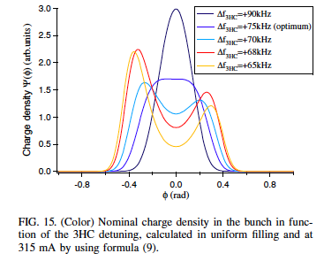
Overstretching
Increasing the harmonic voltage past a flat potential well creates multiple fixed points in the RF bucket.
Penco and Svandrlik PRSTAB 9, 044401 (2006)
Interesting? Yes. Useful? Better lifetime increase.
What is the effect on transverse head-tail instabilities?

Slide 11

Passive Cavity Operation
Because the harmonic voltage is almost completely reactive (90 deg out of phase with beam), we can use the beam to drive the harmonic cavity.
The optimum harmonic voltage and phase are given by
~1/n
~0
(90 deg)
δω
For a fixed cavity Q, it is possible to achieve the optimum lengthening for one current.
For high Q cavity, the beam induced voltage is given by

Slide 12
Passive Cavity with Variable Current
If the beam current varies with time (sans topoff), the bunch lengthening varies with current.
To find optimum tuning position, plot lifetime improvement vs. resonant frequency for several beam currents for a fixed beam-induced voltage.
Byrd and Georgsson, PRSTAB 4, 030701 (2001).

Slide 13
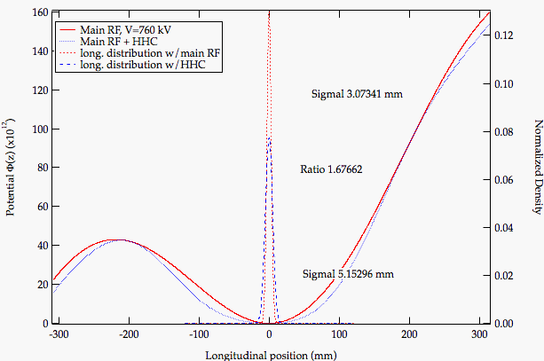
Passive bunch shape vs current

Slide 14

Transients beam loading effects
The unequal filling of the ring (i.e. gaps) create a transient loading of the main and harmonic RF systems, causing bunches to be at different RF phases (i.e. different arrival times.)
I
t0
φ
t0
time
time
For the main RF only, this effect is small (few degrees). With the HCs, the effect is much larger. This affects both the lifetime improvement and operation of the multibunch feedback systems.

Slide 15
Observation of Large Phase Transients
2 cavities in Landau mode
3 parked at ±1.5*f0
3 cavities in Landau mode
2 parked at ±2.5*f0
20 deg
272/328 bunch pattern
320/328 bunch pattern
Unequal fill or gap of 20-25% (users’ demand) aggravates this problem.
This result was NOT expected and not reported in prior literature. We began an investigation to understand the effect.

Slide 16
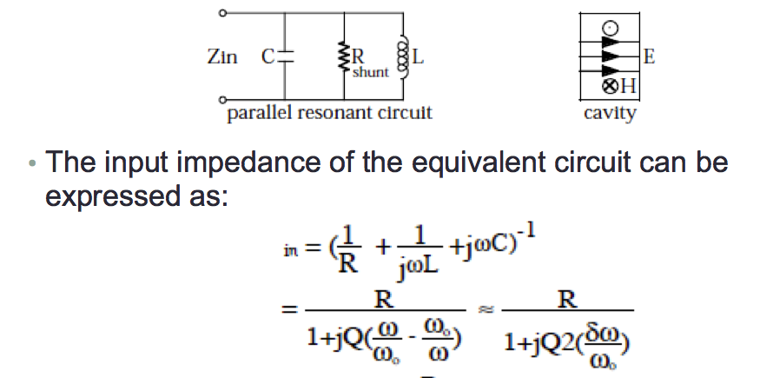

Cavity mode as parallel LRC resonator
Cavity excited well below bandwidth looks like inductor with R/Q=ω_{r}L
The transient effect can be roughly described as the transient effect in an inductor.
See pubs for detailed analysis.

Slide 17
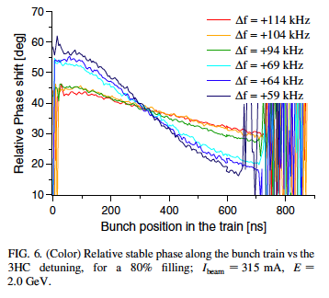
Transient Measurements for SC HC
ST/SLS SuperHC (2 cell cavity R/Q=88 Ohm)
Penco and Svandrlik PRSTAB 9, 044401 (2006)

Slide 18
Main and Harmonic Cavity Options
First, consider 3 different main RF frequencies: 100, 352, 500 MHz.
  Well developed RF power amplifiers exist for all 3 frequencies. SS PA are better developed at lower frequencies.
  Bunch length ~f^{-1/2}. Short bunches are harder to achieve at lower frequency.
  For equal beam current, bunch charge is ~f⁻¹ and peak current ~f^{-1/2}. Therefore IBS effects are worse at lower frequency.
Second, consider both passive and active systems at 3rd, 4th, and 5th harmonics. Cavity can be either NCRF or SCRF.

Slide 19
Passive or Active HC?
 | Active | Passive
NCRF | Requires input coupler Requires RF source and controller Can reach optimum BL at any current Multiple cavities | Lower cost Only “optimum” bunch lengthening at most at a single high current (maybe nowhere) Higher total R/Q for transients Multiple cavities
SCRF | Requires SC infrastructure Requires input coupler Requires RF source and controller Can reach optimum BL at any current Lower R/Q for transients One or two cells | Requires SC infrastructure Never reaches optimum BL (always 90 deg phase) Lower R/Q for transients One or two cells

Slide 20
HC design considerations
Total voltage of V_{rf}/n. Usually between 0.3-2 MV.
Number of cells determined by and R/Q/cell and voltage/cell limit
Wide tuning range
  In operation at least 0.5*f_{rev}
  Parking: at least 2*f_{rev}
Damping or control of HOMs
NCRF
R/Q~80 Ohm limited by large beam pipe
Two tuners (TM010 and TM110)
Gradient/voltage limited by surface power density. Harder at higher frequency.
SCRF
R/Q~40 Ohm/cell
Strong HOM damping
One tuner
Voltage easily reached with 1 or 2 cell design.

Slide 21
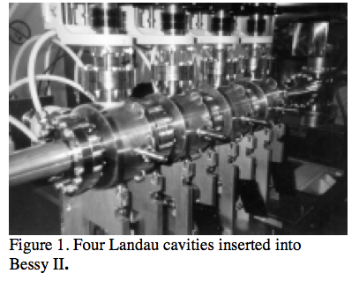
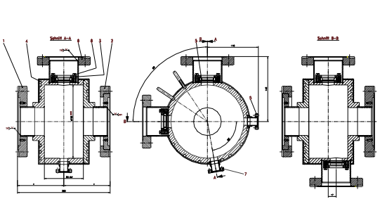
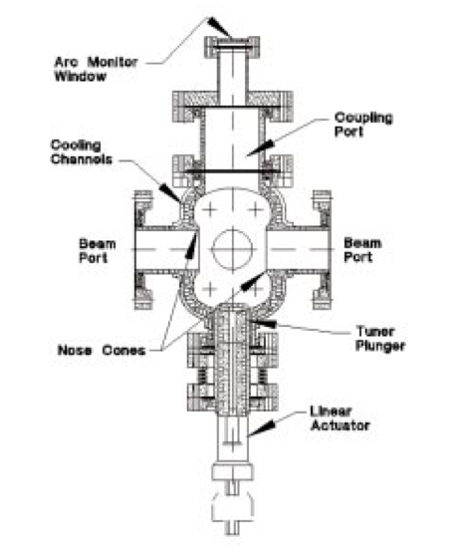
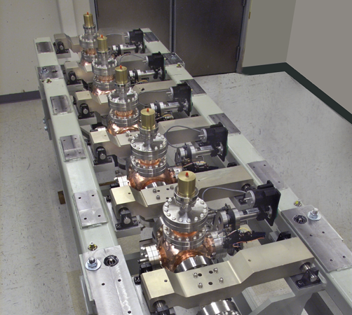
NCRF Harmonic cavity examples
Bessy-II
ALS

Slide 22
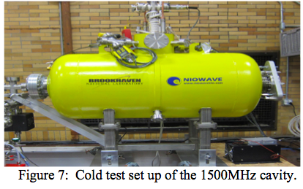
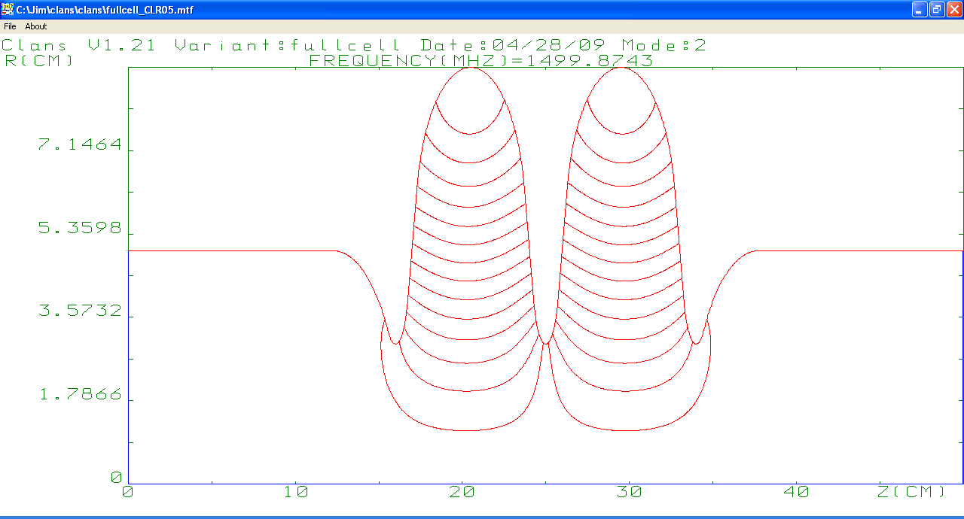
SCRF Harmonic Cavity Examples
NSLS-II (Courtesy Jim Rose)
E-fields
π-mode
Decrease wakefield loss in ferrite by increasing beampipe (ferrite) radii
Decrease R/Q by increasing iris radii
βλ/2

Slide 23
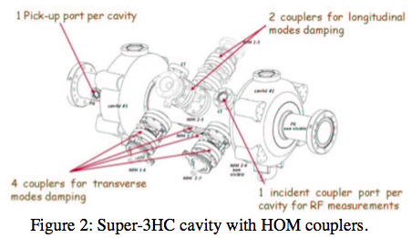
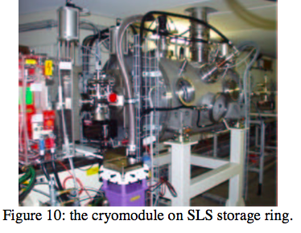
SCRF Harmonic Cavity Examples
Elettra/SLS Super 3HC (Courtesy Michele Svandrlik)

Slide 24
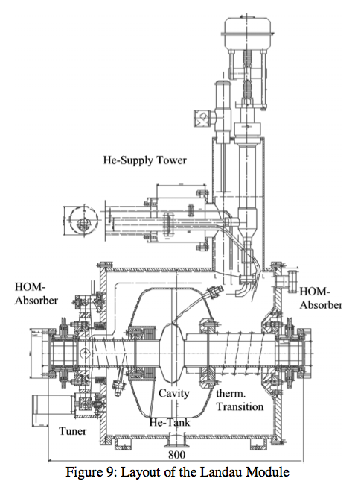
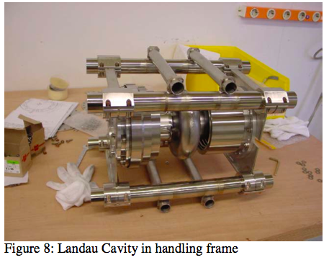
SCRF Harmonic Cavity Examples
BESSY-II (not yet installed?)

Slide 25
APSU Active SC HC Study
The APSU is an upgrade of the APS. The are considering an active SCRF harmonic cavity.
  Energy loss per turn ≈ 2.6 MeV, main RF voltage = 4.5 MV.
  Harmonic voltage for optimum potential-well flattening is 0.9 MV with 79 degree detuning angle at the 4th harmonic RF (1408 MHz).
  With this harmonic voltage, 4-fold beam lifetime improvement is expected.
  To operate at 79 detuning angle, fundamental-mode couplers are necessary. Active-mode operation is chosen for the range of beam currents from 50 mA to 200 mA.
Courtesy Sanghoon Kim, Mike Kelly, and Peter Ostroumov

Slide 26
SC Harmonic Cavity in Active Mode
SC single cell cavity
  Modified from the ILC-shape single cell cavity: larger beam tube to extract HOMs from the cavity.
  Rather low gradient in SC cavity:
  E_{peak} ≈ 17 MV/m, B_{peak} ≈ 35 mT.
Active-mode operation with various beam currents
  For the optimum harmonic voltage and suppression of the Robinson instability, frequency tuning, adjustable RF coupler, and external RF power are required.
  Two 20 kW RF couplers and 10 kW RF source will be required.
S. Kim, M.P. Kelly, S.V. Kutsaev, P.N. Ostroumov, ANL Physics Division

Slide 27
Current study for ALSU
ALSU is an initiative towards an ultralow (50 pm) upgrade of the ALS and incorporates several “new” features: on-axis injection, beam swap-out. 10 nsec risetime assumed.
ALSU requires bunch lengthening to avoid emittance blowup from IBS.
We are performing a study to characterize HC requirements and beam dynamics effects for ALSU. We welcome collaborators in this process.

Slide 28
ALSU RF Options
ALSU is considering two RF options
500 MHz NC Main RF/1500 MHz SC passive HC
Well understood system.
Requires bunch trains with 10 nsec gaps. Transient effects?
Requires addition of SC RF infrastructure.
Allows bunch shortening mode.
100 MHz Main RF/500 MHz NC active HC
Uses half of existing 500 MHz active system as harmonic.
Requires addition of new 100 MHz RF system (ala MAXIV)
Unclear if compatible with existing beam instrumentation (BPMs, etc)
Bunch spacing 10 nsec compatible with kicker risetime. No gaps needed.
Longer bunches better for vacuum system and instabilities.
Reversion to 500 MHz possible for short bunch mode.

Slide 29
Summary
Harmonic cavities are a useful tool for controlling bunch shapes in light sources. Considered to be essential for lower energy MBA lattices to counteract IBS emittance growth.
The reduction of longitudinal focusing makes the bunch shape very sensitive to variations in the harmonic cavity phase.
  Hybrid filling modes will be tricky if harmonic cavities are required. Symmetric filling patterns are best.
  Scale of transient effects is proportional to R/Q of harmonic cavity.
Harmonic cavities provide huge increase in longitudinal Landau damping. All rings see damping of LCBI in uniform fill patterns (negligible transient effects.) Unclear how much damping of HOMs is required if Landau damping is always present.
Harmonic cavity technology well-developed. New developments in active 1.5 GHz RF.

