Slide 1
MPGD detectors
Micro Pattern Gas Detectors (MPGDs) are flexible and widespread devices with promising performances for the next generation High Energy Physics experiments, as well as for many other applications as medical, imaging, dosimetry. Large instrumented surfaces, high rate capability, very good position resolution, radiation tolerance and low material budget are key features of MPGDs. Different technologies and materials entering into this field are providing new possibilities for future detectors. The first part of the training seminar will treat some basic of gaseous detection and the reasons why micro pattern gaseous detector have been introduced. A brief overview of MPGDs at CERN, currently running or planned for next upgrades in the experiments, will be given. In the second part we will focus on the path in between requirements, R&D and final design of detectors for experiments. R&D process and some peculiarities of this technology will be described using real cases where requirements (driven by the experiment) or issues (related to the technology itself) have been faced by the groups that are working with MPGDs.
E. Oliveri (PH-DT-DD)

Slide 2
Main Goal:
- an overview of MPGD detectors at CERN
- show the versatility of MPGD technologies
First Part:
  Basic of Gaseous detection and proportional counter
  MPGDs, a brief history and different typologies overview
  MPGDs @ CERN, detector…running and for upgrades
Second Part
  Technology developments through real examples:
    achieve the performances required by the experiment…one example of playing with the gas (don’t forget that MPGD are still gaseous detectors….)
    cover large areas with GEM…one example of playing with the production processes
    having micromegas spark protected… one example of playing with the induction of the signal in your readout
  ... and a rapid list of other interesting cases

Slide 3
First Part:
  Basic of Gaseous detection and proportional counter
  MPGDs, a brief history and different typologies overview
  MPGDs @ CERN, detector…running and for upgrades

Slide 4


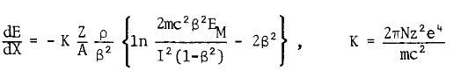






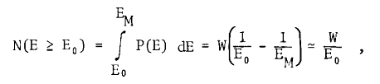




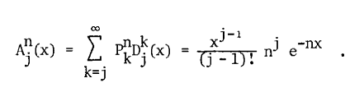

Before entering the MPGD we have to pass through the following formulas…

Slide 5
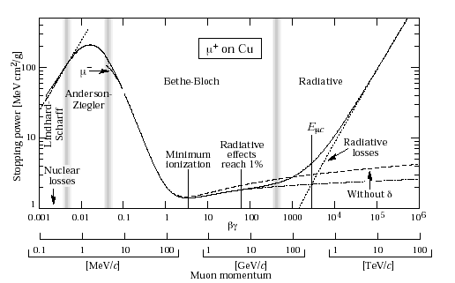
Cathode
-
Gas volume
+
+
+
+
+
+
-
+
+
-
+
Edrift
Edrift
-
-
-
-
-
-
Egain
Charged Particles
Anode
You have to learn how to play with fields
MIP≈ 2 Mev cm² /g… gas density…
Energy loss due to electromagnetic interaction

Slide 6
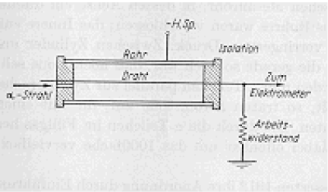
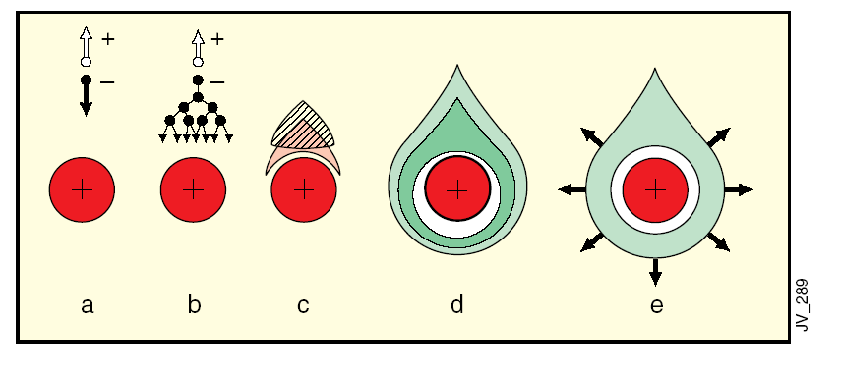
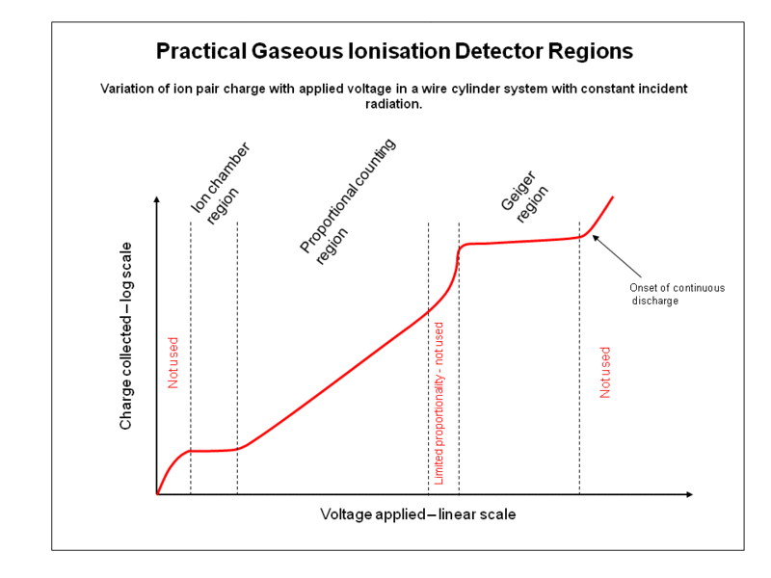
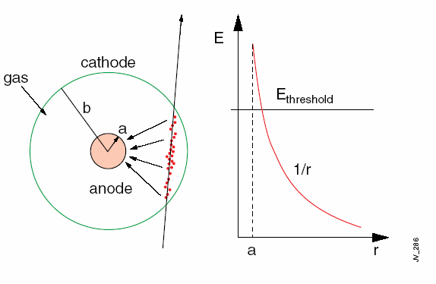
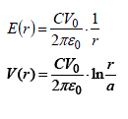
Single Wire Proportional Counter [Rutherford, E. and Geiger, H. (1908)]
Signal proportional to the original ionization
(large collection volume – small amplification volume)

Slide 7
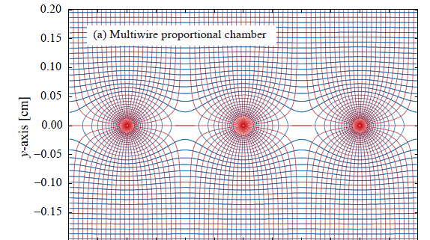
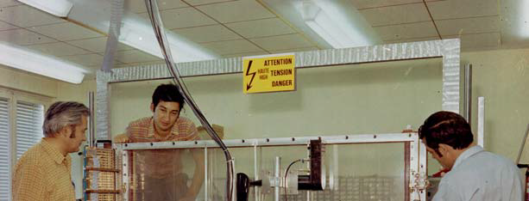
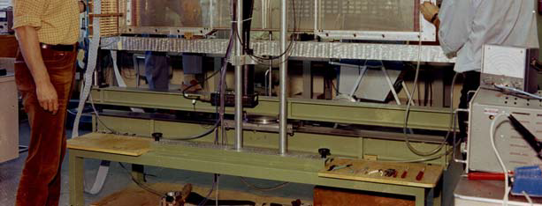
MWPC (Multi Wire Proportional Counter) [Charpak, G. et al. (1968)]
fast position-sensitive detectors (1968)
Continuously active,
Efficient at particle fluxes up to several MHz/cm2
Sub-mm position accuracy
Noble Prize in 1992

Slide 8
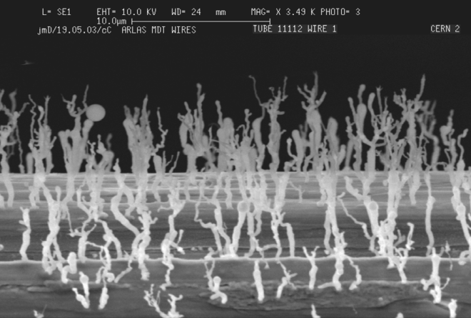
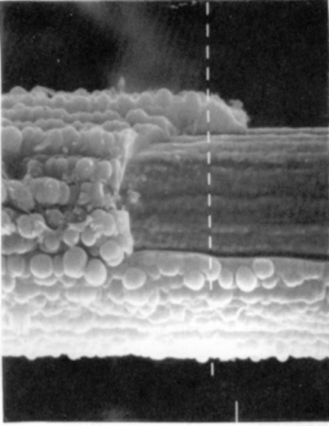
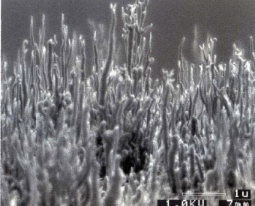
MWPC
Limited multi-track separation
        mechanical instabilities due to electrostatic repulsion - critical length of about 25cm for 10mm wires and 1mm spacing]
Fast gain drop at high fluxes
        field-distorting space charge accumulation due to the long time taken by the ions produced in the avalanches to clear the region of multiplication]
Aging
        permanent damage of the structures after long-term exposure to radiation due to the formation of solid deposits on electrodes.
Anode Aging: drop of the gain, discharges
Cathode Aging: Malter effects

Slide 9
Faster Ions Evacuation
Higher Spatial resolution the first Micro Pattern Gaseous Detector:
MSGC (OED, 1988)
The basic idea: move down in size
(material in between anode and cathode… with many consequences to take into account)

Slide 10
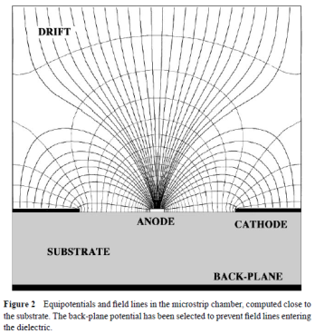
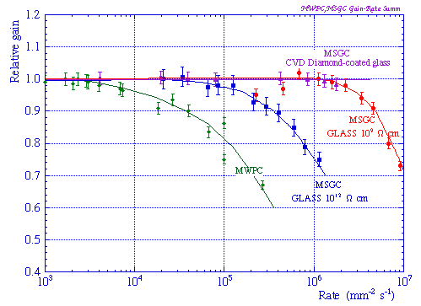
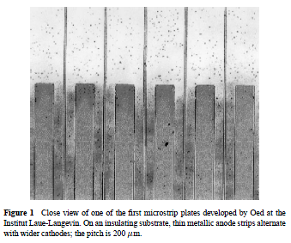
MSGC
  MSGC (Oed A. Nucl. Instrum. Methods A263:351 (1988)) : excellent localization, high rate capability (reduced space charge buildup), good granularity
Observed instabilities:
time-dependent gain shifts (charge movement in the substrate, polarization and charge accumulation)
tendency to discharge
permanent deterioration (aging) during sustained irradiation
medium- and long-term stability determined by physical parameters used to manufacture and operate the detectors as : substrate material, metal of the strips, type and purity of the gas mixture

Slide 11
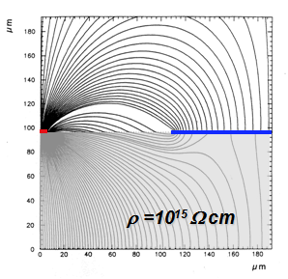
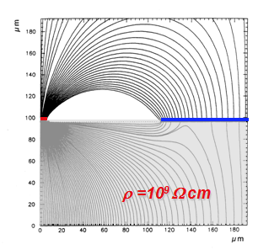
MSGC: Charging Up, polarization, internal charge movement
Playing with material in between and around anode and cathode
Studies of different substrate sand surface coatings to improve charge evacuation, field lines, eliminate polarization or internal charge movements
Substrate resistivity optimization to minimize the charge up

Slide 12
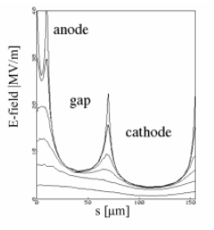
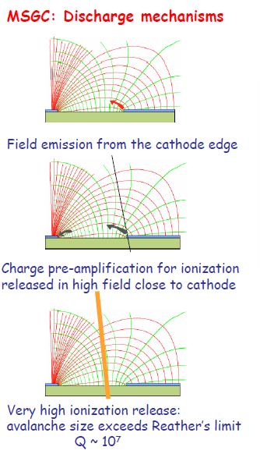
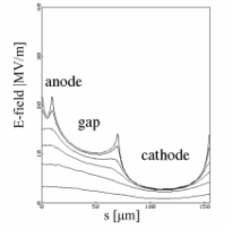
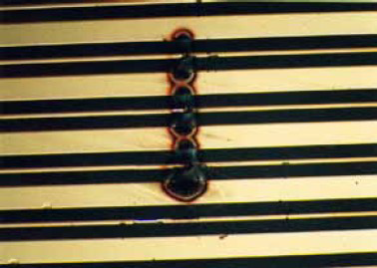
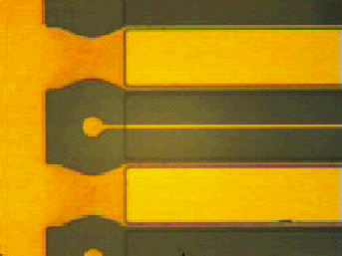
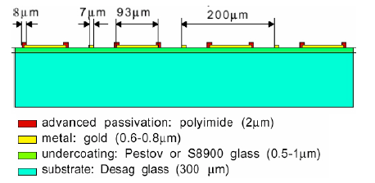
MSGC: Discharges
Micro-cathode → a pre-amplification stage for discharges
CVD Diamond Coated MSGC
Cathode Edge Passivation
[Bellazzini et al]

Slide 13
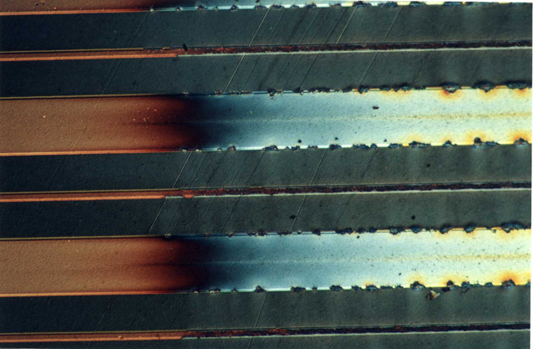
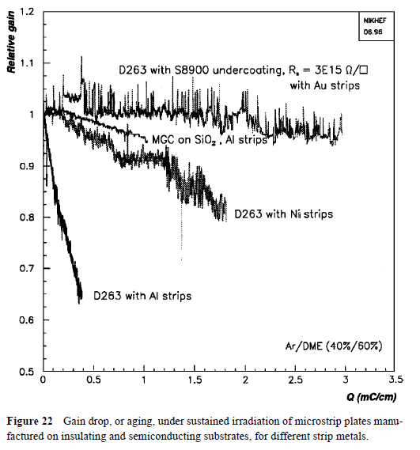
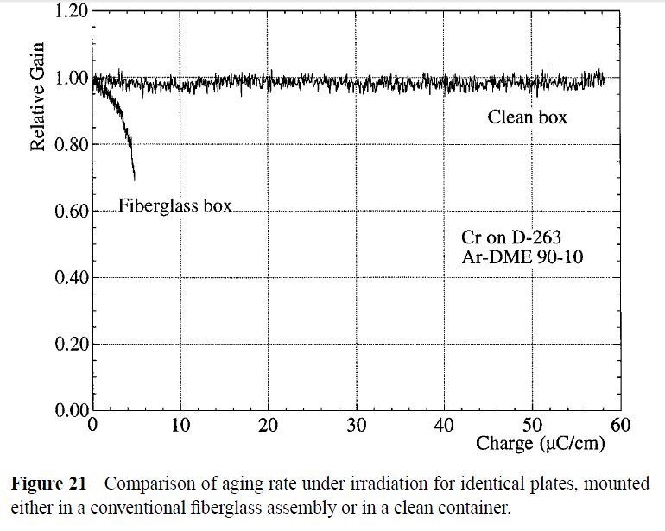
MSGC: Aging
van den Berg FD, et al. Nucl. Instrum.
Methods A392:94 (1997)
Bouclier R, et al. In Proc. MSGC Workshop,
Legnaro, p. 48 (1994)

Slide 14
Rapid Development of many different structures to improve performances and solve problems of MSGC

Slide 15
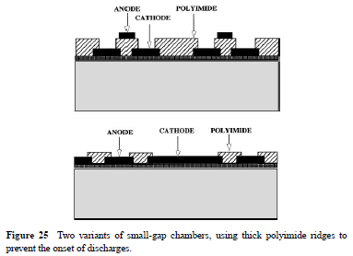
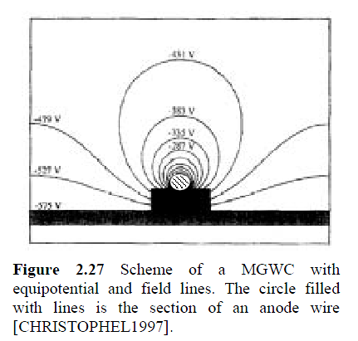
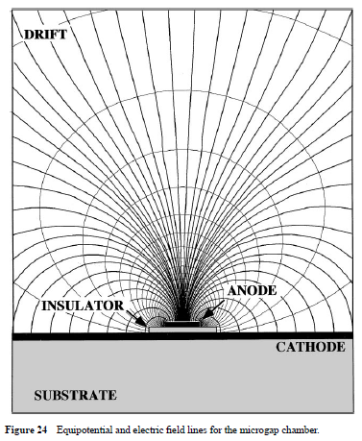
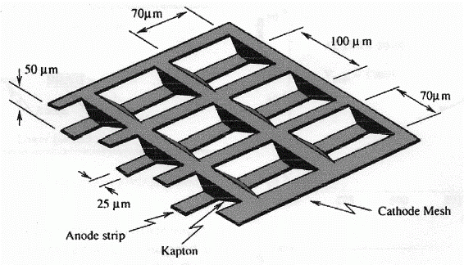
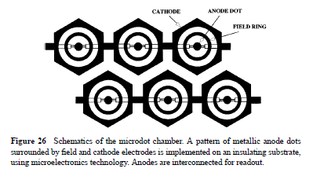
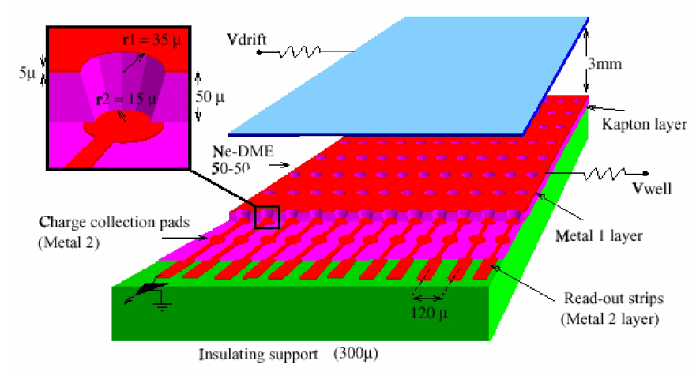
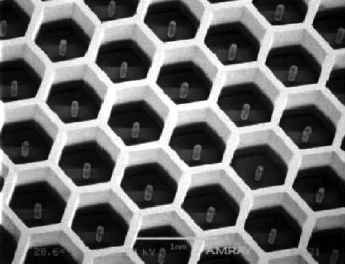
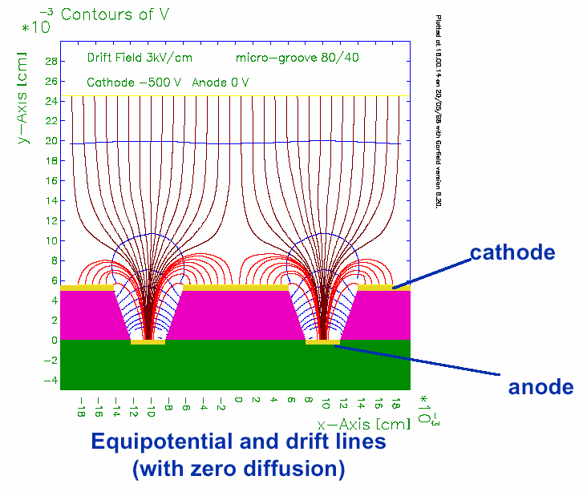
Micro Gap Chambers
Micro Gap Wire Chamber
Micro Wire Chamber
B. Adeva et al., Nucl. Instr. And Meth. A435 (1999) 402
E. Christophel et al, Nucl. Instr. and Meth, vol 398 (1997) 195
MicroDot
Angelini F, et al. Nucl. Instrum. Methods A335:69 (1993)
MicroWELL
MicroPin
MicroGroove
Biagi SF, Jones TJ. Nucl. Instrum. Methods A361:72 (1995)
R. Bellazziniet al
Nucl. Instr. and Meth. A423(1999)125
μPIC
P. Rehak et al., IEEE Nucl. Sci. Symposium seattle 1999
R. Bellazzini et al
Nucl. Instr. and Meth. A424(1999)444
Ochi et al NIMA471(2001)264

Slide 16
“Parallel Plate” Amplification
“…The successful development of multiwire and microstrip structures has somewhat
sidestepped the research on gas detectors that exploit the multiplication in uniform
fields. Parallel-plate multipliers not only are mechanically sturdier but also have
better energy resolution and higher rate capability. ”
From: F,Sauli, A. Sharma, MICROPATTERN GASEOUS DETECTORS , Annu. Rev. Nucl. Part. Sci. 1999. 49:341–88

Slide 17
“Parallel Plate” Amplification
(single stage devices… micromegas family)

Slide 18
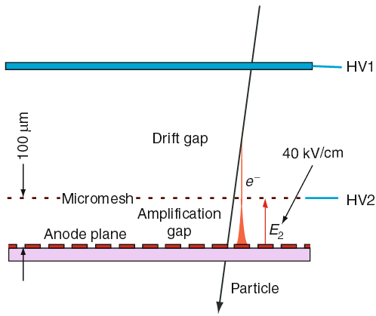
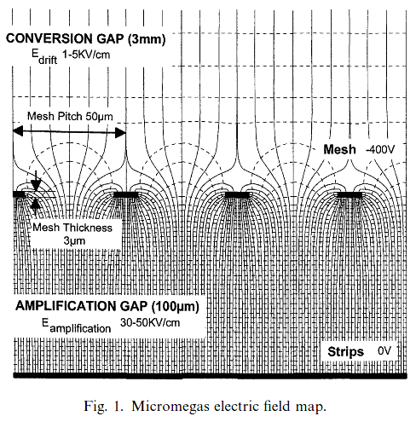
MicroMEGAS: Parallel Plate with Small GAP
MICRO Mesh Gaseous Structure
MICROMEGAS: a high-granularity position-sensitive gaseous detector for high particle-flux environments Y. Giomataris et al, Nucl. Instr. and Meth. A376(1996)29
Two-stage parallel-plate avalanche chamber of small amplification gap
Rate capability and energy resolution of the parallel plate counter.
Y. Giomataris, Nucl.Instr. and Meth. in Physi.Res. A 419 (1998) 239
Small gap , high field: fast movement of positive ions that are mostly collected on the mesh (small space-charge accumulation) and very fast signals

Slide 19
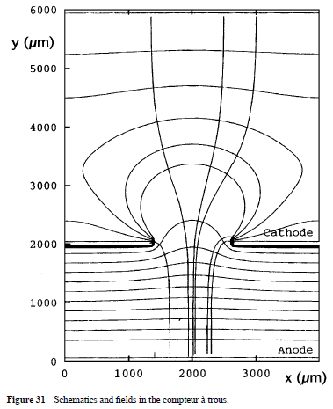
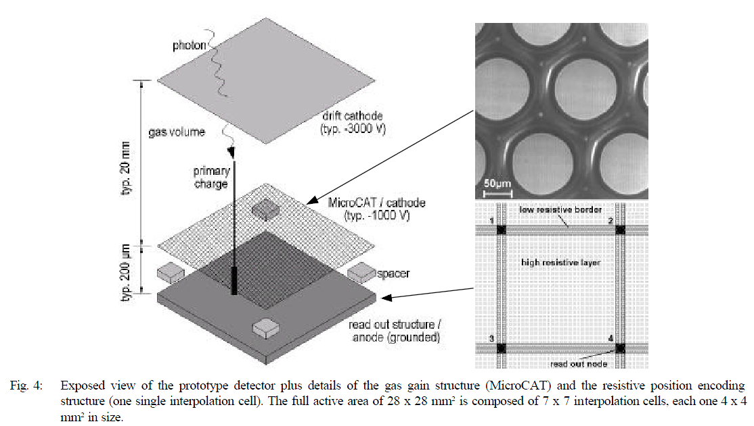
MicroCAT: structurally similar to micromegas but with round holes
Resistive layer (to improve spatial resolution)
A. Sarvestani et al., Nucl. Instr. And Meth. A410 (1998) 238
Cellular resistive readout using a resistive anode foil that is padded with conducting lines and forms a regular matrix of nodes, each connected to a charge-sensitive amplifier.
We will talk later about resistive layer.. But for different purpose

Slide 20
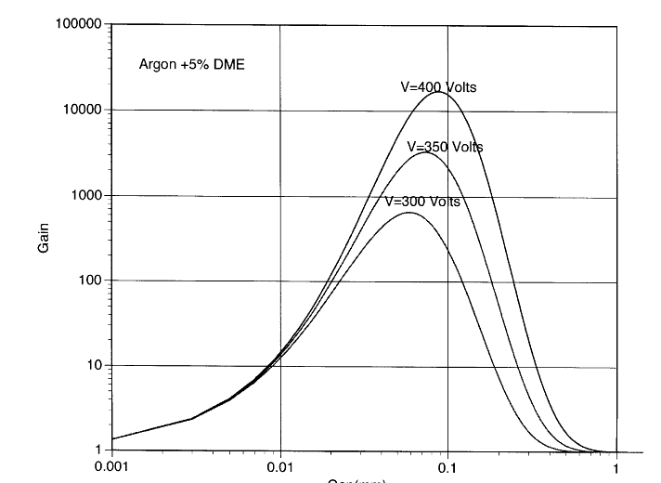




An interesting property of small gaps
Narrow Gap Behaviour
“ Optimum gap provides stable operation and minimizes gain variation from pressure-temperature variations and fluctuations due to gap variations” Introduction to MPGD Y. Giomataris, CEA-Irfu-France
GAIN
small variations of the amplification gap compensated by an inverse variation of the amplification factor
Reduced dependence of gain on the gap thickness because of the saturating characteristics of the multiplication factor at very high field
i.e. good uniformity and stability of response over a large area.
GAP(mm)
Y. Giomataris, Nucl.Instr. and Meth. in Physi.Res. A 419 (1998) 239

Slide 21
“Parallel Plate” Amplification and Transfer
(multi stage devices… GEMs Family)

Slide 22
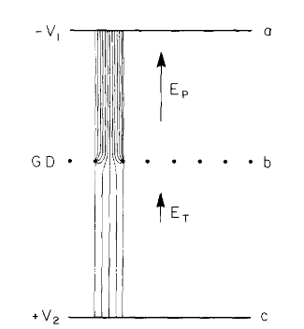
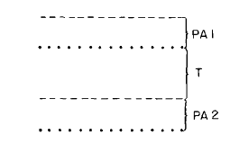
Multistep Avalanche Chamber (Charpak G, Sauli F. Phys. Lett. B78:523 (1978))
Made with a succession of metal meshes, the detector multiplied ionization electrons injected from a drift region into a high field. A fraction of the avalanche was then transferred through a lower field region into a second element of multiplication, a parallel plate or a wire chamber. Despite the loss of charge in the transfer from high to moderate fields, effective preamplification factors of several hundred were possible. Followed by a standard MWPC, the device permitted the high gains necessary to detect single photoelectrons.
PAT
[PreAmplification and Transfer]
To obtain larger gains with parallel-plate structures
“The multistep chamber was mechanically complex to implement and had only limited success, but demonstrated the great potential of subdividing the gain among several cascaded elements separated by low-field gaps”

Slide 23
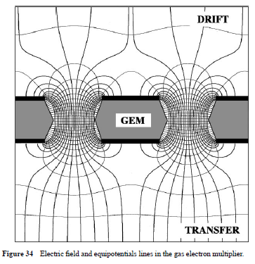
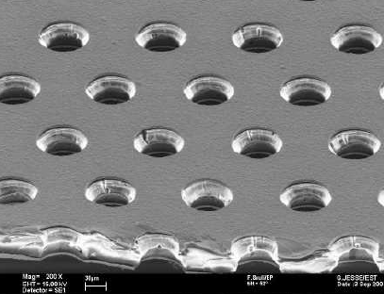
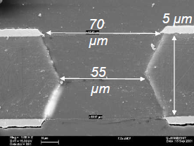
GEM (gas electron multiplier) introduced by Sauli in 1997, consists of a thin, metal-clad polymer foil chemically perforated by a high density of holes, typically 100/mm2
GEM: A new concept for electron amplification in gas detectors
F. Sauli, Nucl. Instr. and Meth. A386(1997)531
UNIQUE FEATURE
PREAMPLIFICATION AND TRANSFER OF CHARGE PRESERVING THE IONIZATION PATTERN
Sharing of the gain between two or more cascaded amplifiers, each operated at a voltage well below the discharge limit, appears to be a good solution to the problems common to all single-stage micro pattern detectors.

Slide 24
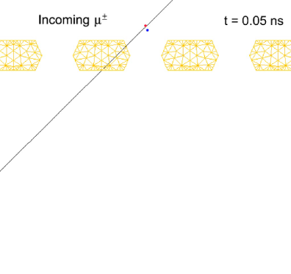
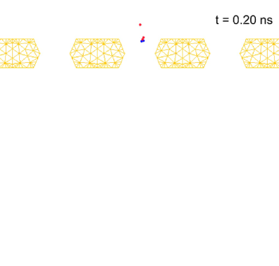
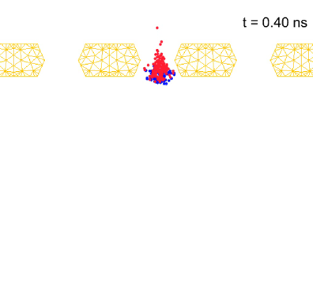












Avalanche Process in GEM: microscopic view
Time (0.2ns/step, From 0 to 0.8ns)
Avalanche
Time (1ns/step, From 1 to 5ns)
Electrons Drift and Diffusion
Time (400ns/step, From 10 to 1600ns)
Ions Drift and Diffusion
S. Dildick & R Veenhof

Slide 25

ThickGEM
( R. Chechik, A. Breskin and C. Shalem,Thick GEM-like multipliers—a simple solution for large area UV-RICH detectors, to be published in NIMA - Similar approach to Peskov’s “optimized GEM”)
THGEM Peculiarity
Geometrical parameters scale respect with standard GEM
while
microscopic behavior of the electrons does not (in particular diffusion in the gas)
therefore
More effective electron collection and transport between cascaded elements
(hole diameter is larger than the electron’s diffusion range when approaching the hole)

Slide 26
Now you may want to ask ….
Which one is the best?
Better GEMs or micromegas…?

Slide 27


Answering it would be like choosing between France and Germany
France
Germany
Italy is out… so, actually we don’t mind, but….

Slide 28

Rolf-Dieter Heuer is a GERMAN particle physicist and the DIRECTOR GENERAL of CERN since 2009
France
Germany
You know what I want ….

Slide 29
More seriously (and polite): no answer a-priori
Define the single event signal properties that you need (energy, space and time resolution, ions tail, cluster size…)
Define the environment where you have to run your detector (flux, highly ionizing particles, occupancy… )
Check the properties of the technology that are critical for the specific application that you have in mind (Ion/photons Back Flow, discharge rate,…)
At this point you will be probably able to chose the best one for your application or maybe you will mix them or….

Slide 30
MPGD detectors @ CERN

Slide 31





The mpgd community is becoming a huge community, involving many research institutes, facilities and plenty of applications (not only hep)
collspotting.web.cern.ch
CERN
CERN
1987
1996
2012
A key role on MPGD development and dissemination
http://rd51-public.web.cern.ch/rd51-public/Welcome.html
…Today we will focus on CERN

Slide 32

MPGD detectors already running at CERN….
TOTEM (GEM)
LHC
Compass (GEM, micromegas)
NA48 (micromegas)
LHCb (GEM)
LHC
CAST (micromegas)
DIRAC (MSGC-GEM)

Slide 33
…. and possible upgrades
COMPASS(TGEM, micromegas upgrade)
TOTEM (GEM)
LHC
Compass (GEM, micromegas)
CMS(GEM)
LHC
GLACIER(LEM)
NA48 (micromegas)
LHCb (GEM)
LHC
ALICE(GEM or ….)
LHCb(GEM)
LHC
LHC
CAST (micromegas)
CAST(InGrid)
ATLAS(micromegas)
LHC
DIRAC (MSGC-GEM)
… and other proposals in progress for future upgrades

Slide 34
Second Part
  Technology development through real examples:
    achieve the performances required by the experiment…one example of playing with the gas (don’t forget that MPGD are still gaseous detectors….)
    cover large areas with GEM…one example of playing with the production processes
    having micromegas spark protected… one example of playing with the induction of the signal in your readout
  ... and a rapid list of other interesting cases

Slide 35
example 1: GEM-LHCb
achieve the performances required by the experiment…one example of playing with the gas

Slide 36

LHCb GEMs for the muons apparatus
achieve the performances required by the experiment…one example of playing with the gas
Small Gap MWPC
http://cds.cern.ch/record/5701
High Rate Capability: up to 1MHz/cm2
Radiation hardness: 1.6C/cm2 in 10 years @6k Gain
Low material budget
Cluster Size < 1.2 for a 10x25mm2pad size
Station Efficiency: >96% in 20ns time Window for two detectors in “OR”
MPGD:GEMs

Slide 37
achieve the performances required by the experiment…one example of playing with the gas
Station Efficiency: >96% in 20ns time window for two detectors in “OR”
nb: two different aspects
You need to sustain high rate environment
Triggering system with 96% of efficiency in 20ns with rate capabilities up to MHz/cm2
You want to be fast to be able to associate the events to the specific bunch crossing
Resistive plate chamber: very fast (much faster than GEMs) but limited rate capabilities

Slide 38
achieve the performances required by the experiment…one example of playing with the gas
Let’s start with a standard triple GEM Ar/CO2 70/30, 3-2-2-2 mm gaps
Closest Cluster to the top of first GEM = First contribution (rising) of the induced signal
cathode
drift volume
t₁=d₁ x v_{drift}
t₂=d₂ x v_{drift}
GEM1
Intrinsic time Resolution
GEM2
GEM3
anode
t_{ArrivalOnGEM1Top} = d_{ClosestCluster} x v_{drift}

Slide 39


achieve the performances required by the experiment…one example of playing with the gas
t_{ArrivalOnGEM1Top} = d_{ClosestCluster} x v_{drift}
Number of ionisation clusters produced in the drift gap (small number of independent events): Poisson-Like statistic
Space distribution of the first cluster created at a distance d from the first GEM:
P (d )=n ・e^{( - nd )}
where n is the average number of ionisation clusters per unit length
St Deviation (spread):
σ(d)=1 /n
i-C₄H₁₀
CF₄
Ar
CO₂
M. P. Lener, Triple-GEM detectors for the innermost region of the muon apparatus at the LHCb experiment, Doctoral Thesis, https://cds.cern.ch/record/940631/files/thesis-2006-013.pdf

Slide 40

achieve the performances required by the experiment…one example of playing with the gas
t_{ArrivalOnGEM1Top} = d_{ClosestCluster} x v_{drift}
Ar/CO2

Slide 41


achieve the performances required by the experiment…one example of playing with the gas
M. P. Lener, Triple-GEM detectors for the innermost region of the muon apparatus at the LHCb experiment, Doctoral Thesis, https://cds.cern.ch/record/940631/files/thesis-2006-013.pdf

Slide 42




achieve the performances required by the experiment…one example of playing with the gas
Proper Gas (to achieve a good intrinsic resolution)
+
Smaller Gap in the first transfer to be protected against Double GEM Signals
+
Smaller Induction gap to increase the signal current
(I=-qv_{d}/Gap_{Ind})

Slide 43
example 2: Large GEM-CMS
cover large areas with GEM…one example of playing with the production processes

Slide 44

CMS, Large GEM proposal
cover large areas with GEM…one example of playing with the production processes
Hundreds of square meters…
Large area detectors needed

Slide 45


Std (small)GEM production:
Double Mask Technique
cover large areas with GEM…one example of playing with the production processes
Progress on large area GEMs Serge Duarte Pinto et al., Jinst, November 26, 2009 [http://arxiv.org/pdf/0909.5039v2.pdf]
Electric Field and performance strongly related to the hole shape

Slide 46

GEM production:
Double Mask Technique
cover large areas with GEM…one example of playing with the production processes
Progress on large area GEMs Serge Duarte Pinto et al., Jinst, November 26, 2009 [http://arxiv.org/pdf/0909.5039v2.pdf]

Slide 47



cover large areas with GEM…one example of playing with the production processes
Progress on large area GEMs Serge Duarte Pinto et al., Jinst, November 26, 2009 [http://arxiv.org/pdf/0909.5039v2.pdf]

Slide 48

GEM production:
Double & Single Mask Technique
cover large areas with GEM…one example of playing with the production processes
Progress on large area GEMs Serge Duarte Pinto et al., Jinst, November 26, 2009 [http://arxiv.org/pdf/0909.5039v2.pdf]

Slide 49

cover large areas with GEM…one example of playing with the production processes
Polyimide Etching
Rui De Oliveira, Latest MPGD developments and readout board guidelines , Tuesday, 28 April 2009, RD51 Week
https://indico.cern.ch/event/56216/session/1/contribution/5/material/slides/1.pdf

Slide 50



cover large areas with GEM…one example of playing with the production processes
Now you have to remove the copper on the bottom without affecting the one in the top
Rui De Oliveira, Latest MPGD developments and readout board guidelines , Tuesday, 28 April 2009, RD51 Week
https://indico.cern.ch/event/56216/session/1/contribution/5/material/slides/1.pdf

Slide 51

cover large areas with GEM…one example of playing with the production processes
Rui De Oliveira, Latest MPGD developments and readout board guidelines , Tuesday, 28 April 2009, RD51 Week
https://indico.cern.ch/event/56216/session/1/contribution/5/material/slides/1.pdf

Slide 52






cover large areas with GEM…one example of playing with the production processes
Rui De Oliveira, Latest MPGD developments and readout board guidelines , Tuesday, 28 April 2009, RD51 Week
https://indico.cern.ch/event/56216/session/1/contribution/5/material/slides/1.pdf

Slide 53



cover large areas with GEM…one example of playing with the production processes
Single Mask GEMs (420cm x 990cm)
S. Colafranceschi, http://indico.cern.ch/event/176664/session/3/contribution/15/material/slides/0.pdf

Slide 54





cover large areas with GEM…one example of playing with the production processes
Measurement with the Large GEM Single Mask CMS Prototype
Mechanical stretching Method
https://indico.cern.ch/event/323839/session/4/contribution/47/material/slides/1.pdf

Slide 55
example 3: micromegas-ATLAS
    having micromegas spark protected… playing with the induction of the signal in your readout

Slide 56

micromegas for the
ATLAS New Small Wheel
    having micromegas spark protected… playing with the induction of the signal in your readout

Slide 57

Sparks Effects
    having micromegas spark protected… playing with the induction of the signal in your readout
Spark signals as seen on the oscilloscope (on 50 Ω, attenuated 1:100)
Dead time,
Critical for the FE chips (need to be very well protected)
J. Wotschack et al, Large-size micromegas for ATLAS (MAMMA), status and prospect, RD51 mini week, 17/01/2011

Slide 58


Sparks effects
    having micromegas spark protected… playing with the induction of the signal in your readout
G. Iakovidis, arXiv:1310.0734v1 [physics.ins-det] 2 Oct 2013
Gas: Ar:CO2 (85:15)
Neutron flux: ≈ 10^6 n/cm2/sec
Pions, no beam, muons
Chamber inefficient for O(1s) when sparks occur
Monitored HV (continuous line) and current (point) as a function of HV mesh under neutron irradiation
HV break-down and currents exceeding several µA already for gains of order 1000–2000 (J, Wotschack et al., Micromegas for the ATLAS Muon System Upgrade, Hefei, 5 Sept. 2011)
J, Wotschack et al., Micromegas for the ATLAS Muon System Upgrade, Hefei, 5 Sept. 2011

Slide 59

Spark Protection: Resistive MicroMegas
    having micromegas spark protected… playing with the induction of the signal in your readout
G. Iakovidis, arXiv:1310.0734v1 [physics.ins-det] 2 Oct 2013
Induced signal because of the charge movement (no charge collected)
A sketch (not in scale) of the resistive-strip protection principle with a view along and orthogonal to the strip direction

Slide 60

Resistive micromegas and sparks
    having micromegas spark protected… playing with the induction of the signal in your readout
G. Iakovidis, arXiv:1310.0734v1 [physics.ins-det] 2 Oct 2013
non-resistive
resistive
x100
Oscilloscope screen shot of about 10 spark signals as seen on the readout strips with 50 termination.

Slide 61

Resistive micromegas and sparks
    having micromegas spark protected… playing with the induction of the signal in your readout
G. Iakovidis, arXiv:1310.0734v1 [physics.ins-det] 2 Oct 2013
non-resistive
resistive
Monitored HV (continuous line) and current (point) as a function of HV mesh under neutron irradiation for a micromegas with resistive-strip protection layer

Slide 62

Resistive micromegas and sparks
    having micromegas spark protected… playing with the induction of the signal in your readout
non-resistive
resistive
Gain ≈ 4000
8000
Gain ≈ 10⁴
Pions, no beam, muons
Chamber inefficient for O(1s) when sparks occur
Stable, no HV drops, low currents for resistive MM
Same behaviour up to gas gains of > 10⁴
J, Wotschack et al., Micromegas for the ATLAS Muon System Upgrade, Hefei, 5 Sept. 2011

Slide 63

Spark Protection – one step more: mesh to gnd
    having micromegas spark protected… playing with the induction of the signal in your readout
gnd
+HV
More stable, reduced dead area after a discharge
Mesh at constant voltage (gnd) – only part of the involved strip discharged, all the rest operative

Slide 64



    having micromegas spark protected… playing with the induction of the signal in your readout
Resistive… i.e. be careful on the rate… accurate studies and “smart solution”
M. Bianco, https://indico.cern.ch/event/323839/session/4/contribution/48/material/slides/1.pdf
High Impedance Locally preserved but globally reduced
S. Franchino, https://indico.cern.ch/event/218341/session/2/contribution/0/material/slides/0.pdf

Slide 65







    having micromegas spark protected… playing with the induction of the signal in your readout
M.Bianco, Large Area MM: ATLAS Experience, RD51/ALICE-TPC workshop
[https://indico.cern.ch/event/323839/session/4/contribution/48/material/slides/1.pdf]

Slide 66
  …and now a rapid list of other (existing, in progress or proposed) interesting MPGDs @ CERN

Slide 67




Choice of the gas….
Field Optimization to trap ions (mpgd) in the amplification stage
Harald Appelshäuser, RD51 Collaboration Meeting, CERN, June 18, 2
https://indico.cern.ch/event/323839/session/4/contribution/43/material/slides/0.pdf

Slide 68




Baseline solution
4-GEM stack
GEM-Based Readout Chambers for the ALICE TPC Upgrade https://indico.cern.ch/event/323839/session/4/contribution/44/material/slides/0.pdf
R&D in parallel
2GEM + mm stack
Combined GEM and Micromegas as Gain Elements in a High Rate TPC https://indico.cern.ch/event/323839/session/4/contribution/45/material/slides/0.pdf

Slide 69

COMPASS… GEM, micromegas, THGEM… almost everything….
study of hadrons structure and hadrons spectroscopy with high intensity muons and hadrons beams (@SPS)

Slide 70





Compass GEM: a “reference” for triple GEM detectors
http://wwwcompass.cern.ch/compass/detector/gem/welcome.html
Detected tracks density in running conditions, peaking at 10⁴mm²s⁻¹
Beam killer, 5 cm Ø
https://gdd.web.cern.ch/GDD/compass.html

Slide 71




Compass micromegas: new pixelized readout
http://arxiv.org/ftp/arxiv/papers/0909/0909.5402.pdf
http://arxiv.org/ftp/arxiv/papers/0909/0909.5402.pdf
Alan Honma and Ian McGill of the CERN bonding laboratory for the production of the
electronic readout cards
Rui de Oliveira, Antonio Texeira and Olivier Pizzirusso

Slide 72


Compass micromegas – discharges: Hybrid & Resistive

Slide 73






Mechanical cleaning (Trieste Group)
Thick GEM
First step mechanical brushing using pumice stone plus water 3 types are used I 0-40 μm II 90-300 μm III (coarse) Hinrichs Pumice Powder, Coarse
THGEM: looking for the pashen limit
Ultrasonic bath @ 50-60 C in Sonica pcb solution, long bath ~1h or more ( check every 20 min) extremely mild chemical attack
Sonica PCB is alkaline pH11 ultrasonic cleaning solution
Polyurethane Coating (CERN workshop)
Cleaning with high pressure water to remove all pumice residuals a/o other materials,
Result after first polishing, reduced irregularities, smoothened borders, still scratches
After washing with demineralized water plus oven at 180 C for 24 h
S. Levorato 22-24 April 2013 CERN, RD51 mini week

Slide 74




Compass Rich: THGEMs
introduced in // by different groups:
L. Periale et al., NIM A478 (2002) 377.
P. Jeanneret, PhD thesis, Neuchatel U., 2001.
P.S. Barbeau et al, IEEE NS50 (2003) 1285
R. Chechik et al, .NIMA 535 (2004) 303
Test beam data
Photon (UV produced in the avalanche) Feedback killed
S. Levorato INSTR-2014 International Conference on Instrumentation for Colliding Beam Physics

Slide 75



Compass Rich - IBF Suppression: Flowers & Hybrids
Intrinsic micromegas IBF suppression
A spark-resistant bulk-micromegas chamber for high-rate applications
NIM A 640, Issue 1, 1 June 2011, Pages 110–118
Kapton/Fused Silica Window
Drift wires
THGEM
Micro Mesh
Anode

Slide 76



TOTEM Triple GEM
Inelastic
Fully inclusive trigger
Tracking Capabilities
IP5(CMS)
The Interaction Point 5
Elastically
(or quasi)
Scattered protons
Elastically
(or quasi)
Scattered protons
Inelastic
Events
Inelastic
Events
-220m
-147m
147m
220m
-180m
180m
T2-
T2+
RP-
-14m
14m
RP+
T1-
T1+
Elastic
Scattering angle and fractional momentum lost reconstruction
Wide range in momentum transfer (-t≈10⁻³GeV² ÷10GeV²)
-9m
9m
IP5

Slide 77







Slide 78




Strips and Pads Readout Plane
Pads: hit angular coordinate “ϕ”
Strips: hit radial coordinate “r”
Pads per Detector: 1560
24 rows x 13 columns
Pad δη≈0.05 (from ≈ 2x2mm² to ≈ 7x7mm²)
Pad δϕ≈2.9º
Strips per Detector: 512
Four Sectors of 128
256 rows x 2 columns
Strip width = 80μm
Pitch = 400μm
Trigger Pattern
M. Berretti, http://indico.cern.ch/event/252473/session/0/contribution/5/material/slides/0.pdf

Slide 79







CAST: InGrid(micromegas & Silicon Pixel readout)
C. Krieger, https://indico.cern.ch/event/323839/session/7/contribution/7/material/slides/0.pdf

Slide 80











MPGD and silicon
Ingrid ( & Timepix chip )
M. Cambell et al, NIMA540(2005)295
M. Chefdeville et al., NIMA556(2006)490
MM( & Medipix chip )
GEMPIx ( & TimePix) Murtas et al
Black, J. K. et al . (2003). Nucl. Instr. and Meth. A513, 639.
Bellazzini et al. (2004) Nucl. Instr. and Meth. A 535, 477.
P. Colas et al., NIMA535(2004)506
Bellazzini, R et al. (2007a) Nucl. Instr. and Meth. A 572, 160

Slide 81
MPGD(@CERN)
MPGD are growing up consistently….
CERN is probably the only place where everything needed to progress with this kind of technology is available
Facilities and first of all… PEOPLE
detectors, mpgd workshop, electronics, gas system, mechanical engineering and workshop experts….
The mpgd future …
consolidation of existing detectors and upgrades of new ones…
and
R&D with new structures, material to go for the next generation of detection

Slide 82
BIBLIOGRAPHY (from F. Sauli - Gas Detectors - KEK March 14, 2009)
D.H. Wilkinson: Ionization Chambers and Counters (Cambridge Univ. Press, 1950)
S.A. Korff: Electron and Nuclear Counters (Van Nostrand, 1955)
P. Rice-Evans: Spark, Streamer, Proportional and Drift Chambers (Richelieu, 1974)
F. Sauli: Principles of Operation of Multiwire Proportional and Drift Chambers (CERN 77-09, 1977)
Th. Ferbel, Editor: Techniques and Concepts of High-energy Physics (Plenum, 1983)
R.C. Fernow: Introduction to Experimental Particle Physics (Cambridge Univ. Press, 1986)
W.R. Leo: Techniques for Nuclear and Particle Physics Experiments (Springer, 1987)
C. Fabjan and J. Pilcher, ed.: Instrumentation in Elementary Particle Physics (World Scientific, 1988)
C.F.G. Delaney and E.C. Finch: Radiation Detectors (Clarendon Press, 1992)
R. Gilmore: Single Particle Detection and Measurement (Taylor and Francis, 1992)
F. Sauli, ed.: Instrumentation in High Energy Physics (World Scientific, 1992)
K. Grupen: Particle Detectors (Cambridge Monographs on Part. Phys. 1996)
K. Kleinknecht: Detectors for Particle Radiation (Cambridge Univ. Press 1998)
G.F. Knoll: Radiation Detection and Measurements, 3d Ed. (Wiley, 2000)
W. Blum, W. Riegler and L. Rolandi: Particle Detection with Drift Chambers, 2d Ed. (Springer 2008)
F. Sauli - Gas Detectors - KEK March 14, 2009

Slide 83
and something more specific on mpgd…
F,Sauli, A. Sharma, MICROPATTERN GASEOUS DETECTORS , Annu. Rev. Nucl. Part. Sci. 1999. 49:341–88
L. Ropelewski, Gas Micropattern Detectors for Tracking
The RD51 Collaboration: Development of Micro-Pattern Gas Detector Technologies, L. Ropelewski, M. Titov, 114th LHCC Meeting, CERN, 12-13 June 2013
S. Dalla Torre, State of the Art of MPGD detection techniques, RD51 Special Workshop "Detecting Neutrons with MPGDs" (October 14 - 15, 2013)
M. Titov, New developments and future perspective for gaseous detector, 11th Vienna Conf on Instr. (2007)
F. Sauli, Gas electron multiplier (gem) detectors: principles of operation and applications, RD51-note-2012-007 revised 21.09.2012
Y. Giomataris, Development and prospects of the new gaseous detector Micromegas, Nuclear Instruments and Methods in Physics Research A 419 (1998) 239
R. Chechik, A. Breskin and C. Shalem,Thick GEM-like multipliers
F. Sauli, Gaseous Radiation Detectors: Fundamentals and Applications, Cambridge Monographs
S. Della Torre, State of the Art of MPGDs Detection Techniques,. Academia-Industry Matching Event Special Workshop on Neutron Detection with MPGDs, 14-15 October 2013, CERN (https://indico.cern.ch/getFile.py/access?contribId=19&sessionId=4&resId=0&materialId=slides&confId=265187)
R&D on Micropattern Gas Detectors & Summary of MPGD Workshop Leszek Ropelewski CERN PH-DT2
( http://ph-dep.web.cern.ch/ph-dep/NewsMeetings/FM/FM15Nov07/Leszek.pdf)
Academic Training Lectures: Particle Detectors - Principles and Techniques (April 2005) (http://indico.cern.ch/getFile.py/access?resId=1&materialId=6&confId=a042930)
http://gdd.web.cern.ch/GDD/
https://dl.dropboxusercontent.com/u/5091297/CAT2005_2a.pdf
https://dl.dropboxusercontent.com/u/5091297/Sauli_77-09.pdf
https://dl.dropboxusercontent.com/u/5091297/RD51-NOTE-2012-007.pdf
Charge amplification and transfer processes in the gas electron multiplier (http://ac.els-cdn.com/S0168900299008207/1-s2.0-S0168900299008207-main.pdf?_tid=3e8ed35a-47ab-11e3-8e31-00000aab0f01&acdnat=1383828836_0eb49d8da4b254b121259f63b1dce214)

