Slide 1


Gas Systems for
Particle Detectors
R.Guida
on behalf of the PH-DT-DI/Gas Service Team
PH-DT Seminar CERN September 4th, 2014

Slide 2

Outlook
Introduction
Gases for particle detectors: working principle
  Working principle
  Gas mixtures
Gas systems:
  Construction
  Building blocks. Examples: mixer, purifiers, analysis, recuperation, …
Gas systems performances:
  Reliability
Long Shutdown 1:
  Maintenance, consolidation and upgrades
Gas emissions from particle detectors
Small systems for lab applications
Conclusions
Outlook

Slide 3
Ionization chambers
Ionizing particles are producing primary ionization (free electrons and ions)
Few primary electrons can gain enough energy to produce further ionization
Primary ionization
Total ionization
Ionizing particle
Gases for particle detectors
n_{total}: total number e⁻/Ion
ΔE: total energy loss
W_{i}: <energy loss>/(total number e⁻/Ion)

Slide 4
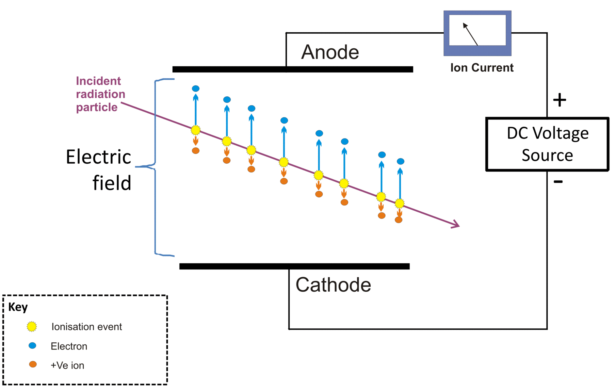
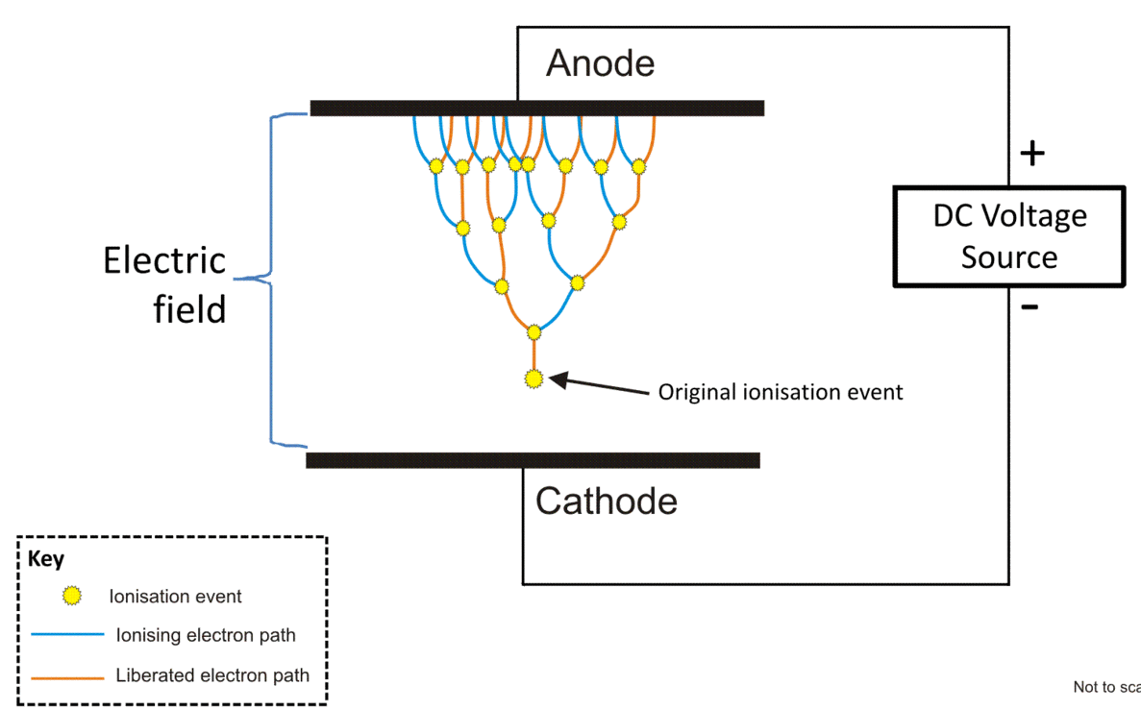
Ionization chambers
Primary ions/electrons start drifting under the effect of the applied electric field
Primary electrons
Primary ions
Gases for particle detectors
Secondary
electron
Primary
electron
Electrons can gain enough energy to produce secondary ionization and finally electron avalanche

Slide 5
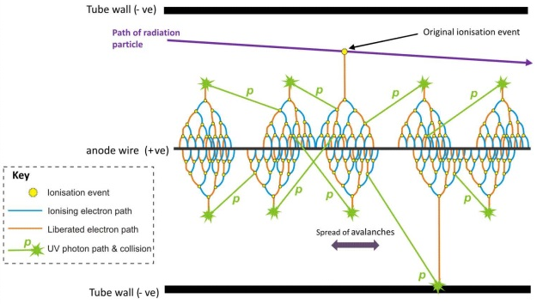
Ionization chambers
The ionization process depends strongly on the gas type
Air is not a good medium ☹
Right mixture can be quite complex and difficult to find
Typical gas mixture components:
Bulk gas: Argon – common, not toxic, …
quenching gas added for stability (photons absorption): CO₂, CH₄, iC₄H₁₀, …
Others: CF₄, SF₆, …
Process is affected even by presence of very low concentration of impurities
Gases for particle detectors

Slide 6
Ionization chambers
Several applications
Different geometries, gas mixtures, combination of effects, …
Gases for particle detectors

Slide 7
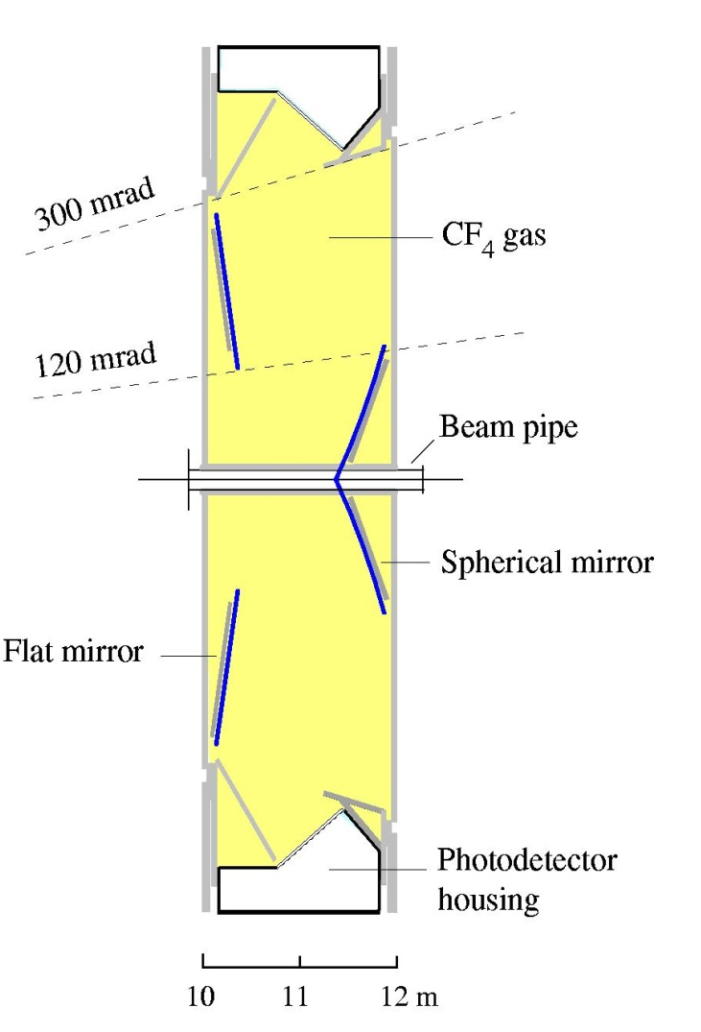
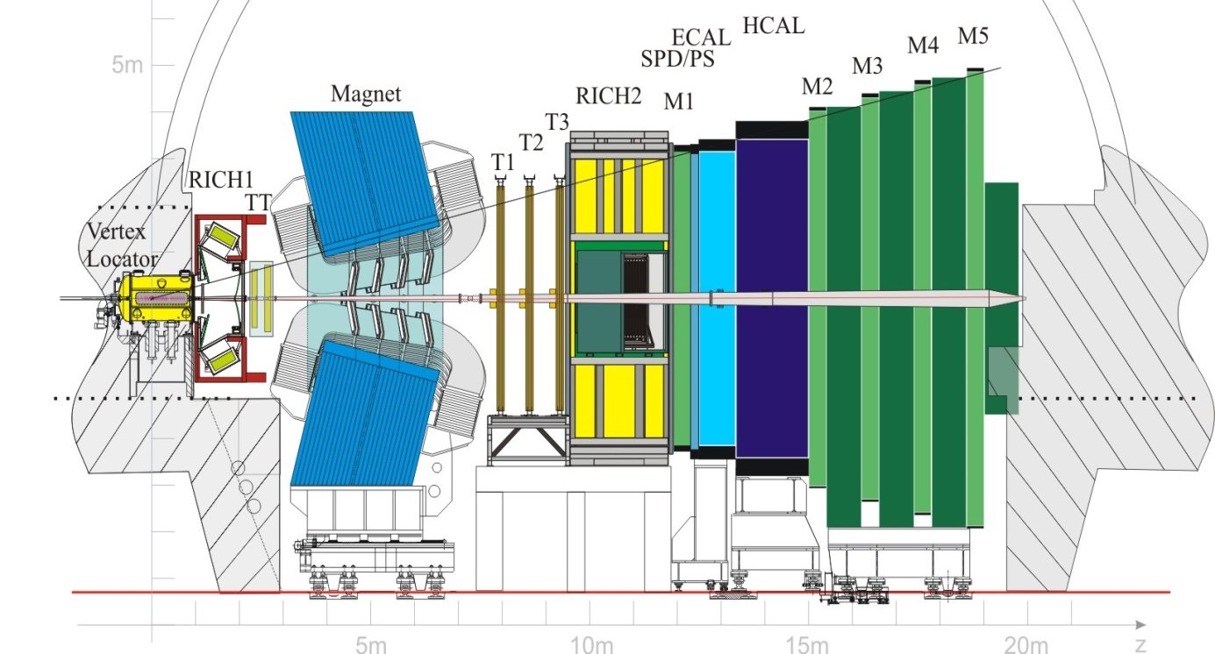
Cherenkov radiation
Not only gas for ionization chambers
→ also gas as radiator
RICH detector
LHCb: RICH2
Example: LHCb experiment:
Gases for particle detectors

Slide 8

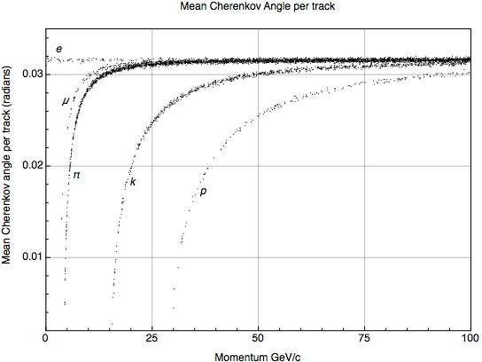
Cherenkov radiation
Cherenkov rings
θ_{C}
Charged particle
Radiator volume
Gases for particle detectors
Particle identification

Slide 9
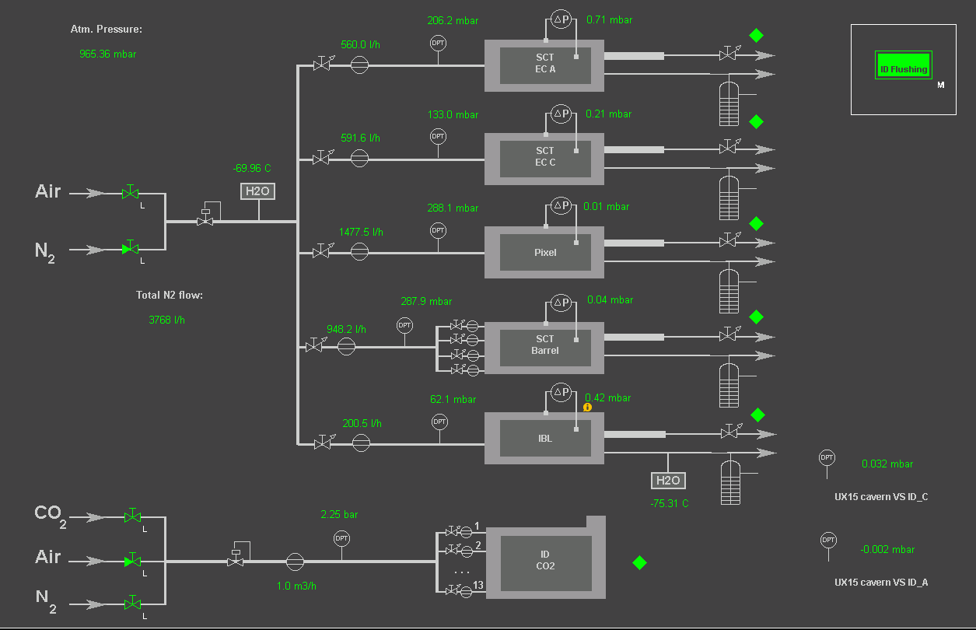
Inner detectors flushing
Right environmental conditioning:
Inert gas flushing system ensuring dry environment allowing operation of pixel detector at temperature as low as -40 °C
Gases for particle detectors

Slide 10
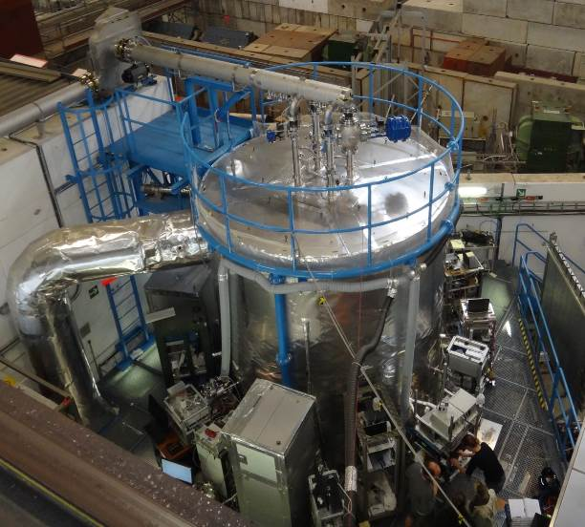
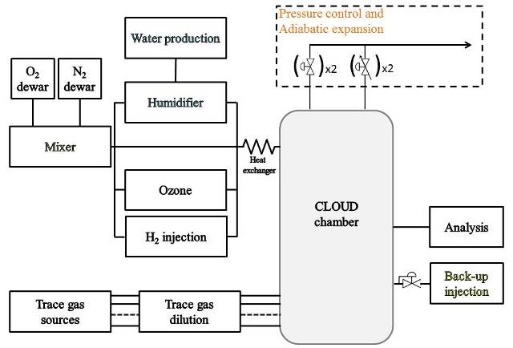
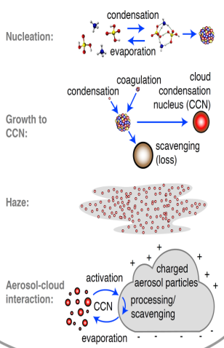
Beyond particle detection…
CLOUD experiment: tackling most challenging problems in atmospheric science
Gases for particle detectors

Slide 11
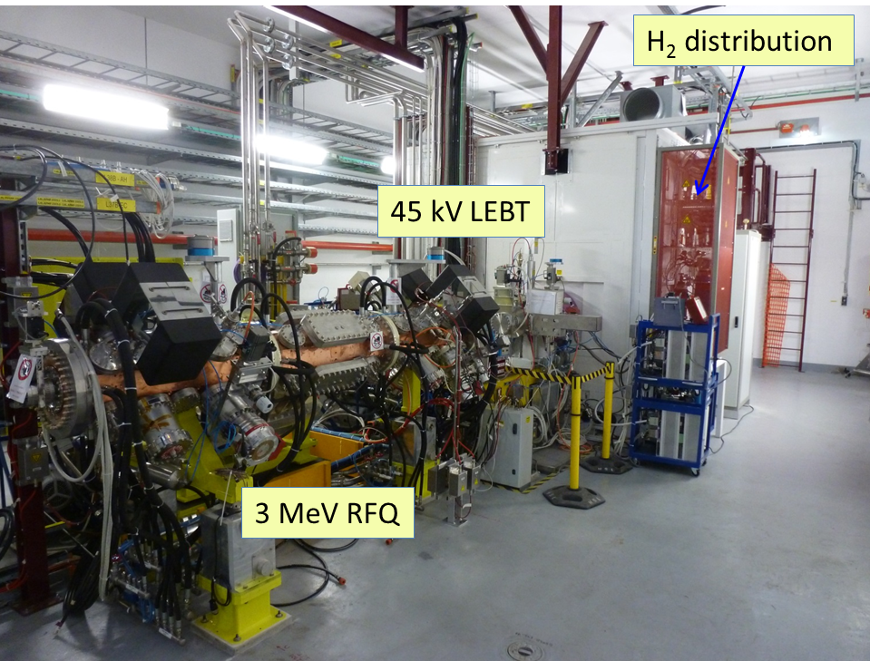
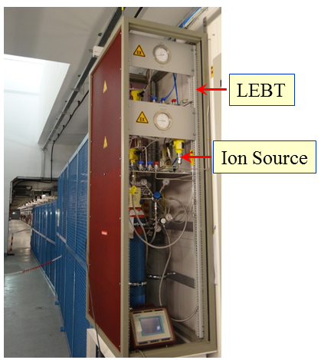
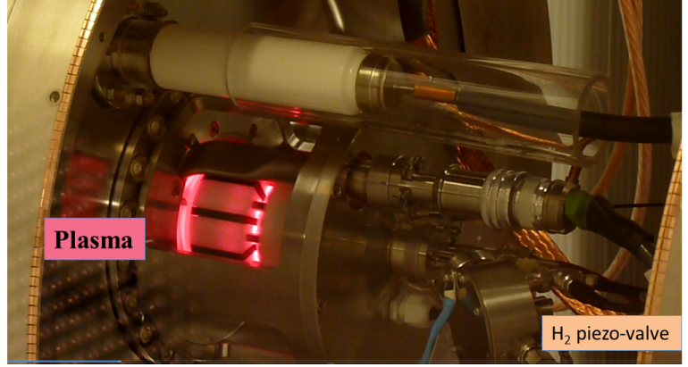
Beyond particle detection…
LINAC4: The new linear accelerator will be the first stage of LHC injector complex.
Gases for particle detectors
Pandora's box: the good side ☺

Slide 12
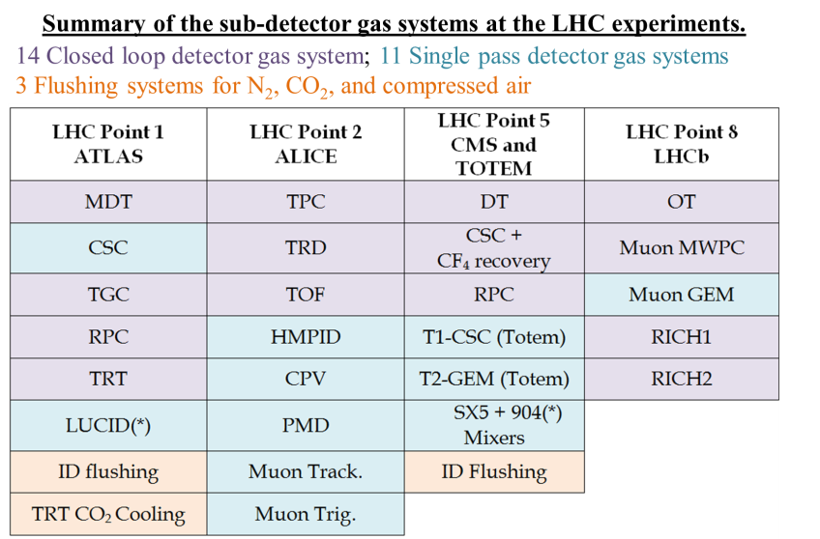
Gas systems for the LHC experiments
The basic function of the gas system is to mix the different gas components in the appropriate proportion and to distribute the mixture to the individual chambers.
30 gas systems (about 300 racks) delivering the required mixture to the particle detectors of all LHC experiments.
Gas mixture is the sensitive medium where the charge multiplication is producing the signal.
Correct and stable mixture composition are basic requirements for good and stable long term operation of all detectors.
Gas Systems

Slide 13
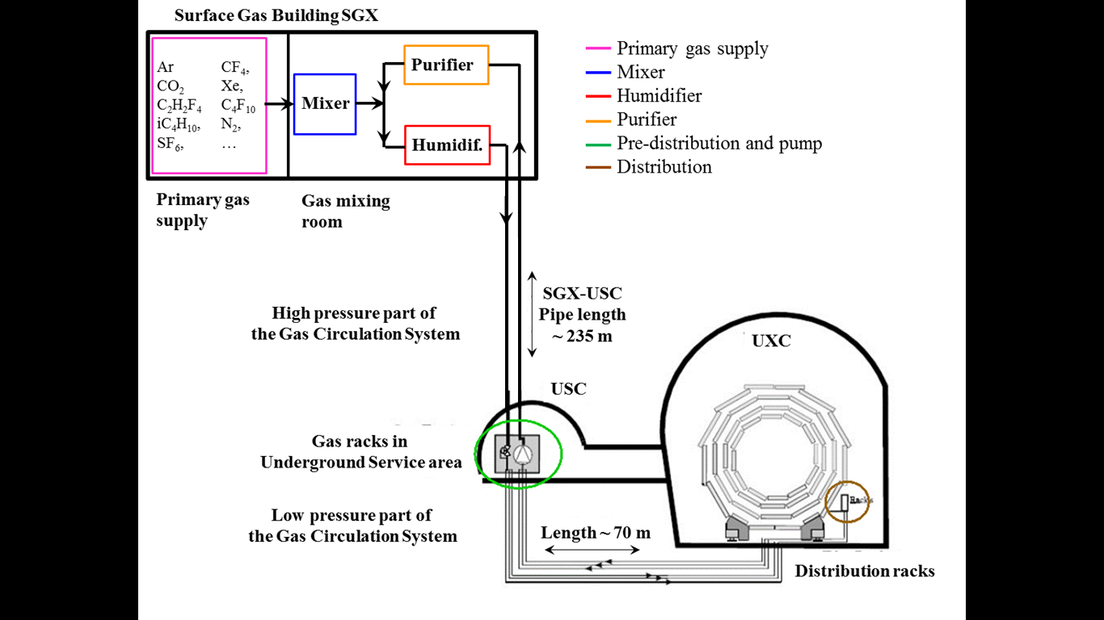
Gas systems for the LHC experiments
Gas systems extend from the surface building to the service balcony on the experiment following a route few hundred meters long.
Primary gas supply point is located in surface building
Gas system distributed in three levels:
  Surface (SG)
  Gas Service room (USC)
  experimental cavern (UXC)
Gas systems
Large detector volume
(from m³ to several 100 m³) and
use of expensive gas components:
→
The majority is operated in closed loop gas circulation with a recirculation fraction higher than 90-95 %.

Slide 14

The “CERN Gas Service Team”
The gas systems were built according to a common standard allowing minimization of manpower and costs for maintenance and operation.
  Construction started early 2000
  Operational since 2005-2006
The CERN gas service team (PH-DT-DI, EN-ICE, EN-MEF)
Patrick Carrie
Mar Capeans
Andrea D‘Auria
Louis-Philippe De Menezes
Roberto Guida
Ferdinand Hahn
Stefan Haider
Beatrice Mandelli
Frederic Merlet
Steven Pavis Ernesto Regano
Albin Wasem Several trainee, students
Gas systems construction
Jonathan Dumollard
Abdelmajid Laassiri
Benjamin Philippe Marichy
Herve Martinati
+ support from CERN users Andrei Kiver Ace Ordanov
Software controls developed
in collaboration with EN-ICE
Gas supply ensured by EN-MEF

Slide 15
Gas system: design
Gas systems (as detectors) are subject to severe requirements on material & gas for safe detector operation:
Mainly (if needed only) stainless steel pipe and components
Need to validate most of the gas system components
Documentation for QA and easy operation/maintenance follow up
Monitoring of gas system operation
Monitor of supply gases and mixture composition
Evaluation of operational cost
Flexible design to accommodate detector requirements/upgrades
Careful evaluation of
  resources for operation
  resources for maintenance activity
  Stability required
  Balance requirements vs safety (as much as possible)
Gas systems construction

Slide 16
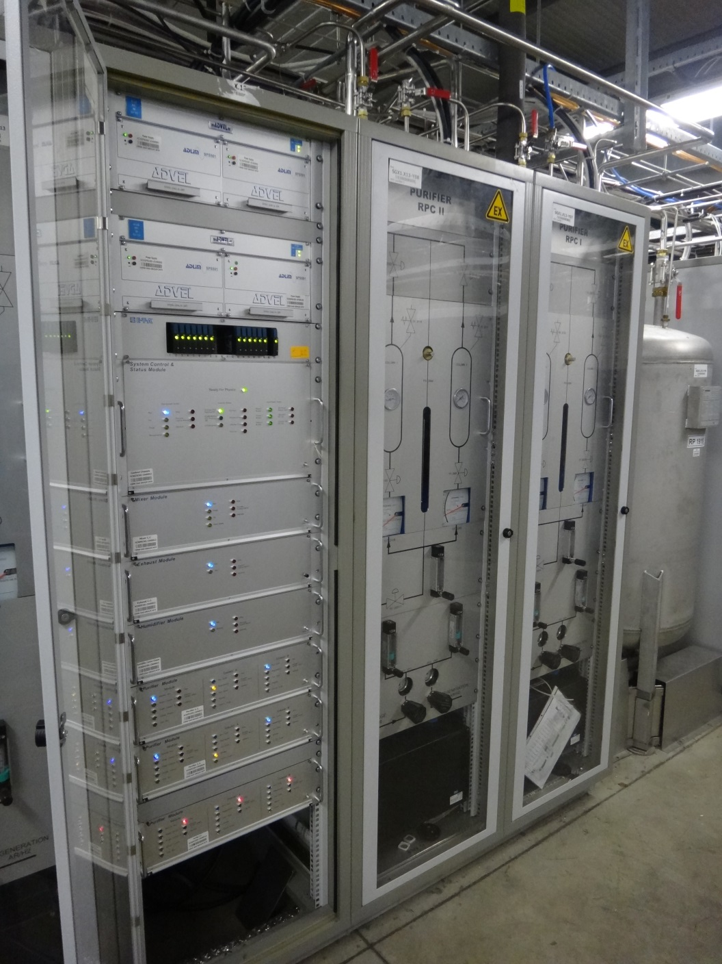
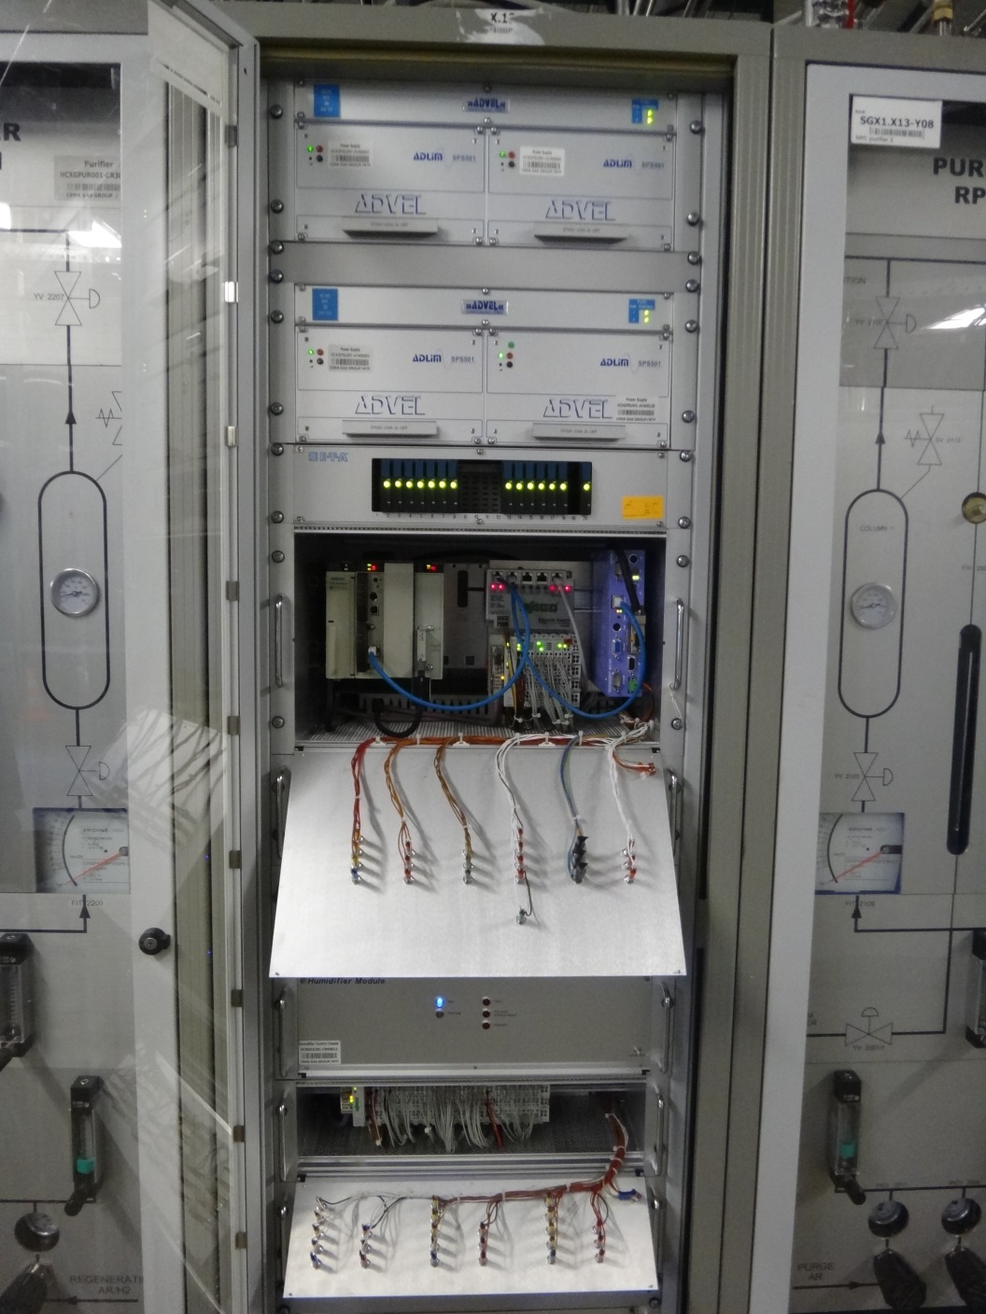
Gas system construction
Gas systems are made of several modules (building blocks): mixer, pre-distribution, distribution, circulation pump, purifier, humidifier, membrane, liquefier, gas analysis, etc.
Functional modules are equal between different gas systems, but they can be configured to satisfy the specific needs of all particle detector.
Implementation: control rack and crates (flexible during installation phase and max modularity for large systems)
Control rack
Control crate
(PLC)
Modules crates
Profibus connection to control crate
Gas systems construction

Slide 17
Example: Gas supply monitoring system
Where is it?
Gas systems building blocks

Slide 18
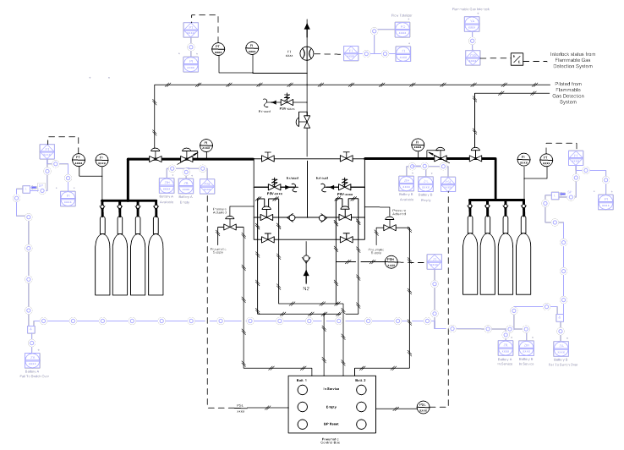
Gas supply monitoring system
Monitoring for :
  Gas quality (via analysis devices) before in service operation
  Replaced battery availability
  Gas flow for each gas supply
Operational Warnings and Alarms:
  Battery failed to change over
  Low pressure/weight in active supply
  High flow demand
  Flammable gas interlock active
  I/O faults
  H₂O levels in analysed gas too high
  O₂ levels in analysed gas too high
  Backup gas supply not enabled
  Dewar full but not in service
Implemented in collaboration with EN-MEF
Gas systems building blocks

Slide 19
Example: Mixer module
Where is it?
Gas systems building blocks

Slide 20
Mixer module
Standard Mixer module can have up to 4 input lines (gas and liquid).
Primary task: provide the sub-detector with a suitable gas mixture during run.
Different needs for filling or purging (i.e. high flow or different mixture)
Mixture injection regulated according to detector need:
  Correction for atmospheric pressure change (majority of detector are operated at constant relative pressure, i.e. the quantity of gas in the detector follow the atmospheric pressure changes → mixture need to be stored)
  Mixture replacement in the detector
  Recuperation efficiency or leak rate
Warning/Alarms available:
  Gas supply pressures
  Flow not stable/reliable
  Flow regulation (Mixing ratio)
Gas systems building blocks

Slide 21
Example: Gas analysis module
Where is it? Many connections in SGX, but also in US or UX…
basically everywhere
Gas systems building blocks

Slide 22
Gas analysis module
Used to analyze the gas mixture
Two types: gas source selected by means of standard valves or special n-way valves.
  Several sample chains may be organized in several physical location.
  Each sample chain completely independent
The module operated in automatic mode:
  sample the gas streams or the reference gases selected by experts.
  experts are able to trigger sampling of selected sources.
  length of the sampling lines taken in considerations to define flushing delays.
Alarm and data exchange with detector DCS
Used for safety (flammability level)
Gas chromatographs connected for more specific analysis
Gas systems building blocks

Slide 23
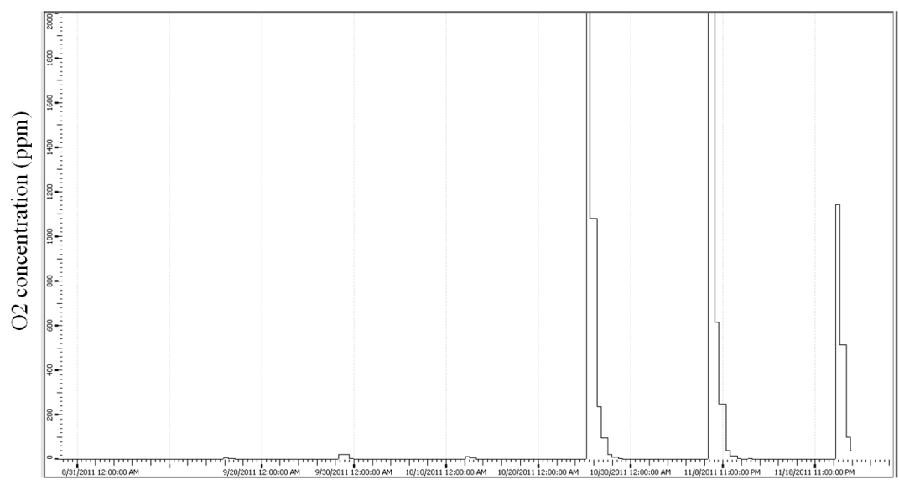
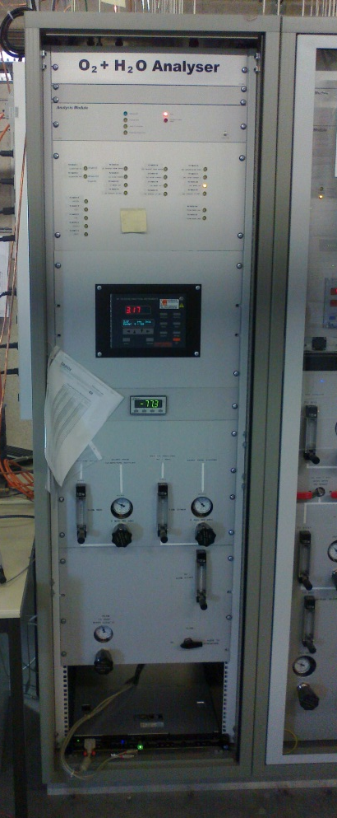
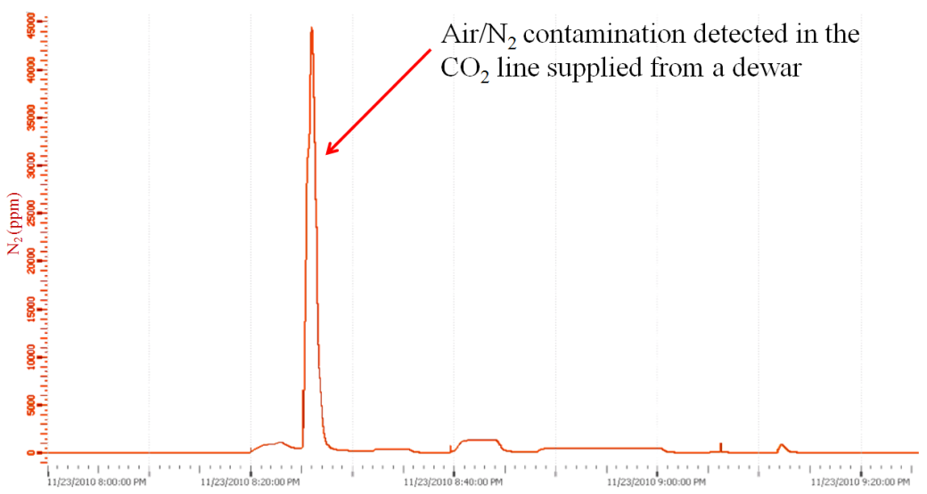
Gas analysis module
Fully automated O2 + H2O analysis module
O₂ in C₂H₂F₄ supply:
usually below 50 ppm
Sometime contamination up to thousand ppm.
Gas systems building blocks

Slide 24
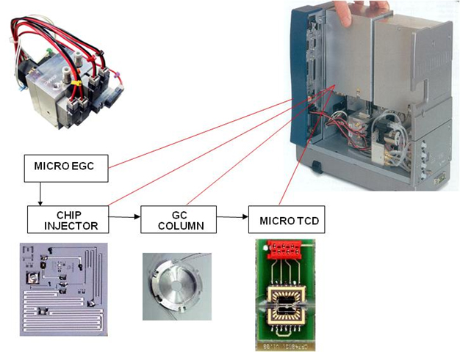
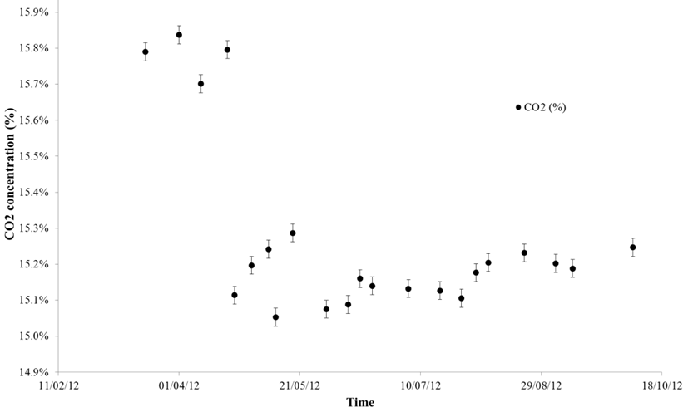
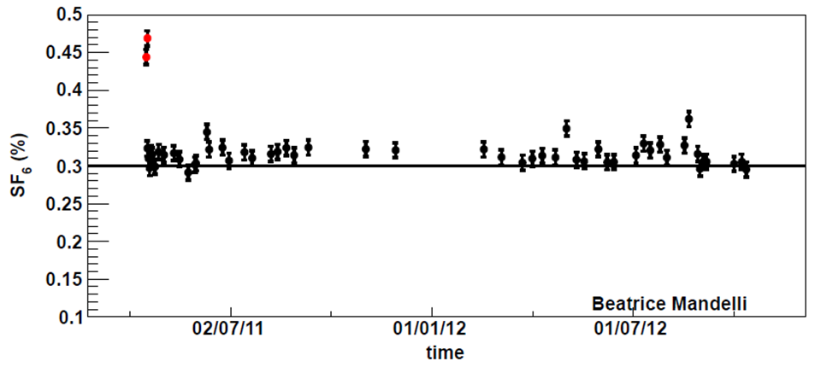
Gas analysis module
Gas chromatographs are used to monitor:
  Stability of mixture composition
  Presence of more complex impurities
CMS and LHCb equipped with GC connected to the selection manifold of the standard analysis rack.
Others GC are directly operated by users
Gas systems building blocks
SF6 in RPC system
CO2 in DT system
Other monitoring system based on detector are under development

Slide 25
Example: Purifier module
Where is it?
Gas systems building blocks

Slide 26
Purifier module
One of the most complex modules
Used to remove O₂, H₂O and more from mixture
Fully automated cycle
2 x 24 l columns filled
with suited absorber:
  Molecular sieves
  Metallic catalysts
  others
Gas systems building blocks

Slide 27
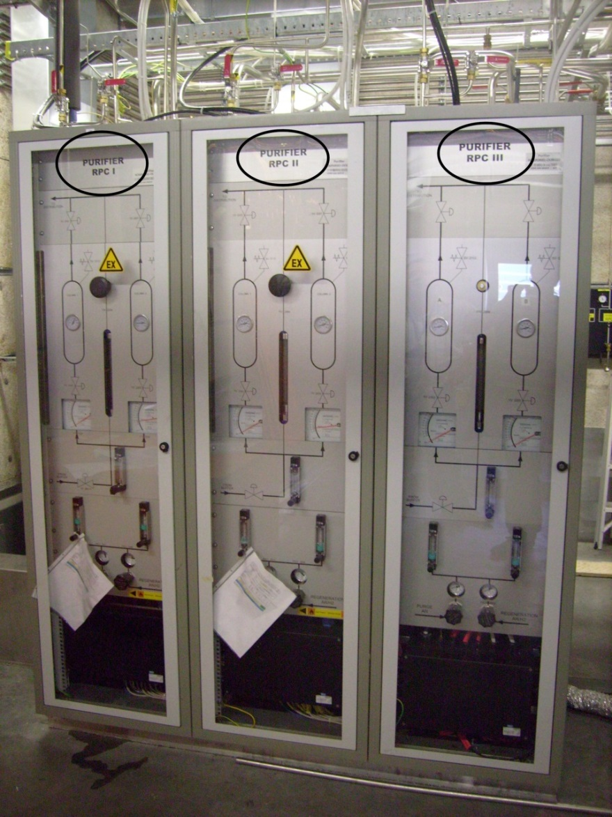
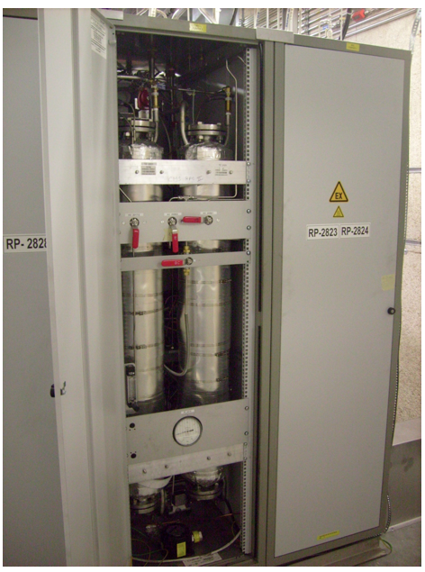
Purifier module
Many modules operational with many different gas mixtures and cleaning agents
Gas systems building blocks

Slide 28
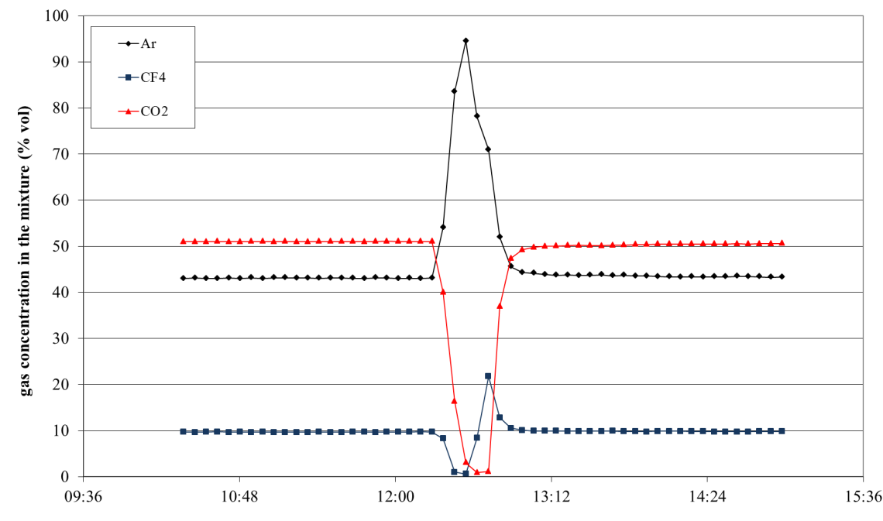
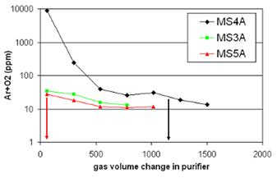
Purifier module
Many development tricks:
  Cleaning agents absorb not only impurities → mixture was destabilized at the beginning of each cycle
  Gas used during regeneration remains trapped in the cleaning agents
  Too much gas was absorbed right at the beginning of the cycle → pressure destabilized
CO₂ absorbed at the beginning of the cycle
Gas systems building blocks
Argon is released by molecular sieves:
Operation sequence was completely reviewed and still under discussion:
  Preparation for Run phases introduced
  Optimization of regeneration sequence

Slide 29
Example: Distribution module
Where is it?
Gas systems building blocks

Slide 30
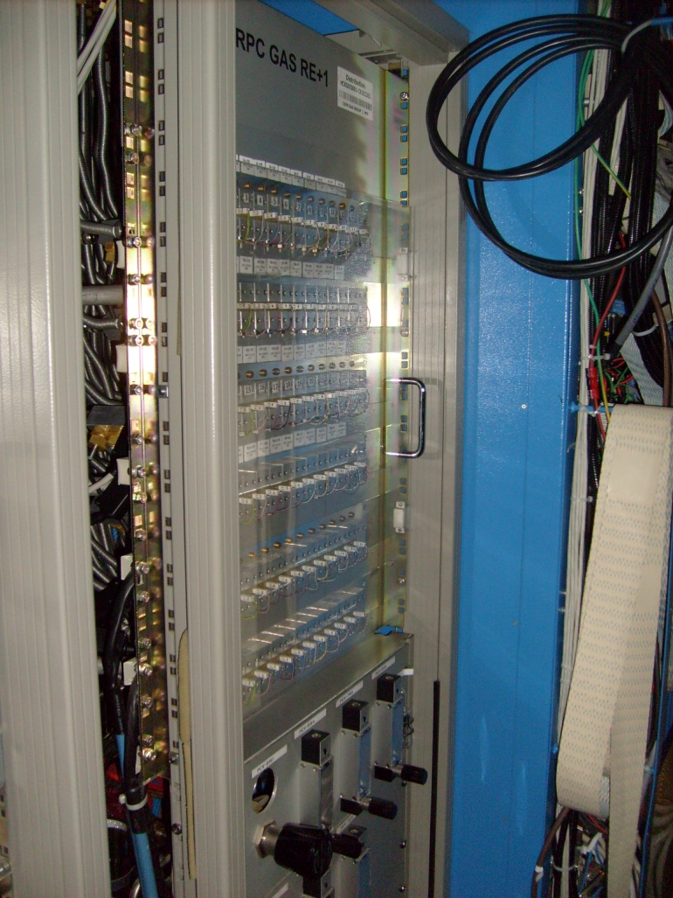
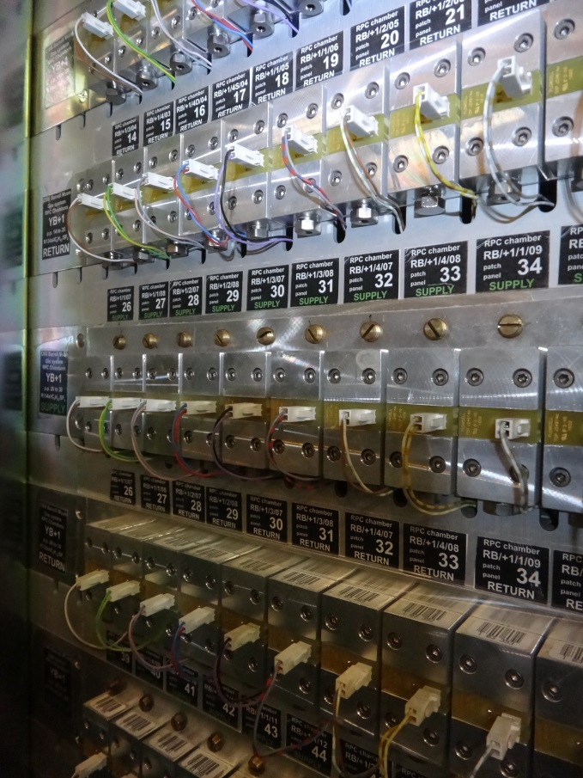
Example: distribution module
Mixture distribution modules equipped with:
Supply and return flow read-out system developed in the team
Flow regulation system
At channel/chamber level
Gas systems building blocks

Slide 31
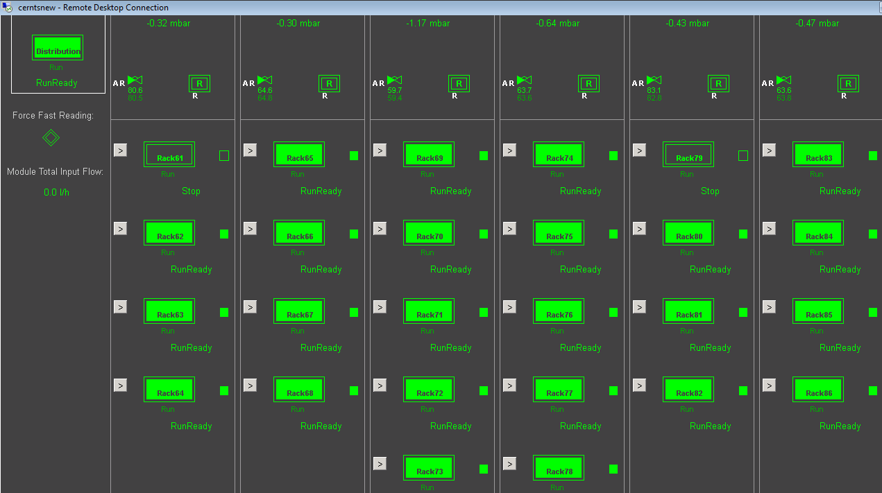
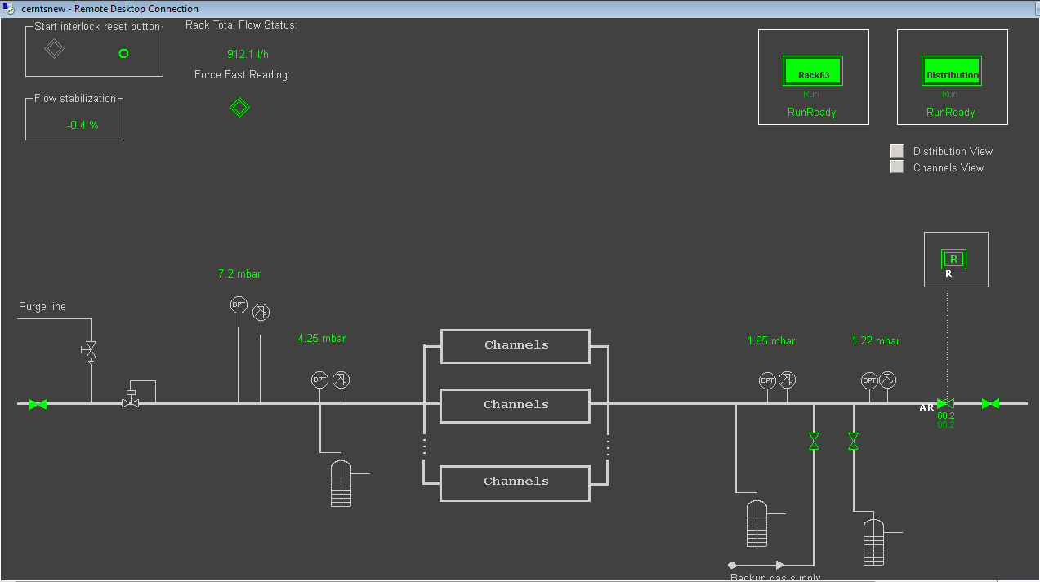
Example: distribution module
View of control system for mixture distribution of one gas system
Gas systems building blocks
Parameters monitored
for each unit

Slide 32
Example: Recuperation plants
Where is it?
Gas recuperation plant
Gas systems building blocks

Slide 33
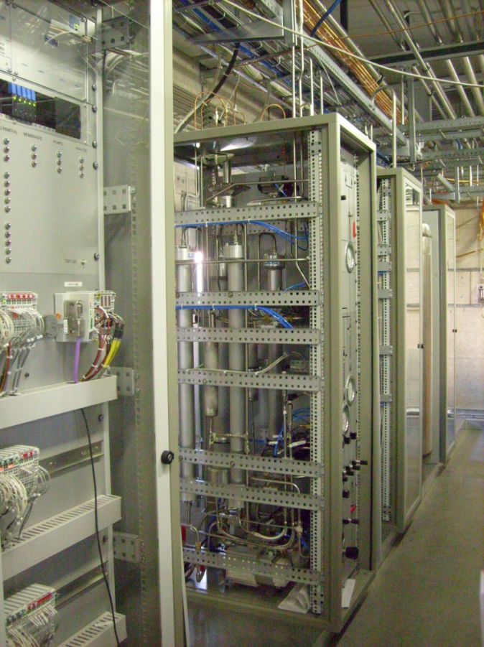
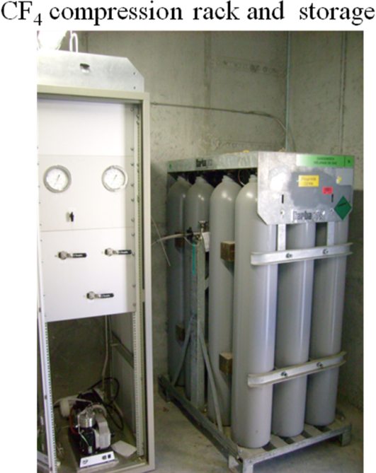
Recuperation systems: CF₄
Recuperation systems: needed for empting and regulating impurity levels reducing as much as possible gas consumption
Example:
CMS-CSC CF₄ warm adsorption:
built and fully commissioned during 2011-2012.
fully automated system running on a dedicated PLC. All the parameters can be monitored and controlled through a PVSS remotely accessible software interface.
the system consists of 5 physical racks
it was built following the standard used for the construction of the gas systems for the LHC experiments.
plant is paid back in about two years of operation.
operational since June 2011
Gas systems building blocks

Slide 34
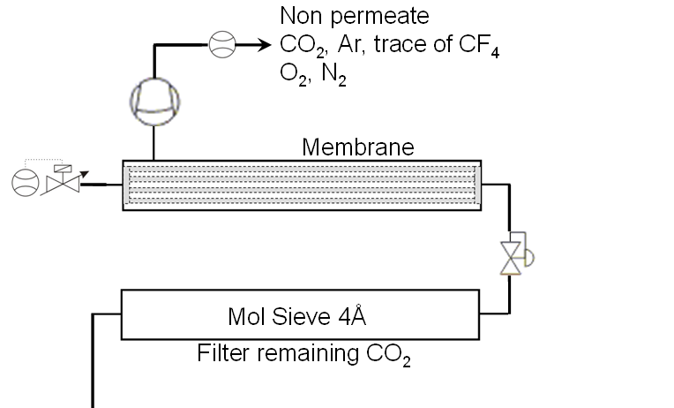

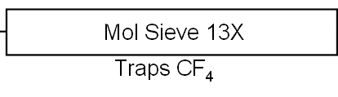
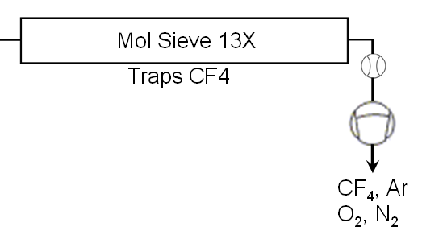
Recuperation systems: CF₄
Input to
the plant
Technical challenge:
first plant built for CF₄ warm adsorption
It is a completely non-standard system
Phase 1:
Bulk CF₄ separation from the mixture
→ membrane
Phase 2:
adsorption of remaining CO₂
→ Molecular Sieve 4Å
Phase 3a:
CF₄ adsorption
→ filling Mol. Sieve 13X from -1 to 0 bar
Phase 3b:
CF₄ recovery
→ extraction from Mol. Sieve 13X
(0 → -1 bar)
Gas systems building blocks
open
close
CF₄ adsorption and extraction

Slide 35
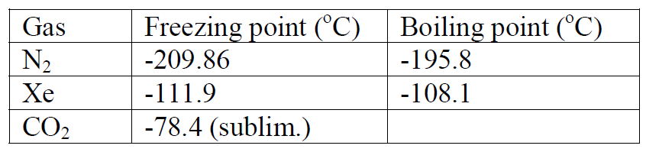
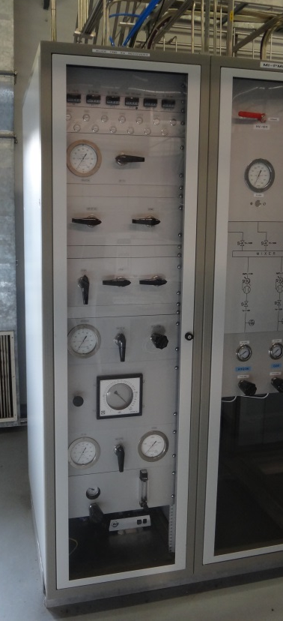
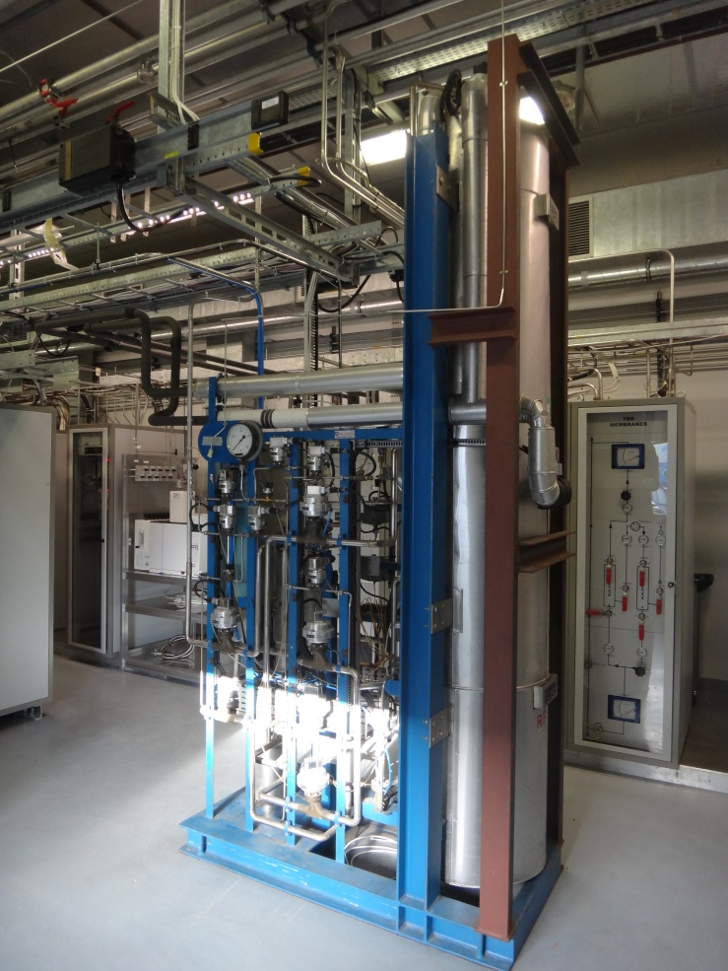
Recuperation systems: Xe
Xe cold trapping (ALICE-TRD, ATLAS-TRT)
New control rack and interface for automated operation
Old distillation column
Gas systems building blocks

Slide 36
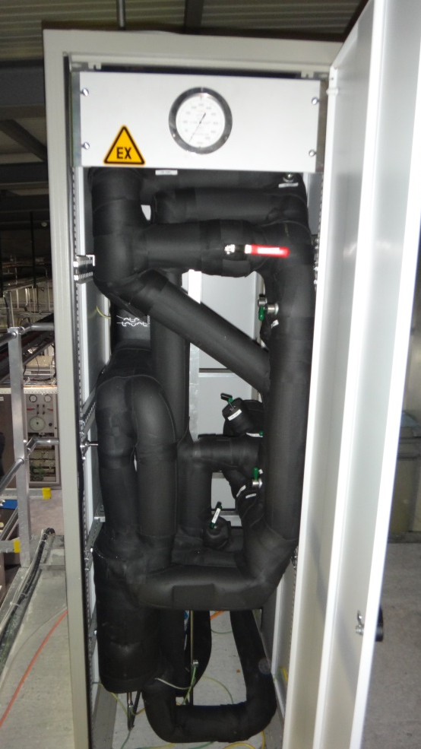
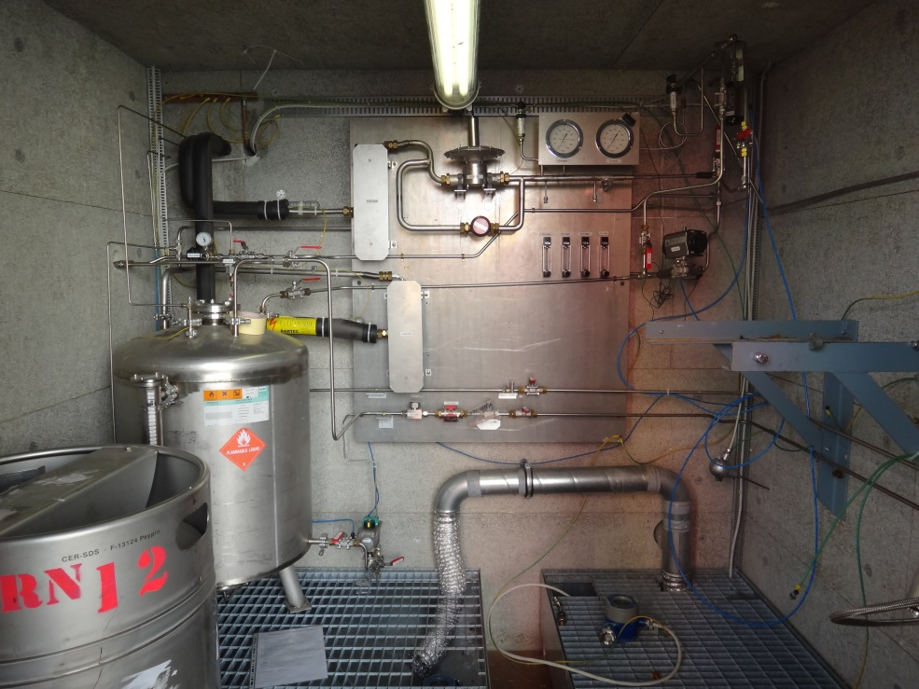
Recuperation systems: nC₅H₁₂
nC₅H₁₂ cold trapping (ATLAS-TGC)
Liquefier
Storage tank
Gas systems building blocks

Slide 37
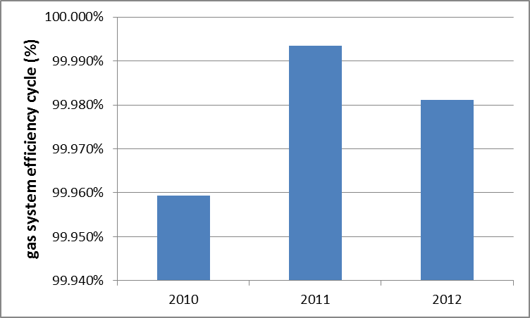
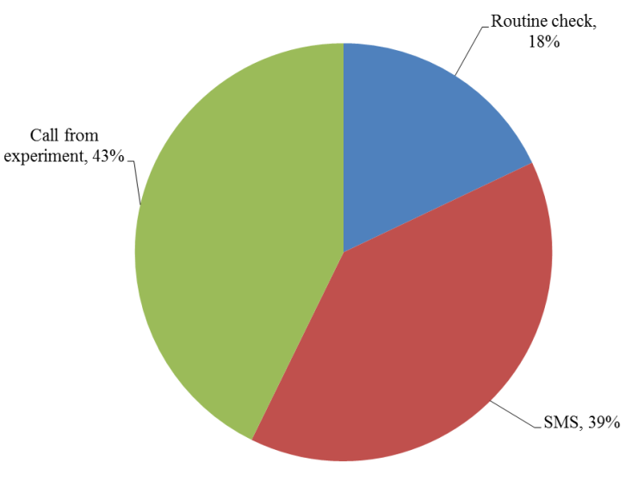
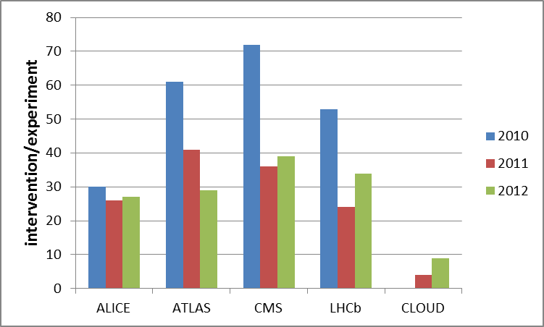
Reliability over the past years
Results from analysis of the interventions performed during 2010-2012
On average only 1.5 h/year/system of downtime
(power-cuts and outside events excluded)
24/24h on-call service provided
Intervention triggered by:
Gas systems performances
Intervention are
Equally distributed between experiments
Decreasing with time ☺

Slide 38
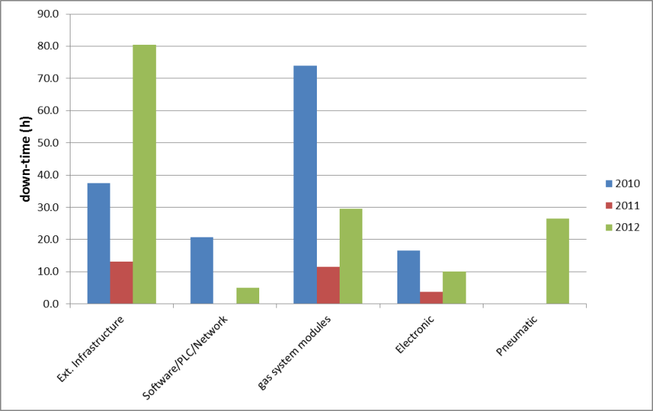
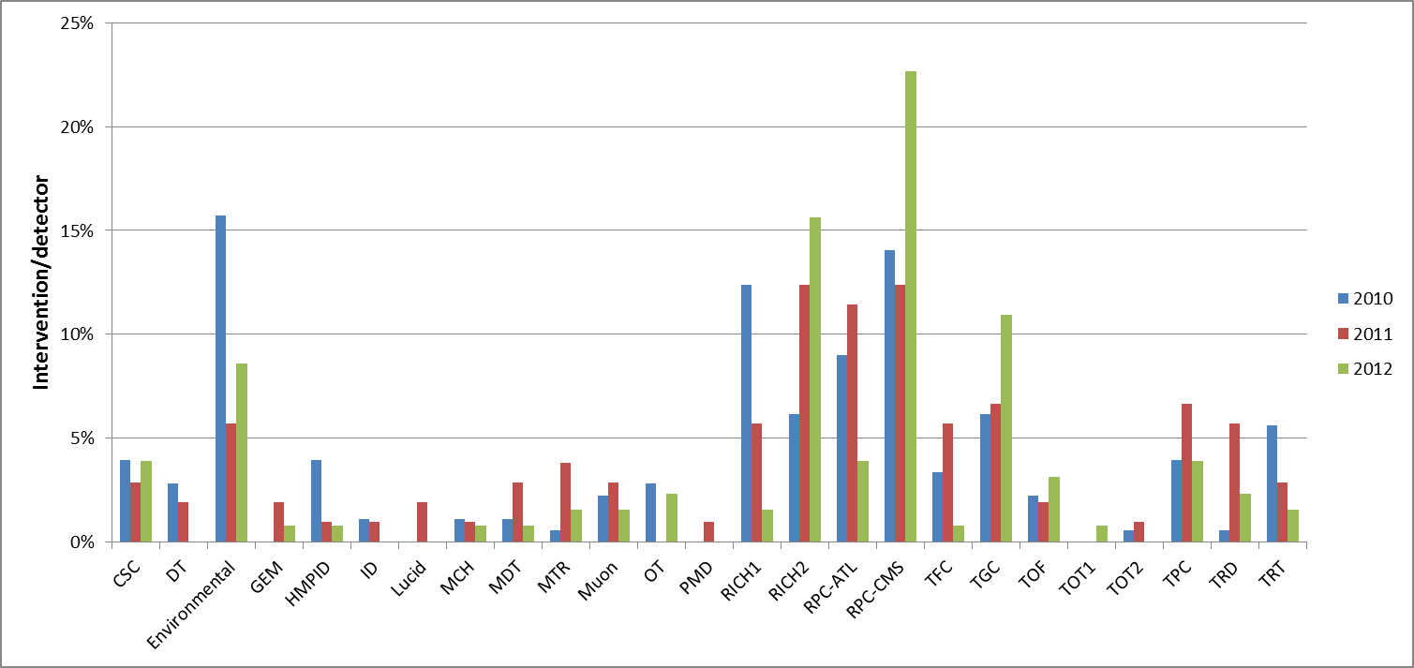
Reliability over the past years
Sources of down-time, analysis:
Issues with gas system modules account only for about 30 h / 150 h
Gas systems performances
Known issues (partially related to detector weaknesses)

Slide 39
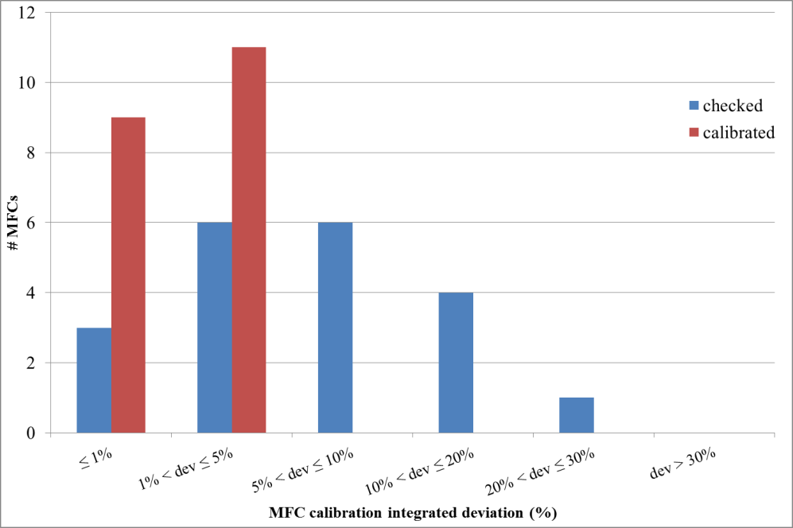
LS1 maintenance activities
Extensive maintenance program on going during LS1 including:
  Standard maintenance (yearly maintenance), i.e. circulation pumps, safety valves, power supply, …
  LS1 extraordinary maintenance, i.e. analysis devices, flow-cells calibration, MFCs calibration, …
Consolidation/upgrade program during LS1:
  upgrade circulation pump modules (one pump redundancy)
  Replace H₂O analysers
  Complete analysis modules for gas supply monitoring system
  Modify system from open mode to recirculation
Gas systems performances
Example:
About 150 MFCs need to be checked/calibrated
Maintenance started
Found important discrepancy especially in high flow MFCs (used during detector fill)

Slide 40
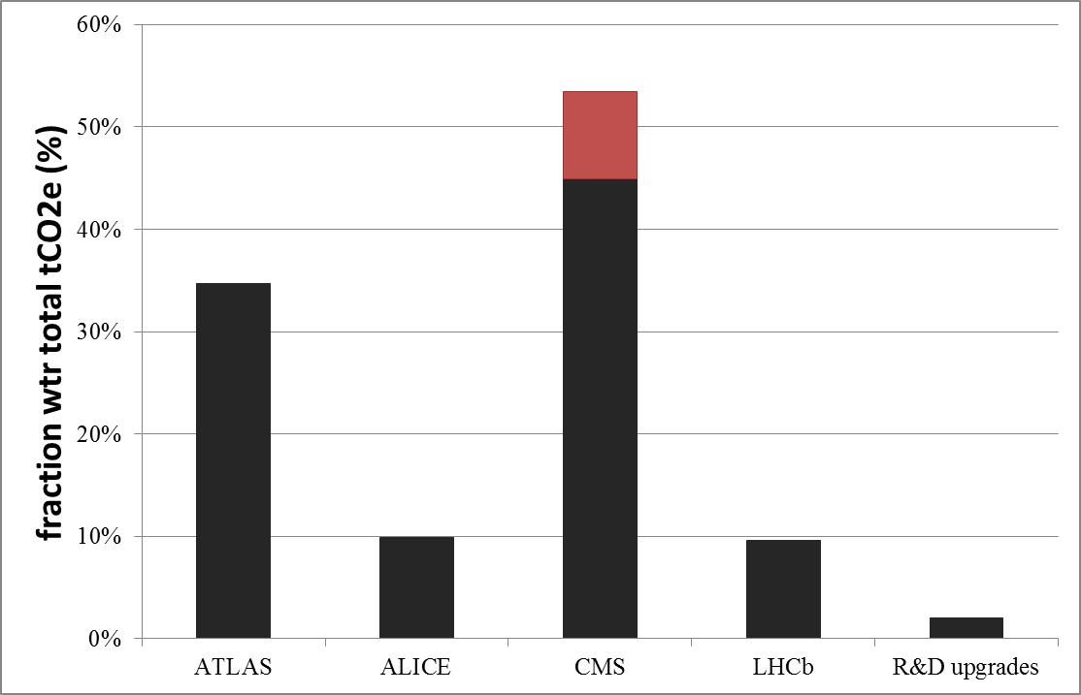
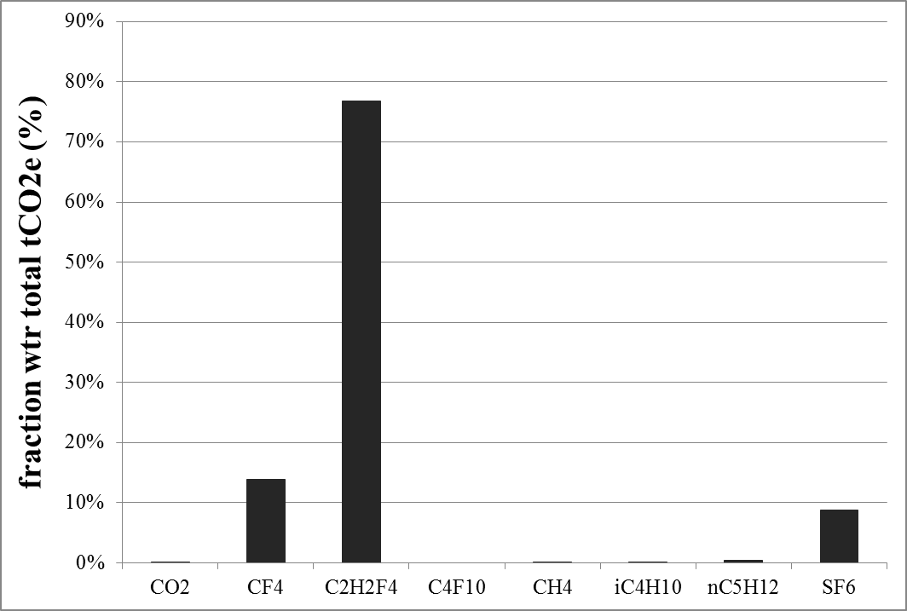
Gas emissions from particle detectors
Operational costs and Greenhouse Gas (GHG) emission
Total emission: ∼127100 tCO₂e
Main contribution C₂H₂F₄(R134a), CF₄, SF₆
Upgrade activities
ATLAS and CMS
RPC systems
Normal operation
Gas emissions from particle detectors

Slide 41


Gas consumption: cost and GHG emission
13 gas systems already equipped with gas recirculation:
nevertheless they represent 85% of total tCO₂e emission
but emissions already reduced by more than 90%.
  Remaining 10% due to:
    Leaks in detector: 74 % (mainly ATLAS and CMS RPC systems)
    Need of controlling N₂, H₂O, O₂ levels and purifiers: 11% (mainly CMS-CSC)
12 gas systems without gas recirculation
15% of total tCO₂e emission
some room for improvement (details in the following)
3 ID flushing systems
negligible contribution (< 1%)
Recirculation efficiency
tCO₂e wrt
recirculation efficiency
Gas emissions from particle detectors

Slide 42

Gas consumption: cost and GHG emission
GHG emission by detector: expectation after LS1
ATLAS
ALICE
CMS
LHCb
Very
Optimistic
(almost achieved)
Very
optimistic
CF₄ recuperation
Plant operational
☺
Easily achievable:
on-going upgrade
☺
Not clear plan for future
Gas emissions from particle detectors
Short term activity
High [SF₆]
Possible overall reduction by 40%... However, strongly dependent on results from leak search campaign on RPC systems

Slide 43


Small recirculation system for R&D
Two small systems developed:
Prototype used at GIF (2003)
New simplified version for lab R&D (2012-2014)
Conclusions

Slide 44
Conclusions
30 gas systems (about 300 racks) delivering the required mixture to the particle detectors of all LHC experiments.
Designed and built according to functional modules:
  Simplified maintenance and operation activities for the team
  Fully automated systems with remote control/monitoring
  few examples (mixer, purifier, analysis, recuperation, …) were briefly discussed
Gas systems have demonstrated an impressive availability level:
  On average 1.5 h downtime/year (excluded external causes, i.e. power-cuts, …)
LS1 maintenance and consolidation plan (trying to improve, prepare for new detector requirements, anticipate ageing of components)
Strategy for reducing gas emissions due to particle physics activities at CERN (reduce operational costs and greenhouse gases)
Small prototype systems developed for R&D applications in any lab
Thanks for your attention
Conclusions

