Slide 1
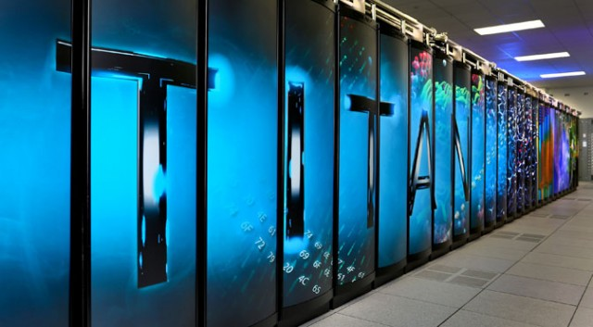
Big PanDA on HPC/LCF Update
Sergey Panitkin, Danila Oleynik
BigPanDA F2F Meeting. March 2014

Slide 2
Outline
Introduction
BigPanDA architecture for Titan
Pilot
  PanDA Pilot initial changes
  New features
  Next steps
Workloads
  Current
  MPI based
Summary

Slide 3
Current HPC resources for Big PanDA
Currently we have accounts at:
  Oak Ridge Leadership Class Facility (OLCF)
    Titan (our own Big PanDA project (CSC108) allocation – 0.5M hours)
    Kraken (part of NSF XSEDE infrastructure, through UTK allocation)
  National Energy Research Scientific Computing Center (NERSC@LBNL)
    Hopper, Carver, Edison (through OSG allocation – 1.1M hours)
We concentrate on ORNL development right now.
  Great support and interest from OLCF management in Big PanDA
  Significant CPU time allocation
Parallel ports to NERSC machines
  Similar platforms to ORNL - Cray

Slide 4
Titan at ORNL features
Titan Cray XK7 (#2 in Top 500)
  18,688 nodes with GPUs
  node: 16 core, 32 + 6 GB RAM (2GB per core)
  27 PetaFLOPs theoretical
Parallel file system shared between nodes, recently upgraded: project workspace 100TB quota (30 PB total capacity)
3 types of nodes:
  Interactive nodes: user interactive login
  Service nodes: job setup operations, managed through PBS/Torque directives
  Worker nodes: job executions, managed through ALPS (Application Level Placement Scheduler)
Special data transfer nodes (high speed stage in/out)
Highly restricted access:
  One-Time Password Authentication
  No network connection with worker nodes
Limitation of number of jobs in scheduler for one user

Slide 5
PanDA set up on HPC platforms
Main idea - try to reuse existing PanDA components and workflow logic as much as possible
PanDA connection layer runs on front end nodes, in user space
All connections to PanDA server at CERN are initiated from the front end nodes
“Pull” architecture over HTTPS connections to predefined ports on PanDA server
For local HPC batch interface use SAGA (Simple API for Grid Applications) framework
  http://saga-project.github.io/saga-python/
  http://www.ogf.org/documents/GFD.90.pdf

Slide 6
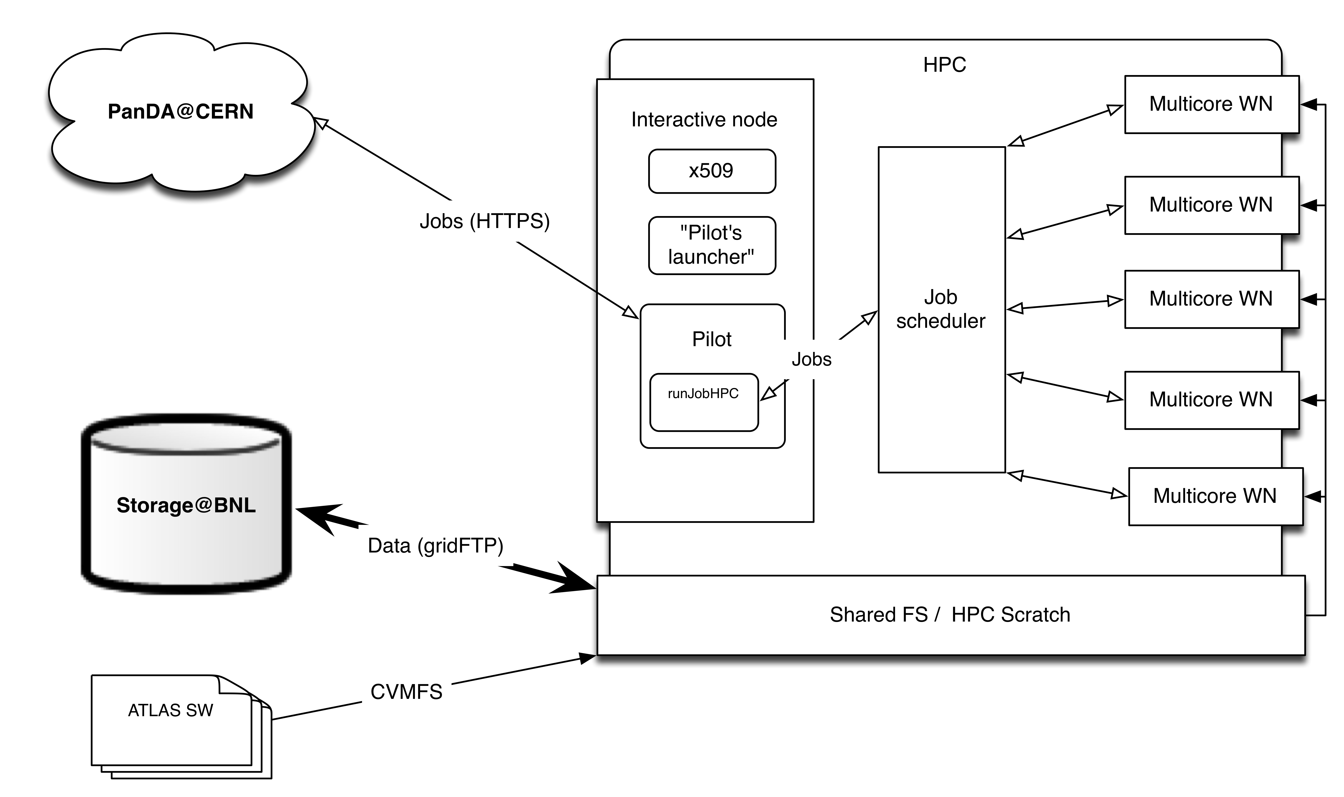
BigPanDA architecture for Titan
Pilot(s) executes on HPC interactive node
Pilot interacts with local job scheduler (PBS) to manage job
Output transferred to a designated Grid site

Slide 7
PanDA Pilot initial changes
Native PanDA pilot was ported to Titan interactive nodes.
  Correct definition of PanDA queue was needed.
Main modification was performed for payload execution part: runJobTitan.py module was developed based on runJob.py module.
  Method, which call payload execution was changed for run and collect results of job execution through PBS;
  Interface with PBS job manager was implemented by using SAGA API
Some minor modifications of cleanup procedures was done (subdirectories cleanup).

Slide 8
New features in Pilot
Proper setup and execution of MPI jobs through ALPS.
Function for collecting information about available resources for backfill was implemented
Simple service for Pilots management on Titan was developed.
  Full PanDA job submission chain on Titan was tested.

Slide 9
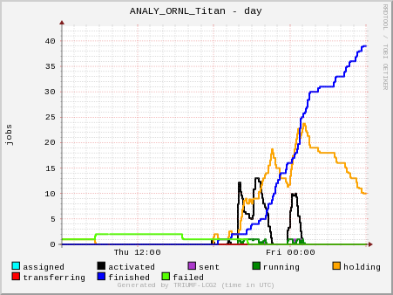
PanDA jobs on Titan

Slide 10
Dealing with Transformations
On a Grid worker node pilot starts a transformation to pull in and set up user payload
From pilot’s point of view transform is a part of payload.
  When you submit a job using prun it “wraps/adds” runGen.py transformation script that pilot uses.
  runGen.py is ~1000 lines of Python code
  runGen.py needs internet connection (~5 wget), to DDM, to PanDA,,etc
Problem for HPC application
  We removed Pilot from worker node space to a place with internet connection
  Transform still needs to be executed on worker node.
Can’t use standard grid transforms. Need a substitute of some kind.

Slide 11
New transforms for HPC
Substitute ATLAS transform with our custom transform script specific to Titan.
  Sets up Titan specific environment – like appropriate modules, etc
  Sets up workload specific environment
  Executes workload
Right now every workload has it’s own local transform script
Workloads are precompiled and installed on Titan
Transforms are installed on Titan
  Simple python scripts, potentially just shell scripts

Slide 12
Workloads
Several workloads were ported to Titan
Root,etc
  Root based ATLAS analysis
  Limits setting code (aTGC)
Event generators
  SHERPA (v. 2.0.b2 and v. 1.4.3) was ported to Titan and Hopper
  MadGraph 5 (v. 1.5.12) was ported to Titan and Hopper
  ALPGEN v 1.4 ported to Titan
  Simple examples and tutorials for EvGens run
  Started ATLAS specific ALPGEN test runs on Titan

Slide 13
Limits on aTGC Calculations
Request from Brian Lindquist (USB) came through ADC to help with his project.
Limits setting for anomalous triple gauge coupling calculations.
  CPU intensive
  Single threaded job takes ~50 hours to calculate one point.
  Typically 1000 points are needed for one set of parameters.
  Several sets of parameters are needed for analysis.
  C++ code
  Code uses RooFit extension of Root.
  Can be ran in multi-threaded mode .
Difficult to run on the Grid. Ideal workload for HPC.
Converted code to use MPI libraries
Ran for 50k core-hours run on Carver@NERSC

Slide 14
Need for MPI
To run effectively on HPC MPI aware workloads are needed
Use of MPI will allow us to run multiple independent serial jobs as an ensemble, with just one submission at time.
  Every job knows it’s place in a group and size of the group
Good for backfill job submission
  MPI allows to adjust the size of submitted jobs in a natural way.
  The size of the available "backfillable" gap becomes MPI rank.
MPI allows to avoid, or at least mitigate, batch queues limits on number of simultaneously submitted tasks
As a separate note: GPU aware workloads are prime targets for HPC these days.
  More efficient use of allocated time. Accounting system counts whole node as a node with GPU.
  It would be great to have such codes in ATLAS.

Slide 15
MPI Workloads
Workloads with Native MPI support (SherpaMPI, etc)
Customized ATLAS codes (f.e. like aTGC code or Alpgen@ANL)
MPI transforms
  We tested a transform to run a set of ALPGEN jobs as MPI collection
  In principle this type of transforms can be used for other non MPI jobs
  Working on running ATLAS Z-tautau-jets Alpgen production on Titan
    Problem with Alpgen input file definition extracted from ATLAS job definition
    Very long Alpgen “warm-up” phase (>>24hours) prevents from running this on Titan directly
    Discussing this with ANL group. Hopefully resolved soon.
    Issue with random number generation for very large number of events. Limited generator period.
    Working on more general Alpgen transform for Titan based on ATLAS AlpGenUtil.py

Slide 16
Opportunistic backfill on Titan
More details in Danila’s slides
As a first step a simple algorithm was implemented:
  Pilot queries MOAB scheduler about unused transient resources
  Information about available resources returns in a format that includes a number of currently unscheduled nodes and period of their availability
  Pilot chooses the largest available block of free nodes and generates appropriate job submission parameters, taking into account Titan’s scheduling policy limitations
  Pilot uses MPI based transform

Slide 17
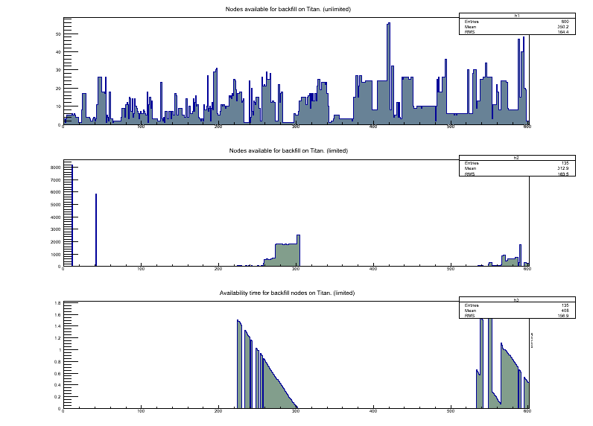
Titan Backfill 1
Indefinitely available
nodes
Nodes available
for a limited time
Availability time
estimate
Availability query index

Slide 18
Initial backfill tests on Titan
Submitted | Account | Nodes | Cores | Wait | Walltime limit | Runtime | State | Completed
Mar, 04 16:26 | CSC108 | 6 | 96 | 0.00 | 1:59:00 | 0,01 | Completed | Mar, 04 16:27
Mar, 04 16:52 | CSC108 | 185 | 2960 | 0.07 | 5:59:00 | 0,02 | Completed | Mar, 04 16:58
Mar, 04 17:32 | CSC108 | 608 | 9728 | 0.01 | 11:59:00 | 0,02 | Completed | Mar, 04 17:34
Mar, 04 17:45 | CSC108 | 578 | 9248 | 0.01 | 11:59:00 | 0,03 | Completed | Mar, 04 17:47
Mar, 04 17:51 | CSC108 | 1,649 | 26,384 | 0.00 | 11:59:00 | 0,03 | Completed | Mar, 04 17:53
Mar, 04 18:03 | CSC108 | 636 | 10176 | 0.01 | 11:59:00 | 0,02 | Completed | Mar, 04 18:05
Mar, 04 18:09 | CSC108 | 740 | 11840 | 0.13 | 11:59:00 | 0,02 | Completed | Mar, 04 18:18
Mar, 04 18:21 | CSC108 | 577 | 9232 | 0.00 | 11:59:00 | 0,03 | Completed | Mar, 04 18:22
Mar, 04 18:25 | CSC108 | 596 | 9536 | 0.04 | 11:59:00 | 0,02 | Completed | Mar, 04 18:28
Jobs submitted through PanDA to Titan
“Backfill capture” is almost instantaneous!
No competition for the resource?
More studies of backfill properties are planned

Slide 19
Next steps
Additional redesign of Pilots components still needed for:
  parallel execution of pilots on same worker node
  Changing of data format for parameters which describe setup and execution of payload (partly done for current PanDA – Titan execution, quite difficult for debug due to dependencies from experiment specifics and different types of jobs
  Multi HPC site demonstrator in PanDA (Titan, Kraken, NERSC, EOS,…)
  New Cray XC30 installation became available at ORNL – called EOS
    744 nodes, Xeon E5-2670, no GPUs
    Better scheduling policy limits
  Need a meeting with Titan folks to discuss backfill status and possibilities
  Discuss with ALICE (Ken Read) possible workloads to run on Titan as multi-VO demonstrators
  Take another look at ATLAS software on Titan (cvmfs)

Slide 20
Summary
Work on integration of OLCF, NERSC machines and PanDA is in progress
Successful “backfill through PanDA” demonstrator on Titan
Workloads ports are in progress
  HEP event generators ported (ALPGEN, Sherpa, Madgraph)
Conversion of ATLAS code to MPI
  aTGC limits calculations performed. Direct code conversion to MPI. 50k core hours delivered @NERSC
  MPI transform for ALPGEN tested
MPI and GPU aware codes are needed
Discussion about SUSY parameter scan has started

