Slide 1
Fundamental Limits of Timing Resolution for Scintillation Detectors
W. W. Moses, W. S. Choong, & S. E. Derenzo
Lawrence Berkeley National Laboratory
March 13, 2013
Outline:
  Basic Theory
  Real World Effects
  Optical Photon Propagation
This work was supported in part by the U.S. DOE (contract No. DE-AC02-05CH11231) and in part by the NIH (NIBIB grant No. R01-EB006085).
1

Slide 2
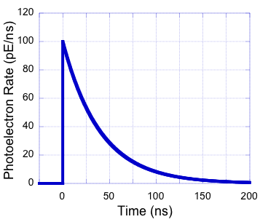
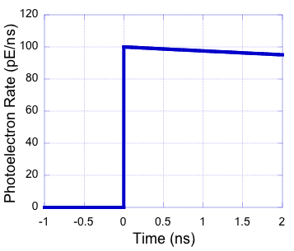
The Fundamentals…
Zoom In…
I(t) = I₀ exp(-t/τ)
Light Output = I₀ τ
Timing Determined by I₀ (Initial PE Rate)
I₀ = E_{ϒ} (Light Output / τ) Collect_Eff Quantum_Eff
Look at Arrivial Times of Individual Photoelectrons
2

Slide 3
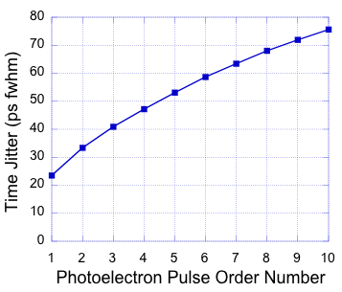
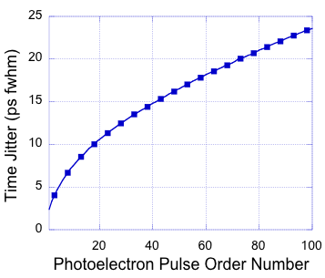
Time Jitter of n^{th} Photoelectron
PE Rate = 100 PE/ns
PE Rate = 1000 PE/ns
“Poor” TOFPET
“Good” TOFPET
LSO (40ns, 30k ph/MeV)
PMT (25% QE), 50% CE
50 PE/ns
LaBr₃ (15ns, 72k ph/MeV)
UBA PMT (50% QE), 75% CE
900 PE/ns
Jitter (fwhm) = 2.35 sqrt(n) / I₀
First Photoelectron has Least Jitter
3

Slide 4
Timing Pickoff
Trig. Level
Trig. Level
Leading Edge Discriminator Often Used
If the trigger level is at n photoelectrons,
timing resolution ≈ jitter of n^{th} photoelectron
Valid if PD_Rise ≪ PE Jitter ≪ PPD_Fall
(individual photoelectrons resolved)
First PE Traditionally Favored
Described by Post & Schiff in 1960
4

Slide 5
Problem: Predicts Incredible Timing
“Poor” TOFPET
LSO (40ns, 30k ph/MeV)
Standard PMT (25% QE)
50% CE
50 PE/ns
“Good” TOFPET
LaBr₃ (15ns, 72k ph/MeV)
UBA PMT (50% QE)
75% CE
900 PE/ns
⇒ 66 ps fwhm PET Timing
⇒ 3.7 ps fwhm PET Timing
5

Slide 6
Why? Real World Effects
Overlap of photoelectron pulses
Photodetector transit time jitter
(Gaussian)
Photodetector rise & fall time
(Bi-Exponential)
Intrinsic scintillator rise time
(Exponential)
Optical transport in scintillator
(Exponential)
Our Contribution
Estimated Through Monte Carlo Simulation
Described by Hyman in 1964 & 1965
6

Slide 7
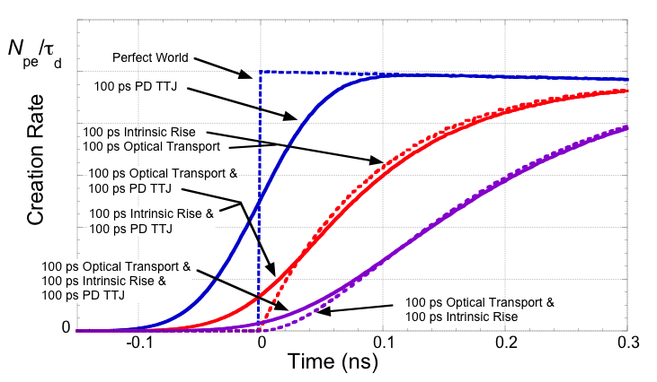
“Real World” Probability Density Function
“Abrupt” Rising Edge Disappears…
7

Slide 8
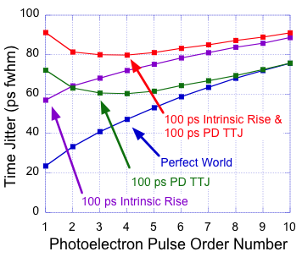
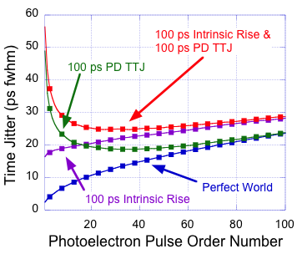
“Real World” Jitter of n^{th} Photoelectron
PE Rate = 100 PE/ns
PE Rate = 1000 PE/ns
First PE No Longer Has Lowest Jitter
Broad Minimum – Many PEs Have Similar Jitter
8

Slide 9
Run Lots of Monte Carlo
820 Combinations
Initial Photoelectron Rate I₀: 10 – 10,000 PE/ns
Intrinsic Scintillator Rise Time: 0 – 1 ns (exponential)
Photodetector Transit Time Jitter: 0 – 0.5 ns fwhm (Gauss)
Optical Photon Propagation Time: 0 – 0.2 ns (exponential)
Convolve w/ Photodetector Response to Simulate Analog Out
(results insensitive to PD response, including rise time)
Simulate Leading Edge Discriminator with
Optimized Threshold for Each Combination
Get Tables of Simulated Timing Resolution
Fit Tables to Analytic Formula
9

Slide 10
Analytic Formula for Timing Resolution
Timing Resolution (ns fwhm) = B / sqrt(I₀)
B (τ_{r} , d, J, I₀) =
sqrt[ 5.545 I₀⁻¹ + 2.424 ( τ_{r} + d ) + 2.291 J + 4.938 τ_{r} d + 3.332 J²
+ 8.969 J² I₀^{-1/2} + 9.821( τ_{r}² + d² ) I₀^{-1/2} − 0.6637( τ_{r} + d ) I₀^{-1/2}
− 3.305 J ( τ_{r} + d ) − 6.149 J I₀^{-1/2} − 0.3232 ( τ_{r}² + d² ) − 3.530 J³
− 5.361 J τ_{r} d − 9.287 τ_{r} d I₀^{-1/2} − 5.814 J𝜏( τ_{r}³ + d³ ) ]
I₀ = E_{ϒ} (Light Output / τ) Collect_Eff Quantum_Eff
(photons/MeV/ns)
τ_{r} = Intrinsic Scintillator Rise Time (ns)
J = Photodetector Transit Time Jitter (ns)
d = Optical Photon Propagation “Decay Time” (ns)
Formula Obtained Using “Eureqa” Software
10

Slide 11
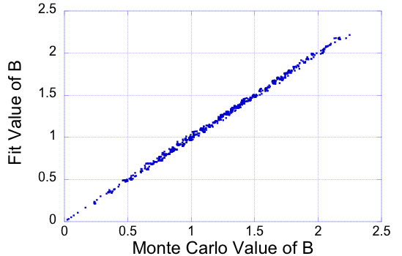
Fit vs. True Value for B
Excellent Fit (RMS Deviation ~ 2%)
For Virtually All Conditions, 0.5 < B < 2
11

Slide 12
Other Observations
No Other Significant Dependencies
  Photodetector Rise Time
  Photodetector Fall Time
Timing Resolution Using “Optimal” Estimator that Uses All Detected Photoelectrons is ≤15% Better than Leading Edge Timing
(for τ_{r} = 0.5 ns, d = 0.1 ns, J = 0.2 ns)
Paper submitted to Phys. Med. Biol.
12

Slide 13
Timing Resolution Predicted If You Know:
✔
Initial Photoelectron Rate I₀
  Gamma Ray Energy
  Scintillator Luminosity
  Scintillator Decay Time
  Collection Efficiency
  Quantum Efficiency
Intrinsic Scintillator Rise Time
Photodetector Transit Time Jitter
Optical Photon Propagation Time
✔
✔
✔
✔
✔
✔
✔
What Value to Use for Propagation Time???
13

Slide 14
Estimate Using GEANT / GATE / DETECT
Index of Refraction n = 1.82 (same as LSO)
Light Generated as a Delta Function in Time
at Random Positions in the Scintillator
Three Surface Finishes Simulated
  Polished
  Chemically Etched
  Rough
Two Simulation Types for Each Surface
  “Unified Model” (σ_{α} = 0°, 6°, and 12°)
  “RealReflector” (measured values in LUT)
14

Slide 15
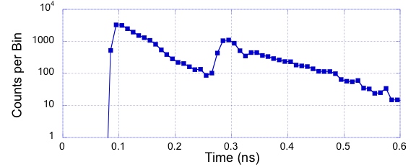
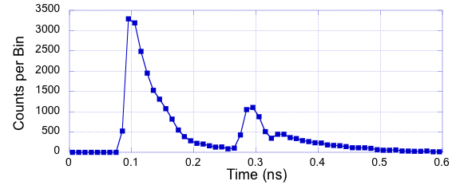
Basic Pulse Shape
Photo-
detector
Reflector
3x3x30 mm
Amplitude
Polished
Surfaces
Delay
“Decay” Time
Well-Described By Exponential Decay
15

Slide 16
Simplifying the Simulation
L
Photo-
detector
Reflector
x
∞
3 x 3 x ∞ mm
Photo-
detector
2L – x
Run Single Simulation w/ Infinitely Long Crystal
Superpose Signals from Positions x and 2L–x
Reflected Signal Less Important for Timing…
16

Slide 17
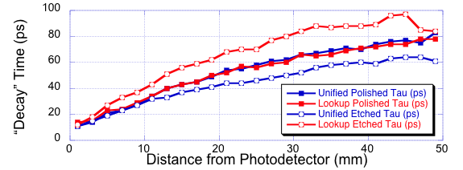
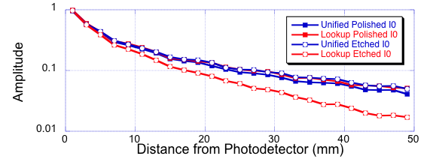
Simulation Results (Polished & Etched)
Delay =
Distance *
n
c
17

Slide 18
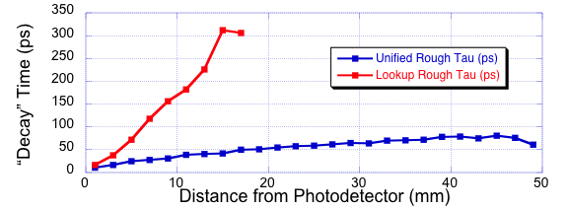
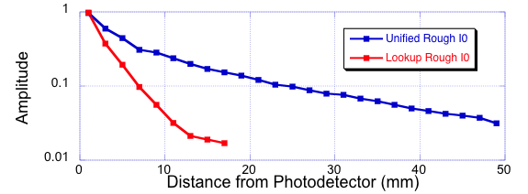
Simulation Results (Rough)
Unified “Rough” Very Similar to “Etched” and “Polished”
Lookup “Rough” is VERY Different
18

Slide 19
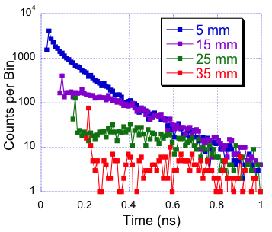
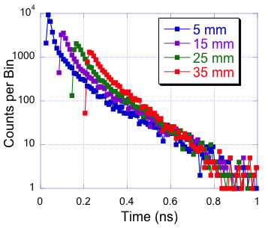
Simulation Results (Rough Surface)
Lookup Table
Unified Model
Different Models Predict Very Different Behavior
19

Slide 20
Scaling Crystal Dimensions
L
Photo-
detector
t
W
x
1.5 L
1.5 t
Photo-
detector
1.5 W
1.5 x
Simulations Run on 3 mm x 3 mm Crystal
Results for a W x W Crystal Can Be Found By
Multiplying All Distances & Times on Graphs by W/3
20

Slide 21
Conclusions
Simulation used to estimate timing resolution for many combinations of scintillation detector parameters
Includes virtually all known effects
Results encapsulated in “simple” formula that predicts timing resolution
All inputs to formula readily obtained
(including optical dispersion in crystal)
Needs experimental validation!
21

