Slide 1
Timing capabilities of Ultra-Fast Silicon Detector
A parameterization of time resolution
A program to calculate Time resolution
UFSD Timing capabilities
Nicolo Cartiglia
With
F. Cenna, F. Marchetto, A. Picerno F. Ravera, H. Sadrozinski, A. Seiden, A. Solano, A. Vinattieri, N. Spencer, A. Zatserklyaniy

Slide 2

UFSD: a time-tagging detector
Sensor
Pre-Amplifier
Time measuring circuit
Time is set when the signal crosses the comparator threshold
The timing capabilities are determined by the characteristics of the signal at the output of the pre-Amplifier and by the TDC binning:
σ_{Total}² = σ_{Jitter} ² + σ _{Time Walk} ² + σ_{TDC}²

Slide 3
Time walk and Time jitter
Time walk: the voltage value Vo is reached at different time for signal of different amplitudes
Jitter: the noise is summed to the signal, causing amplitude variations
Due to the physics of signal formation
(see backup slides for full calculation and reduction techniques)
Mostly due to electronic noise
(see backup slides for capacitance and noise values used)

Slide 4
A parameterization of σ_{t}
(1)
Jitter
Time Walk
TDC
l
d
d: detector thickness [micron]
l: pitch [micron]
C: Detector capacitance [fF]
Depends on the pitch and thickness
N: Noise at preamp.
Dominated by the voltage term
S: Signal
t_{rise}: Pre-Amp Shaping time
V_{th}: Comparator threshold
Depends on the noise level
TDC:Width of the TDC LSB [ps]

Slide 5
What is the best shaping time (t_{rise}) ?
To minimize time resolution:
Shaping time = Collection time
Note: This value also minimizes fake signals in neighboring pixels.

Slide 6
Where to set the threshold
Charge Sensitive Amplifier output
Shaper Signal
Shaper Derivative
Time Walk:
set the threshold at the minimum possible value
Jitter: set the threshold at the maximum derivative
How to minimize
Time Walk and Jitter:
Compromise!

Slide 7
State of the Art
Following eq. (1)
Below d = 100 micron:
signal too small
Best resolution achievable: ~ 100 ps
(assuming Time Walk reduction of ~ 3)

Slide 8
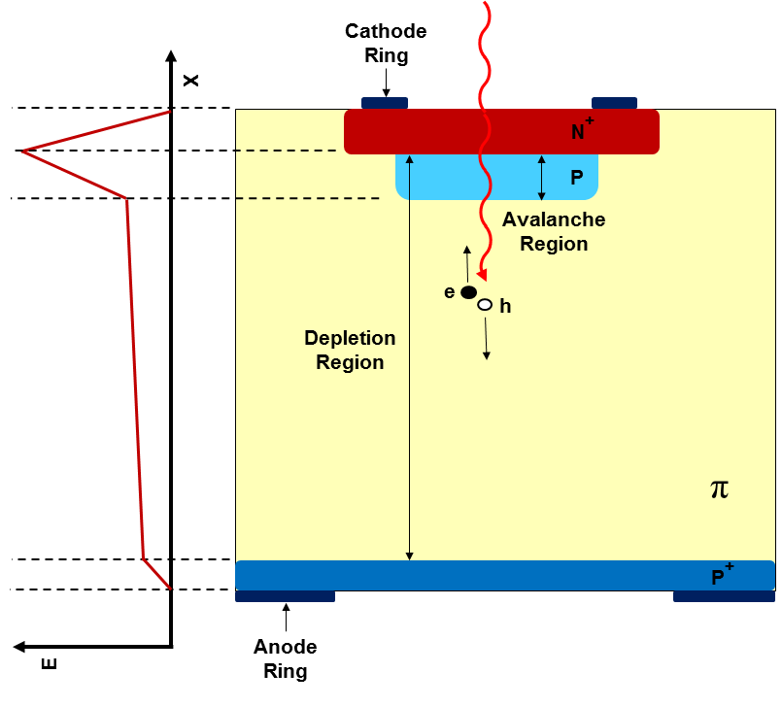
Sensor: Ultra-Fast Silicon Detector
UFSD: pixelated silicon detector with internal gain
Main point: boost the signal
  Minimize jitter and TW
  Allows for very thin detector
UFSD gain: Add an extra deep p+ implant
High field
Gain layer

Slide 9
Sensor: Status
Presented at the 9th
Trento Workshop, 2014 Genova
Measured Gain: 2-10

Slide 10
Sensor: Simulation
We developed a full sensor simulation (WeightField2, F. Cenna, 9th Trento workshop) avalilable at http://personalpages.to.infn.it/~cartigli/weightfield2
It includes:
Custom Geometry
Calculation of drift field and weighting field
Currents signal via Ramo’s Theorem
Gain
Diffusion
Temperature effect
Non-uniform charge deposition
Electronics

Slide 11
WeightField2: a program to simulate silicon detectors

Slide 12
WeightField2: a program to simulate silicon detectors

Slide 13
WeightField2: a program to simulate silicon detectors

Slide 14
WeightField2: a program to simulate silicon detectors

Slide 15
WeightField2: a program to simulate silicon detectors

Slide 16
WeightField2: a program to simulate silicon detectors

Slide 17
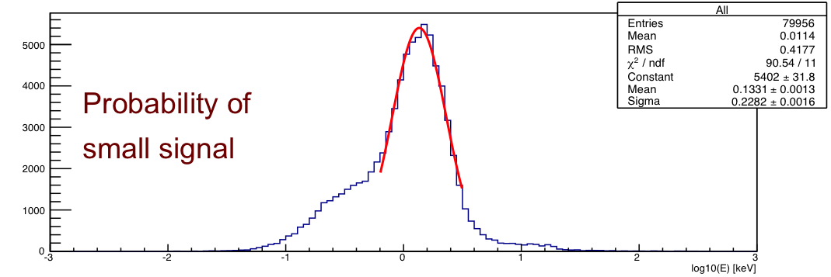
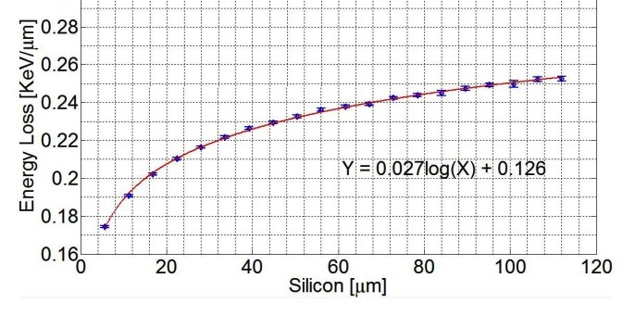
Aside: Non-Uniform Energy deposition
5 micron
5 μm
We have created, using GEANT4, a library of the energy depositions of a MIP in silicon, every 5 micron. Using this library, we can predict the value in any thickness
Comparison with the measurement presented in 2011 JINST 6 P06013
S. Meroli, D. Passeri and L. Servoli
11 JINST 6 P06013
0.027ln(d)+0.126

Slide 18
Time walk
Signals cross a given threshold with a delay that depends on their amplitude, on the rise time and on the value of the threshold:
t _{delay}
Time walk has 2 different source:
Amplitude variation (Landau distributed)
Non-uniformity charge deposition
Bumps:
Due to non-uniformity

Slide 19
Comparison Data-Simulation
MIP
Alpha from Top
Alpha from bottom

Slide 20
Comparison Data Simulation
MIP
Alpha from Top
Alpha from bottom

Slide 21
Simulation prediction
Using Weightfield we are able to simulate many geometries, and to predict the timing capabilities of UFSD.
NOTE: We simulate the value of TimeWalk without any correction.
Constant Fraction Discriminator and Time-Over-Threshold circuits are able to reduce this component by a large fraction (3-10)

Slide 22
UFSD – Timing Capability
Pixel size [μm]
300
TW ~ 130 ps
Jitter ~ 30 ps
TW ~ 200 ps
Jitter ~ 85 ps
TW ~ 110 ps
Jitter ~ 30 ps
200
TW ~ 80 ps
Jitter ~ 25 ps
TW ~ 110 ps
Jitter ~ 20 ps
100
TW ~ 50 ps
Jitter ~ 20 ps
TW ~ 120 ps
Jitter ~ 15 ps
50
100
200
Sensor Thickness [μm]
UFSD with Gain = 10
Blue = NA62

Slide 23
UFSD – Summary
We are just starting to understand the timing capability of UFSD
The internal gain of UFSD makes them ideal for accurate timing studies
We developed a program, Weightfield2.0, that is able to reproduce accurately the output response of UFSD
(available at http://personalpages.to.infn.it/~cartigli/Weightfield2.0/)
Many geometries allow for small jitter (~20 ps) and TimeWalk (~ 100 ps)
10 ps looks really difficult, 20 ps looks 1/4 as difficult, 30 ps 1/9 …

Slide 24
References
Several talks at the 22nd and 23rd RD50 Workshops:
23rd RD50: https://indico.cern.ch/event/265941/other-view?view=standard
22nd RD50: http://panda.unm.edu/RD50_Workshop/
9Th Trento Workshop, Genova, Feb 2014.
F. Cenna “Simulation of Ultra-Fast Silicon Detectors”
N. Cartiglia “Timing capabilities of Ultra-Fast Silicon Detector”
Papers:
[1] N. Cartiglia, Ultra-Fast Silicon Detector, 13th Topical Seminar on Innovative Particle and Radiation Detectors (IPRD13), 2014 JINST 9 C02001, http://arxiv.org/abs/1312.1080
[2] H. Sadrozinski, N. Cartiglia et al., Ultra-fast Silicon Detectors, NIM-A, RESMDD12 proceeding (2012), Firenze, http://dx.doi.org/10.1016/j.nima.2013.06.033

