Slide 1
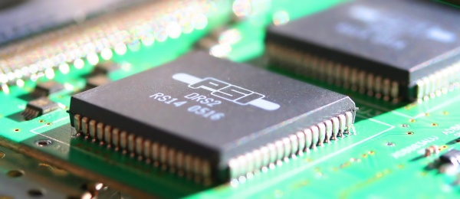
A new timing calibration method for switched capacitor array chips to achieve sub-picosecond resolutions
Stefan Ritt, Paul Scherrer Institute, Switzerland

Slide 2
Overview
Limitations of timing resolutions in Switched Capacitor Arrays (SCA)
New method for SCA calibration
Results

Slide 3
Schematic Overview (DRS4)

Slide 4
Noise limited time accuracy
1
3
2

Slide 5
A few examples
U [mV] | DU[mV] | t_{r} [ns] | f_{3dB} [MHz] | f_{S} [GSPS] | Dt [ps]
10 | 1 | 1 | 333 | 3 | 60
100 | 1.8 | 1 | 333 | 2 | 13
100 | 0.65 | 1 | 333 | 3 | 3.8
100 | 0.7 | 0.23 | 1500 | 10 | 1.9
100 | 0.35 | 0.36 | 950 | 5 | 1
TARGET
SAM
PSEC4
DRS4
Small (<20 mV) signals give poor timing
Theoretical limit for TARGET/SAM/PSEC4 is reached
Limit for DRS4 is lower than current resolution ( O(20ps) )
What is the reason for this?

Slide 6
Time definition
single inverter delay: Δt_{i} → differential nonlinearity
Sum of single inverter delay: Δt_{a,b} = ΣΔt_{i} → integral nonlinearity

Slide 7
Local Calibration
Credits: D. Stricker-Shaver, Univ. Tübingen, NSS/MIC 2012 proceedings

Slide 8
Local Calibration

Slide 9
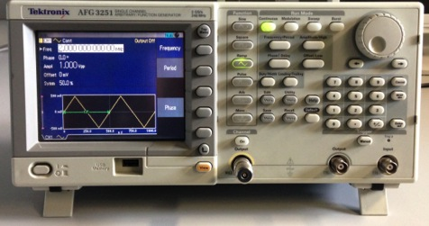
How to calibrate?
External function generator
  Not convenient for re-calibration
  Arbitrary waveform generation
  has ~20 ps jitter
FGPA: LVDS output with slew rate limitation
  Anything coming from an FPGA has 50-100 ps jitter
Dedicated quartz oscillator
  Can be on-board
  Generate sine wave via passive low-pass filter
  Only use region around zero as linear slope

Slide 10
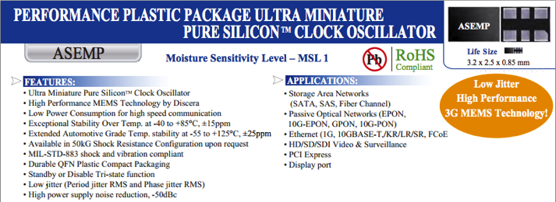
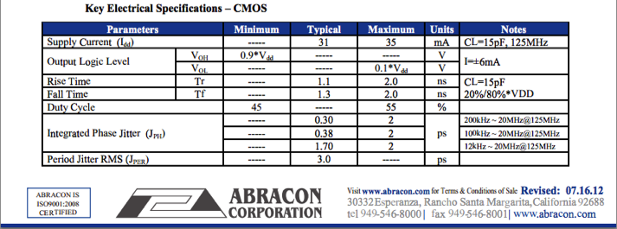
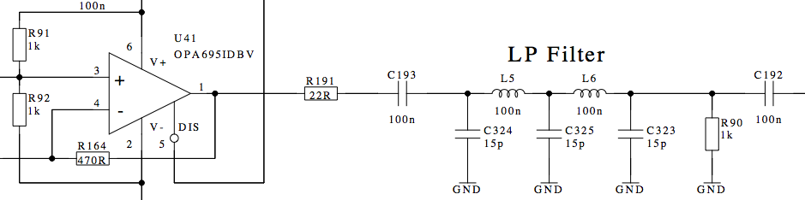
Oscillator
100 MHz
OSC.
BUF
Low
Pass
to all
channels

Slide 11
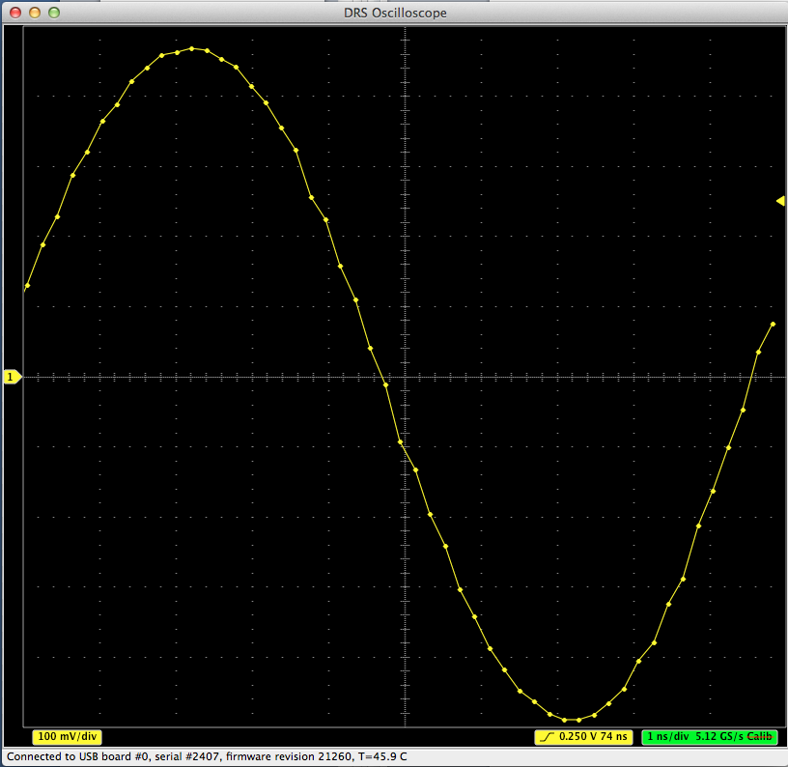
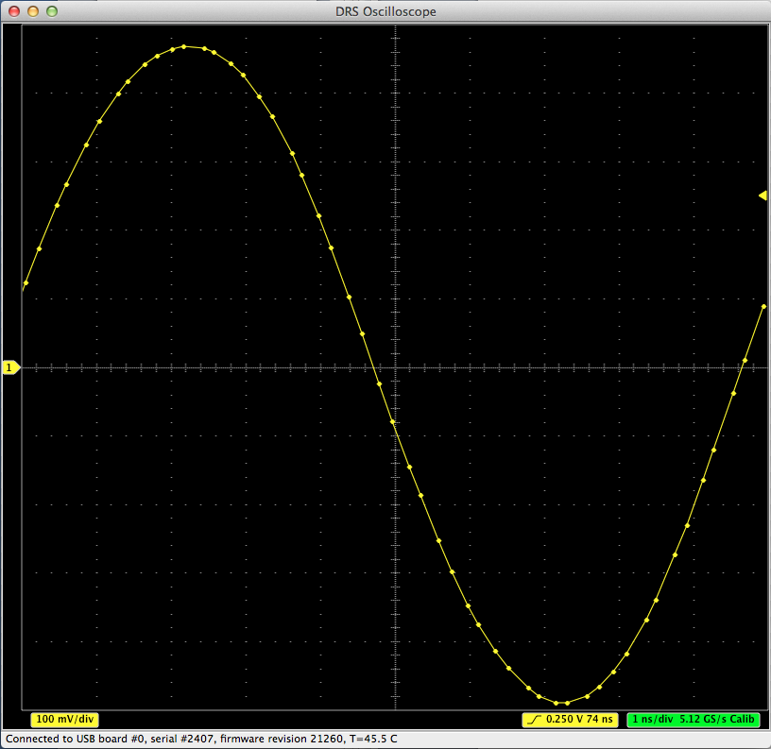
Effect of local calibration
before
after

Slide 12
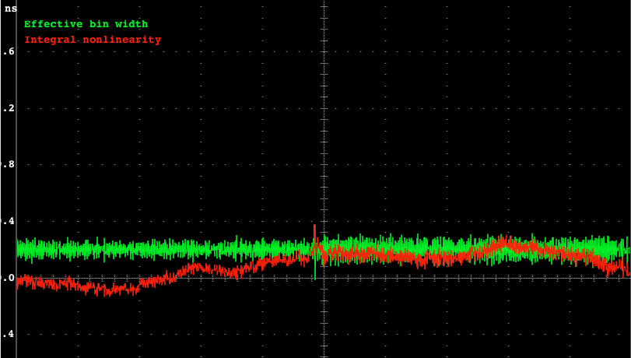
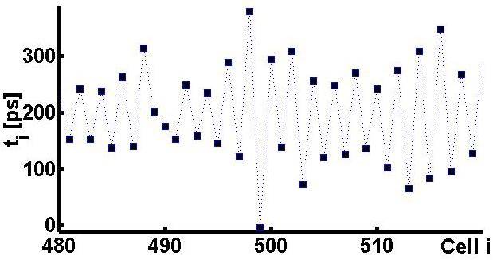
Distribution of Δt_{i}
nominal value = 0.2 ns

Slide 13
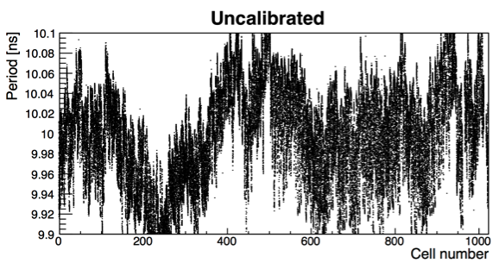
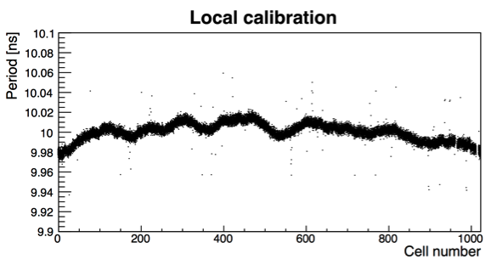
How to quantify accuracy of calibration
sine with random phase
cells
10 ns

Slide 14
Global Calibration
cells
!
Δt_{a,b} = Σt_{i} = 10 ns
Measure period of sine wave (linearly interpolate zero crossings)
Calculate correct factor
Distribute correction equally to cells between zero crossings
Iterate with random phase

Slide 15
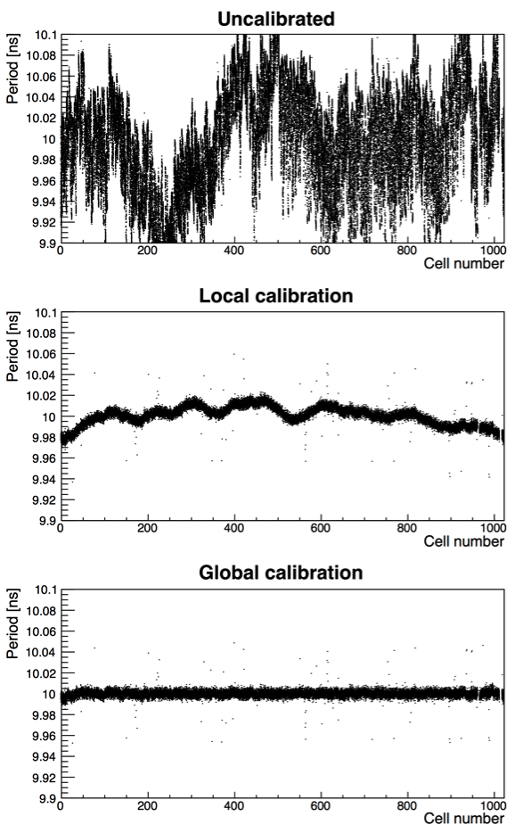
Effect of global calibration

Slide 16
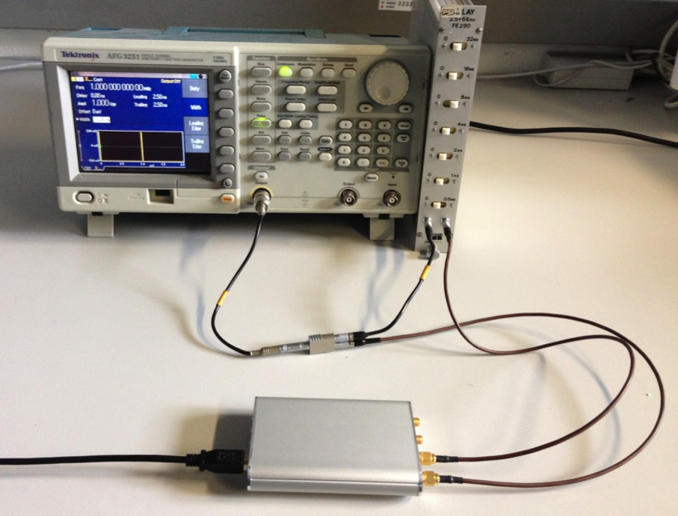
Measure resolution with real pulses
Pulse
Generator
DRS4
Evaluation
Board
CH1
CH2

Slide 17
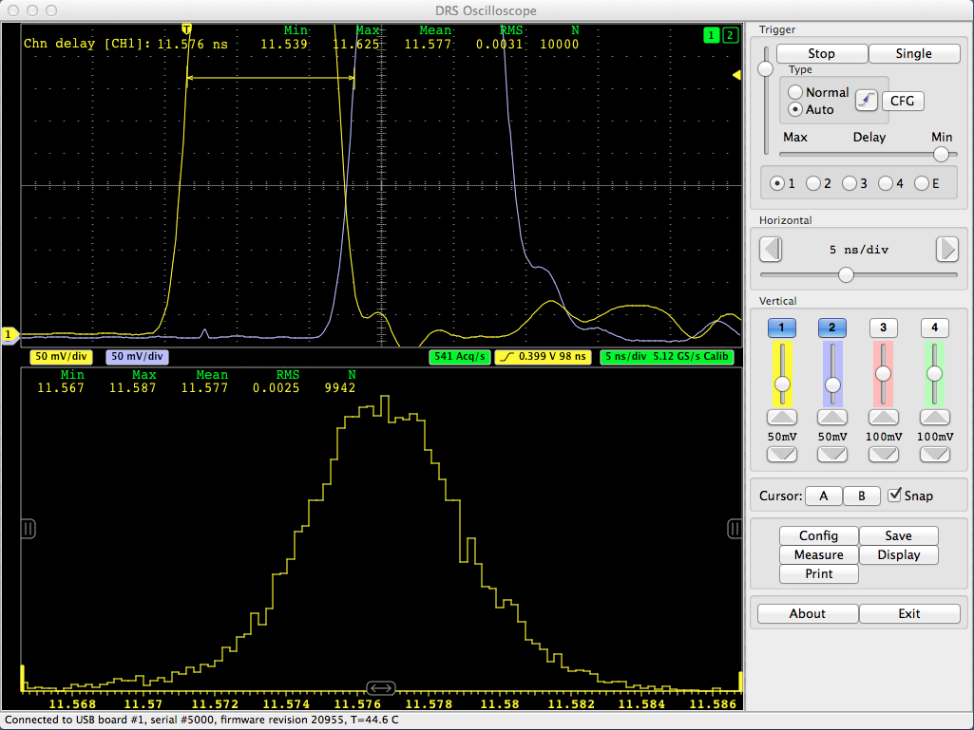
Result of time difference @ 5 GSPS
Rise time:
500 mV / 2 ns
=
100 mV / 0.36 ns
Delay = 11.6 ns
Value in RMS
Linear interpolation
Single
measurement
2.5ps/√2 = 1.8 ps
2.5 ps

Slide 18
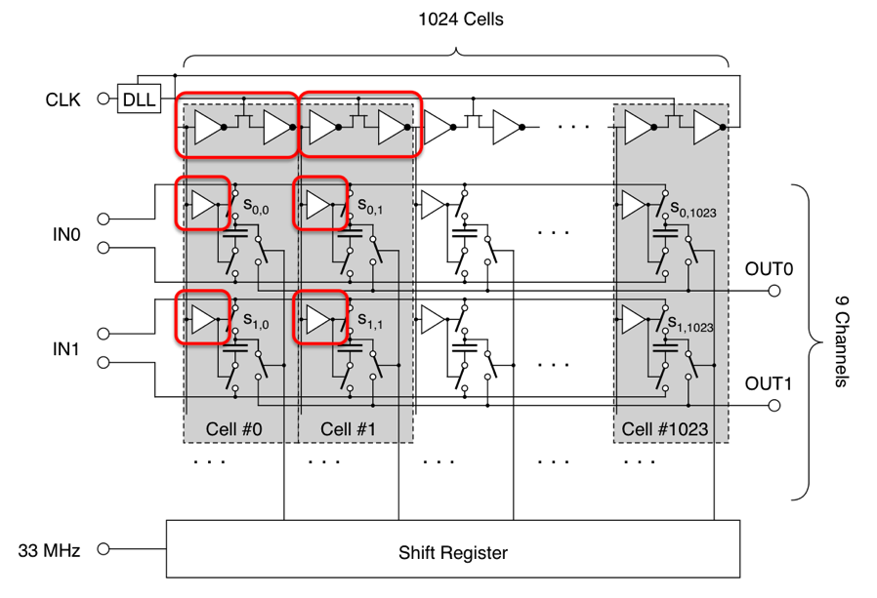
Calibration of all channels
Calibrating one channel of DRS4 chip
→ 12 ps
Calibrating each channel individually
→ 2.5 ps
Large system
needs clock
distribution
with ~ps
accuracy

Slide 19
Advanced Analysis
Accuracy can be increased by taking more points into account (unlike TDC)
Line Fit
Simple Threshold
threshold
line distance
Win √n !
Cross-correlation
with interpolation

Slide 20
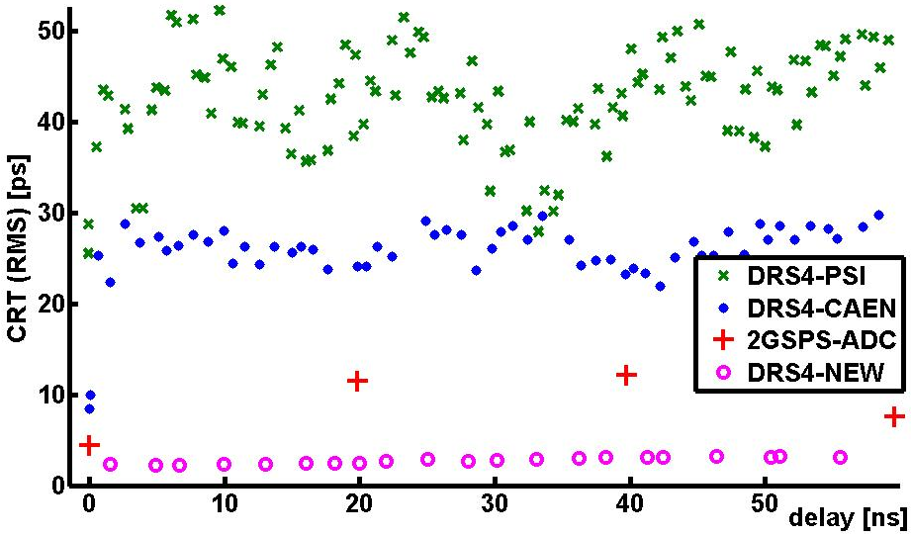
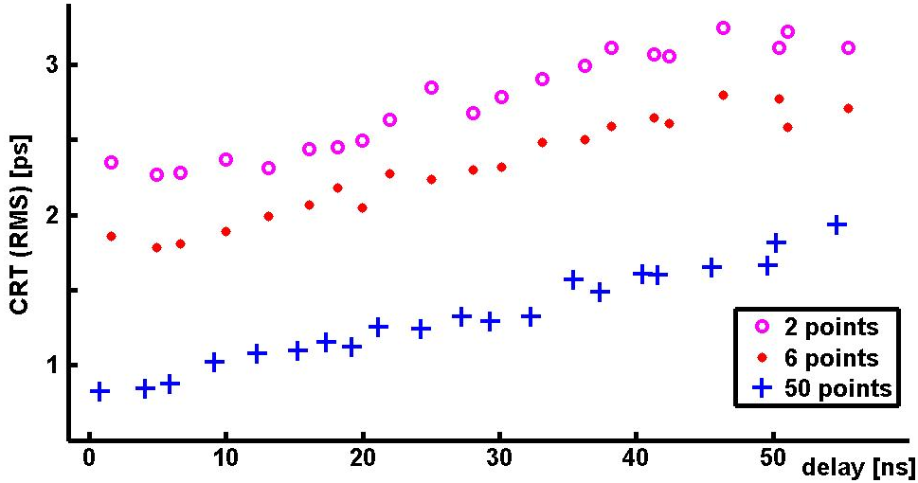
Results in dependence of delay
Improvement of ~40 x to old calibration
No degradation for delay > 0
10x better than Acquiris ADC 2 GSPS/10 bit
Cross correlation gives best result
Result < 1ps (single measurement) for delay < 30 ns
Δt [ps RMS]
Δt [ps RMS]
1.42 ps

Slide 21
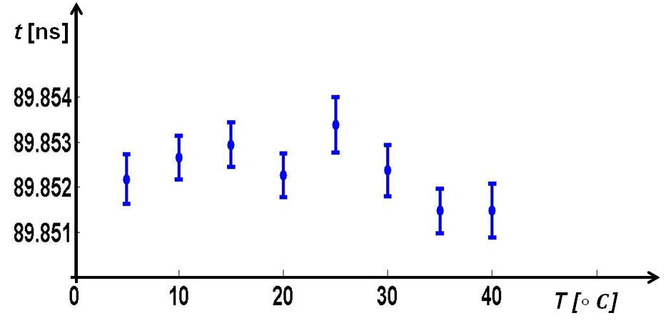
Temperature Dependence
Calibration seems stable on the 1-2 ps level over wide temperature range

Slide 22
Limitation of time measurement
SNR of detector signal
Variation of V_{th} → calibration
Noise inside inverter chain
DLL phase noise
V_{th}
2.5 V
→ Δt=0.03 ps
100 ps

Slide 23
DLL Phase Noise
REFCLK
PLLOUT
CLK

Slide 24
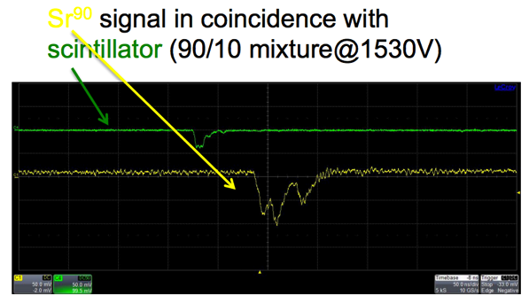
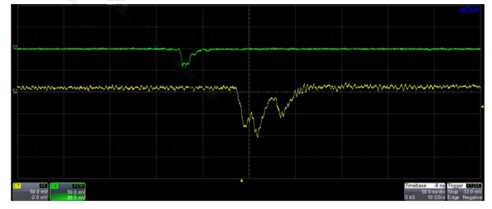
Application of precise timing
Readout of straw tubes / drift chambers
Position along the wire with charge division
Time measurement with cluster technique should give 3 ps → 0.5 mm
HV

Slide 25
Conclusions
New calibration for DRS4 chip give sub-ps resolution for delay < 30 ns
Patent PCT/EP2013/070892 <Bernd.Pichler@med.uni-tuebingen.de>
SNR of detector signal limits timing
To improve timing even further:
  work hard on SNR
  carefully calibrate voltage response of EACH cell
  reduce DLL phase noise

Slide 26
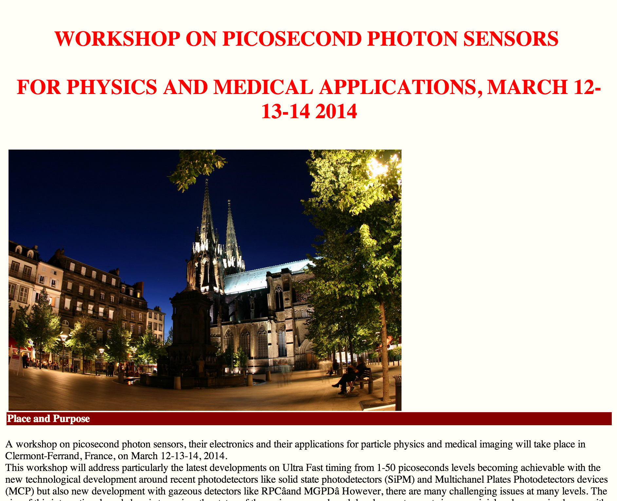
FEMTO
2017

