Slide 1
Signal Processing for Fast Photo-detectors
Jean-François Genat
With the help of:
Mircea Bogdan, Henry Frisch, Eric Oberla, Fukun Tang
U Chicago and
Dominique Breton, Eric Delagnes
Orsay Saclay
Workshop on Pico-second sensors, LPC Clermont-Ferrand March 12-14th 2014

Slide 2
Outline
- Fast Imaging Devices and Timing Resolution
- Silicon PMTs and Micro-Channel Plates (MCPs)
- Timing with Waveform Sampling
- 2D Readout with Timing
- Switched Capacitor Arrays
- Conclusion
Workshop on Pico-second sensors, LPC Clermont-Ferrand March 12-14th 2014

Slide 3
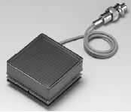
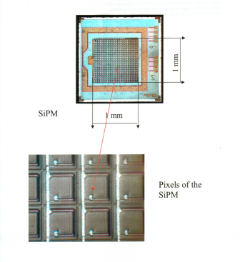
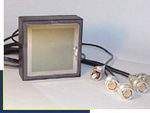
Fast Timing and Imaging Photo-detectors
Multi-anodes PMTs Silicon-PMTs Micro Channel Plates
Dynodes Quenched Geiger Micro-Pores
QE 30% 90% 20-30%
CE 90% 70% 60%
Rise-time 0.5-1ns 250ps 50-200ps
TTS (1PE) 150ps 100ps 30-50ps
Pixel size 2x2mm² 50x50μm² 1.5 x1.5 mm²
Dark counts 1-10Hz/cm2 1-10MHz/cm2 1-10 kHz/cm²
Dead time 5ns 100-500ns 1μs
Magnetic field no yes 15kG
Radiation hardness 1kRad (PC) noise x 10 1kRad (PC)
Workshop on Pico-second sensors, LPC Clermont-Ferrand March 12-14th 2014

Slide 4
Outline
- Fast Imaging Devices and Timing Resolution
- Silicon PMTs and Micro-Channel Plates (MCPs)
- Timing with Waveform Sampling
- 2D Readout with Timing
- Switched Capacitor Arrays
- Conclusion
Workshop on Pico-second sensors, LPC Clermont-Ferrand March 12-14th 2014

Slide 5
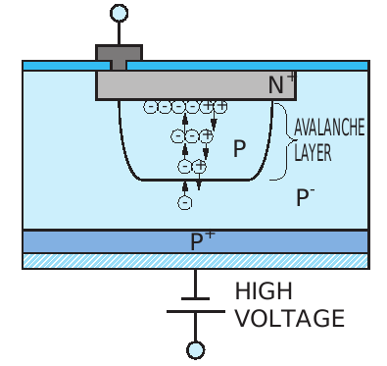
Fast Solid State imaging Devices
Silicon Photo-Multipliers
PN junction reverse biased beyond the breakdown voltage
Avalanche “quenched” with a series resistor
Good Quantum Efficiency,
but small sensitive area
High Gain10⁵⁻⁶
- Noise: Avalanches from reverse currents: MHz/cm2
- Trapped carriers: after-pulses
- Optical Crosstalk
- “Cheap”
M. Haigh, Univ Oxford
Workshop on Pico-second sensors, LPC Clermont-Ferrand March 12-14th 2014

Slide 6
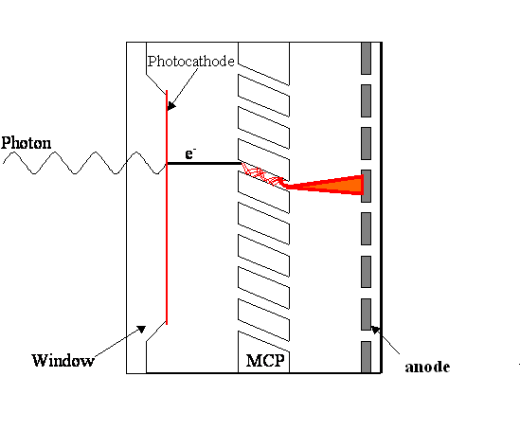
Fast Solid State Imaging Devices
Micro-Channel Plates
Photonis Glass MCP: area: 2” x 2”
Photocathode + amplifying MCP: a few microns diameter pores, secondary emitter
Space resolution: 0.1-1mm, timing 30-50ps
Tentative: large area (20 x 20 cm) : 2D delay line readout See Eric Oberla talk
Workshop on Pico-second sensors, LPC Clermont-Ferrand March 12-14th 2014

Slide 7
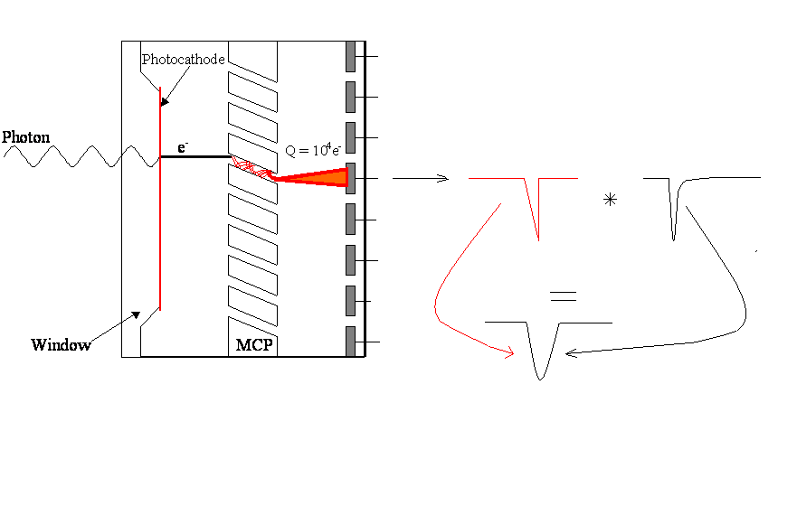
MCPs signal development
MCP signal rising edge: qE = ma
l = 1mm, E=100V/mm, tr=250ps
Short Transit Time: - Thin photo-cathode gap,
- High electric field
- Thin MCP: small pore size (L/d = 40) < 5μm, l < 200 μm
Fast pulse: - Thin anode gap,
- High electric field
10⁻⁵ mm Hg vacuum rigidity is 1kV/100μm
Workshop on Pico-second sensors, LPC Clermont-Ferrand March 12-14th 2014

Slide 8
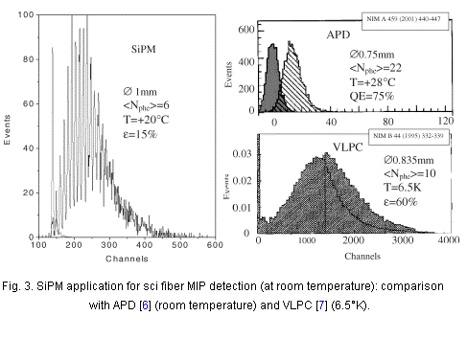
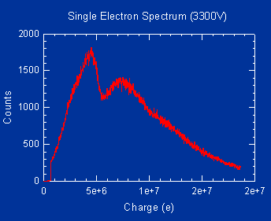
Single Photo-electrons signals
25 microns, MCP from Burle-Photonis
From B. Dolgoshein et al. From P. Hink (Burle-Photonis)
MCP: Gain fluctuations in the pores: “noise” as loss of energy information
Statistical nature of the amplification process: SEE, number of bounces
Workshop on Pico-second sensors, LPC Clermont-Ferrand March 12-14th 2014

Slide 9
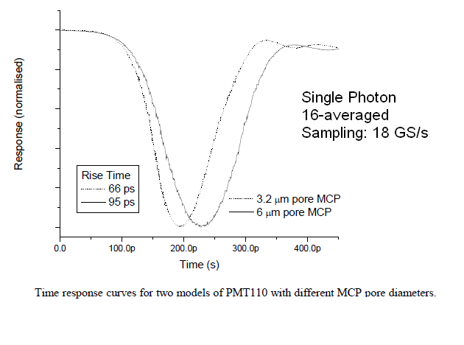

Micro-Channel Plate Signals
Courtesy P. Hink, Photek
The fastest solid-state photo-detector to date
Workshop on Pico-second sensors, LPC Clermont-Ferrand March 12-14th 2014

Slide 10
Micro-Channel Plates
  Timing resolutions (Transit Time Spread) in the 10-100 ps range
  MCP parameters impacting transit time:
  Rise-time
  First strike, Tilt angle, Pore size (diameter, length)
  Bias voltage (gaps transit times)
  - MCP parameters impacting noise and rise-time
  Photo-cathode noise (mainly impulse noise)
  Secondary emitter noise
  Gain fluctuations
  MCP environment
  2D readout elements: delay lines
  Magnetic field
  - MCP readout electronics parameters with waveform sampling
  Analog bandwidth
  Sample rate
  Electronics gain (if any)
  Electronics noise
  Signal integrity (system noise)
Workshop on Pico-second sensors, LPC Clermont-Ferrand March 12-14th 2014

Slide 11
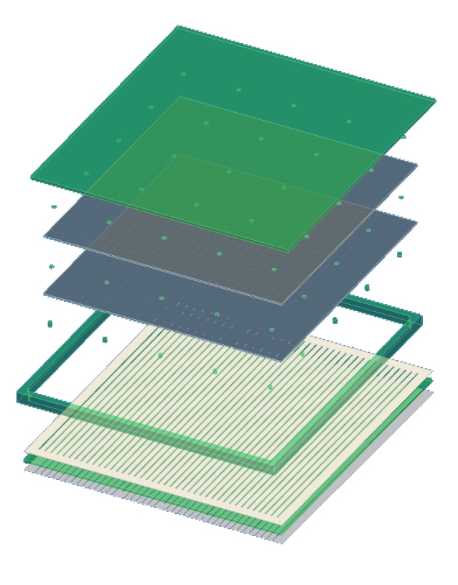
Large Area Micro-Channel Plates Devices
Present MCPs Photek, HPK, Burle-Photonis 2’’ x 2’’
LAPPD project : Chicago-Hawaii Large Area MCP 8’’ x 8’’
See Ossy Siegmund ’s and Eric Oberla’s talks
Transmission lines 2D readout:
limits the number of electronic channels compared to pixels
Goal: Both position O(mm²) and timing O(10-100ps)
Electronics Hawaii, PSI, Orsay, Chicago-Hawaii
- GigaSample/s Waveform Sampling and Digital Processing
Workshop on Pico-second sensors, LPC Clermont-Ferrand March 12-14th 2014

Slide 12
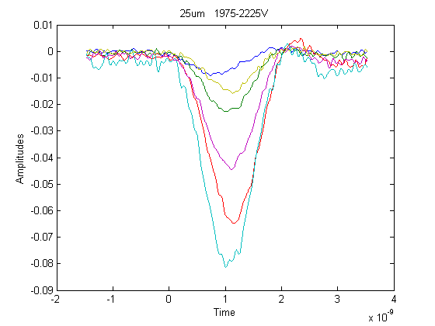
Micro-Channel Plates Signals
Burle-Photonis
25 μm pores
50PEs, HV steps of 50 V
anodes
Micro-Channel Plates signals: bandwidth = 1- 2 GHz
Good candidates for fast timing
Workshop on Pico-second sensors, LPC Clermont-Ferrand March 12-14th 2014

Slide 13
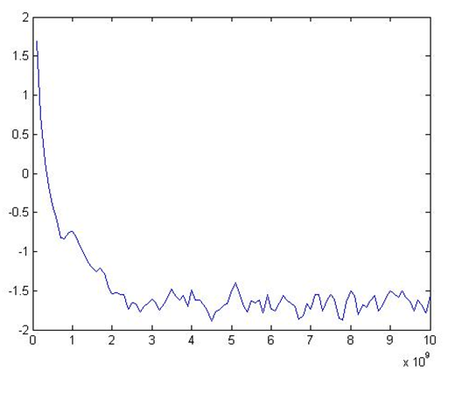
GHz Bandwidth Micro-Channel Plate Signals
Digitization: Sampling frequency > 2 x Shannon-Nyquist=4GHz
Dynamic range ~150: 700 uV noise, 100 mV max
Micro-Channel Plate
Signal Spectrum
Noise as small as possible
2
2 GHz
4 GHz
13
Workshop on Pico-second sensors, LPC Clermont-Ferrand March 12-14th 2014

Slide 14
MCP Timing resolution estimate/measured
- First gap: 10ps
- Assume 2-stage pores TTS of 20ps
Anode gap: 10ps
Noise: 20ps
Total is 32ps
Measured Burle-Photonis 2’’ x 2’’ is 30ps
Workshop on Pico-second sensors, LPC Clermont-Ferrand March 12-14th 2014

Slide 15
Outline
- Fast Imaging Devices and Timing Resolution
- Silicon PMTs and Micro-Channel Plates (MCPs)
- Timing using Waveform Sampling
- 2D Readout with Timing
- Switched Capacitor Arrays
- Conclusion
Workshop on Pico-second sensors, LPC Clermont-Ferrand March 12-14th 2014

Slide 16
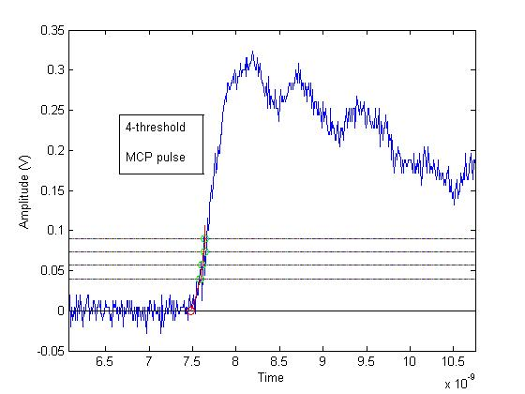
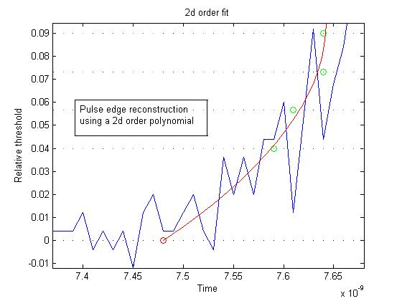
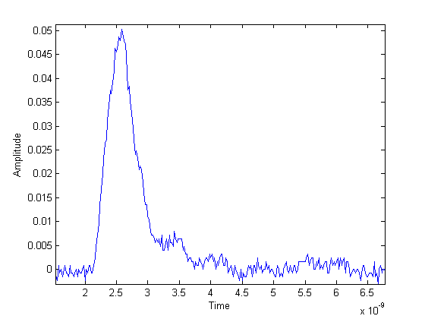
Timing techniques
Multi-threshold
Constant-fraction
Constant fraction
Leading
edge
Extrapolated time
Leading edge errors
Waveform sampling
Workshop on Pico-second sensors, LPC Clermont-Ferrand March 12-14th 2014

Slide 17
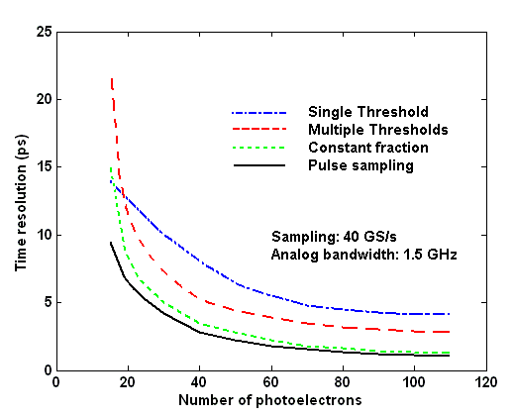
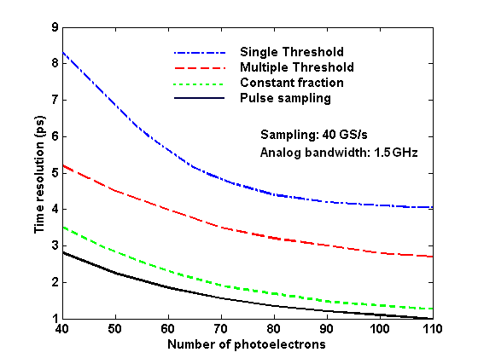
Timing Methods (simulation)
Methods: Single threshold
Multiple thresholds
Constant fraction
Waveform sampling
Time resolution vs Number of photo-electrons
zoom
Workshop on Pico-second sensors, LPC Clermont-Ferrand March 12-14th 2014

Slide 18
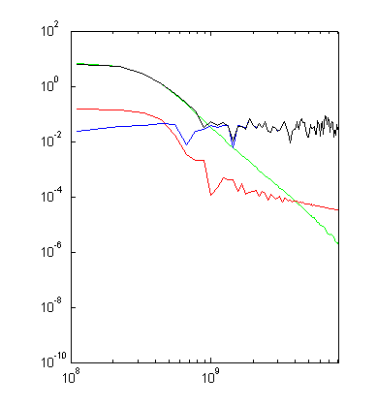
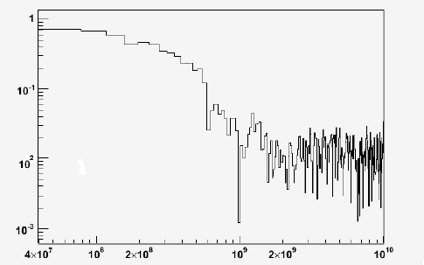
MCP Signals spectra
2x2mm²
1”x 1”
MCP signal
White noise
MCP noise
Total
Measured (FNAL T979 Beam-Tests) Simulated
Same noise corner at 1.2 GHz
Workshop on Pico-second sensors, LPC Clermont-Ferrand March 12-14th 2014
Jean-Francois Genat, March 19th 2009, Argonne

Slide 19
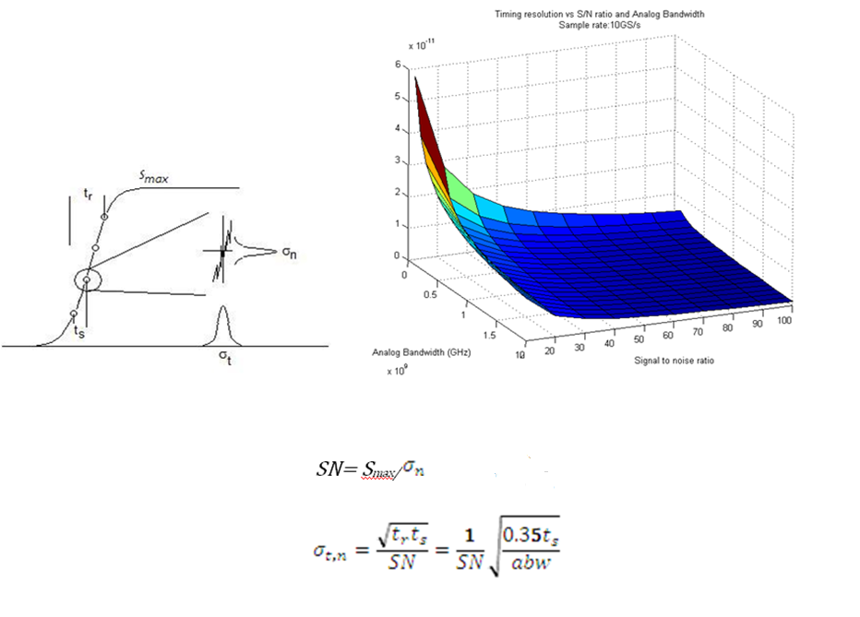
Timing Spreads
Main contributors to timing spreads:
Detector:
Noise_{detector}
Transit time fluctuations
Rise time
Signal/noise ratio
Noise_{elec}
Analog bandwidth abw
With Sampling Electronics:
Sampling period ts
σ_{n} = σ_{n det} + σ_{n elec}
S = G Npe
Stefan Ritt:
With SN=50, fs=5GS/s, ABW=1GHz σ = 5.3ps
Workshop on Pico-second sensors, LPC Clermont-Ferrand March 12-14th 2014

Slide 20
Fast Sampling Electronics Timing Resolution
Method Institute Device Sample rate Timing resolution 50PEs
Constant fraction SLAC - NIM 3.4ps
- ASICs:
Waveform Hawaii - BLAB line 6GS/s 10ps
Sampling Orsay/Saclay - SAM line 2GS/s
Chicago - PSEC4 10GS/s 6ps
- PSEC5 (dev) 15GS/s
PSI - DRS line 5GS/s 3ps
PSEC5 under development Chicago + Hawaii + Orsay/Saclay
Workshop on Pico-second sensors, LPC Clermont-Ferrand March 12-14th 2014

Slide 21
Outline
- Fast Imaging Devices and Timing Resolution
- Silicon PMTs and Micro-Channel Plates (MCPs)
- Timing with Waveform Sampling
- 2D Readout with Timing
- Switched Capacitor Arrays
- Conclusion
Workshop on Pico-second sensors, LPC Clermont-Ferrand March 12-14th 2014

Slide 22
2D+ time with T-lines
Transmission lines (T-lines) readout and pulse sampling provides
  - Fast timing (2-10ps)
  - One dimension with T-lines readout 100μm- 1mm
  Transverse dimension from centroids
  Less electronics channels for large area sensors
Fast waveform sampling electronics
t₁, a₁
t₂, a₂
Fast sampling electronics
½ (t₁+ t₂) = time
v(t₁-t₂) = longitudinal position
Σ α_{i} a_{i} / Σ α_{i} = transverse position
Workshop on Pico-second sensors, LPC Clermont-Ferrand March 12-14th 2014

Slide 23
Position sensing using fast timing
MCP T- line card
Laser 408nm
TDS 6154C
Ch 1
Scope
Ch 2
Scope trigger
Edward May, JFG, Argonne (2011-2012)
Laser test bench calibrated with the single PE known response of an MCP
25/10um pores MCP on transmission lines card
Scope triggered by the laser signal
Record two delay lines ends from the same trigger
Tek 6154C scope at 20 Gs/s
lsub-mm position resolution
Workshop on Pico-second sensors, LPC Clermont-Ferrand March 12-14th 2014

Slide 24
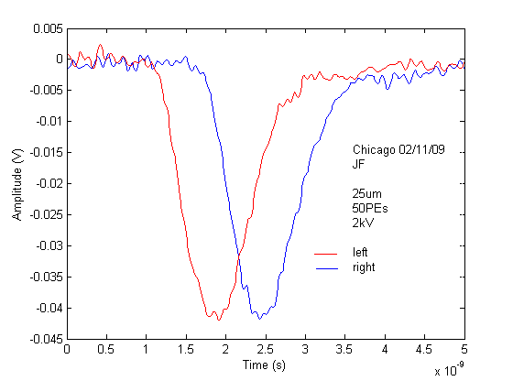
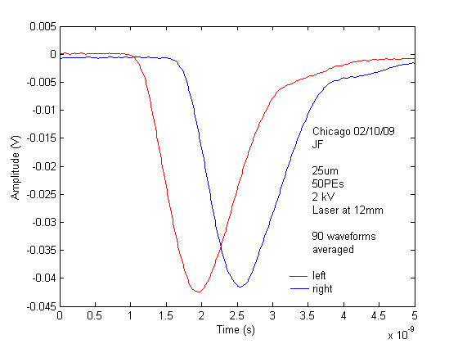
Sampled waveforms signal processing
Many techniques
Signal Template
Real MCP
Laser data
B. Cleland and E. Stern, BNL
Extract precise time and amplitude from minimization of χ² evaluated wrt a template deduced iteratively from the measurements, at the two ends of the T-line.
With T-lines, the two ends responses are highly correlated, the MCP noise is removed.
Other technique (Henry Frisch) : sample the rising edge, fit to a straight line, intersect with the time axis
Workshop on Pico-second sensors, LPC Clermont-Ferrand March 12-14th 2014

Slide 25
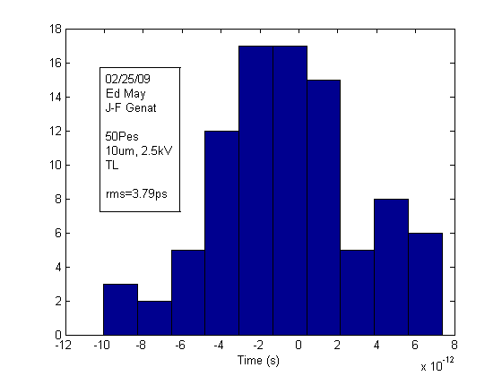
Pico-second timing with 2D T-lines readout
Waveform sampling provides fast timing (MCPs: 30-50ps with 1 PE).
Delay lines responses provide position information along the lines using fast timing
Less electronics channels for large area sensors wrt pixels devices
Laser tests:
3.8 ps (measured) spread in the difference translates
in 190 μm position resolution with 50 photo-electrons
½ (t₁+ t₂) = time
v(t₁-t₂) = longitudinal position
Σ α_{i} a_{i} / Σ α_{i} = transverse position
Workshop on Pico-second sensors, LPC Clermont-Ferrand March 12-14th 2014

Slide 26
Outline
- Fast Imaging Devices and Timing Resolution
- Silicon PMTs and Micro-Channel Plates (MCPs)
- Timing with Waveform Sampling
- 2D Readout with Timing
- Switched Capacitor Arrays
- Conclusion
Workshop on Pico-second sensors, LPC Clermont-Ferrand March 12-14th 2014

Slide 27
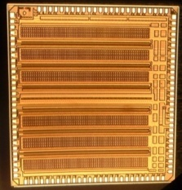
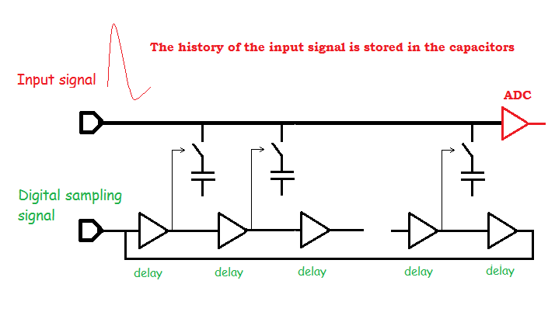
Switched Capacitors Arrays (SCA)
Chicago PSEC4 ASIC
The input signal is sampled at the delay period (ps-ns)
Readout slow: the ADC may need to be very accurate, at the expense of conversion delay
PSEC4 digitization: one ramp generator + ( one comparator + one 12-bit register ) / channel
Workshop on Pico-second sensors, LPC Clermont-Ferrand March 12-14th 2014

Slide 28
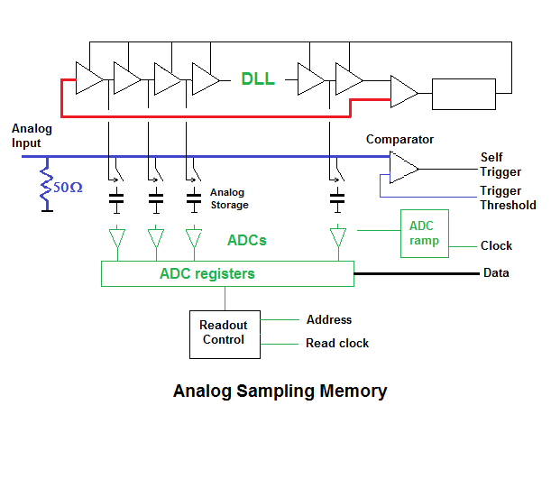
Fast Sampling Switched Capacitor Array
28
Workshop on Pico-second sensors, LPC Clermont-Ferrand March 12-14th 2014

Slide 29
Fine timing: Digital Delay Lines
Locked delay line (DLL) or ring oscillator (PLL) if looped
Loop of voltage controlled delay elements locked on a clock.
- Generation of subsequent logic transitions distant by τ that can be as small as 10-100 ps
Clock
Delay + time offset controls
Time arbiter
N delay elements τ
Total delay is half a clock period when locked, the two edges can be locked
Workshop on Pico-second sensors, LPC Clermont-Ferrand March 12-14th 2014

Slide 30
40 GS/s Timing generator
640 MHz clock in
0ps
16 cells
100ps 100ps 100ps 100ps
125ps
150ps
175ps
16 x 4 = 64 cells, 25ps step delays
Jorgen Christiansen, CERN
Workshop on Pico-second sensors, LPC Clermont-Ferrand March 12-14th 2014

Slide 31
Delay Elements
Active RC element: R resistance of a switched on transistor
C total capacitance at the connecting node
Typically RC = 20ps-1ns using current IC technologies
an inverter propagation delay is 10ps in 32nm CMOS technology
n delay elements with propagation delay τ = RC
The propagation delay of RC ’s spread limits the accuracy
is technology dependent: the fastest, the best.
Within a chip ~ 1 %
a wafer ~ 5-10%
a lot ~ 10-20%
In practice, lines of 16-32 delay elements can be safely used
Workshop on Pico-second sensors, LPC Clermont-Ferrand March 12-14th 2014

Slide 32
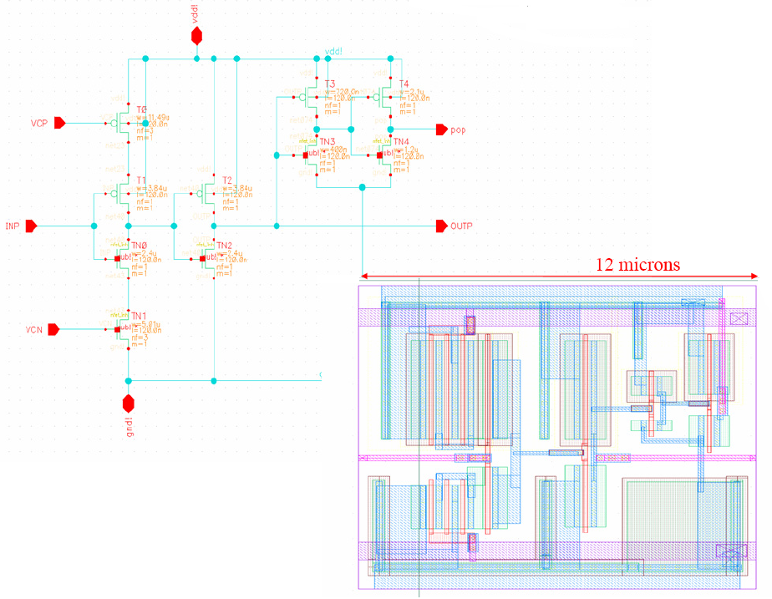
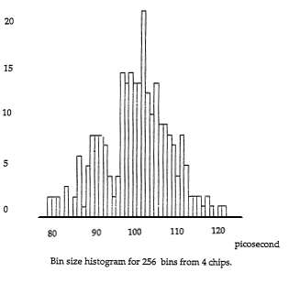
Starved CMOS inverter cell (CMOS 130nm)
TDC bins histogram
1990 2 micron CMOS
Workshop on Pico-second sensors, LPC Clermont-Ferrand March 12-14th 2014

Slide 33
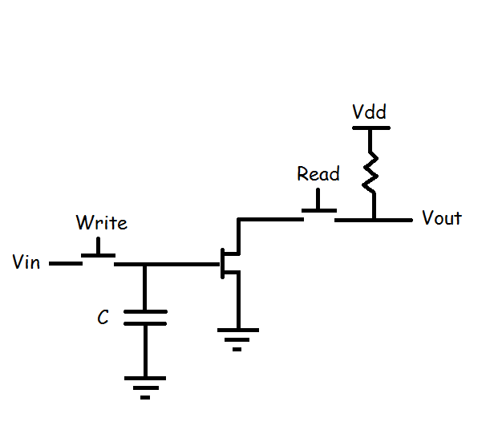
Sampling Cell
Bandwidth:
The sampling capacitor C should be as small as leaks, parasitics
and kT/C switching noise allow. C = 30 fF typical in 130nm CMOS technology
- Take care of the Write switches capacitance in the open state
- An input buffer may be a bandwidth killer
Speed depends on the IC process feature size
GHz bandwidth
Workshop on Pico-second sensors, LPC Clermont-Ferrand March 12-14th 2014

Slide 34
Issues for High Frequency SCA Design
Input signal trace
The analog bandwidth is limited by the input distribution line since all the open switches capacitors add up. The input signal distribution trace resistance is critical. The sampling capacitors should be as small as gate transistor leaks and parasitics allow, typ 20-100fF. (50fF x 1kΩ = 50ps)
The input distribution line has to be designed as a high frequency transmission line
- Trade-off between recording length and analog bandwidth
- In practice, analog bandwidths > 1GHz, > 10GHz sampling rates , 12-bit dynamic range
Workshop on Pico-second sensors, LPC Clermont-Ferrand March 12-14th 2014

Slide 35
Fast Sampling ASICs
Several ASICS reported in this workshop
See e.g.
Eric Oberla’s, D. Breton, E. Delagnes, S.Ritt, G. Varner …
Workshop on Pico-second sensors, LPC Clermont-Ferrand March 12-14th 2014

Slide 36
Conclusion
Sampling electronics and waveform analysis for 2” x 2” Micro-Channel Plate achieve
O(30ps) timing electronics (1 PE signals)
2-dimension position sensing with millimeter precision
Expect to be on the same order on Chicago-Hawaii
8” x 8” large dimensions devices
See talks by Henry Frisch, Ossy Siegmund, Eric Oberla
Workshop on Pico-second sensors, LPC Clermont-Ferrand March 12-14th 2014

Slide 37
Thanks…
Workshop on Pico-second sensors, LPC Clermont-Ferrand March 12-14th 2014

