Slide 1


Mordicus-hw
Framework for backend electronics control and configuration
G. Stelmakh
CEA Irfu Saclay
Workshop on picosecond photon sensors
March 2014

Slide 2
What is Mordicus-hw?
Mordicus-hw is a C++ framework designed to optimize
collaborative development between electronics and software
engineers by providing them software tools that are adapted
to their respective activities.

Slide 3
Device Server
Embedded platform
device #1
MBus
Workstation
Network
TCP/IT
device #2
Client
Device
Server
I²C
ICE
Middleware
device #3
AGET
device #4
MBus
Memory-mapped register access
I²C
I²C register access
AGET
Proprietary register access

Slide 4
Highly Distributed Application
Distributed processes
Client-Server Architecture
Middleware: Internet Communication Engine
TCP Protocol
IP Networking
Switched Ethernet

Slide 5
Client-Server over ICE
Implemented
Client
Server
Generated
Contract:
Interface Defintion
Code:
Client Language
Code:
Server Language
Code:
Server Implementation

Slide 6
Electronics Control & Configuration
Network
Embedded
Embedded
Target
ECC Server
Target
ECC Server
Communication
middleware (ICE)
Electronics
Control & Config
Mordicus-hw Framework
  Policy-based register access
  Dynamic Remote Registers
Communication middleware
(ICE)

Slide 7
Electronics Control & Config
Mordicus-HW
  Policy-based register access
  Dynamic Remote Registers
(C++ templates)
(CConfig framework)
ECC
Node
(network)
Device
(Mem, ASIC…)
*
*
*
Register
*
Bit Field
ICE Interface & data definitions
Embedded C++ library (VxWorks & Linux)
Host C++ library (Linux, MacOS)
Optimal collaborative work between
electronics and software engineers

Slide 8
Register Access Policies
Every device is associated to a “register access policy” representing the protocol through which hardware registers are read from or written to.
The framework architecture confines the specification of the register access policy to a single Policy class that basically implements the 4 elements:
the type that represents a register reference: Policy::AddrType;
the data type that is read from / written to the register: Policy::DataType;
the register write function: void Policy:: poke(const AddrType& addr, const DataType& value);
the register read function: void Policy::peek(const AddrType& addr, DataType& value);

Slide 9
Scripting tools for electronics design
Based on the described architecture, we can develop powerful clients running on general-purpose workstations capable with dynamic description of target hardware devices and then running any sequence of register accesses in the form of scripts.
Once firmware reaches a sufficient level of maturity, the scripts themselves can be either directly reused or ported to the final system.

Slide 10
Optimization Issues
Bit-field access optimization was actually implemented in Mordicus-hw
resulting in significant acceleration of control sequences.
The caching mechanism uses C++ transient objects which accomplish
the single register read in their constructor and the final write-back in their
destructor, doing all the bit-field access operations in the form of chained
method calls such as (bit-fields are referenced here as strings):
myReg.poke("ctrl",2).poke("status",11).poke("cs",1);
In this example, myReg is a register object and the first call to the poke()
method returns the transient object on which, from then on, the subsequent
poke() calls are made.

Slide 11
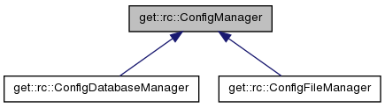
Configuration Framework
Electronics
Control & Config
Run
Control
Config ID
    C++ framework (Std & embedded OS)
    XML File & Database persistence
    Graphical Editor (based on Qt4)
    Parameter default value mechanism
    Multilanguage server access (using ICE)
    …
Config
store
Database

Slide 12
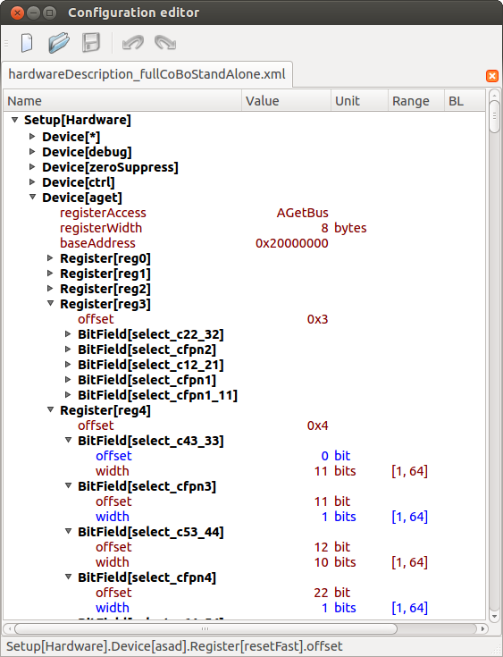
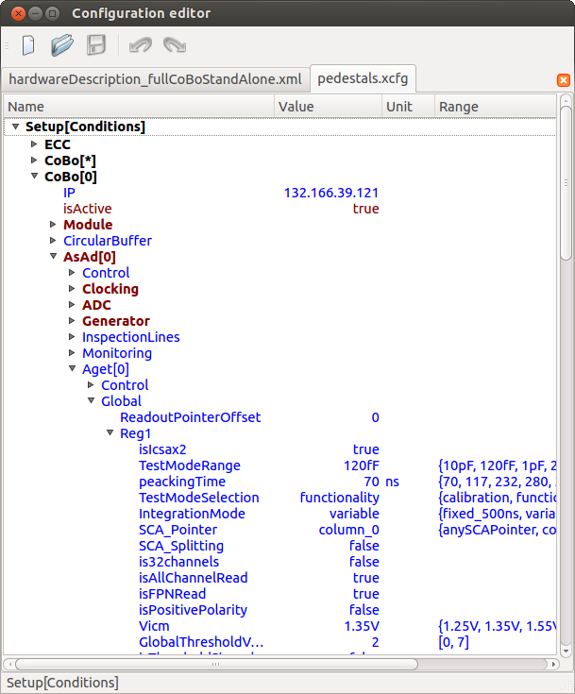
Configuration Framework
#include "CCfg/CConfig.h"
#include "CCfg/Document.h"
Ccfg::Document doc("hardware_descr.xcfg");
CCfg::CConfig cfg(doc.getConfig());
CCfg::CConfig agetCfg = cfg("Setup","Hardware")("Device","aget");
int offset = agetCfg ("Register","reg3")("offset");;
Default value
Overriden value

Slide 13
Further developments
“Batch” objects
Series of remote register access instructions than would be transported in
a single network operation to their target node and then locally interpreted and
executed.
Advanced device parameterization
The possibility to instantiate register devices of any kind with an arbitrary
number of parameters.
Parameters in more than 64-bit values.
The possibility to transfer in a single network operation the whole configDB.

