Slide 1
Development of fast frontend electronics for single-photon timing in RICH counters
M. Hoek
(hoek@uni-mainz.de)

Slide 2
Overview
Fast Timing in DIRC detectors
TRBv3 FPGA TDC Development
Frontend Electronics Developments for PANDA Barrel DIRC
Characterisation of Frontend Cards
  Laser pulser
  Test experiment with DIRC prototype
Conclusions

Slide 3

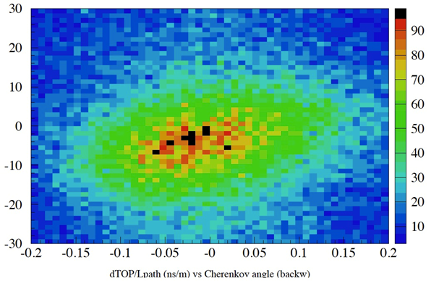
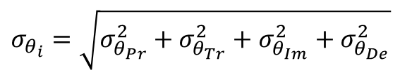
Fast Timing in Cherenkov Detectors
Fast single photon detection aids in
Pattern recognition
Improving angular resolution
1 GeV/c π
1 GeV/c K
$$σ_{θ_{i}}=\sqrt{σ_{θ_{Pr}}^{2}+σ_{θ_{Tr}}^{2}+σ_{θ_{Im}}^{2}+σ_{θ_{De}}^{2}}$$
Production
Chrom. smearing
Mult. scattering
Track bending
Transport
Scattering
Surfaces (DIRC)
Imaging & Detection
Optics
Pixel size
Stand-off distance
FDIRC Prototype
D. Roberts, RICH 2013
Planacon
MCP-PMT
Δθ_{c} [mrads]
dTOP/L_{path} = (TOP_{measured} - TOP_{expected})/L_{path}

Slide 4
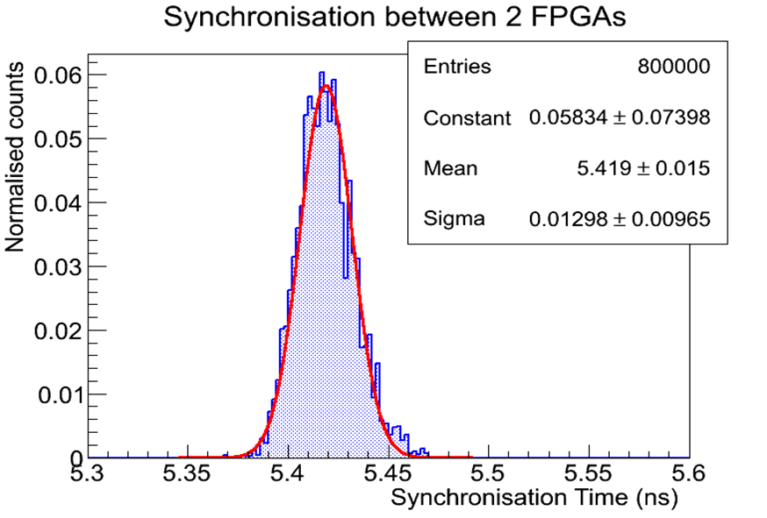
TRBv3 Platform
Signal Inputs (LVDS)
Central FPGA
(Lattice ECP3-150EA)
Central Trigger System
4 TDC channels
GbE controller
Peripheral FPGAs
(Lattice ECP3-150EA)
Each with 64 TDC channels + Synchronisation
10ps RMS time precision (<20ps RMS on all channels)
Minimum pulse width <500ps
50 MHz max hit rate (burst, up to 63 events)
700 kHz max data readout trigger rate (empty frames)
Data transfer via optical links or GbE
Signal Inputs (LVDS)
Developed at GSI (see http://trb.gsi.de/)
Readout for PANDA Barrel DIRC prototypes

Slide 5
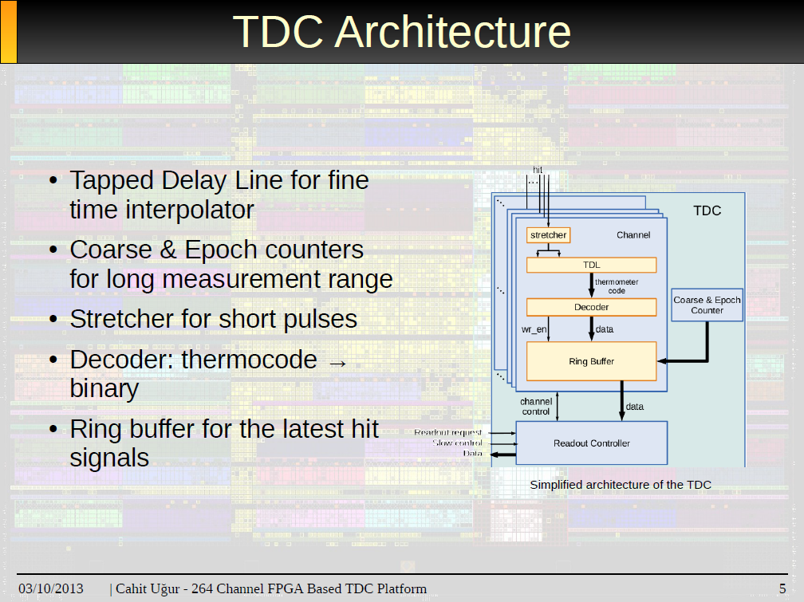
TRBv3 TDC Implementation

Slide 6
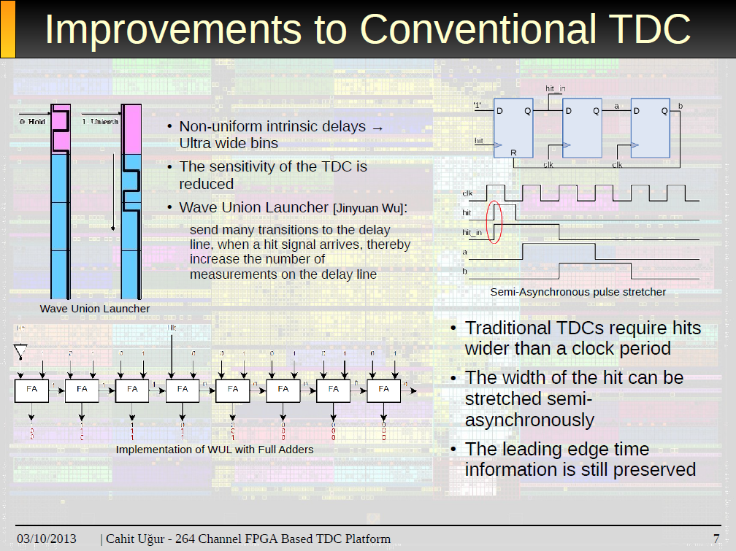
TRBv3 TDC Implementation

Slide 8
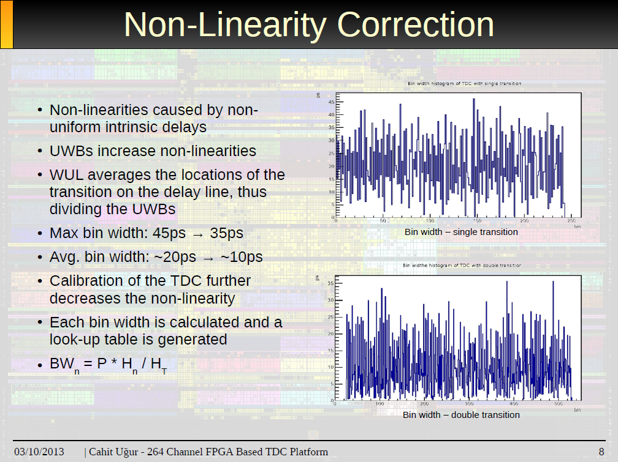
TRBv3 TDC Implementation

Slide 9
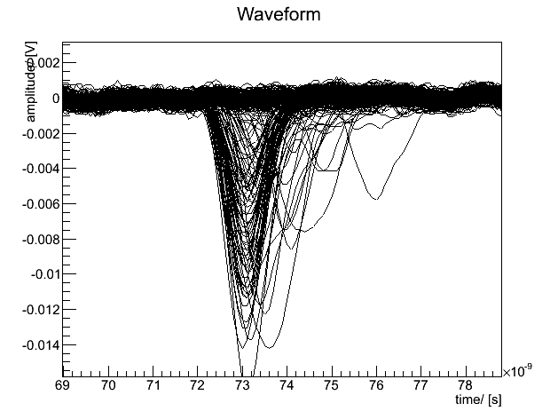
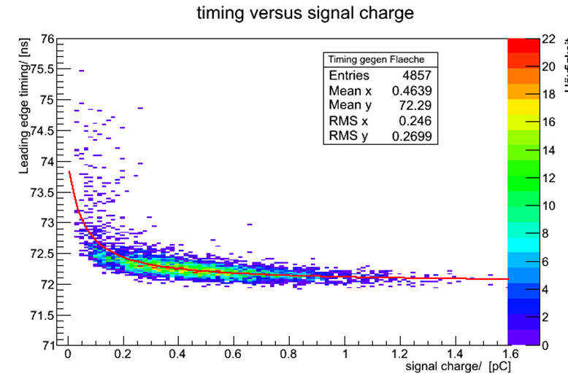
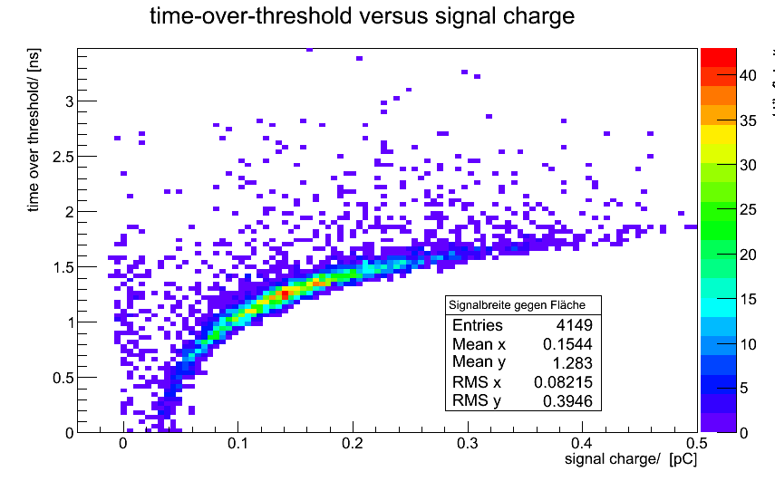
Analogue Signals (MCP-PMTs)
Single photon response
Walk correction needed for best timing resolution
Measure charge
PANDA environment demands fast readout
Use Time-over-Threshold (ToT)
Non-linear correlation!

Slide 10
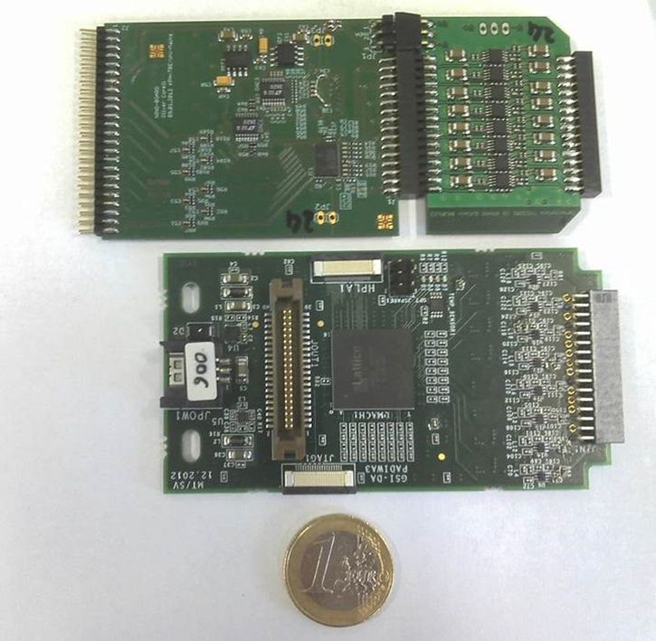
Frontend Electronics Development
FEE Brief
Form factor set by MCP-PMT (5cm height)
16 channels per card (one connector row on Planacon MCP-PMT)
LVDS output to interface TRBv3
Low power consumption
Discriminator
Card (16ch)
Pre-amplifier
Card (16ch)
LVDS output+ slow control
MCP-PMT
connector
NINO
NINO ASIC
(8 ch)
Current feedback amplifier (THS3201)
Power supply
(+5V)
PADIWA
Compare different technologies
  ASIC: NINO chip (ALICE TOF)
  FPGA: PADIWA (GSI)
LVDS output
MCP-PMT
connector
FPGA programming interface
Pre-amplifier
(MMIC)
FPGA
(Lattice MachXO2)

Slide 11
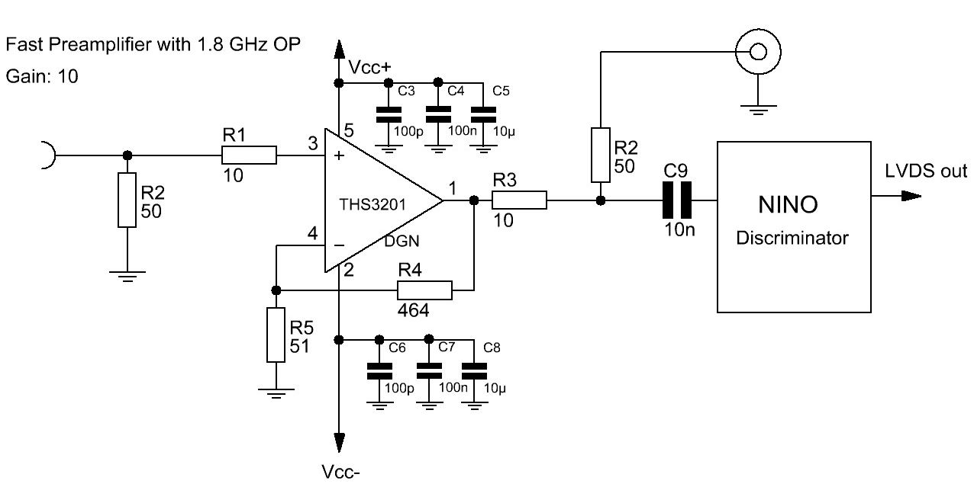
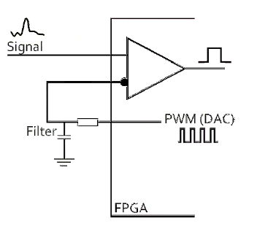
Frontend Electronics Development
NINO Card
  Adapt to single-ended signals
  Pre-amplifier (1.8 GHz) to avoid low-charge behaviour of NINO chip
PADIWA
  Input LVDS buffers in FPGAs (Lattice MachXO2) are used as discriminators
  Leading edge time and ToT are encoded in the output
  The thresholds are set by using the FPGA as DAC via PWM and low pass filter

Slide 12
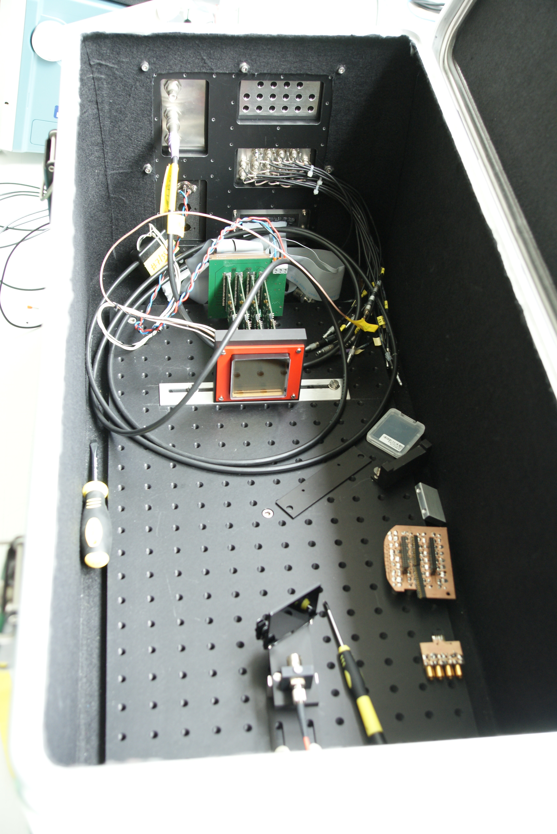
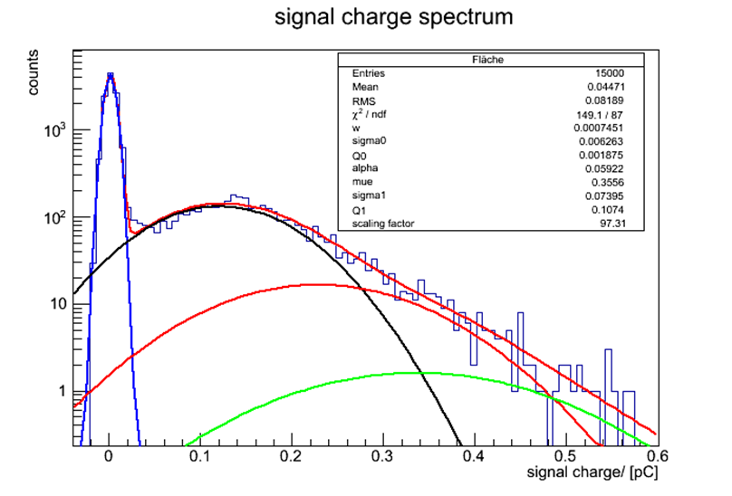
FEE Characterisation – Fast Laser
PiLas system with 633nm diode
Use ND filters to attenuate laser light
Avg photon yield ~0.3 (<4% multi photon events)
Illuminate one pixel only (laser spot ~1mm)

Slide 13
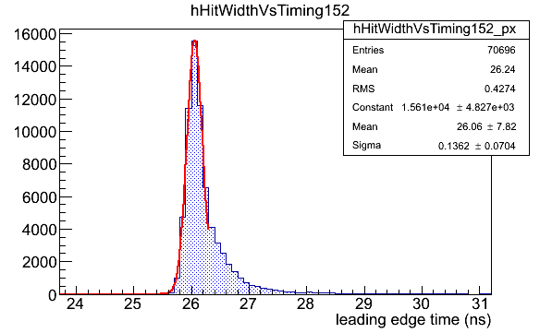
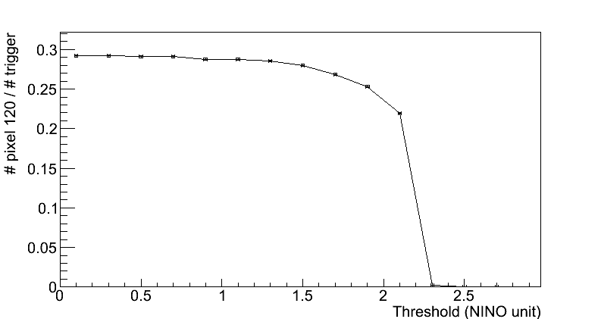
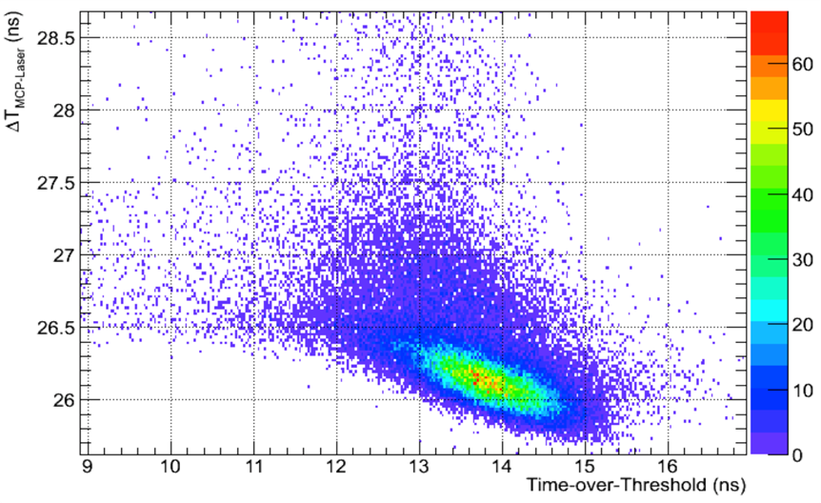
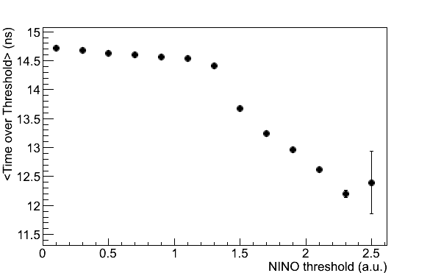
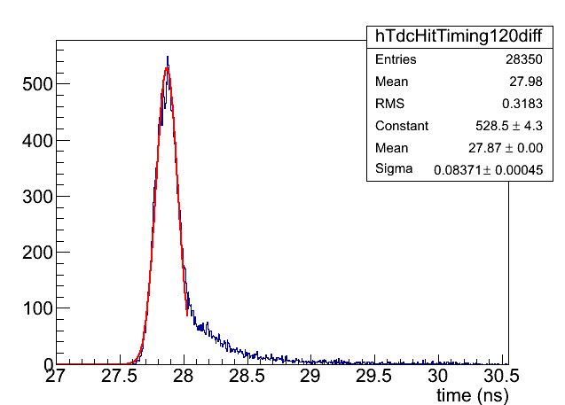
FEE Characterisation – NINO Cards
Stable threshold achieved
Observed plateau for thresholds
Walk corrections effective
136ps
Plateau
84ps

Slide 14
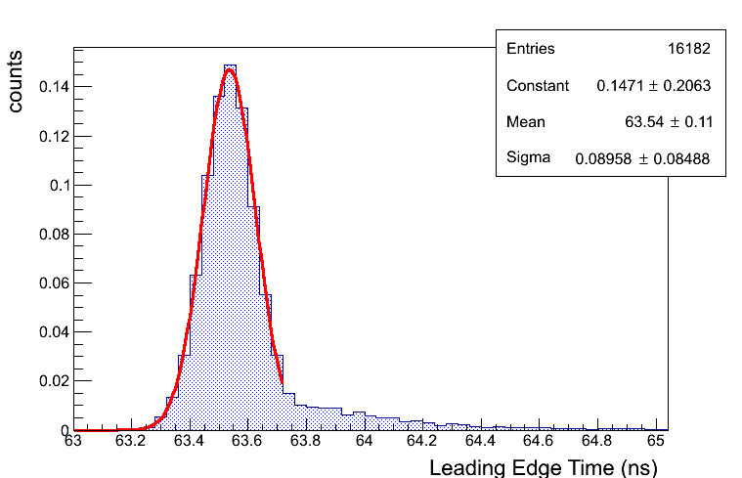
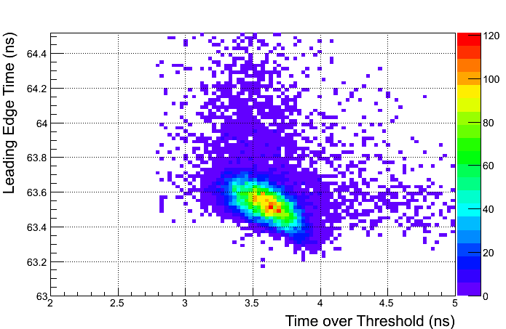
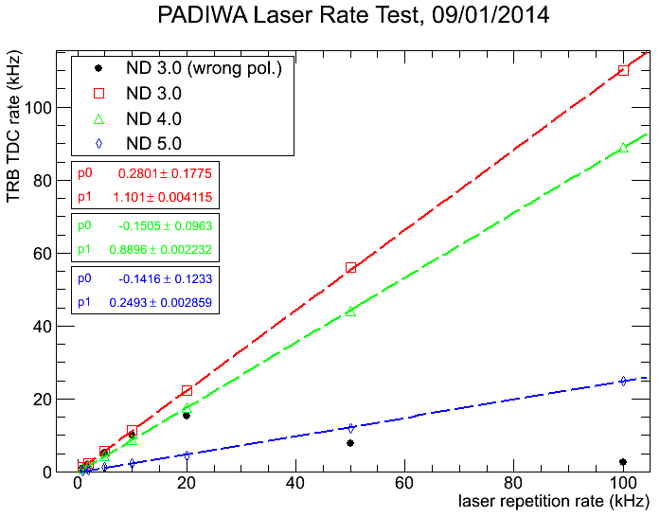
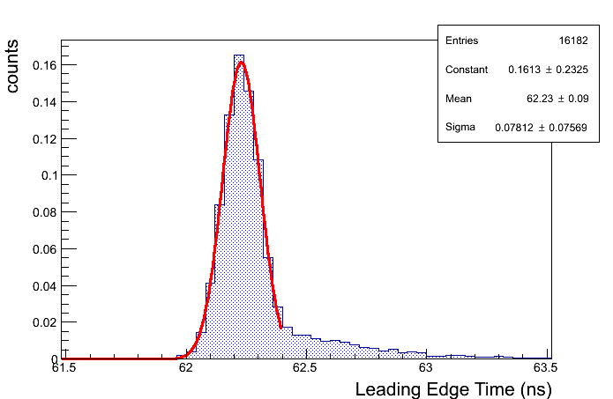
FEE Characterisation – PADIWA
Raw single photon timing resolution ~ 90ps
Walk correction implemented as 1st order polynomial based on ToT
Corrected timing resolution ~ 78ps
Rate capability tested up to 100kHz
Threshold setting very sensitive to noise
90ps
78ps

Slide 15
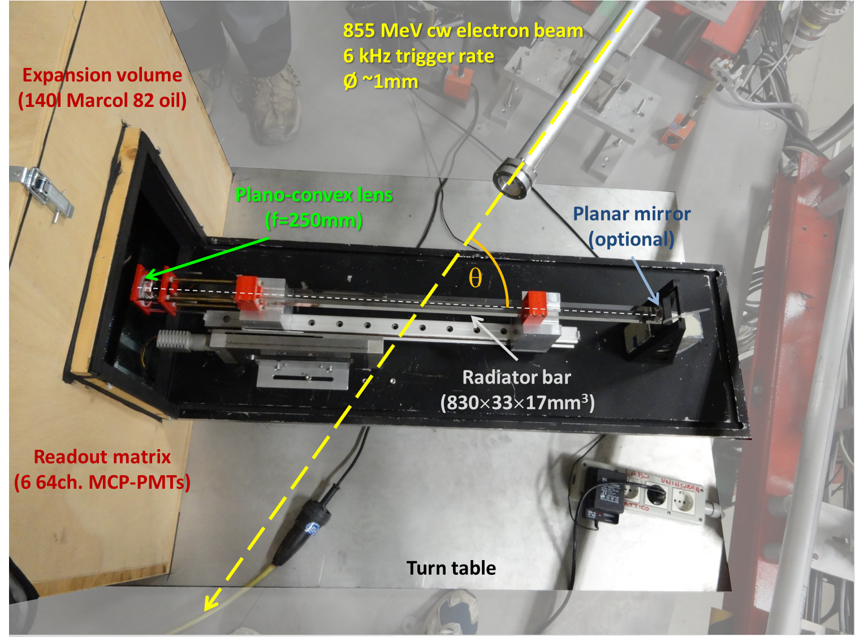
Test Experiment at MAMI (Mainz)
MCP Tower
2013 – MAMI B, 855 MeV electron beam
Test of frontend electronics
  Timing resolution
  Time walk correction
  Thresholds

Slide 16
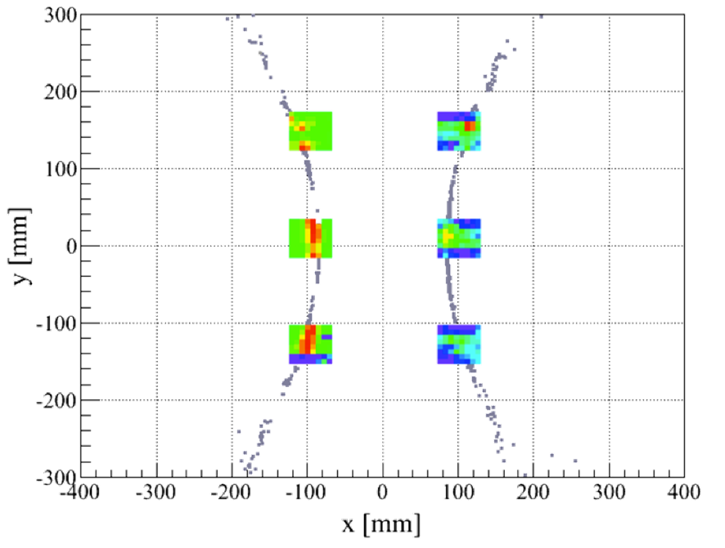
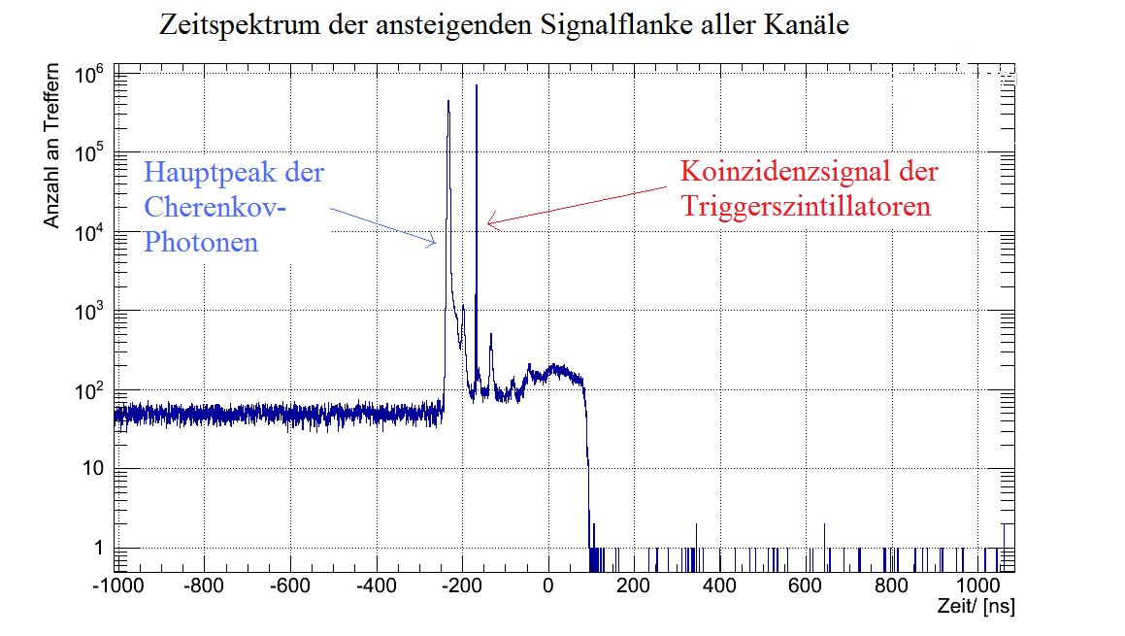
Test Experiment – Cherenkov Patterns
Up to 384 channels readout with TRBv3
Different angles to check pattern shift
Different configuration of NINO & PADIWA cards
MCP-PMT gain ~1×10⁶
NINO
PADIWA
Simulation
Cherenkov light
Trigger signal
Problems with threshold setting for PADIWA cards
No useful data from test experiment

Slide 17
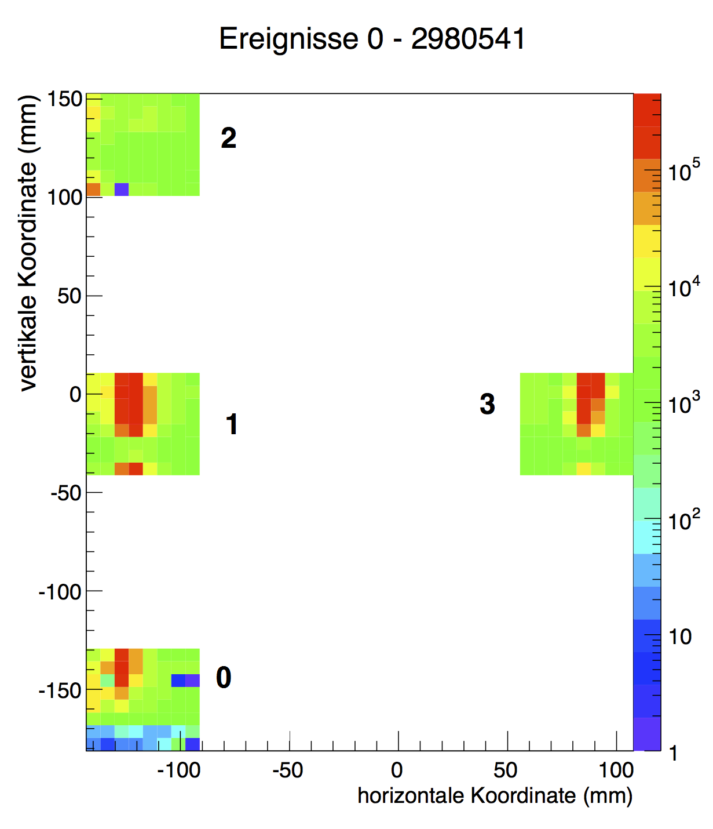
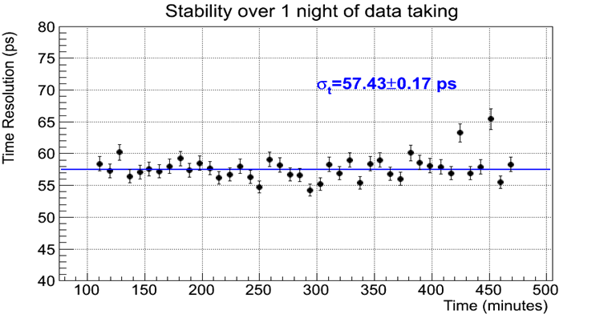
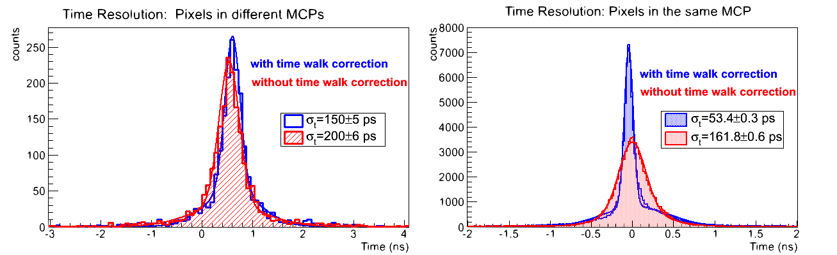
Test Experiment – Timing Results
100ps from pixel acceptance
Electronics contribution

Slide 18
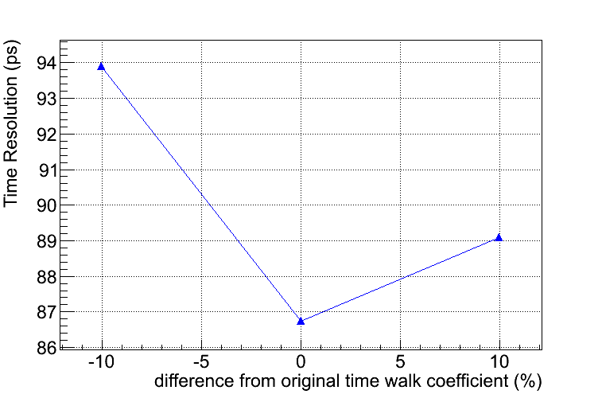
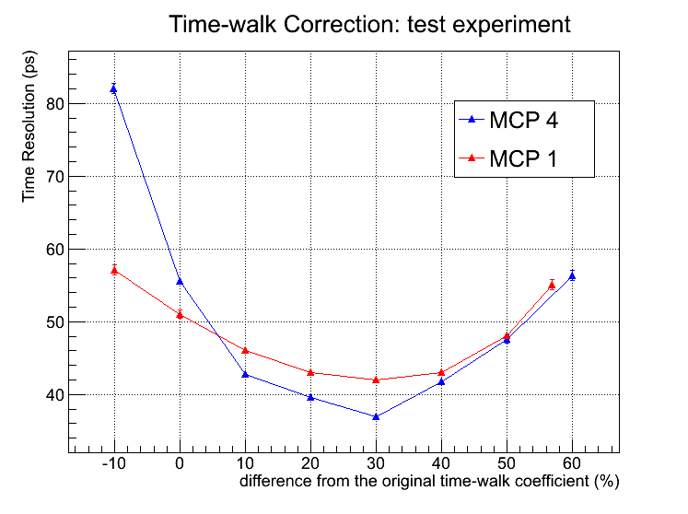
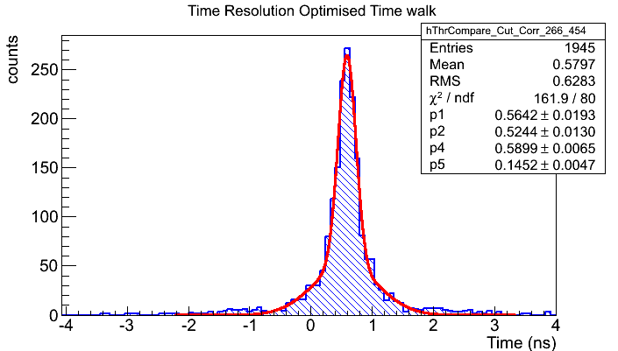
Optimisation of Timing
Initially using walk parameters from laser characterisation
Different parameters during test experiment
  Optimise walk parameters using charge sharing
Improving resolution to ~40ps
  Works on different MCP-PMTs
Little impact on system timing (~5ps)
  Governed by path length variation
145ps

Slide 19
Conclusions
Fast single photon timing (<100ps) in DIRC counters aids
  Pattern recognition
  Chromatic correction
TRBv3 FPGA TDC provides
  High-precision low cost TDC
  Up to 256 channels with <10ps RMS
Two types of Frontend Electronics developed
  NINO ASIC
  PADIWA based on FPGA
Successful characterisation with laser & test experiment
  Similar performance (<100ps SPE timing)
  Electronics contribution to timing resolution ~40ps

