Slide 1
AFP Technical Review
ToF Electronics
Michael Rijssenbeek
for the AFP QToF Institutes:
U Texas at Arlington, Stony Brook U, U Alberta at Edmonton
U New Mexico, Oklahoma SU

Slide 2
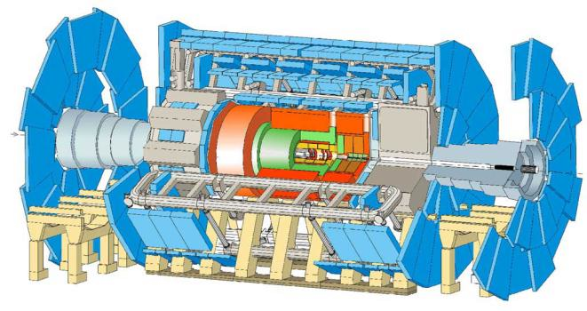
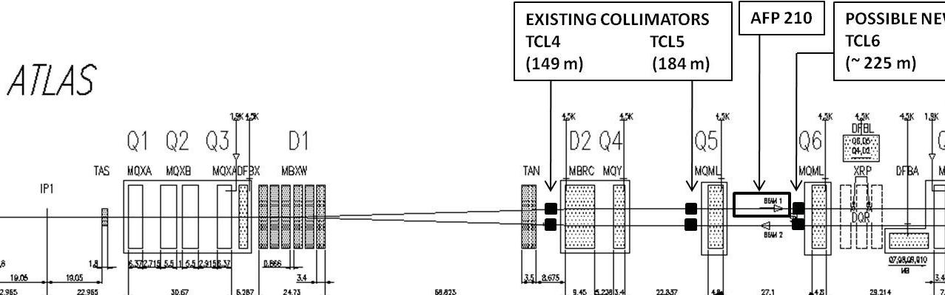
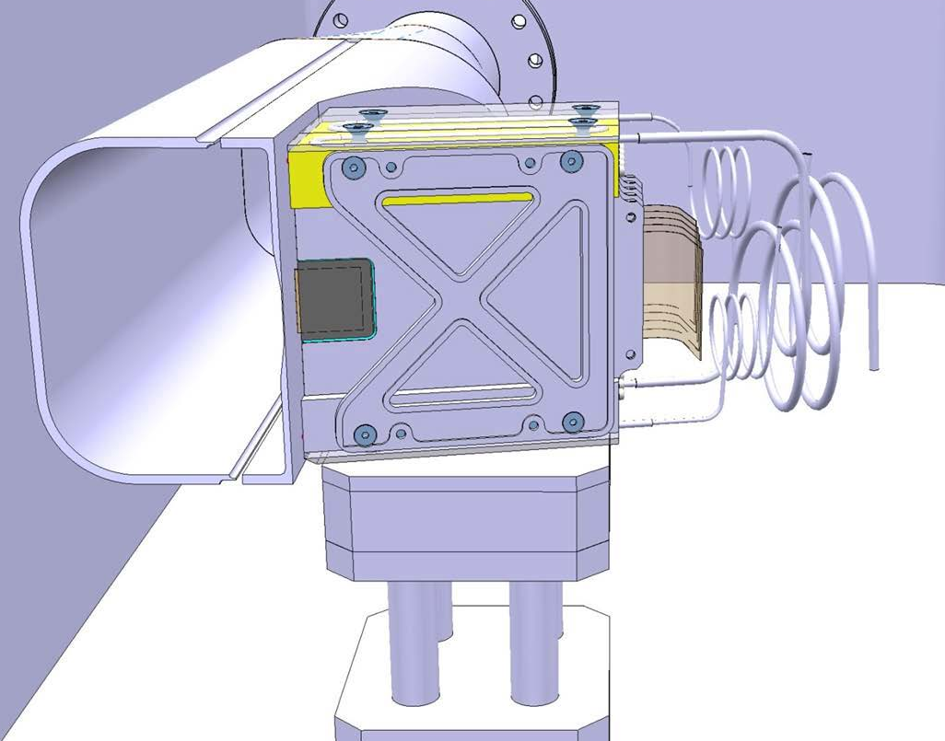

AFP – ATLAS Forward Protons
AFP
206m-214m
Diffractive
protons
Forward Proton Detectors (AFP):
  detect/measure protons
  going down the beam pipe
e.g. For pp→pXp:
where s=14 TeV, ξ fractional proton energy loss
Time of Flight:
Time difference between protons from same interaction
arriving in the two AFP arms: z_{vtx}= c(t_{L} – t_{R})/2
σ_{z}=(c/√2)×σ_{t} ~2 mm➔ σ_{t} ~10 ps
Use to reject pileup background
7 TeV
proton beam
6.5 TeV
diffractive proton
p*
p*
P
IP
IP
IP
X
γ
IP
γ
IP
X
X
γ
IP
γ
IP

Slide 3
Electronics – Goals & Constraints
preserve timing resolution of the detector: <20 ps/channel
  multiple measurements/proton ➔ <10 ps/proton
  need multiplicity also for rejection of spurious background rejection!
  trade multiplicity for resolution: 4 measurements of 20 ps ≃ 10 ps
provide fast ξ-bin trigger; transverse deflection x ∝ ξ
  data rate up to 1 MHz/channel
radiation-hardness or tolerance
  fluence/dose estimate for 100 fb^{–1} (1 yr @ 10³⁴ cm^{–2}s^{–1})
  FLUKA, IP primary/secondary interactions only, NO beam-gas (2×)
estimates for 100 fb^{–1} | 5 cm from beam @214 m | Tunnel floor @214 m | RR13 @beam level
Electronics exposed: | PA-a | PA-b, Trigger | CFD, HPTDC, Clock
High-Energy hadrons | 5·10¹²/cm² | 10¹⁰/cm² | 5·10⁹–10⁸/cm²
1 MeV-equiv. neutrons | 5·10¹¹/cm² | 5·10¹⁰/cm² | 10⁹/cm²
Integrated dose | 5000 Gy | 50 – 10 Gy | 1 – 0.1 Gy
(1 Gy = 100 rad)

Slide 4
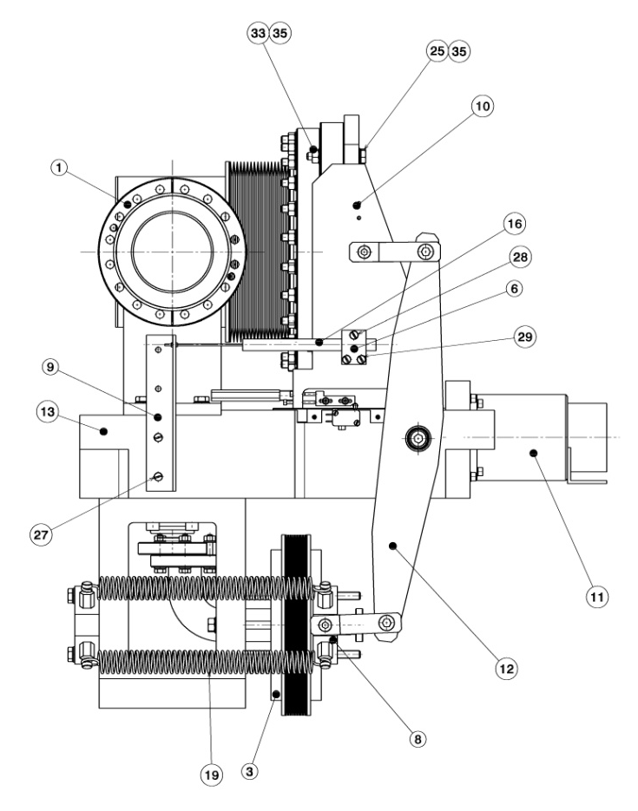
Fast Timing Electronics
Two methods to deal with pulse-height variations:
  CFD + TDC …
  Sampling of the (leading edge of the) pulse and time-walk correction
  see slides by J-F Genat, and many others at this workshop!
AFP Baseline: CFD + HPTDC
  see Jim Pinfold ‘s talk
AFP Electronics R&D: SAMPIC

Slide 5
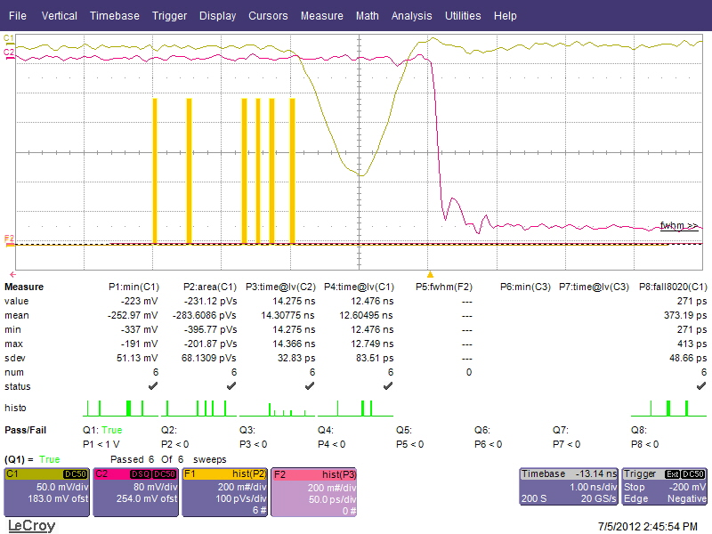

Pulse Shape and Gain Requirements
Pulse shape from UTA Laser-Lab testing (25μm pore) : 
  Gaussian, FWHM ~700 ps (t_{rise}~300 ps)
  Minimum pulse height at 2 pe, G=1E5: V_{peak}~2 mV (~30 fC in 50 Ω)
Trigger: needs ~100 fC
CFD needs: 250 – 1500 mV
  2 mV ➔ 200 mV: 40 dB
  PMT pixel variation: ~6 dB
  PMT ageing: ~6 dB
Need ~50 dB gain
  2 or 4 (inverting) stages of ~20 dB each

Slide 6
Irradiation of AFP Electronics
estimates for 100 fb^{–1} (need update!) | 5 cm from beam @214 m | Tunnel floor @214 m | RR13 @beam level
Electronics exposed: | PA-a | PA-b, Trigger | CFD, HPTDC, Clock
High-Energy hadrons | 5·10¹²/cm² | 10¹⁰/cm² | 5·10⁹–10⁸/cm²
1 MeV-equiv. neutrons | 5·10¹¹/cm² | 5·10¹⁰/cm² | 10⁹/cm²
Integrated dose | 5000 Gy | 50 – 10 Gy | 1 – 0.1 Gy
HiRad protocol:
  Neutrons or HE protons: 10¹² – 10¹³ /cm²; γ: 1 – 10 kGy.
MedRad protocol:
  Neutrons or HE protons: 10¹¹ – 10¹² /cm²; γ: 10 – 1 kGy.
PA-a chips (PSA4-5043+): HiRad
PA-b boards & trigger: MedRad
NINO chips (trigger): MedRad
CFD daughter boards: MedRad
HPTDC chips: MedRad
Cfr. ALFA radiation dose LHC Run1 measured over 2010–2013 (~30 fb^{–1}): ~20-30 Gy in each pot (≥10 cm from beam)
See: K.Hiller, S.Jakobsen, S.Franz, ALFA General Meeting, Cracow, June 5-7, 201.

Slide 7
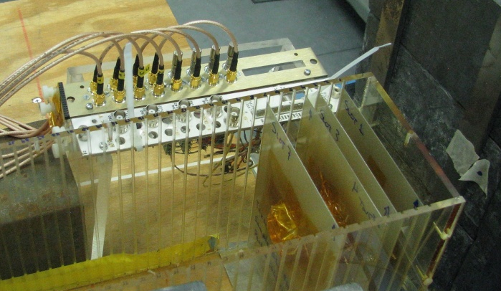
Irradiation – Sep 2013
Irradiated at LANL Sept 2013; S. Seidel et al. (UNM), K. Gray (UTA):
800 MeV p, ~7 cm from direct beam; passive
  dose: 6.5-8.7×10¹² p/cm², 2.3-3.1 kGy
  for 100 fb^{–1}: ~expected for PA-a; ~50× expected
  for PA-b and CFD
  devices are all operational after irradiation!
Feed
through
AFP2
crate
RR13 ?
crate
USA15
crates
Quartic
Trigger (LMR600)
PA-b
CTF
Trigger
64× Signal
(SMA)
LE
TDC
ToT
PA-a
Att
CFD
ToT
(50 Ω)
Signals
Opto
Board
Data
BOC-ROD
or RCE
LV
+6V 5A
LV
+6V 20A
DCS
DCS
DCS
8× Temp
(uD)
DCS
2× Pressure
DCS
iseg
HV
8× HV
(32 ch REDEL-HV)
214 m
214 m
240 m
0 m

Slide 8
Irradiation @ LANSCE – Jan 2014
LANSCE Beam
PA-a
4×
PA-b
Att
4×
CFD
4 HPTDC
chips
1→4
–6 dB
2 HPTDC chips: 1×10¹² p/cm²
2 HPTDC chips: 1×10¹³ p/cm²
–20
dB
+5V
+5V
+3.3V
+1.3V
–5V
30 m
Data
Pulse
LMR400
Ref CLK
Trigger
CTP
(NIM)
CFD-LV
(NIM)
HPTDC
(NIM)
Safe Area
NIM LV
±6V 3A

Slide 9
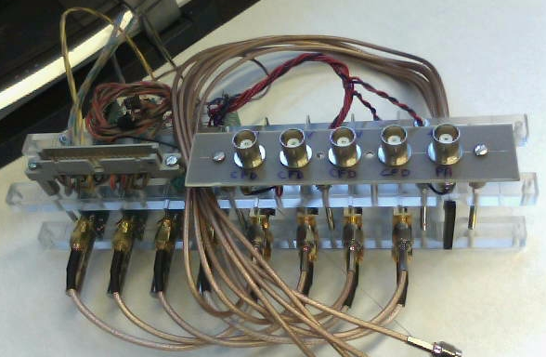
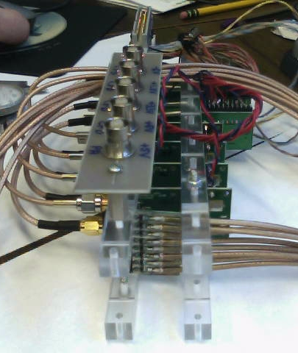
4-Channel Electronics Setup
Jan 31- Feb 2 irradiation at LANSCE
Protocol:
  Active irradiation
  up to 1.0×10¹³ p/cm², in 10 steps of 1×10¹² p/cm²
  i.e. 10 pulses of 10¹¹ protons per step
CFD
PA-b
PA-a
Beam View

Slide 10
January 31- Feb 2 Irradiation
People: Tim Hoffman (UTA); Sally Seidel, Martin Hoeferkamp (UNM)
Protocol: Active irradiation – keep voltages on!
  up to 1.0×10¹³ p/cm², in 10 ‘steps’ of 1×10¹² p/cm²; verify operation before & after each step.
  i.e. 1 ‘step’ equals ~10 pulses of 10¹¹ protons/pulse, 1 Hz, ~1 cm Ø
Early results:
  HPTDC readout did not work (cable too short) ➔ 2 Channels were monitored on scope; all 4 channels were powered throughout the run.
  Irradiation up to 5.0×10¹³ p/cm²
  2 monitored channels were still operating at the end of the run
Next:
  Wait for cool-off and return of parts (<2 months)
  Pre-Amps, CFDs: Re-test performance and compare with non-irradiated parts
  HPTDC chips: mount on HPTDC board and check operation

Slide 11
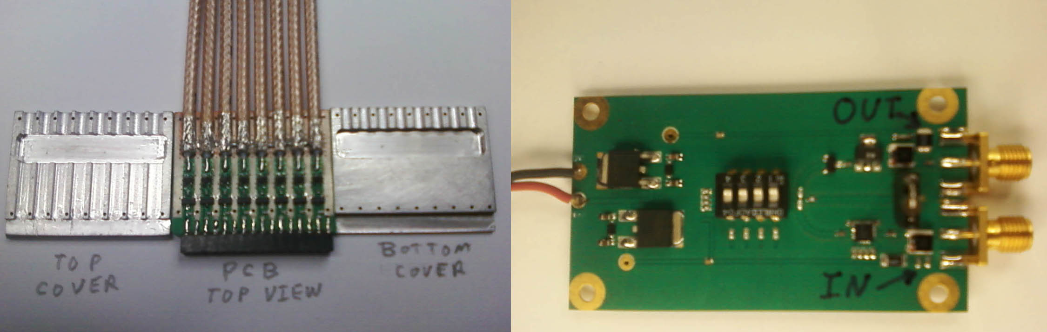
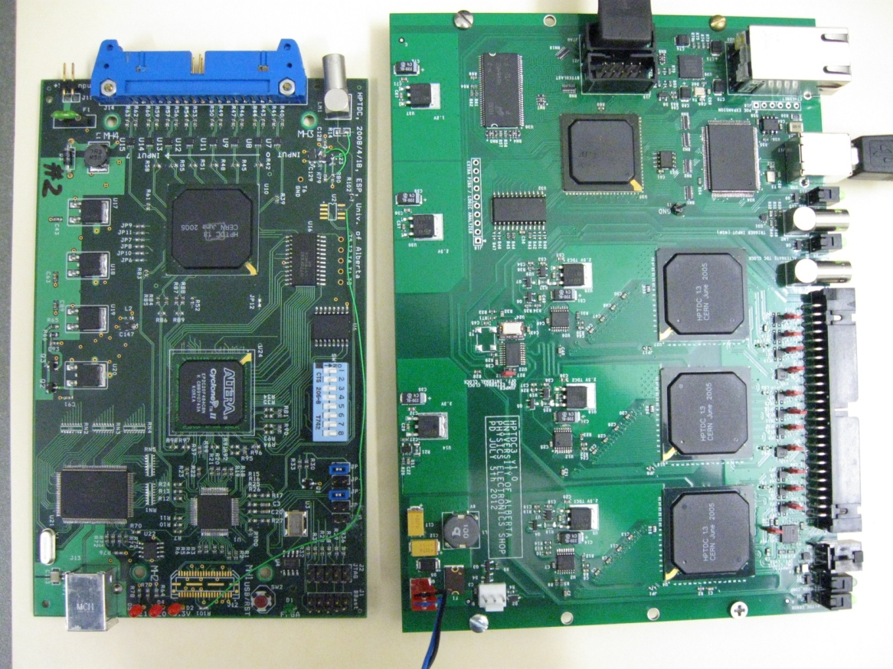
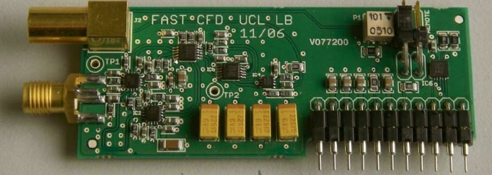
Fast ToF Electronics: we have …
Proven designs & prototype 8-ch modules for:
  Preamp on PMT (PA-a) (4×8 channels)
  2nd stage variable-gain amp on tunnel floor (PA-b) (2×8 channels)
  Constant Fraction Discriminator (CFD) (3×8 channels)
  High-Precision Time to Digital Converter (HPTDC) (3 12-ch modules)
Have design for:
  Trigger pick-off and Multiplicity Trigger board (based on NINO chip)
SMA
pigtails
PA-b 1st Prototype
8-Channel Preamplifier (PA-a)
Alberta CFD Daughter Board
Alberta HPTDC Board

Slide 12
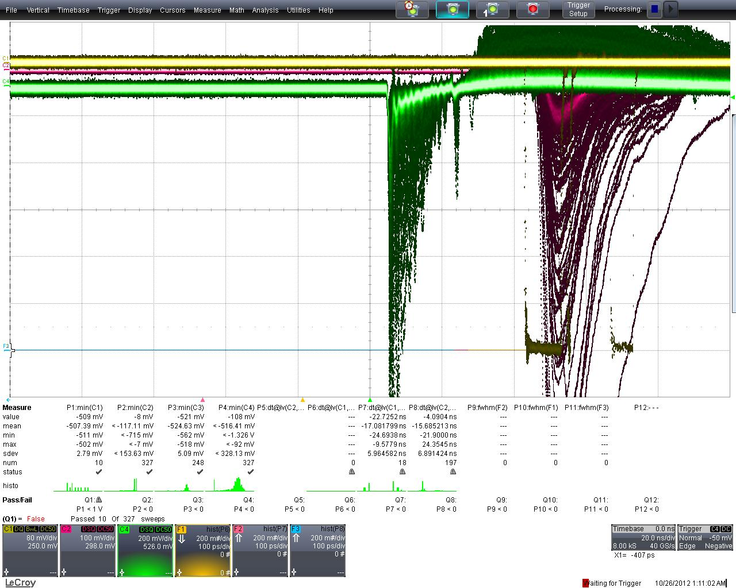
Preamp/amp reflections
20 ns/div; need to reduce “ringing”, tail, and reflection @ 20 ns
  Reflection:
  Understood:
  caused by
  mismatch of
  PA-b traces …
  Re-do PA-b PCB
  1 ns ringing:
  unclear, not seen
  with test pulses …
  PMT?
20 GHz LeCroy Oscilloscope pictures from beam test

Slide 13
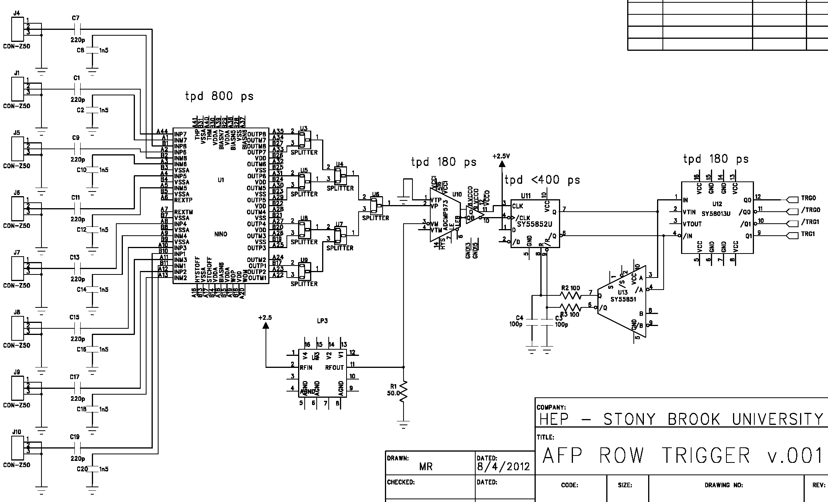
To Do: Trigger – Stony Brook
on PA-b motherboard; uses signal pick-offs from PA-b
  to be simulated with final layout and prototyped
  Output driver: to be designed …
Trigger Schematic

Slide 14
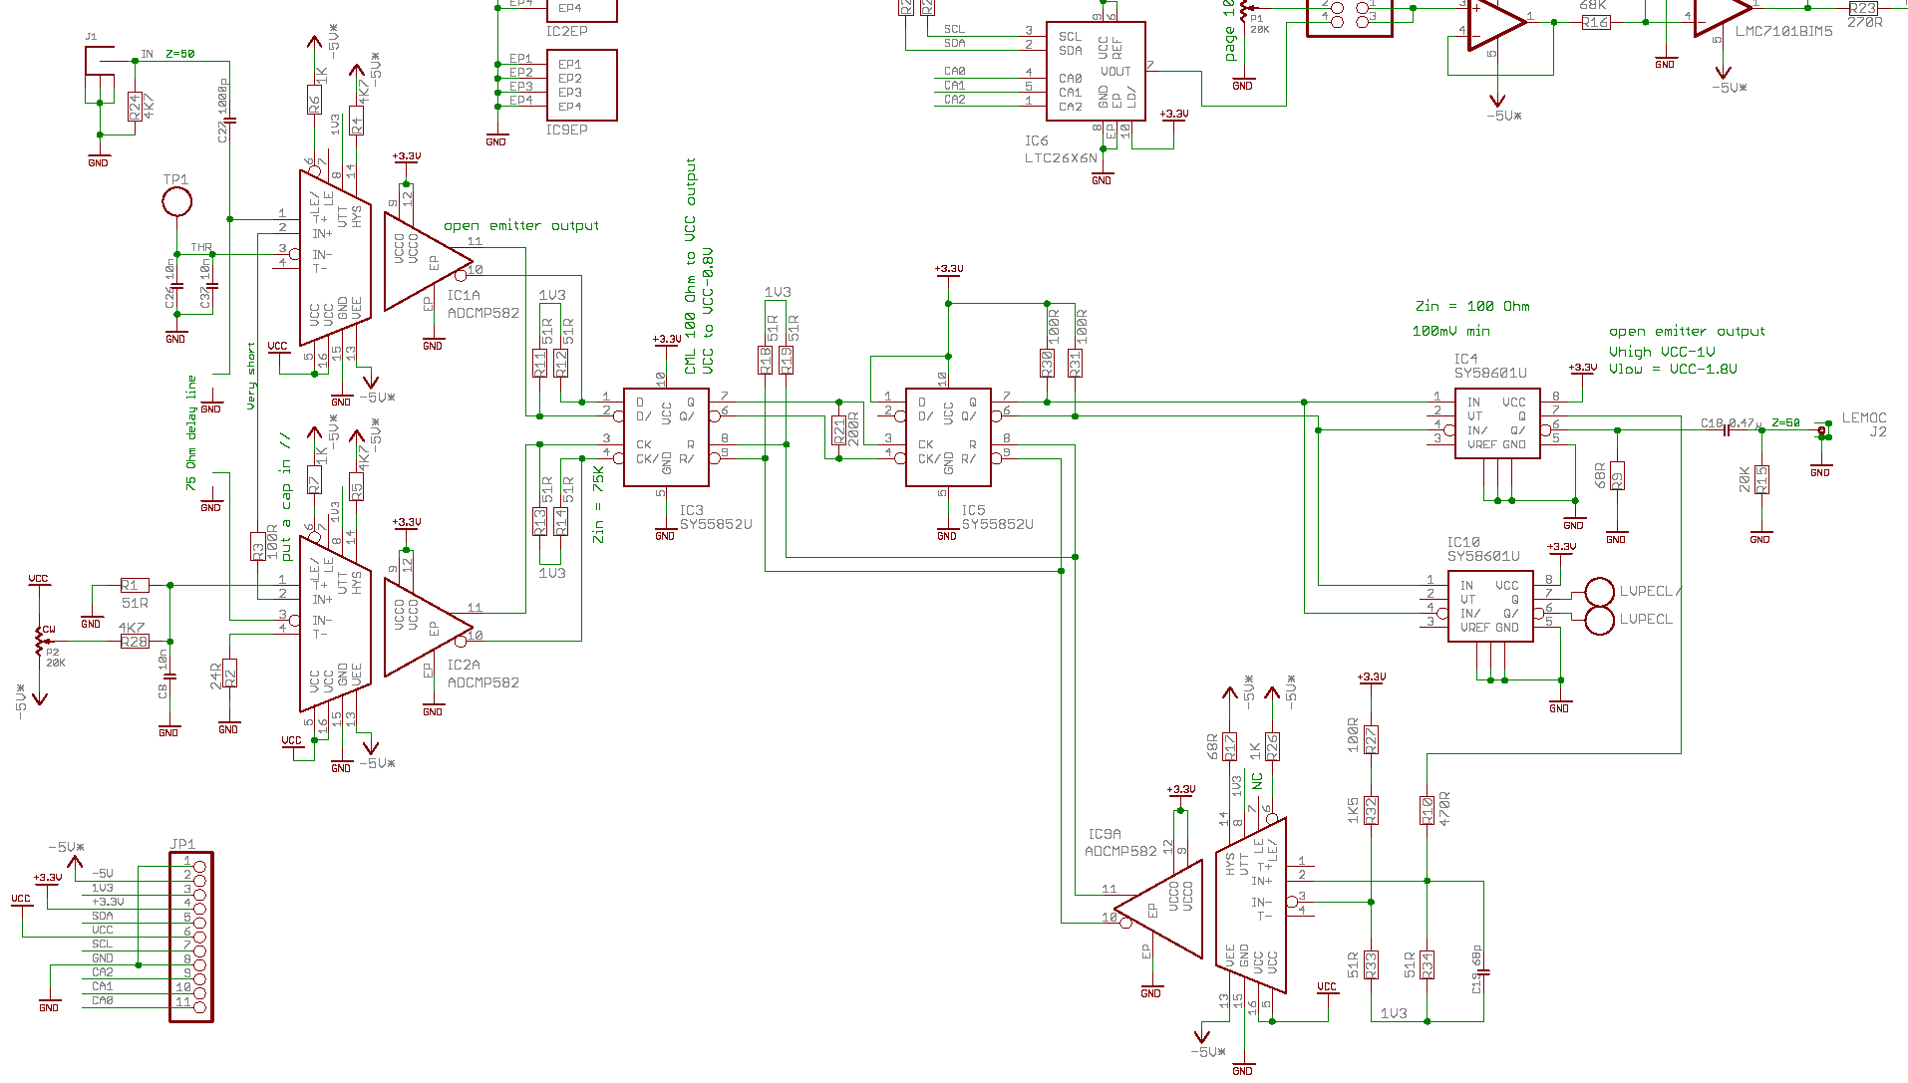
To Do: Modify CFD – U Alberta
  add “Latch Enable”
  add Time-over-Thres-
  hold functionality
  Design Almost complete
D/FF and Drivers from Micrel
8 GHz SiGe Comparators from Analog Devices: 10 ps deterministic jitter, 0.1 ps random jitter

Slide 15
Status Fast ToF Electronics: To Do …
Fast, ultra-stable, long-distance reference clock (U Texas at Arlington)
  prototype working: ~5 ps jitter
  Clock fanout: to be designed & built: (U New Mexico)
Trigger (Stony Brook):
  build prototype (Design almost complete)
  Radiation testing
  AFP trigger interface with CTF
Modification of CFD (Alberta):
  add Time-over-Threshold functionality (Design almost complete)
  build prototype
Modification of HPTDC (Alberta):
  Rad-tolerant design
  add ToT functionality (Design almost complete)
  build prototype
  Radiation testing
Readout:
  Opto board (2 pc ordered)
  RCE Interface (SLAC/SBU) used for IBL tests
DCS (?)

