Slide 1
LHC Fast Timing Detector R&D
Andrew Brandt, University of Texas at Arlington
(for North America fast timing group:Alberta, New Mexico, Oklahoma State, Stony Brook, UTA)
Purpose: Pileup background rejection/signal confirmation
Purpose: Pileup background rejection/signal confirmation
Use arrival time difference between protons to measure z-vertex compared with the central tracking primary vertex
Use arrival time difference between protons to measure z-vertex compared with the central tracking primary vertex
Ex: Two protons from one interaction and two jets from another
Intro/overview
PMT lifetime including new approach
New detector development

Slide 2
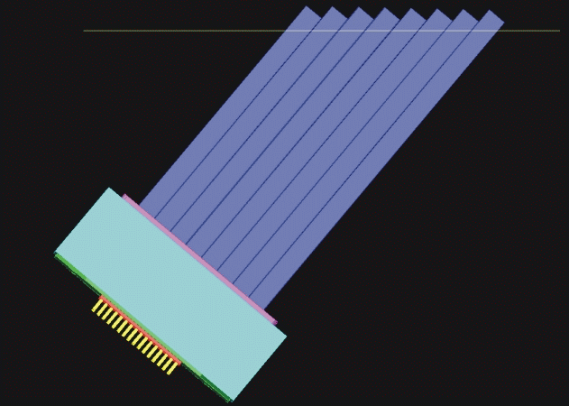
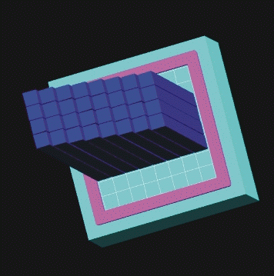
QUARTIC Concept (an oldie but a goodie)
Quartz bars at Cherenkov angle read out by MCP-PMT
Idea of Mike Albrow for FP420 (joint ATLAS/ CMS effort) 2004 based on Nagoya detector
proton
photons
1.4.1.1
Initial design: 4x8 array of 6x6 mm² ~10 cm long quartz (fused silica) bars, not coincidentally well-matched to then Burle now Photonis Planacon
Isochronous—by mounting detector at Cherenkov angle, all light reaches tube at ~same time
1 2 3 4
MCP-PMT
Proton is deflected into one of the rows and measured by eight different bars/detector with a micro-channel plate PMT.
If δt= 40 ps/bar need 16 measurements/row for 10 ps
If δt= 28 ps/bar need 8 measurements/row for 10 ps
Increase #rows to avoid multi-proton and rate effects (pixelation)

Slide 3
An R&D Success Story
Led by UTA/Brandt raised ~400k$ in Generic R&D funds from Texas ARP (2006) , DOE ADR (2007 w/ Burle/Photonis), NSF SBIR (2011 w/ Arradiance Inc.) , DOE ADR (2011 w/Stony Brook), and in-kind from Universities
From first test beam in 2006 to last one in 2012 improved the resolution: - by a factor 5 from 100 ps/bar to 19 ps/bar (for PMT/MCP-PMT/CFD) - by a factor 4 (24 ps/bar) if you include the HPTDC
The improvement was due to a combination of many factors:
- coupling of q-bar to MCP-PMT
- MCP-PMT pore size (25 µm to 10 µm) and optimized gain/HV
- improved amplifier and CFD (based on Louvain design with modest improvements from Alberta + Stony Brook) . Note: a low noise, well-shielded amplifier is really a crucial, rarely discussed aspect of fast timing (electronics discussed in M. Rij talk)
Designed and built prototypes for a full system including all electronics

Slide 4
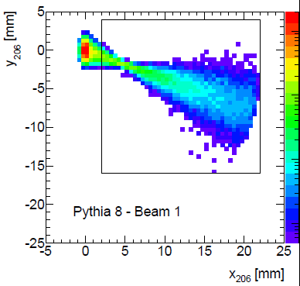
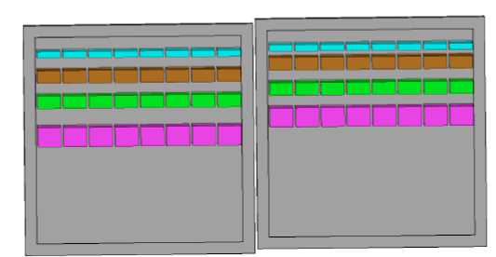
We Developed a 10 ps TOF System for use with a Hamburg Pipe
2 cm x2 cm
beam
Large x proton
Deflection from beam)
Validated the components of this design in test beam and at UTA Picosecond Test Facility with laser and “undergrad army”
Design considerations:
1) full acceptance, excellent timing expected <10 ps
8 rows with Δx =1.5 to 3 mm (x=distance of proton from beam) to
minimize multi-proton effects (>90% efficient ) and keep rate/pixel
under 5 MHz to help control current/lifetime issues
gaps between rows to reduce cross talk
capable of operating beyond 50 interactions/crossing (where <N>=1/det/BC)

Slide 5
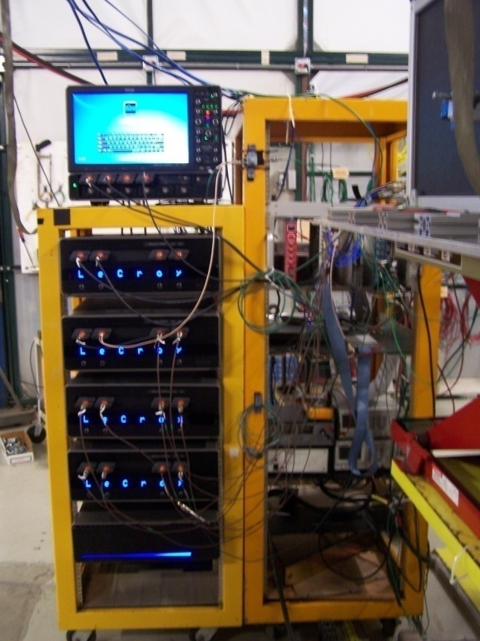
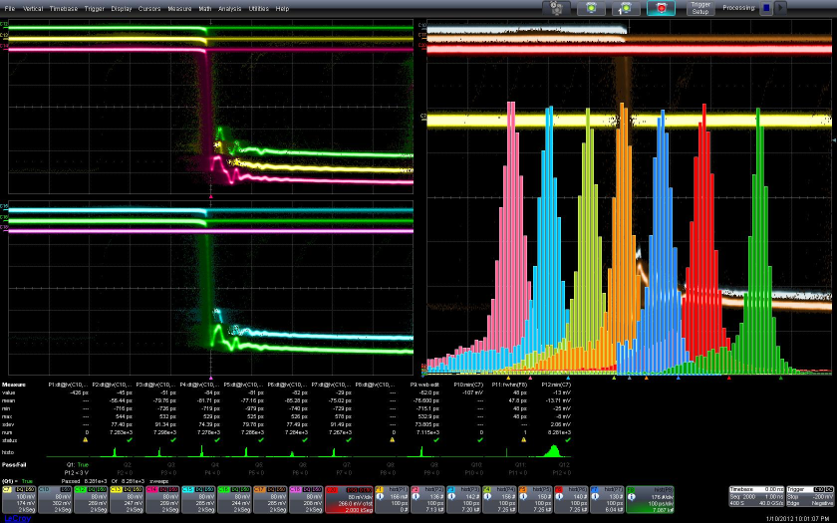
T958 DAQ (FNAL 1/2012)
Time difference between reference detector (FNAL SiPM in Nagoya mode courtesy of Albrow +Ronzhin) and 6 –bar Quartic average gives online FWHM=47 ps (σ=20 ps), removing SiPM resolution gives δQavg=14-15 ps
2 3 4 5 6 7 Avg
Just your garden variety 20 channel, 20 GHz/ch, 40 Gs/s/ch (point every 25ps) 500k$ LeCroy 9Zi scope! Thanks for the loaner LeCroy

Slide 6
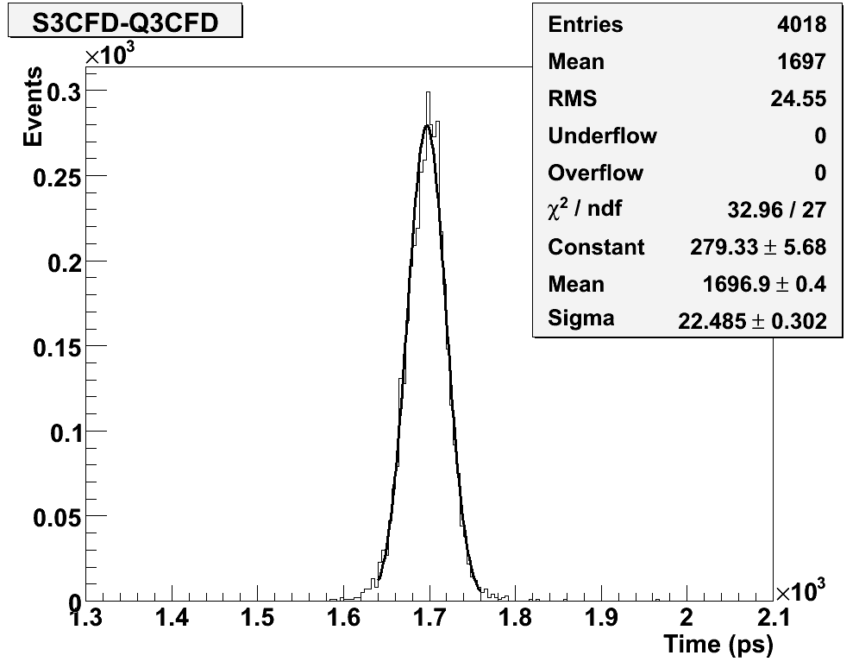
Validate Thin Bar
With 10 um tube and 2x6x140mm quartz bar we get same results as 5x6x140 mm bar, and both are improved from 1/2012 single bar timing. Resolution: Bar+PMT+CFD=22ps - SiPM = 19 ps +HPTDC~24 ps/bar!
We have some 1x6 bars, but
they look very fragile

Slide 7
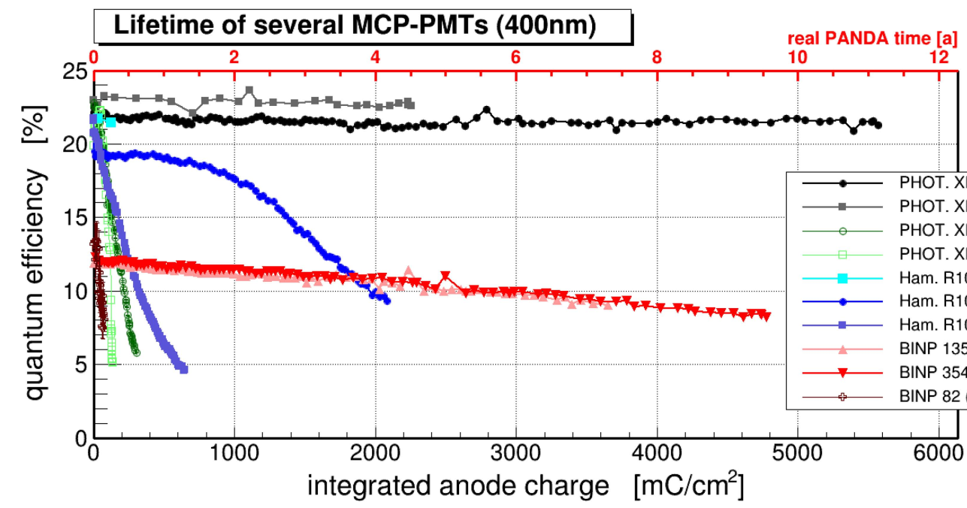
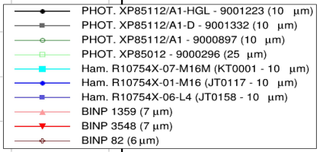
Rate and Lifetime Issues
Historically MCP-PMT’s have not been extremely robust, their performance (QE) degrades from positive ion feedback (“an unsolvable problem”) Challenge accepted!
Formed a collaboration between UTA, Arradiance Inc. , and Photonis in 2009 to help address this [phone call with Emile, Bruce Leprade, Paul Hink, Neal Sullivan and me] (2011 SBIR funds important for ALD development including refining process leading to Lehman Super tube)
<20 ps single bar resolution at 5 MHz rep rate (10 pe per event) even at low gain for EDR MCP (11 MΩ); 10 μm pore would improve resol. and rate capability
Photonis Planacon with Arradiance ALD-coated 10 (25) μm pores
Hamamatsu ion barrier SL10
Lehman et al. (Panda conditions) No loss in QE with ∫Q>6 C/cm² >10x improvement over non-ALD tube For LHC 1C~10 fb⁻¹

Slide 8
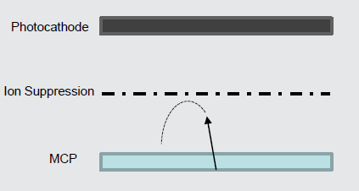
Lifetime Solutions (NEW!)
Photonis Parallel Development Effort (patent pending)
Could be used instead of, or as acomplement to, ALD coating of MCP’s
-Features an electrostatic ion suppression
grid (basically an energized ion barrier)
Grid between MCP and photocathode
to reduce/prevent + ions from reaching
and damaging photocathode
Complete suppression requires grid bias
to be energetically higher than the
highest bias source of + ions (MCP-out)
Time delay (ion TOF aka afterpulsing) increases as the ions are decelerated
and eventually suppressed from reaching the photocathode
Coulds still get some level of afterpulsing from ions on surface of MCP or from energetic neutrals

Slide 9
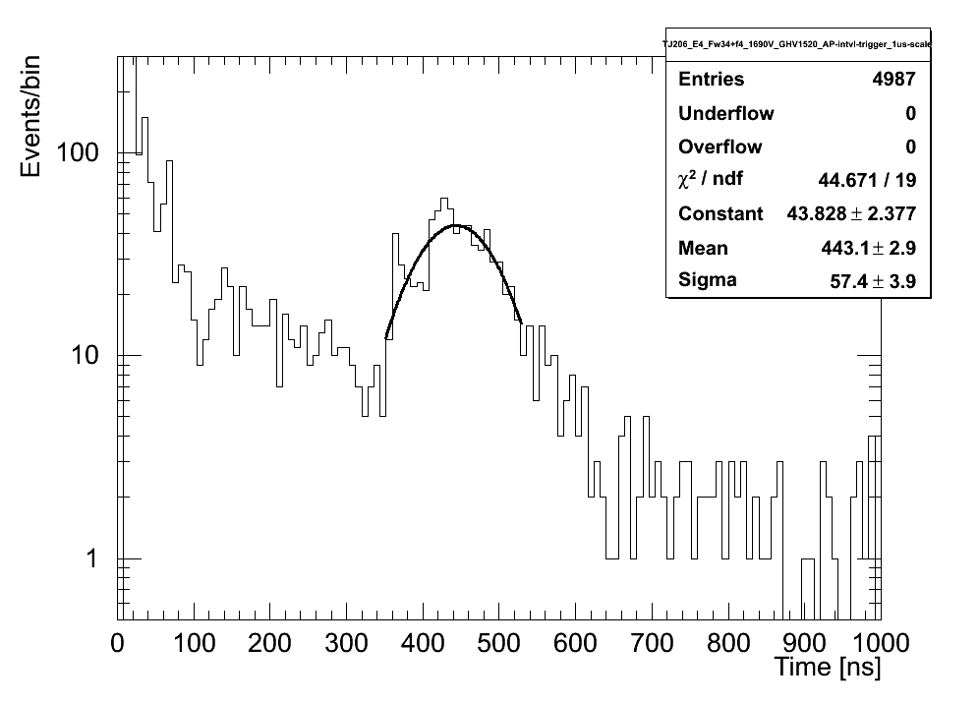
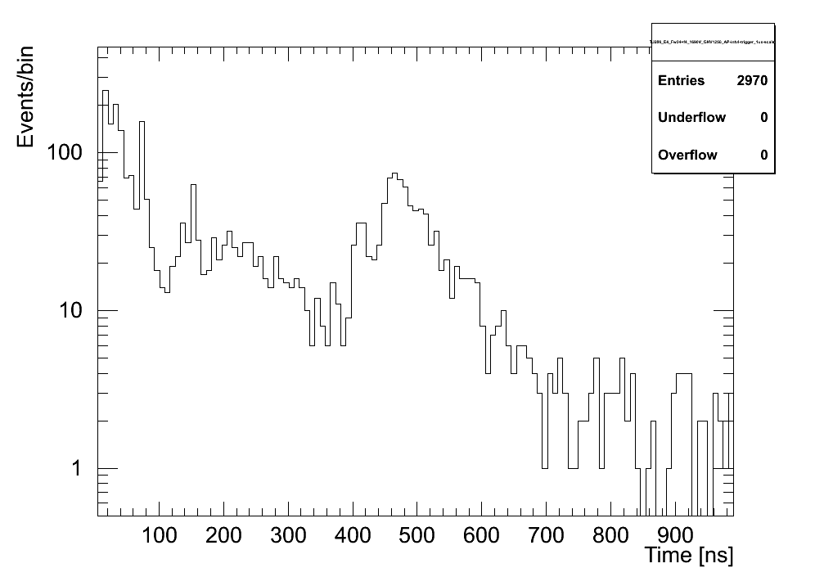

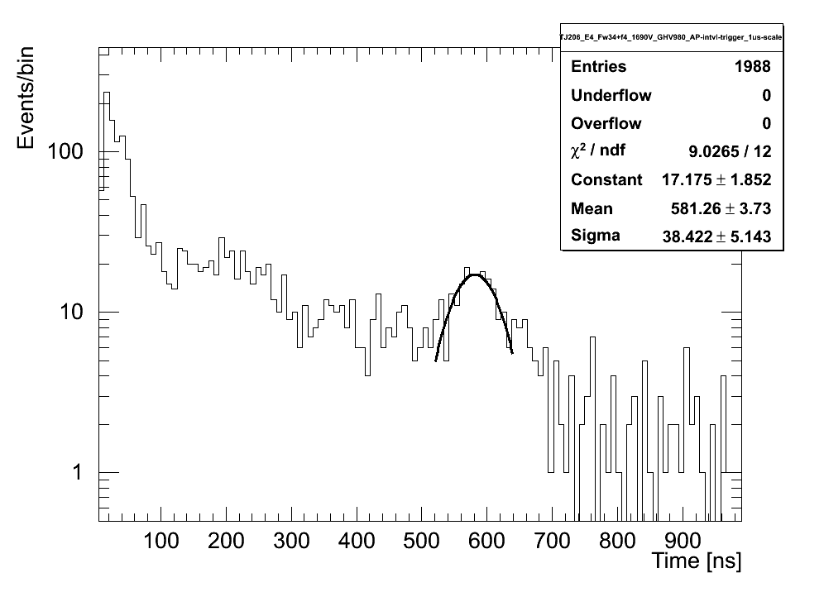
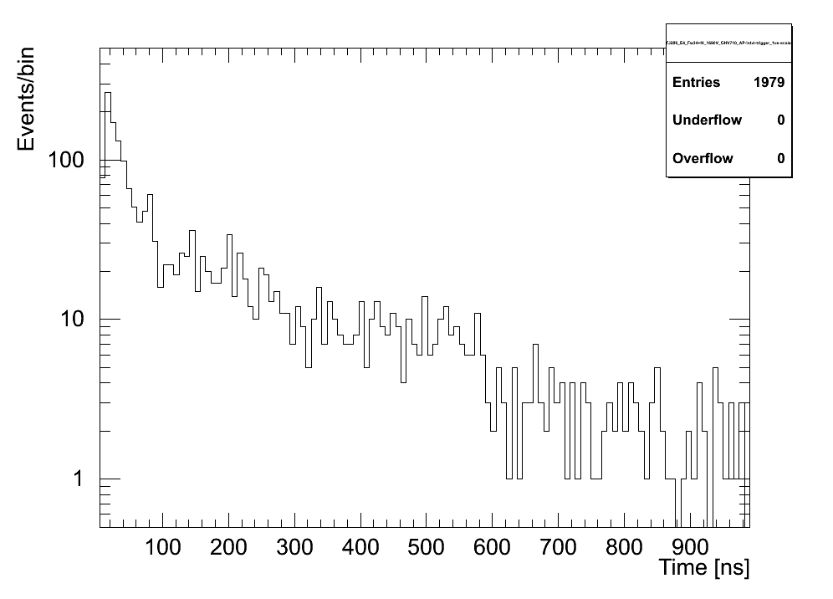
Afterpulsing as a f(GridVoltage)
Grid off
Grid 20%
Tests
Done
In
Secret
At
UTA
PTF
Preliminary
Grid 40%
Grid 60%
Large suppression in “heavy metals” as grid is activated;
generic positive ion suppresion factor (#AP grid on/grid off) is about 4x

Slide 10
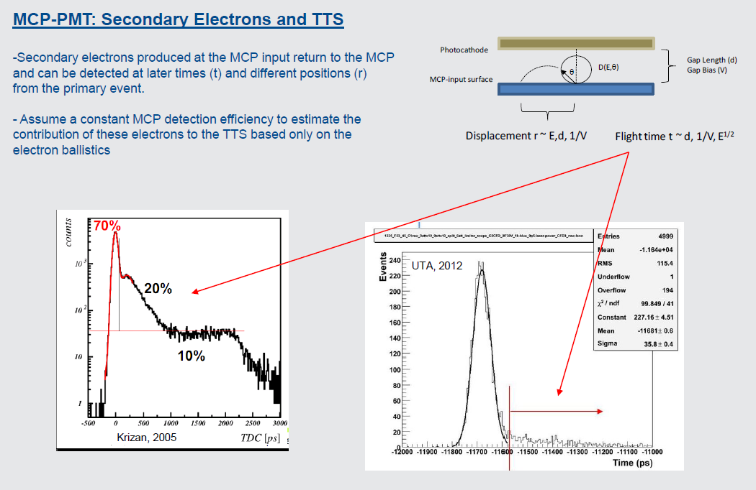
MCP-PMT 101 Courtesy of J. Defazio , Photonis USA

Slide 11
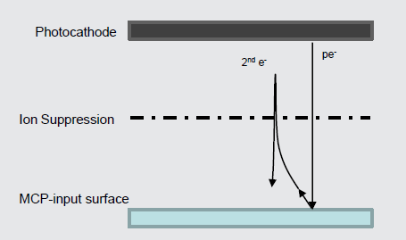
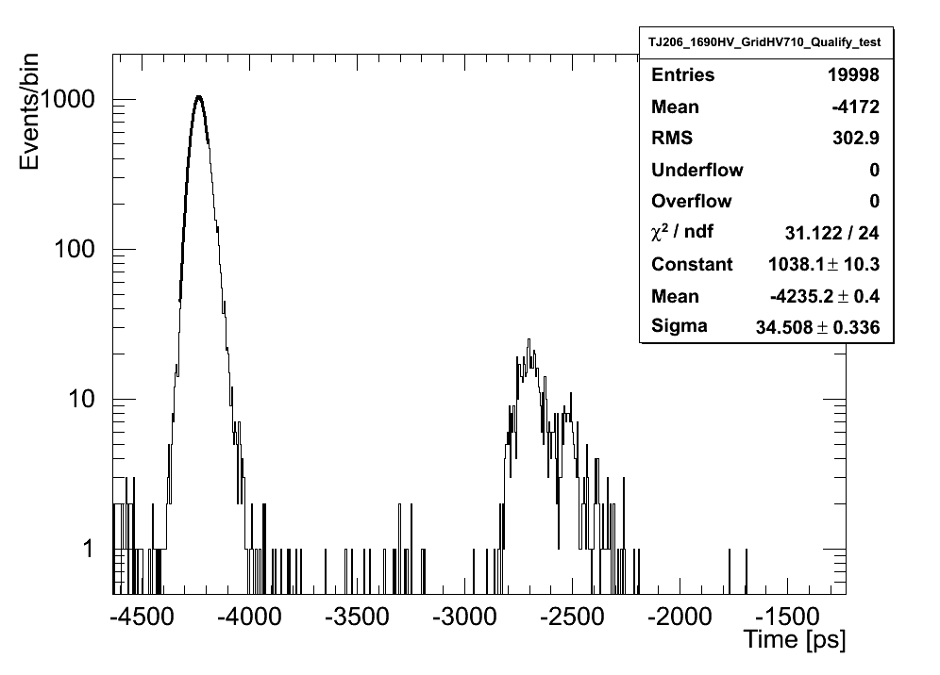
Active Ion Barrier Improves TTS
Seconday electron peak is focussed a couple ns later, results in improved TTS by 10-20% (we obtained 34 ps for 25 um tube)
Scattered electrons are organized and delayed (separated from main peak)
Tail of TTS distribution is suppressed

Slide 12
Active Ion Suppression Conclusions
Promising new development effort by Photonis
We obtained a 4x suppression in positive ion acceptance, this potentially implies a 4x improvement in lifetime (lifetime testing in progress at Photonis)
which should be orthogonal to ALD improvement (suppress +ion creation with better MCP’S, then coat them with ALD to further suppress, and if they do escape inhibit them — life is getting tough for positive ions).
Seconday electron peak is focussed a couple ns later, results in improved TTS by 10-20%!
Still have a loss in collection efficiency, not quite as bad as an inactive ion barrier, but leads one (me) to conclude that this active ion barrier approach is probably most useful for multiple PE detectors (and in conjunction with ALD)

Slide 13
MCP-PMT Lifetime Summary
Over past several years the difficult problem of PMT lifetime has been attacked on several fronts leading to significant improvements in the prospects of using MCP-PMTs in a high rate environment
Multiple PE’s allows running tube at lower gain x10-20
ALD suppresses creation of +ions x10-100
Further suppression possible with more ALD tuning, R2D2
at least x2-3
Electrostatic ion barrier to deter the rest x4- xlarge
*The net effect of these gains is O(1000) improvement over initial calculations
that led some to abandon the technology.
HOWEVER, too early to declare victory! Development effort is
not complete! More R&D funds required to finish optimization
and make “long-life” a standard product option

Slide 14
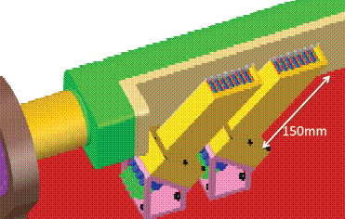
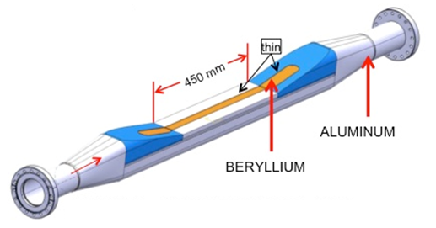
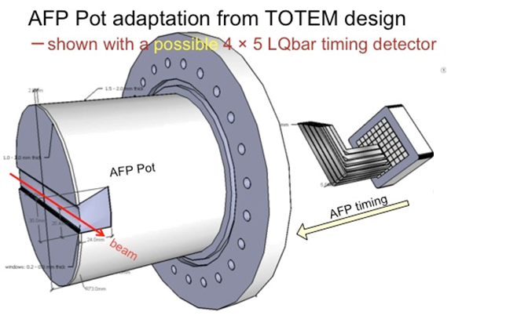
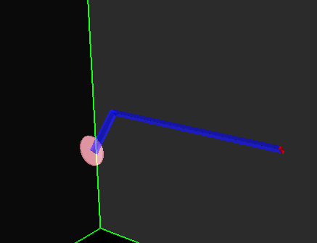
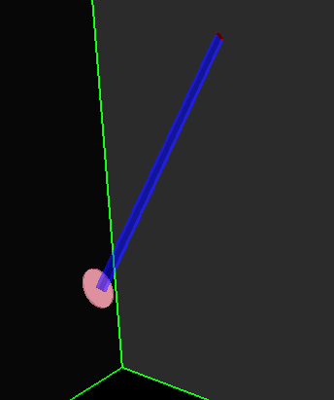
New Challenge: Adapt Timing Detector to be compatible with Roman Pot instead of HBP…
1) Arggh! 2) Challenge Accepted
Q-Bar straight bar at Cherenkov angle
LQBar still at Cherenkov angle but take light out at 90 degrees
(Albrow Lbar parallel to beam takes light out at 90)
Notes:
LHC logistics required us to move away from our original Hamburg Pipe design to a Roman pot design
Need to conserve detector performance
Simulation of single elements, now require a 90 degree bend

Slide 15
New GEANT4 Simulation Effort
Led by Tom Sykora’s group at Palacký University, Olomouc Czech Republic (Libor Nozka, Leszek Adamczyk et al with UTA UG Tim Hoffman)
Start with straight Qbar (θ_{c} ~48°) (2mm x 6mm x 150 mm), since we have test beam data for this we can normalize simulation of LQbars and other geometries (heh heh) to Qbar
We also are undergoing detailed studies of how MCP-PMT treats different photon arrival time distributions , as correlations between photon arrival times exist are a f(TTS, gain, rise time, etc.) and are generally not well modelled.

Slide 16
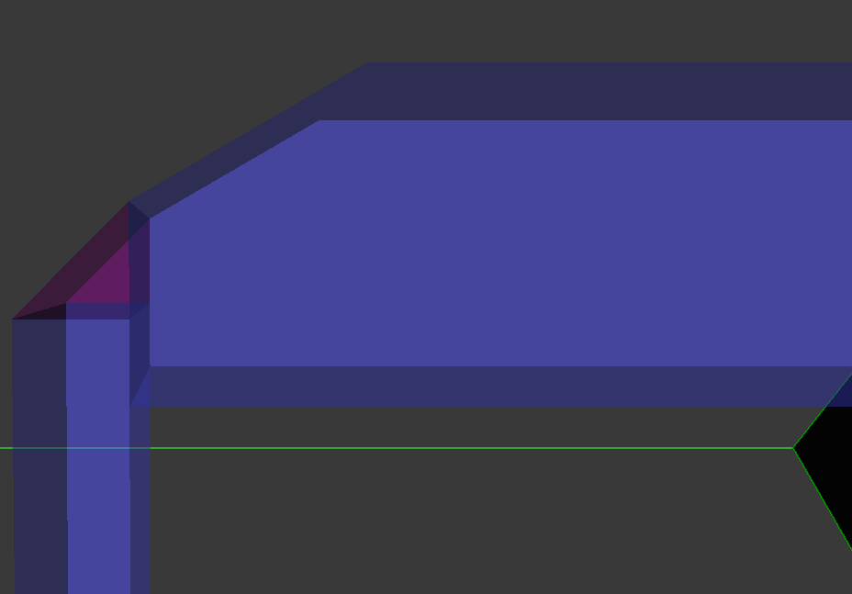
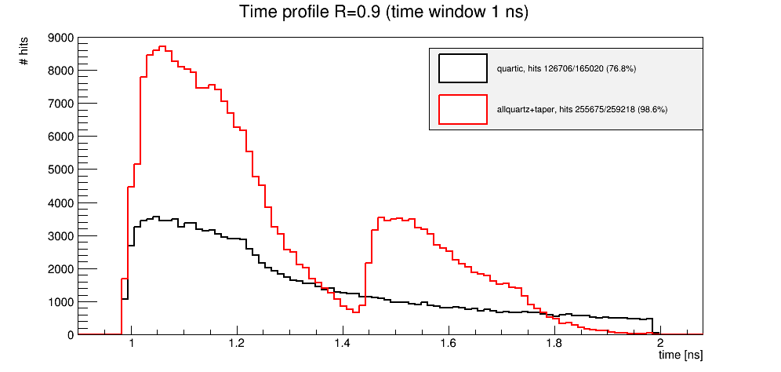
LQbar Design Conclusions
Taper
Quartz-Guide
Square cut
(b)
(c)
(a)
Mirror
Quartz Radiator
Parallel cut
The expectation was that the LQbar would be inferior to the Qbar, due to light lost at the elbow, but a taper (a) to focus the slower wide angle light and replacing a square cut (b) with a parallel cut at the bottom end of the bar (c) actually gives an improved distribution (d) from which we can infer that the bent bar will actually have superior performance
(d)
Qbar
LQbar
Plot arrival time of photon
at tube corrected for QE

Slide 17
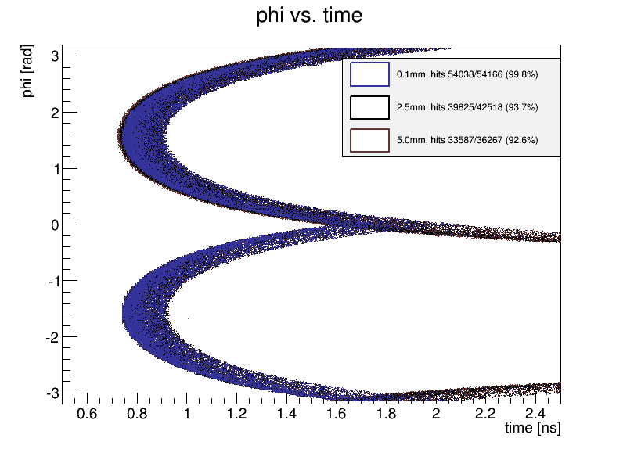
Phi vs Time for Parallel Cut on Qbar
φ = π/2 straight down bar φ ≠ π/2 ⇒longer path
length ⇒ longer time
Color dispersion
Much of bottom hemisphere of the Cherenkov cone (negative phi) is reflected up the bar as shown earlier (depending on proton height with respect to parallel cut)

Slide 18
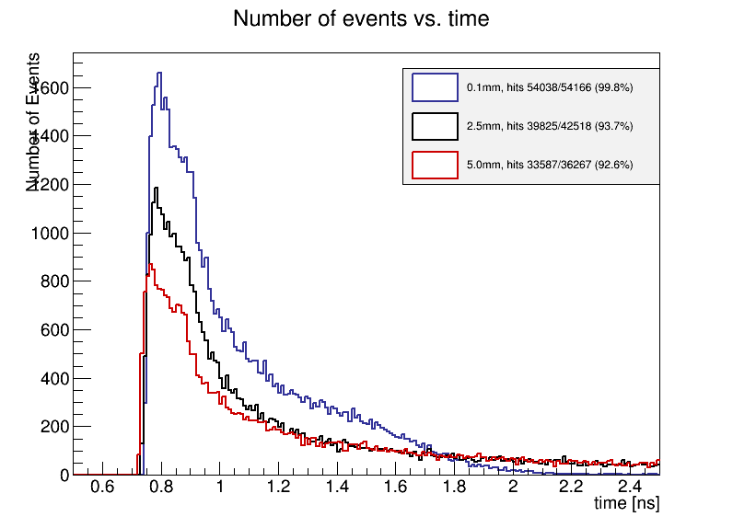
N_{γ} vs. time for Qbar with Parallel Cut as f(y)
Protons close to the parallel cut (y~0) give the biggest gain in photon acceptance (if we stayed with Q-bars we would use this feature)
For y>5 mm there is no gain from the parallel cut
Test beam data uses rectangular bars, so will use this as baseline for comparison with
simulation
N_{γ}
N_{γ} vs. time
1600
0.1 mm height
2.5 mm height
1400
5 mm height
1200
1000

Slide 19
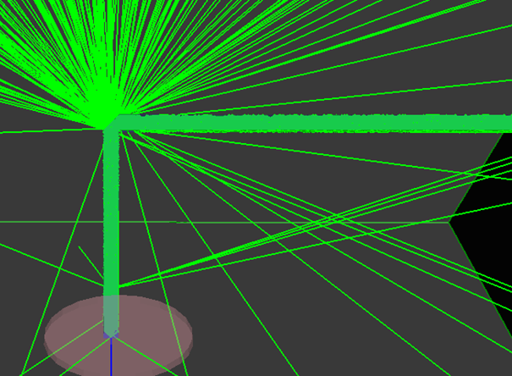
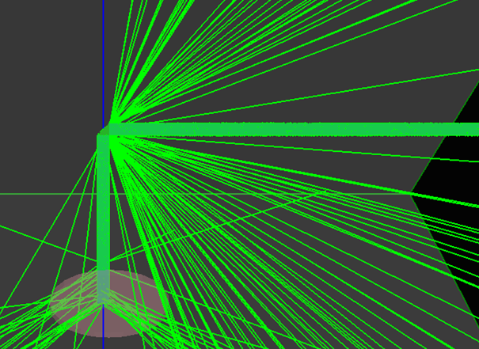
LQbar* (radiator bar at θ_{c} +light guide bar)
2x6x(30+120)mm
Without Mirror
With Mirror
*Not to be confused with Albrow’s Lbar
which is oriented parallel to beam and has no elbow
45 degree bend to route light from radiator to perpendicular light guide bar, lose some light at elbow
Aluminizing helps but light ~⊥ tp mirror lost oopposite to elbow.still lost at elbow
Notes:
Talk about bouncing up and down vs. side to side (mapping a cone onto a rectangle)

Slide 20
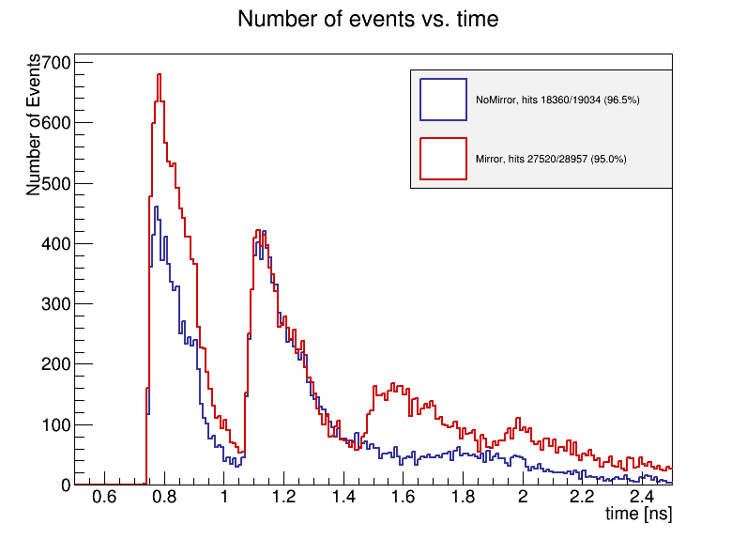
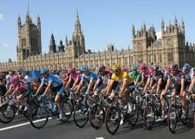
LQbar: what’s with all the peaks?
No Mirror
~30% improvement in the first peak
Mirror
Tough mountain stage today
Mirror adds ~30% more good light (1st peak) and some bad (late) light (3rd +4th
peak) 2nd peak is unchanged, so this light is missing the mirror region
Notes:
Talk about 90 bend separating up/down side/side bouncing

Slide 21
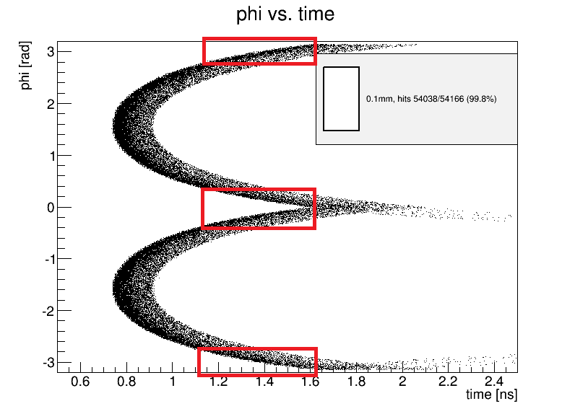
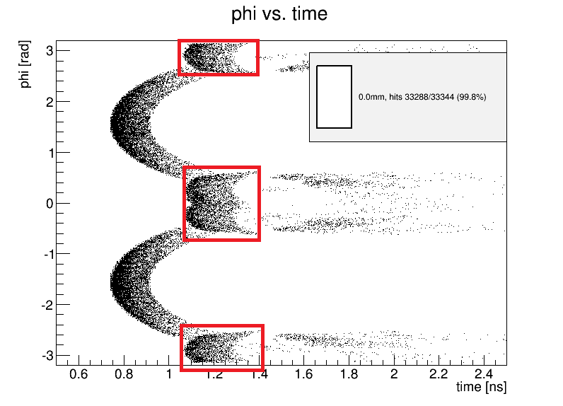
“Wings”
Taking the Cherenkov cone around the 90° degree bend leads to “wings” that are relatively faster (shorter path length) compared to the prompt light then for the straight bar case.
Qbar
Lqbar (unoptimized)

Slide 22
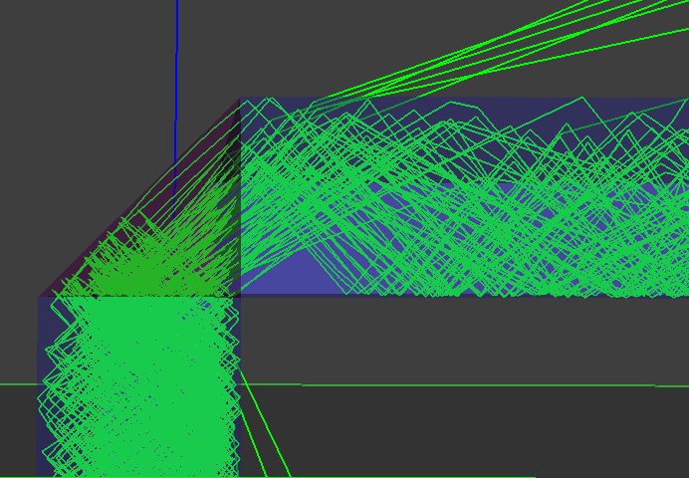
Harnessing the “Wings”
Can we optimize the light guide design to speed up the wings?
Study adding a taper (angle +length) and a wider light guide bar
This is a side view of 2x6 LQbar
2
mirror
taper
3b
Extended
light guide bar
Recoverable
(3rd+4thpeak)
Light at Cherenkov angle
light guide bar
3c
2 mm
6 mm
1
Top of radiator bar
Light bouncing just before mirror bypasses it
3a
Interior side of light guide bar

Slide 23
New Nuclear Interaction Study
At 14 TeV find about 2% chance per bar (8 mm of quartz) of an interaction
These interactions have a high multiplicity
O(tens) particles, which would typically saturate amps and cause that bar timing to be mismeasured (but the event could be salvaged with somewhat degraded resolution almost all of the time).
Significant Implications on timing detector optimization: Ex. Filling a pot or pipe w/quartz is a good fixed target experiment, may not be so great as timing detector

Slide 24
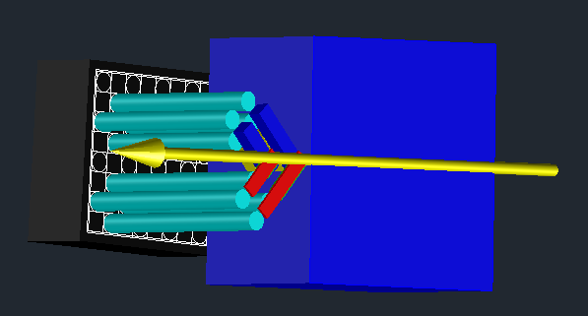
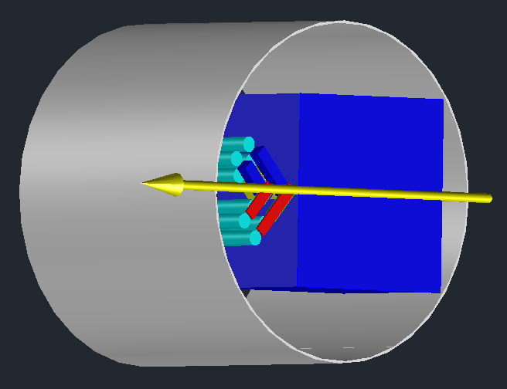
UPTOP: Detector
Low lum Baseline:
16 ch/side
4 layers in x
2 layer in y (+/-)
2 meas. each
Latest drawing censored
Only showing cartoons
today
shared RP with silicon detector

