Slide 1
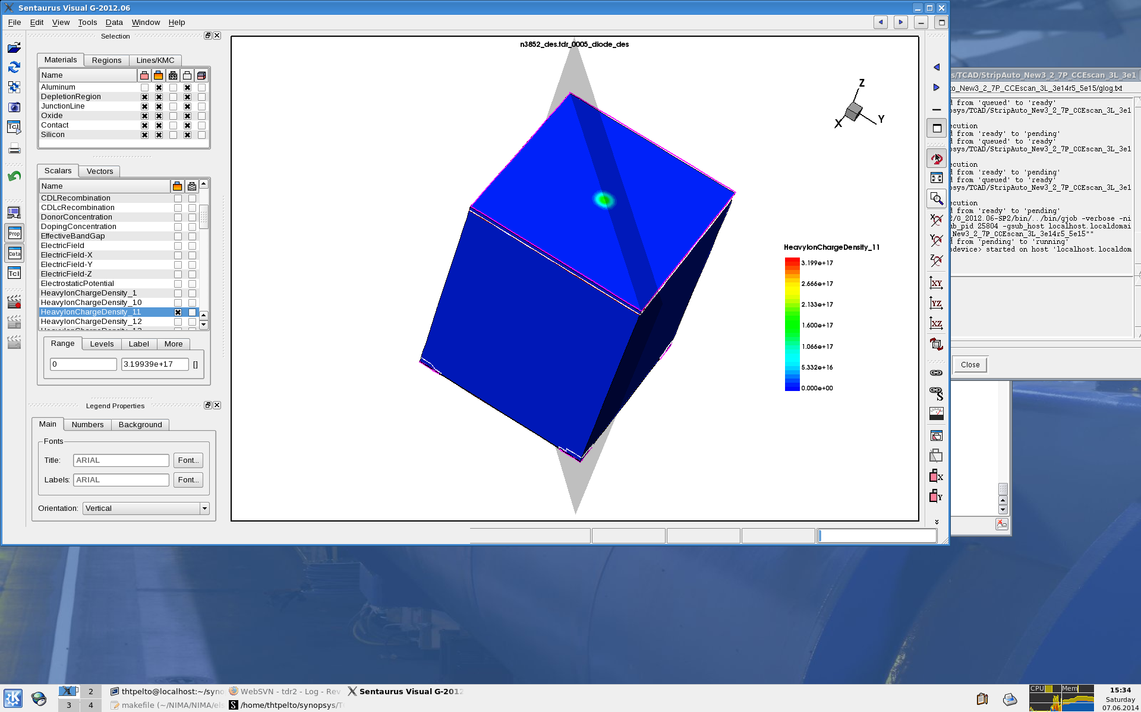
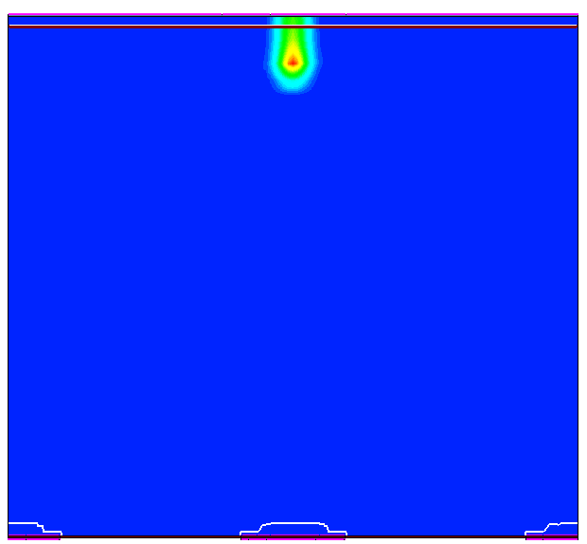
A method to model the accumulation of oxide charge with fluence in an irradiated MSSD
24th RD50 Workshop, 11-13 June 2014
T. Peltola¹⁾, J. Härkönen¹⁾, T. Mäenpää¹⁾
¹⁾Helsinki Institute of Physics, CMS Upgrade Project.

Slide 2
Outline
Motivation & method to determine CCE(x)
  Motivation: why non-uniform 3-level defect model?
  CCE(x): Iteration method
  CCE(x): proton model vs non-unif. 3-l model
Q_{f}(Φ) & c(Φ) modelling
  Measured CCE(x) vs simulation:
    d & η varied
    d = constant
  Q_{f}(Φ) & c(Φ) of region 5 200P MSSD

Slide 3
Motivation & method to determine CCE(x)

Slide 4
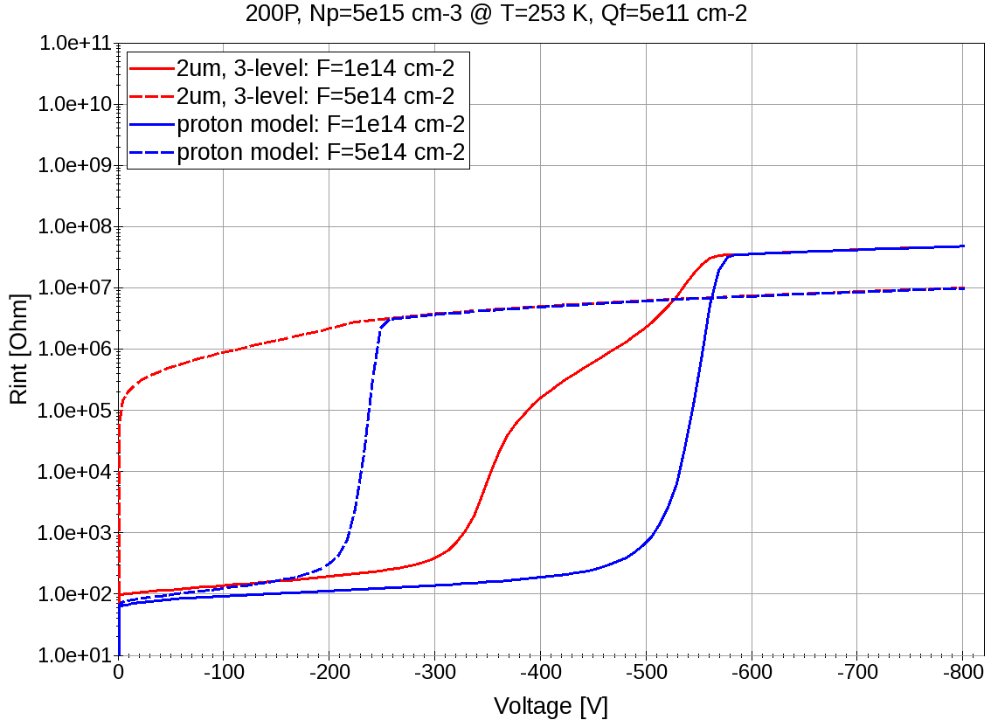
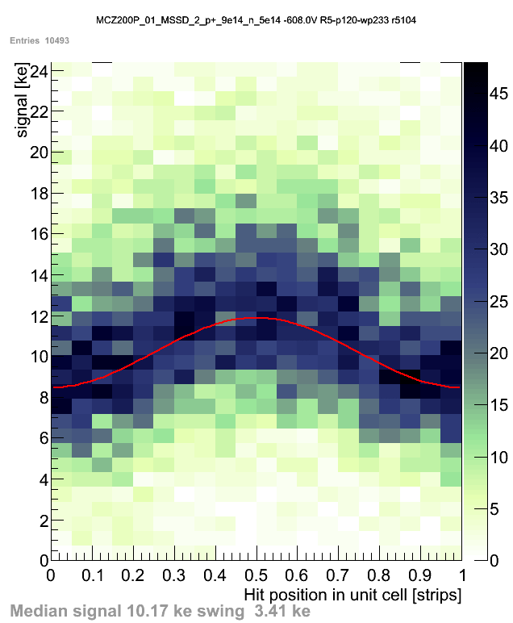
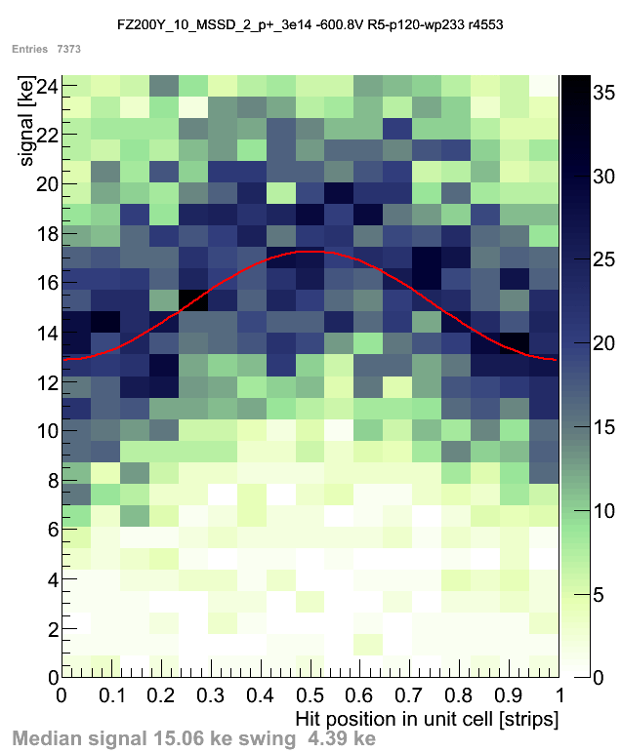
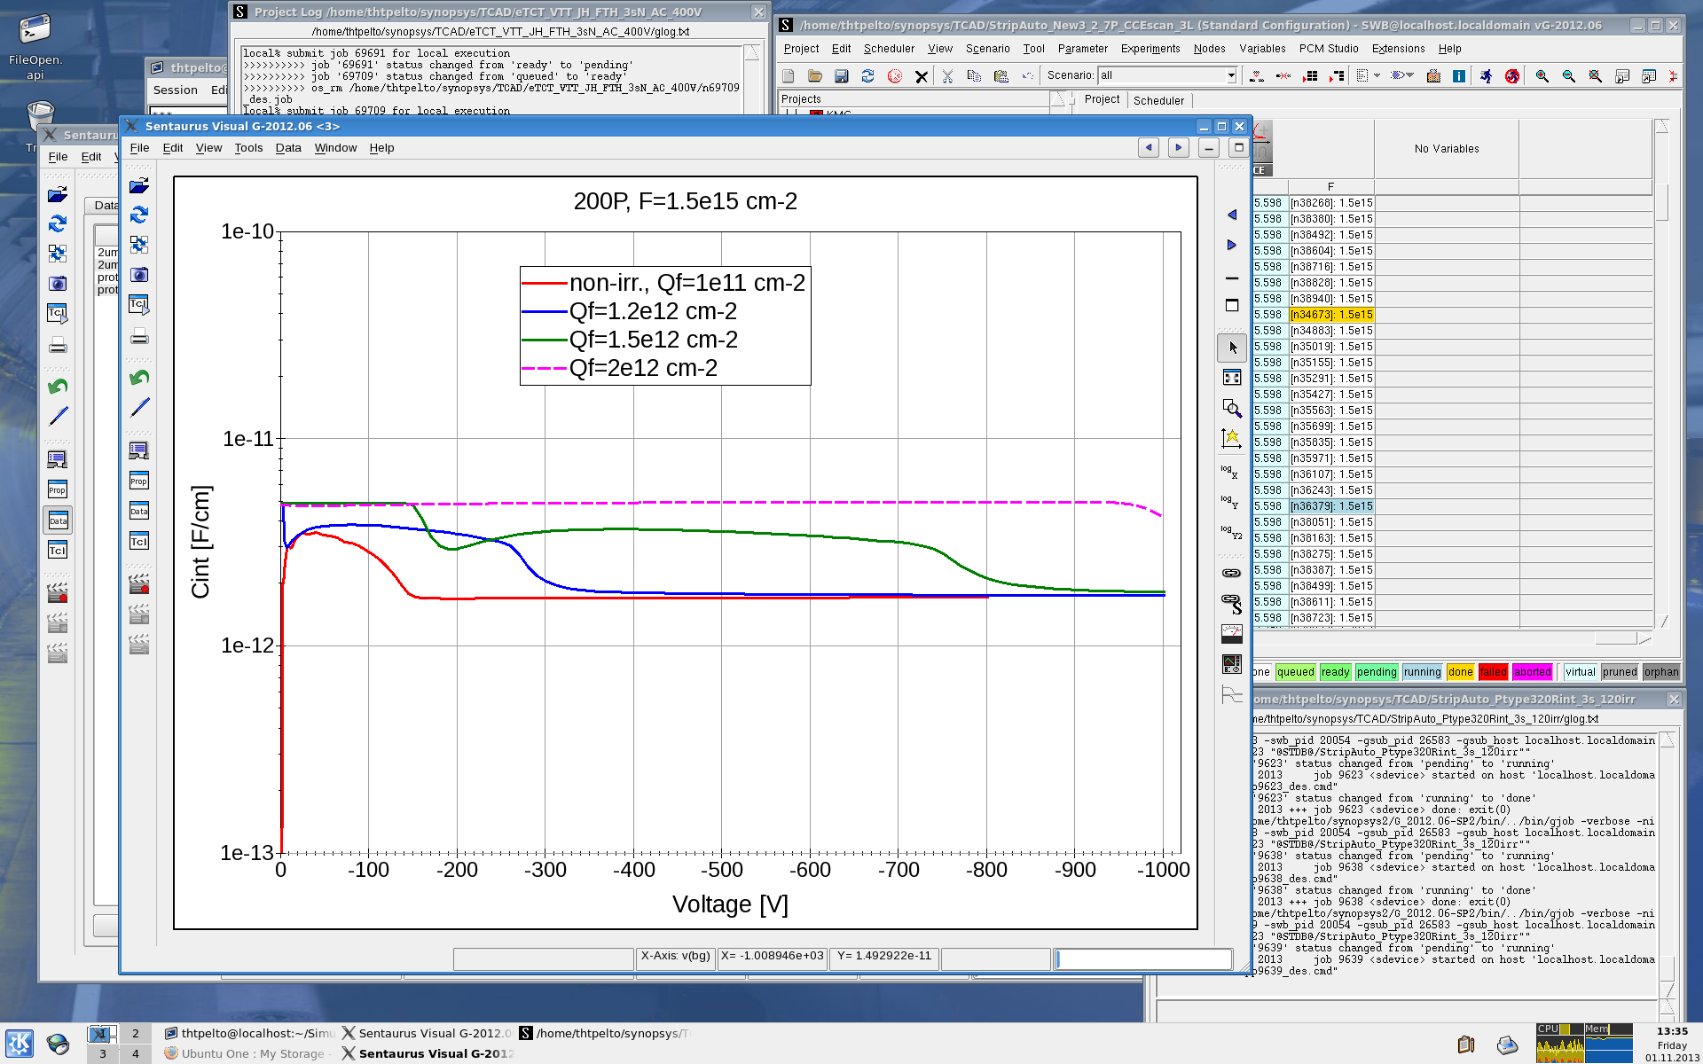
Non-unif. 3-level defect model: Motivation
3-level model within 2 μm of device surface + proton model in the bulk:
R_{int} (fig. 1) & C_{int} (fig. 2) in line with measurement also at high fluence & Q_{f}
Non-unif. 3-l model can be tuned to equal bulk properties (TCT, V_{fd} & I_{leak}) with proton model → suitable tool to investigate CCE(x)
Figure 1: R_{int}
SiBT measured CCE(x) for proton & mixed fluences (T. Mäenpää):
Φ_{eq}=1.4e15 cm⁻²
Center of strip
Figure 2: C_{int}
Φ_{eq}=3e14 cm⁻²
Non-unif. 3-l model: n-on-p, r5
@ F=1.5e15 cm⁻²
Center of gap
f = 1 MHz
MCz200P, region 5
FZ200Y, region 5

Slide 5
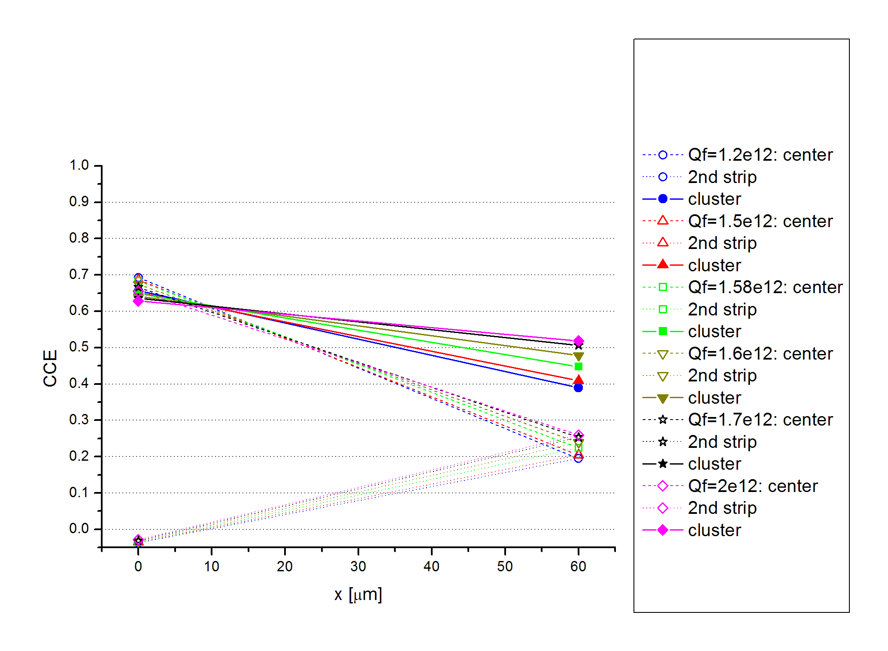
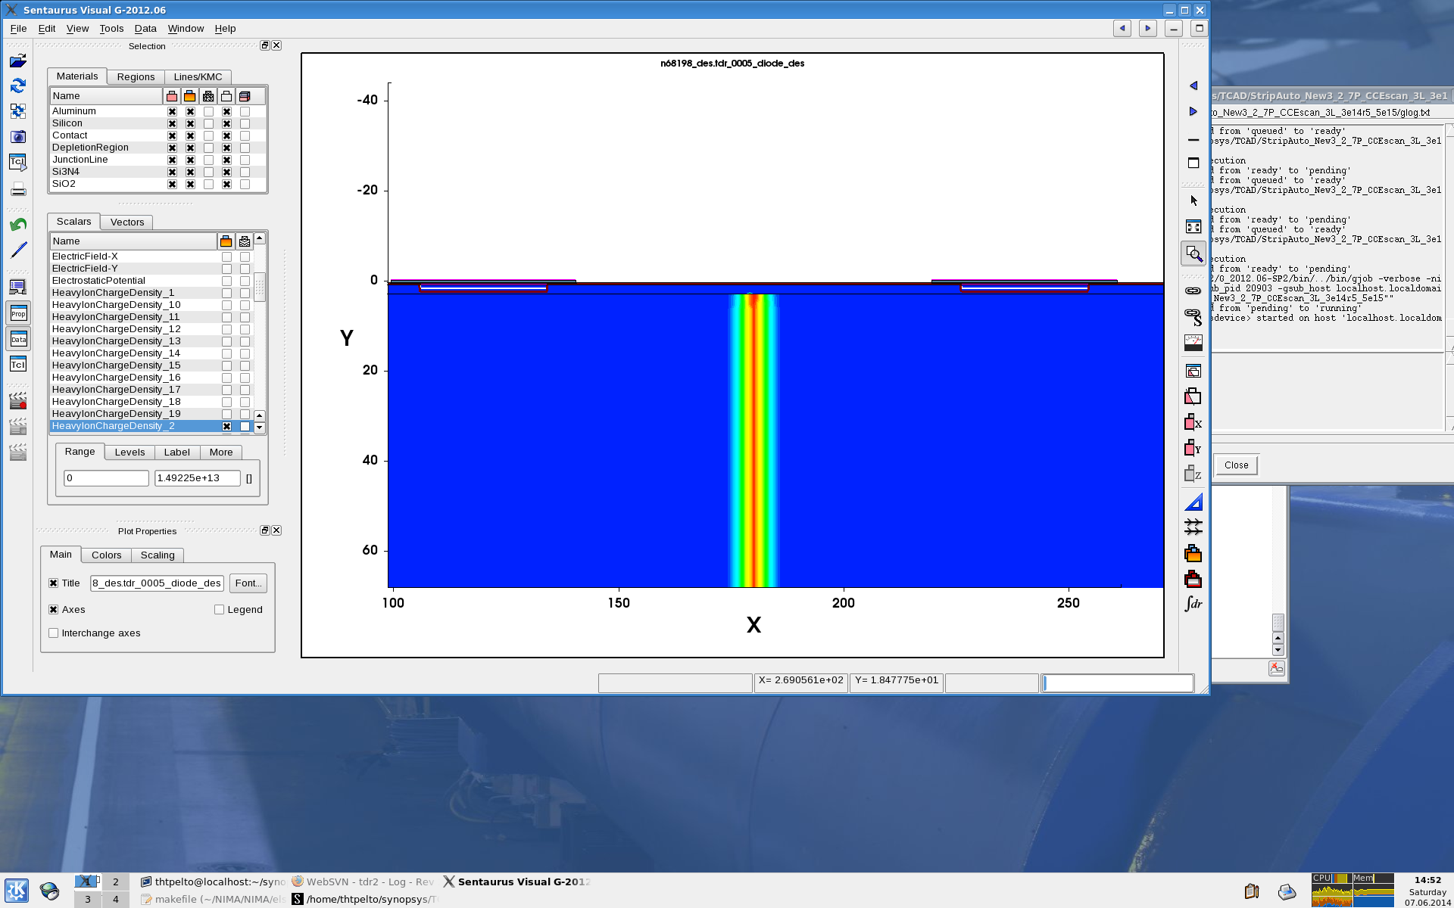
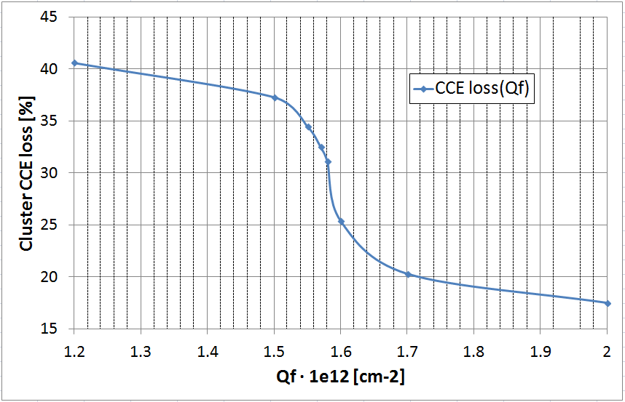
CCE(x) @ Φ_{eq} = 1.5e15 cm⁻²: Iteration method
CCE loss:
60 μm
0 μm
Q_{f} increases
→ Q_{coll} decreases
Q_{f} increases
→ Q_{coll} increases
40.6%
37.3%
2nd
strip
center
strip
31.1%
mip
positions
25.4%
20.3%
17.5%
Principle of CCE(x) simulation for given c(shallow acc.) & voltage
5 strip 200P, region 5 @ Φ_{eq} =1.5e15 cm⁻², V=-1 kV, T=253 K
Acceptor traps remove both inversion layer & signal electrons: better radiation damage induced strip isolation → larger CCE loss between the strips
Increased Q_{f} fills more traps → CCE loss decreases, undepleted region between strips grows
Space charge dominated region
Oxide charge dominated region

Slide 6
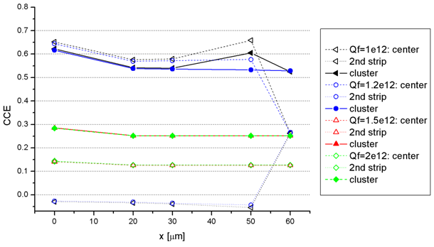
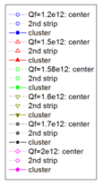
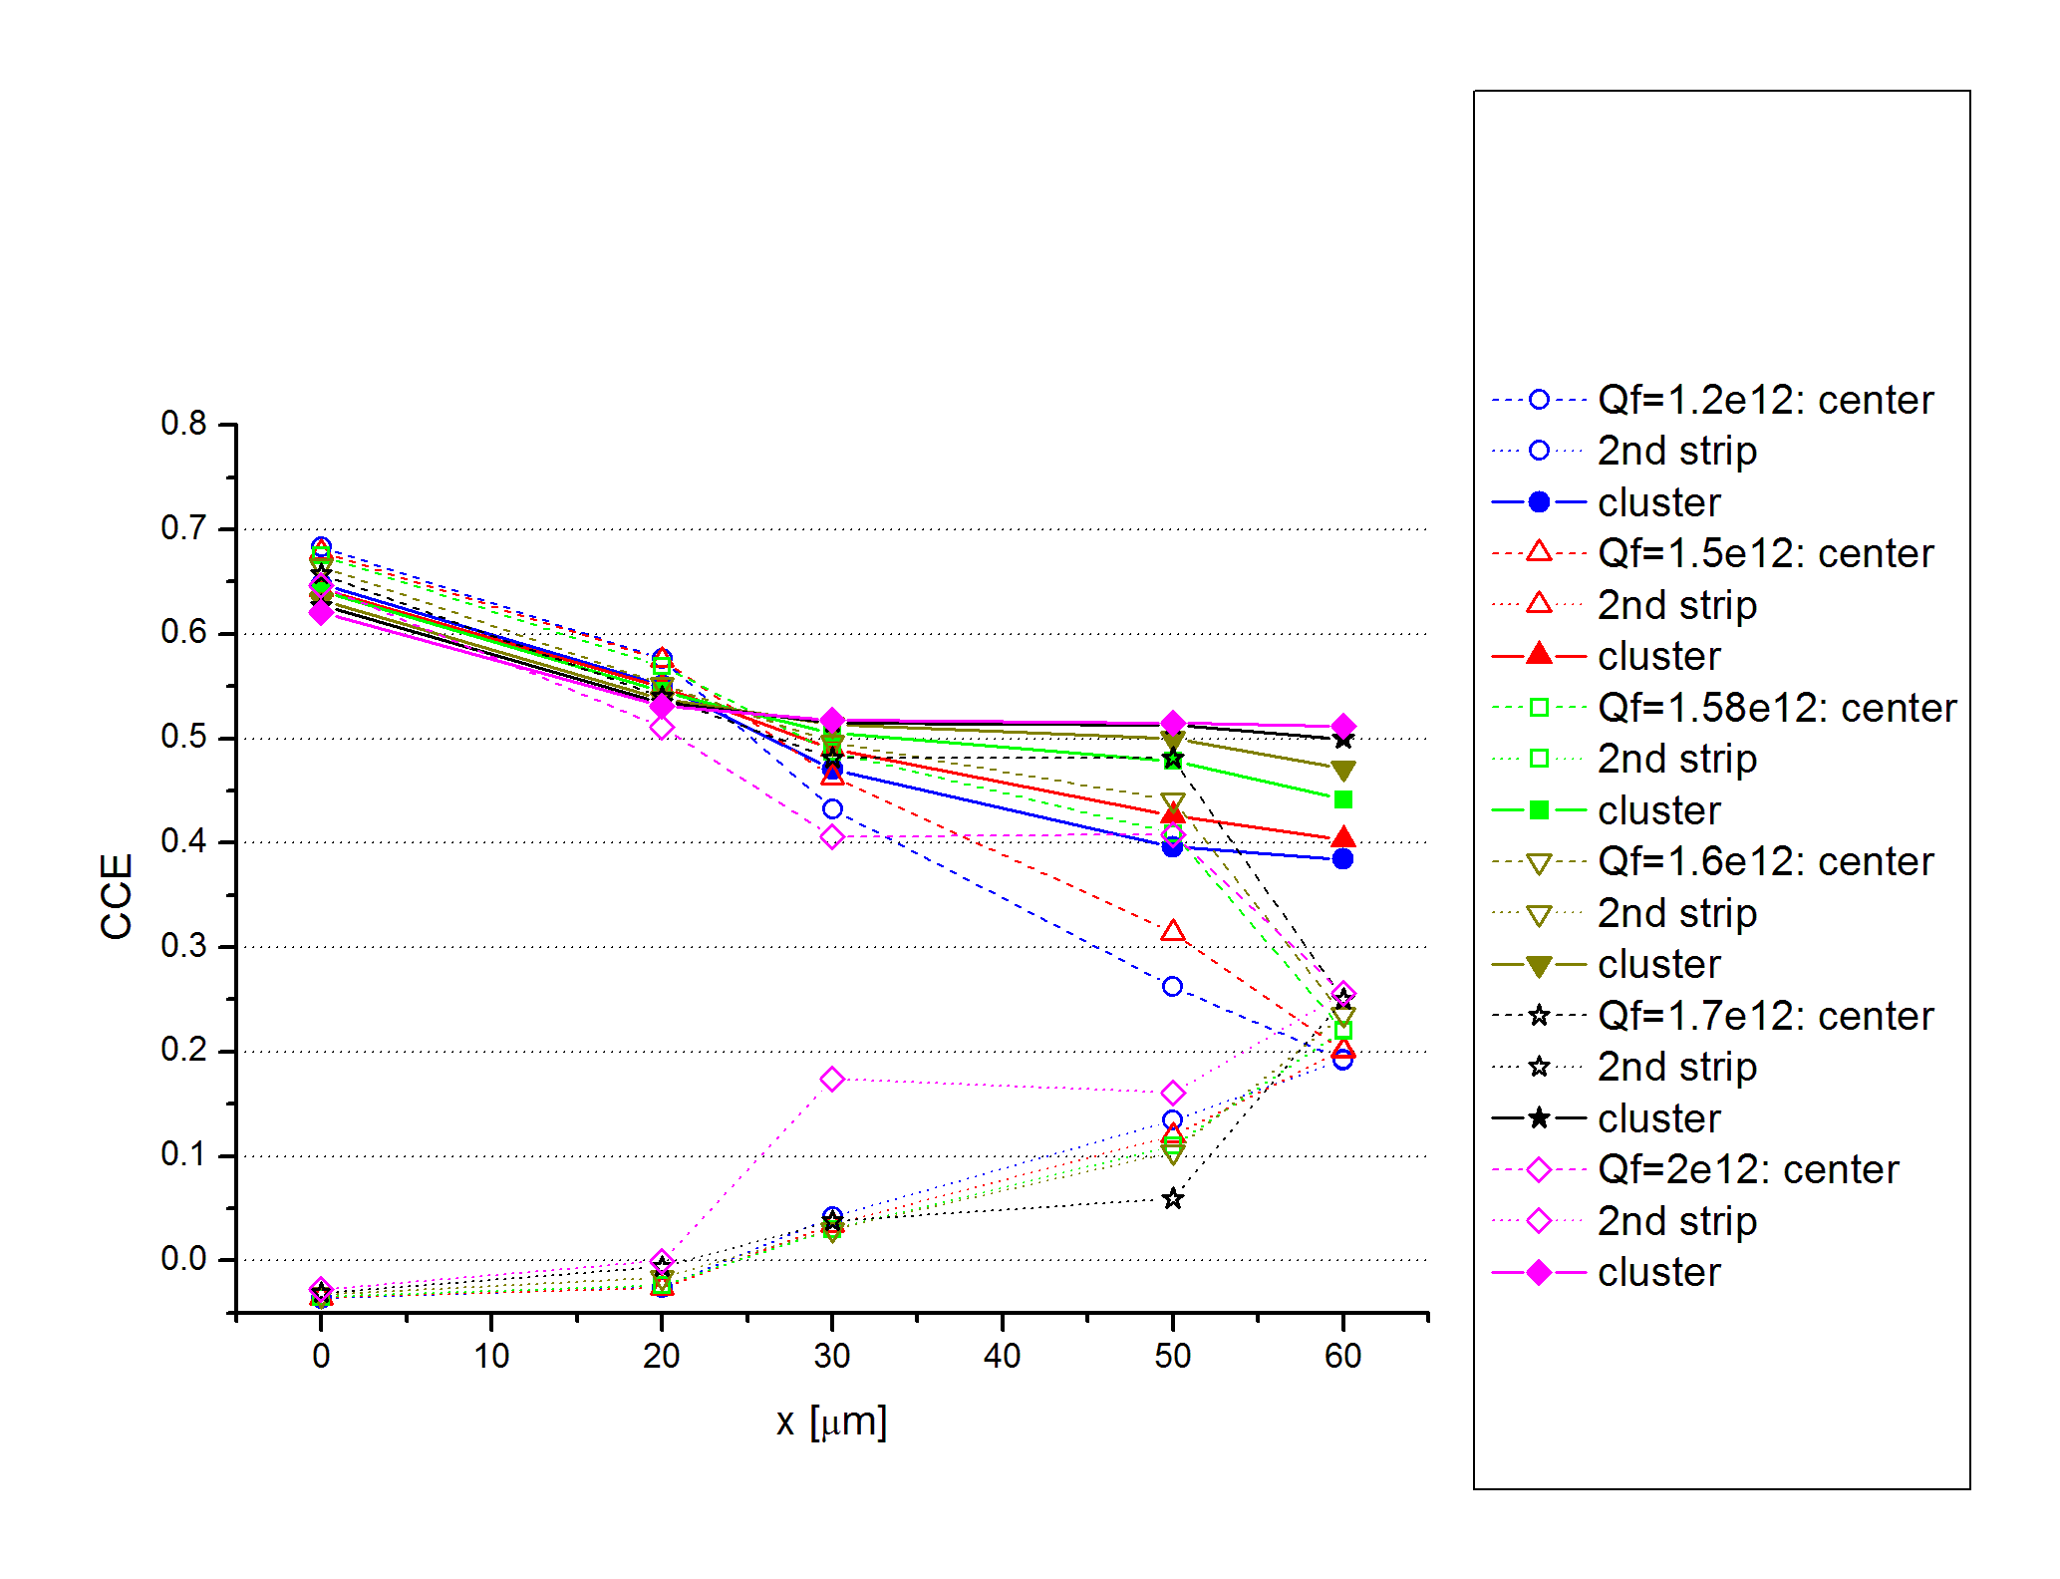
CCE(x): proton model vs non-unif. 3-l model
200P region 5 @ Φ_{eq} =1.5e15 cm⁻², V=-1 kV, T=253 K
Proton model (tuned by R. Eber)
Type of defect | Level [eV] | σ_{e} [cm²] | σ_{h} [cm²] | Concentration [cm⁻³]
Deep acc. | E_{C} - 0.525 | 1e-14 | 1e-14 | 1.189*Φ + 6.454e13
Deep donor | E_{V} + 0.48 | 1e-14 | 1e-14 | 5.598*Φ - 3.959e14
Proton model
Q_{f} = 1.2e12 cm⁻²: CCE loss ≈ 15 %
Q_{f} ~ 1.5e12 cm⁻²: no strip isolation & cluster CCE ~0.5 of expected due to undepleted region produced by high Q_{f}
3-level model within 2 μm of device surface
Type of defect | Level [eV] | σ_{e} [cm²] | σ_{h} [cm²] | Concentration [cm⁻³]
Deep acc. | E_{C} - 0.525 | 1e-14 | 1e-14 | 1.189*Φ + 6.454e13
Deep donor | E_{V} + 0.48 | 1e-14 | 1e-14 | 5.598*Φ - 3.959e14
Shallow acc. | E_{C} - 0.40 | 8e-15 | 2e-14 | 40*Φ
Q_{f} = 1.2e12 cm⁻²: CCE loss ≈ 41 %
Q_{f} = 2e12 cm⁻²: increased charge sharing when mip position ≥ 30 μm from center strip, but still producing position information
When strips are isolated both models produce same cluster CCE at the center of the strip
Non-unif. 3-l model
Center of strip = 0
Center of gap = 60 μm

Slide 7
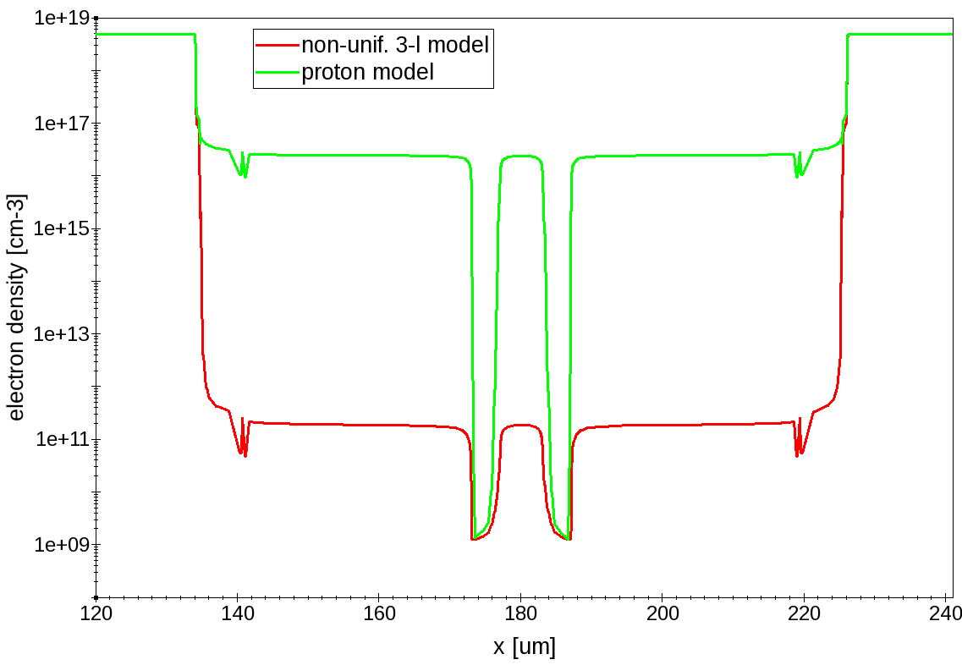
proton model vs non-unif. 3-l model: electron density
Electron density @ Q_{f} = 1.2e12 cm⁻², V=-1 kV from previous slide
Effect of acceptor traps in non-unif. 3-l model is clearly visible:
~5 orders of magnitude difference between models (from n⁺ to p-stop)
n⁺
Cut @ 50 nm below oxide
n⁺
2nd
strip
p-stops
center
strip

Slide 8
Q_{f}(Φ) & c(Φ) modelling

Slide 9
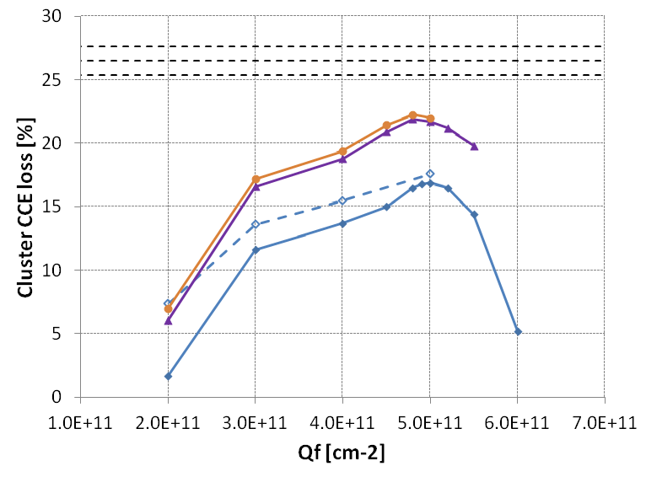
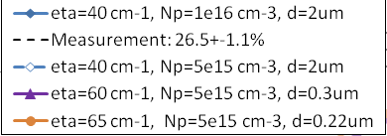
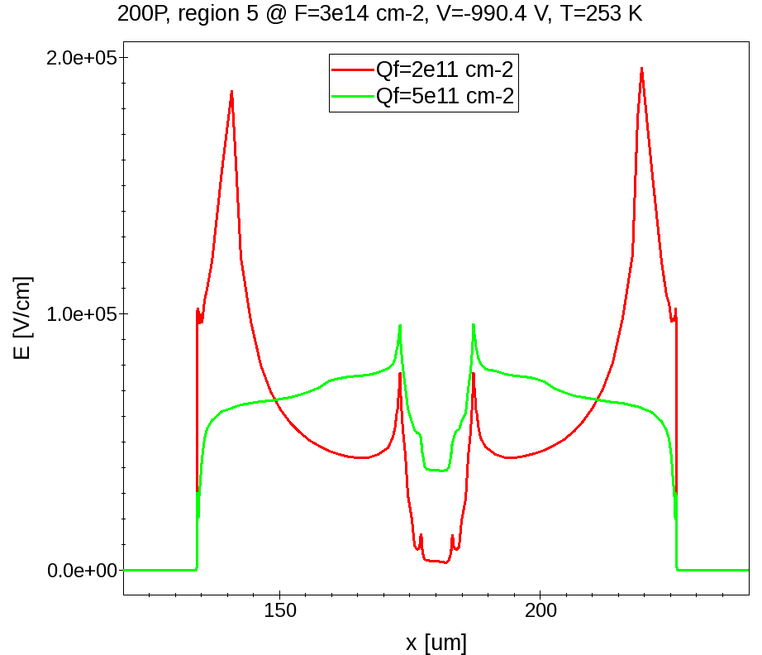
Measured CCE(x) vs simulation: d & η varied
200P Region 5: p+ Φ_{eq}=3e14 cm⁻², V=-990 V, T=253 K
SiBT measured CCE loss(FZ200P/Y, MCz200P) @ V=600 – 990 V: 26.5±1.1%
Double p-stop: d_{p}=1.5 μm=d_{implant}, w_{p}=4 μm, spacing=6 μm
Approach:
  Iterate η to find CCE loss within measured error margins @ Q_{f} ~5e11 cm⁻²
  Change 3-level model thickness to preserve transient signal shape
3.1%
Charge multiplication region
8.5%
Oxide charge dominated region
Cut @ implant curvature
E(x) between 2nd & center strip for η=40 cm⁻¹, N_{p}=1e16 cm⁻³
Two low CCE loss regions observed in Q_{f} scan
Not seen in Φ_{eq}=1.5e15 cm⁻² CCE loss simulations, because of higher Q_{f} values (1.2e12…2e12 cm⁻²)
Interpretation: At very low Q_{f} high E produces charge multiplication → additional charge carriers fill traps → CCE loss decreases significantly
→ New approach: keep 3-level region thickness constant & add constant factor to shallow level c

Slide 10
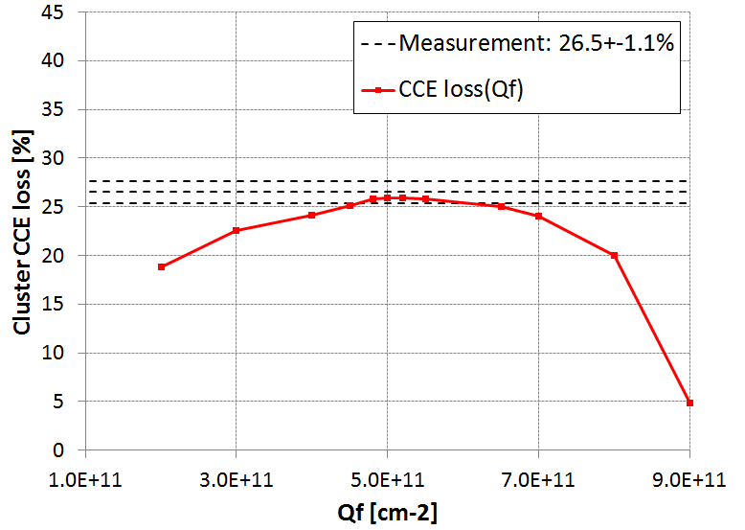
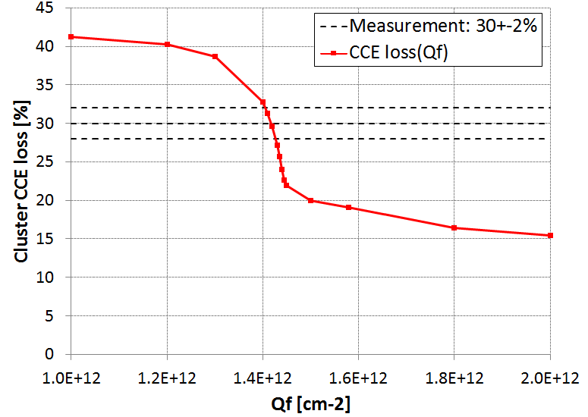
Measured CCE(x) vs simulation: d = constant
3-level region: d=2 µm, strip length = 3.049 cm
Φ_{eq}≈1.5e15 cm⁻² has largest statistics at ~600 V → simulation V adjusted
Type of defect | Level [eV] | σ_{e} [cm²] | σ_{h} [cm²] | Concentration [cm⁻³]
Deep acceptor | E_{C} - 0.525 | 1e-14 | 1e-14 | 1.189*Φ + 6.454e13
Deep donor | E_{V} + 0.48 | 1e-14 | 1e-14 | 5.598*Φ - 3.959e14
Shallow acceptor | E_{C} - 0.40 | 8e-15 | 2e-14 | 40*Φ
Target Q_{f} ~5e11 and ~1.5e12 cm⁻² for given fluences
Measurement: 6 μm resolution
Shallow acc. | E_{C} - 0.40 | 8e-15 | 2e-14 | 14.417*Φ + 3.1675e16
Measured CCE loss(FZ200P/Y, MCz200P) @
Φ_{eq} (p+) = 3e14 cm⁻², V = 600 – 990 V: 26.5 ± 1.1 %
Measured CCE loss(FZ200P/Y, MCz200P/Y) @
Φ_{eq} (mixed) = (1.4 ± 0.1)e15 cm⁻², V = 606 ± 2 V: 30 ± 2 %
Φ_{eq}=3e14 cm⁻²
V=-990 V
Q_{f}=(1.405–1.425)e12 cm⁻²
Q_{f}=(4.6–6.0)e11 cm⁻²
Φ_{eq} =1.5e15 cm⁻²
V=-608 V

Slide 11
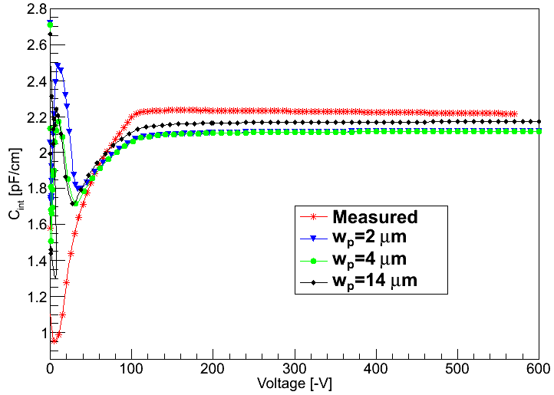
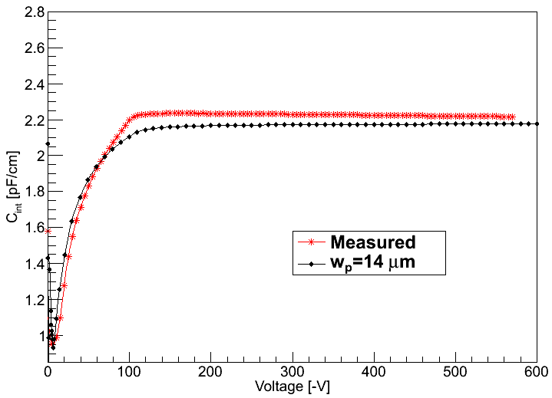
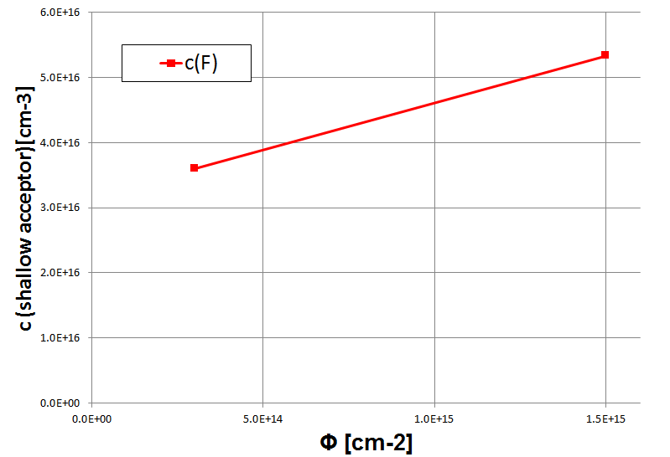
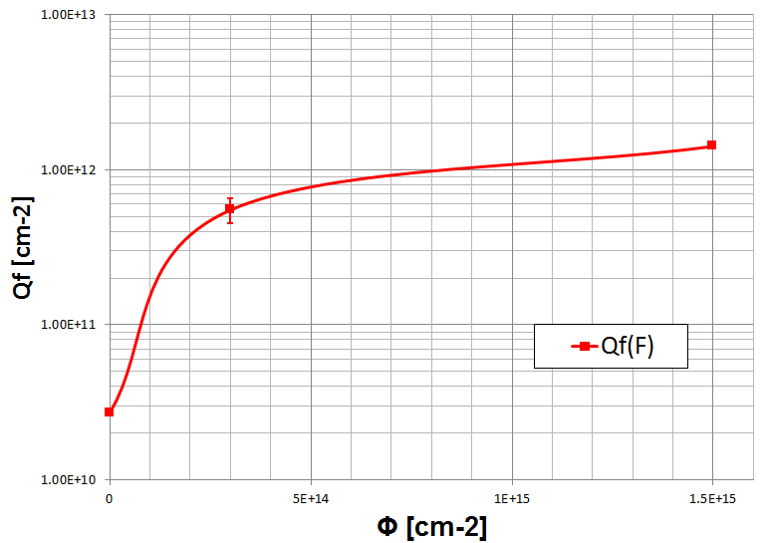
Q_{f}(Φ) & c(Φ) in p+ irradiated region 5 200P
Q_{f} of non-irradiated 200P from measured initial dip of C_{int}, that is reproduced by decreasing Q_{f}=2.7e10 cm⁻²
c(shallow acc.) parametrized by using ‘fixed’ values of Q_{f} → fixed c, parametrized Q_{f}
Increase of the shallow acceptor concentration is found to be ~0.5 of constant factor at the given fluence range
Q_{f} = 5e10 cm⁻²
Q_{f} = 2.7e10 cm⁻²
C_{int}(V)
C_{int}(V)
Fluence [cm⁻²] | Q_{f} [cm⁻²] | c(shallow acceptor) [cm⁻³]
3e14 | (5.3±0.7)e11 | 3.6e16
(1.4±0.1)e15 | (1.415±0.010)e12 | 5.33e16

Slide 12
Summary
When position dependency of CCE is modeled by non-unif. 3-l defect model, it is governed by Q_{f} and shallow acceptor concentration
By tuning these two parameters it is possible to reproduce measured CCE loss between strips for given fluence
If one of the parameters is fixed, the other can be solved reliably → potential for Q_{f}(Φ) parametrization
With test values of Q_{f} the shallow acceptor concentration does not have strong dependence on fluence in the range 3e14 → 1.5e15 cm⁻²

Slide 13
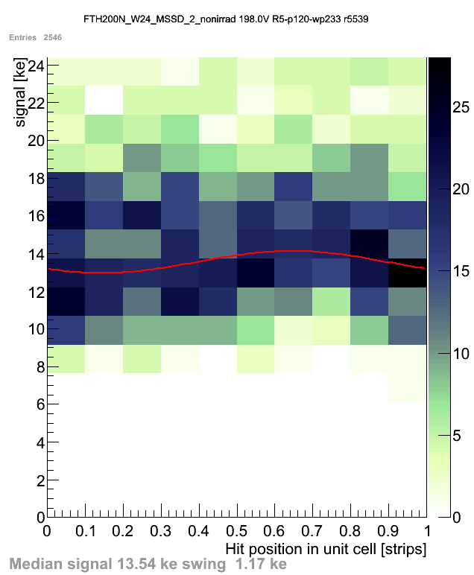
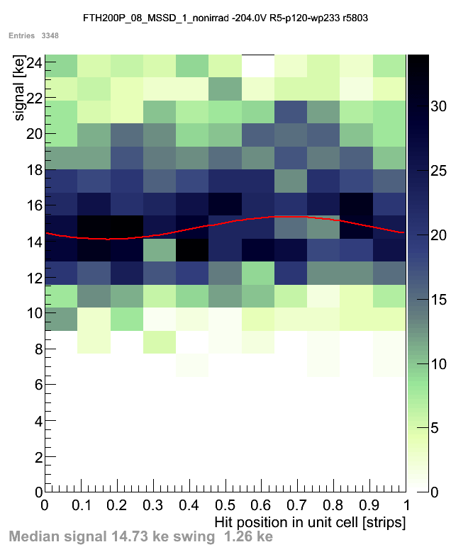
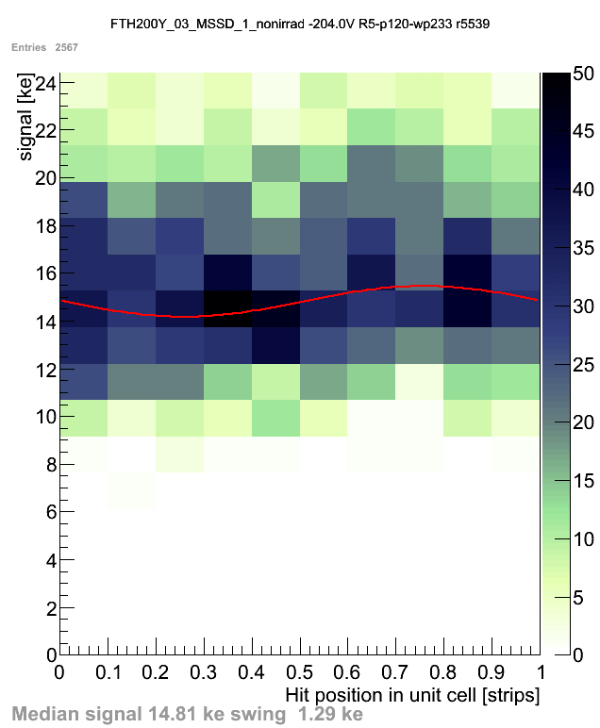
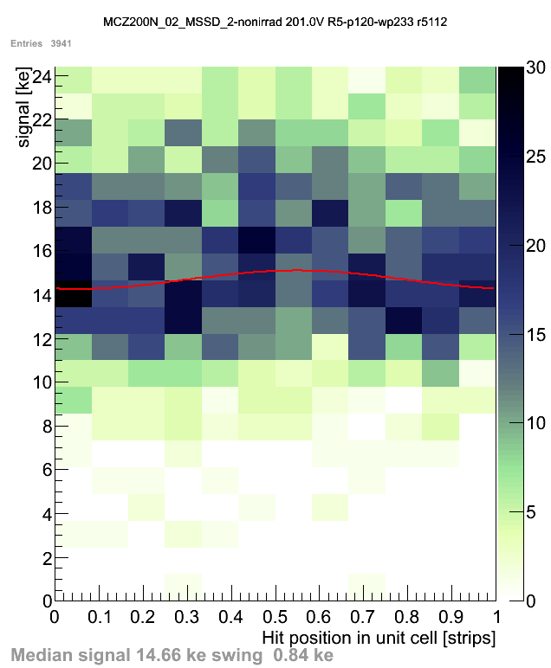
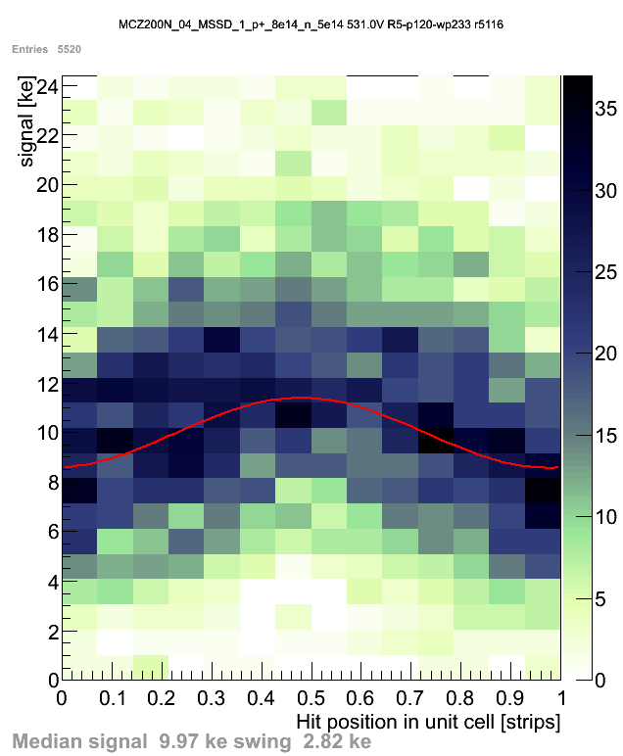
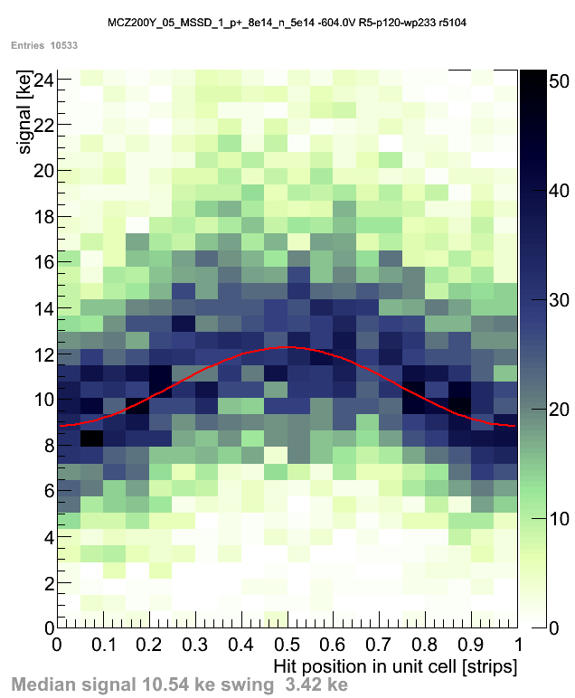
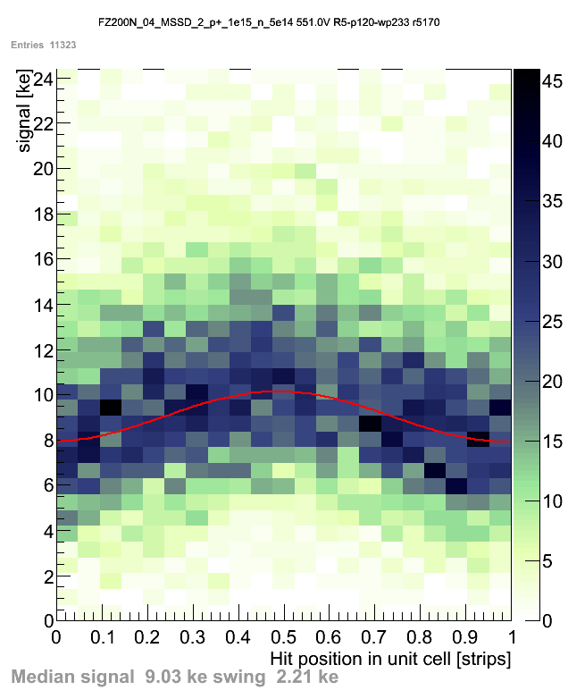
Backup: SiBT measured CCE loss between strips
Signal loss in-between strips (p=120µm, w/p~0.23)
non-irradiated
FTH200N
FTH200P
FTH200Y
MCz200N
No loss before irrad.; after irrad. ~30% loss; all technologies similar [Phase-2 Outer TK Sensors Review]
MCz200N
MCz200P
MCz200Y
FZ200N
mixed irradiated 1.5e15n_{eq}/cm²

Slide 14
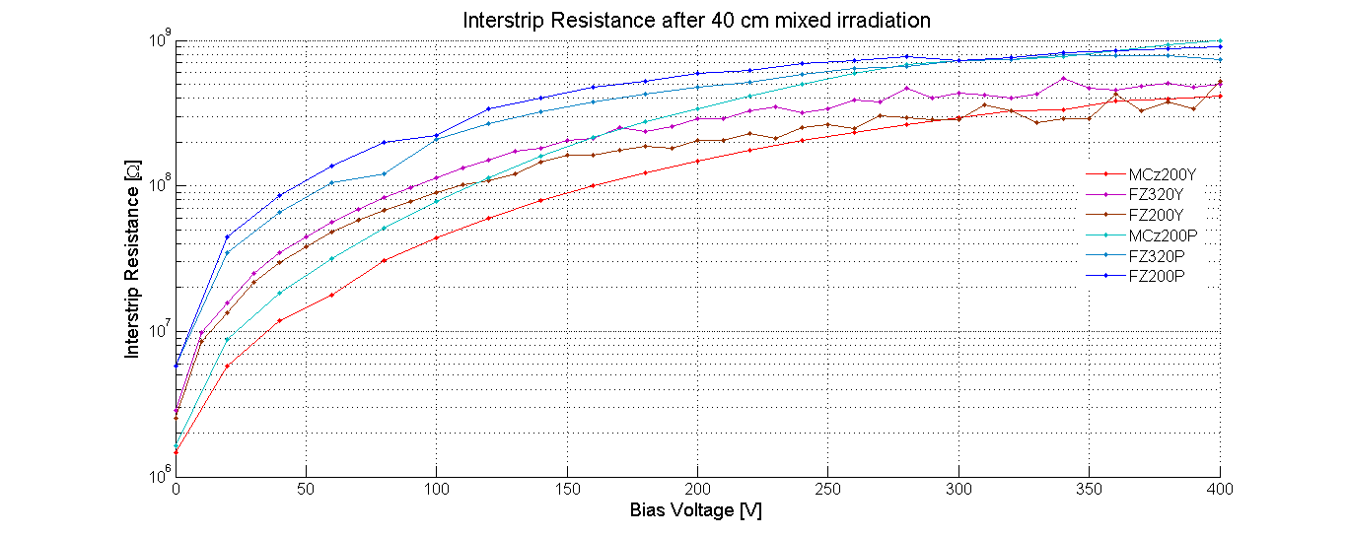
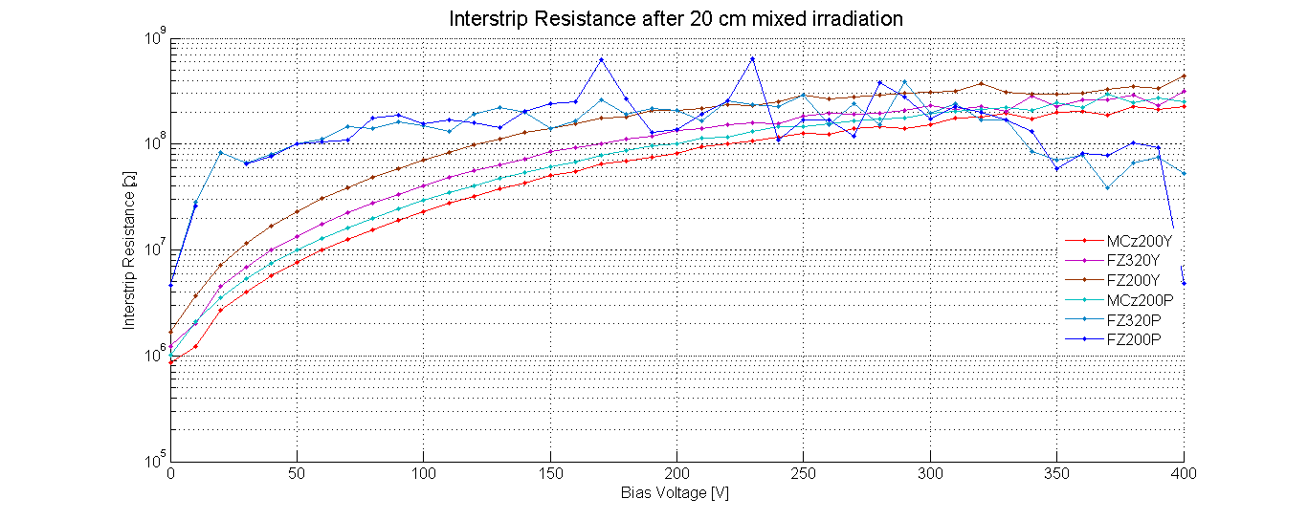
  Backup: Measured R_{int}
10⁹
P and Y types: R_{int}
P and Y types: R_{int}
F=5e14 cm⁻²
Measurement (W. Treberspurg)
DC-CAP
F=1e15 cm⁻²
10⁶

Slide 15
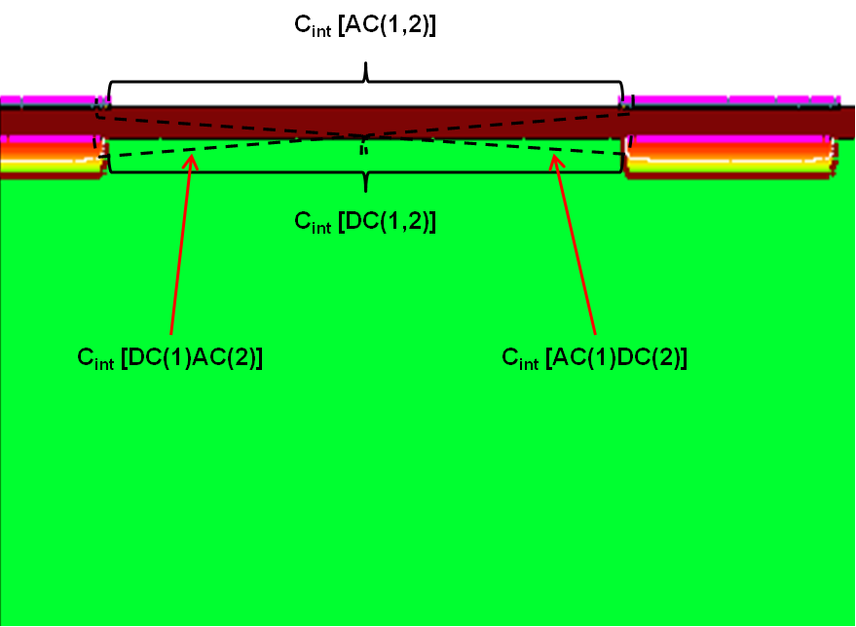
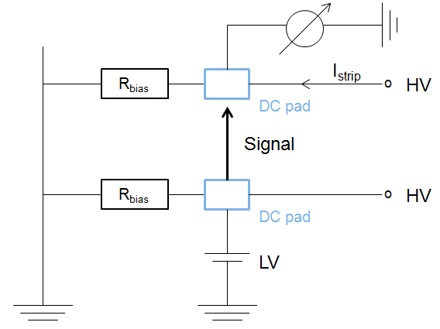
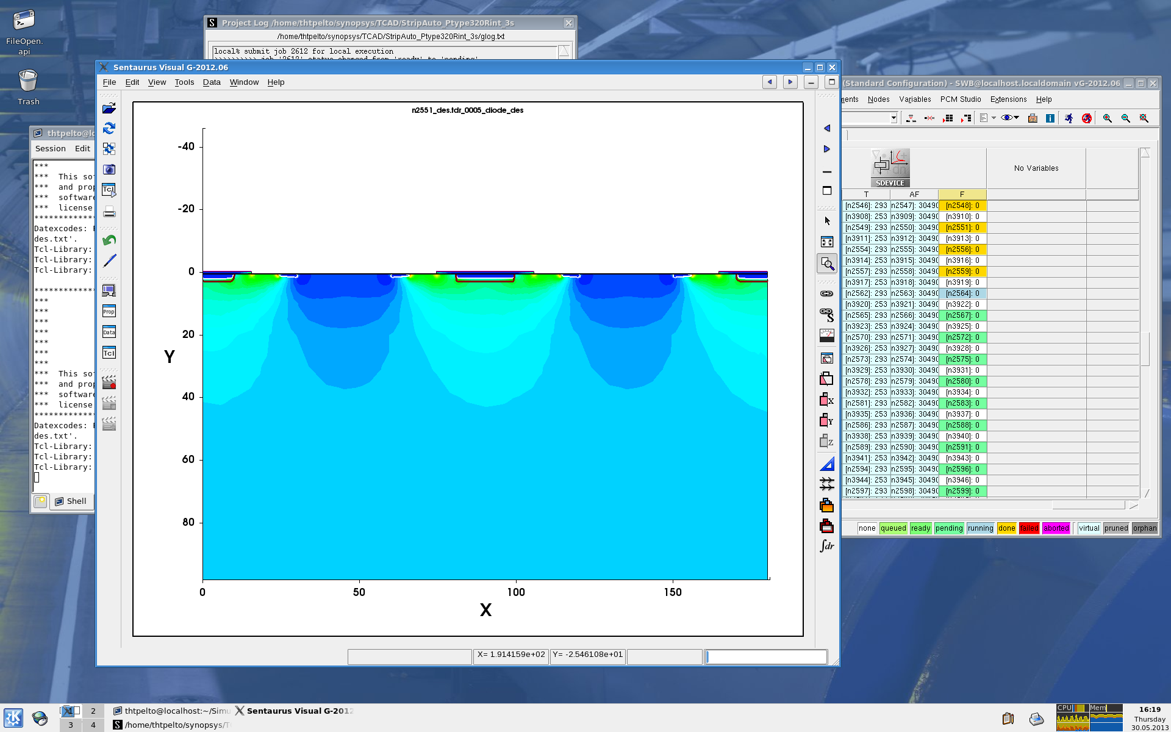
Backup: simulated R_{int} & C_{int}
3 strip structure, V_{strip1} = V_{strip3} = 0, V_{strip2} = LV and 0 V
V = -HV at the backplane
Interstip resistance (R_{int} ) is defined as (Induced Current Method):
R_{int} is plotted as a function of applied voltage V
C_{int} simulation principle
Electrical circuit diagram of R_{int} measurement :
C_{int} = 2*[AC(1,2)+DC(1,2)+AC(1)DC(2)+DC(1)AC(2)]
R_{int} simulation principle
V_{strip1} = 0
1: V_{strip2} = LV 2: V_{strip2} = 0
V_{strip3} = 0

