Slide 1


VSC group seminar
Leak propagation dynamics: experiment and simulation
M. Hermann, M. Ady, D. Ziemianski, G. Vandoni, R. Kersevan,
21st March 2014
The research project has been supported by a Marie Curie Early Initial Training Network Fellowship of the European Community’s Seventh Programme under contract number (PITN-GA-2010-264330-CATHI)
1

Slide 2
Outline
Motivation
Gas dynamics
Simulations
Fast valve systems
Experimental test-bench
Experiments and results
Conclusions and outlook
2

Slide 3
Motivation
What we do? Study behaviour of propagating gas within beam pipes theoretically and experimentally
Purpose ?
Accidental vacuum failure or leak may result in an inrush of ambient air which might propagate with supersonic velocity
Support safe and efficient operation of the HIE-ISOLDE and SPIRAL2 facilities
Benchmark Molflow+ simulation results
Such a propagating pressure wave could…
  carry contaminated particles through beamlines
  have mechanically destructive effects on components
  transport inrushing air to cold surfaces of cavities and worsen their performance due to condensation
  increase heat load to cavities
→ Gained knowledge is necessary to dimension and operate suitable protective systems
3

Slide 4
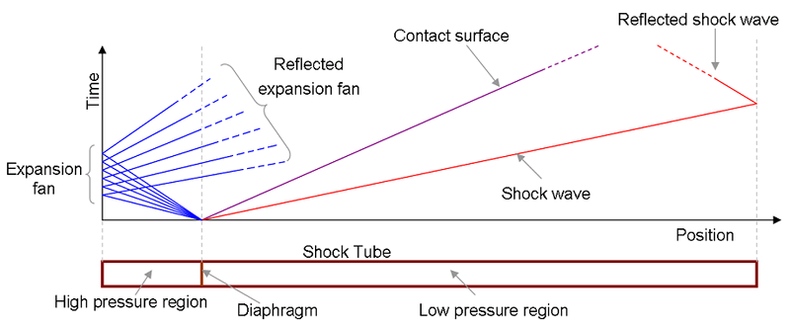
Generic knowledge regarding shock waves
Shock tubes consist in most cases out of two volumes with different pressure levels. The volumes are separated by a destroyable membrane.
Shock tubes are mostly applied for the experimental observation of gas and plasma propagation behaviour and measurement of properties such as velocities, pressures, temperatures, etc. at different positions
The shock wave velocity is supersonic. It depends on the low pressure with a max. velocity ≥ 1000 m/s (air) for expansion into UHV. Acoustic wave follows at velocity of ca. 400 m/s.
Analytical model describes properties
Flow regimes:
  Viscous flow regime:
  gas-gas collisions predominant
  Molecular flow regime:
  gas-chamber collisions predominant
http://en.wikipedia.org/wiki/File:Shock_tube.png
4

Slide 5
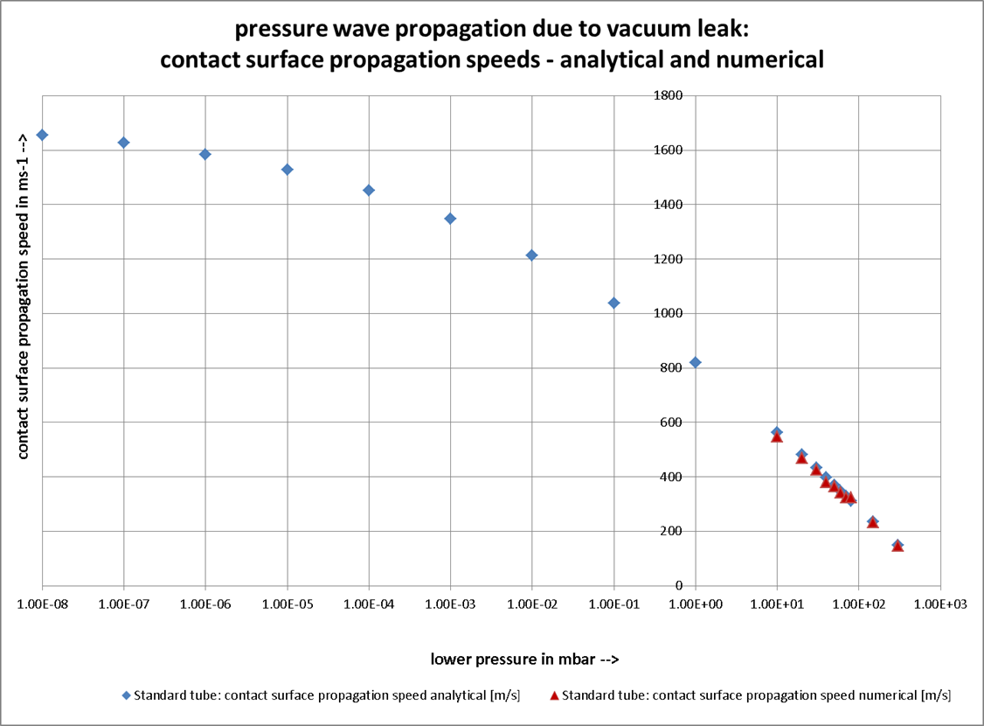
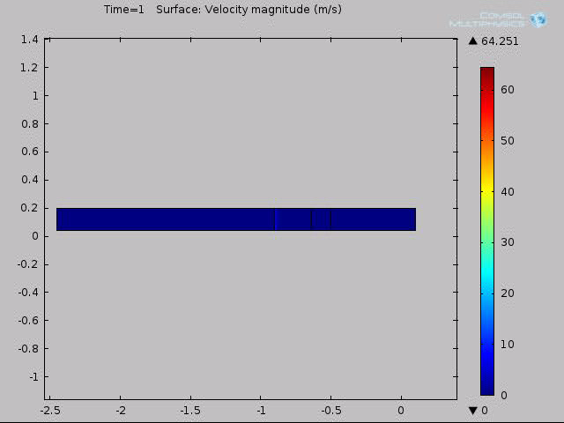
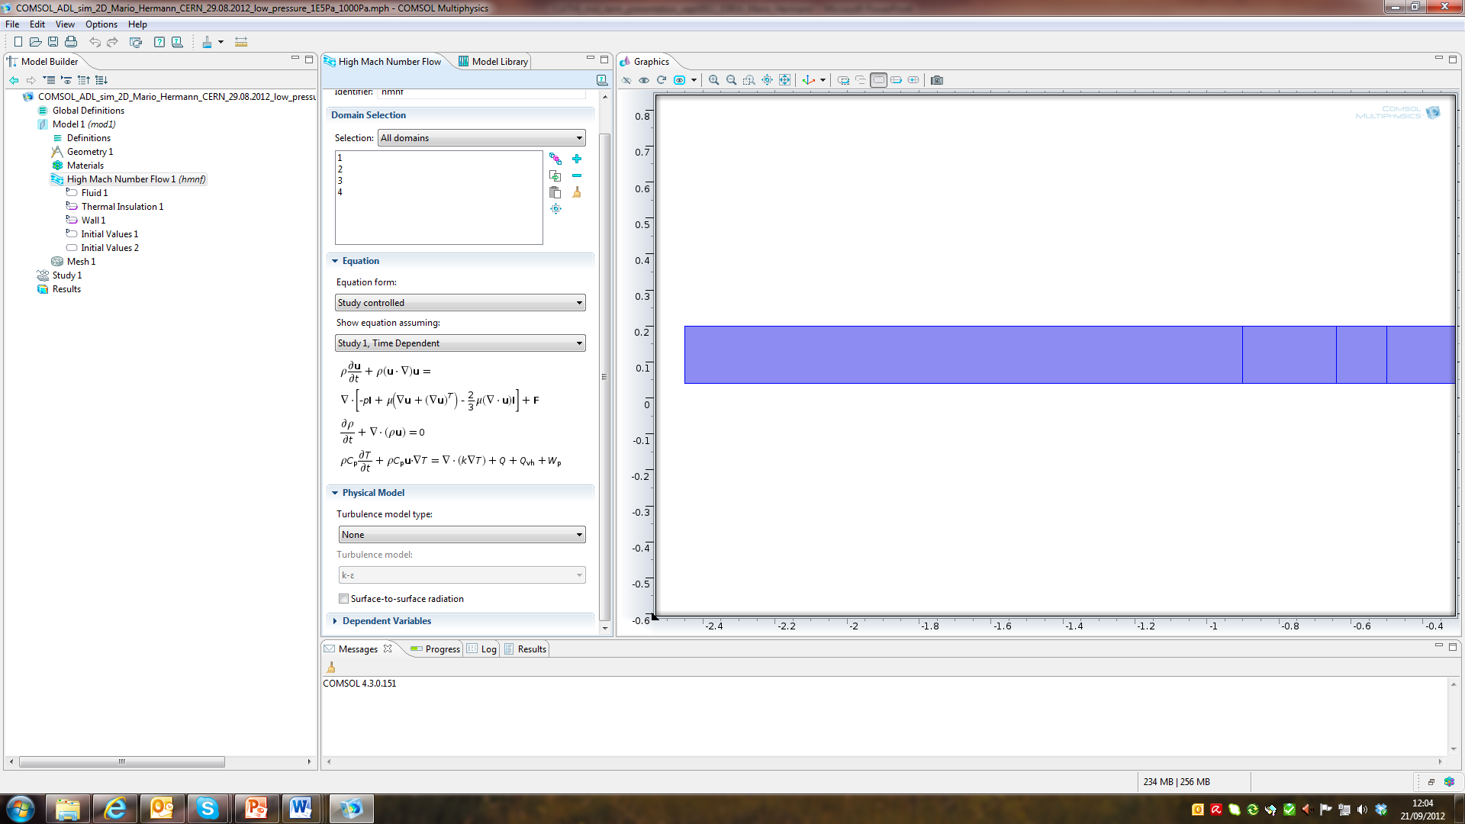
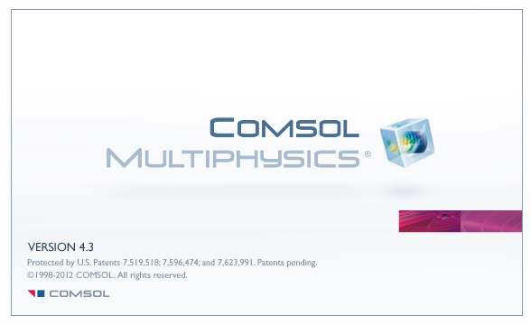
Analytical model vs. COMSOL simulation
Lower pressure limit for
COMSOL simulation: 10 mbar
→ usable for viscous flow regime
5

Slide 6
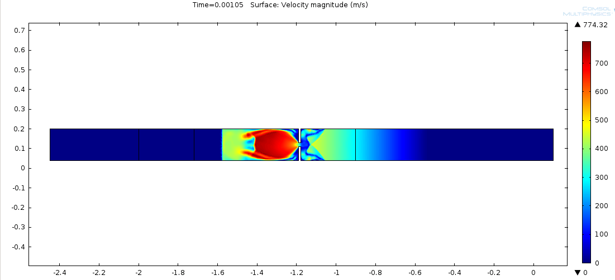
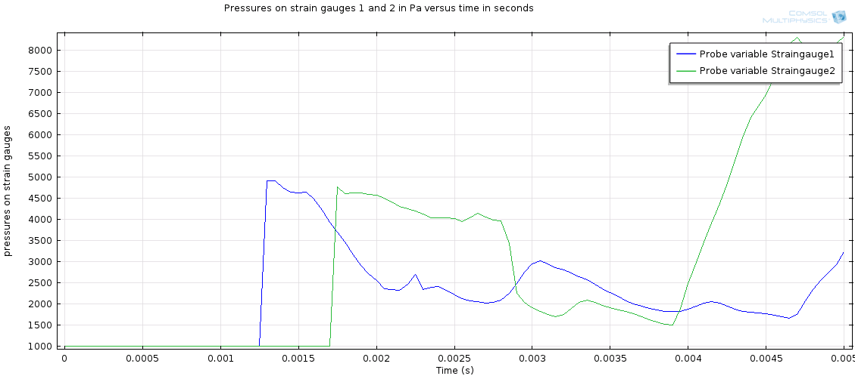
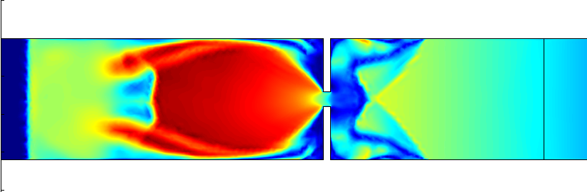
Example of viscous regime simulation
Shock wave simulations
1000 mbar vs. 10 mbar
Pressures at positions
1 and 2 vs. time
1 baffle and 2 pressure gauges
6

Slide 7
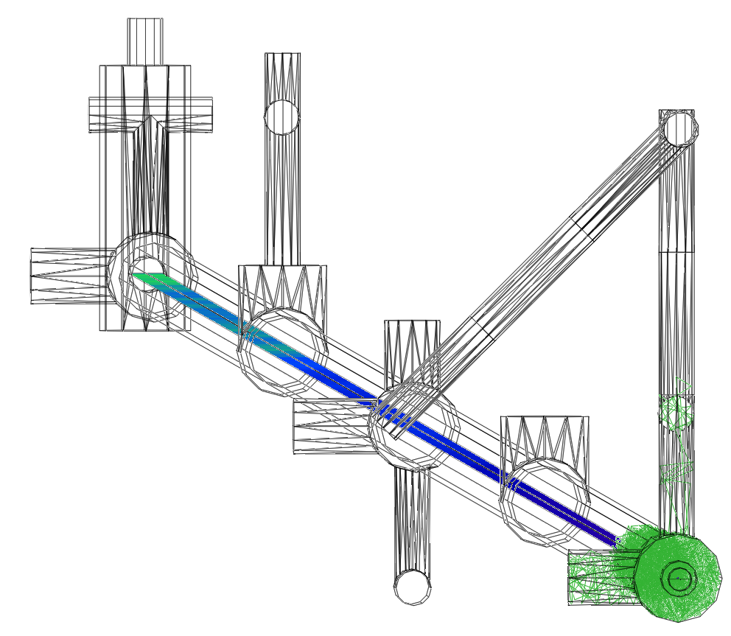
Recent Molflow+ improvements
Recent improvement of the Molflow+ code by M. Ady
Molflow+ now determines speed distribution and flight times of particles
This enables transient (time dependant) simulations
Inventor model of test bench in b. 113 imported into Molflow+
7

Slide 8

Exemplary dynamical Molflow+ simulation
Courtesy M. Ady
High pressure
Haute pression
Low pressure
Basse pression
8

Slide 9
Measures to protect SC linac from contamination with ambient air
Anticipatory actions
  Robust vacuum design of experiments
  e.g. Minimize amount and aperture of valves to atmosphere
Actions during operation
  Raising awareness of experimentalists for problematic
Implementation of protective equipment
  Usage of slow-down devices such as acoustic delay devices
  Implementation of fast pressure detection and fast valve system
9

Slide 10
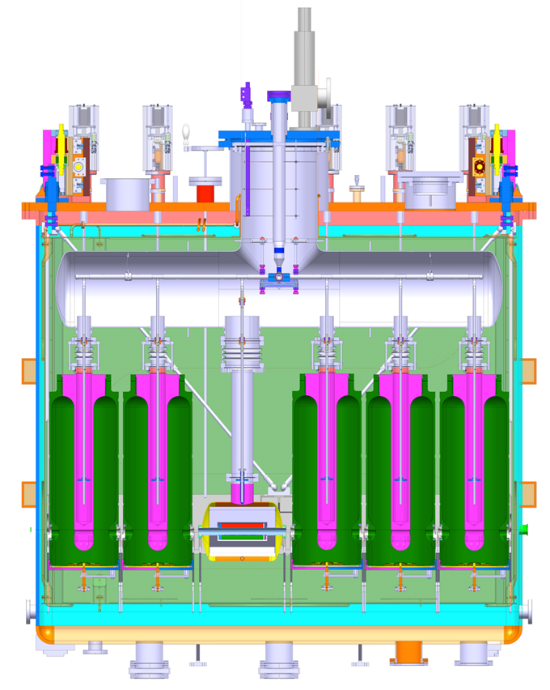
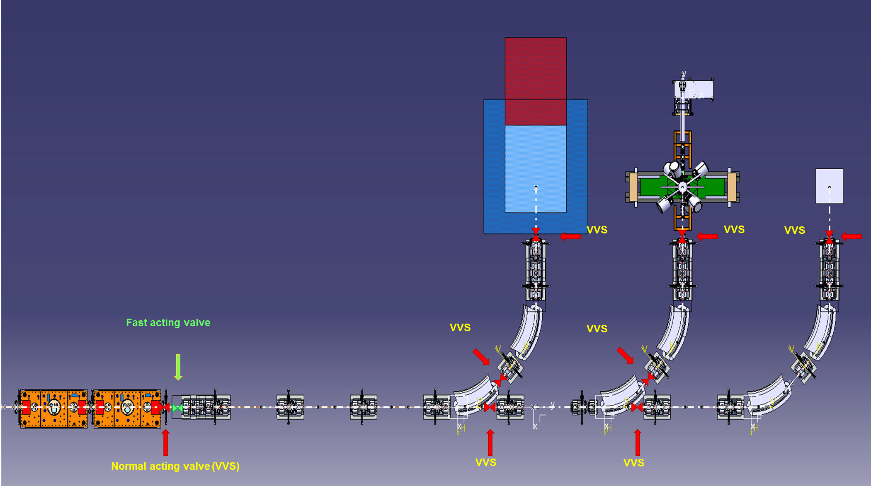
Fast valve system for HIE-ISOLDE SC linac
Penning gauges
2
3
5
1
4
3m
10

Slide 11
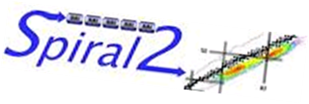
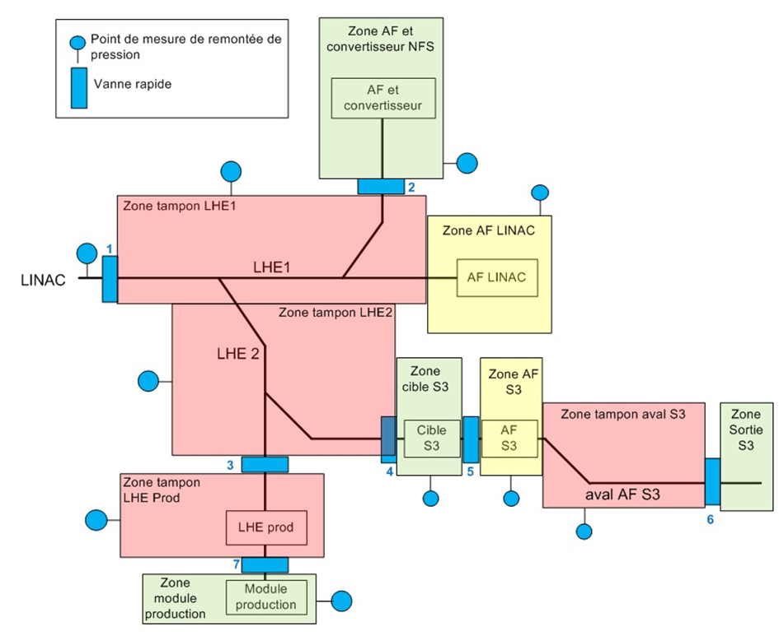
Collaboration with vacuum team of SPIRAL2
SPIRAL2 beam lines with foreseen
fast valves and pressure gauges
Common problematics:
- delicate components upstream,
- space constraints
Differences:
SPIRAL2: risk of propagating radioactive gases
HIE-ISOLDE: no safety risk but necessity of cryomodule regeneration
Since rated as nuclear facility: obligation to prove
functionality of fast valve system and
compliance of response times
on frequent basis (yearly intervals)
11

Slide 12
VAT fast valve system
What is a fast valve system ?
Consists of fast valve, pressure gauge,
controls and connecting cables
Enables leak tight closure of a vacuum
sector within less than 20 ms for
DN40 aperture
ca. 15 ms
12

Slide 13
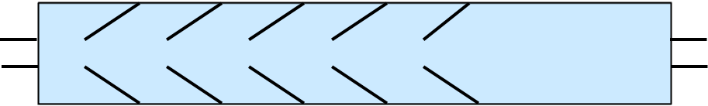
Acoustic delay devices
Acoustic delay lines,
even as short as 30 cm
can help to “gain time” for valve closure
Efficiency of an ADL = v_out / v_in
Values down to 0.2 measured in lit.
Turbulent flow regime created
Signal processing
v_in
v_out
direction of gas flow
13

Slide 14
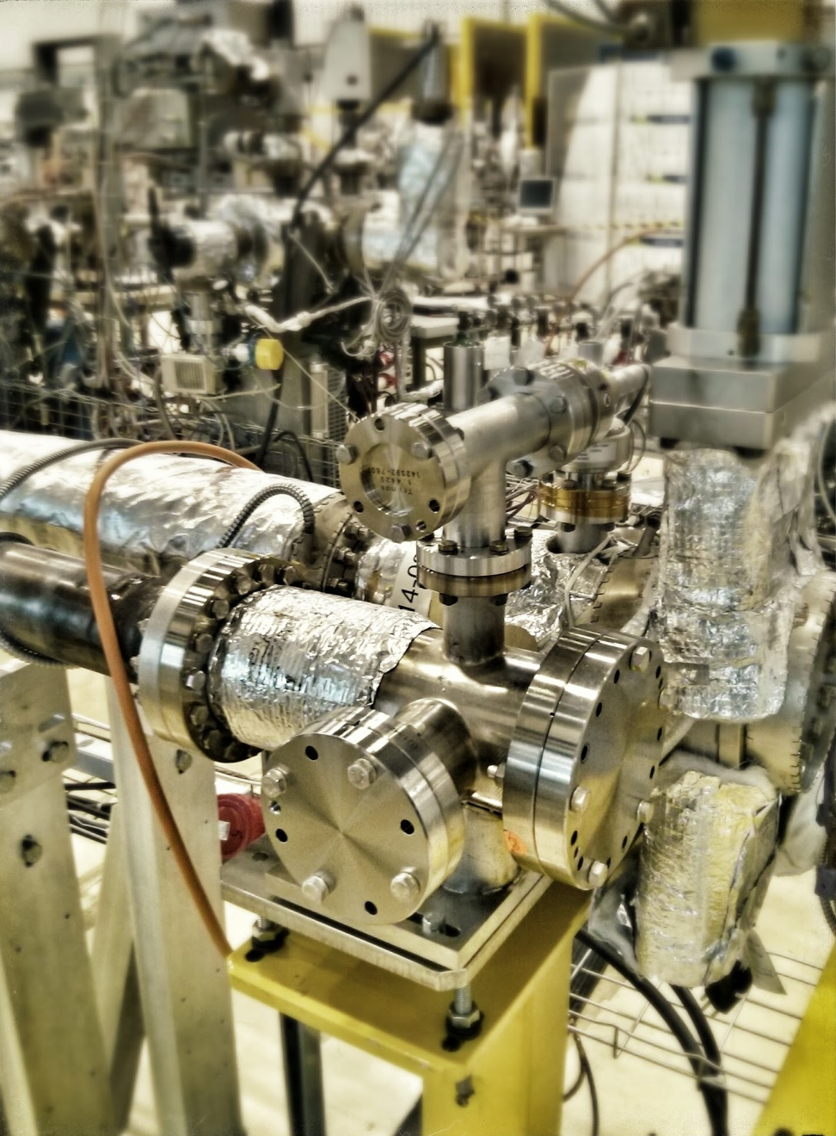
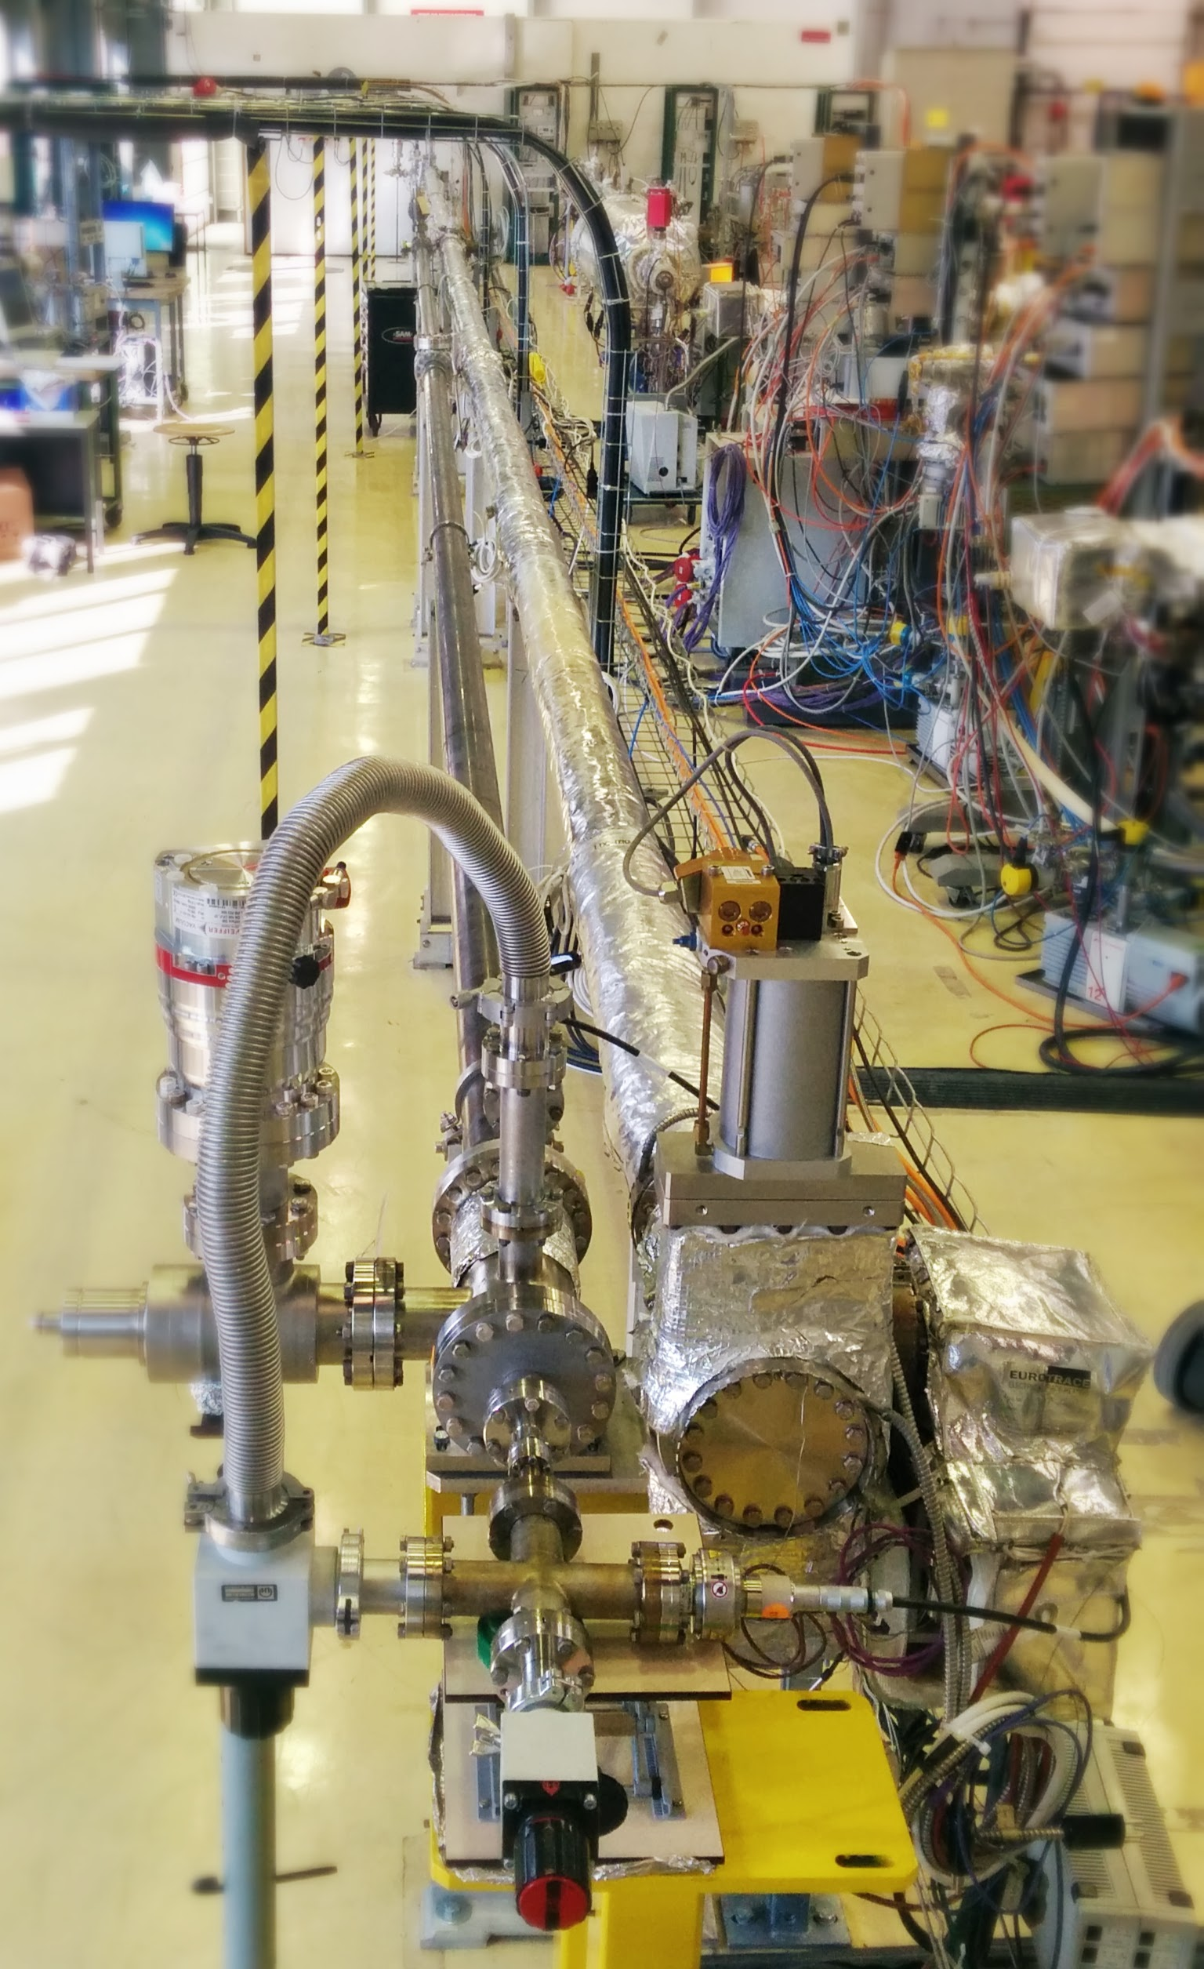
Experimental setup: schematic
A
B
Installed in building 113, usage of former LHC long straight section test bench
4 sections of 7m length
DN80 stainless steel tube
Pumped by 3 turbomolecular pumping groups at the extremities and in the center
14

Slide 15
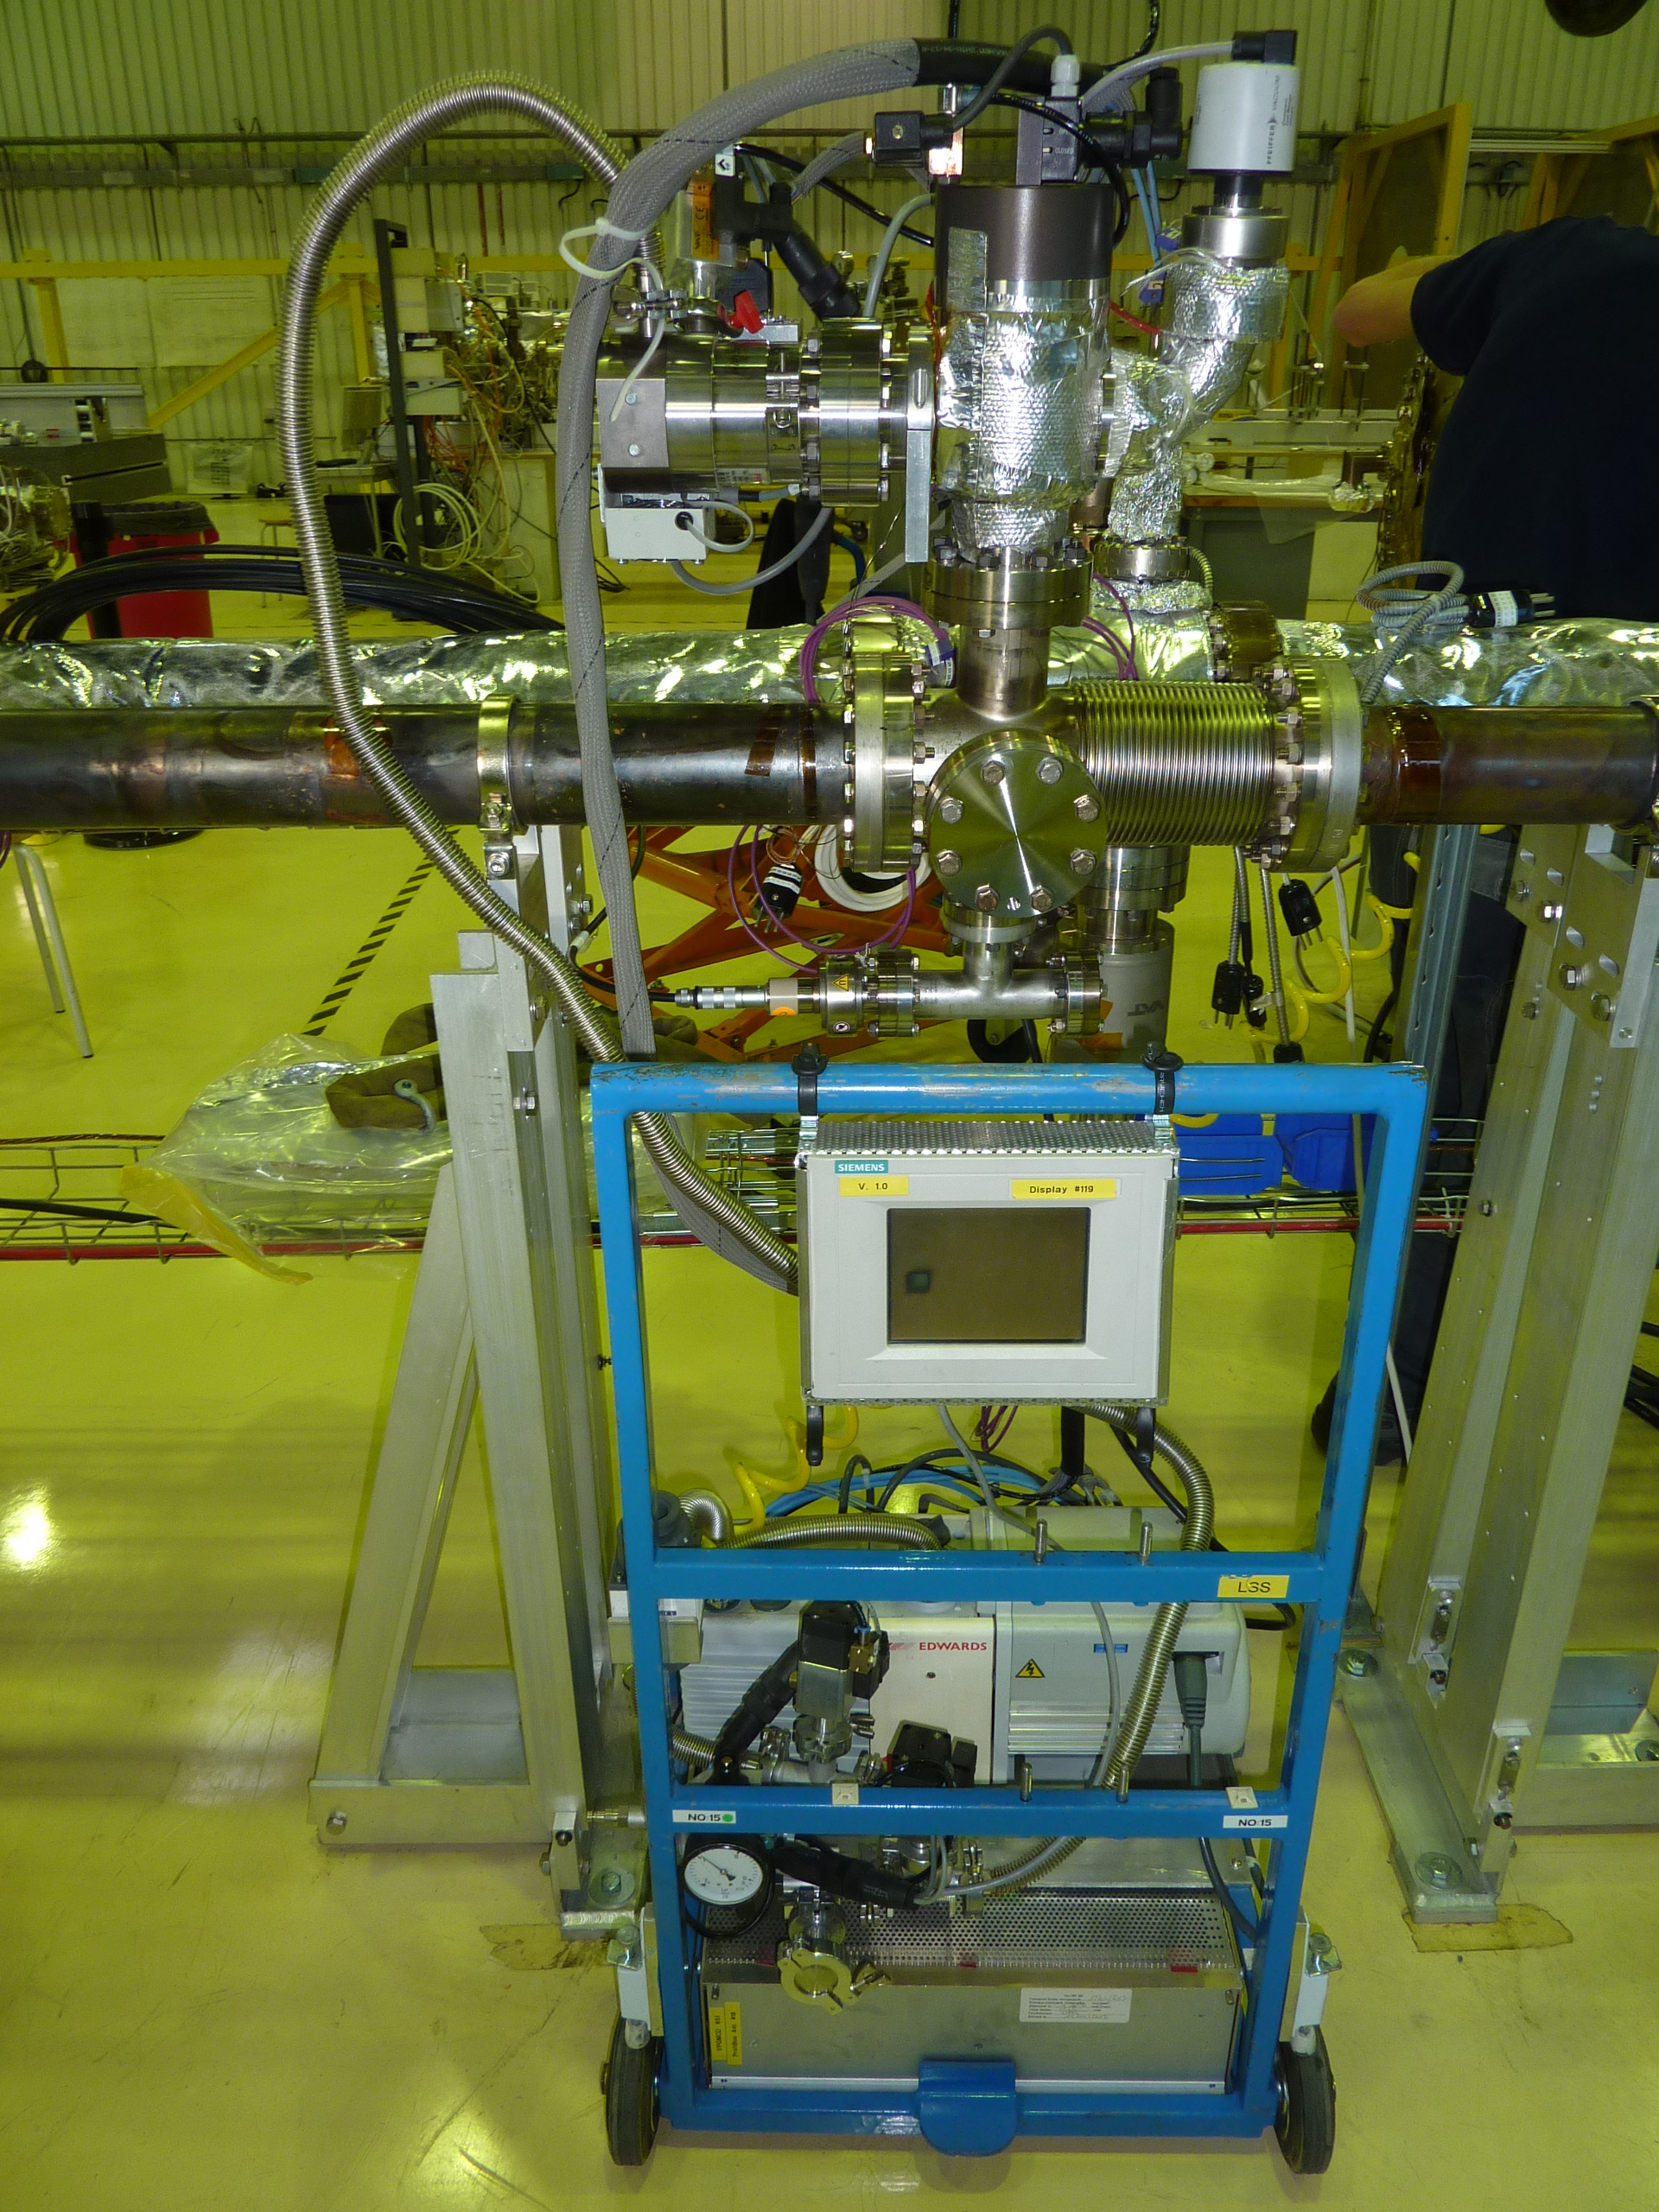
Experimental setup: schematic
Installed in building 113, usage of former LHC long straight section test bench
4 sections of 7m length
DN80 stainless steel tube
Pumped by 3 turbomolecular pumping groups at the extremities and in the center
15

Slide 16
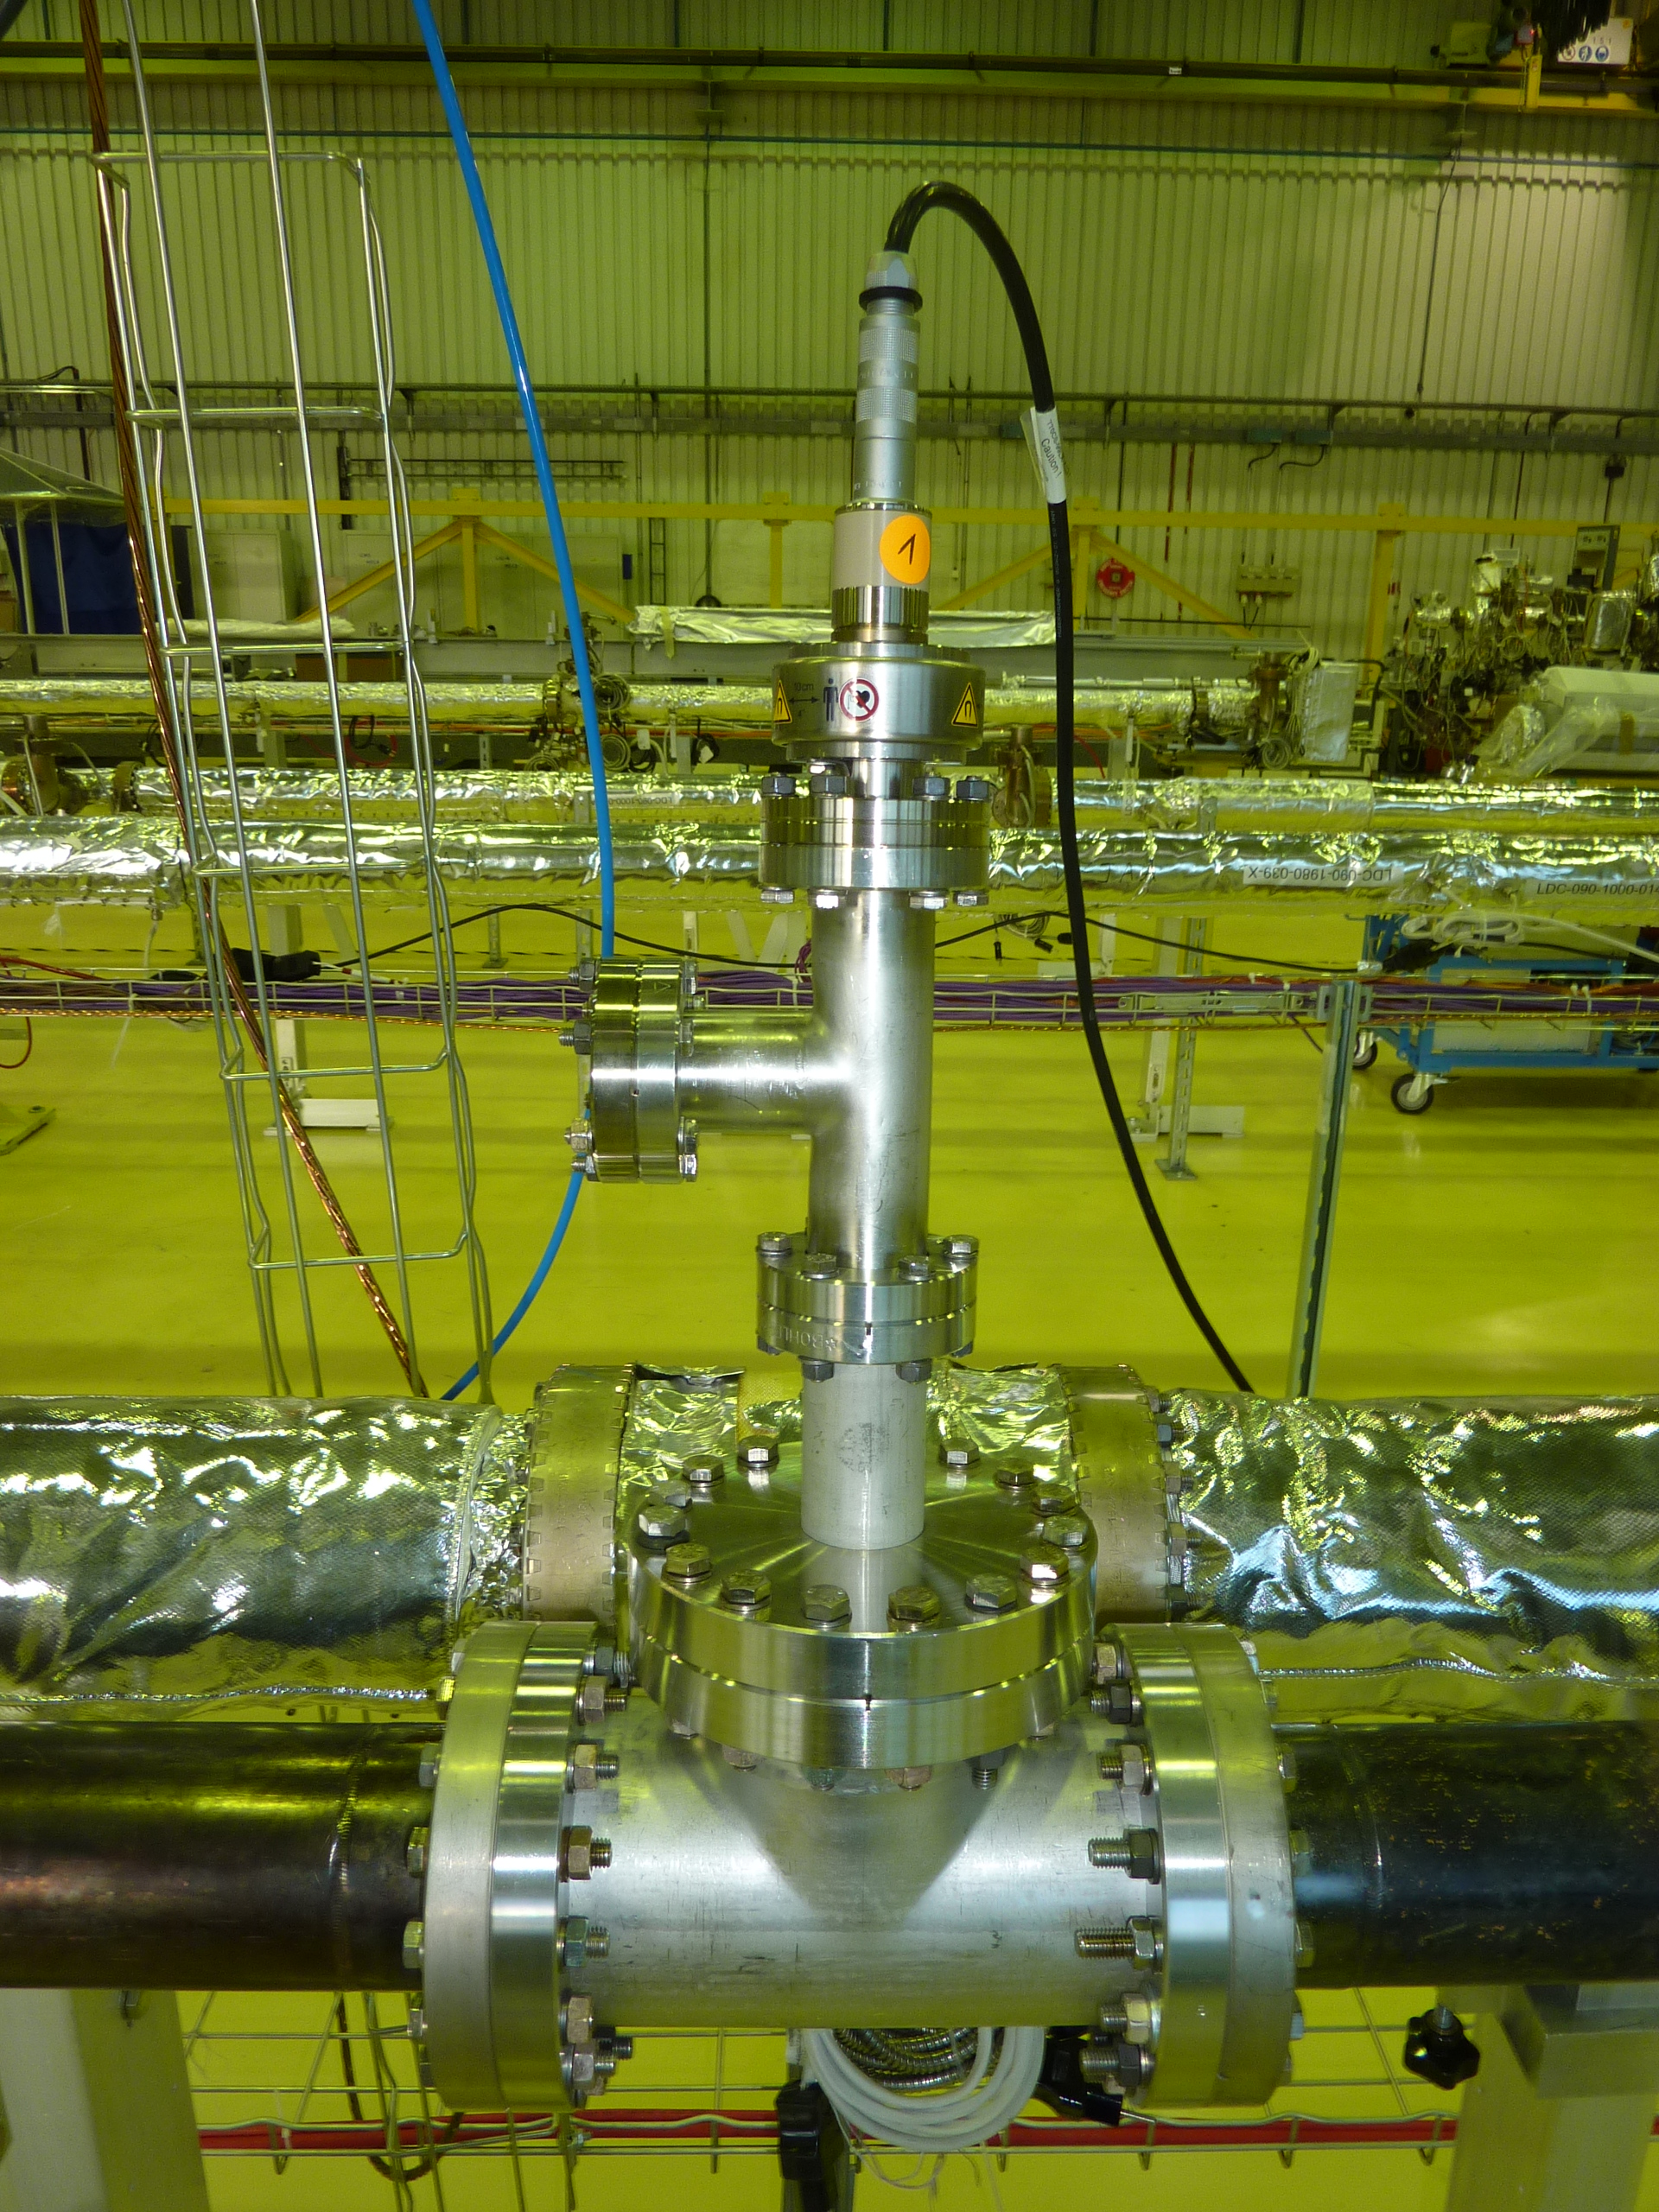
Experimental setup: schematic
Installed in building 113, usage of former LHC long straight section test bench
4 sections of 7m length
DN80 stainless steel tube
Pumped by 3 turbomolecular pumping groups at the extremities and in the center
16

Slide 17
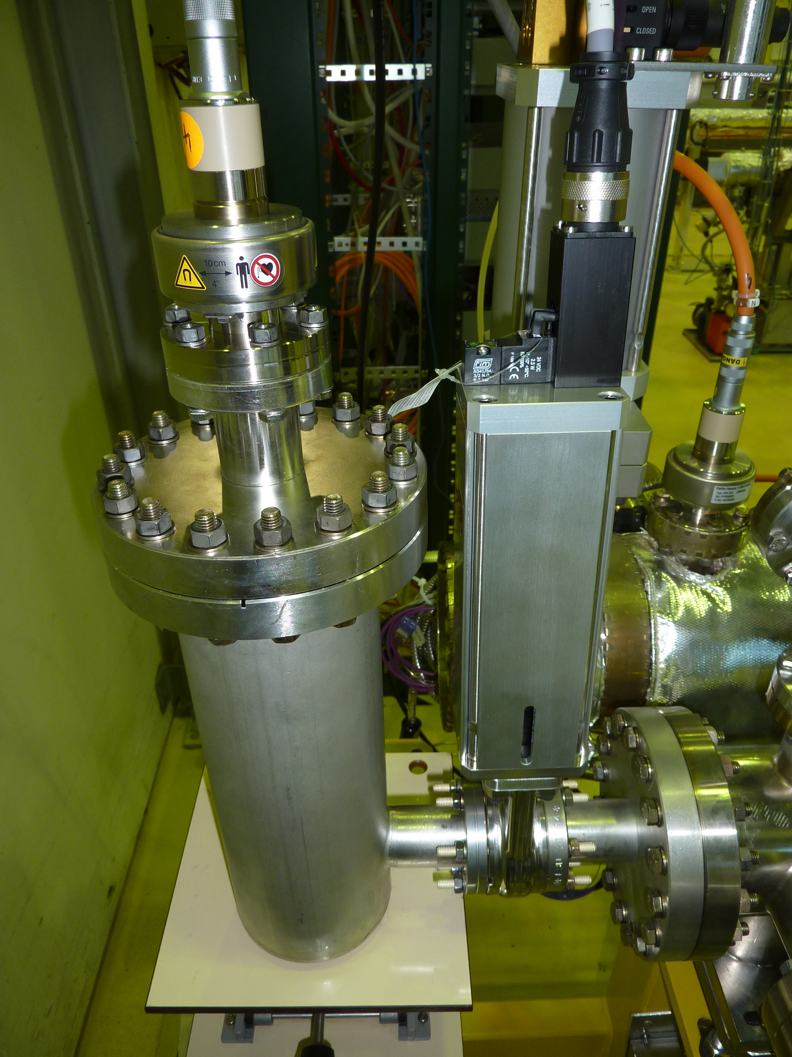
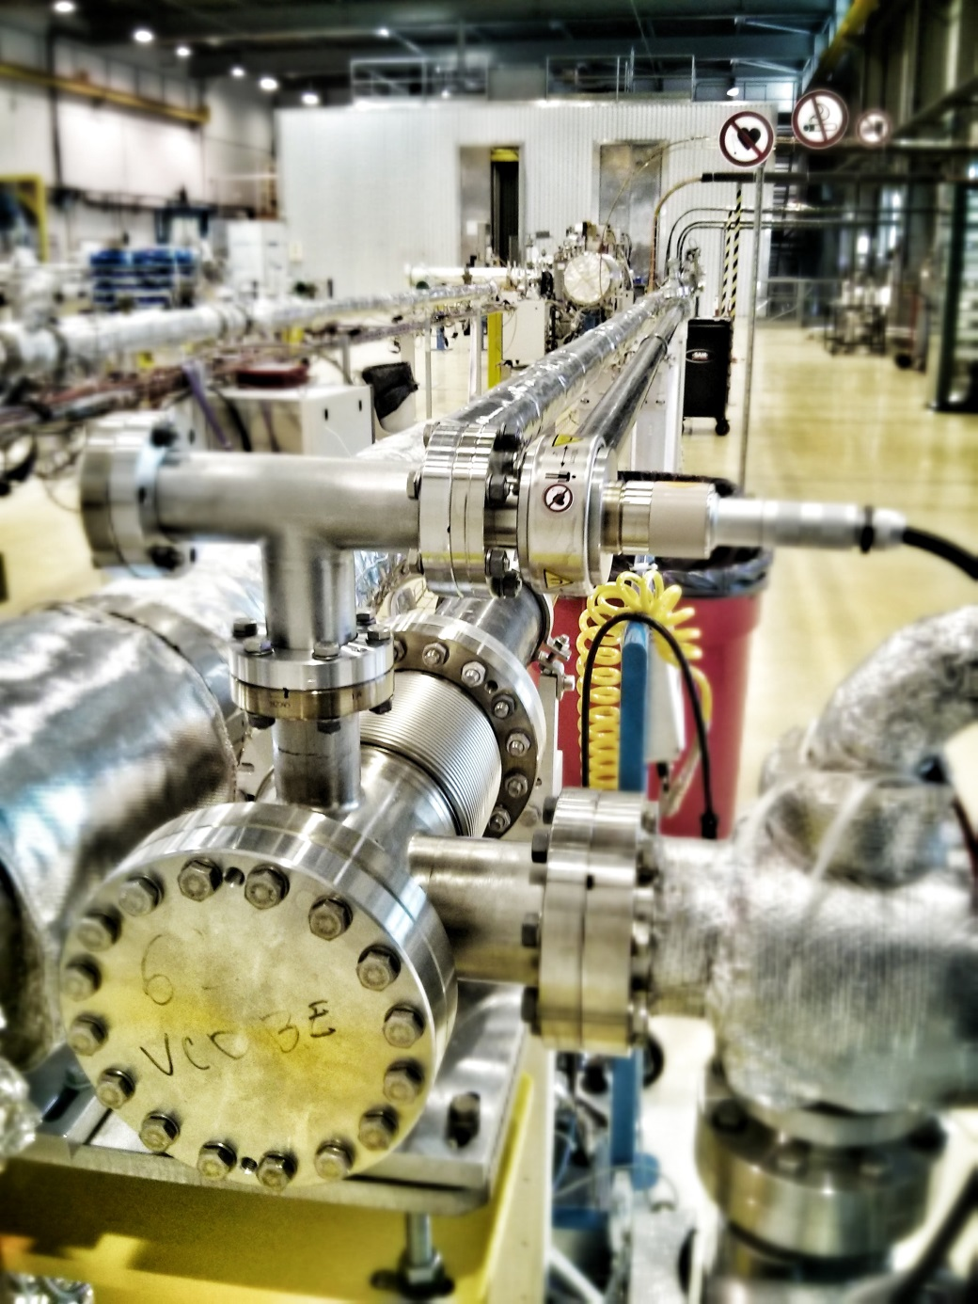
Experimental setup: schematic
A
B
Installed in building 113, usage of former LHC long straight section test bench
4 sections of 7m length
DN80 stainless steel tube
Pumped by 3 turbomolecular pumping groups at the extremities and in the center
17

Slide 18
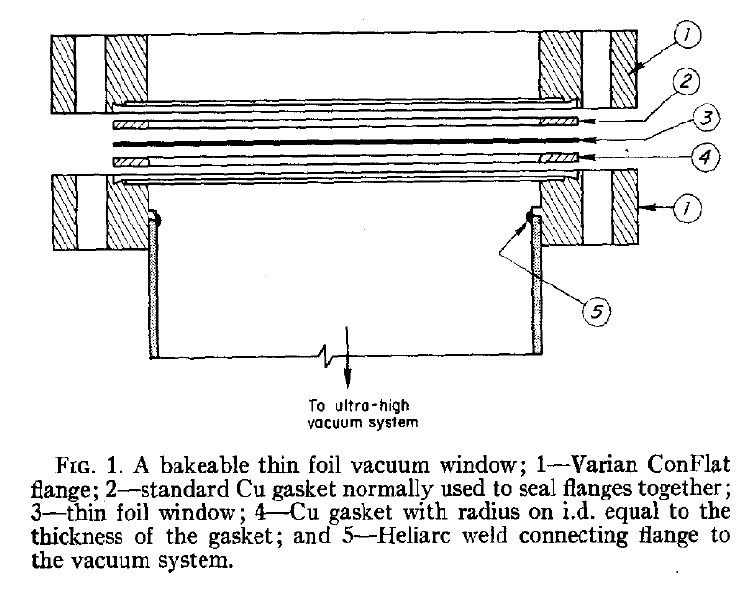
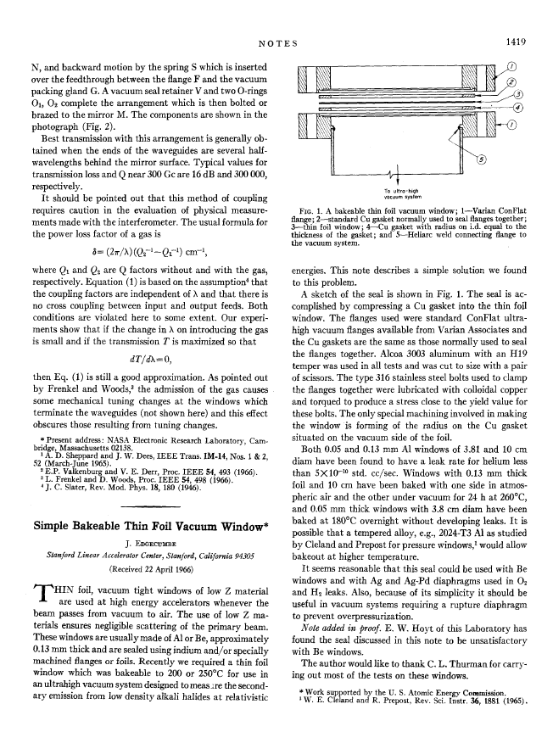
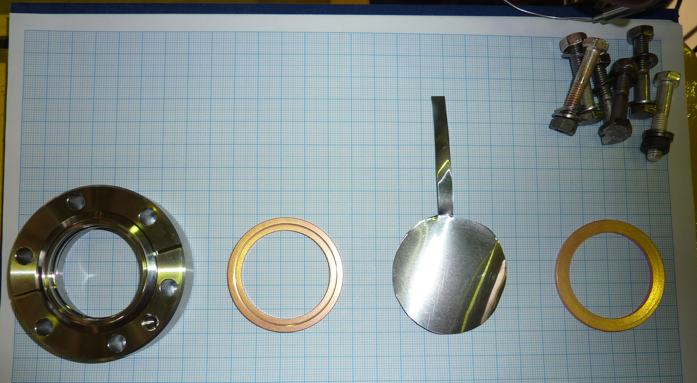
Experimental setup: window design
Requirements for window:
Leak tightness
Withstand dp between pa = 1000 mbar and pv = 1E-8 mbar on diameters up to DN100
Low outgassing and permeation
100 micron alu foil
18

Slide 19
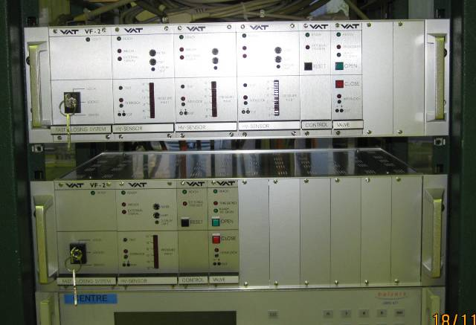
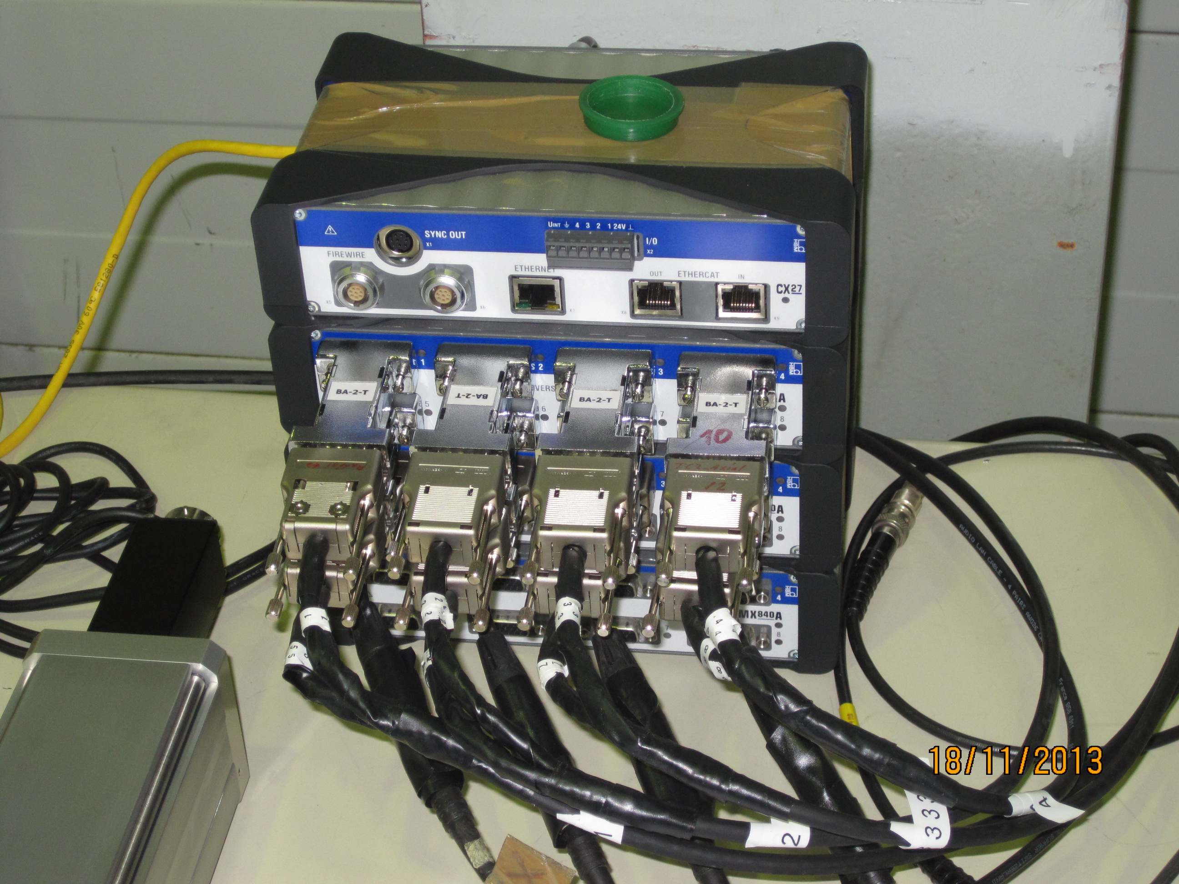
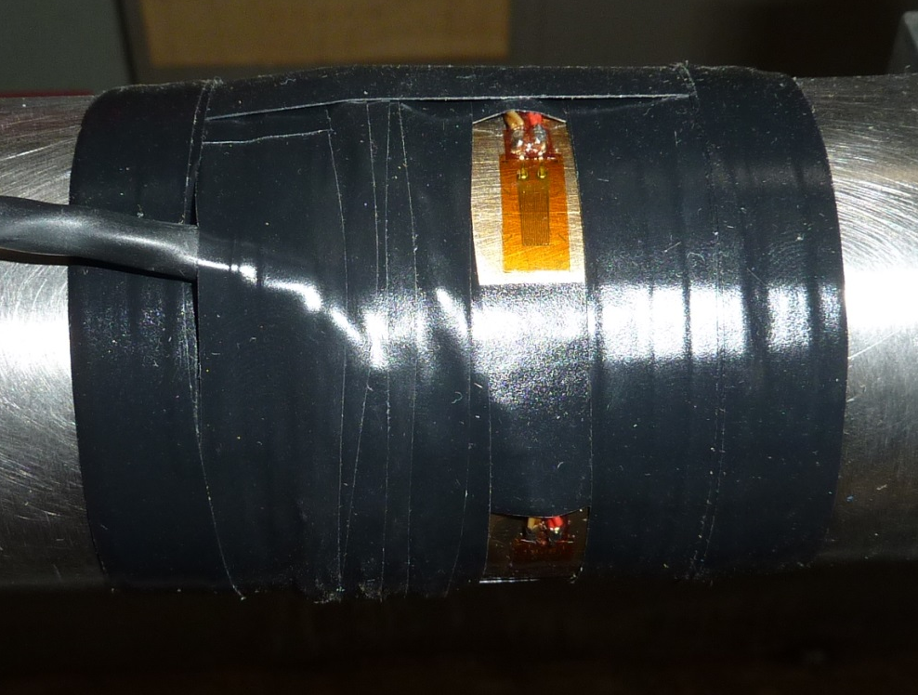
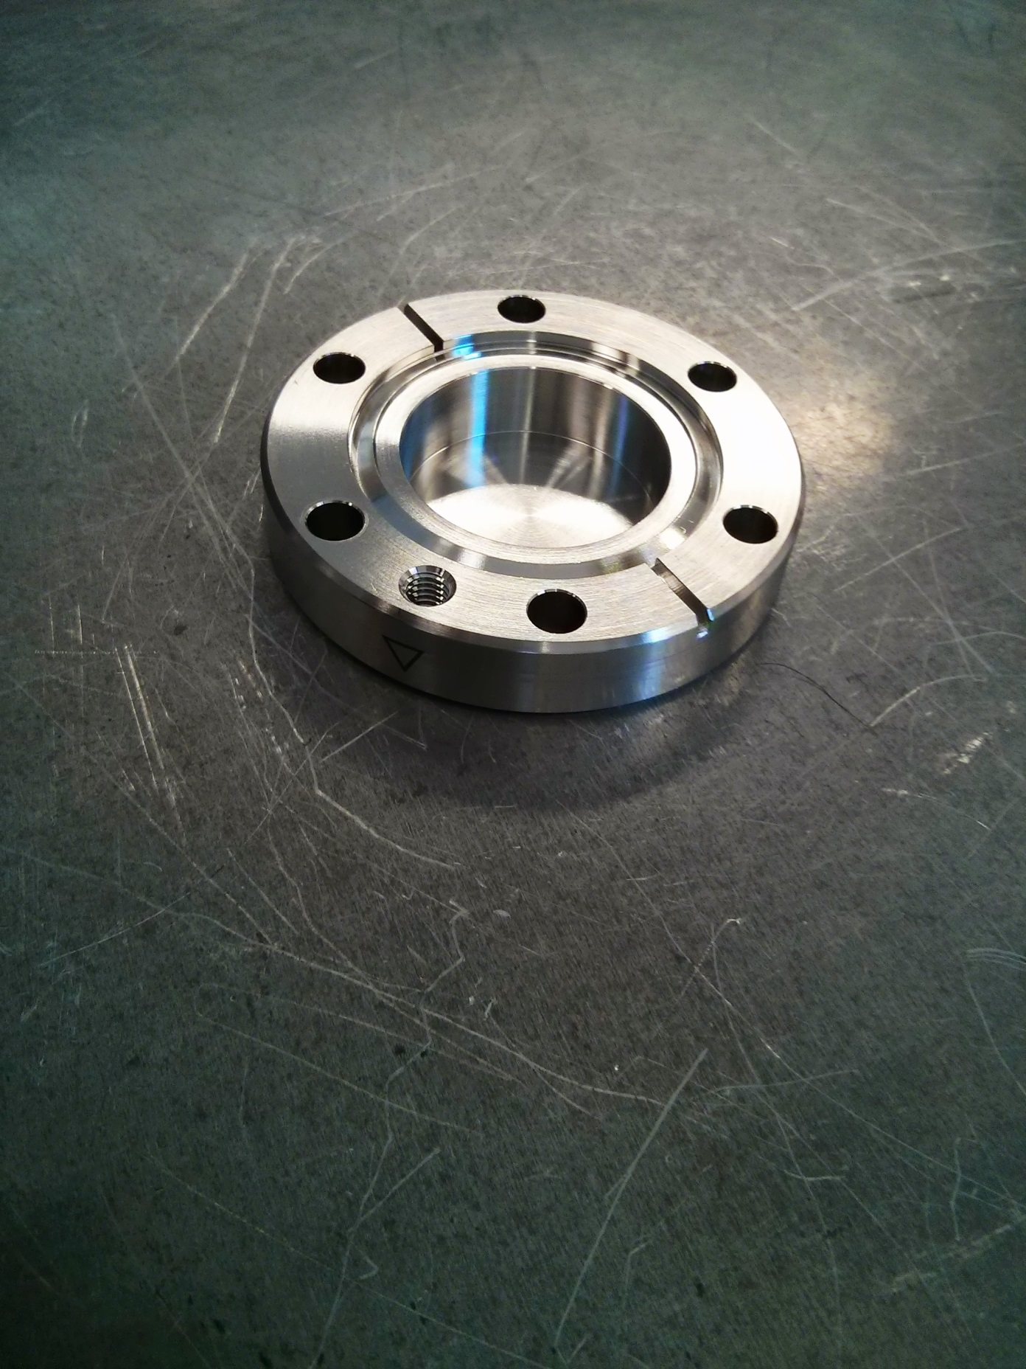
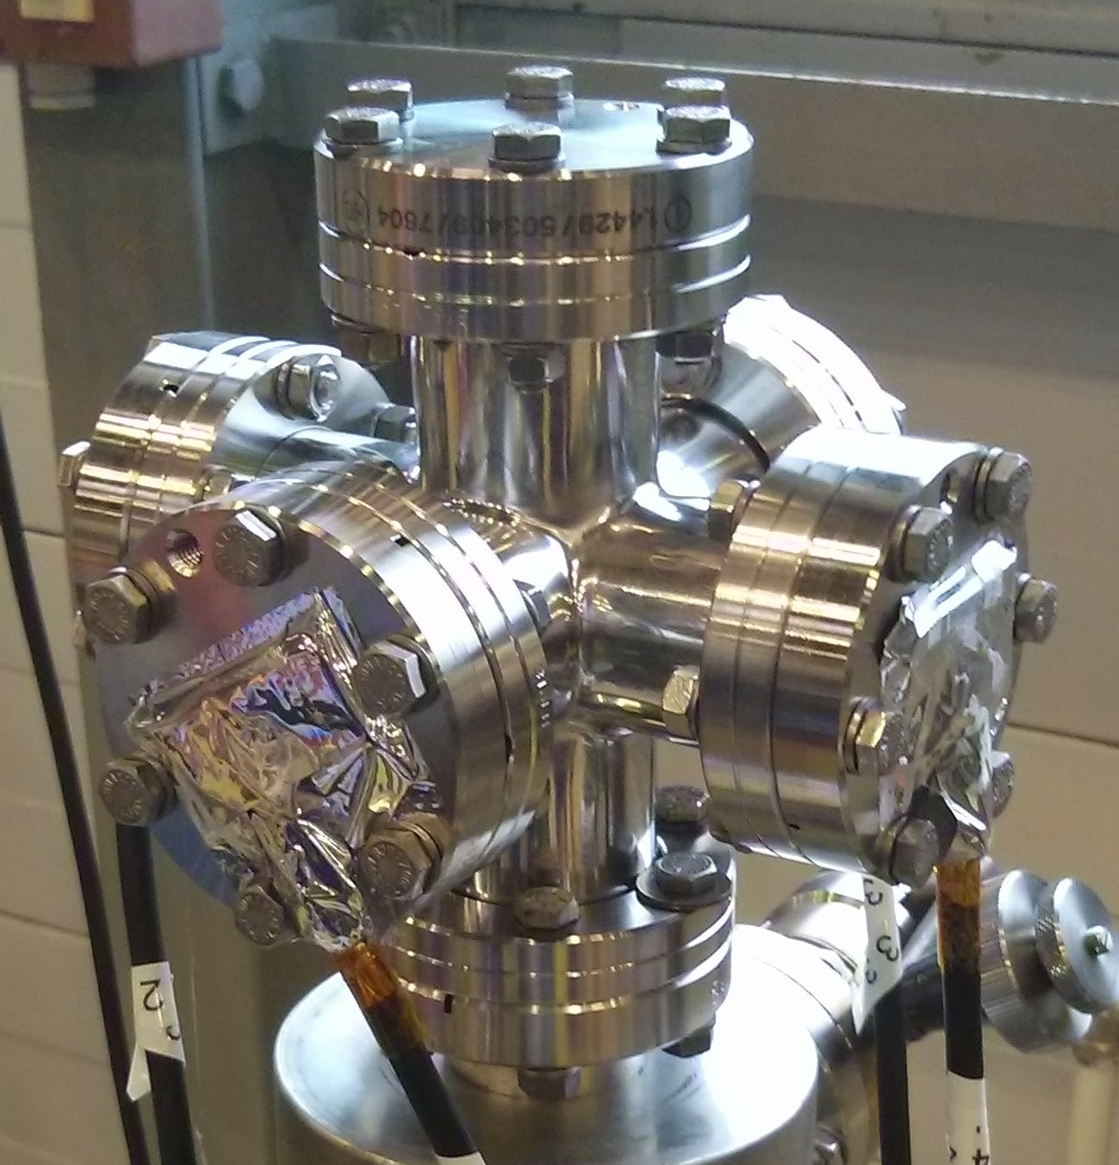
Experimental setup: DAQ
Penning gauges to measure pressure range below 1E-3 mbar
Strain gauges foreseen to measure from atmospheric pressure
VAT control crates for SC linac
Collaboration with
Mechanical measurement lab of Dep. EN for fast DAQ
Collaboration with
company VAT for troubleshooting
Sampling rate of fast DAQ: 9kHz
DN40 CF blind flange with 100 micron thickness
Calibration pump stand
19

Slide 20
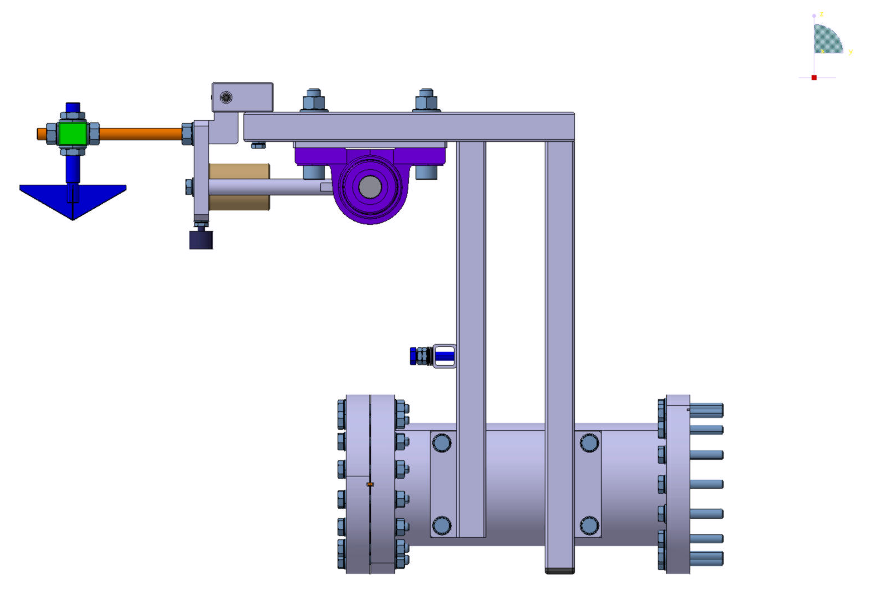
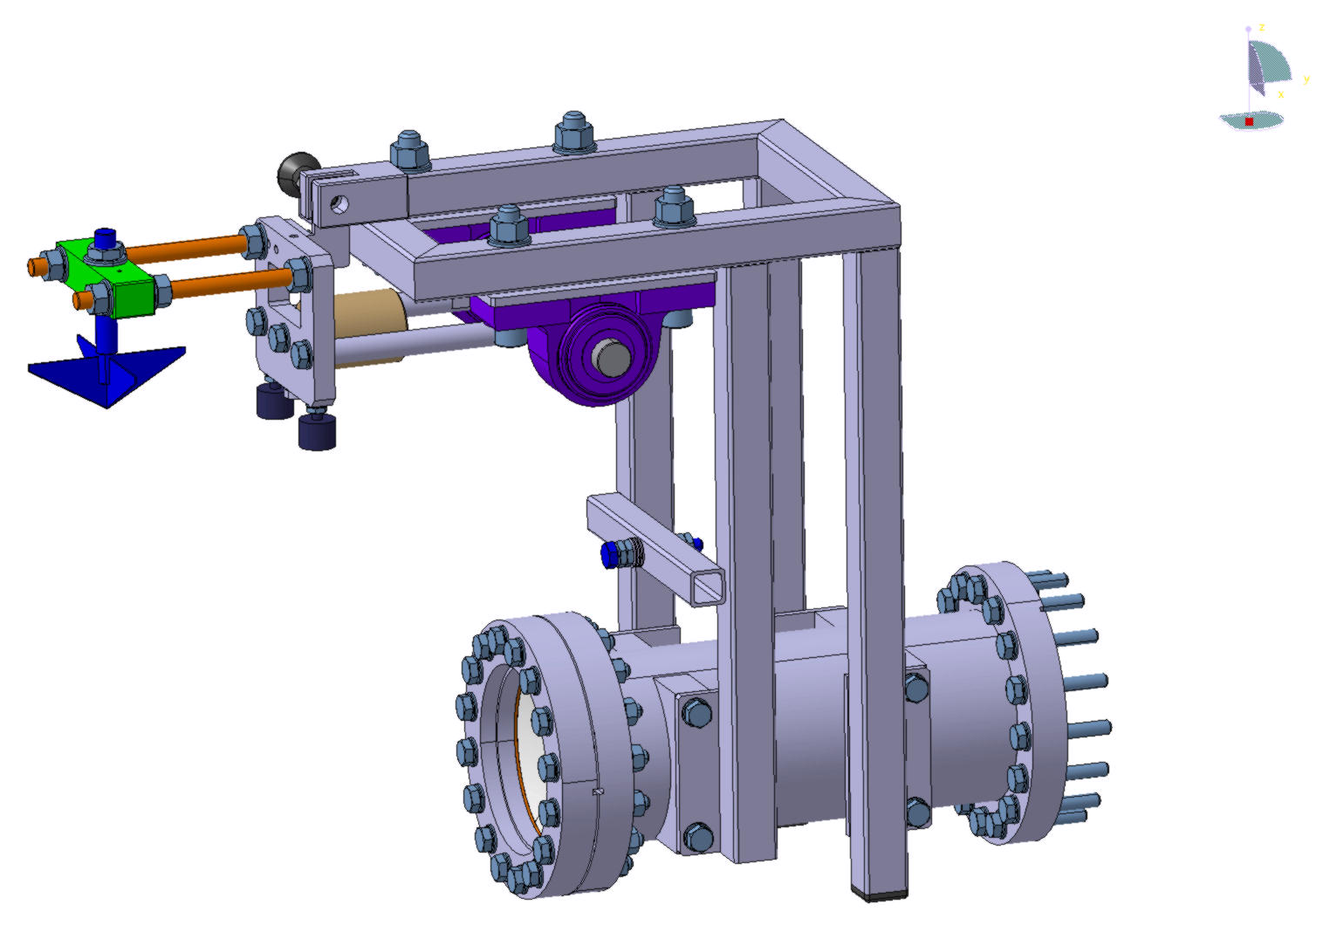
Experimental setup: pendulum design at SPIRAL2
Pendulum on DN100 CF flange designed at GANIL, one will be delivered to CERN
Used to enable repeatable triggering (using accelerometer) of DAQ and foil break
  Time stamp of breaking foil
Courtesy R. Levallois
20

Slide 21
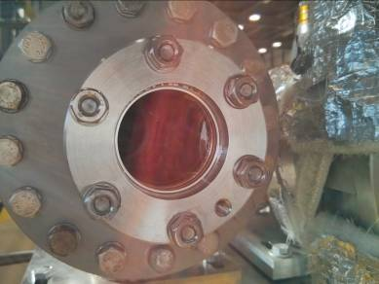
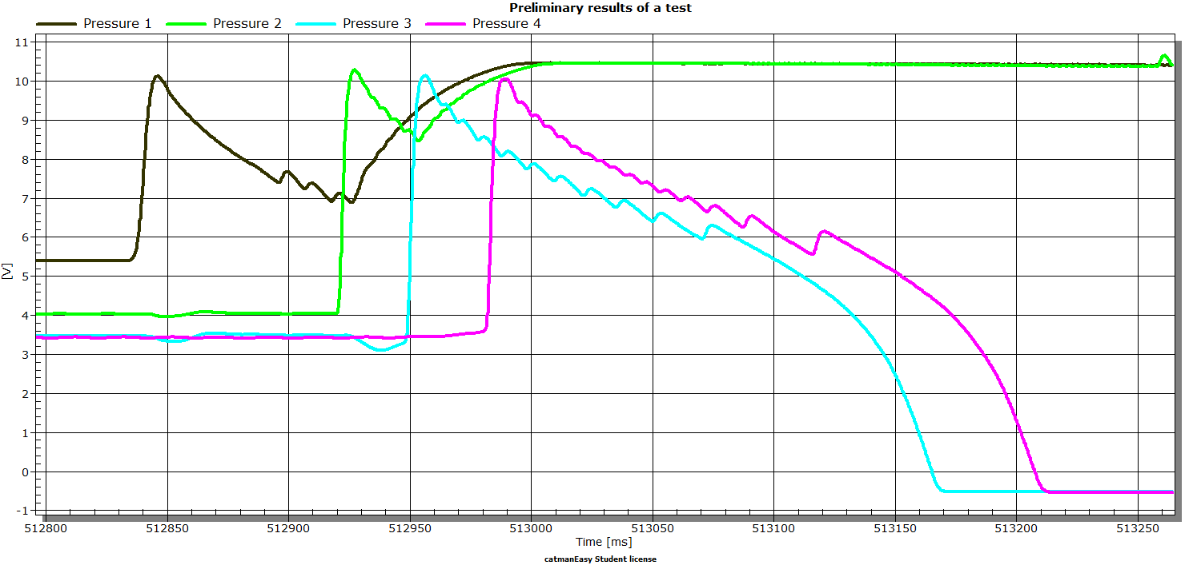
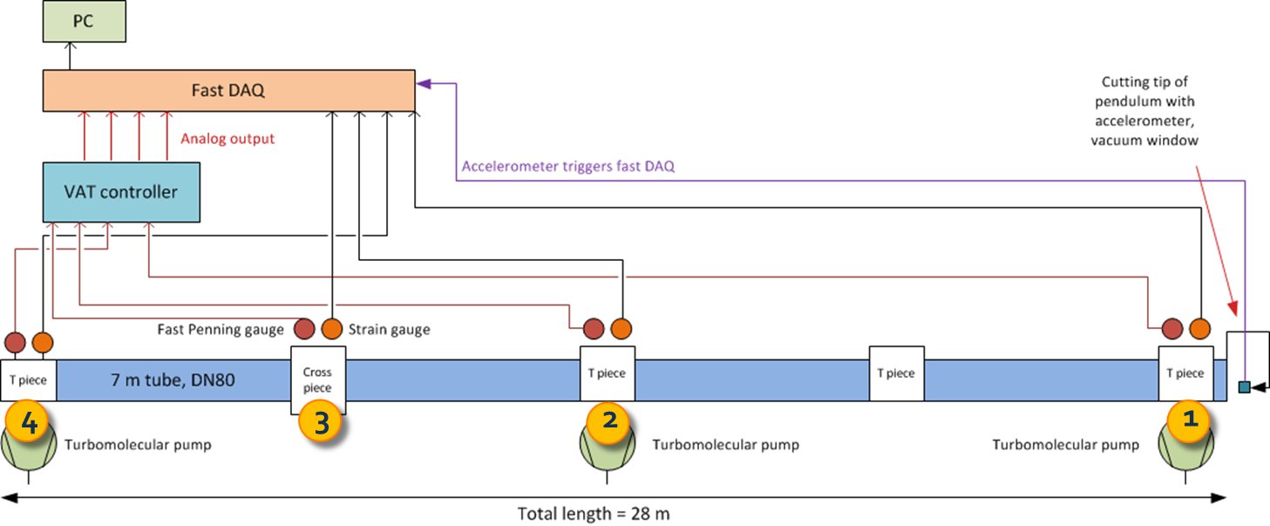
Preliminary results with setup A
First test using DN40 CF flange and polymer foil
A
1E-3 mbar
1
2
3
4
Velocity 200 m/s
1E-8 mbar
21

Slide 22
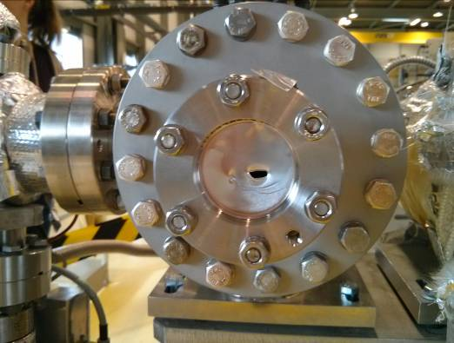
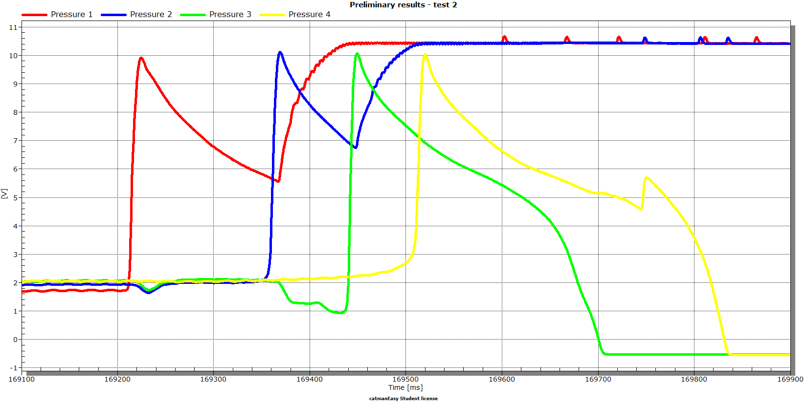
Preliminary results with setup A
Second test using DN40 CF flange and 200 micron aluminum foil
A
1E-3 mbar
1
2
3
4
1E-8 mbar
Velocity 100 m/s
22

Slide 23
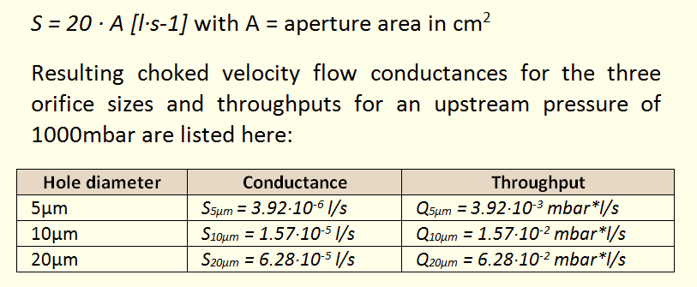
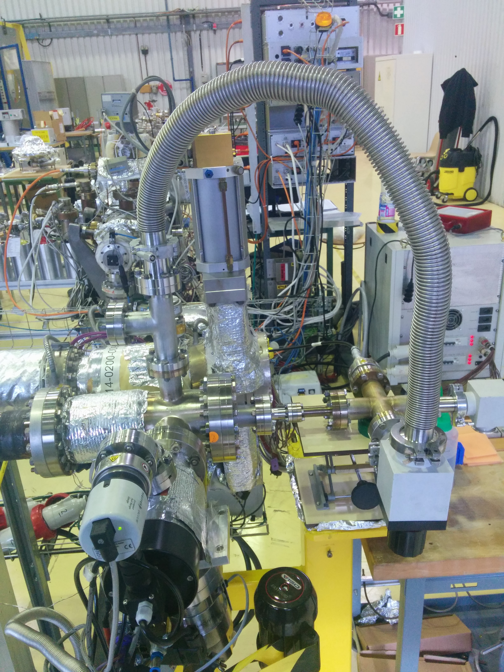
Study of micro-leaks
Micro-leaks of 5, 10 and 20
micron diameter
Bernoulli’s equation for choked velocity flow
Pressure ratio p1/p2 < 0.53
Test bench measurements
Molflow+ simulation
23

Slide 24
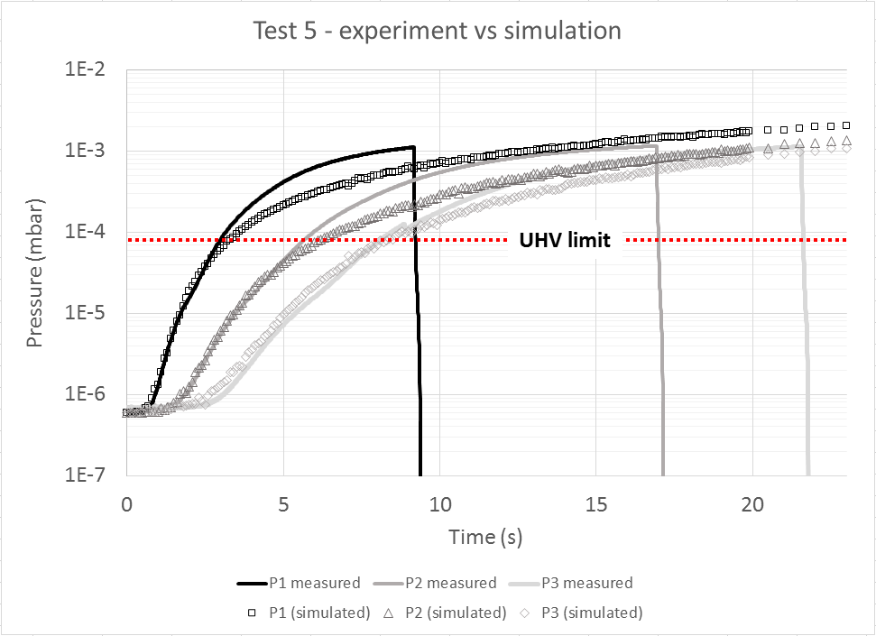
Study of micro-leaks
24

Slide 25
Study of micro-leaks
25

Slide 26
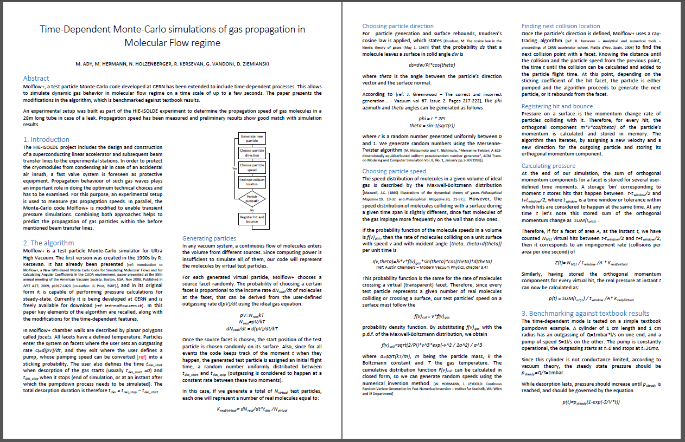
Conclusions and outlook
Protection of SC linac from air inrush of high importance
Simulations allow better understanding of propagating pressure waves
Test-bench in b.113 enables us to examine these and delivers important and useful insights regarding:
  Gas propagation velocities (for various leak sizes)
  How to operate a fast valve system
  Validation of closing times
  Quantification of transferred gas
Publication about results
Study of fast valve system using adjustable time lag
Implementation of accelerometer on pendulum as trigger for DAQ
26

Slide 27
Acknowledgements
Special thanks to
  My supervisor Giovanna Vandoni
  My colleagues from VSC, esp. Paul, Jan, Claude, Alice, Berthold, Ivo, Jose, Chiara, Anthony, Marina, Philippe, Andrew, Henrik, Sebastien, Krzysztof
  Section LBV, esp. Giuseppe
  Colleagues on ground floor of b.30 for nice atmosphere
27

Slide 28
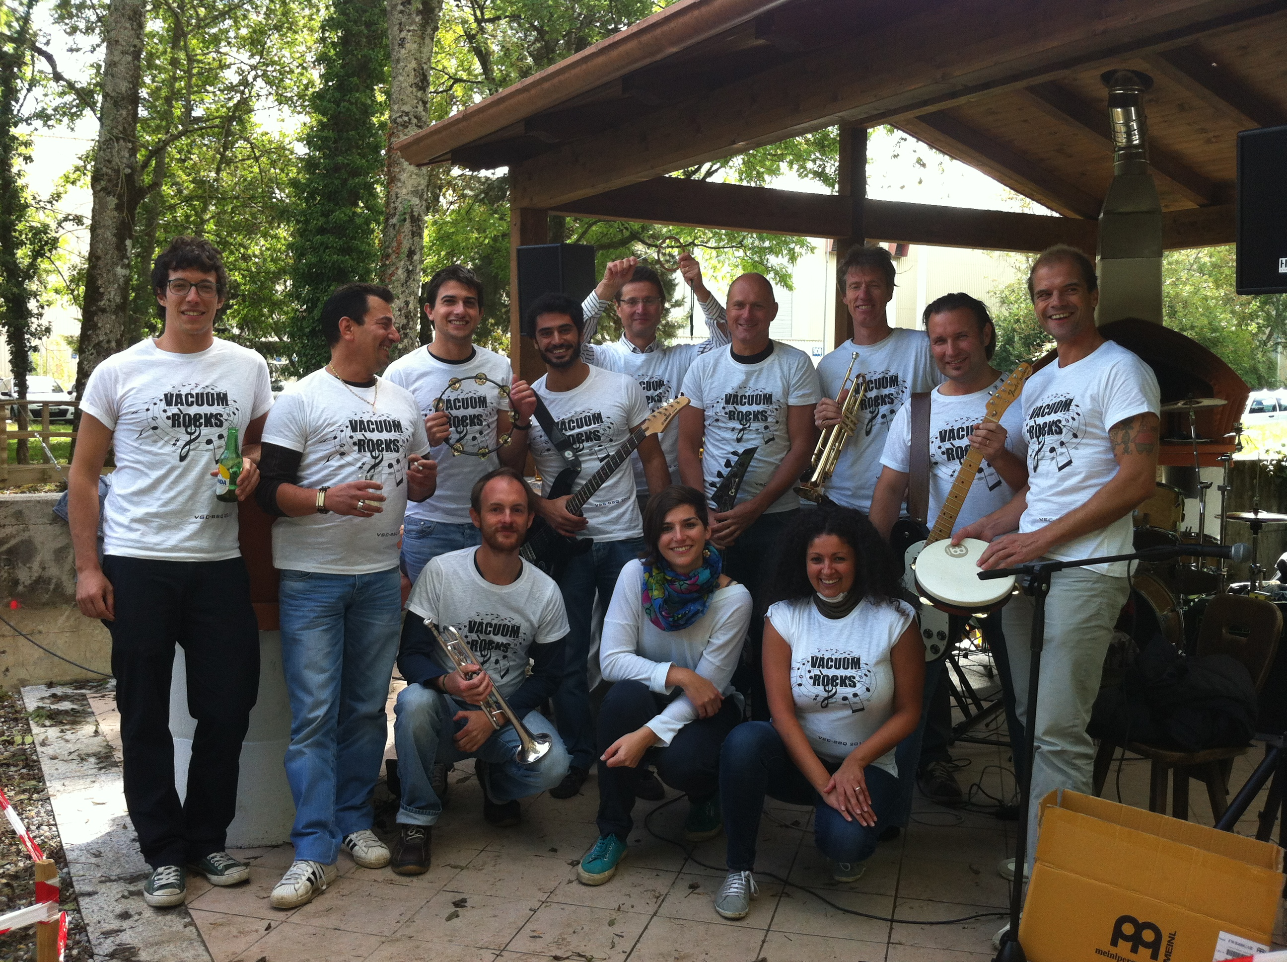
Thank you for your attention…
…and for your support during the last 3 years ☺
28

