Slide 1
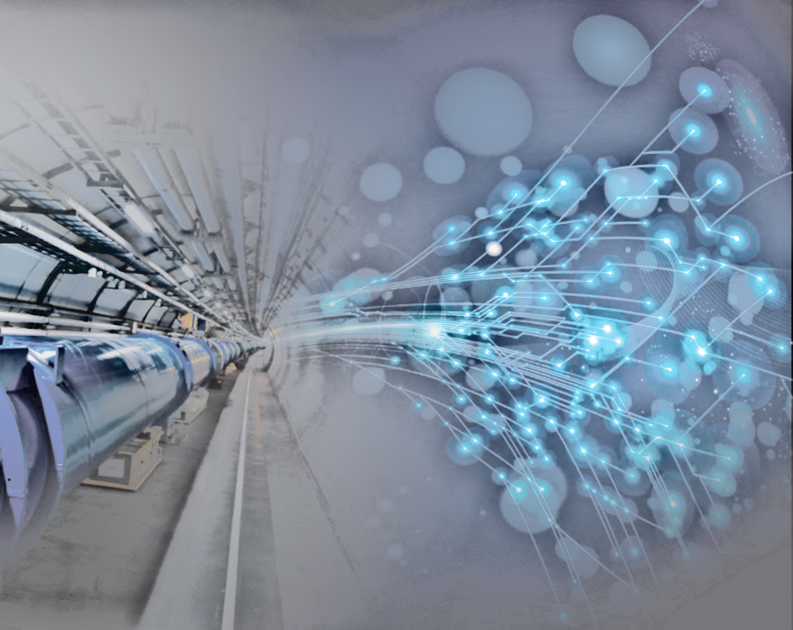

Probing the electron coupling to the H⁰
R. Aleksan
April 14, 2014
(…trying the impossible!)
Introduction
Direct H production at TLEP
Next steps
Very preliminary … many pending issues

Slide 2


Measuring the particle coupling to H⁰
$$g_{HVV}∝ m_{V}{}_{}^{2}{}$$
$$g_{Hff}∝ m_{f}$$
f ⁺
H
f ⁻
e
u
d
s
μ
c
τ
b
W
Z
t
1st generation
2nd generation
3rd generation +VB
?
HL-LHC
TLEP/LC
LHC
…yet the electron mass is one of the most fundamental quantity in physics

Slide 3
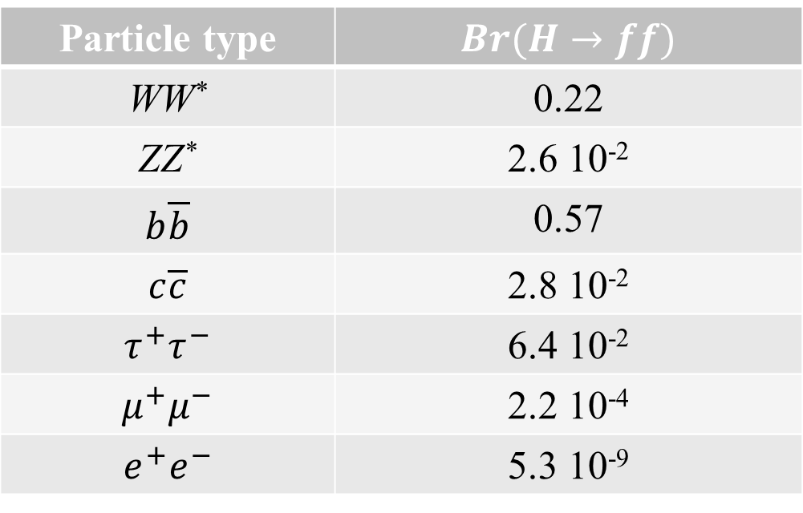
Measuring the H⁰ -electron coupling is challenging!
Particle type | $$Br(H→ff)$$
WW* | 0.22
ZZ* | 2.6 10⁻²
$$b\overline{b}$$ | 0.57
$$c\overline{c}$$ | 2.8 10⁻²
$$τ^{+}τ^{−}$$ | 6.4 10⁻²
$$μ^{+}μ^{−}$$ | 2.2 10⁻⁴
$$e^{+}e^{−}$$ | 5.3 10⁻⁹
Extremely difficult to observe H⁰ decays to a such tiny BR
Note: Even the observation of H decays to muon pair is tough (e-pair is 5 order of smaller and suffers from higher background)
e.g. HL-LHC (3ab⁻¹, i.e. 10 years) a ~1 H⁰ g e⁺e⁻ expected!
and TLEP (10ab⁻¹, i.e. 5 years, 4 IP) a ~10⁻² H⁰ g e⁺e⁻ expected!!!

Slide 4
What about direct H⁰ production at e⁺e⁻ colliders ?
It has been proposed to build a Higgs factory based on a muon collider
Cross section is ~20 pb (δE/E=10⁻⁴)
Several thousand H produced per year with L ~0.6 10³² cm⁻² s⁻¹
S/B ratio is OK, i.e. ~1/4
But still a lot of R&D necessary before building a muon collider?
Is a ~10³² luminosity feasible?
Even so, an e⁺e⁻ collider such as TLEP would produce >10 times more H per year at 240 GeV and has a much broader physics programme
… and in any case, a muon collider cannot address the H coupling to electrons
If one decides to build an e⁺e⁻ collider, let us investigate whether Higgs particles can be produced directly?

Slide 5

What about direct H⁰ production at e⁺e⁻ colliders ?
Advantages at a circular e⁺e⁻ collider:
Excellent beam energy resolution (ΔE/E=10⁻⁵)
Very high luminosity @ 126 GeV (> 10³⁵ cm⁻² s⁻¹ )
$$L=3×{10}^{35}{cm}^{−2}s^{−1}$$
But what is the cross section (i.e. do we produce Higgs at all)?
What is the background and can it be overcome?
… if not, what sensitivity of the electron coupling to H can we get?

Slide 6




Higgs cross section in e⁺e⁻ collisions
$$\frac{∆E}{E}={10}^{−5}$$
$$\frac{∆E}{E}={3×10}^{−5}$$
$$\frac{∆E}{E}={5×10}^{−5}$$
$$σ(e^{+}e^{−}→H^{0})≈1.4fb$$

Slide 7

Higgs cross section in e⁺e⁻ collisions
$$σ(e^{+}e^{−}→H^{0})≈1.4fb$$
L= 1.5-3 10³⁵ cm⁻² s⁻¹
18-36 events/day/IP!!!
Full day operation = 8.6 10⁴ s
About 90% of H decays are 2 jets or more
Higgs Decay | Branching Fraction (%) | Main topology | Total
bb | 58 | 2 jets | ~69
cc | 2.8 | 2 Jets
gg | 8.2 | 2 jets
WW->4j | 10 | 4 jets | 18
WW->2j+l | 8 | 2jets+1lept.
ZZ_>4j | 1.3 | 4 jets | 1.56
ZZ->2j+2l | 0.26 | 4j+2lept.

Slide 8

Background @ e⁺e⁻ collisions
$$σ(e^{+}e^{−}→Hadrons)≈90pb$$
Huge background to be overcome!!!
Signal/Background =1 / (6 x 10⁴)!!!
Clearly this makes the observation of the BW very difficult (understatement!)
But it should not prevent us to set a limit on g_{Hee}

Slide 9

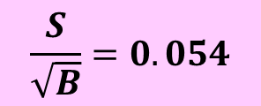



Sensitivity to g_{Hee}
For illustration, let us assume that
the Higgs mass is precisely known
L = 1.5 x 10³⁵ cm⁻² s⁻¹
One takes the equivalent of 10 full days (8.6 10⁵ s) per IP at the peak
$${Br}_{H→ee}<54×{Br}_{H→ee}^{SM} at the 3σ level$$
$$\frac{S}{\sqrt{B}}=0.054$$
$${Br}_{H→ee}<30×{Br}_{H→ee}^{SM} at 95\% CL$$
If one assumes $Γ_{H}≡Γ_{H}^{SM}$
$$g_{Hee}<5.5 g_{Hee}^{SM}@95\% CL$$
$$g_{Hee}<7.5 g_{Hee}^{SM}@ 3σ level$$
Alternatively, if a signal is observed with 5σ significance
$${Br}_{H→ee}=90×{Br}_{H→ee}^{SM} (5σ) and g_{Hee}=9.5×g_{Hee}^{SM} (5σ )$$

Slide 10
Words of caution
This is an oversimplified study and several caveats apply
How precisely will the Higgs mass be measured (7 MeV @ TLEP)
  Can one do a better mass measurement ?
    Essential to have the simulation tools in place
  If not, an energy scan would be required (say 10 points with 1 MeV intervals, i.e. 100 full day equivalent); note however that running at ~126 is useful for other physic topics, e.g. neutrino species counting with Zγ events)
What is the beam resolution (including beamstrahlung) ?
A convolution of the signal with ISR is required
  initial estimate leads to a reduction of σ by factor ~3

Slide 11



Words of caution
Courtesy S. Jadach
$$\frac{σ_{BW}^{ISR}\left(e^{+}e^{−}→H^{0}\right)}{σ_{BW}\left(e^{+}e^{−}→H^{0}\right)}$$
$$g_{Hee}<9.2 g_{Hee}^{SM}@95\% CL$$
$$g_{Hee}<12.5 g_{Hee}^{SM}@ 3σ level$$

Slide 12
… but there is also room for improvement
S/B can be improved when using final state characteristics (b-tagging, 3(4) jet events, angular distribution…)
  Essential to have the simulation tools in place
… and any new ideas!!!

Slide 13
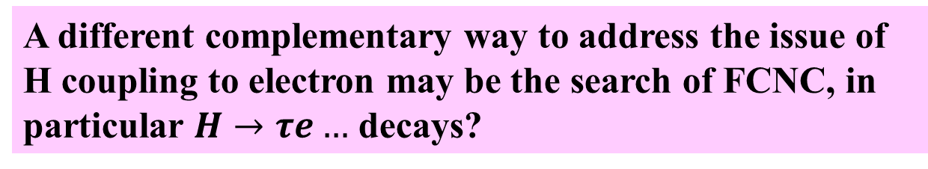
Physics Case
Is there a theoretical motivation to carry out such a search?
How important is it to set a limit on g_{Hee} at the level deemed feasible (i.e. < 10 times SM)?
Alternatively, is there realistic models, which would predicts g_{Hee} to be significantly higher by a factor of ~10 than the SM while not affecting the other couplings?
e⁺
e⁺
e⁺
+
W⁺
H
ν
H
+ ...
+
?
H
e⁻
e⁻
W⁻
e⁻
A different complementary way to address the issue of H coupling to electron may be the search of FCNC, in particular $H→τe…$ decays?
Here TLEP should be enable significant improvements

Slide 14


Conclusions
Difficult to observe resonant Higgs production @TLEP if g_{Hee} is the SM value
If deemed important, possible to set limits at TLEP for each IP at the level of:
$$g_{Hee}<9.2 g_{Hee}^{SM}@95\% CL$$
$$g_{Hee}<12.5 g_{Hee}^{SM}@ 3σ level$$
This is an order of magnitude estimate. Further work is needed to assess these numbers as there are pending issues (some of which can even leads to improvements)
Many thanks to C. Grojean and S. Jadach for discussions and useful inputs

