Slide 1
High Energy Physics
and
Outreach
in the Czech Republic
Jiří Dolejší, Charles University
15th EPPCN Meeting, May 12th, 2014, Prague

Slide 2
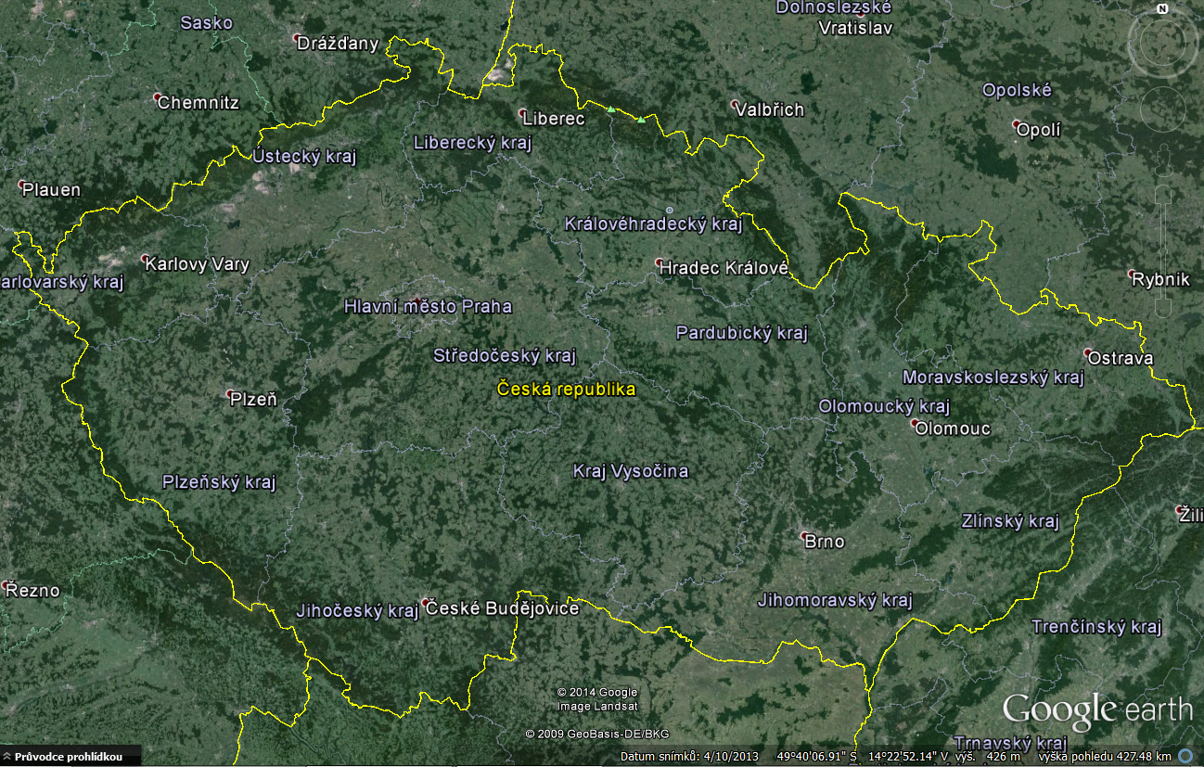
HEP Institutes: Academy of Sciences of the CR (IoP, INP),
Charles University, Czech Technical Univ., Palacky University
Prague
Olomouc

Slide 3
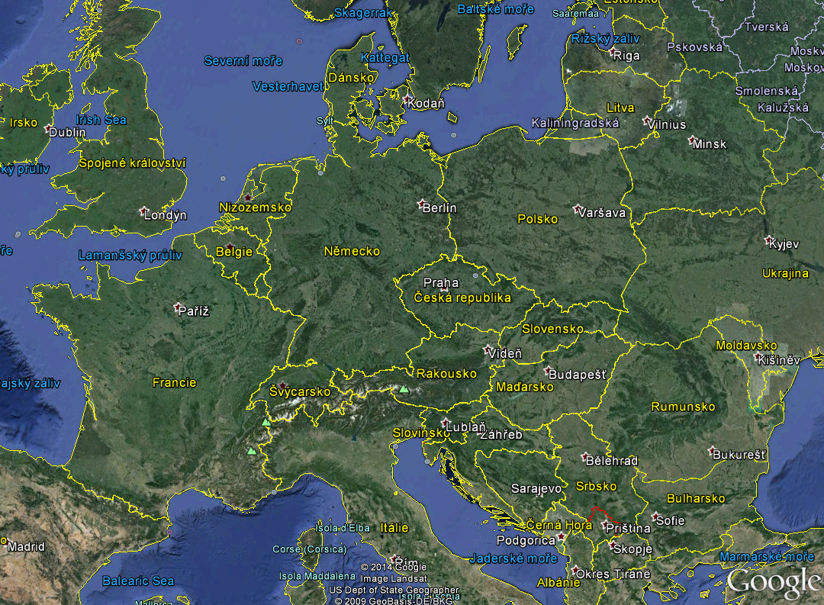
KEK, Belle
JINR
FNAL, D0, NOVA
DESY, H1
CERN, ATLAS, ALICE, TOTEM, COMPASS, nTOF, NA62 …
Auger
Day Bay
HESS

Slide 4
People and Money in HEP
about 200 scientists, students, technicians …
about 10 master students per year
About 10 MCHF member contribution to CERN
(1% of the CERN budget)
About 60 MKč = 3 MCHF support to CERN projects
+ salaries + further grants
With 10 Mcitizens of thr Czechthe expences of HEP
represent about one beer per capita per year.

Slide 5
Outreach – “Permanent“
… focused to students, teachers and general public
… lectures, masterclasses, seminars for teachers,
teacher weeks at CERN, teaching aids …
… participation in outreach activities is now considered
in the particle community as “standard“, “useful“
and „rewarding
Big thanks to
Jiří Rameš, Vladimír Wagner, Stanislav Němeček,
Michal Marčišovský, Ina Chalupková, Martin Rybář
and many others

Slide 6
Teachers: good teachers attract students
teachers in CZ educated separately from physics students
usually specialized in two sciences, best case being physics-mathematics
no centralized “quality control“
no systematic in-service training
possibly have heard something about particles, but probably didn’t digest it
…
Instead of complaints, let’s help them!
… active teachers form an appreciative audience!
R-ECFA meeting in Prague
March 9.-10., 2007
I am repeating myself …

Slide 7
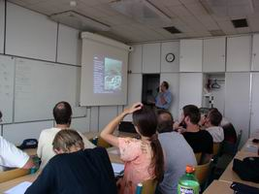
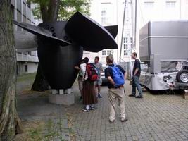
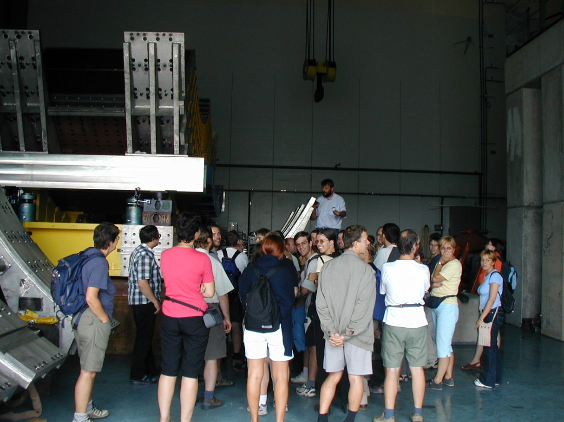
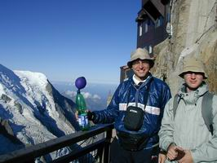
Exciting teachers - Excursions …
From Prague via Munich
to Geneve
… and Chamonix

Slide 8
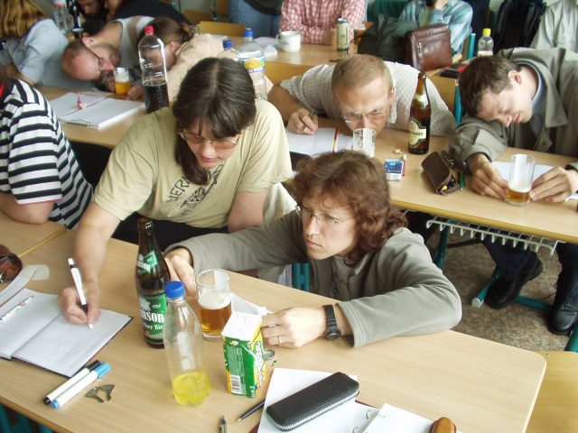
Exciting teachers:
We have a „club“ of interested teachers – „Heureka“
Seminars should help in basic orientation in given field, they should enhance the qualification of teachers, stimulate the contacts and bring fun.
Nuclear Physics in Czech manner: Teachers measure the decay law of the beer froth ...

Slide 9
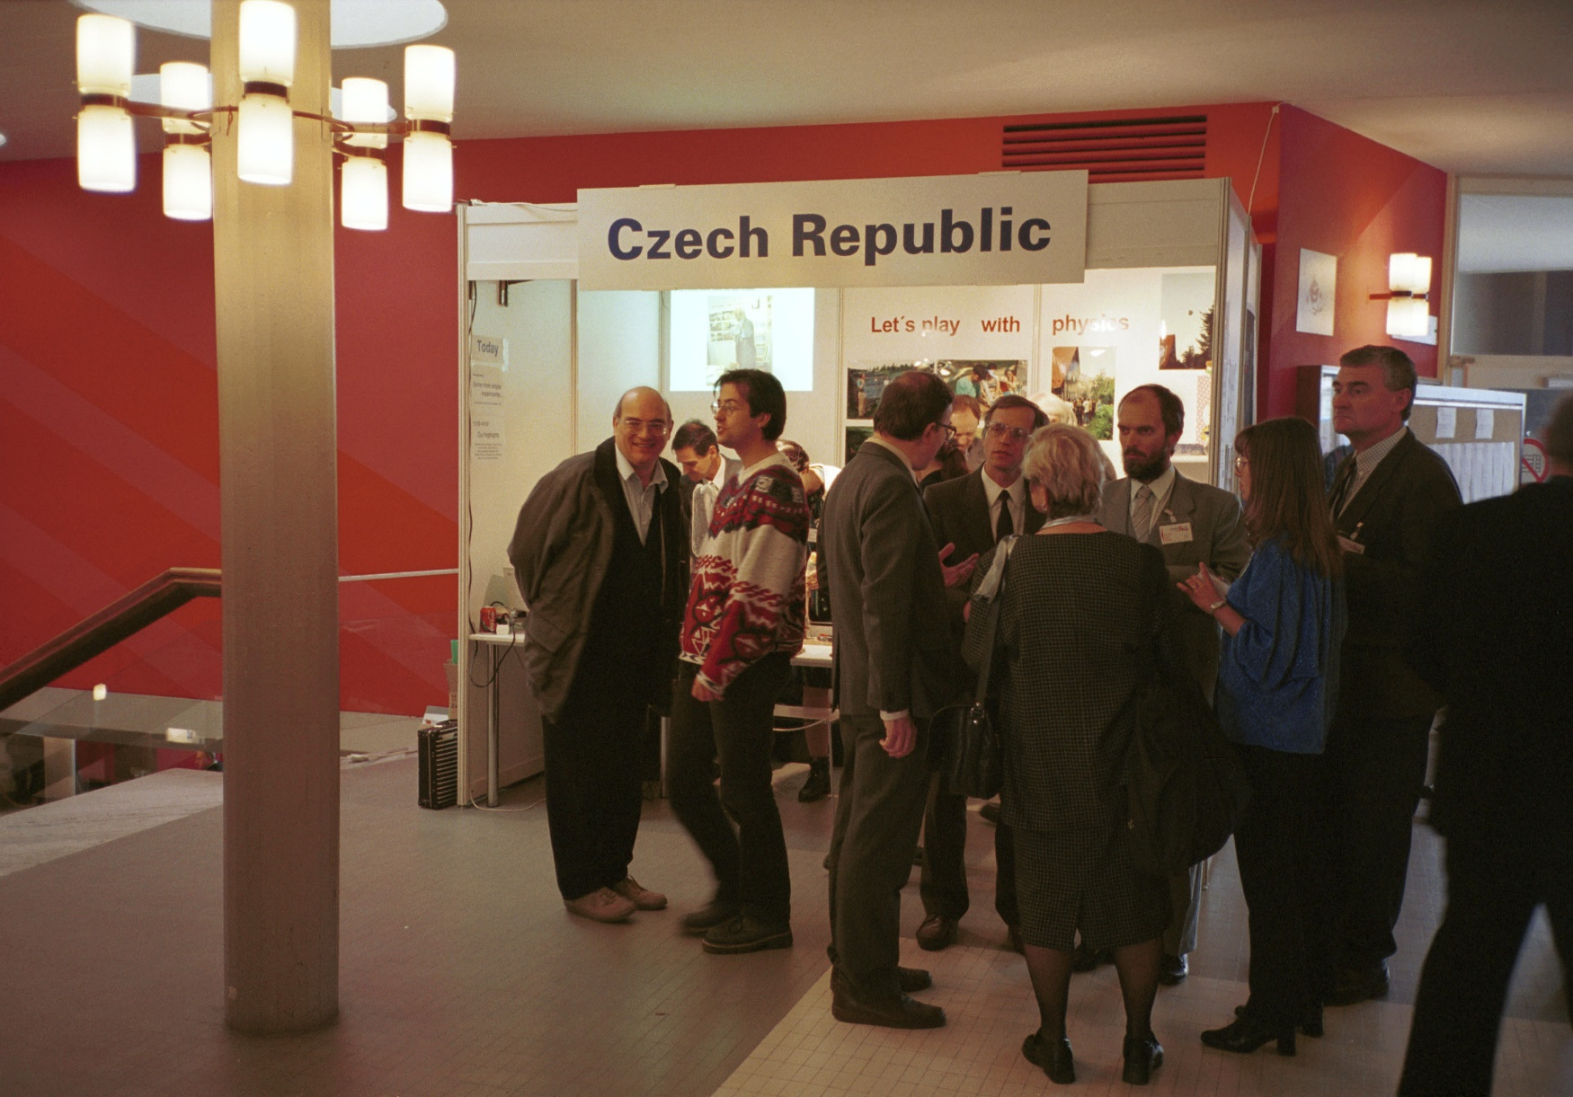
Exciting teachers … Physics on Stage
Geneva 2000
Communication & Collaboration
Institute of Physics, Academy of Sciences
Dept. of Physics Education, Charles University
Teachers
PhD Students
Me … Inst. of Particle and Nuclear Physics, Charles University

Slide 10
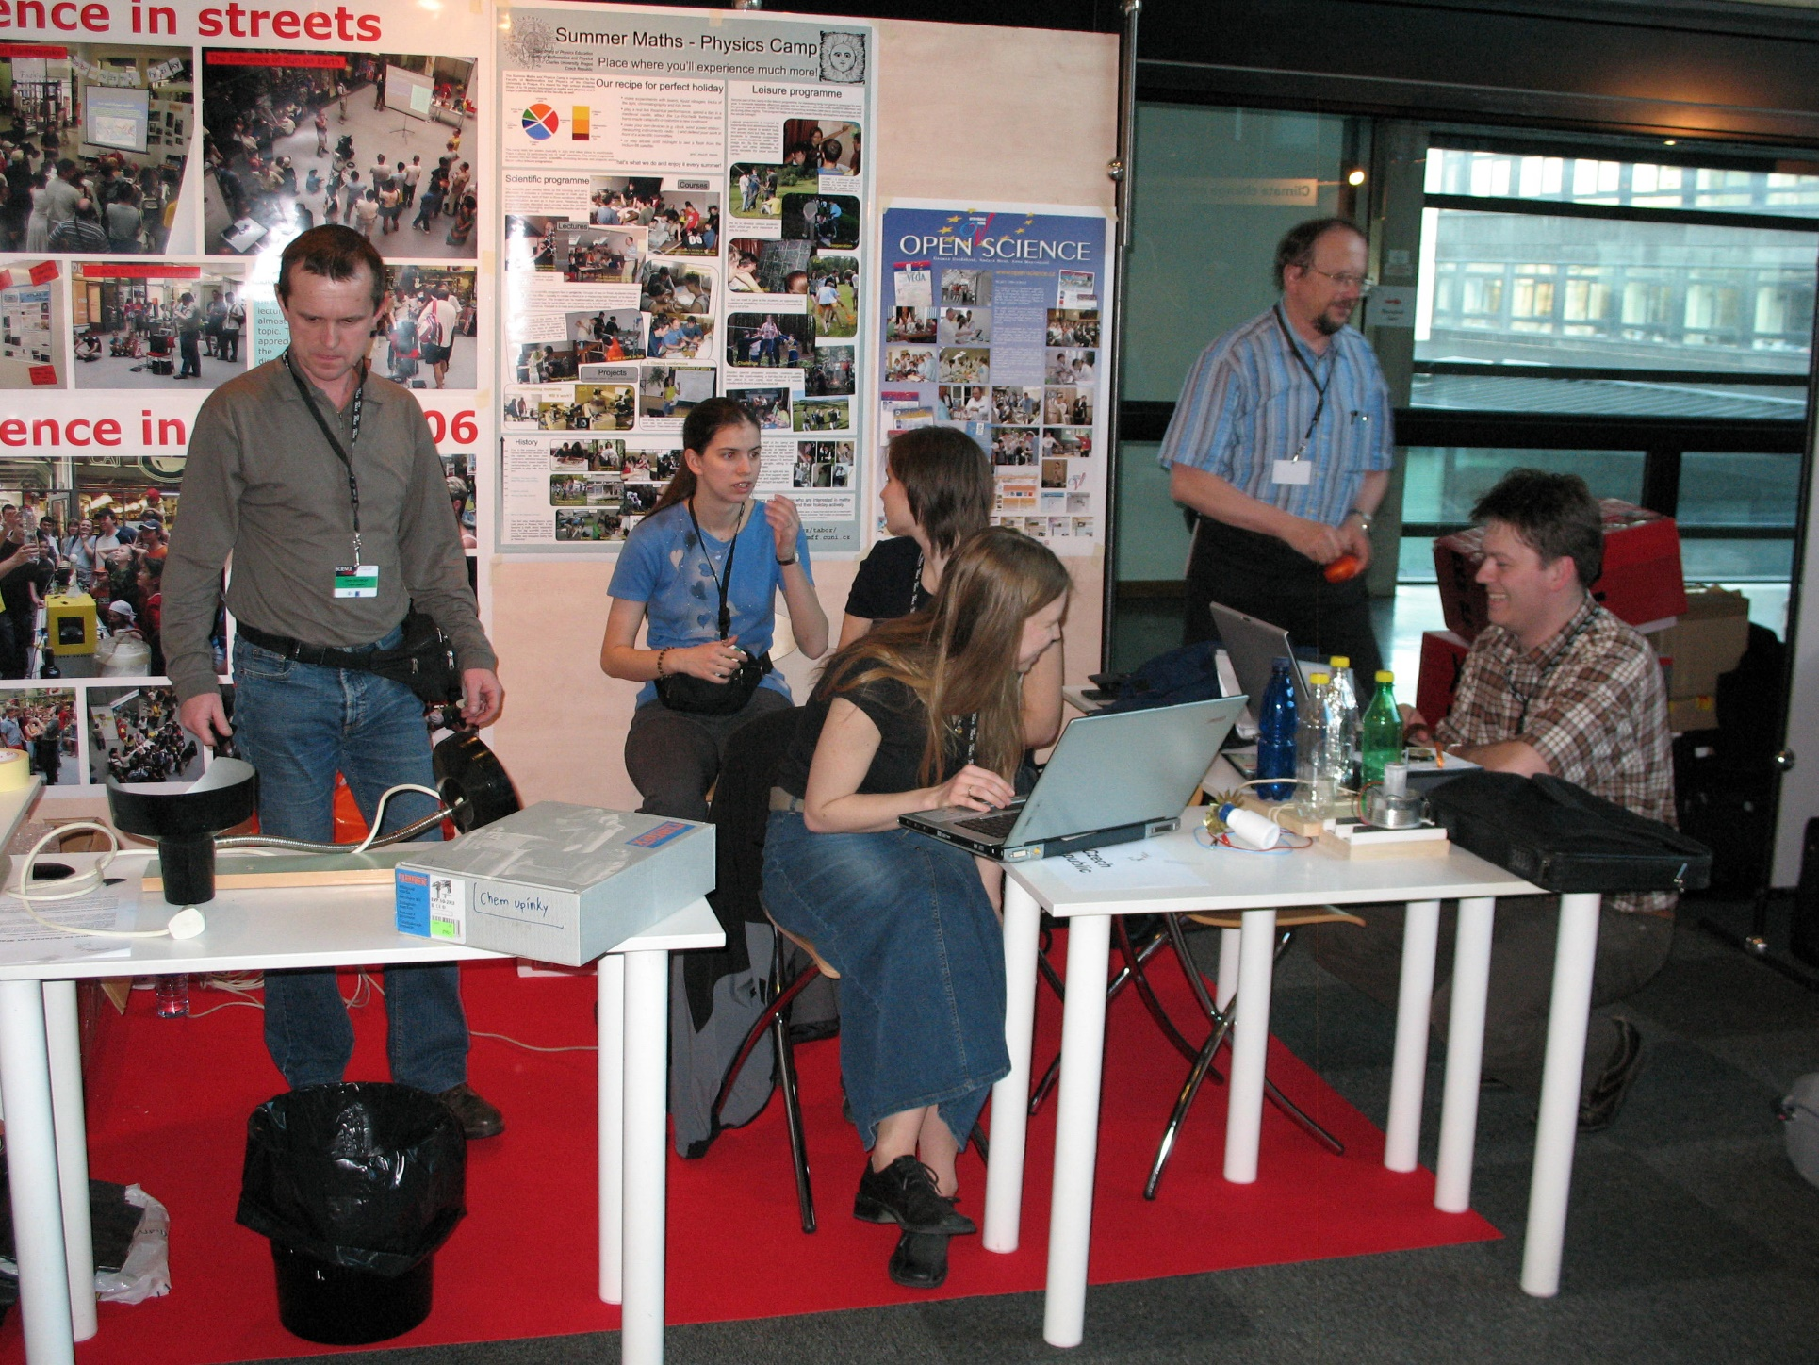
Exciting teachers … Science on Stage
Grenoble 2007
Communication & Collaboration
Me …
Teachers
PhD Students
Masaryk University Brno
Academy of Sciences

Slide 11
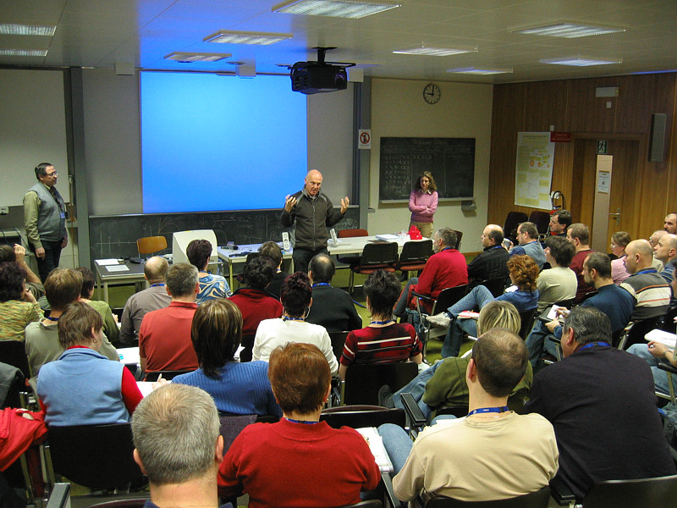
Exciting (and teaching) teachers … CERN Teachers Programme

Slide 12
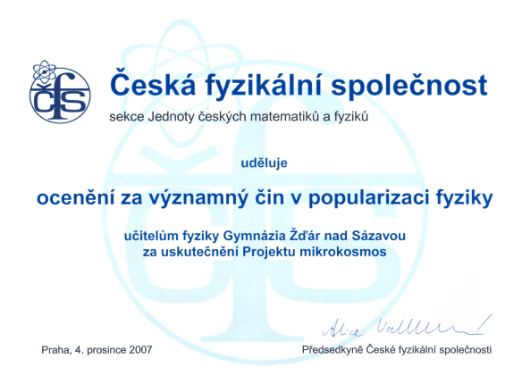
Support for teachers and students
… we do care for
a moral support

Slide 13

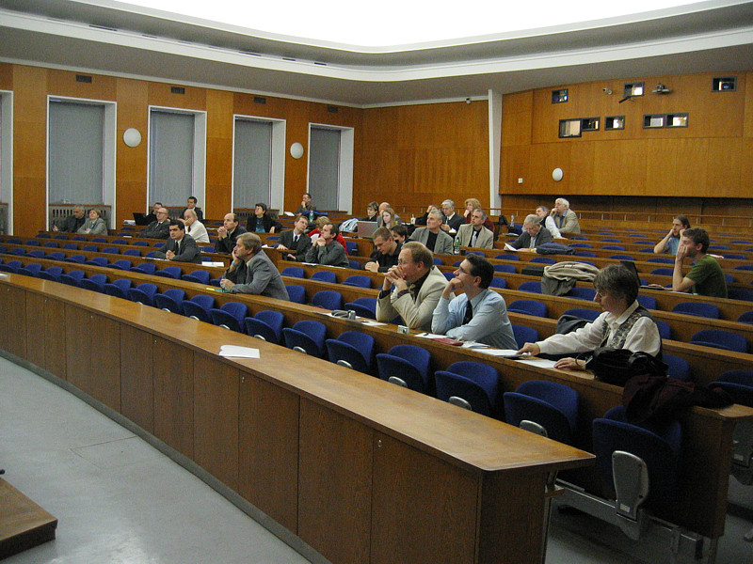
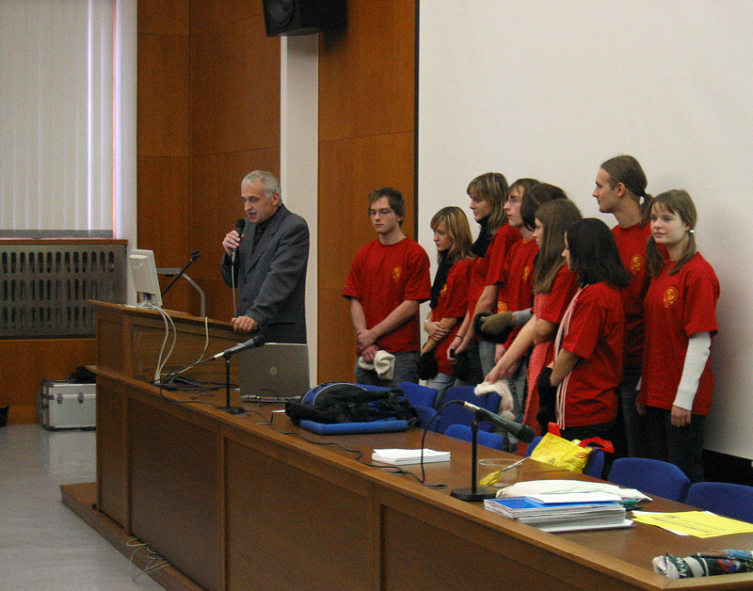
Not only particle physics …
Review of outreach activities
organized by the Czech Physical Society
School projects
Institutional outreach
Active people
WWW and media

Slide 14
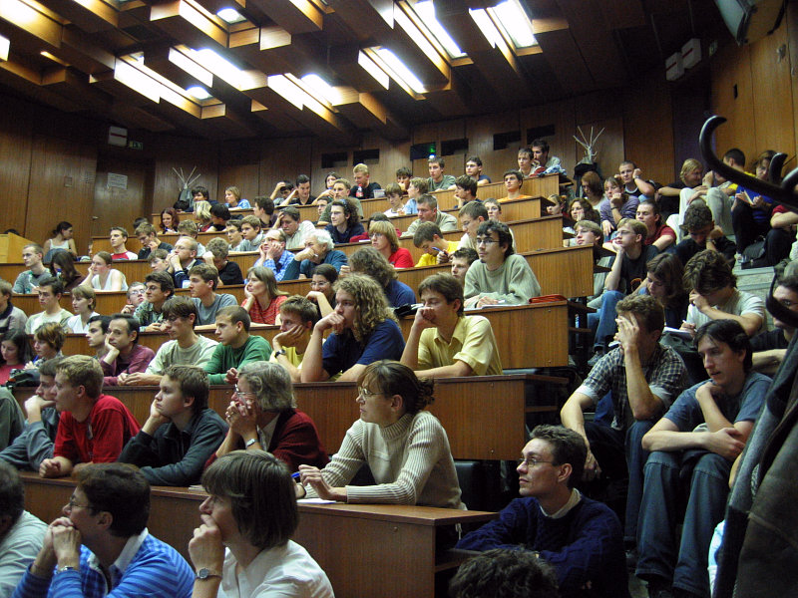
Attracting enough students to physics …
Public lecture
High school students and their teachers

Slide 15
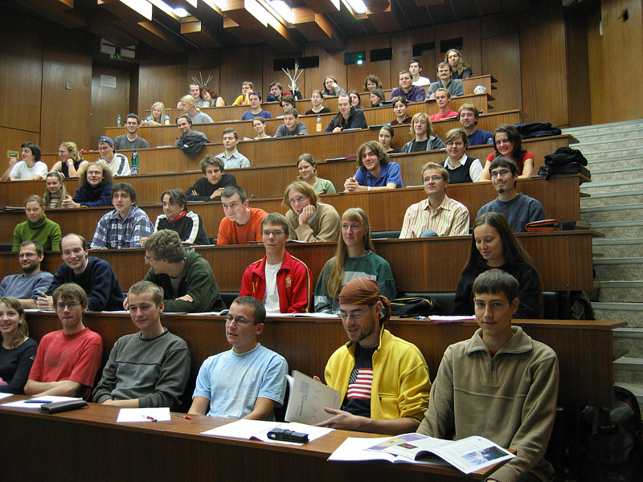
On the path to particle physics
Introductory lectures
bachelor thesis
selection of the
specialization
of the master
study
master thesis
deciding
whether
to stay
for PhD
studies, …
Summary:
We don‘t know about the
BEST METHOD for outreach (and from our past experience we are suspicious to any B.M.)
a significant number of people know about CERN, LHC …
we have roughly constant number of students coming to (particle) physics
R-ECFA meeting in Prague
March 9.-10., 2007

Slide 16
Outreach – “Occasional“
… 50 years of CERN
… start of LHC operation
… 20 years of the Czech membership in CERN
… the announcement of 2013 Nobel prize for Physics
… 60 years of CERN
…

Slide 17
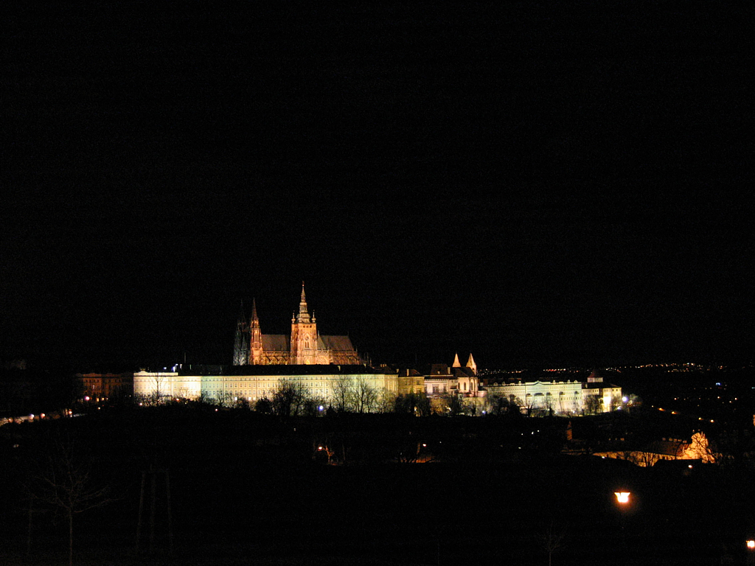
Promotion of LHC in a small country
Jiří Dolejší, ATLAS Outreach Meeting, 7. 10. 2008

Slide 18
Events – Collaboration – Media

Slide 19
Events – Collaboration – Media
Two weeks from 20th to 31st October:
Multimedia exhibition (posters, prototypes of detectors, presentations) with experts;
including a special presentation of CERN to industry representatives
LHC Day in the Planetarium
(Short programme for schools, projection of films, seminar@party for collaborators and guests)

Slide 20
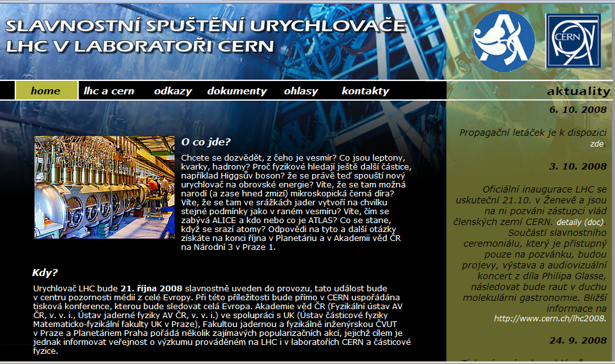
Events – Collaboration – Media

Slide 21
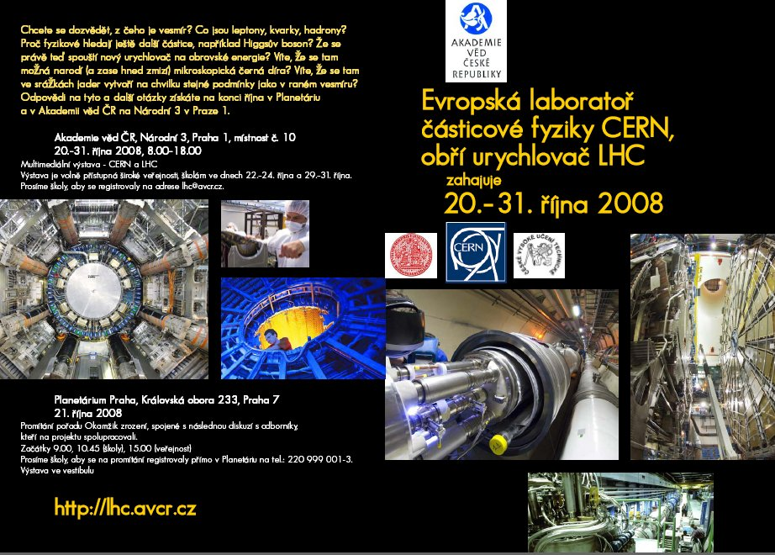
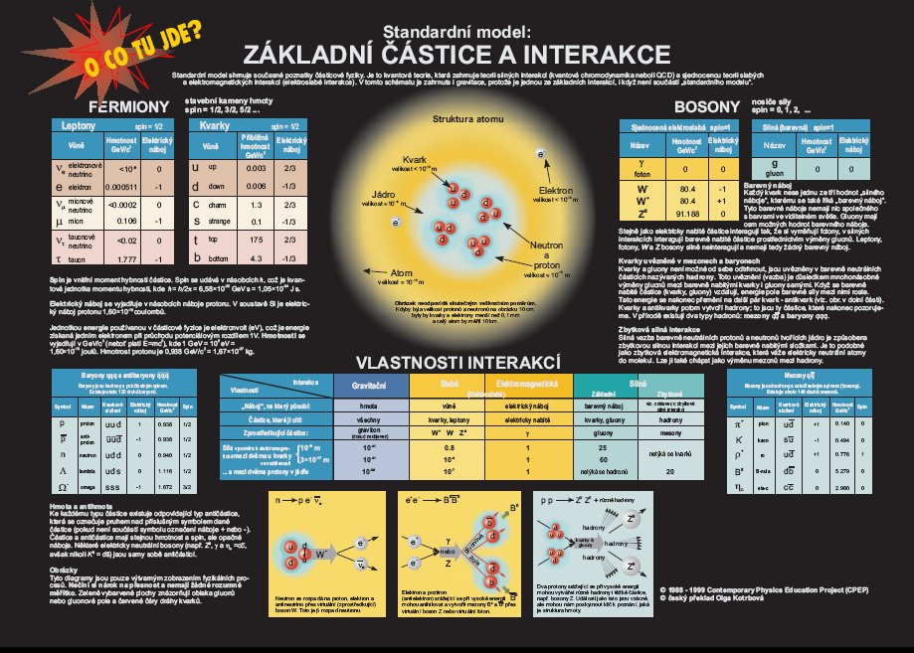
Events – Collaboration – Media
Invitation to the exhibition

Slide 22
Events – Collaboration – Media
Posters on trams

Slide 23

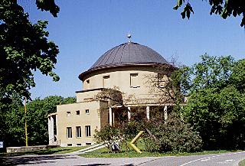
Events – Collaboration – Media
LHC Day in the Planetarium will profit from the „curiosity stimulating environment“.
We are preparing a particle physics & LHC show which will stay there.
The Cosmorama Hall can accomodate an audience of 210 people. It is a circular hall with 23,5 metres in diameter and a projection dome - an artificial sky vaulted to a height of 15 metres. The projection screen is the biggest one in the Czech Republic (843 sq.m.). The dome is equiped the large Planetarium device called "Cosmorama" (Carl Zeiss - Jena) and laser systems.
http://www.planetarium.cz

Slide 24
Events – Collaboration – Media
Unprecedented and very effective collaboration of
INSTITUTE OF PHYSICS
of the AS CR
Jiří Rameš, member of EPPOG
CHARLES UNIVERSITY
Faculty of Math. and Physics
Jiří Dolejší
ACADEMY OF SCIENCES of the Czech Republic
Department of Media Communication
Dagmar Dvořáková, member of European Particle Physics Communication Network
Anna Martinková
NUCLEAR PHYSICS INSTITUTE
of the AS CR
Vladimír Wagner
CZECH TECHNICAL UNIVERSITY
Faculty of Nuclear Sciences and Physical Engineering
Vojtěch Petráček

Slide 25
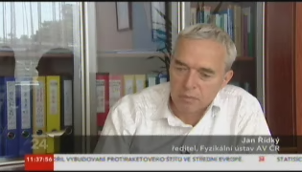
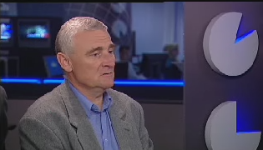
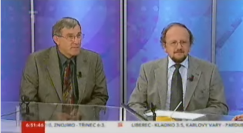
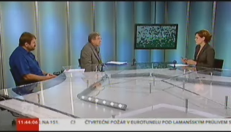
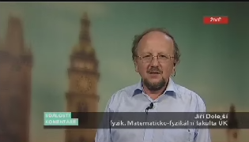
Events – Collaboration – Media
September 10th – great peak in media interest

Slide 26
Events – Collaboration – Media
September 10th – great peak in media interest
+ –
+ great media interest – just temporary
– triggered from outside
+ possibility to promote – most of the time spent
LHC, CERN, particles on black holes
+ possibity to explain the
use of basic science
+ many colleagues showed up
We would like to have more space!

Slide 27
Challenges
to defend the role of basic science
to look for feedback to different activities
to collaborate more intensively
with media, to build the working
relation media-science
(„new hope“ = Luboš, EPPCN …)
to tune everything

