Slide 1
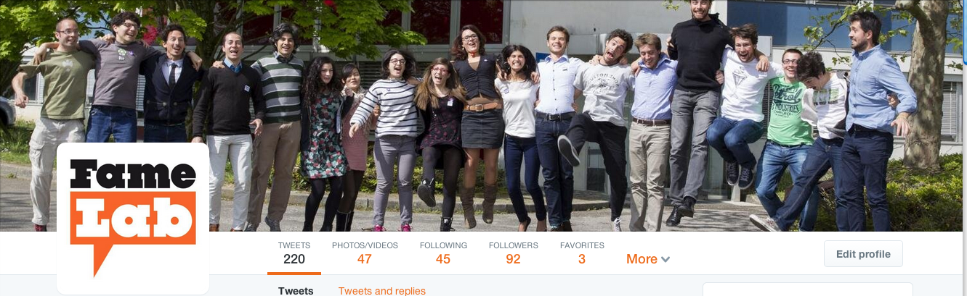
The magic formula for science communicators

Slide 2
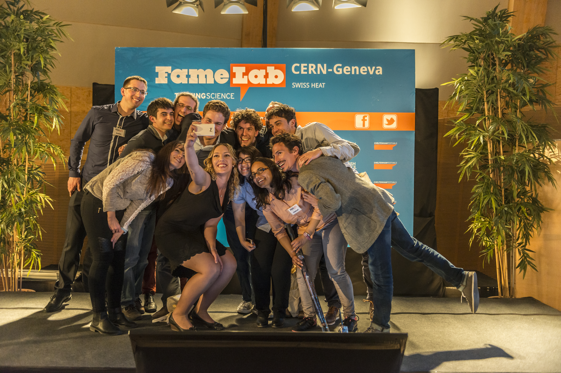

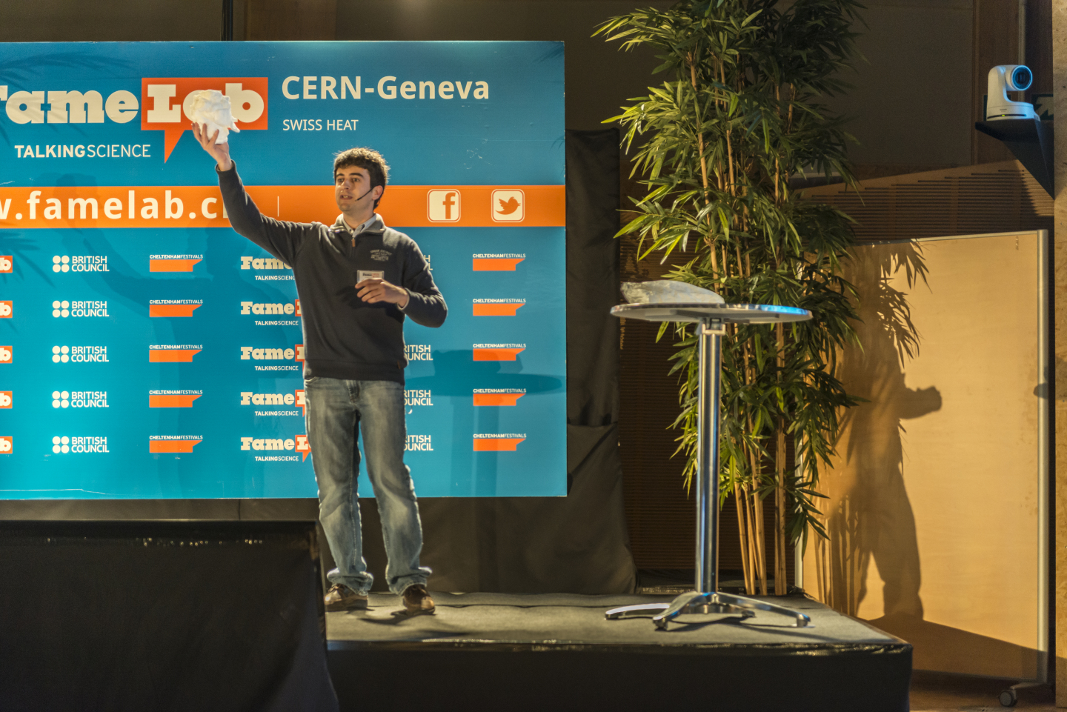
Why
?
Excellent training for scientists
Networking opportunity
Huge distribution across the planet. FameLab is already organized in several CERN Member States

Slide 3
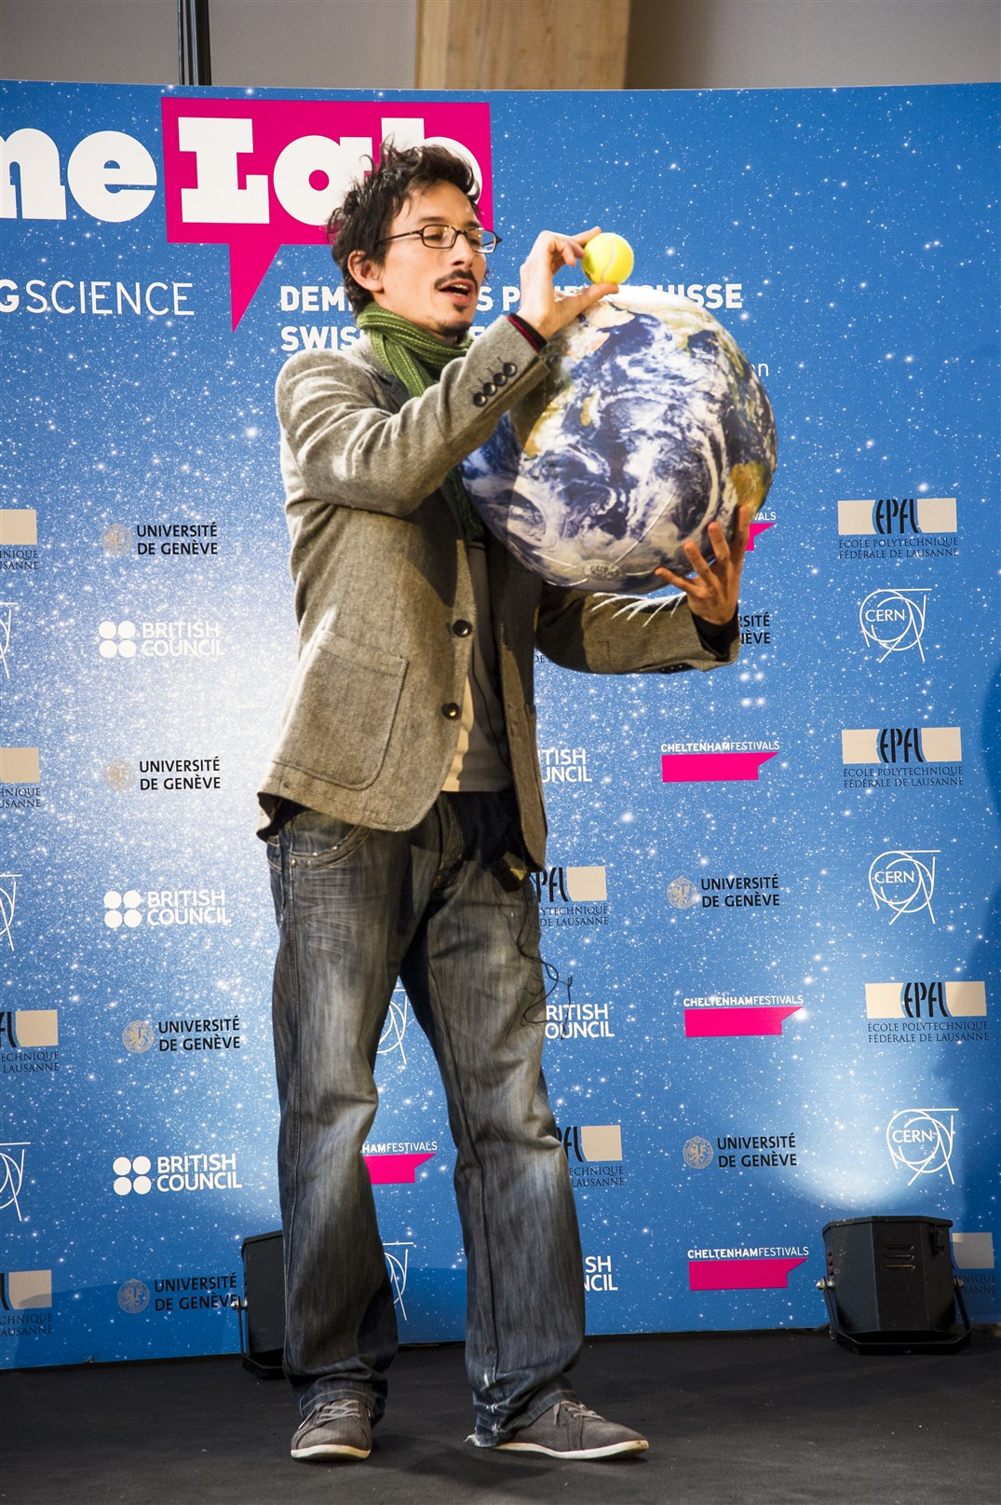
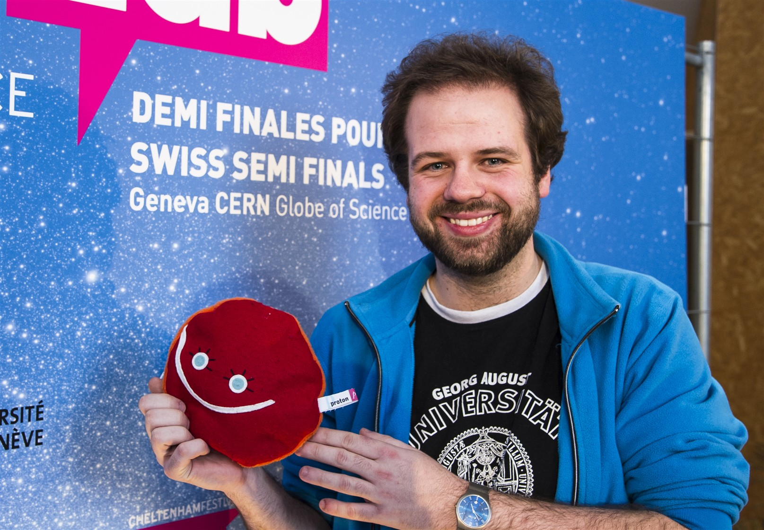
Why CERN
?
We strongly believe that it is a very powerful way of training the young generation of scientists to communicate their science effectively and with fun.
We aim at giving fundamental physics a special focus.

Slide 4
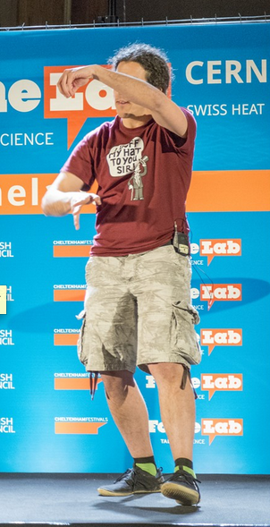
Who can participate CERN in
?
Researchers aged 18-35
Members (from Member States) of collaborations included in the Gray Book (http://greybook.cern.ch/)

Slide 5
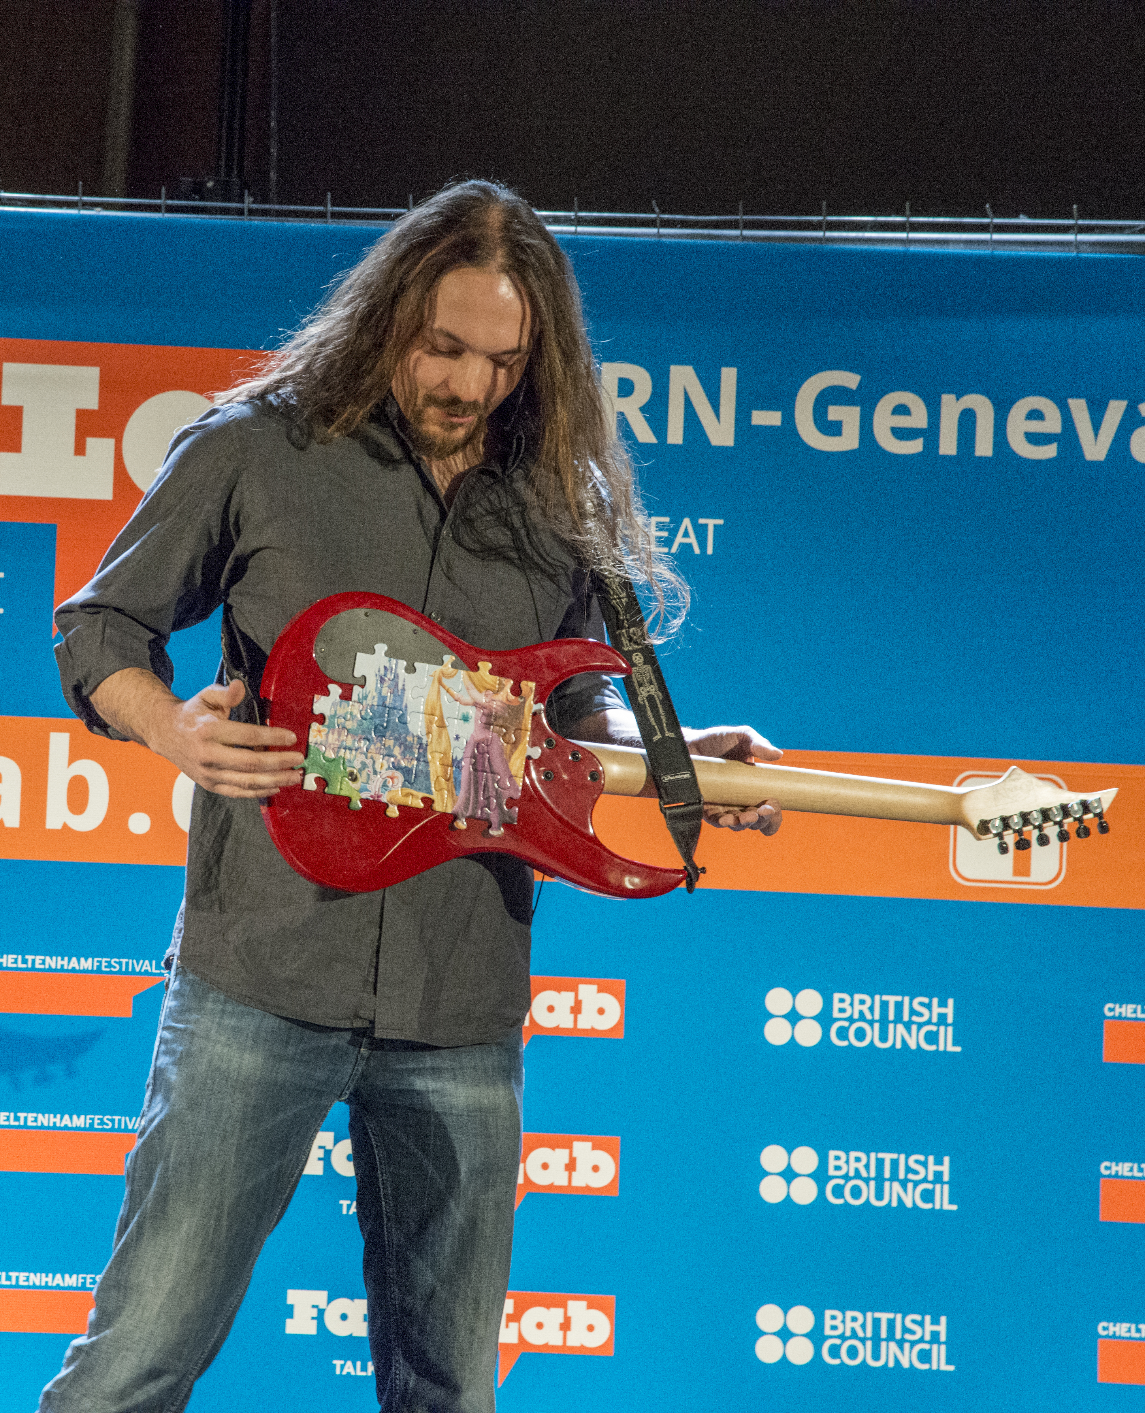
CERN
: programme and schedule
Proposed date for the event at CERN: Jan 2015
Candidates selected by: Dec 2014
There are two possible ways of selecting candidates:
by you (either in collaboration with your local FameLab organizers or independently with dedicated heats)
by CERN with your help (through videos)
TODAY: let’s discuss how

Slide 6
In CERN’s Member States (EPPCN):
CH, FR, IT, UK, D, PT, ES, BeNeLux, GR, IL

