Slide 1
Embargo: tricks and tips
Eleonora Cossi - INFN

Slide 2
Embargo: tricks and tips
Historical: An order of a state forbidding foreign ships to enter, or any ships to leave, its ports:an embargo laid by our Emperor upon all vessels whatsoever
General: An official ban on any activity
In journalism: a news embargo or a press embargo is a request by a source that the information provided will not be published until a certain date

Slide 3
Embargo: tricks and tips
News embargoes are commonly applied on information of science and health-related news regarding upcoming scientific journal articles
The reasons given for such embargoes are twofold. First, they enable journalists to produce more comprehensive and accurate coverage, as the embargo provides time in which they can research the background to a story
Second, they enable doctors and scientists to receive and to analyze scientific studies before the general public does, enabling them to be better informed when called upon to comment

Slide 4
Forthcoming Nature Physics paper
“Dear Colleague, I am writing to inform you that “Parity–time-symmetric whispering-gallery microcavities” by Yang has been scheduled for Advance Online Publication (AOP) on Nature Physics's website on 06 April at 1800 London time…
You are receiving this letter because one or more of the authors are affiliated to your institution and/or because your organization provided funding for the research.
Every Tuesday, the Nature research journals distribute a press release of papers to be published AOP the following Sunday. Within this release, a few papers of particular newsworthiness are highlighted, with author contact details, and the rest are listed. Journalists are given the name of the author(s) to contact, together with phone numbers and e-mail addresses. At this time, journalists are also given online access not only to the papers on the press release but to all the papers due to appear…
We would be delighted to cooperate with yiu (US!) in ensuring maximum publicity for this paper. You can send any press releases that you have created for this research to trusted media contacts, under embargo, from today. Please do not post to third-party internet journalist resource sites (such as EurekAlert or AlphaGalileo) until the Thursday before publication. Wire services stories must always carry the embargo time at the head of each item, and may not be sent out more than 24 hours before that time.

Slide 5
Embargo: tricks and tips
If the policy is clear when working with Nature or Science, it is less formal when the embargo is set among institutions
Publication of an article on http://arxiv.org/ (late at night!)
Scientific seminar that will announce results submitted for publication

Slide 6
Embargo: tricks and tips
TRICKS
A Press office never really knows when a big news will come up and from where : blog? Internet is like an ocean…
PR face an international contest (US/CET)
Journalists get easily upset
TIPS
Enforce international collaboration with our PR (…have you seen this?)
PR must be strategic with journalists
Always a B plan

Slide 7
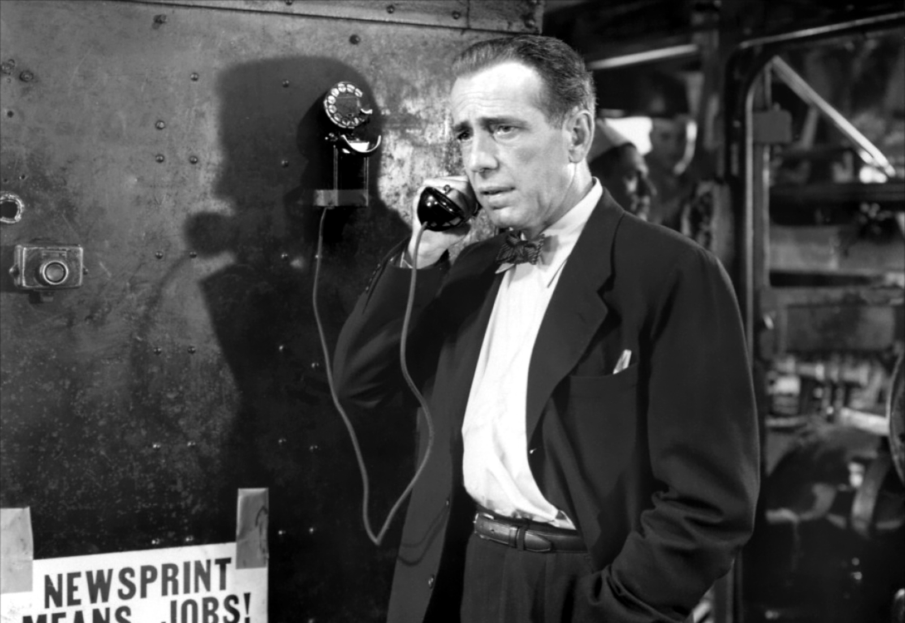
"That's the press, baby, the press, and there's nothing you can do about it, nothing."

