Slide 2
A Latency Picture is Worth a Thousand Storage Metrics
Luca Canali – CERN

Slide 3
About Me
Senior DBA and Team Lead at CERN IT
  Joined CERN in 2005
Working with Oracle RDBMS since 2000
Sharing knowledge with the Oracle community
Home page: http://cern.ch/canali
Blog: http://externaltable.blogspot.com
Twitter: @LucaCanaliDB

Slide 4
Outline
CERN and Oracle
Storage latency investigations and Oracle
Examples
Tools
More sources of latency data
Conclusions

Slide 5
Outline
CERN and Oracle
Storage latency investigations and Oracle
Examples
Tools
More sources of latency data
Conclusions

Slide 6

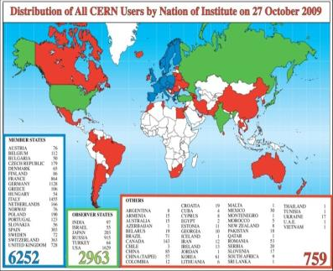
CERN
European Organization for Nuclear Research founded in 1954
Membership: 21 Member States + 7 Observers
60 Non-member States collaborate with CERN
2400 staff members work at CERN as personnel + 10000 researchers from institutes world-wide

Slide 7
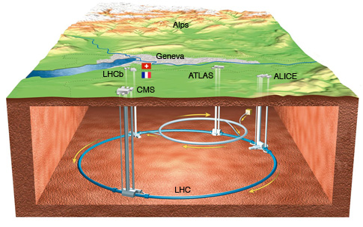

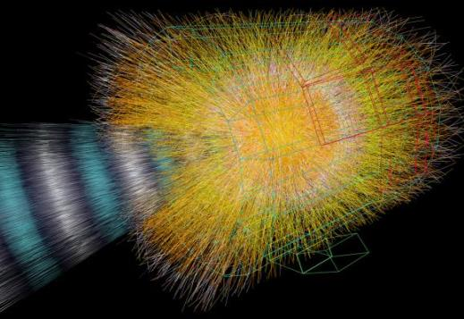
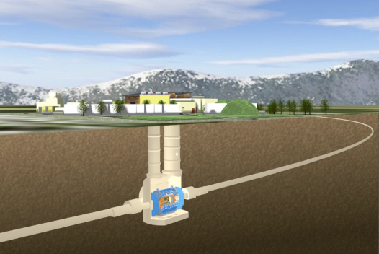
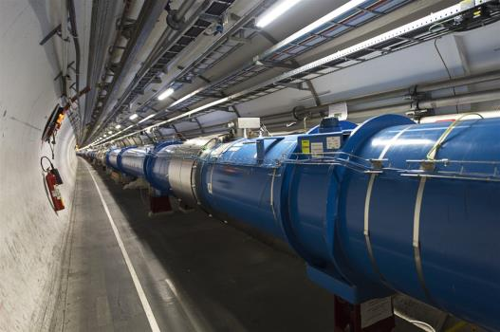
LHC, Experiments, Physics
Large Hadron Collider (LHC)
  World’s largest and most powerful particle accelerator
  27km ring of superconducting magnets
  Currently undergoing upgrades, restart in 2015
The products of particle collisions are captured by complex detectors and analyzed by software in the experiments dedicated to LHC
Higgs boson discovered!
The Nobel Prize in Physics 2013 was awarded jointly to François Englert and Peter W. Higgs "for the theoretical discovery of a mechanism that contributes to our understanding of the origin of mass of subatomic particles, and which recently was confirmed through the discovery of the predicted fundamental particle, by the ATLAS and CMS experiments at CERN's Large Hadron Collider"
Notes:
New particle discovery: see also CMS and Atlas announcement on July 4th 2012.

Slide 8
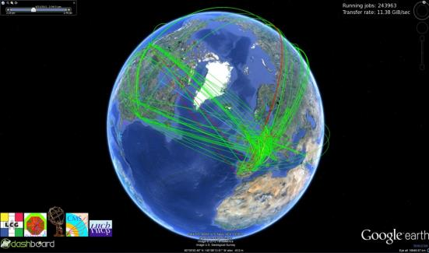
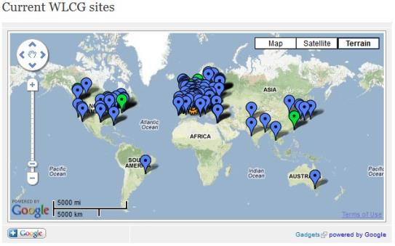
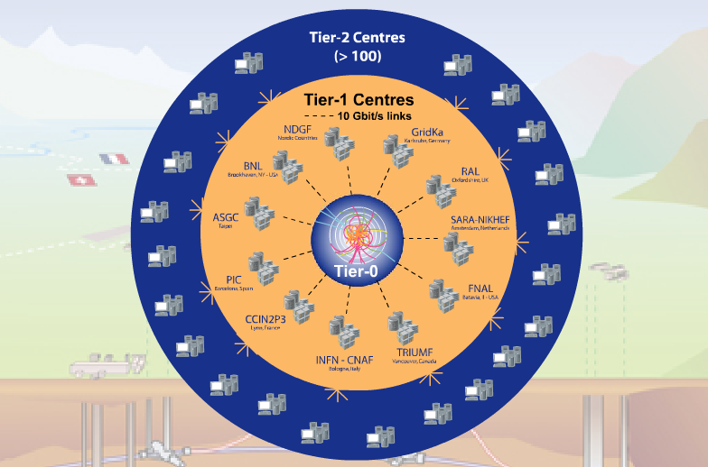

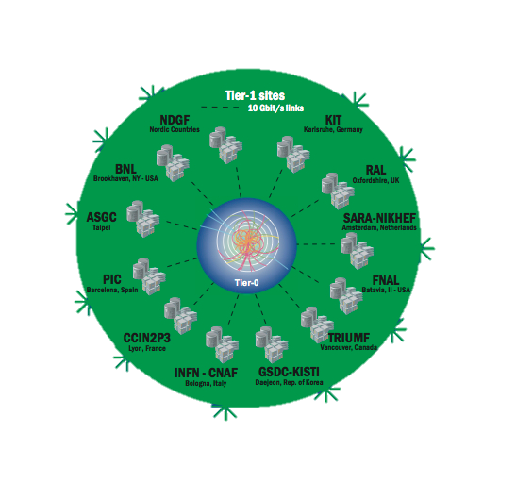
WLCG
The world’s largest scientific computing grid
  More than 100 Petabytes
  of data stored in a custom file system and analysed. Increasing: 20+ Petabytes/year
  CPU: over 250K cores
  Jobs: 2M per day
  160 computer centres in 35 countries
  More than 8000 physicists with real-time access to LHC data

Slide 9
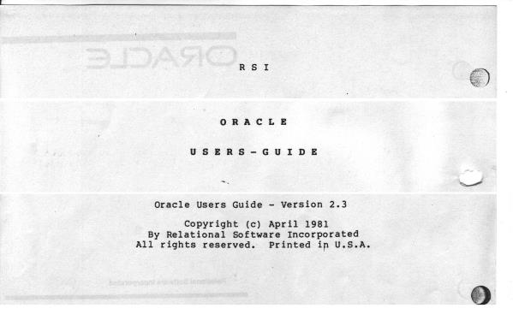
Oracle at CERN
Since 1982
(accelerator
controls)
More recent:
use for Physics
Source: N. Segura Chinchilla, CERN

Slide 10

CERN’s Databases
~100 Oracle databases, most of them RAC
  Mostly NAS storage plus some SAN with ASM
  ~500 TB of data files for production DBs in total
Examples of critical production DBs:
  LHC logging database ~170 TB, expected growth up to ~70 TB / year
  13 production experiments’ databases ~10-20 TB in each
  Read-only copies (Active Data Guard)

Slide 11
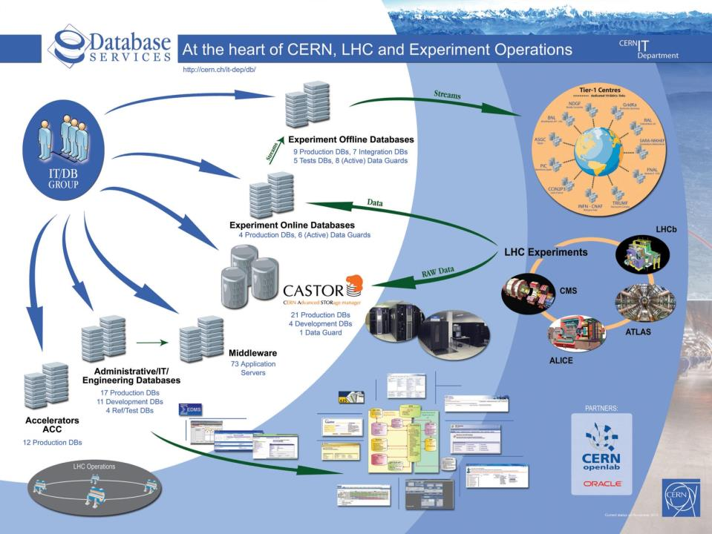

Slide 12
Outline
CERN and Oracle
Storage latency investigations and Oracle
Examples
Tools
More sources of latency data
Conclusions

Slide 13
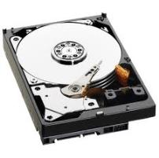
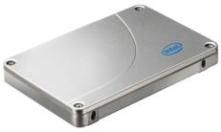
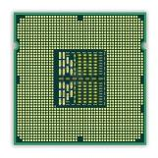
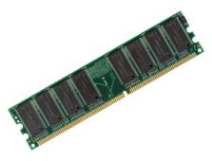
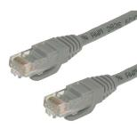
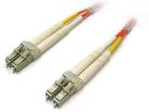
Latency
Latency, a measure of time.
  In the context of this presentation: time to access data

Slide 14
Why is Storage Latency Important?
Performance analysis and tuning:
  Where is the time spent during a DB call?
  What response time do the user sessions experience from the DB?
OLTP-like workloads:
  Response time can be dominated by I/O latency
  Examples: index-based access, nested loops joins

Slide 15

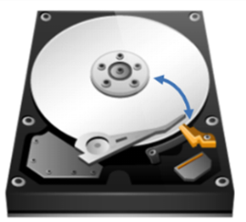

Physical Sources of Latency
Blocking I/O calls:
  Think access to a large table via an index
  Random access
  HDD: head movement and disk spinning latency

Slide 16
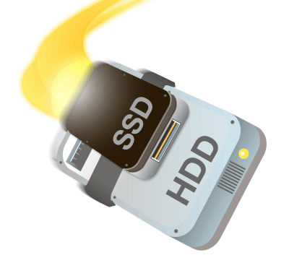
What can we do: Hardware
Current trends for HW
  Size I/O subsystem for IOPS not TB
  Large flash cache in storage
  Flash cards on servers
  Servers with large amounts of memory
    Avoid reading from storage!
A balance act performance vs. cost

Slide 17
What can we do: Software
Big gains in application/SQL optimization
  SW optimizations beat HW optimizations most of the times
Oracle tuning:
  Understanding when single-block access is or is not optimal
  Full scan vs. index-based access
  Hash join vs. nested loops
  In general: get a good execution plan!

Slide 18

So Where is the Problem?
DB Admin:
- Storage is slow!
Storage Admin:
- The problem is with the DB!
Reality check:
  Lack of clear storage performance data.
  Changing database workloads.

Slide 19
Performance Analysis
Finding the root causes can be hard:
  Applications are slow because of storage?
  Or Storage is slow because overloaded by a runaway application?
We want to build a model of what is happening
  That can be proven with data
  That we can use for tuning

Slide 20
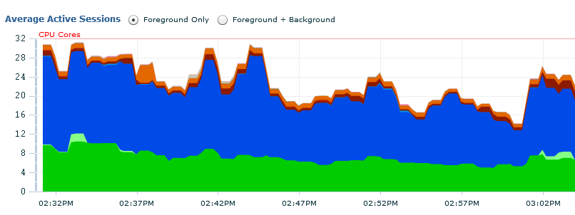
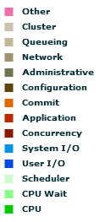
Transactional Workload
We will focus on systems like this example (OLTP):
  DB time dominated by ‘db file sequential read’
    CPU usage is not a bottleneck
    We can ignore locks and other serialization events

Slide 21
Wait Event Drill-Down
What is available?
  Drill down on ‘db file sequential read’ wait event data
  Using event histogram data
What can we gain?
  Make educated guesses of what is happening on the storage
  Attack the root causes when investigating performance problem

Slide 22
A Story From Production
Migrated to a new storage system
  NAS storage with SSD cache
  Good performance: because of low-latency reads from SSD
Issue:
  From time to time production shows unacceptable performance
Analysis:
  The issue appears when the backup runs!

Slide 23
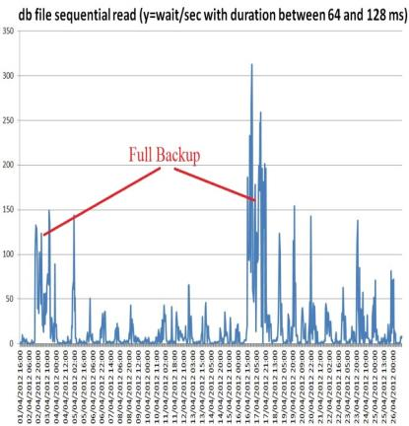
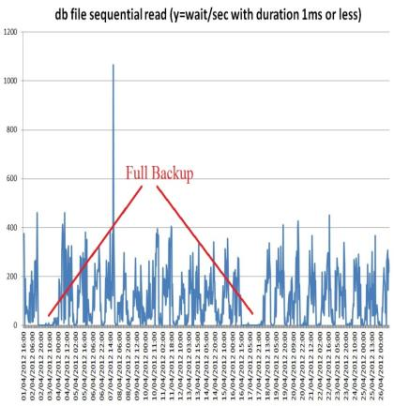
Wait Event Drill Down
Number of waits
Very slow reads appear
Reads from SSD cache go to zero
Notes:
Data taken from AWR and in particular wait event histograms data aggregating over RAC nodes.
Example:
select cast(sn.begin_interval_time as date) snap_time,
--eh.dbid,
sn.instance_number,
eh.event_name,
eh.wait_time_milli,
--eh.wait_count,
eh.wait_count - lag(eh.wait_count) over (partition by eh.dbid,eh.instance_number,eh.event_id,eh.wait_time_milli order by sn.snap_id nulls first) Delta_wait_count,
round((eh.wait_count - lag(eh.wait_count) over (partition by eh.dbid,eh.instance_number,eh.event_id,eh.wait_time_milli order by sn.snap_id nulls first)) /
(extract(hour from END_INTERVAL_TIME-begin_interval_time)*3600
-extract(hour from sn.snap_timezone - lag(sn.snap_timezone) over (partition by eh.dbid,eh.instance_number,eh.event_id,eh.wait_time_milli order by sn.snap_id nulls first) )*3600 --deals with daylight savings time change
+ extract(minute from END_INTERVAL_TIME-begin_interval_time)* 60
+ extract(second from END_INTERVAL_TIME-begin_interval_time)),2 ) Rate_wait_count_per_bin
from dba_hist_event_histogram eh,
dba_hist_snapshot sn
where
sn.snap_id = eh.snap_id
and sn.dbid = eh.dbid
and sn.instance_number = eh.instance_number
and sn.begin_interval_time &delta_time_where_clause
and eh.wait_class in ('User I/O','System I/O','Commit') -- need to limit search or dump file can grow too big
order by sn.snap_id;

Slide 24
Our Analysis
AWR data used to examine the issue
  DBA_HIST_EVENT_HISTOGRAM
  Wait event: db file sequential read
I/O slow during backups
  because fewer I/O requests were served from SSD
Note on how we worked around this issue
  Short term: moved backup to Active Data Guard Medium term: upgraded filer model

Slide 25
Real-Time Monitoring
Problem:
  Hourly AWR average is often too coarse
  How to perform real-time monitoring of the event latency?
Answer: data from GV$EVENT_HISTOGRAM
  CLI script to compute deltas from cumulative counters

Slide 26
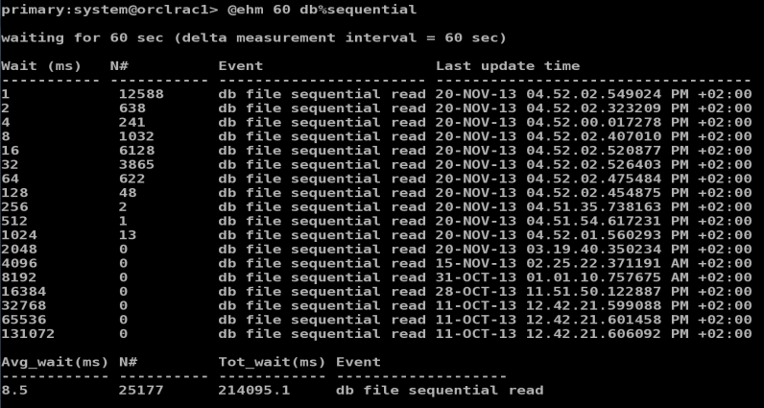
Monitoring Latency - Snapshots
Custom script: ehm.sql
Script can be downloaded from: http://cern.ch/resources.htm
Notes:
Ehm.sql
-- even_histogram_metric, RAC version (from gv$ views)
-- Luca April 2012
-- Usage: @ehm <delay> <event>
-- example @ehm 15 db%sequential
set serverout on
set verify off
prompt
prompt waiting for &1 sec (delta measurement interval = &1 sec)
DECLARE
v_event_pattern varchar2(100) := '%'||'&2'||'%';
v_sleep_time number := &1;
v_dtime_wait_milli number;
v_dwaits number;
v_avg_wait_milli number;
CURSOR c1 IS
SELECT event, wait_time_milli, sum(wait_count) wait_count, max(last_update_time) last_update_time
FROM gv$event_histogram
WHERE event like v_event_pattern
GROUP by event, wait_time_milli
ORDER BY event,wait_time_milli;
CURSOR c2 IS
SELECT event, sum(time_waited_micro) time_waited_micro, sum(total_waits) total_waits
FROM gv$system_event
WHERE event like v_event_pattern
GROUP by event
ORDER BY event;
TYPE EventHisto IS TABLE OF c1%ROWTYPE;
TYPE SysEvent IS TABLE OF c2%ROWTYPE;
t0_histval EventHisto; -- nested table of records for t0 snapshot
t1_histval EventHisto; -- nested table of records for t1 snapshot
t0_eventval SysEvent; -- nested table of records for t0 snapshot
t1_eventval SysEvent; -- nested table of records for t1 snapshot
BEGIN
-- collect t0 data
OPEN c1;
OPEN c2;
FETCH c1 BULK COLLECT INTO t0_histval;
FETCH c2 BULK COLLECT INTO t0_eventval;
CLOSE c1;
CLOSE c2;
IF t0_eventval.COUNT <=0 THEN
RAISE_APPLICATION_ERROR(-20001,'Not enough data. Probably wrong event name');
END IF;
IF t0_eventval.COUNT >= 100 THEN
RAISE_APPLICATION_ERROR(-20002,'Too many values, soft limit set to 100');
END IF;
-- put wait time here note user needs exec privilege on dbms_lock
sys.DBMS_LOCK.SLEEP (v_sleep_time);
-- collect t1 data
OPEN c1;
OPEN c2;
FETCH c1 BULK COLLECT INTO t1_histval;
FETCH c2 BULK COLLECT INTO t1_eventval;
CLOSE c1;
CLOSE c2;
-- check and report error if number of points is different (can happen if new histogram bin is created)
if t0_histval.COUNT <> t1_histval.COUNT then
RAISE_APPLICATION_ERROR(-20003,'Number of histogram bins changed during collection. Cannot handle it.');
end if;
-- print out results
-- compute delta values and print.
-- format with rpad to keep column width constant
DBMS_OUTPUT.PUT_LINE(chr(13));
DBMS_OUTPUT.PUT_LINE ('Wait (ms) N# Event Last update time');
DBMS_OUTPUT.PUT_LINE ('----------- ----------- ----------------------- -----------------------------------');
FOR i IN t1_histval.FIRST .. t1_histval.LAST LOOP
DBMS_OUTPUT.PUT_LINE (
rpad(t1_histval(i).wait_time_milli,13,' ')||
rpad(to_char(t1_histval(i).wait_count - t0_histval(i).wait_count),11,' ')||
t1_histval(i).event || ' ' ||
t1_histval(i).last_update_time
);
END LOOP;
DBMS_OUTPUT.PUT_LINE(chr(13));
DBMS_OUTPUT.PUT_LINE ('Avg_wait(ms) N# Tot_wait(ms) Event');
DBMS_OUTPUT.PUT_LINE ('------------ ---------- ------------ -------------------');
FOR i IN t1_eventval.FIRST .. t1_eventval.LAST LOOP
v_dtime_wait_milli := (t1_eventval(i).time_waited_micro - t0_eventval(i).time_waited_micro)/1000;
v_dwaits := t1_eventval(i).total_waits - t0_eventval(i).total_waits;
IF v_dwaits <> 0 then
v_avg_wait_milli := round(v_dtime_wait_milli/v_dwaits,1);
ELSE
v_avg_wait_milli := 0;
END IF;
DBMS_OUTPUT.PUT_LINE(
rpad(to_char(v_avg_wait_milli),13,' ') ||
rpad(to_char(v_dwaits),11,' ')||
rpad(to_char(round(v_dtime_wait_milli,1)),13,' ')||
t1_eventval(i).event
);
END LOOP;
END;
/

Slide 27
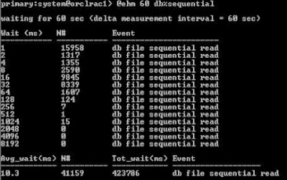
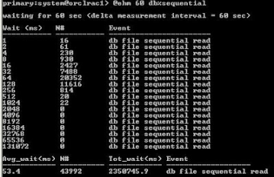

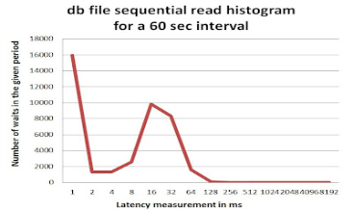
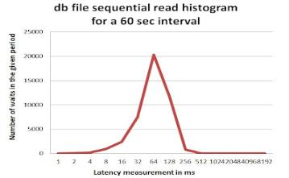


Monitoring Latency - Snapshots

Slide 28
Checkpoint #1
Average latency can hide details
  Multi-modal distributions in modern storage (think HDD arrays with large SSD cache)
How-to drill down on the latency dimension:
  Use Latency histograms
Take care of the time dimension too:
  Collect data over short time intervals

Slide 29
Display Latency Data over Time
It’s a 3D visualization problem:
  (1) Latency bucket, (2) time, (3) value
Heat Map representation
  Used for example in Sun ZFS Storage 7000 Analytics
  Reference: Brendan Gregg, Visualizing system latency, Communications of the ACM, July 2010

Slide 30
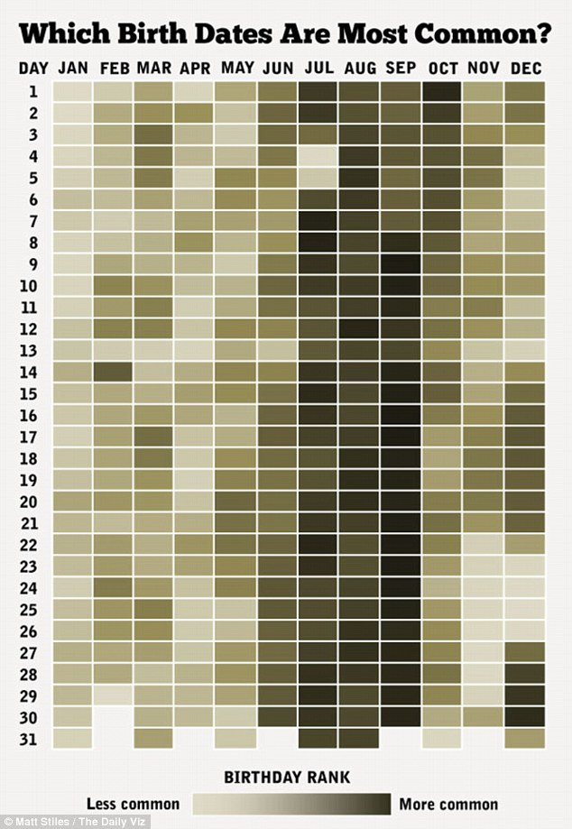
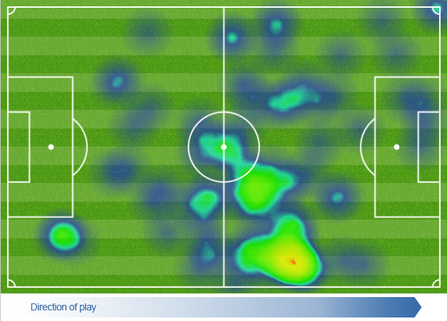
Heat Maps
Definition:
  graphical representation of data where the individual values contained in a matrix are represented as colors (wikipedia)
Examples:

Slide 31
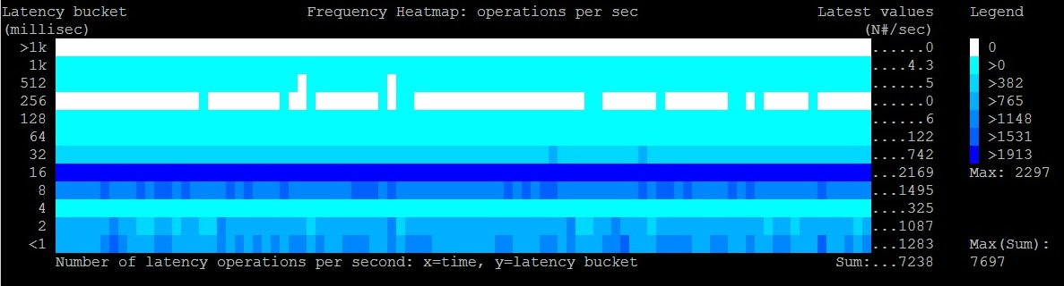
Latency Heat Maps - Frequency
X=time, Y=latency bucket
Color=events per second (e.g. IOPS)

Slide 32
Latency Heat Maps - Frequency
X=time, Y=latency bucket
Color=events per second (e.g. IOPS)
TIME

Slide 33
Latency Heat Maps - Frequency
X=time, Y=latency bucket
Color=events per second (e.g. IOPS)

Slide 34
Latency Heat Maps - Frequency
X=time, Y=latency bucket
Color=events per second (e.g. IOPS)

Slide 35
Latency Heat Maps - Frequency
X=time, Y=latency bucket
Color=events per second (e.g. IOPS)

Slide 36
Time-Waited Histogram
How much time do we wait in a given bucket?
  Not directly available in gv$event_histogram
How to estimate it? Example:
  100 waits in the bucket 8ms means
  Wait time between 100*4 ms and 100*8 ms
  Approximate: 100 * 6 ms [that is 100 * ¾ * 8 ms]
Definition:
  Intensity = 0.75 * bucket_value * frequency_count

Slide 37
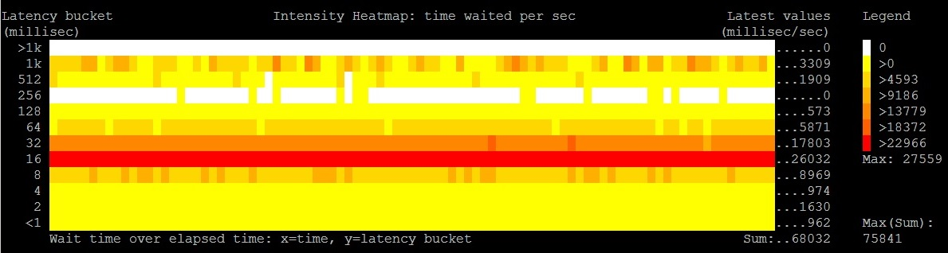
Latency Heat Maps - Intensity
X=time, Y=latency bucket
Color= intesity [time waited per bucket]

Slide 38
Checkpoint #2
Heat Maps
  A representation of latency histograms over time
Frequency Heat Map
  IOPS details per latency bucket and time
Intensity Heat Map
  Time waited details
  Visual representation of the weight of each bucket

Slide 39
Outline
CERN and Oracle
Storage latency investigations and Oracle
Examples
Tools
More sources of latency data
Conclusions

Slide 40
Stress Testing
Use case:
  Investigate HW performance
  Compare different systems
  Example: compare current storage with a new system
It can be hard:
  Choosing test workloads that are representative of production usage
  Understanding the effects of caching

Slide 41
SLOB 2
An Oracle-based stress testing tool
  Search: “SLOB 2 by Kevin Closson”
Great tool to generate lots of random IO
  I/O directly from Oracle processes
  Physical reads
    Visible as Oracle’s wait events db file sequential read
Size of test data is configurable
Concurrency is configurable

Slide 42
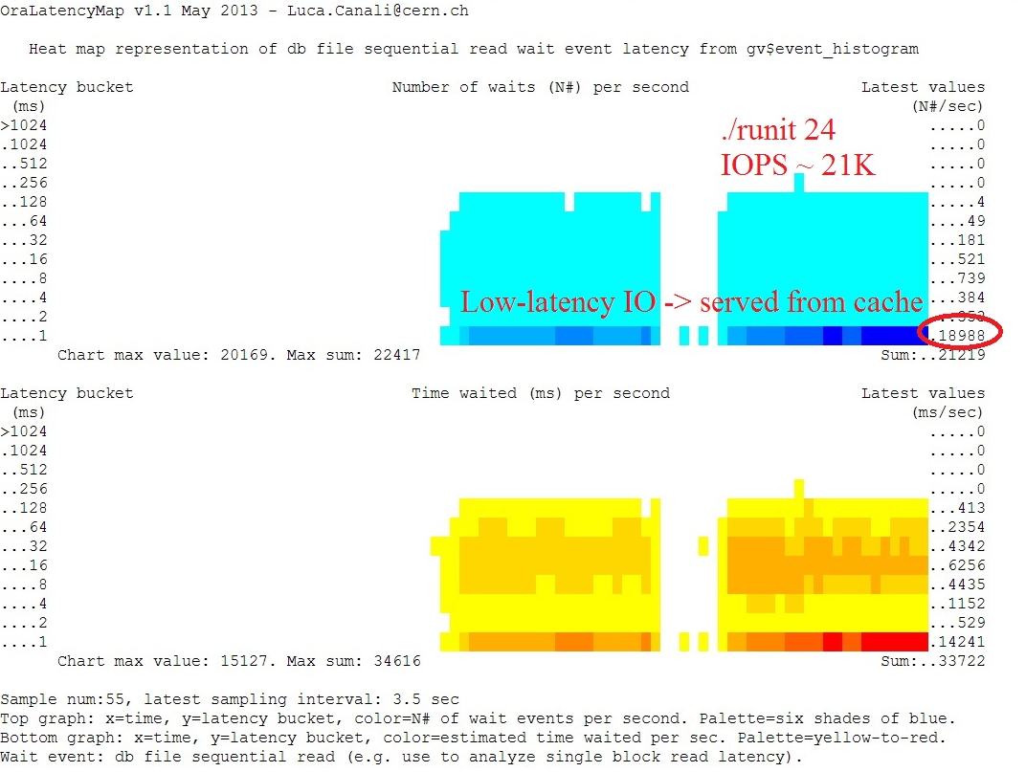
Example: “Too Good To Be True”
23 SAS disks delivering 20K IOPS?
It doesn’t make sense
Latency is the clue
Reads served by controller cache!
Lesson learned: test data size was too small

Slide 44
Example: “Too Good To Be True”
23 SAS disks delivering 21K IOPS?
It doesn’t make sense
Latency is the clue
Reads served by controller cache!
Lesson learned: test data size was too small

Slide 45
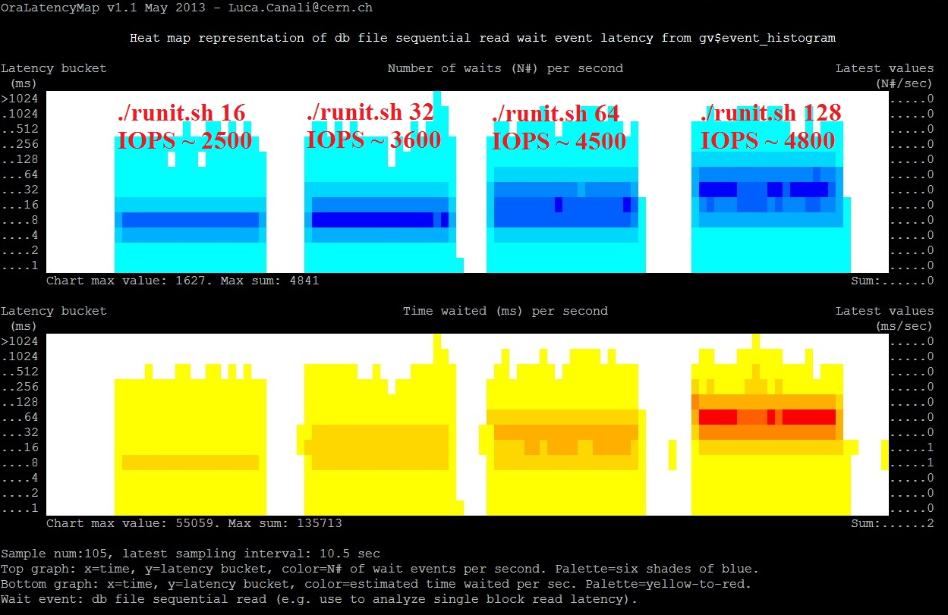
Example: “Load Till Saturation”
23 SAS disks
JBOD & ASM
4 consecutive
tests with
increasing load
Lesson learned: don’t accept IOPS numbers without latency values

Slide 46
Example: “Load Till Saturation”
23 SAS disks
JBOD & ASM
4 consecutive
tests with
increasing load
Lesson learned: don’t accept IOPS numbers without latency values

Slide 47
Example: “Load Till Saturation”
23 SAS disks
JBOD & ASM
4 consecutive
tests with
increasing load
Lesson learned: don’t accept IOPS numbers without latency values

Slide 48
IOPS and Latency are Related
Observation: as IOPS approach saturation latency increases very fast
Data fits a simple model from queueing theory:
Calculation performed using
MMm Multiserver model
By Cary Millsap, 2003

Slide 49
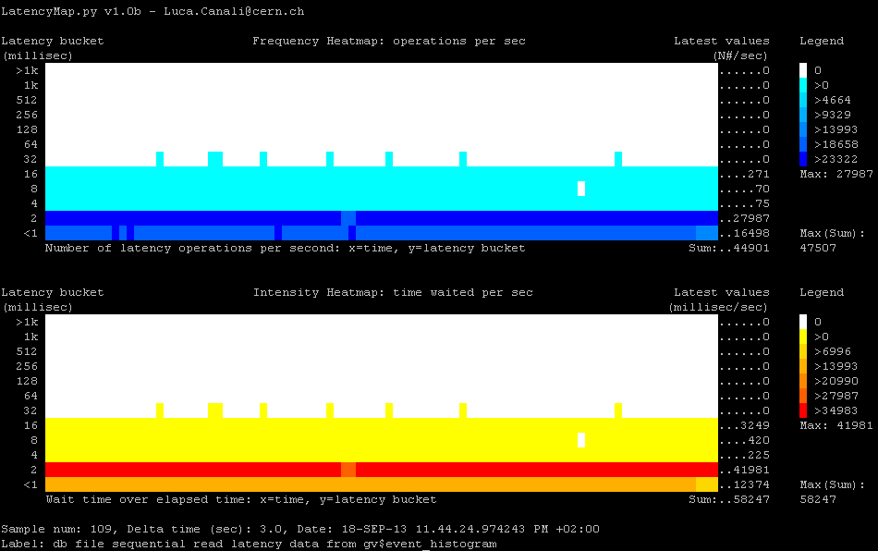
0.5 TB dataset, 100% in SSD cache, 56 sessions, random reads - NAS system

Slide 50
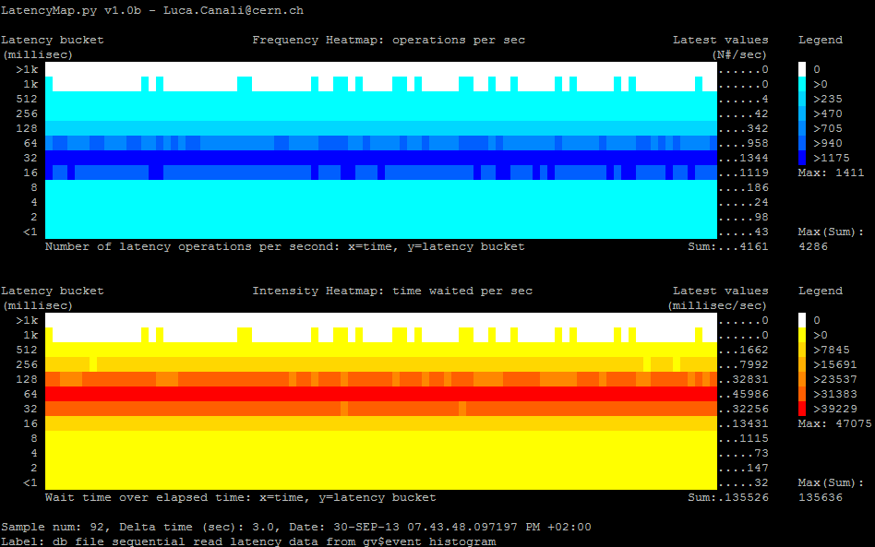
10TB dataset, 128 sessions, random reads, onset of disk I/O saturation - NAS

Slide 51
Monitoring Production Systems
Understand I/O response time
  Help for tuning and capacity planning
  Attack questions like: is the storage slow?
Drill down on three areas:
  I/O served by SSD/controller cache
  I/O served by physical disks ‘spindles’
  I/O with very large latency: outliers

Slide 52
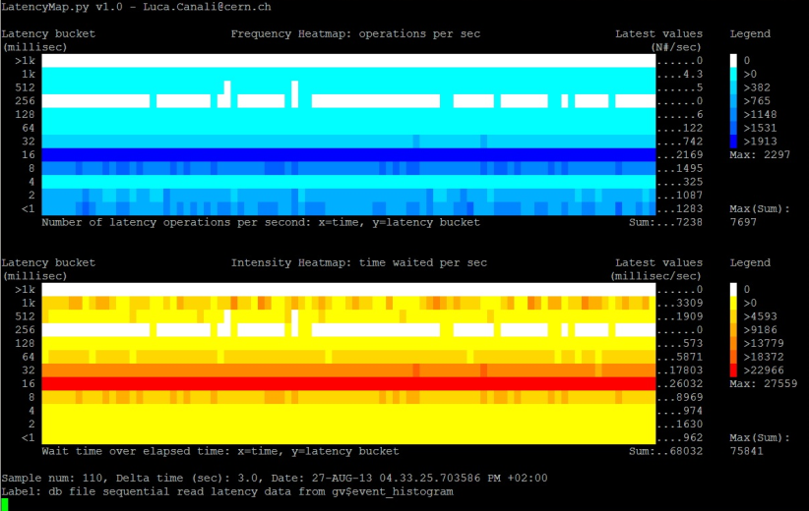
An Example of a Loaded Storage

Slide 53
Example Analysis
Are disks close to saturation?
  NO, but latency high (SATA disks)
I/O outliers?
  YES, Further investigation on controller needed
Do we have SSD/cache?
  YES, ~30% reads with low latency
  We could profit from a larger SSD cache maybe?

Slide 54
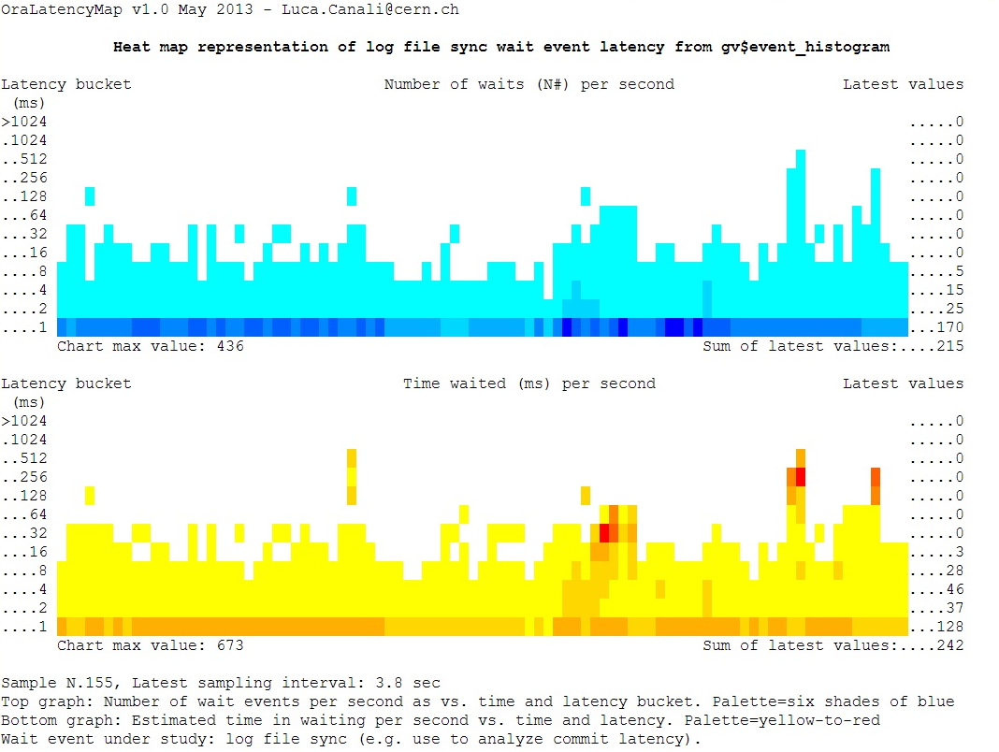
Heat Maps for Log File Sync
Example from a production system
Low latency from
writes because of
storage cache

Slide 55
Log File Sync
Example from a production system
low latency from
writes because of
storage cache

Slide 56
Heat Maps for Log File Sync
Example from a production system
Low latency from
writes because of
storage cache

Slide 57
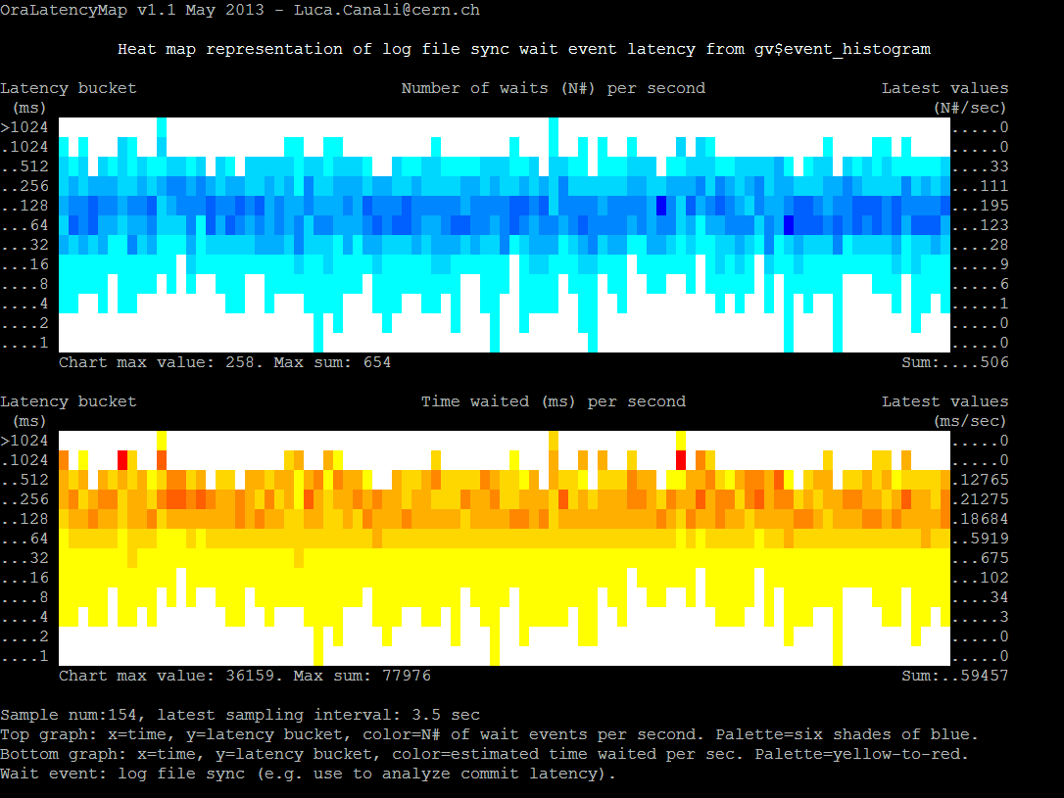
Log File Sync Troubleshooting
Anomaly, on a test system
High latency
caused by high
load from Oracle and a few faulty HW components

Slide 58
Checkpoint #3
IOPS data alone can be misleading because of saturation effects
  Need IOPS with latency breakdown
We can get insights on the storage performance
  With latency histograms and heat map visualization
  Analysis of random reads by drilling down ‘db file sequential read’
  Use this method also for commit wait: ‘log file sync’

Slide 59
Limitations of Using Wait Events
Wait event timing is done by the Oracle code
  May not reflect actual I/O response time
  CPU time may also be accounted as I/O wait
  Server high load can distort the timing values
  V$event_histogram lowest bucket is 1 millisecond

Slide 60
Random Reads
Db file sequential read
  Is the easiest event to relate to I/O service time
  Instruments single-block reads, blocking I/O
Limitations:
  In some cases Oracle can use async I/O for random reads, e.g. for prefetching and batching.
  The wait event used in that case is ‘db file parallel read’
Notes:
These parameters taken from SLOB (Kevin Closson) documentation can be used to make oracle use db file sequential read instead of db file parallel read:
_db_block_prefetch_limit=0
_db_block_prefetch_quota=0
_db_file_noncontig_mblock_read_count=0

Slide 61
Log File Sync
Log file sync
  Big part of the commit-time wait
  Complex: it’s not a pure I/O event
The root causes of high latency for log file sync can be
  CPU starvation
  LGWR behaviour
    with inter-process communication and/or bugs
See also Kevin Closson’s blog
Notes:
Log file sync: From 11.2.0.3 adaptive mechanism
Automatic switching to a poll-based method instead of post-based
Disable this behaviour with: alter system set “_use_adaptive_log_file_sync”='FALSE‘;

Slide 62
Limitations for Multi-Block I/O
Asynchronous I/O
  Wait events of this family are very hard or impossible to utilize precisely in the context of latency
  See Frits Hoogland’s work
Multi-block I/O
  Hard to compare latency for I/Os of different sizes
Keeping in mind these limitations.
  Heat maps of db file parallel write can be used to study DBWR performance issues (e.g. high write latency)
Notes:
Asynch IO, for example in Linux for block devices: OS calls (ASM example): io_submit(), io_getevents
We can tap Oracle code with DTrace to see where the wait event timing is handled:
# this is for Oracle 11.2.0.3, Linux and Solaris: trace os process pid=1737 (edit os pid as relevant)
dtrace -n '
pid1737:oracle:kews_update_wait_time:entry {
self->ela_time = arg1;
}
pid1737:oracle:kskthewt:entry {
printf("event#= %d, time(mu sec) = %d", arg1, self->ela_time);
}'

Slide 63
Outline
CERN and Oracle
Storage latency investigations and Oracle
Examples
Tools
More sources of latency data
Conclusions

Slide 64
Tools
Automate tedious tasks
  Data collection
  Visualisation
Three tools I have built and shared:
  PerfSheet4 -> AWR analytics
  OraLatencyMap -> Heat Maps in SQL*Plus
  PyLatencyMap -> Advanced version

Slide 65
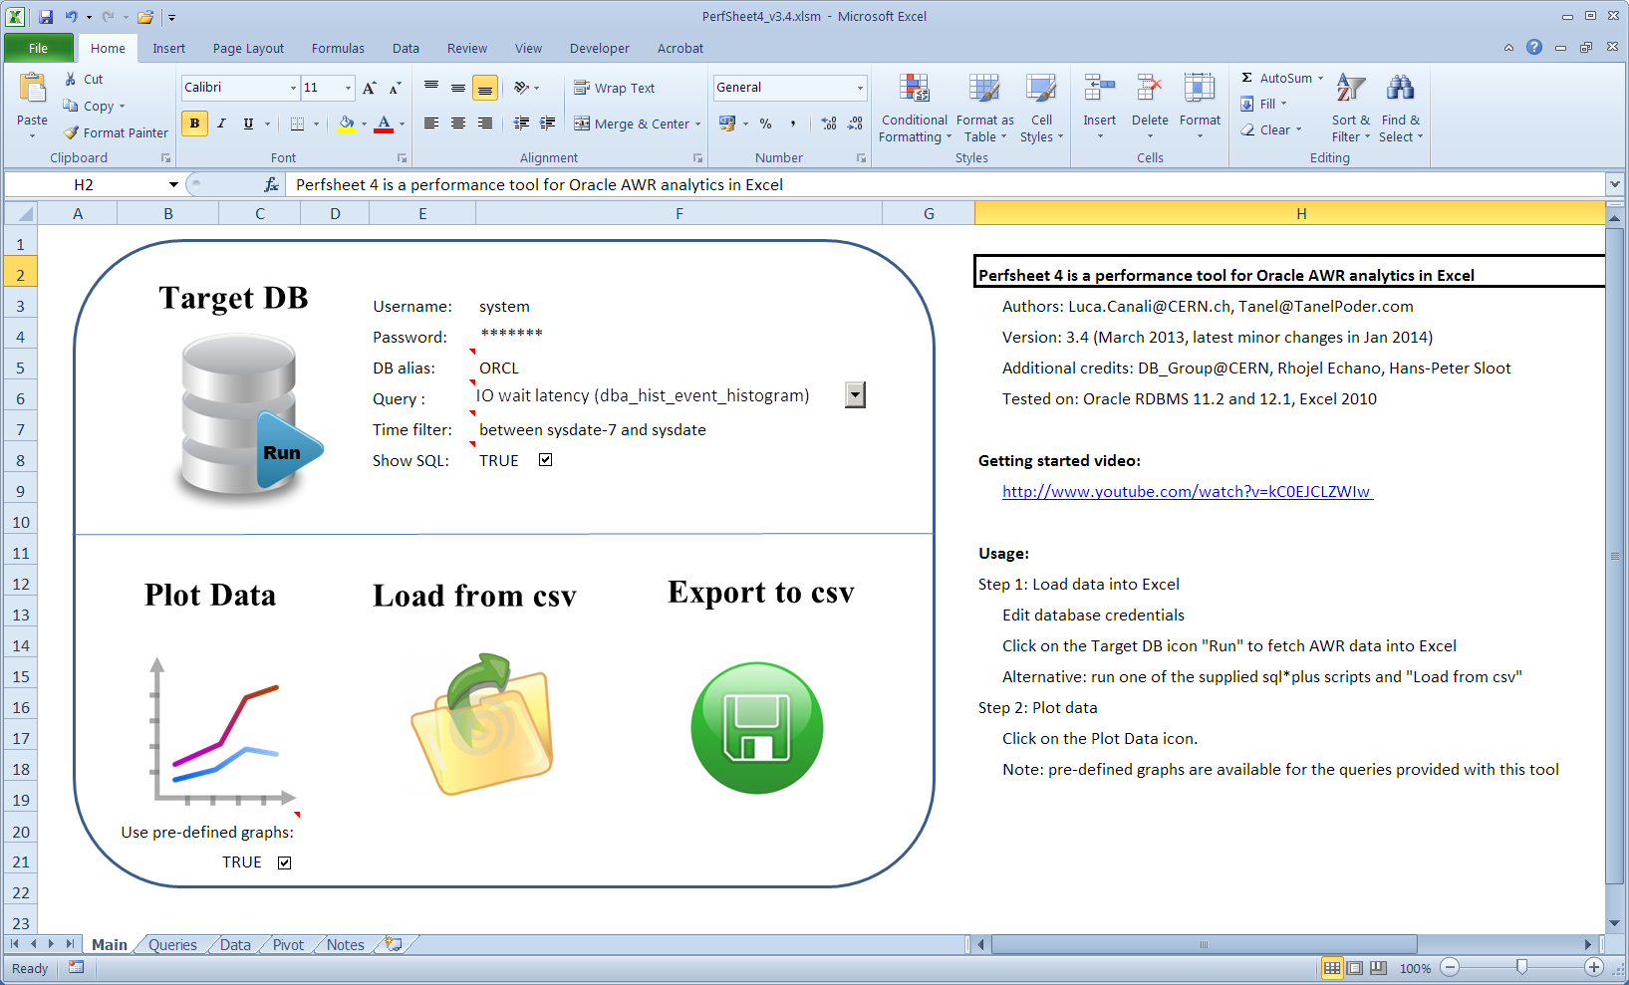
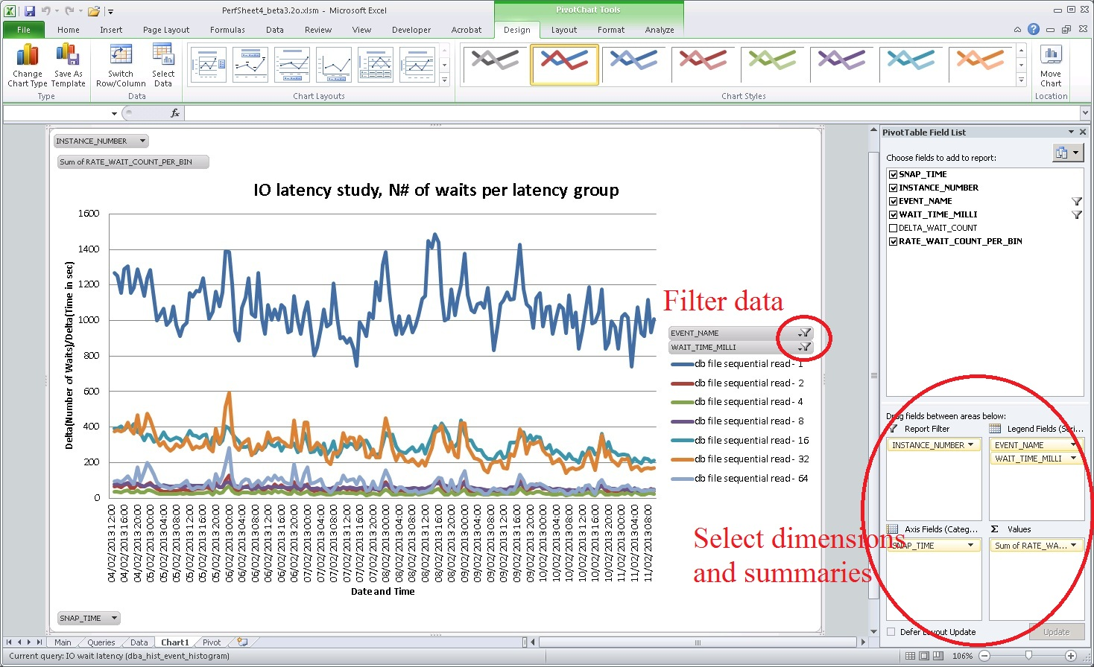
Tools: PerfSheet 4
Simple analytic platform for AWR data
Predefined queries and graphs
Power of Pivot Charts

Slide 66
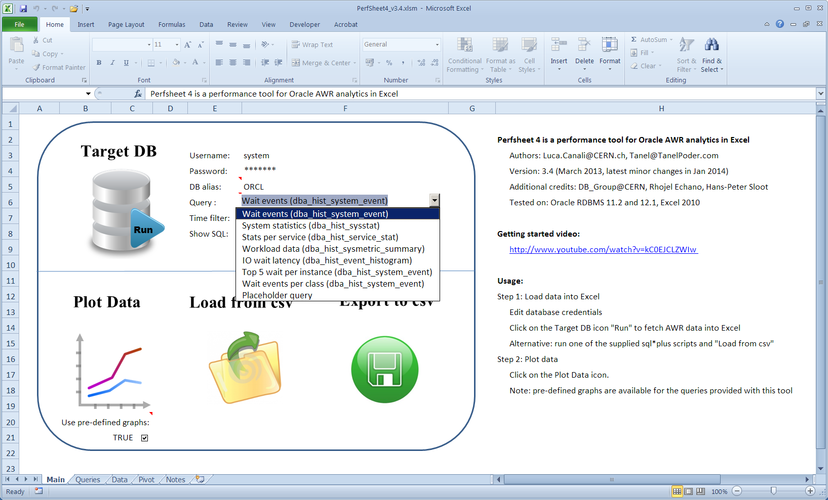
Tools: PerfSheet 4

Slide 67
Tools: PerfSheet 4

Slide 68
Tools: OraLatencyMap
Run on SQL*Plus, core written in PL/SQL
  Lightweight, does not require any installation
  Command line interface
  Heat maps generated using ANSI escape codes
Getting started:
SQL> @OraLatencyMap

Slide 69
Tools: PyLatencyMap
It’s written in Python + SQL*Plus scripts
  No installations required, CLI, lightweight
  It’s an advanced version of OraLatencyMap
Can be used for generic latency sources
  Oracle v$, trace files, AWR, DTrace data, etc
  Pre-built examples available
  Additional features: record and replay

Slide 70
Getting Started with PyLatencyMap
Modular architecture
  Source | <optional filter> | visualization engine
Getting started
Video, getting started with PyLatencyMap
http://www.youtube.com/watch?v=-YuShn6ro1g
$ ./Example1_oracle_random_read.sh

Slide 71
Outline
CERN and Oracle
Storage latency investigations and Oracle
Examples
Tools
More sources of latency data
Conclusions

Slide 72
More Latency Sources
Latency can be collected from various other sources
  From the OS
  From Oracle RDBMS trace files and X$ tables
  From the storage instrumentation

Slide 73
OS Level
DTrace
  Great performance tool, coming to Linux too
  Naturally fits to gathering I/O latency data
    Histograms collected with the quantize operator
dtrace -n '
syscall::pread64:entry { self->s = timestamp; }
syscall::pread64:return /self->s/ { @pread["ns"] = quantize(timestamp -self->s); self->s = 0; }
tick-10s {
printa(@pread);
trunc(@pread);
}'

Slide 74
More DTrace
DTrace Oracle executable for wait event data
  This scripts uses the DTrace PID provider
dtrace -n '
pid2349:oracle:kews_update_wait_time:entry,pid2350:oracle:kews_update_wait_time:entry {
self->ela_time = arg1;
}
pid2349:oracle:kskthewt:entry,pid2350:oracle:kskthewt:entry {
@event_num[arg1] = quantize(self->ela_time);
}
tick-10s {
printa(@event_num);
trunc(@event_num);
}'
Notes:
How to find which functions Oracle uses internally for instrumenting waits? By profiling the execution, see for example digger by Alexander Anokhin.

Slide 75
Sample DTrace Output
1 294099 :tick-10s
146 (edited: db file sequential read)
value ------------- Distribution ------------- count
128 | 0
256 |@ 14
512 |@@@@@ 120
1024 |@@@@@@@@ 182
2048 |@@@@@@@@@@@@@@ 320
4096 |@@@@@@@@@@@@@ 302
8192 | 5
16384 | 4
32768 | 0
dtrace -s DTrace/pread_tracedata.d |python DTrace/dtrace_connector.py |python LatencyMap.py
Notes:
Dtrace quantize data is already in histogram format with exponentially growing buckets. With a little transformation they can be fed to PyLatencyMap for visualization as heat maps.

Slide 76
Latency From 10046 Trace Files
Latency data is available in 10046 trace files
  Wait event data with micro second precision
  Allows the drill-down to session level
  Snippet from the trace file:
  Plug into PyLatencyMap for heat map display
SQL> exec dbms_monitor.session_trace_enable(sid,serial#)
nam='db file sequential read' ela= 977 file#=7 block#=29618220 blocks=1 obj#=82015 tim=1377520823036634
cat tracefile.trc| python 10046_connector.py |python LatencyMap.py
Notes:
10046_connector.py is a simple script that aggregates 10046 traces in histrograms.

Slide 77
Sampling Instead of Tracing
We want to process a stream of wait events
ASH data OK but sampling frequency too low
  Not fast enough for capturing all I/O events
  “_ash_sampling_interval”=1000 -> 1 Hz
I propose a different method:
  High frequency sampling of v$session_wait_history
  10 latest wait events for each session
    “_session_wait_history”=10
Notes:
Oracle ASH data is sampled at 1Hz ('_ash_sampling_interval=1000), maximum frequency is 10 Hz. See also:
LRM-00122: value '1' for '_ash_sampling_interval' must be between '100' and '10000‘
The default is 10 values per sid in v$session_wait_history. See alsounderscore parameter: _session_wait_history=10

Slide 78
Latency Data From X$KSLWH
V$session_wait_history is based on X$KSLWH
Use X$KSLWH as ring buffers indexed by SID
  Extract all captured wait events, wrap on kslwhwaitid
  Selected columns from X$KSLWH:
kslwhsid | kslwhwaitid | kslwhetext | kslwhetime
42 | 21016 | db file sequential read | 300
42 | 21015 | db file sequential read | 1000
42 | 21014 | db file sequential read | 16000
42 | 21013 | db file sequential read | 400
Notes:
SQL> desc X$KSLWH
Name Null? Type
------------------------------------------------------------ -------- -----------------------------------------
ADDR RAW(8)
INDX NUMBER
INST_ID NUMBER
CON_ID NUMBER
KSLWHSID NUMBER
KSLWHRIDX NUMBER
KSLWHWAITID NUMBER
KSLWHSNAPID NUMBER
KSLWHSEQ NUMBER
KSLWHEVT NUMBER
KSLWHETEXT VARCHAR2(64)
KSLWHP1TEXT VARCHAR2(64)
KSLWHP1 NUMBER
KSLWHP2TEXT VARCHAR2(64)
KSLWHP2 NUMBER
KSLWHP3TEXT VARCHAR2(64)
KSLWHP3 NUMBER
KSLWHPX1TEXT VARCHAR2(64)
KSLWHPX1 NUMBER
KSLWHPX2TEXT VARCHAR2(64)
KSLWHPX2 NUMBER
KSLWHPX3TEXT VARCHAR2(64)
KSLWHPX3 NUMBER
KSLWHTOUT NUMBER
KSLWHSTIME NUMBER
KSLWHETIME NUMBER
KSLWHTTIME NUMBER
KSLWHEWCALL NUMBER
KSLWHEOSW NUMBER
KSLWHCOMP NUMBER
KSLWHLTIME NUMBER

Slide 79
Custom Event Histograms
X$KSLWH sampling with a custom python script
  SIDs as input, latency histograms as output
  Latency is measured in microseconds
$ python event_sampler_latency_histogram.py -i 3 -c
sampling rate: 6333 Hz, iops: 10396
bucket (microsec), wait count
...
256 , 20535
512 , 7708
1024 , 1923
2048 , 129
4096 , 78
...
Notes:
Event_sampler_latency_histogram.py is a python script available for download at cern.ch/canali
$ python event_sampler_latency_histogram.py -h
Event_sampler_latency_histogram.py, v1.0 Feb 2014, by Luca.Canali@cern.ch
a script for Oracle performance analysis, specifically targeted to latency studies of random I/O
this script collects wait event details, by high-frequency sampling of x$kslwh (v$wait_event_history)
the output is a frequency histogram of the wait event
Usage: event_history_sampler_histogram.py <options>
Options are:
-i arg or --interval=arg : data collection time interval in sec between data points, default is 3 sec
-m arg or --max_bucket=arg : value of the highes bucket, default is 20
-p or --pylatencymap : print output to pipe into PyLatencyMap for visualization
-c or --count : print event count instead of event rate, defaul is event rate
--recompute_sql_timeout=arg : timeout after which the SQL to recompute the SIDs under monitoring, default is 100 sec
--sql=arg : sql filter used to define the Oracle SIDs to monitor, default is: "username is not null"
--sid=arg : static list of Oracle SIDs to monitor, use in alternative to sql
--event=arg : define event to monitor, default: "db file sequential read"
--tns=arg : connect string to the dtaabase as sysdba, default is "/"

Slide 80
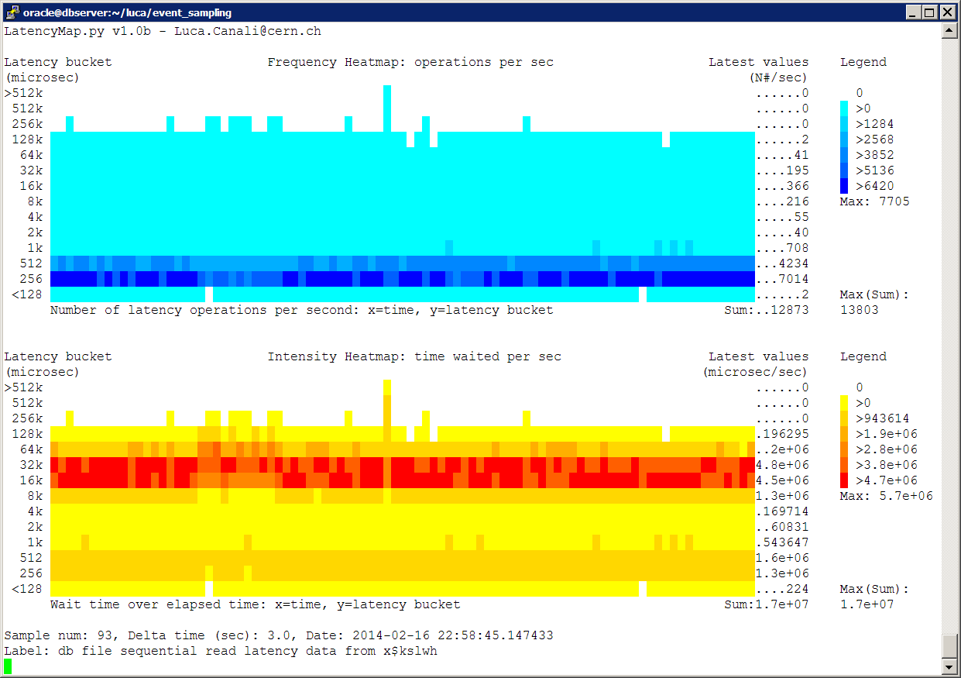
Sampling Events and Heat Maps
Heat maps from X$KSLWH
  High frequency sampling of 16 busy SLOB sessions
Notes:
Workload generated with SLOB 2 with 16 concurrent sessions. Tracing only slob sessions
./runit.sh 16
Slob.conf
UPDATE_PCT == 0
RUN_TIME == 600
WORK_LOOP == 0
SCALE == 1000000
WORK_UNIT == 256
ADMIN_SQLNET_SERVICE == ""
ADMIN_CONNECT_STRING == "/ as sysdba"
NON_ADMIN_CONNECT_STRING == ""
SQLNET_SERVICE_MAX == "0"

Slide 81
NetApp ONTAP 8
Latency data from the storage OS
  Latency measured at the source
mynas::> system node run -node dbnas1 stats show -r -n 100 -i 3 volume:myvol1:nfs_protocol_read_latency
volume:myvol1:nfs_protocol_read_latency.<20us:2656
volume:myvol1:nfs_protocol_read_latency.<40us:25885
volume:myvol1:nfs_protocol_read_latency.<60us:1040
volume:myvol1:nfs_protocol_read_latency.<80us:95
volume:myvol1:nfs_protocol_read_latency.<100us:16
volume:myvol1:nfs_protocol_read_latency.<200us:14
volume:myvol1:nfs_protocol_read_latency.<400us:11
volume:myvol1:nfs_protocol_read_latency.<600us:1043
volume:myvol1:nfs_protocol_read_latency.<800us:37
…
Notes:
Comparing latency data between the storage and OS/DB can give precious information on what happens in between
For example comparing the data in this slide with the x$kslwh example histogram taken at the same time we can see that dNFS/Networking in this system adds abuot 200 microsec of latency on cached IO. Also storage latency is for all IO sync and async, so it has more information than what can be collected at OS/database level.
Note for ONTAP this is a new feature of version 8 (here used in cluster mode).

Slide 82
Outline
CERN and Oracle
Storage latency investigations and Oracle
Examples
Tools
More sources of latency data
Conclusions

Slide 83
Summary
I/O latency data
  Allows DBAs to get insights on storage performance
  We need histograms, average latency is not enough
‘Db file sequential read’ event histogram
  Great for investigations of random reads
  Visualize data using latency heat maps
  Scripts to automate this process in Oracle:
    Download OraLatencyMap or PyLatencyMap

Slide 84
Wish List:
More awareness of I/O latency
  No more IOPS data without latency values!
  ‘Average latency’ hides details, use histograms instead
We need more features for measuring and analysing I/O latency for Oracle DB workloads
  A PL/SQL interface?
  DTrace static probes for Oracle RDBMS?
OEM could make use of Heat Maps for I/O studies
V$event_histogram should be extended
  Latency details extended to the microsecond bucket

Slide 85
Acknowledgements
CERN Database Group
  In particular for their contributions to this presentation: Marcin Blaszczyk and Ruben Gaspar
Many thanks for sharing their work and ideas to:
  Brendan Gregg, Tanel Poder, Kevin Closson, Frits Hoogland, Marcin Przepiorowski, James Morles, Kyle Hailey, Cary Millsap

Slide 86
Thank you!
Luca.Canali@CERN.ch
Download scripts and tools from:
http://cern.ch/canali/resources.htm

