Slide 1
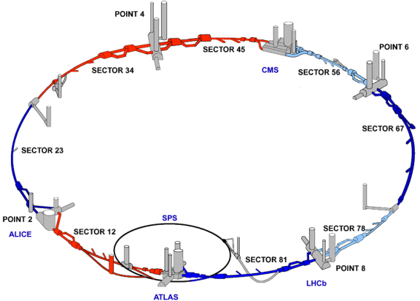
Update on the Hardware commissioning
LEMIC April 29th , 2008
Roberto Saban
Commissioning of the Technical Systems of the LHC

Slide 2
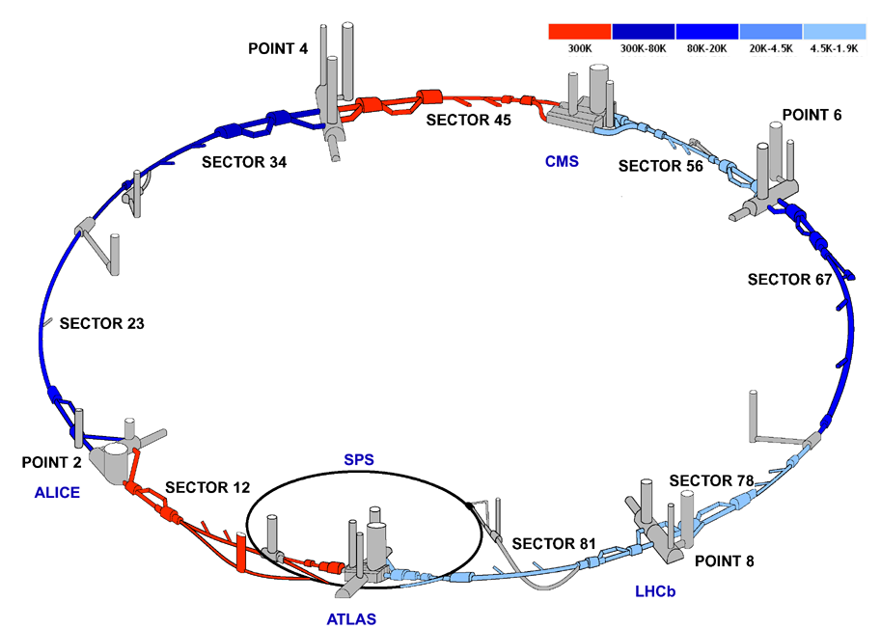
Status of the LHC

Slide 3

Consolidation
Connection of the inner triplet left of CMS
Other repair work which includes
  The consolidation of the interconnection cryostat
  Repair of a cryogenic line inside the bayonet heat exchanger
  The replacement of plug-in modules where RF fingers buckled following the warm up
Cool down expected to start after week 17

Slide 4
Preparation for Cool down
Cool down starts in three weeks: W19

Slide 5
The latest cool downs
2
3
4
5
6
Presently three sectors are below 2K
The helium inventory in the LHC is 75 t
Sector 78
Sector 67
Sector 34
Sector 81
Sector 23
Sector 56
6 weeks to cool down from 300 to 2K +
3 weeks for stabilization at 2K
Courtesy S.Claudet

Slide 6
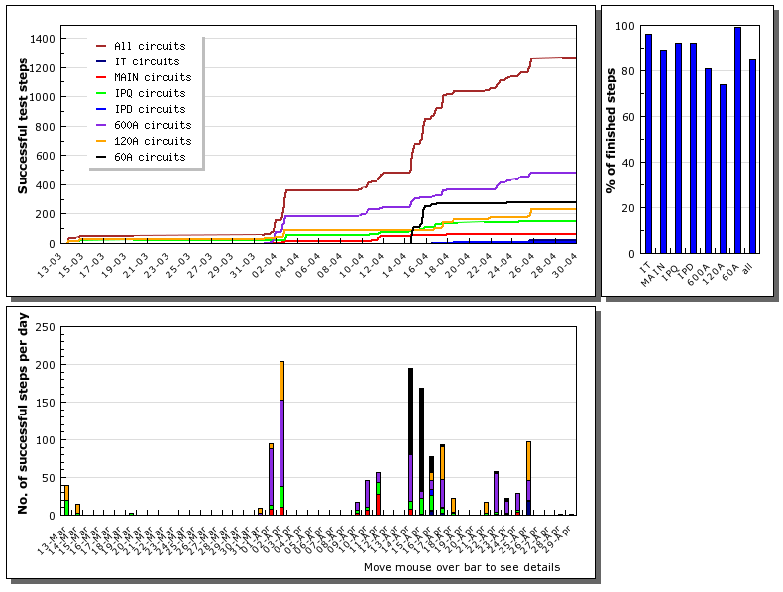
Sector 56 : successful test steps

Slide 7
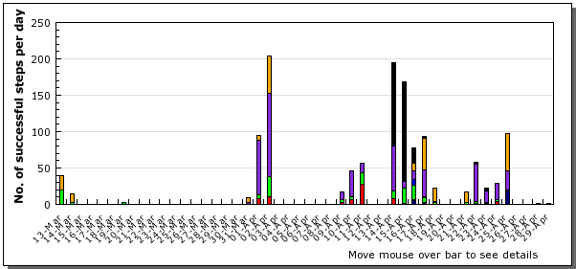
Sector 56
Very high efficiency, thanks to improved powering test procedures, automated sequences, good performance of the cryogenics.
w-e
Easter
w-e
Open
Days
w-e
400 kV power cut

Slide 8
Sector 56 : status
☑
60 A: 93 out of 94 circuits commissioned
at nominal current
☑
80/120 A:
    ML6&LR5 - all circuits fully commissioned
    ARC – 54% of steps completed
    IT – circuits not commissioned
☑
600 A: 35 over 39 ARC circuits fully commissioned
IT – 1 circuit over 7 already at nominal
☑
IPD: RD2.R5 fully commissioned
☑
☑
IPQ’s: 9 over 12 fully commissioned
for the remaining 3, one test step is missing
7 TeV equivalent
☑
5.5 TeV equivalent
☑
Main circuits: RB commissioning completed
RQD/F powered at 7 kA
☑
IT: powered at nominal current in the 2 PC’s
configuration

Slide 9
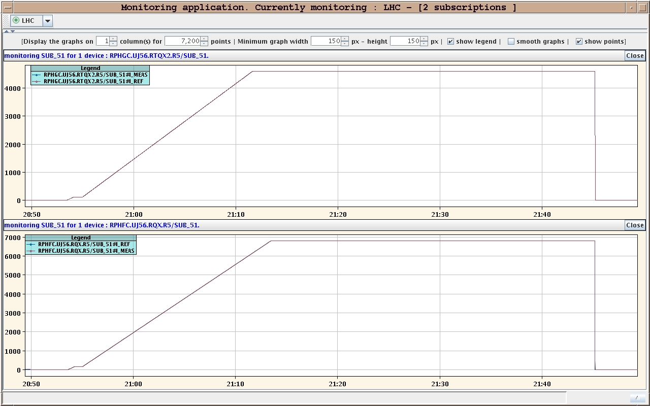
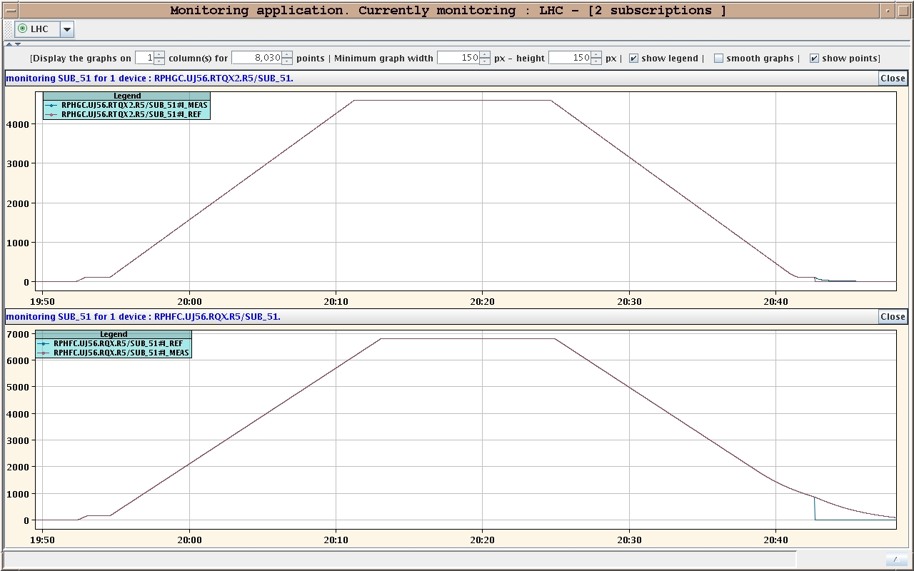
Sector 56 : the first inner triplet
on Thursday April 24th 2008

Slide 10
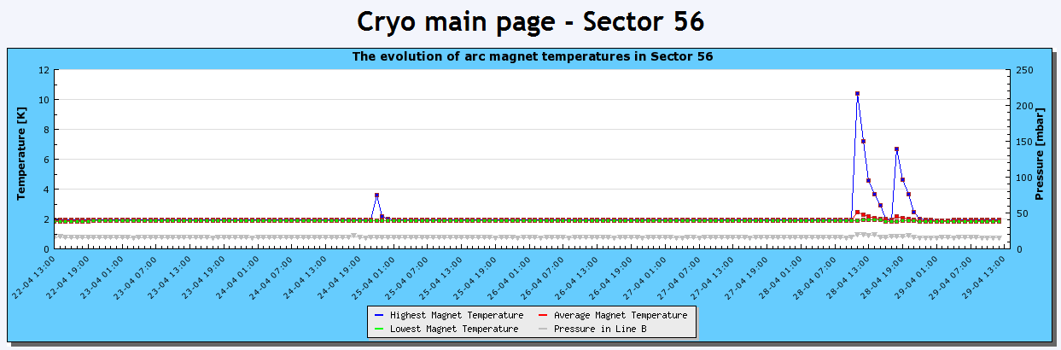
Dipole training quenches
First at 10.004 A / two magnets
Second 10.227 A

