Slide 1
Introduction to the Workshop
Wolfgang Lohmann, BTU and DESY
May 26, 2014

Slide 2
Publications, conferences, applications
Publication on test-beam results is progressing
Two abstracts prepared for ICHEP → one talk and one poster
Report to the “Detector R&D” liaison
AIDA II application
Beam-time at SLAC and CERN

Slide 3
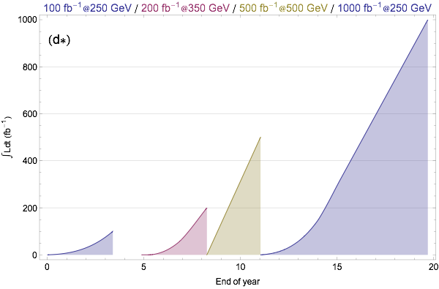
ILC issues
Energy staging (example)

Slide 4
ILC and CLIC issues
Physics and Detector working groups
Detector R&D liaison
Compiling detector R&D efforts
Publication of a report in Belgrade, LCWS14
Conference talk group
Coordinating the abstract submission to major conferences (firstly done for ICHEP 2014)
ILC parameter working group
Scenarios for energy staging
physics./detector and accelerator interplay
Physics working group
Physics case of ILC/CLIC

Slide 5
ILC and CLIC issues
Physics and Detector working groups
Software and computing working group
Developement of common software tools
Computing needs for the experiments
MDI working group
Design of the detector hall
Integration of the detectors
Alignment, feedback near the IP
Detector assembly/installation

Slide 6
Science and politics
Expert committee under MEXT
Currently 13 members, no ILC proponents
Report end of March 2016
Mission:
  physics case
  total budget and international sharing
  human resources for construction
  social and economic effects in Japan
P5 report in US: Motivated by the strong scientific importance of the ILC and the recent initiative in Japan to host it, the U.S. should engage in modest and appropriate levels of ILC accelerator and detector design where the US can contribute critical expertise. Consider higher levels of collaboration if ILC proceeds.

Slide 7
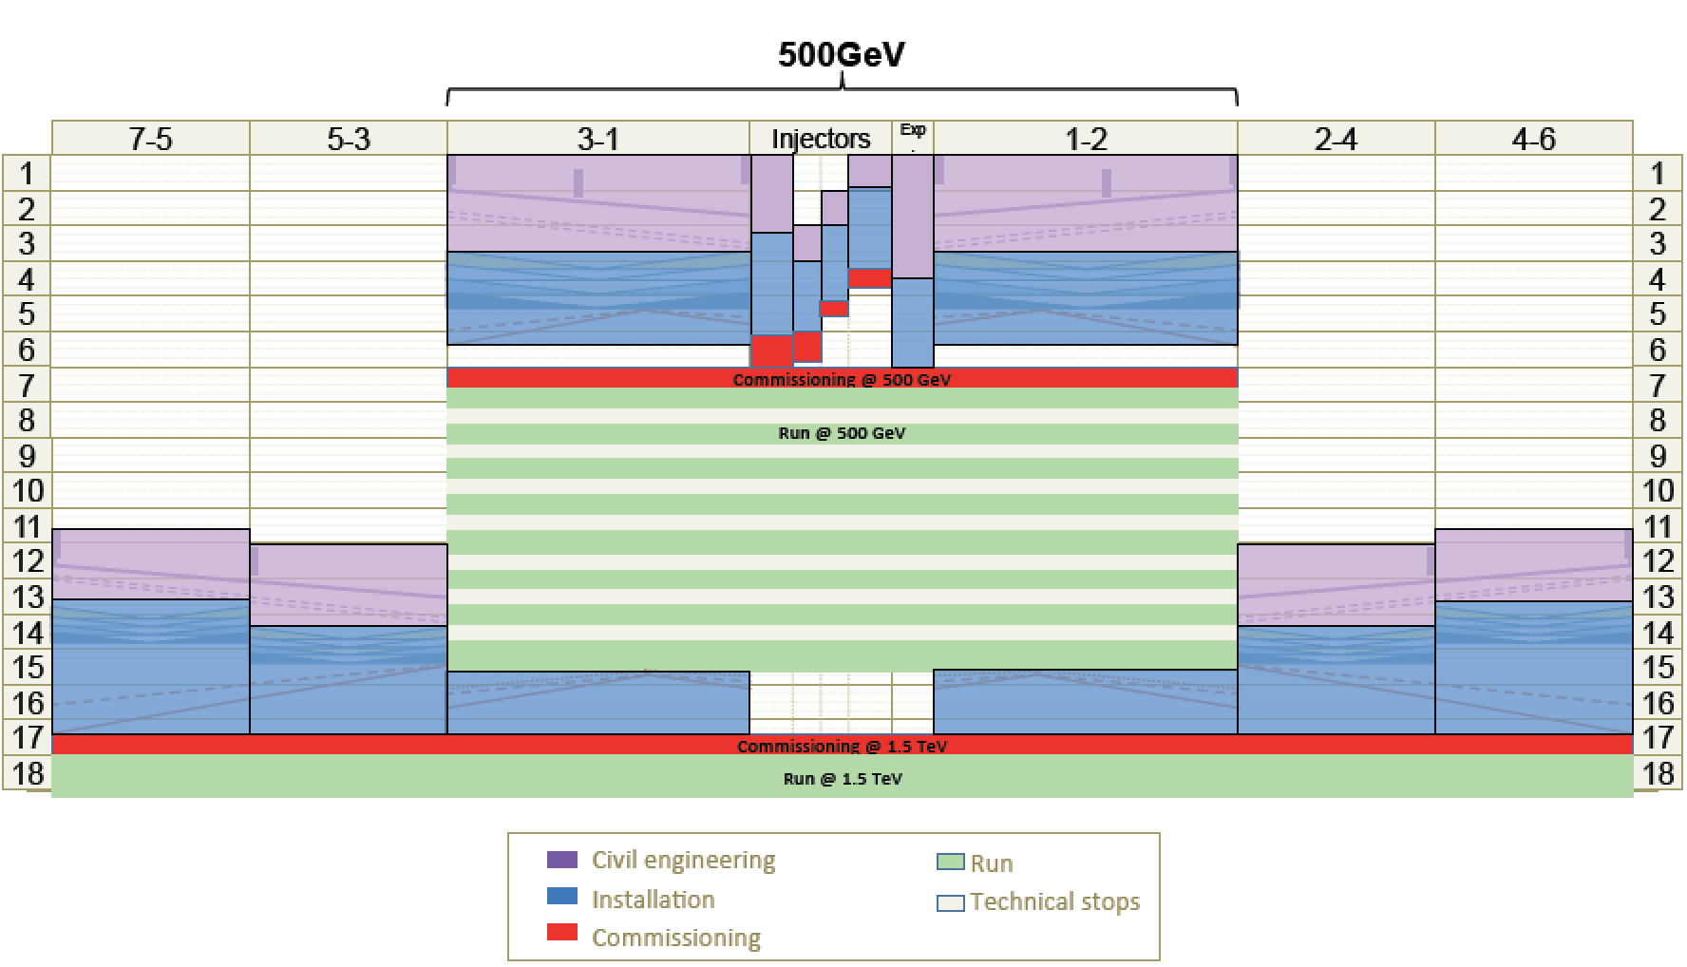
CLIC timeline
2013-18 Development Phase
Develop a Project Plan for a staged implementation in agreement with LHC findings; further technical developments with industry, performance studies for accelerator parts and systems, as well as for detectors.
4-5 year Preparation Phase
Finalise implementation parameters, Drive Beam Facility and other system verifications, site authorisation and preparation for industrial procurement.
Prepare detailed Technical Proposals for the detector-systems.
Construction Phase
Stage 1 construction of CLIC, in parallel with detector construction.
Preparation for implementation of further stages.
2018-19 Decisions
On the basis of LHC data
and Project Plans (for CLIC and FCC in particular), take decisions about next project(s) at the High Energy Frontier.
2024-25 Construction Start
Ready for full construction
and main tunnel excavation.
Commissioning
Becoming ready for data-taking as the LHC programme reaches completion.

Slide 8
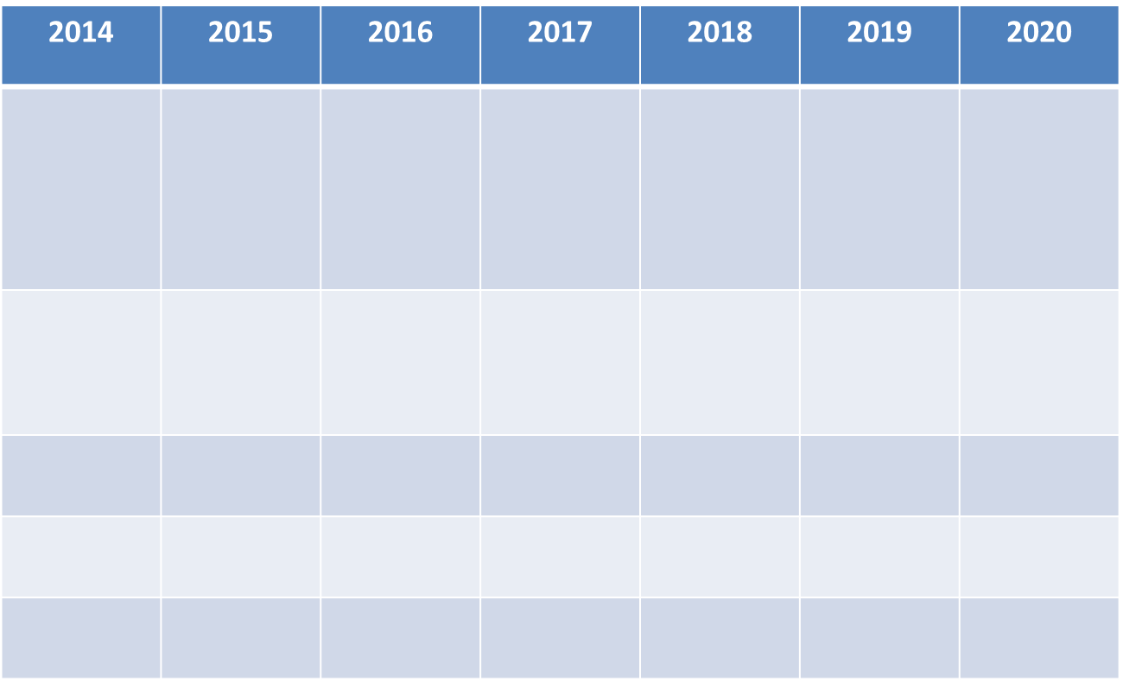
ILC timeline
Global Cryomodule development timeline
ILC
-Japan
Production/Test infra.
planning
Production line/Test infra.
Preparation and construction
Construction
start
JP
STF-2 Construction/beam operation
COI Construction
COI Operation
EU
XFEL Construction
US
LCLS-II Construction
  ?

Slide 9
FCAL future topics
Finalize and submission of the paper on the test-beam
results
Preparation of the next test-beam with 4-5 sensor layers
Continuation of the irradiation studies at SLAC
Complete AIDA II application
Design and realization of a ‘’full length calorimeter”
Design optimization
Physics case sharpening

Slide 10
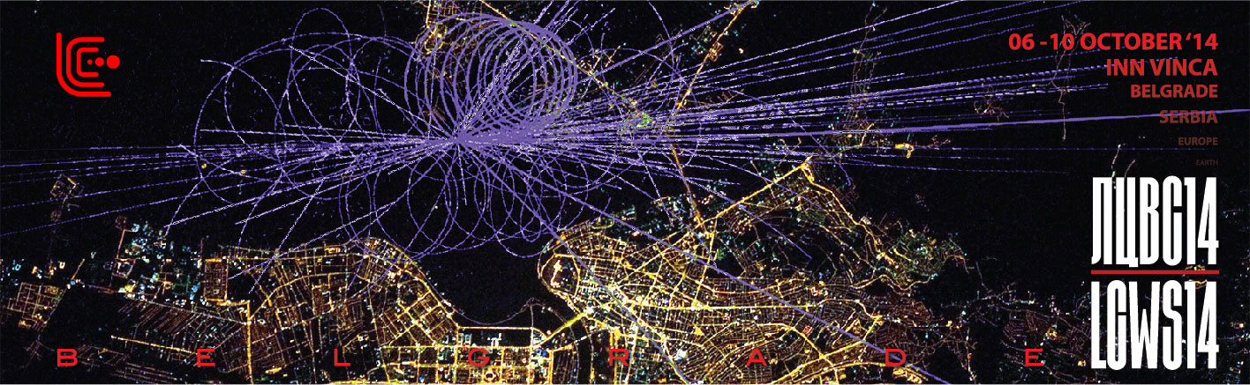
Next International Workshop
Belgrade in October
Auf dem Weg zur Trendmetropole: Belgrade is seen as a trendy city of change from the Swiss Magazine.

