Slide 1
Project management in a fully matrixed organisation
Fabio Biancat Marchet ESO

Slide 2
SCOPE
Projects at ESO
Aspects of the matrix structure
Implementation at ESO
Conclusions – Discussion topics

Slide 3
The mission of ESO
Enable major scientific discoveries by constructing and operating powerful observational facilities that are beyond the capabilities of individual Member States and
Foster astronomical cooperation within its Member States.
ESO’s mission is accomplished mostly through project-related work

Slide 4
The Projects at ESO
Astronomical Observatories (large infrastructures)
  design and construction
  10 years/ 1 Billion
  alone or in partnership
Astronomical Instruments
  complex optical-mechanical, electrical, systems
  Several years/Several Millions
  Mostly in partnership with other Institutes
Upgrade existing facilities (HW and SW)
Technology dev.: detectors, RF receivers, Electronics, SW
Wide variety of engineering disciplines involved:
Civil, Electrical, Mechanics, Optics, Software, etc…
Currently: 1 Observatory (E-ELT) + ~25 Instruments +…

Slide 5
ESO Structure
ESO is structured in 5 Directorates:
ADMINISTRATION: HR, Finance, Contract and Procurement...
ENGINEERING: technical competence
OPERATIONS: facilities management
PROGRAMMES: projects development
SCIENCE: definition of strategies and projects (requirements)
Projects (grouped in programmes) are:
  Promoted (mostly) by SCIENCE
  Managed within PROGRAMMES
  Executed within ENGINEERING

Slide 6
Why the matrix
  Until the recent past roles not well defined: technical staff distributed and project management taking place in several areas
  Hybrid or incomplete matrix structure suitable for a limited amount of undertakings or a relatively small Organization, providing the highest flexibility
  Shortcomings emerged with the increasing number of projects, facilities to operate and amount of staff: large number of ad-hoc arrangements, some level of discomfort within the staff, difficulty of planning, unbalanced distribution of effort, unsatisfactorily projects coverage

Slide 7
Why the matrix
Philosophy: separate staff management from project management
Advantages
  Best usage of resources: “everybody busy on something”, all projects staffed
  Flexibility: project-people assignment easily adapted to best fit projects and staff interests
  Development and share of key competences
Disadvantages
  Overhead
  Dual command structure
  Requires good coordination Line/Project managers (discussions…)
Risks
Staff motivation: “body shopping” perception, lack of project ownership
    Fragmentation: projects/people unnecessarily “chopped”

Slide 8
Critical aspects of the matrix
  Allocation of resources - competition
  Competition for resources is not a matrix’s consequence, rather a consequence of the strategic decision of undertaking concurrent projects. The matrix approach aims at optimizing the resources, however it requires a strong managerial leadership and clear guidelines, for instance on priorities.
  Staff management: hiring, appraisal, development, training
  These aspects are normally under the responsibility of the functional manager, but are tightly related with the project(s): strong coordination by means of policies, based on exchange of information, mutual trust, and good will is essential

Slide 9
The reorganizations process at ESO
Started in early 2013, four phases planned
Phase 1: definition of the objectives
Phase 2: inter-Directorate staff reassignment:
Phase 3: Directorates internal re-organization:
Phase 4: consolidation, review, adjustments
Currently in Phase 3
Staff and middle management involved as much as possible in all phases

Slide 10
Phase 1-process establishment
  3-day coached workshop involving the whole management
  Planning of the following phases
  Configured as a “Project”
  Allocation of resources
  Process stirred by interdisciplinary Core Team
  Process monitored by Advisory Team

Slide 11
Phase 2-actual implementation
Management plan
Substantial staff movements:
  Most of the technical staff moved into DoE
  Most of the project managers moved into DoP
Definition of the policies:
  Resource allocation (policy, software tool)
  Performance Management and Professional Development
  Training

Slide 12
Phase 3 -complete the re-structure
Internal re-organization of Engineering Directorate departments
  To best suit the matrix structure making the key competences available to projects
  Identify the critical core competences
Internal reorganization of Programme Directorate
  Creation of the Project Management Department
  Unify Project Management processes and procedures

Slide 13
Phase 4 - consolidation
Evaluate results
  By objective metrics (to be defined…)
  By subjective feedback
Devise margins and establish a process for continuous improvement

Slide 14
The Project management at ESO
Director of Science
Director of Programme
Programme Scientist
Programme
Manager
Project Scientist
Project Manager
Directorate of Engineering
System Engineer
Project Manager
WorkpackageManager
WorkpackageManager
WorkpackageManager
Engineering Team

Slide 15
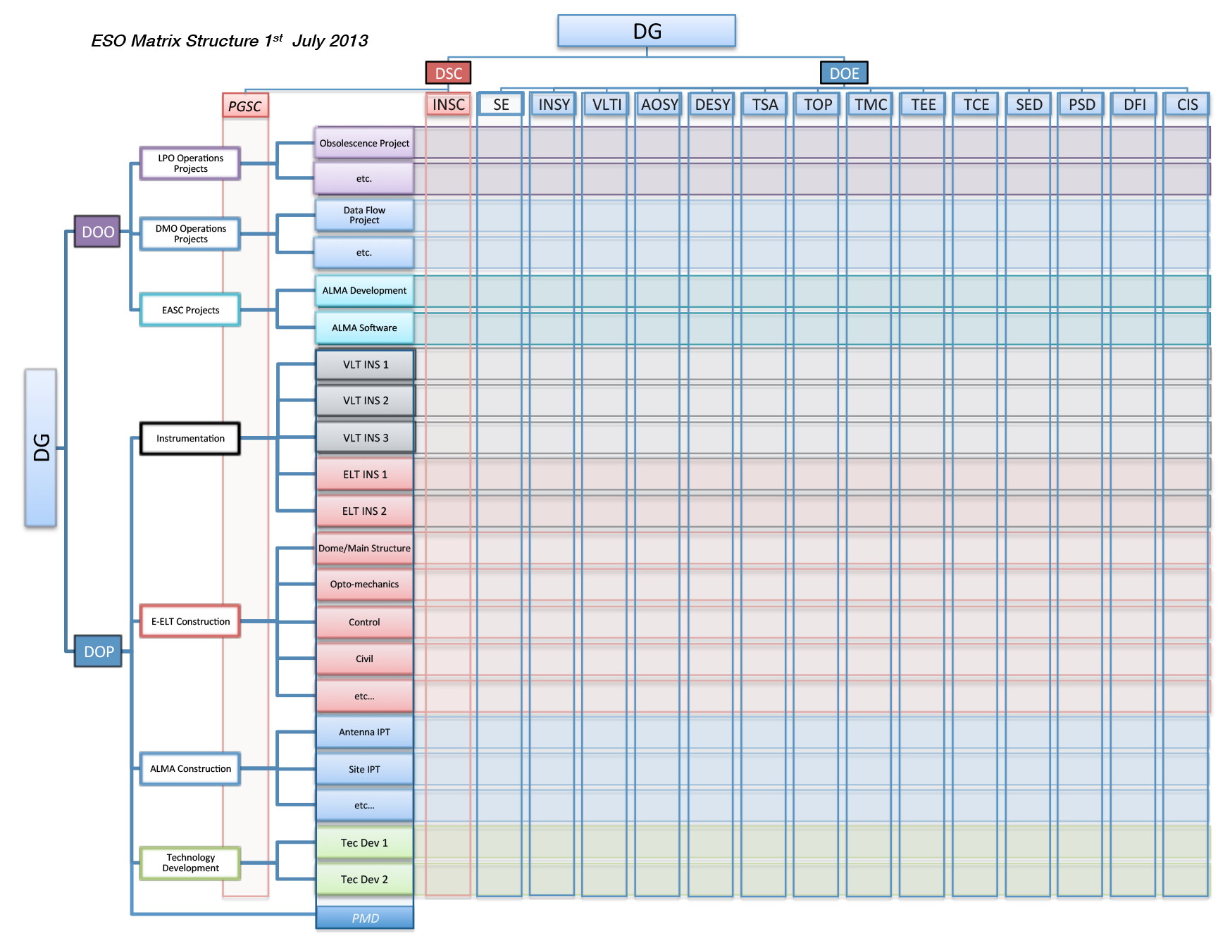
ESO Matrix

Slide 16
How much successful at ESO?
A metrics for an objective evaluation is still matter of discussion at ESO. The subjective perception varies, but in average the change is being well digested by the staff, although key matters are still pending (restructure of Directorate of Engineering).
“…the tendency toward hopelessly complicated and ultimately unworkable structures reaches its ultimate expression in the formal matrix organization structure which regularly degenerates into anarchy and rapidly becomes bureaucratic and non-creative.”
Stated some authors back in 1982, however today the Matrix structure in its various flavors is still widely used…

Slide 17
Conclusions
The new matrix structure at ESO is strongly project-oriented, though with some flexibility (projects outside DoP allowed)
Since the early decades of the last century several theories on best organization structures appeared and faded away
Industrial experience is only partially portable to scientific organizations
No perfect solution exists: tension being the back side of optimization
Suitable procedures are necessary, however the success (or failure) relies on:
Effective interaction between Organizational Units and especially people at all levels

