Slide 1
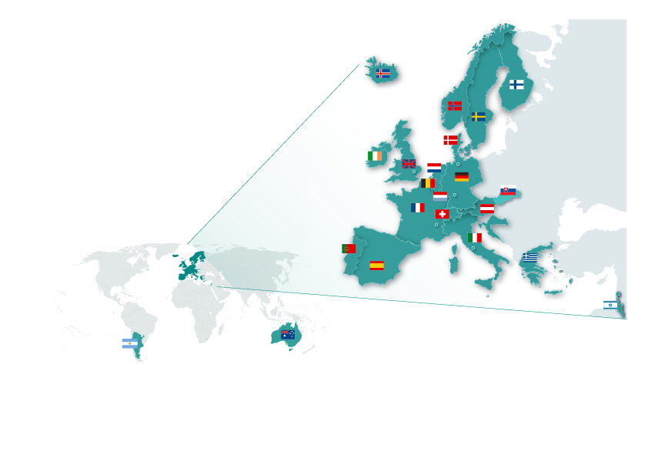
European Molecular Biology Laboratory
Funded 1974
Inter-governmental organization
Missions
  Basic Research in Molecular Biology
  Technology and Instrumentation
  Facilities and Services
  Teaching and Training
  Technology Transfer
20 member states + 2 + 1
5 sites
1800 employees from >80 nations
Annual Budget ca. 150 + 60 M€
Notes:
x

Slide 2
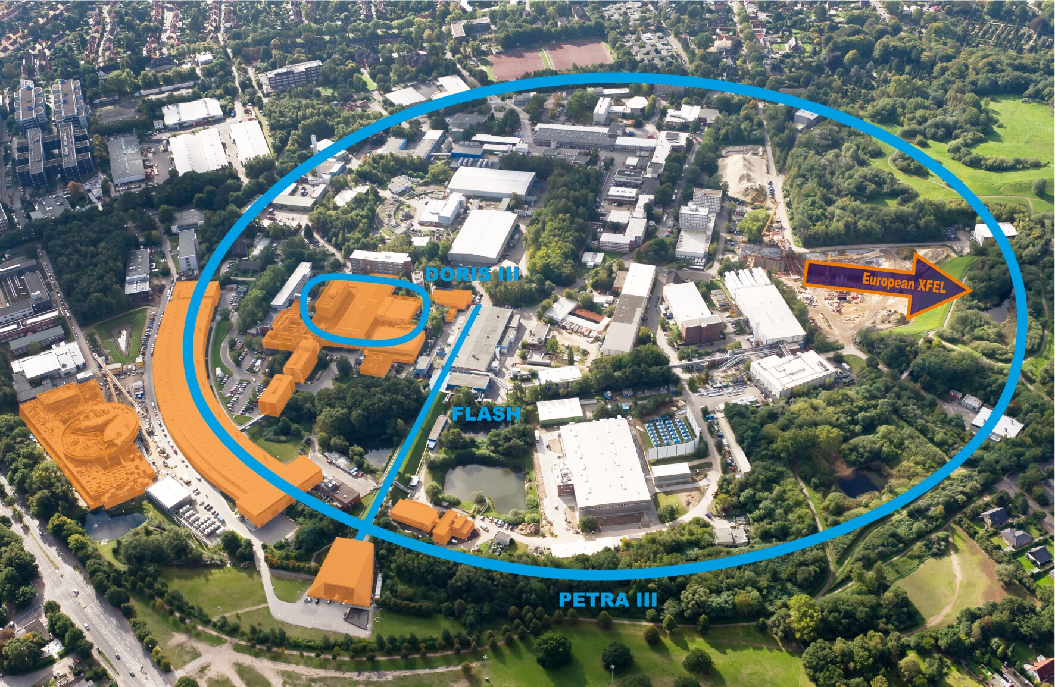
http://bilder.desy.de:9080/DESYmediabank//ConvertAssets/2010-09-30_Luftfoto_DESY_mit_Lichtquellen_RS-0059-bum70.jpg

Slide 3
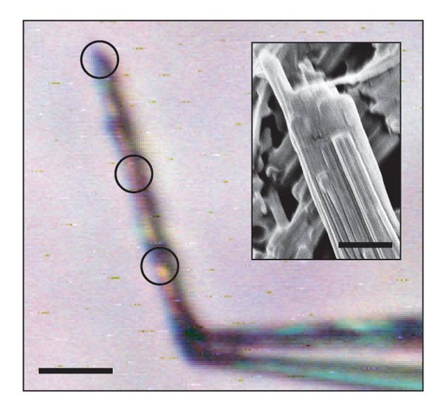
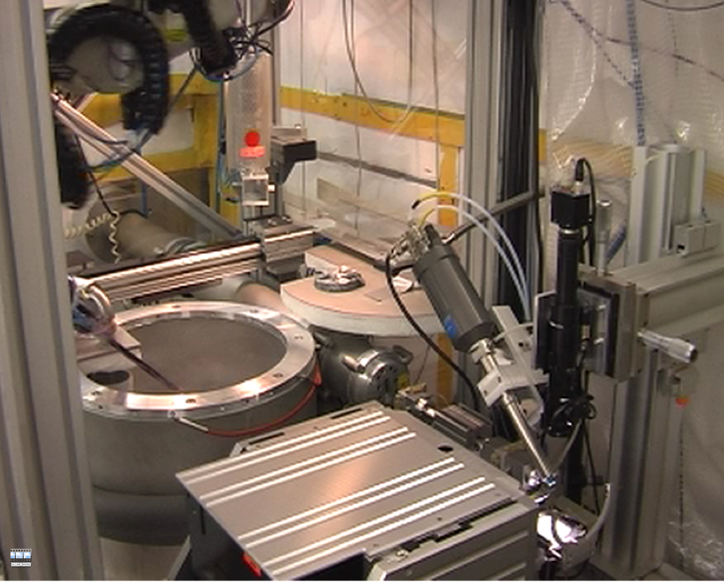
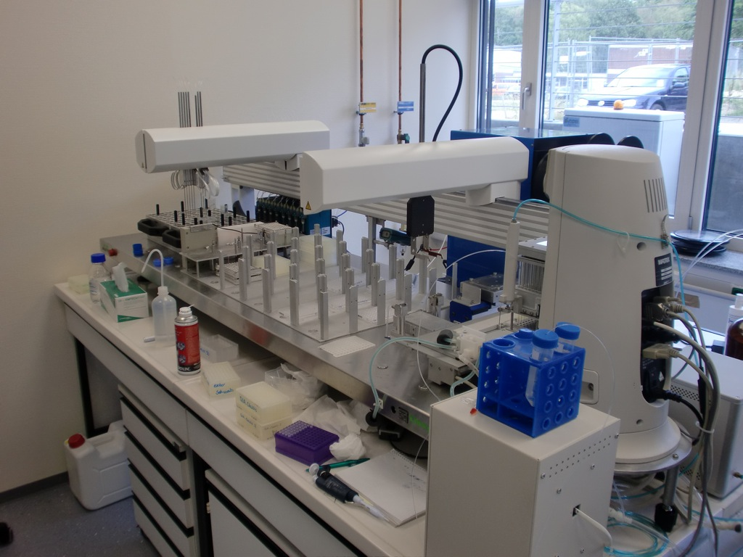
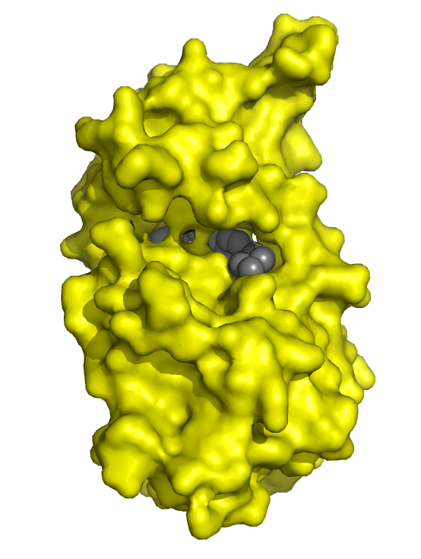
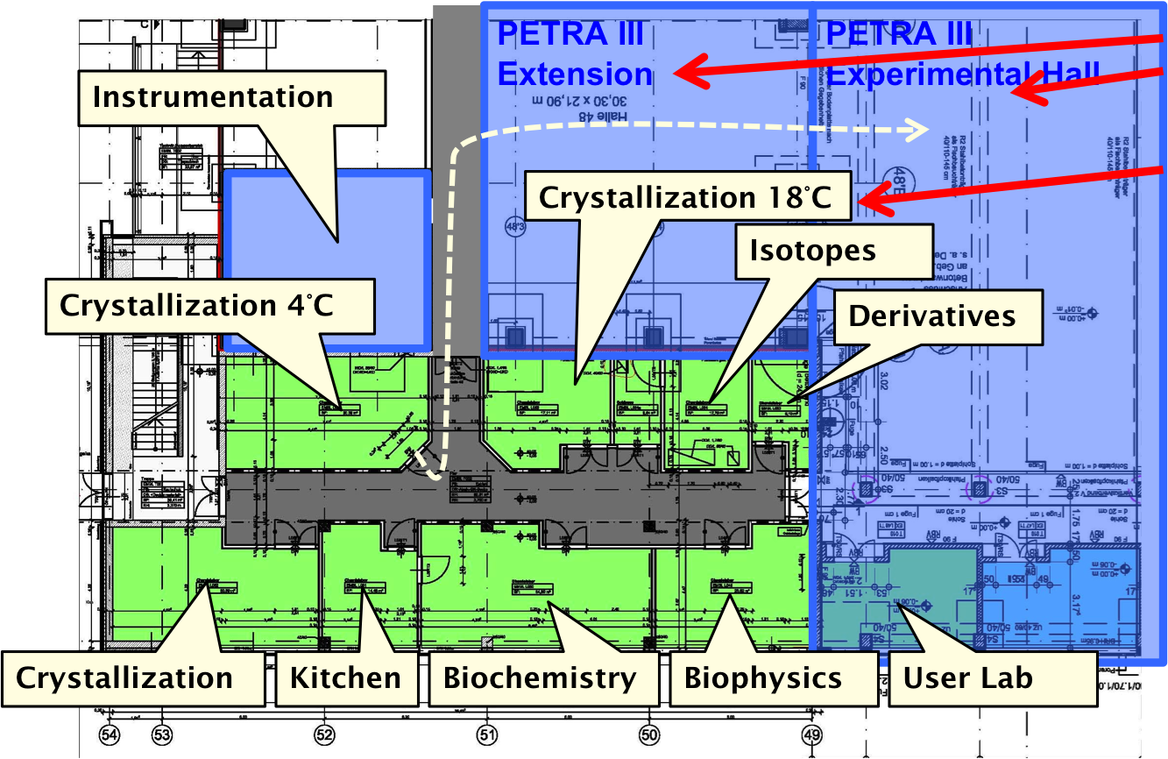
Technologies/Services enabling Science
Core Facilities
Instrumentation for synchrotron radiation
Nano-Positioning
Liquid handling
Automation
Sample Characterization
and Preparation
Data Evaluation
Integrated User Facilities
for the non-specialists
Several 100 user groups per year visiting the beam lines

Slide 4
EMBL - typical projects
100 k€ to 15 M€
6 months to 5 years
No 'prescribed' project management model
Collaboration with similar sites is absolutely crucial (critical mass)
Advisory boards (1/ y)
Review boards (1/ 4y)
5 year plans
<10% of staff on rolling tenure, others have to leave after 9y
Many projects receive financing on short notice (ext & int grants)

