Slide 1




CPV in B and D decays at B Factories
Introduction
CPV in B Decays
CPV in D Decays | Summary
Int. Conference on B-Physics
at Frontier Machines
Univ. of Edinburgh
14th-18th July 2014
Introduction
CPV in B decays
charmless decays
- t-dependent
B → η‘ K⁰
B → ω K_{S}
- t-integrated
B → η‘ K*⁰
- Dalitz
B⁺ → KKK
B⁺ → K_{S}π⁺π⁰
CPV in D decays
D⁰ → π⁰π⁰
Boštjan Golob
University of Ljubljana/Jožef Stefan Institute Belle/Belle II Collaboration
University
of Ljubljana
“Jožef Stefan”
Institute

Slide 2
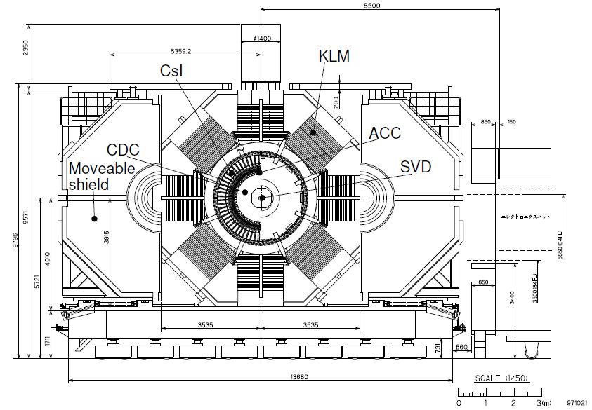

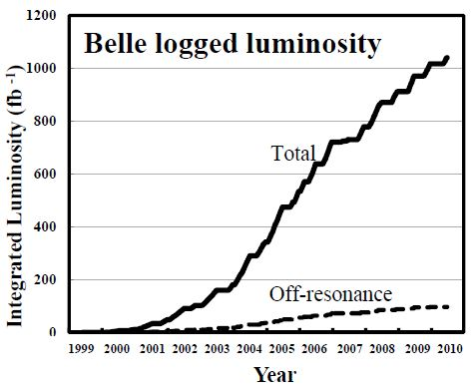
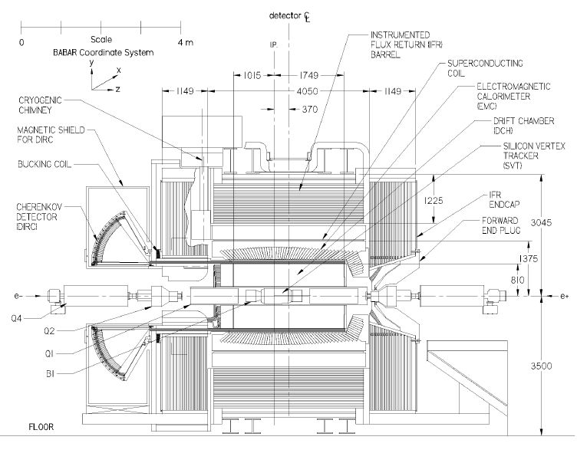
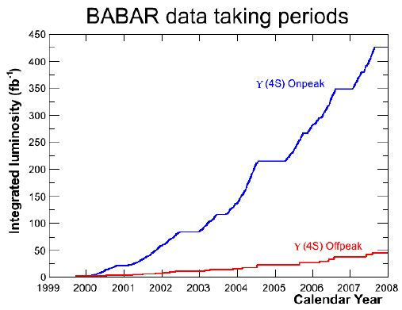

Introduction
Introduction
CPV in B Decays
CPV in D Decays | Summary
B factories
datataking:
Belle: 1999-2010, BaBar: 1999-2008
analyses still ongoing
∫L ^{Υ(4S)}dt ~710 fb⁻¹
e⁺e⁻ →Υ(4S) → BB
∫L ^{off}dt ~ 90 fb⁻¹
e⁺e⁻ → γ∗ → qq
∫L ^{Υ(4S)}dt ~420 fb⁻¹
∫L ^{off}dt ~ 40 fb⁻¹
A. Bevan et al., submitted to EPJC, SLAC-PUB-15968, KEK Preprint 2014-3

Slide 3
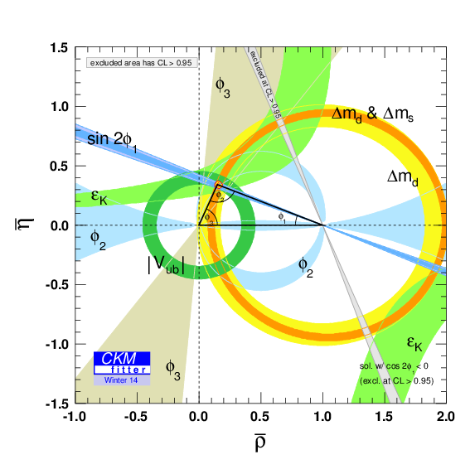
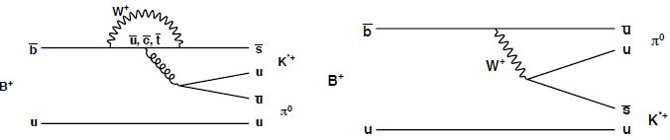
Introduction
Introduction
CPV in B Decays
CPV in D Decays | Summary
UT angles
precise determination of
angles
φ₁(β) = (21.9±^{0.8}_{0.7})º
φ₂(α) = (85.4±^{4.0}_{3.9})º
φ₃(γ) = (66.5±^{1.3}_{2.5})º
After confirmation of Kobayashi –
Maskawa general picture of CPV
efforts of B Factories turned to
precise measurements in rare decays
to search for possible deviations from
it.
b → qqs, q ≠ c;
CKMFitter, ckmfitter.in2p3.fr
φ₂
φ₃
φ₁
sin2φ₁^{eff} = sin2φ₁ + O (0.01-0.1)

Slide 4
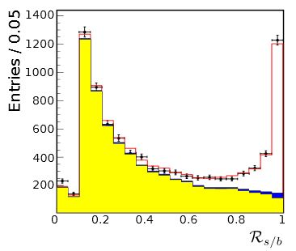


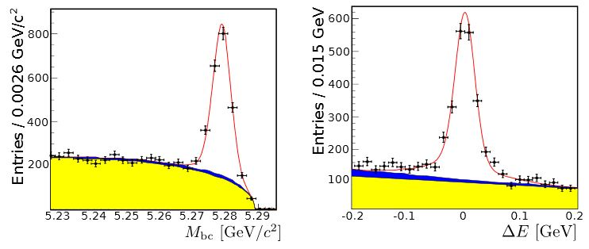
Introduction
Introduction
CPV in B Decays
CPV in D Decays | Summary
Charmless B decays
continuum background (e⁺e⁻ → qq);
multivariate discriminants based on topological
observables;
Υ(4S) → B_{sig}B_{tag};
B_{sig} reconstruction:
B_{tag}: tagging of flavor
for flavor independent
final states
(e.g. B_{sig} → η‘ K_{S})
Δt=(z_{sig}-z_{tag})/βγc
cont. bkg.
BB bkg.
bkg.+signal
data
B → η‘ K_{S}
Belle, to be subm. to
JHEP, 770 M BB

Slide 5
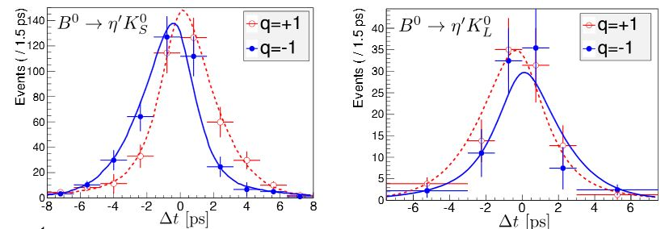
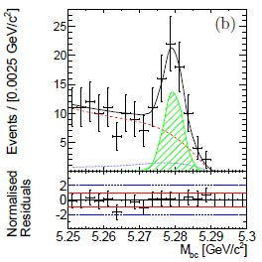
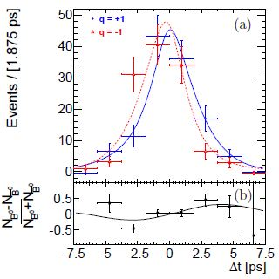
CPV in B system
Introduction
CPV in B Decays
CPV in D Decays | Summary
B → η´K⁰
S_{η‘ K0} = sin2φ₁^{eff} =0.68 ± 0.07 ± 0.03
compared to
sin2φ₁ =0.679 ± 0.020
from b → ccs
(e.g. B → J/ψ K_{S}⁰)
B → ω K⁰
S_{ωKS} = sin2φ₁^{eff} =0.91 ± 0.32 ± 0.05
K_{S}⁰ → ππ, π⁰π⁰; K_{L}⁰; η´→ ργ, η(γγ, πππ⁰)ππ
Belle, to be subm. to JHEP, 770 M BB
N_{sig} = 3541 ± 91
sim. fit M_{bc}, ΔE, R_{b/s}
HFAG,www.slac.stanford.edu/xorg/hfag
Belle, arXiv:1311.6666, acc. to PRD, 770 M BB
B → ω (πππ⁰)K_{S}⁰
N_{sig} = 234 ± 22
fit M_{bc}, ΔE, m(πππ⁰), F_{b/s}

Slide 6
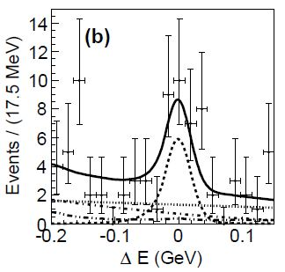
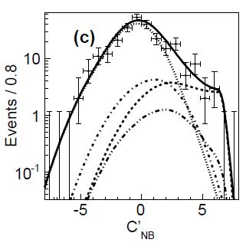
CPV in B system
Introduction
CPV in B Decays
CPV in D Decays | Summary
B⁰ → η´ K*⁰
Belle, to be subm. to PRD, 770 M BB
K*⁰ → K⁺π ⁻, η´→ η(γγ)ππ
1st observation (5 σ) of the decay
mode
N_{sig} = 31 ± 9
sim. fit M_{bc}, ΔE, C‘_{NB}, cosθ_{H}
Br(B⁰ → η´ K*)=(2.6 ± 0.6 ± 0.3)·10⁻⁶

Slide 7
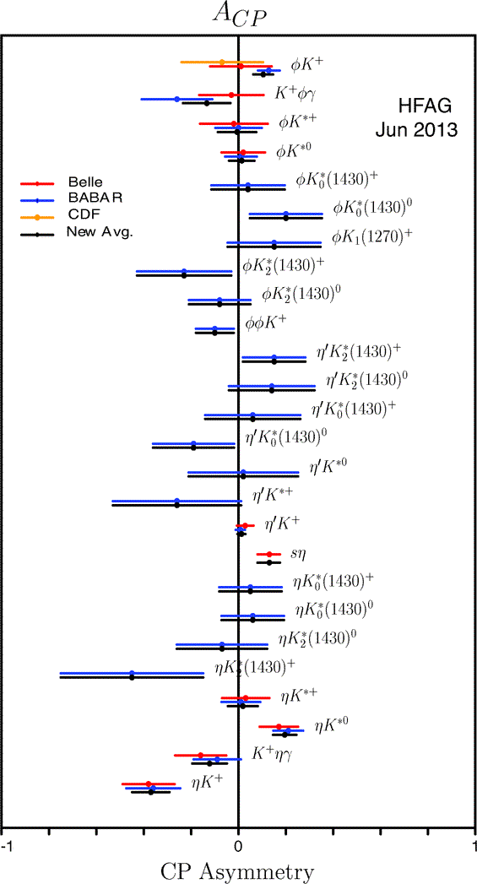
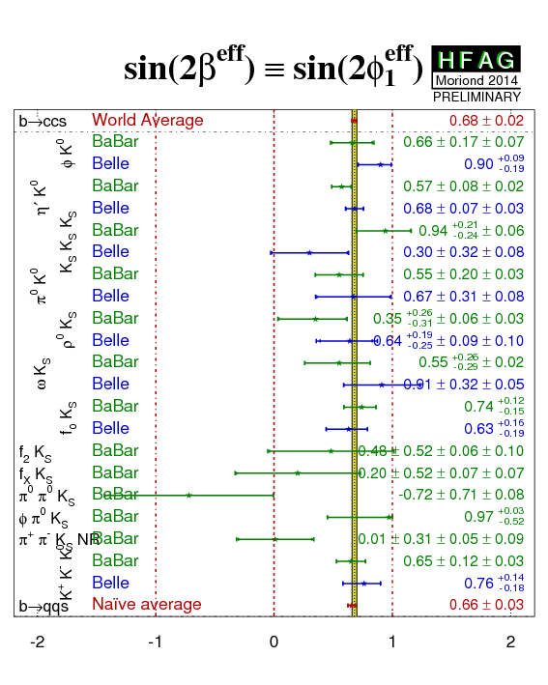
CPV in B system
Introduction
CPV in B Decays
CPV in D Decays | Summary

Slide 8
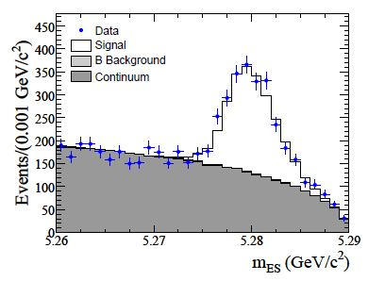
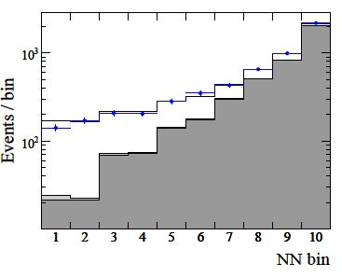

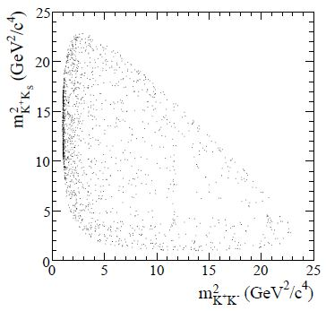
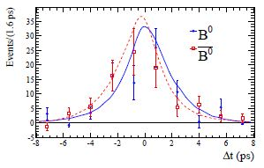
CPV in B system
Introduction
CPV in B Decays
CPV in D Decays | Summary
B → KKK
B → φK_{S}⁰
sin2φ₁^{eff} - sin2φ₁ ~ [-0.01,0.04]
CPV parameters
B → KKK_{S}⁰
φ₁^{eff, j} = φ₁+δ_{j}
S_{φKS} =0.66 ± 0.17 ± 0.07
KKK, KKK_{S}⁰ , KK_{S}⁰K_{S}⁰
K_{S}⁰ → ππ, π⁰π⁰
BaBar, PRD 85, 112010 (2012), 470 M BB
N_{sig} = 1579 ± 46
fit M_{bc}, ΔE, NN, Dalitz
KKK_{S}⁰
( )
( )
( )
H.Li, S. Mishima, PRD 74,
094010 (2006)
KKK_{S}⁰
m(KK) ~ m_{φ}

Slide 9
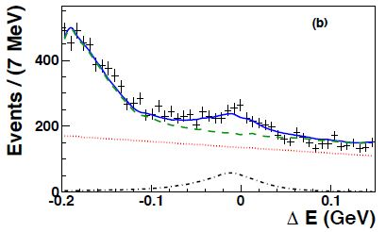
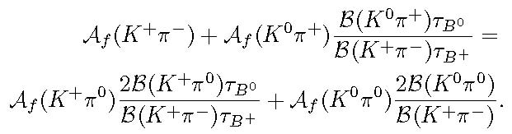
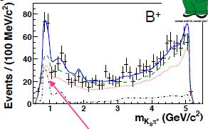
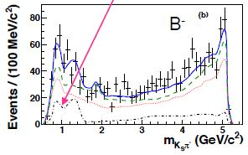
CPV in B system
Introduction
CPV in B Decays
CPV in D Decays | Summary
B → K_{S}⁰ππ⁰
B → K⁽*⁾π
„Kπ puzzle“:
ΔA_{Kπ}= A(K⁺π ⁻)- A(K⁺π ⁰)= -0.122±0.022
generalization of Kπ sum rule to K*π, Kρ
A_{CP}(K*⁺π⁰) = -0.52 ± 0.14 ± 0.04 ± 0.04
stat. syst. Dalitz
A_{CP}(K*⁺π ⁻) -A_{CP}(K*⁺π⁰) = -
+0.16 ± 0.14
N_{sig} = 1014 ± 63
sim. fit M_{bc}, ΔE, NN
BaBar, FPCP‘14, 470 M BB
preliminary
M. Gronau et al., PRD 81, 094011 (2011)
M. Gronau, PLB627, 82 (2005);
D. Atwood, A. Soni, PRD58, 036005 (1998)
HFAG,www.slac.stanford.edu/xorg/hfag

Slide 10
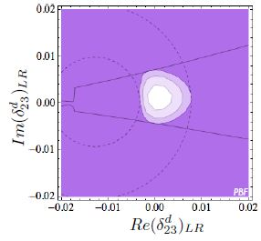
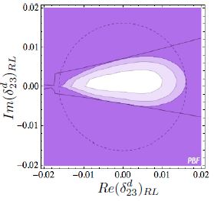
CPV in B system
Introduction
CPV in B Decays
CPV in D Decays | Summary
Constraints from charmless B decays CPV in MIA SUSY
example for B → φ K_{S}⁰
A. Bevan et al., submitted to EPJC, SLAC-PUB-15968, KEK Preprint 2014-3
Br(B → sγ )
Br(B → sγ )
S(B → φ K_{S}⁰)
S(B → φ K_{S}⁰)
ΔS(φ K_{S}⁰) = 0.06 ± 0.12
Br(B → sγ ; E_{γ} > 1.6 GeV) = (3.43 ± 0.21 ± 0.07) ⋅ 10⁻⁴

Slide 11
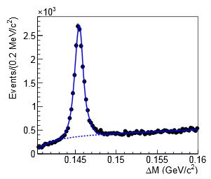
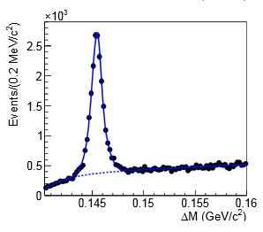
CPV in D system
Introduction
CPV in B Decays
CPV in D Decays | Summary
D → π⁰π⁰
CPV meas. continue in charm
sector;
expected to be small,
A_{CP} ~ few 10⁻³ – 10⁻² ⇒ sign of NP
a_{CP}^{dir}(K⁺K⁻) –a_{CP}^{dir}(π⁺π ⁻) = (-0.253±0.104)·10⁻²
Sign of NP ?
Large SM penguin contr. to D → ππ ?
(would lead to significant A_{CP} ^{π0π0})
use D*⁺→ D⁰⁽K⁻π⁺)π_{s}⁺ and untagged
D⁰ → K⁻π⁺ to determine A^{π0π0}_{exp} due to
π_{s}⁺ / π_{s}⁻ asymmetry;
A^{f}_{exp}: e.g. asymmetry between
h⁺/h⁻ reconstruction eff.;
10⁻³ effects, must be determined
using data control samples;
D⁰ flavor tagged by D*⁺→ D⁰π_{s}⁺
HFAG,www.slac.stanford.edu/xorg/hfag
D*⁺→ D⁰π_{s}⁺
D* ⁻→ D⁰π_{s}⁻
Belle, PRL 112, 211601 (2014) 966 fb⁻¹

Slide 12
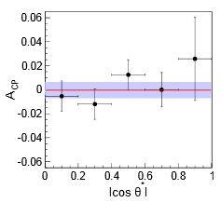
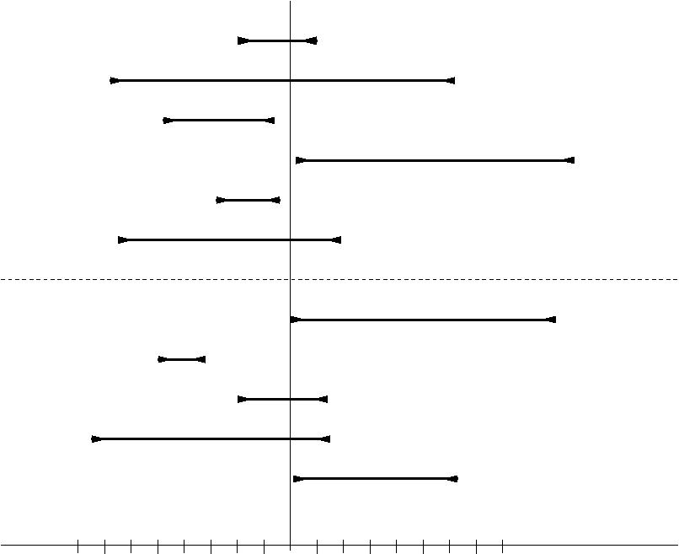
CPV in D system
Introduction
CPV in B Decays
CPV in D Decays | Summary
D → π⁰π⁰
determine A^{π0π0}_{CP} as function
of cosθ_{D*} (since A^{π0π0}_{exp} depends on it)
A^{π0π0}_{CP} = (-0.03 ± 0.64 ± 0.10)⋅10⁻²
also measured:
A^{Ksπ0}_{CP} = (-0.21 ± 0.16 ± 0.07)⋅10⁻²
Belle, PRL 112, 211601 (2014) 966 fb⁻¹
π⁺π ⁻
π⁰π⁰
K_{S}π⁰
K_{S}η
K⁺K⁻
π⁺π ⁻π⁰
D⁰
K_{S}
π⁺η
K_{S}π⁺
K_{S}K⁺
K⁻π⁺π⁺
K⁻K⁺π⁺
D⁺
K_{S}
adopted from HFAG,www.slac.stanford.edu/xorg/hfag
-0.8 -0.6 -0.4 -0.2 0 0.2 0.4 0.6 0.8 A_{CP} [10⁻²]

Slide 13
Summary
Introduction
CPV in B Decays
CPV in D Decays | Summary
B Factories confirmed Kobayashi-Maskawa predictions to
high accuracy (σ_{φ1}<1º, σ_{φ3}~2º, σ_{φ2}~4º)
Numerous measurements of penguin dominated decays
in search for NP
charmless decays, new (most precise) measurements
B → η´ K⁰, B → ω K_{S}, B → η‘ K*⁰,
B⁺ → KKK , B⁺ → K_{S}π⁺π⁰
Search for CPV continues in D decays
D⁰ → π⁰π⁰
B Factories continue to analyze their full data sets

Slide 14
Additional information
Introduction
CPV in B Decays | Additional material
CPV in D Decays | Summary
Additional information

Slide 15
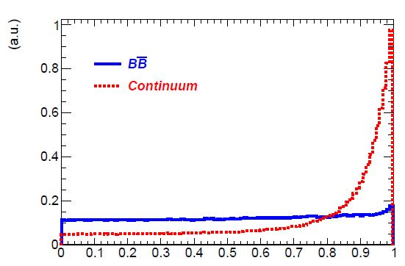
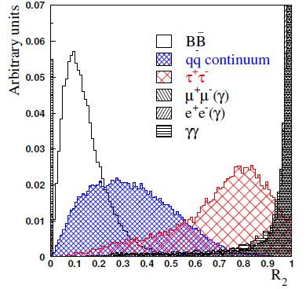


Topological variables
Introduction | Inclusive
 | Neutrals
E_{miss} | Summary
A. Bevan et al., submitted to EPJC, SLAC-PUB-15968, KEK Preprint 2014-3
cosθ_{S}
θ_{S}: angle between B meson sphericity axis and
R.O.E.
R₂=H₂/H₀

Slide 16
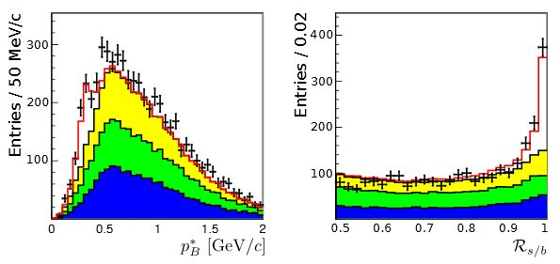
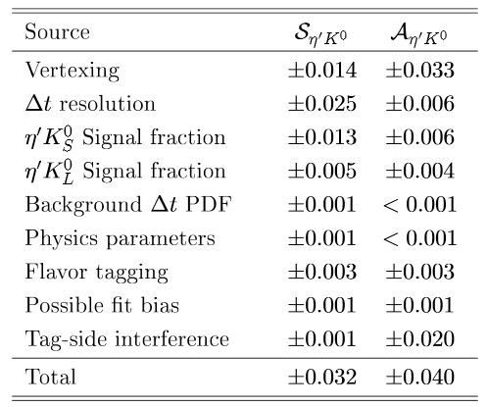
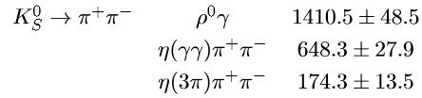


B → η‘ K⁰
Introduction | Inclusive
 | Neutrals
E_{miss} | Summary
Belle, to be subm. to JHEP, 770 M BB
B → η‘ K_{L}⁰
B → η‘ K⁰
E(K_{L}⁰) not known;
determine p_{B}* from p_{η‘},
K_{L}⁰ direction and assuming
ΔE = 0.
real K_{L}⁰ and η‘ bkg.
fake η‘ bkg.
fake K_{L}⁰ bkg.
bkg.+signal
data

Slide 17
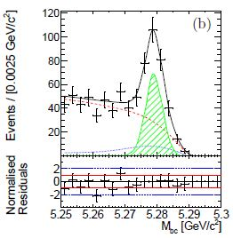
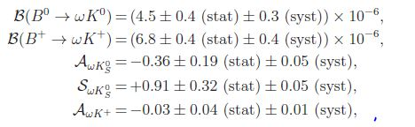
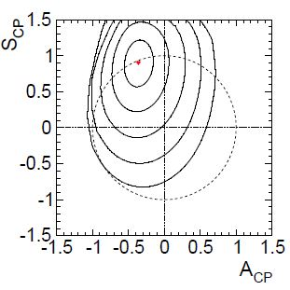
B → ω K
Introduction | Inclusive
 | Neutrals
E_{miss} | Summary
B → ω K
B → ωK⁺
Belle, arXiv:1311.6666, acc. to PRD, 770 M BB
B → ω K_{S}⁰

Slide 18
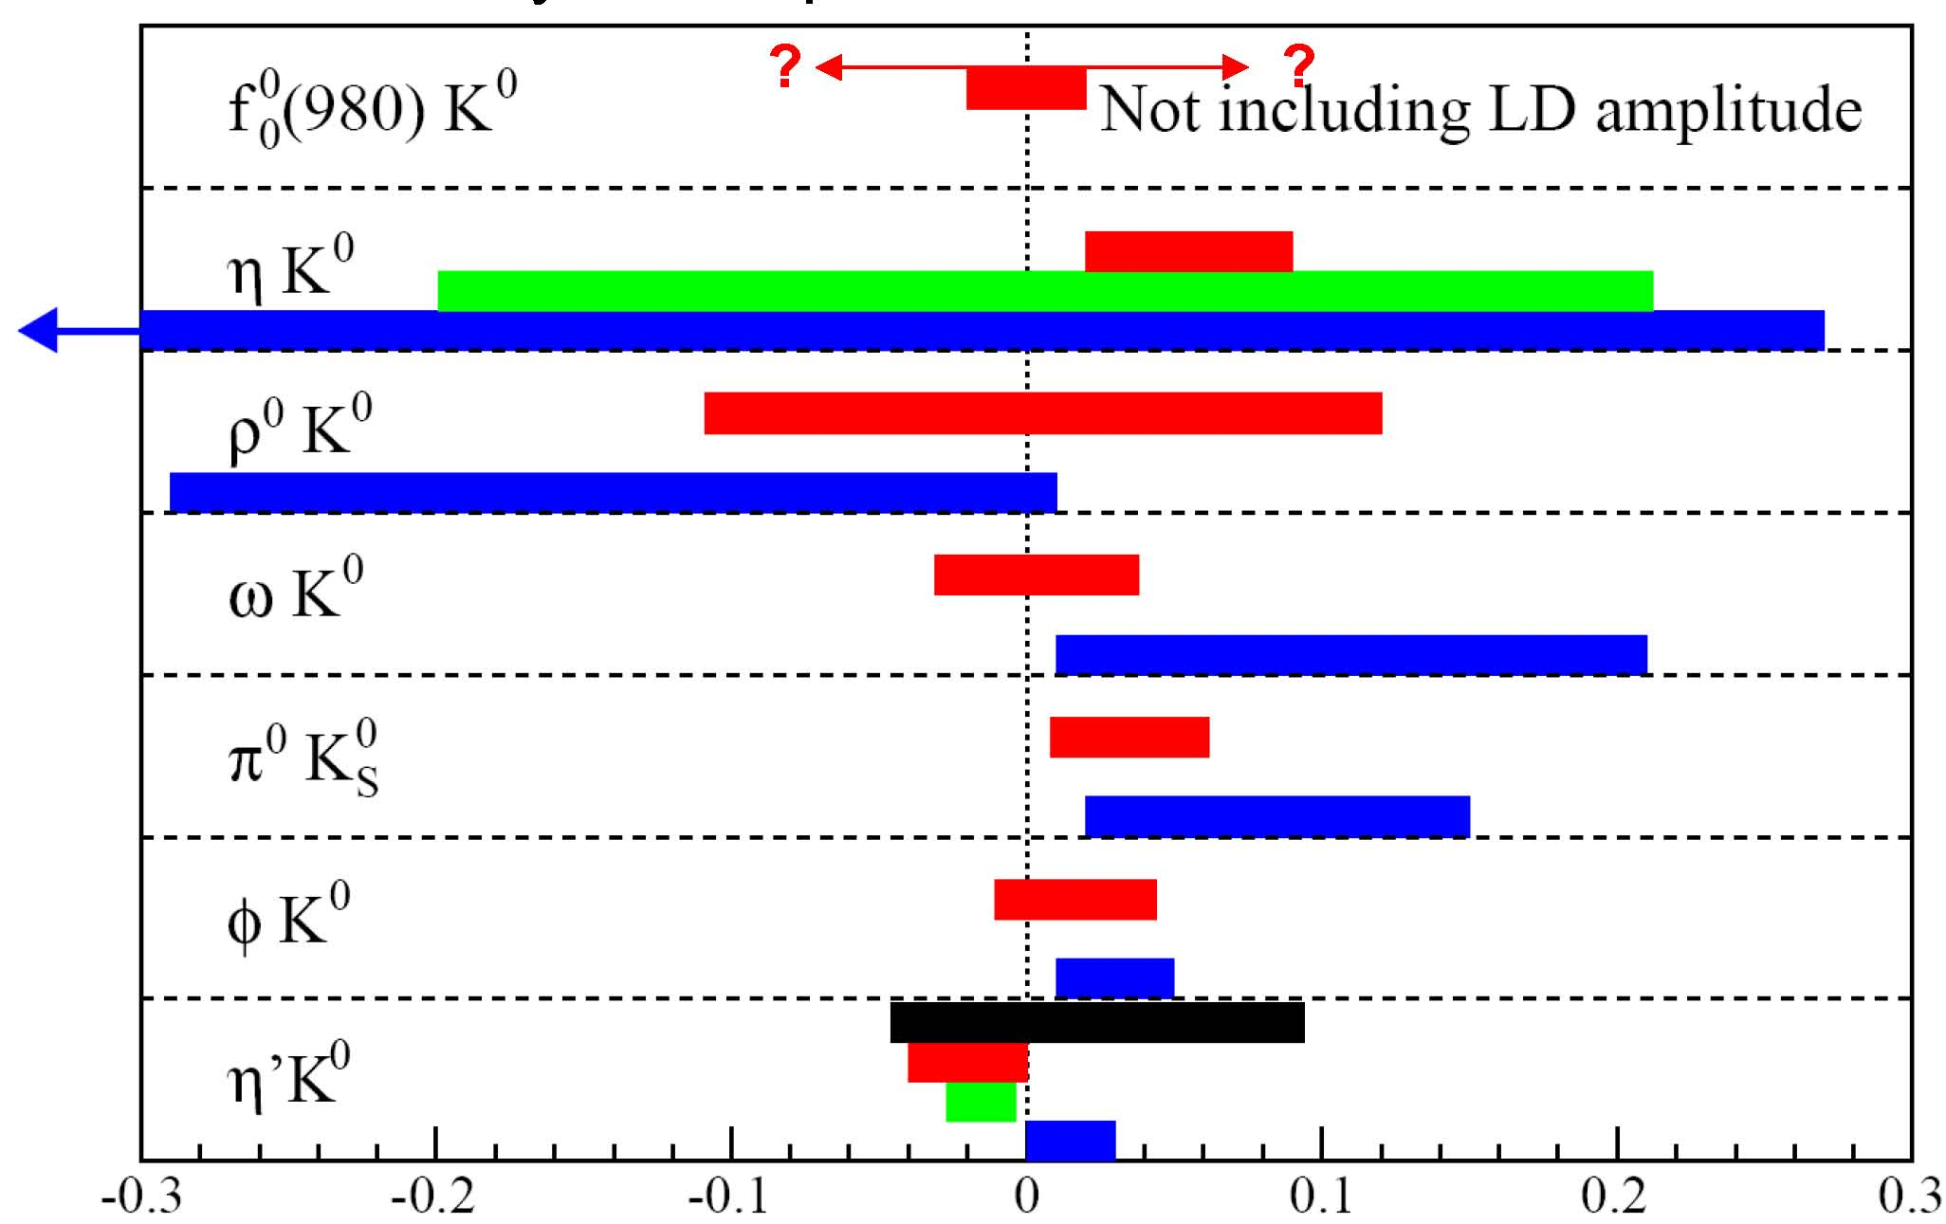
Charmless B decays
Introduction | Inclusive
 | Neutrals
E_{miss} | Summary
ΔS theory
Beneke, PLB620, 143 (2005), QCDF
Williamson, Zupan, PRD74, 014003 (2006), SCET/QCDF
Cheng et al., PRD72, 014006 (2005), QCDF
Gronau et al., PRD74, 093003 (2006), SU(3)

Slide 19
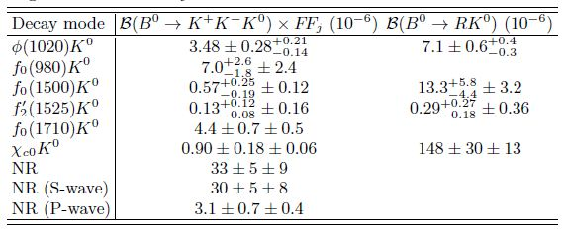
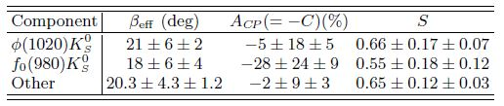
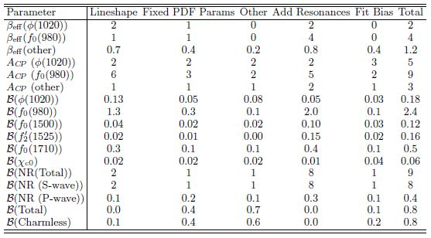
B → KKK
Introduction | Inclusive
 | Neutrals
E_{miss} | Summary
B → KKK
BaBar, PRD 85, 112010 (2012), 470 M BB
Results B → KKK_{S}⁰
CP conserving
CP violating
syst. uncertanties

Slide 20
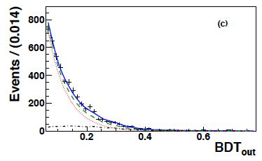
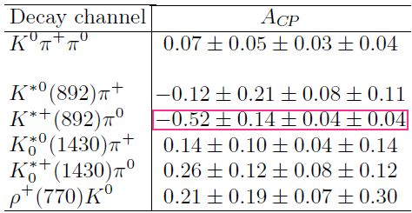
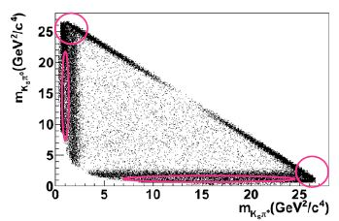
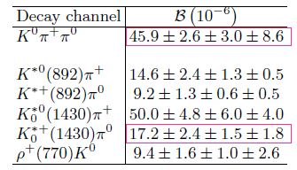
B → K_{S}⁰ππ⁰
Introduction | Inclusive
 | Neutrals
E_{miss} | Summary
B → K_{S}⁰ππ⁰
BaBar, FPCP‘14, 470 M BB
preliminary
A_{CP} results
Br results

Slide 21
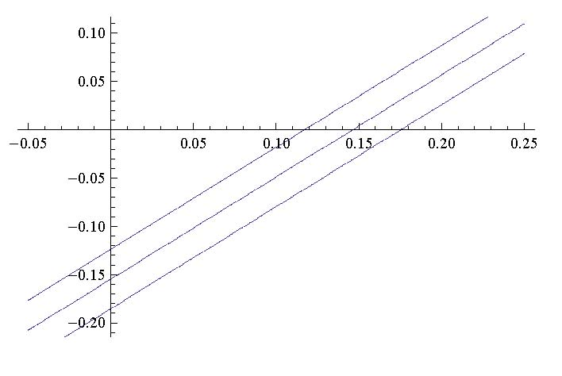
B → K_{S}⁰ππ⁰
Introduction | Inclusive
 | Neutrals
E_{miss} | Summary
B → K_{S}⁰ππ⁰
A_{CP} results
A_{CP}(K*⁺(K_{S}⁰π⁺)π⁰) = -0.52 ± 0.14 ± 0.04 ± 0.04
A_{CP}(K*⁺(K⁺π⁰)π⁰) = -0.06 ± 0.24
A_{CP}(K*⁺π⁰) = -0.39 ± 0.13 (my average)
A_{CP}(K*⁺π ⁻) = -0.23 ± 0.06
BaBar, FPCP‘14, 470 M BB
preliminary
HFAG,www.slac.stanford.edu/xorg/hfag
HFAG,www.slac.stanford.edu/xorg/hfag
A(K⁰π⁰)
δA(K⁺π⁰)
measured
(HFAG)
A(K⁰π⁺)
sum rule
expected
(sum rule)

Slide 22
B → K_{S}⁰ππ⁰
Introduction | Inclusive
 | Neutrals
E_{miss} | Summary
B → K_{S}⁰ππ⁰
A_{CP} results
A_{CP}(K*⁺(K_{S}⁰π⁺)π⁰) = -0.52 ± 0.14 ± 0.04 ± 0.04
A_{CP}(K*⁺(K⁺π⁰)π⁰) = -0.06 ± 0.24
A_{CP}(K*⁺π⁰) = -0.39 ± 0.13 (my average)
A_{CP}(K*⁺π ⁻) = -0.23 ± 0.06
BaBar, FPCP‘14, 470 M BB
preliminary
HFAG,www.slac.stanford.edu/xorg/hfag
HFAG,www.slac.stanford.edu/xorg/hfag
A(K⁰π⁰)
δA(K⁺π⁰)
Belle II 50 ab⁻¹
HFAG, Summer’11
measured
(HFAG)
A(K⁰π⁺)
sum rule
expected
(sum rule)

Slide 23
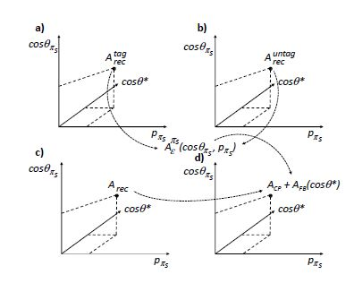
D → π⁰π⁰
Introduction | Inclusive
 | Neutrals
E_{miss} | Summary
D → π⁰π⁰
Detector asymmetry
A. Bevan et al., submitted to EPJC, SLAC-PUB-15968, KEK Preprint 2014-3

Slide 24
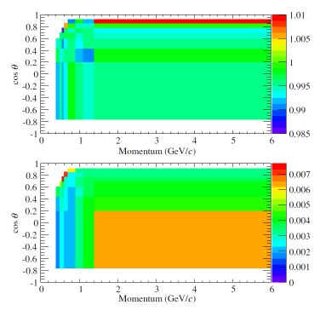
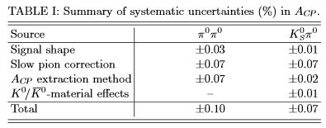
D → π⁰π⁰
Introduction | Inclusive
 | Neutrals
E_{miss} | Summary
D → π⁰π⁰
BaBar, PRD 83, 071103 (2011)
Detector asymmetry
Systematics

Slide 25
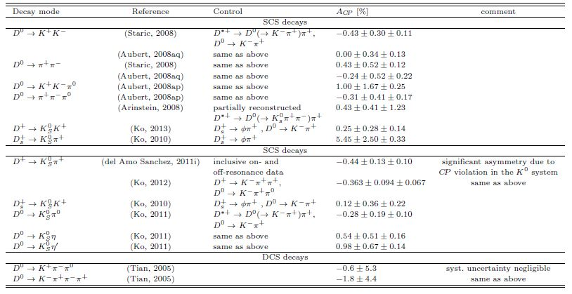
D → π⁰π⁰
Introduction | Inclusive
 | Neutrals
E_{miss} | Summary
D → π⁰π⁰
D asymmetries
SCS
CF
DCS

