Slide 1


4th School on High Energy Physics
HIGGS BOSON RECONSTRUCTION
Prepared by
Ahmed fouad Qamesh
Cairo university

Slide 2
What is out there?

Slide 3
How did we get here?
What is out there?

Slide 4
How did we get here?
What is out there?
What is the world made of?

Slide 5
How did we get here?
What is out there?
What is the building block of matter?
What is the world made of?

Slide 6

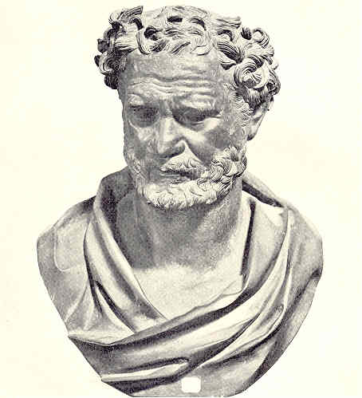
more than 2400 years ago
The first attempts in descriping the building block of matter was by the the Greek philosopher Democrituse (460-370 bc).
It leads him to conclude that: the building block of matter called (atom)

Slide 7
more than 2400 years ago
The first attempts in descriping the building block of matter was by the the Greek philosopher Democrituse (460-370 bc).
It leads him to conclude that: the building block of matter called (atom)
Atoms are
1. very small
2. hard

Slide 8
more than 2400 years ago
The first attempts in descriping the building block of matter was by the the Greek philosopher Democrituse (460-370 bc).
It leads him to conclude that: the building block of matter called (atom)
Atoms are
1. very small
2. hard
3. all made of the same material

Slide 9
more than 2400 years ago
The first attempts in descriping the building block of matter was by the the Greek philosopher Democrituse (460-370 bc).
It leads him to conclude that: the building block of matter called (atom)
Atoms are
1. very small
2. hard
3. all made of the same material
4. different in shapes and sizes
5. infinite in number

Slide 10
more than 2400 years ago
The first attempts in descriping the building block of matter was by the the Greek philosopher Democrituse (460-370 bc).
It leads him to conclude that: the building block of matter called (atom)
Atoms are
1. very small
2. hard
3. all made of the same material
4. different in shapes and sizes
5. infinite in number
6. always moving
7. capable of joining together.

Slide 11
more than 2400 years ago
The first attempts in descriping the building block of matter was by the the Greek philosopher Democrituse (460-370 bc).
It leads him to conclude that: the building block of matter called (atom)
Atoms are
1. very small
2. hard
3. all made of the same material
4. different in shapes and sizes
5. infinite in number
6. always moving
7. capable of joining together.
Democrituse said
“I think I finally understand atoms ”

Slide 12

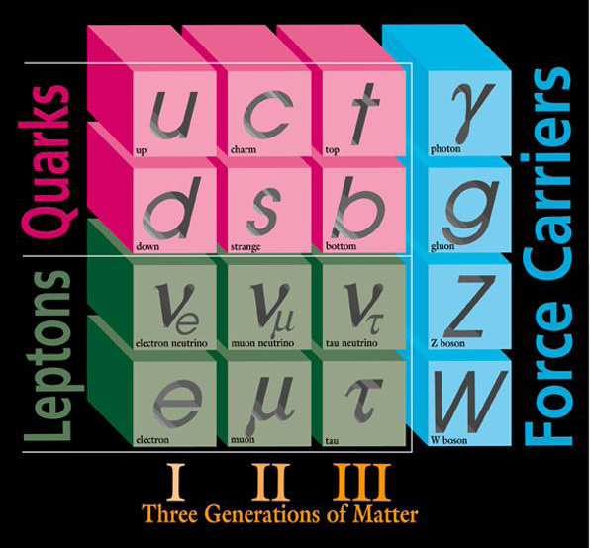
less than 2400 years later a mathematical model combines theory and experiment to describe and explains all observed elementary particles and its interactions discovered in the universe. it concluded that : every thing is made of
12 basic building blocks called ( fundamental particles)
Notes:
R. Oerter (2006). The Theory of Almost Everything: The Standard Model, the Unsung Triumph of Modern Physics (Kindle ed.). Penguin Group. p. 2. ISBN 0-13-236678-9.

Slide 13
less than 2400 years later a mathematical model combines theory and experiment to describe and explains all observed elementary particles and its interactions discovered in the universe. it concluded that : every thing is made of
12 basic building blocks called ( fundamental particles)
6 Quarks
Notes:
R. Oerter (2006). The Theory of Almost Everything: The Standard Model, the Unsung Triumph of Modern Physics (Kindle ed.). Penguin Group. p. 2. ISBN 0-13-236678-9.

Slide 14
less than 2400 years later a mathematical model combines theory and experiment to describe and explains all observed elementary particles and its interactions discovered in the universe. it concluded that : every thing is made of
12 basic building blocks called ( fundamental particles)
6 Quarks 6 leptons
Notes:
R. Oerter (2006). The Theory of Almost Everything: The Standard Model, the Unsung Triumph of Modern Physics (Kindle ed.). Penguin Group. p. 2. ISBN 0-13-236678-9.

Slide 15
less than 2400 years later a mathematical model combines theory and experiment to describe and explains all observed elementary particles and its interactions discovered in the universe. it concluded that : every thing is made of
12 basic building blocks called ( fundamental particles)
6 Quarks 6 leptons
Governed by 3 Forces
Notes:
R. Oerter (2006). The Theory of Almost Everything: The Standard Model, the Unsung Triumph of Modern Physics (Kindle ed.). Penguin Group. p. 2. ISBN 0-13-236678-9.

Slide 16

less than 2400 years later a mathematical model combines theory and experiment to describe and explains all observed elementary particles and its interactions discovered in the universe. it concluded that : every thing is made of
12 basic building blocks called ( fundamental particles)
6 Quarks 6 leptons
Governed by 3 Forces
Strong
Notes:
R. Oerter (2006). The Theory of Almost Everything: The Standard Model, the Unsung Triumph of Modern Physics (Kindle ed.). Penguin Group. p. 2. ISBN 0-13-236678-9.

Slide 17
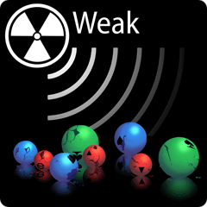
less than 2400 years later a mathematical model combines theory and experiment to describe and explains all observed elementary particles and its interactions discovered in the universe. it concluded that : every thing is made of
12 basic building blocks called ( fundamental particles)
6 Quarks 6 leptons
Governed by 3 Forces
Strong
Weak
Notes:
R. Oerter (2006). The Theory of Almost Everything: The Standard Model, the Unsung Triumph of Modern Physics (Kindle ed.). Penguin Group. p. 2. ISBN 0-13-236678-9.

Slide 18
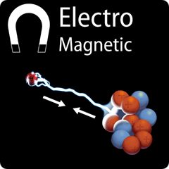
less than 2400 years later a mathematical model combines theory and experiment to describe and explains all observed elementary particles and its interactions discovered in the universe. it concluded that : every thing is made of
12 basic building blocks called ( fundamental particles)
6 Quarks 6 leptons
Governed by 3 Forces
Strong
Weak
Electromagnetic
Notes:
R. Oerter (2006). The Theory of Almost Everything: The Standard Model, the Unsung Triumph of Modern Physics (Kindle ed.). Penguin Group. p. 2. ISBN 0-13-236678-9.

Slide 19
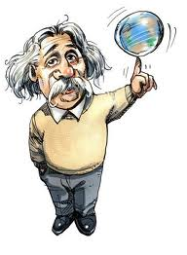
So far so good, but....
... Is this the time for every physicist to say
“I think I finally understand atoms “
There are also some Questions that couldn’t be solved!!!

Slide 20
So far so good, but....
...it is not time for every physicist to say
“I think I finally understand atoms “
There are also some Questions that couldn’t be solved!!!
1. what is dark matter?

Slide 21
So far so good, but....
... Is this the time for every physicist to say
“I think I finally understand atoms “
There are also some Questions that couldn’t be solved!!!
1. what is dark matter?
2. what happened to the missing antimatter?

Slide 22
So far so good, but....
...it is not time for every physicist to say
“I think I finally understand atoms “
There are also some Questions that couldn’t be solved!!!
1. what is dark matter?
2. what happened to the missing antimatter?
3. The existence Super symmetric Particles!
4.Why are there three generations of quarks and leptons?

Slide 23
So far so good, but....
...it is not time for every physicist to say
“I think I finally understand atoms “
There are also some Questions that couldn’t be solved!!!
1. what is dark matter?
2. what happened to the missing antimatter?
3. The existence Super symmetric Particles!
4.Why are there three generations of quarks and leptons?
5. How does gravity fit into all of this?

Slide 24
So far so good, but....
...it is not time for every physicist to say
“I think I finally understand atoms “
There are also some Questions that couldn’t be solved!!!
1. what is dark matter?
2. what happened to the missing antimatter?
3. The existence Super symmetric Particles!
4.Why are there three generations of quarks and leptons?
5. How does gravity fit into all of this? and finally
6. what gives the particles mass?

Slide 25
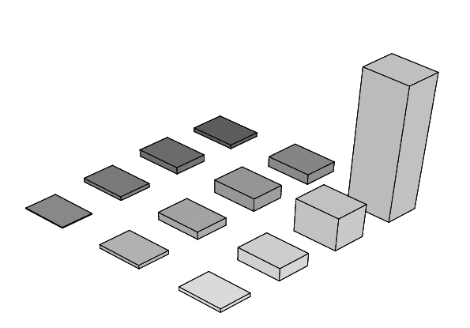
the unsolved Mysteries of the standard model
Mass problem why a particle has a certain mass? why is the photon massless and the W particle massive?
The standard model couldn’t explained that !!
Physicists have theorized the existence of a field which interacts with other particles to give them mass the field called (the Higgs field)
The Higgs field requires a particle called (Higgs boson)
Mass
t
u
d
c
e
s
b

Slide 26
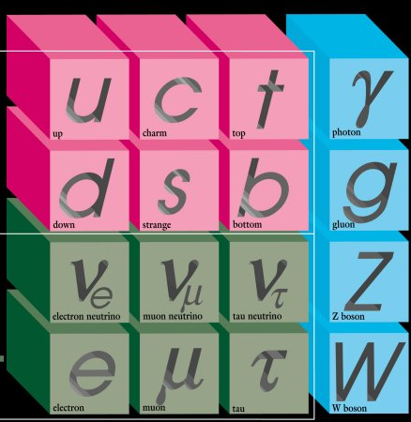

Slide 27


Slide 28

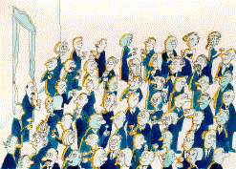
How the Higgs mechanism Works?
Suppose
(1)A Lot of physicists chat quietly in a fairly crowded room.

Slide 29
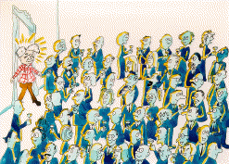
(2) A famous scientist enters the room causing a disturbance in the field
.

Slide 30
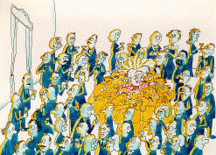
(3)Followers cluster and surround Einstein as this group of people forms a “massive object”.
Notes:
Source: David Miller (University College London)

Slide 31
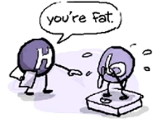

How the Higgs mechanism Works?(continued)
The Higgs Mechanism operates in a way similar to the case of the famous scientist in the crowded room.
Particles that normally would have mass (e.g. Fermions, weak force carriers) move through the Higgs field interacting with Higgs particles.
Through this interaction or disturbance particles may acquire mass. Heavier particles interact more with the Higgs field taking on more mass.
Those particles that normally do not have mass, do not interact with the Higgs field, and therefore do not acquire mass.
Notes:
Source: David Miller (University College London)

Slide 32
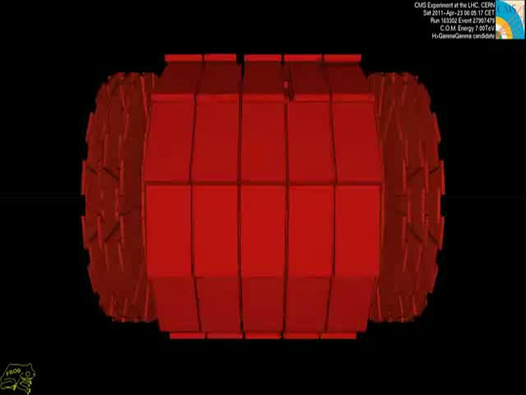

Slide 33
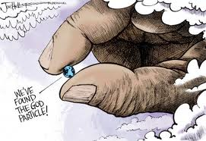
the problem is the Higgs particle has no spin no electric charge no color charge very unstable(1.6×10⁻²² s) so it couldn’t detected directly since
(a) there are several different ways it can decay
(b) there are other collisions among those trillions that produce similar signatures.
Unfortunately
The yield of Higgs particles in Relativistic Heavy Ion Collisions is very low (~ 21 events in 10⁹ events)!!

Slide 34
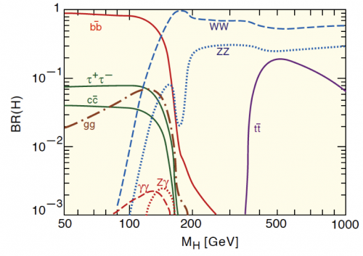
Discovery of Higgs Bosons the observation of the Higgs boson in july 2012 indicates that the mass of the Higgs boson is 125.3 ± 0.6 GeV,
Notes:
A Higgs boson of mass ~ 125 GeV has been tentatively confirmed by CERN on 14 March 2013

Slide 35
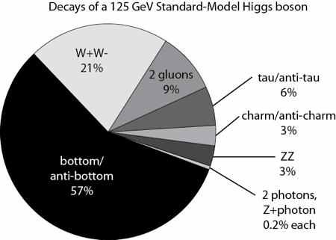

Slide 36
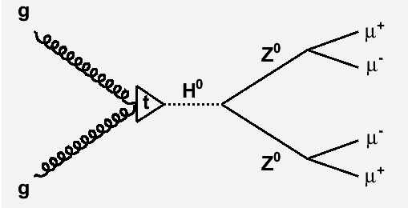
HIGGS BOSON RECONSTRUCTION
THROUGH ALGORITHM DEVELOPMENT AND ANALYSIS
Using the last published data in Cern about the mass of Higgs boson
Using a MontCarlo technique (i.e. Pythia 8.1)
Making a data analysis using (i.e .Root 5.3)
We can reconstruct the Higgs boson from one of its decay channels.

Slide 37
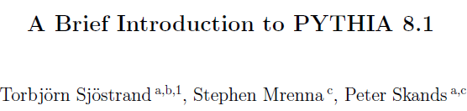

My algorithm has to
1. find all the muons ad anti muons first
2. reconstruct the Z boson masses 91.1876 GEV
3. Reconstructing the Higgs boson of 125.3 GEV from its
Z daughters.
By the help of
1.
2. using the classes that offer the four Lorentz vector
3. opening the decay channels for Higgs and Z
4. tabulating the data so that I can link the daughter and parent for each decay channel

Slide 38

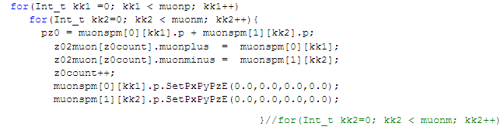
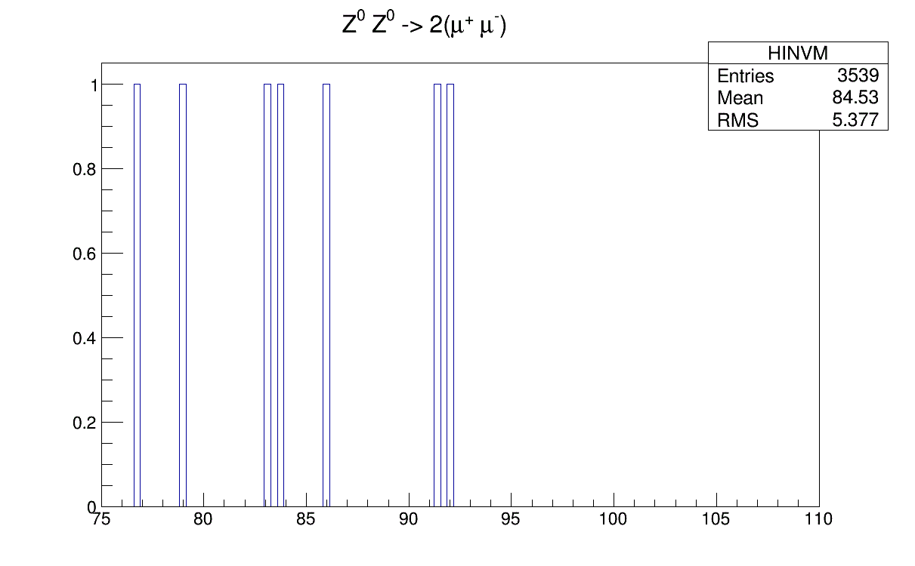

Slide 39


After some investigations , I found the problem
All this time I was constructing all possible muon pairs into Z instead of choosing the best possible pairs(with opposite charge)
Solution
I made lots of combinations between muons so that I can find a special pairs with
opposite signs
total masses add up to 91.1876 GEV

Slide 40
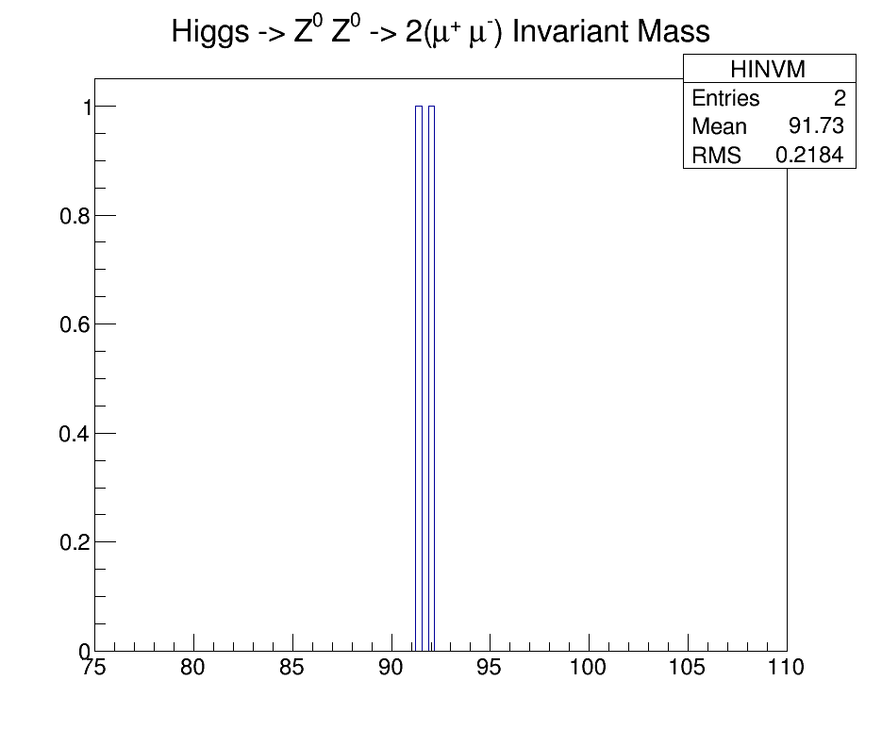

Slide 41
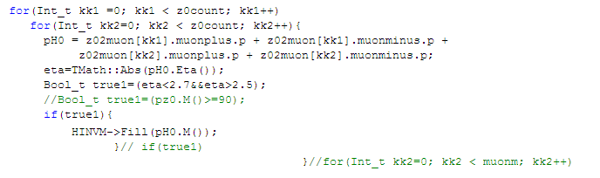
What is the next step
I have to repeat the same mechanism in order to reconstruct the Higgs ‘parents of the Z candidates then applying any kind of specific analysis on it

Slide 42
2. I have to apply the same Idea with different kind of leptons (I.e. 2μ- 2μ+ , 2e- 2e+ and 4e-)
3. I have to improve my code by including some Geometric cuts so that the data could reflects the real experimental one

Slide 43

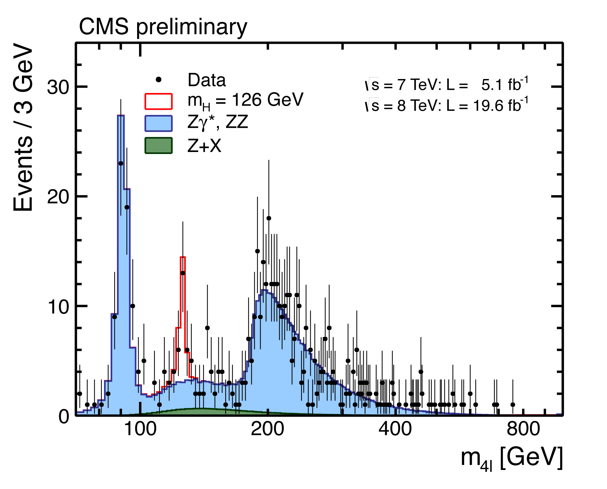
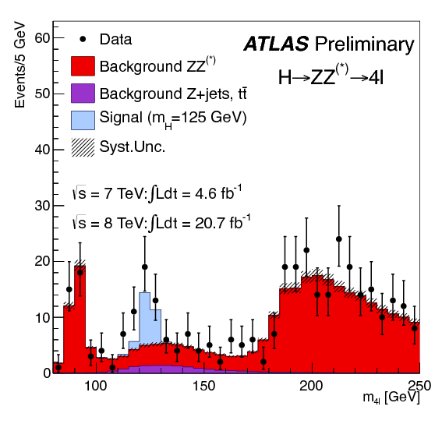

Slide 44

Conclusion on the past two months , I believe that I have learned a lot not only as an academic education by attending schools , conferences and reading books.
But also the practical work increases my knowledge on C++ programming language and offers me a great learning of Pythia and linux shell but I think that I have to read more about the usage of root 5.3 and Expand my limited experience in Pythia and other Montecarlo techniques just to claims that
“I finally understand atoms “

Slide 45
References
1. R. Oerter (2006). The Theory of Almost Everything: The Standard Model, the Unsung Triumph of Modern Physics (Kindle ed.). Penguin Group. p. 2. ISBN 0-13-236678-9.
2. Quantum Field Theory Demystified by David Mcmahon
3. http://en.wikipedia.org/wiki/Higgs_mechanism
4.Spontaneous_symmetry_breaking_in_the_Higgs_mechanism (Review Paper)
5.ArticleImportant_RaimondSnellings_EllipticFlowAbriefReview_NewJPhys13_2011
6- http://www.particleadventure.org
7-D. Griths, Introduction to Elementary Particles ("John
Wiley & Sons, Inc.", 1987).

Slide 46
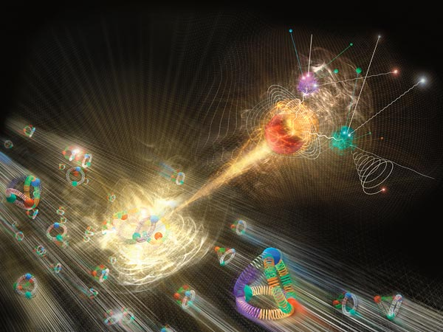
Thank you

