Slide 1
First considerations on collective effects for the HEB in collider tunnel

Slide 2
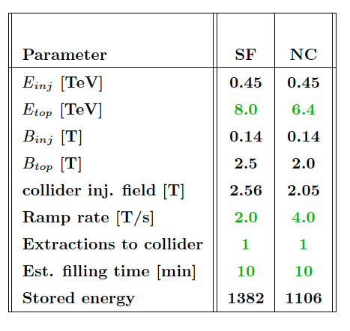
Table from W. Herr
Some “guessed” parameters
 | Injection | Top energy
Energy [TeV] | 450 | 6.4/8
C [km] | 100
N [10¹⁰] | 2-10
Q_{x,y} | 237.9
σ_{z} [mm] | 80
α_{p} | 1.8 10⁻⁵
Q_{s} | 2.3 10⁻³
V = 8 MV

Slide 3
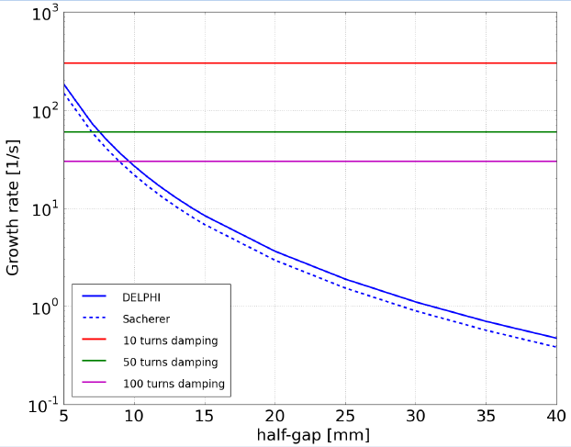
Coupled bunch resistive wall effect
Scaling with β/E ≈ E^{-2/3} → factor 3
If normal conducting, then σ about 50 lower (growth rate goes like square root of σ) → factor 7

Slide 4
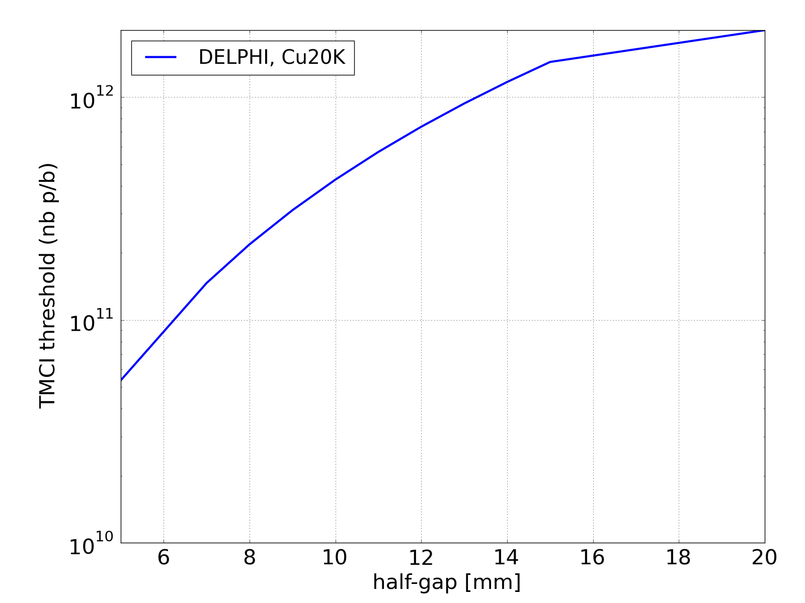
TMCI
Scaling with η<β>δ → factor 7
If normal conducting, then σ about 50 lower (growth rate goes like square root of σ) → factor 7
Thresholds below 10¹² ppb !

Slide 5
Electron cloud
Radii around 2cm cause low thresholds for e-cloud build up with 25 ns beams in both dipoles and quadrupoles (from LHC experience)
Scans of aperture radius can identify the best situation e-cloud-wise for the target bunch intensities and spacings

Slide 6
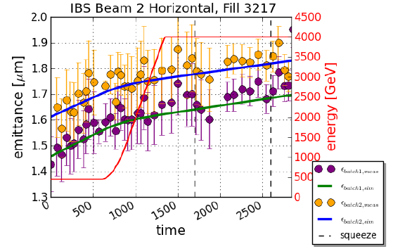
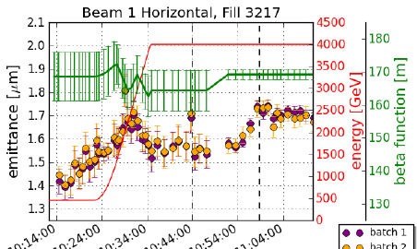
Direct space charge
y
z
x
Prop to circumference means a space charge tune spread ~3.7 times larger than LHC at injection (i.e. ~0.02)
Plots from M. Kuhn

Slide 7
Emittance growth @ injection
Several experiments in coast at the SPS (BBLR, collimator studies, crab cavity studies, UA9) have revealed large emittance growth
This was observed at 26, 55, 120 and 270 GeV with single bunches
Beam lifetime and emittance blow up much more severe than at the ppbar time
From E. Metral, R. Calaga

Slide 8
Emittance growth @ injection
Several experiments in coast at the SPS (BBLR, collimator studies, crab cavity studies, UA9) have revealed large emittance growth
This was observed at 26, 55, 120 and 270 GeV with single bunches
Beam lifetime and emittance blow up much more severe than at the ppbar time
From O. Dominguez, G. Sterbini

Slide 9
Emittance growth @ injection
Several experiments in coast at the SPS (BBLR, collimator studies, crab cavity studies, UA9) have revealed large emittance growth
This was observed at 26, 55, 120 and 270 GeV with single bunches
Beam lifetime and emittance blow up much more severe than at the ppbar time
Emittance growth @120 GeV (Crab Cavity MD)
Summary
 | Δε_{x}/Δt [μm/h] | Δε_{y}/Δt [μm/h]
Q’_{x}=7,Q’_{y}=4, V_{RF}=4 MV | 4.6 | 1.9
Q’_{x}=2,Q’_{y}=2, V_{RF}=4 MV | 1.7 | 0.88
Q’_{x}=2,Q’_{y}=2, V_{RF}=2 MV | 10.7 | 1.8
From F. Zimmermann et al.

Slide 10
Emittance growth @ injection
Several experiments in coast at the SPS (BBLR, collimator studies, crab cavity studies, UA9) have revealed large emittance growth
This was observed at 26, 55, 120 and 270 GeV with single bunches
Beam lifetime and emittance blow up much more severe than at the ppbar time
“My impression is that the ripple of the power supplies is no longer reduced by the same factor as for the ppbar” (W. Scandale)
“In the nineties a consolidation of the SPS power supplies was carried out and management decided then that coasting beams would not be needed in the future. At the time special capacitors were available to reduce noise on magnets, special sublimation pumps for vacuum etc, all of which has not been maintained since.” (K. Cornelis)
In general, is fast ramping compatible with low ripple/noise requirements for power supplies?

