Slide 1
First look at the experimental insertion
Roman Martin
Rogelio Tomas
Thanks to Ezio Todesco

Slide 2
Currently: upscaled LHC design
Scaling factor = 2.0
Guiding principles: Aperture radii no smaller than 20mm and magnetic field of D2 only few T

Slide 3
Currently: upscaled LHC design
Scaling factor = 2.0
Guiding principles: Aperture radii no smaller than 20mm and magnetic field of D2 only few T

Slide 4
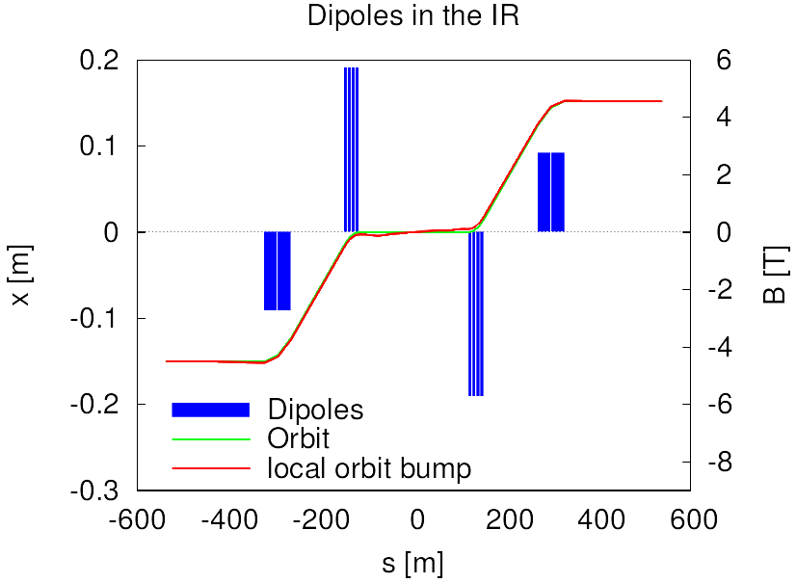
Dipoles

Slide 5
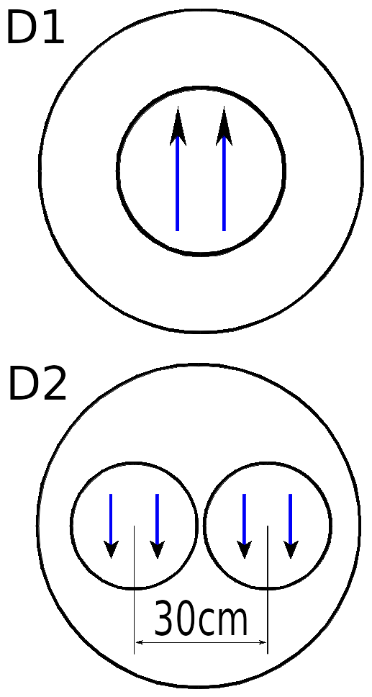
Dipoles
D1: shared by both beams, B= 5.74 T
D2 separate dipoles, but magnetic fields have same direction, B = 2.76 T

Slide 6
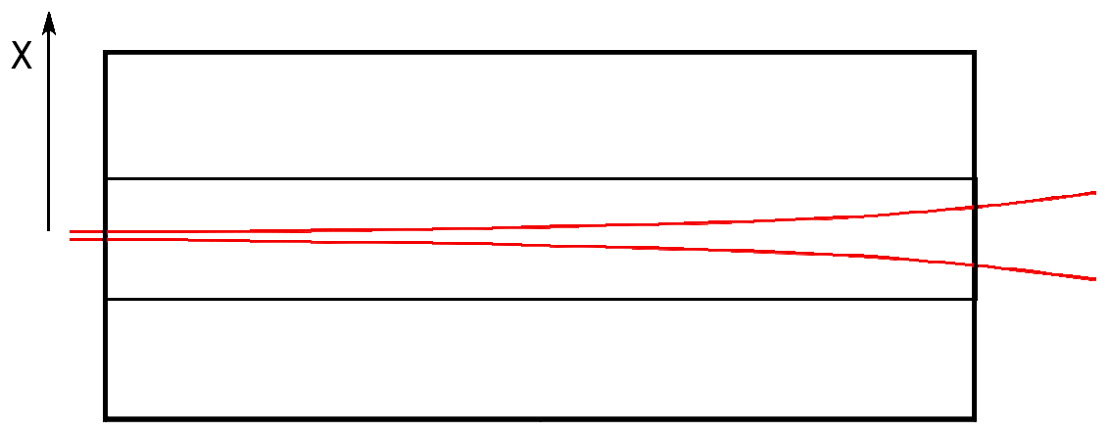
D1
Minimum aperture = x + 12σx = 23.24 mm

Slide 7
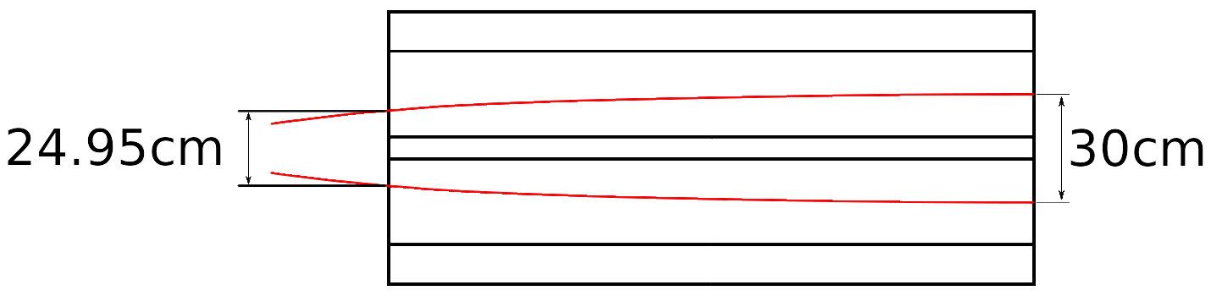
D2 option 1
Minimum aperture = Δx + 12σx = 26.73 mm

Slide 8
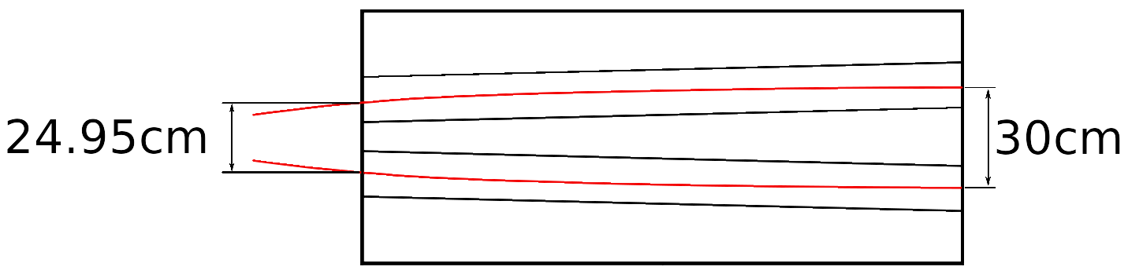
D2 option 2
Tilted/curved dipoles
Minimum aperture = 12σy = 1.41 mm << 20mm

Slide 9
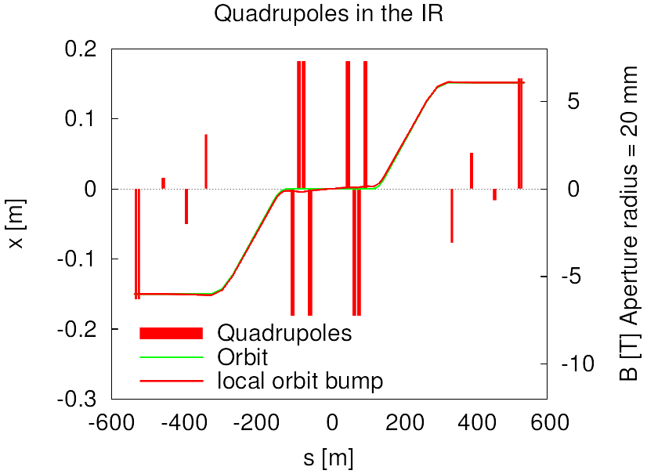
Quadrupoles

