Slide 1
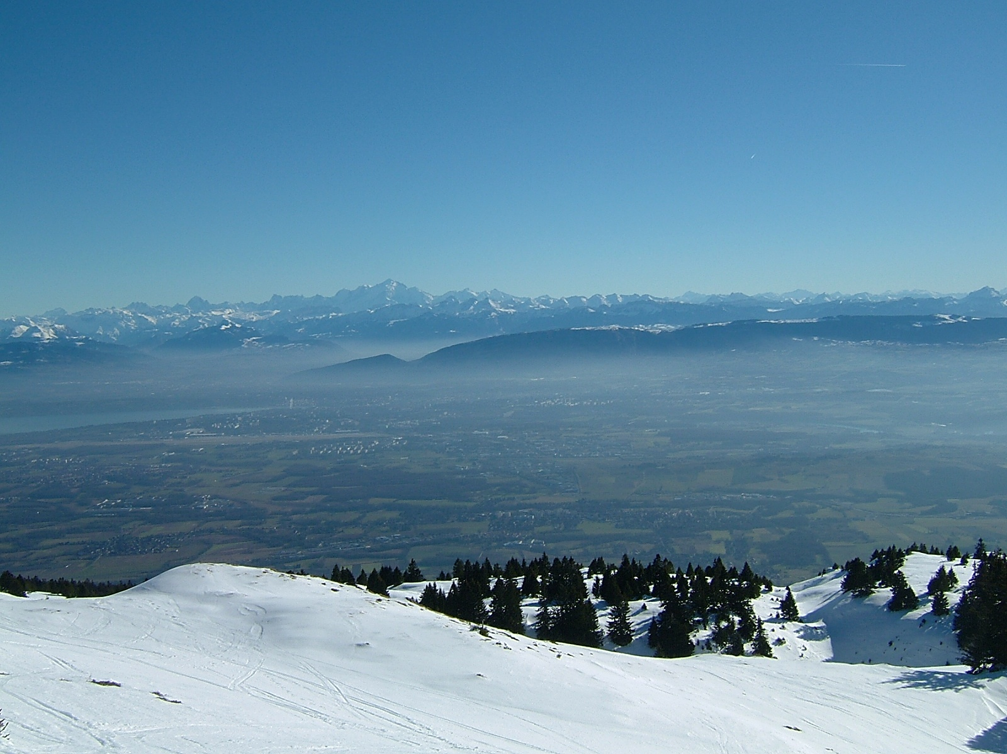

FCC-pp - Collider
First Look at the Arc Lattice
cout J. Wenninger -> photo of the Jura
R. Alemany -> ζ (dipole fill factor)
LHC -> as a very nice example to follow

Slide 2
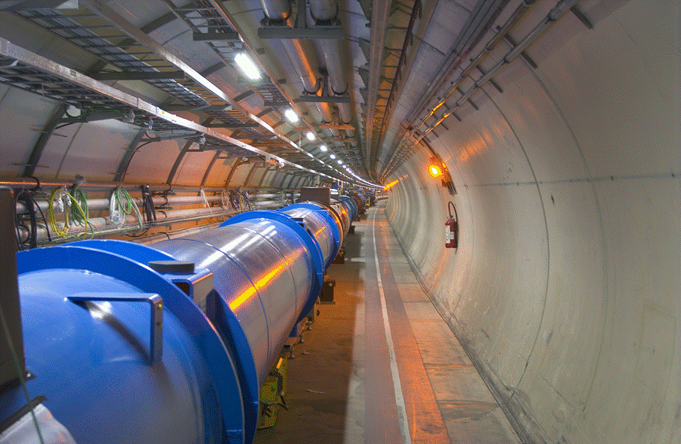
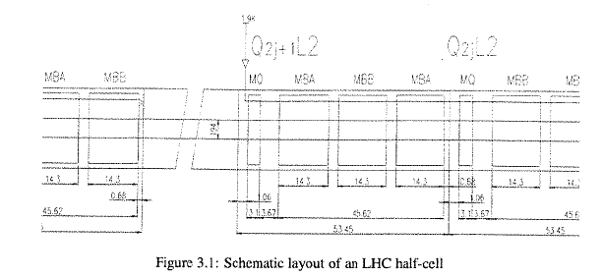
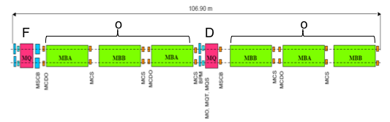
Where do we come from ??
LHC parameters:
energy 7000 GeV
dipole magnets N = 1232
dipole length l = 14.3 m
dipole field
Basic Cell:
For the time being we keep the magnet distances as in the case of LHC. tbcccc

Slide 3
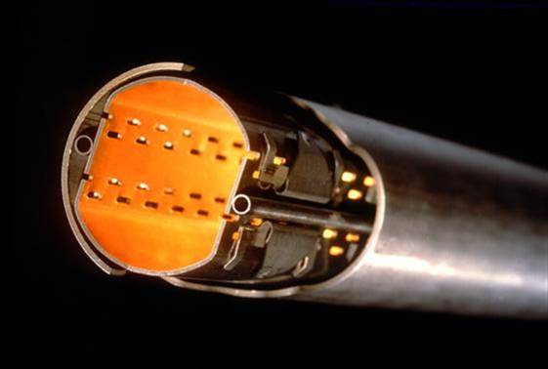
How do we start ??
first scalings from LHC
bare aperture considerations
LHC arc:
Beam pipe:
... at 450 GeV inj energy
... at 7 TeV flat top energy

Slide 4
Scaling for FCCpp
magnet aperture scaled down 56mm -> 40mm
1.) assumption: same rule holds for the future beam screen
2.) normalised emittance a la LHC
3.) we keep the required free aperture
Very first Attempt:
FoDo design for β = 600m
phase advance: optimum for ψ_{cell} =90º
=> L_{cell} = 350m
... to be discussed

Slide 5
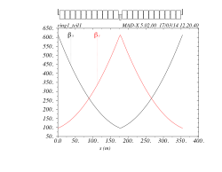
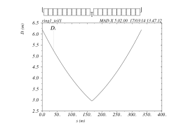
Scaling for FCCpp
Magnets
4.) assumption: dipole B-field increased by factor 2 (Nb₃ Sn) -> B₀=16T
5.) Quadrupole Magnets:
6.) V0 Optics L_{cell}= 350m
... to be discussed / to be checked / to be re-iterated
Pushing the limit (Dipole Fill Factor):
22 dipoles per cell, l_{dipole}=14.0m
19 cells per arc
12 arcs
dipole field =15T <--> 50TeV
or 16T <--> 53.33TeV
5016 dipoles
drifts a la LHC: dipole-quad=3.6m
dipole-dipole=1.3m

Slide 6
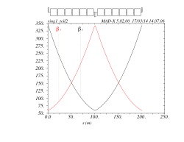
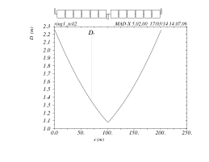
Scaling for smaller Cell Length: FCCpp
Cell Length ≈ 2 * LHC-Cell
„ ... the other extreme“
Realistic compromise:
L_{cell} ≈ 2* L_{cell}(LHC)
12 dipoles per cell
19 cells per arc
12 arcs
4608 dipoles
dipole length=14.2m
drifts a la LHC: dipole-quad=3.6m
dipole-dipole=1.3m
dipole field =16T <--> 50TeV
cell length=202m

Slide 7
Dipole Fill Factor: ζ
For each cell length there is an optimum β_{max}
and there is an optimum dipole length to fit in a integer number of magnets
and to optimise for E=50TeV the fill factor
Ingredients:
Variables:
dipole length
dipole number
cell length
Constants (??):
drift (dipole-dipole) =1.3m
drift (dipole-quadrupole) =3.6m
quadrupole length =3.1m
to be discussed !!!

Slide 8
Cell Length and β function:
For each case the dipole length has been re-optimised to obtain an integer number of
magnets per cell
court. R. Alemany

Slide 9
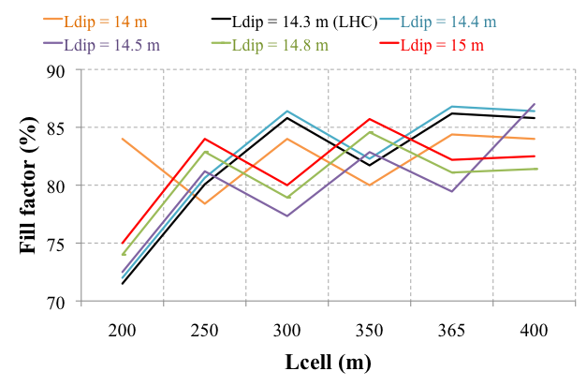
Dipole Fill Factor: ζ
court. R. AlemanyA
The quadrupole length is small compared to overall dipole length per cell
-> increasing the cell length is always helpful to optimise ζ.
-> however the effect is not dramatic and smaller cell lengths might have optical
advantages

Slide 10
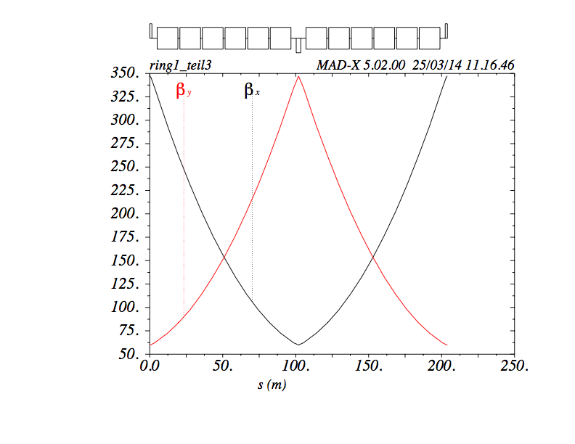
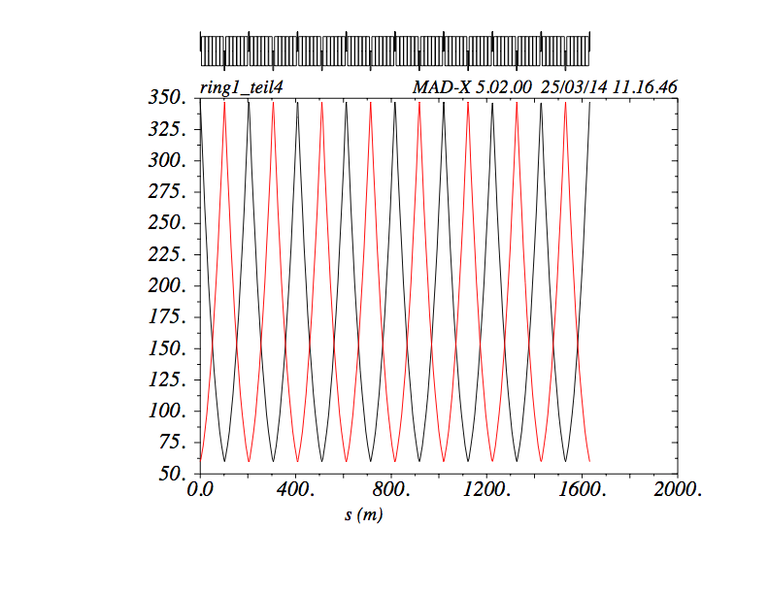
Arc Cell V1:
First Arc Layout:
L_{cell} ≈ 206.4m
L_{dipole}=14.2m
12 dipoles per cell
32 cells per arc
12 arcs
4608 dipoles
drifts a la LHC: dipole-quad=3.6m
dipole-dipole=1.3m
dipole field =16T <--> 50TeV
The storage Ring:
12 Arcs, 12 Straights ... yes yes the racetrack will come soon.
L_{Fccpp}= L_{cell} * N_{cell/arc} * N_{arc} + 12 * L_{straights} + 12 * 2 * 2 * L_{celldispcuppr}
= 206.4m * 32 * 12 + 12 * 1400m + 12 * 2_{li-re}* 2_{cells} * 206.4m
=105 km

Slide 11
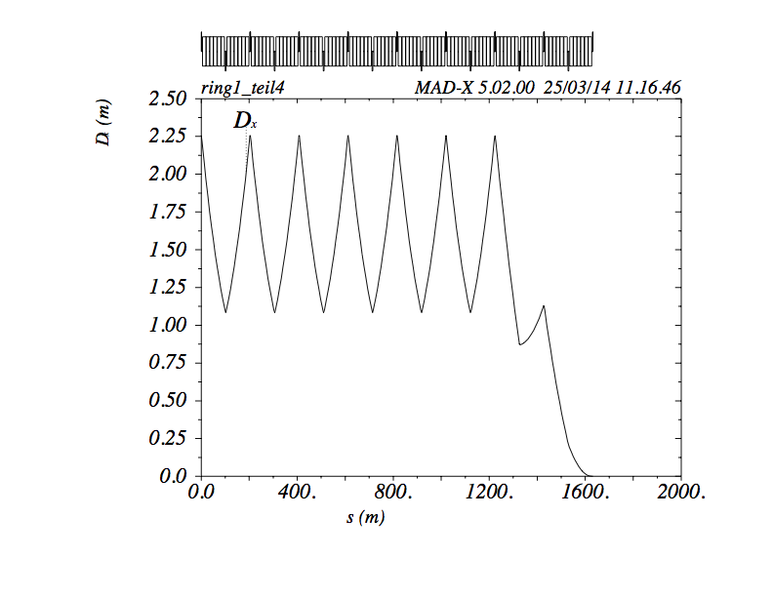
Arc Cell V1:
The storage Ring:
12 Arcs, 12 Straights
Dispersion Suppressor Arc - Straight:
unlike LHC ... text book like approach
Ψ_{cell} = 90º → two half bend cells will do the job

Slide 12
Next Steps:
Complete the Storage Ring:
12 Arcs, 12 Straights
Discuss the magnet parameters
( Re - ) Optimise Cell Length
add matching quadrupoles in Dispersion Suppressor Region,
add empty cells to design the straights
include a first mini-beta
Finalise in first version the “Modules”
Re-Define the Module arrangement to get a first layout of the Racetrack
... mid term planning:
magnet parameters / multipoles / inter magnet drifts ??

