Slide 1
The Cryostat and Cryogenic System for the Far Detector of the Long Based Neutrino Experiment
By Barry Norris, Fermilab
with an Introduction to LBNE and
Time Projection Chambers (TPC’s)
By Jim Stewart
Far Detector Project Manager
CERN
April 2014

Slide 2
LBNE Scientific Motivation
  CP Violation in neutrino sector
    Violation of a fundamental symmetry and viability of leptogenesis models
  Neutrino Mass Hierarchy
    GUTs, String Theory, Dirac vs. Majorana nature and feasibility of 0νββ decay
Testing the Three-Flavor Paradigm
  Precision measurements of known fundamental mixing parameters
  New physics -> non-standard interactions, sterile neutrinos… (beam+ atmos. ν’s)
  Precision neutrino interactions studies (near detector)
Proton decay measurement
    Grand Unification Theory
Astrophysics
    Supernova burst flux

Slide 3
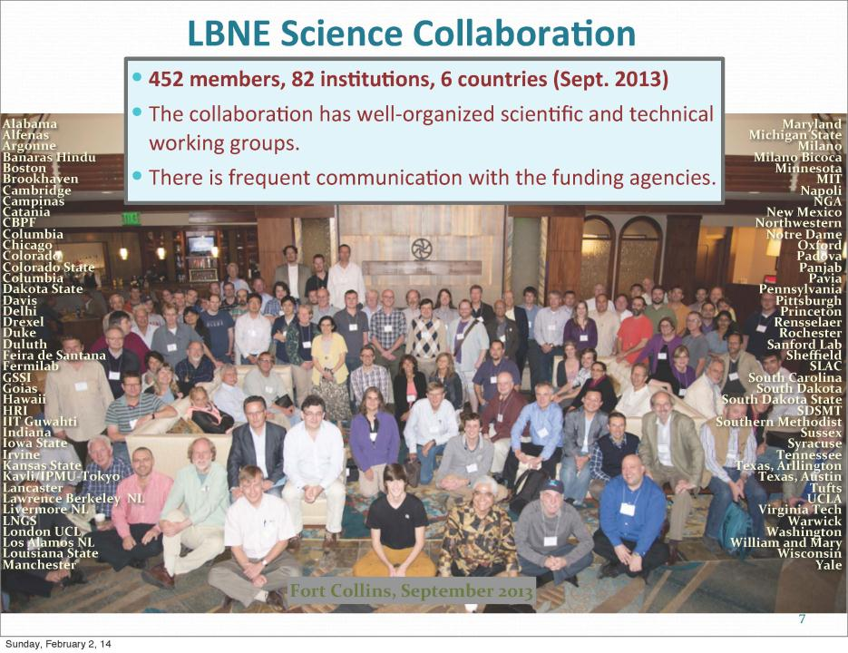

Slide 4
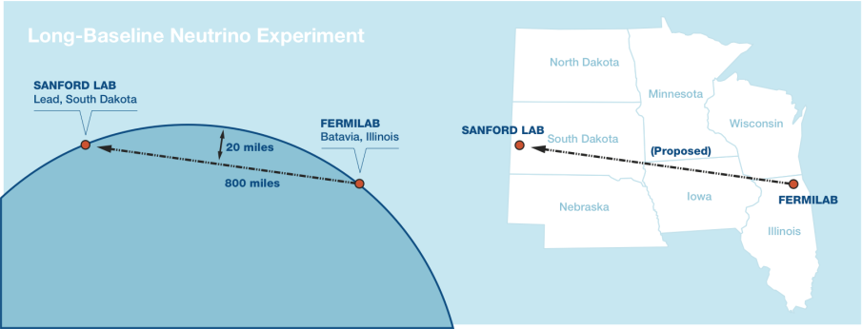
LBNE is…
A new neutrino beam at Fermilab
  1.2 MW, 60-120 GeV proton beam, 2.3 MW capable
A near neutrino detector
An optimal 1300 km baseline: Fermilab-SURF
A 34 kt Liquid Argon TPC with 4850’ overburden
  May need to construct in several steps.
An optimized cost/time effective path to the science

Slide 5
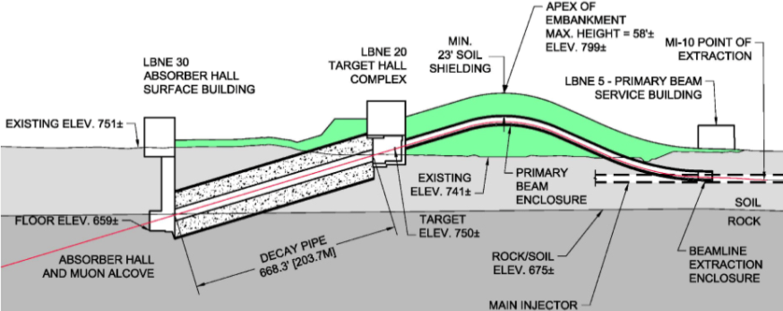
LBNE Neutrino Beam
120 GeV primary proton beam 1.2 MW initial power
  Upgradable to 2.3 MW
Near surface construction
  Can use dig and fill techniques
  Concrete and modern geo-membranes simplify tritium mitigation

Slide 6
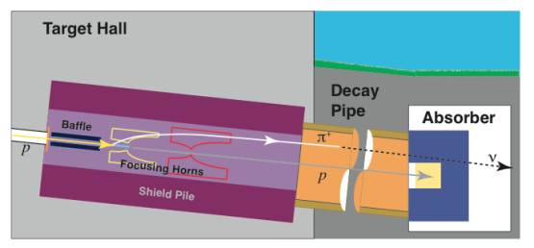
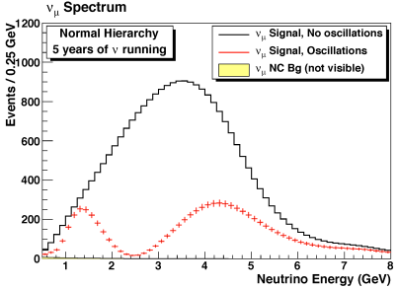
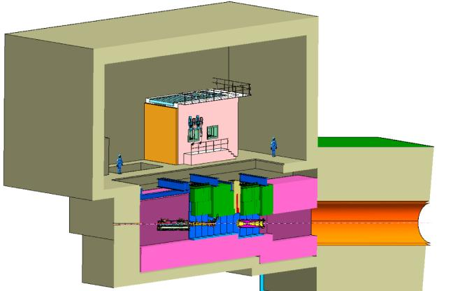
Neutrino beamline
On-Axis configuration
  Broad band beam
  Tunable

Slide 7
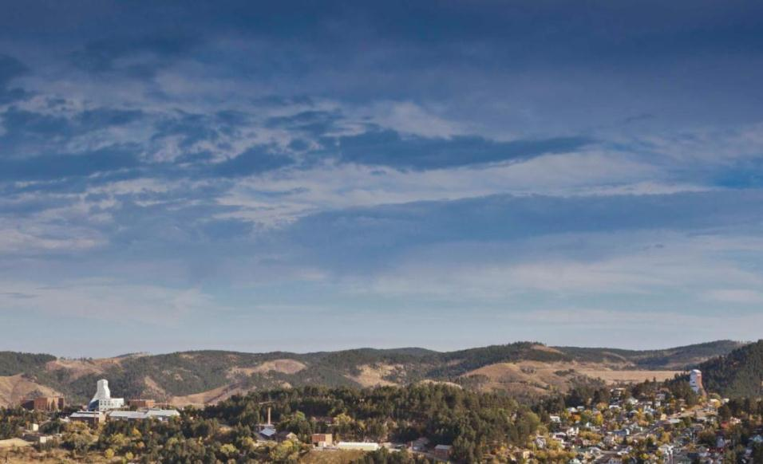
SURF Chronology: 2007-2013
1876 | Start of mining in Lead South Dakota
2000 | Homestake mine closed after mining 40 million ounces of gold in 125 yr
2006 | Homestake mining co. donates the mine to the state of South Dakota
2007 | NSF selects Homestake as site for deep lab (DUSEL).
2008 | Ross Shaft reentry and dewatering begin.
2009 | Yates Shaft reentry and construction on 4850’ Level begin.
2010 | Davis Campus excavation completed. Deep-water pumping begins. NSF discontinues funding for DUSEL.
2011 | DOE agrees to fund Sanford Lab operations. Davis Campus outfitting begins.
2012 | Davis Campus completed. LUX and Majorana experiments move underground. Ross Shaft steel replacement begins.
2013 | LUX dark matter search. MJD construction. Planning for LBNE, LZ and DIANA.
2013 | Start refitting the Ross Shaft

Slide 8
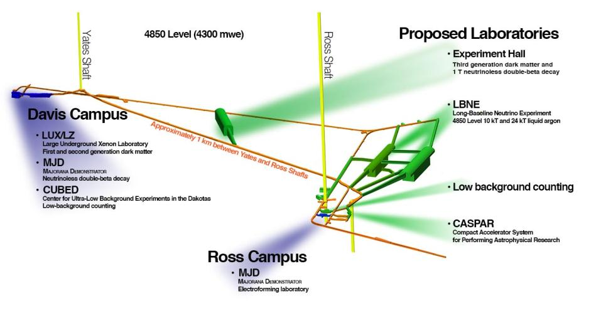
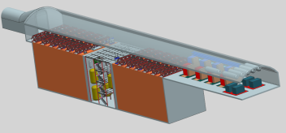
SURF Current & Future Science Program
Cryogenics
Filters
Notes:
- LBNE 34kT cavern: ~100’ W x ~120’ H x ~400’ L (total excavation)

Slide 9
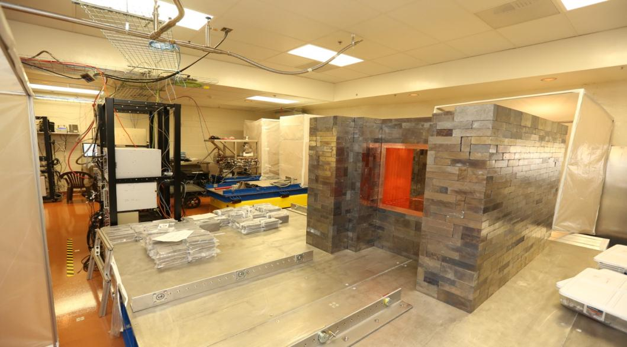
Majorana Demonstrator
Detector Shield Assembly
Notes:
Actually a few more rows completed, current total 2830 bricks
2830/3405 (main shield) = 83%
2830/5200 (total shield) = 54%

Slide 10
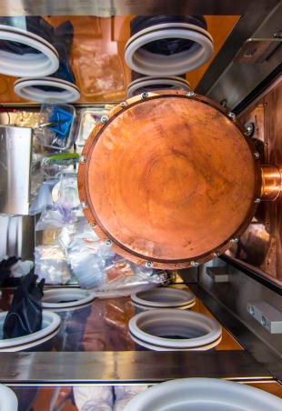
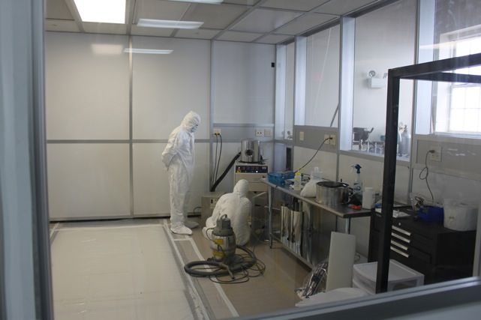
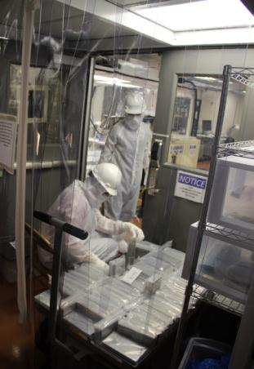
Majorana Demonstrator
Construction and Commissioning Activities
Prototype cryostat inside glovebox
Cable coating activities at Surface Laboratory
Transport and handling for shield construction

Slide 11
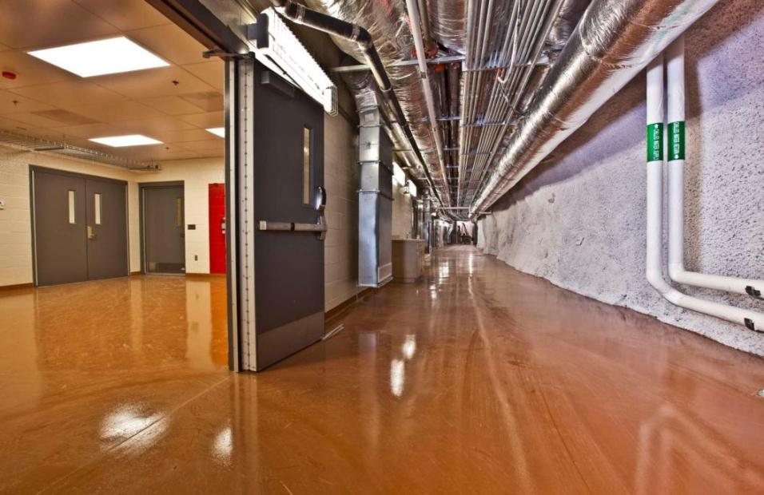
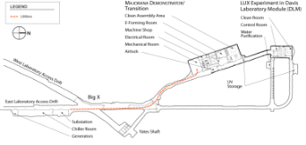
Transition Area After Construction

Slide 12
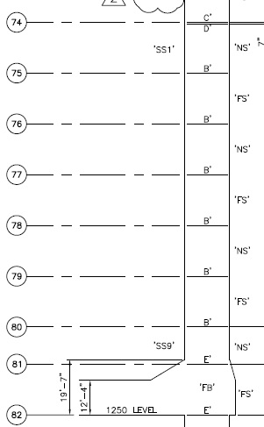
Ross Shaft Rehabilitation
Replacing aging steel to enhance future operations
Surface
Tramway
300 L
800 L
1250 L
1400 L
1550 L
1700 L
1850 L
2000 L
2150 L
2300 L
2450 L
2600 L
2750 L
2900 L
3050 L
3200 L
3350 L
3500 L
3650 L
3800 L
3950 L
4100 L
4250 L
4400 L
4550 L
4700 L
4850 L
5000 L
Schedule
Completed to date
11/28/13
11/30/13
Jan/14
Removing old steel, installing new ground support and new steel
New steel installed to 1378’ mark, installing ladderways, brattices
Entire amount of steel to complete project is on contract
SDSTA has ~$5M into project, expect total of ~$20M
Currently projecting a June 2017 completion
Can Start large excavations in 2017
12/2/13
12/6/13
Jan/15
12/9/13
12/14/13
Jan/16
12/15/13
12/16/13
Jan/17
12/28/13
Jun/17
Notes:
- Mike (Sep 2013): we have ~$5M into project, with expected total of ~$20 M

Slide 13
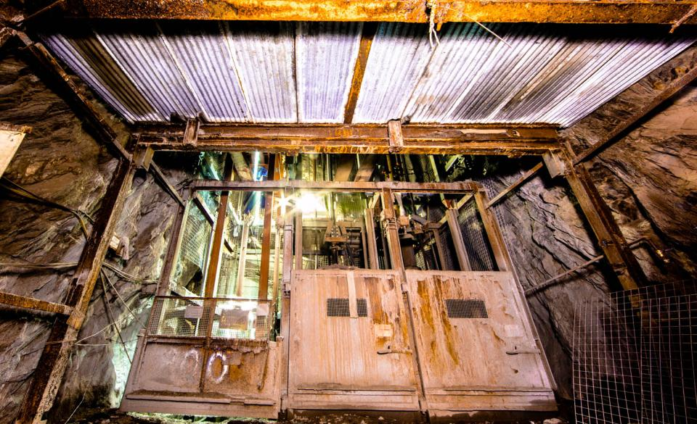
Ross Shaft Rehabilitation
800L Prior To Refurbishment
Notes:
- Set 59 = 978 feet

Slide 14
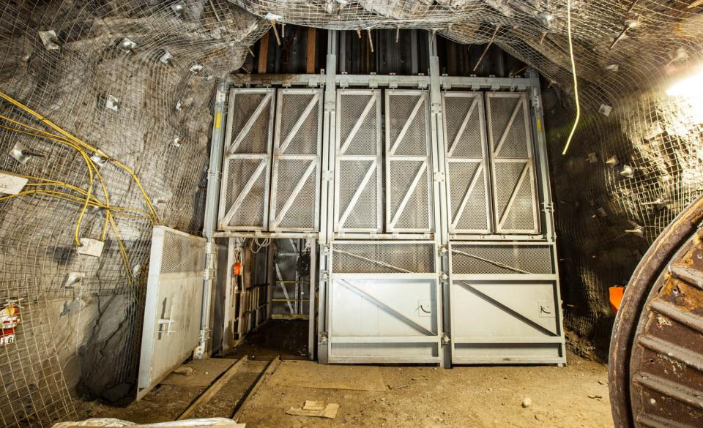
Ross Shaft Rehabilitation
800L After Refurbishment
Notes:
- Set 59 = 978 feet

Slide 15
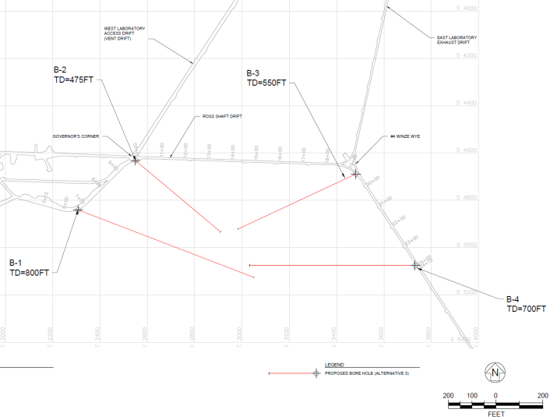
Conventional Facilities Update – Far Site
  A “generic” geotechnical exploration program is underway to explore the rock mass south of the south access drift without regard to detector size or configuration.
  As of April 4th, borings B-1, B-2, and B-4 have been completed and B-3 has been started.
Plan View – 4850L SURF

Slide 16
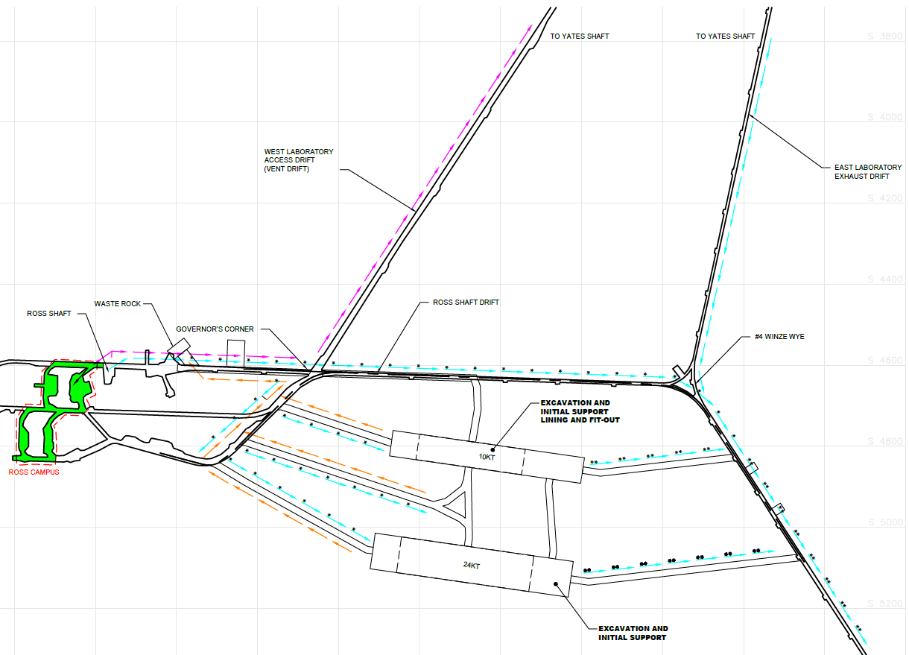
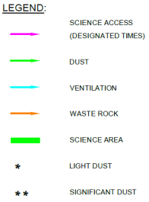
Conventional Facilities Update – Far Site
Implementing a “generic” exploration program allows flexibility to accommodate design changes in the future. However, re-planning the CF cost and schedule requires that we make an assumption regarding the scope of FS facilities.
Two 5-kt detector modules in one cavern and two 12-kt detector modules in a second cavern

Slide 17
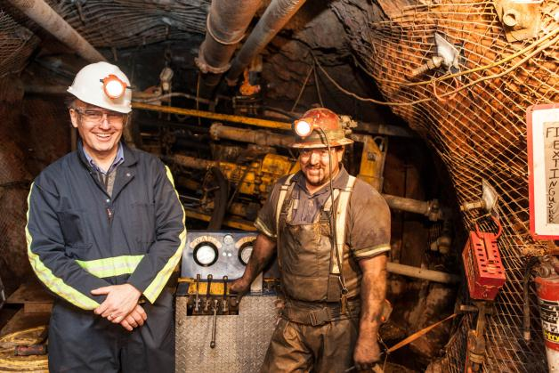
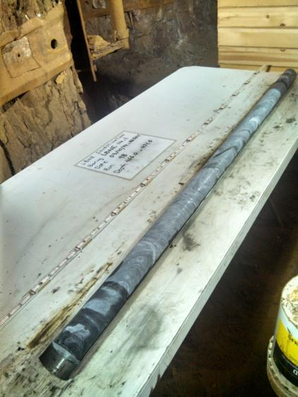
Conventional Facilities Update – Far Site
J. Strait and driller - boring B-4 in progress
B-4 core sample: core recovery consistently 100% and RQD’s consistently between 90-100%

Slide 18
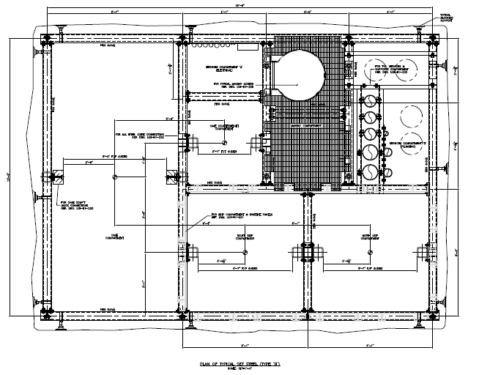
Renovated Ross Shaft – Typical Shaft Set
Ross Shaft post Renovation
Waste Rock Removal – 3,000 tons per day – 11 ton skips
6T payload – Cage Conveyance
  Cage dimensions (7’h 4’ 8”w 12’ 4 ½”long) (2.13 x 1.42 x 3.77m)
  Cage travel time 3.25 min
  Expect 10 min avg one way including loading and unloading
Larger loads can be slung under the cage
No Auxiliary Conveyances
Utilities located in Services Compartment
3.77 m
1.42 m
Ore Skip
Ore Skip

Slide 19
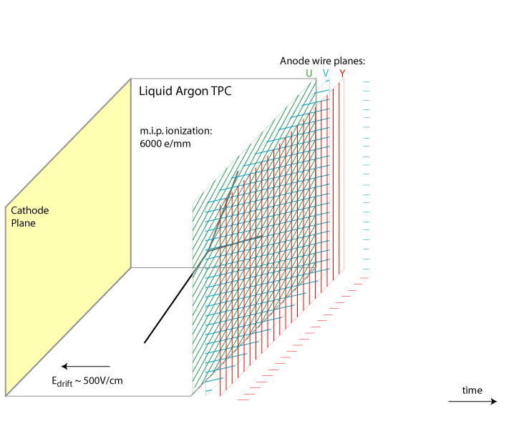
Time Projection Chamber (TPC) Operation
MIP dE/dx = 2.2 MeV/cm
→ ~ 1fC/mm @ 500 V/cm
~1 MeV/wire
x
173 kV
3.45m → 2.16ms
TPC design is
modulal.

Slide 20
2*5kt Detector Design
Beam’s Eye View
2 detector modules 5(9.4)kt fiducal(liquid) volume
2 anode plane assemblies (APA) wide
2 APA assemblies high
10*2.5m wide APAs long (~25m total length)
Each module has 4 drift volumes 25m long
Instrumented with Y,U,V planes
Cathode Plane Assemblies
Anode Plane Assemblies
14m
Field Cage
3.5m
Foam Insulation
Concrete Liner
14m
2 modules x 2 wide x 2 high x 10 long = 80 APA planes

Slide 21
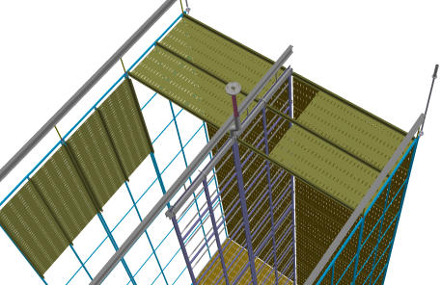
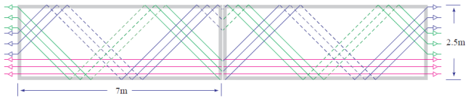
Detector Design
Anode Plane Ass’y (APA) - Standard wire chamber construction
Side View
Detector Concept is modular.
  2.5m wide 7m long anode plane assemblies.
  Will fit in the Ross shaft and on standard trucks.
  Can assemble and test as complete units.
  Storage and transport are manageable.
  Installation is straight forward.
  Can easily expand the detector.
x
u
v
x
2.5m
APAs
HV Feedthrough
Field cage
CPAs

Slide 22
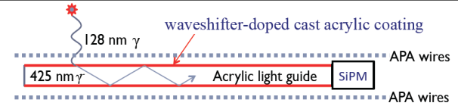
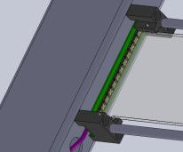
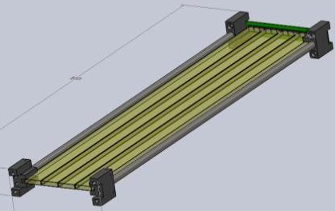
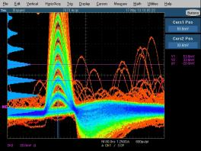
Paddle Design
MIT inspired design
TPB coated/doped cast acrylic
25 mm x 6 mm x 2.25 m bars
4 bars per paddle
SiPM readout
SensL MicroFB-60035-SMT readout at LN2 temp

Slide 23
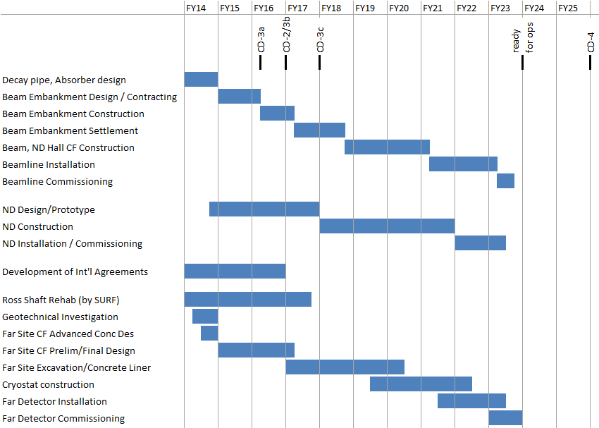
Plausible Schedule for International LBNE accelerated start of far detector cavern

Slide 24
Far Detector
Cryostat and Cryogenic Systems

Slide 25
Overview of Long Baseline Neutrino
Experiment (LBNE) Cryostat Needs
Aspects related to cryogenics:
The detector design is based on the use of membrane tank technology previously developed and used in commercial business for both storage and transport of liquefied natural gas (LNG).
The FD is planned to be initially composed of two membrane cryostats each having the approximate physical dimensions of 28.5 meters long, 15.6 meters wide and 16 meters high (7134 m³ volume).
Each cryostat will contain 9.4 kton (metric) LAr mass.
The FD cryostat will house Time Projection Chambers (TPCs) used for particle detection and be filled with liquid argon filtered to less than 200 parts per trillion (ppt oxygen equivalent) contamination levels in order that electrons drift through the fluid with a lifetime greater than 1.4 ms.
In order to insure that membrane cryostat technology can be used within these requirements, Fermilab and the LBNE project have constructed and commissioned a prototype cryostat (~29 m³) referred to as the ‘35 Ton’, testing the thermal performance and the ability to achieve high purity levels.

Slide 26
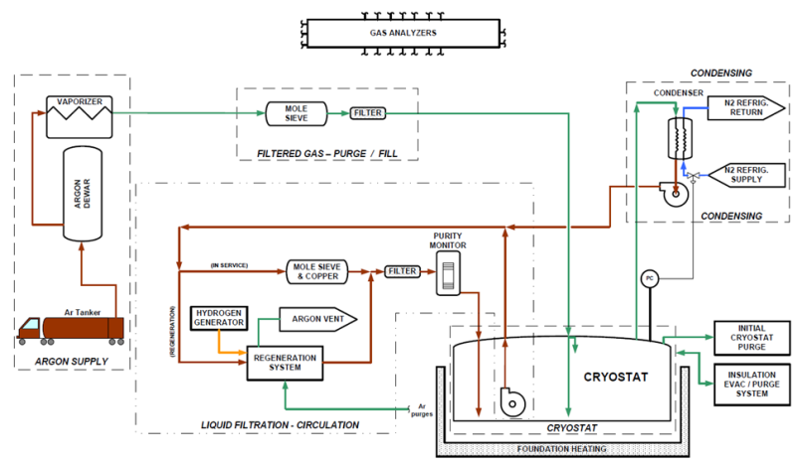
Process Flow Diagram for Far Detector
LAr, GAr Supply
GAr filtration
Cryostat with Liquid Pumps
Mole Sieve & Copper Filtration
Re-condensor with LN2 Refrigeration
2
5
1
4
3

Slide 27
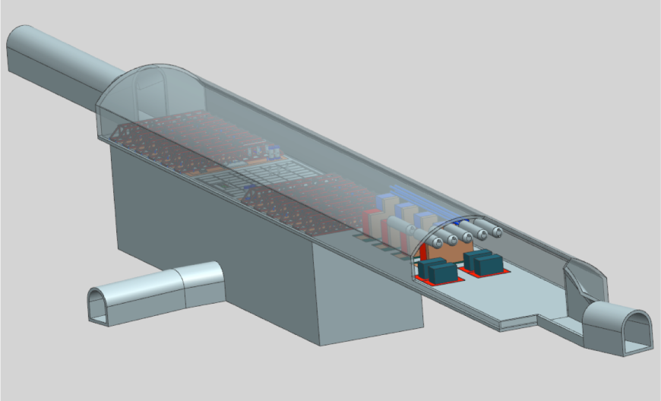
3-D Drawing
Area for LN2 and LAr
Refrigeration Systems
Notes:
3-D Drawing of the 35 ton prototype.

Slide 28
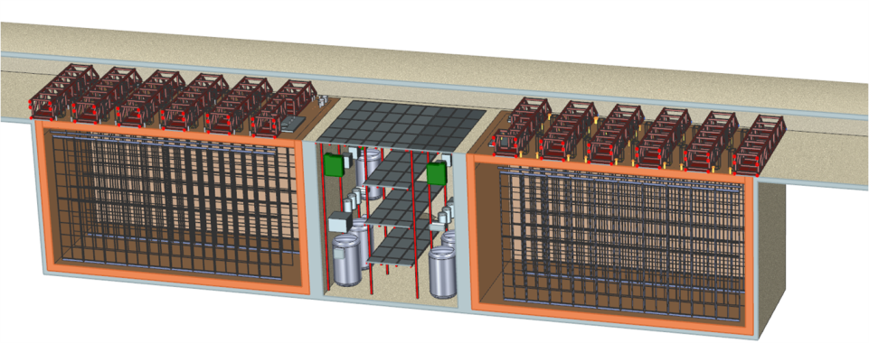
3-D Drawing
Cryostat North (N)
LAr filtration system
in septum region
Cryostat South (S)
Roof with trusses
Roof with trusses
APAs & CPAs
Notes:
3-D Drawing of the 35 ton prototype.

Slide 29
Introducing the Cryostat of Choice

Slide 30
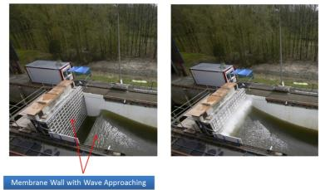
Technology
Selected Membrane cryostat technology:
  Cost effective for > ~1,000 m³ tanks.
  Commercially used with LNG and in much harsher conditions than the 10 kton detector (LNG tankers, sloshing).
  Meets the requirements of LAr storage; has feed through capability.
  Robust design, safe and reliable (see history throughout the world).
  No need to build a evacuable vessel because purge method allows for low ppm levels to be achieved without pumping down (35 ton protot) .
Two vendors that we are aware of: IHI (Japan) and GTT (France). At present we have Intellectual Property issues with GTT, but a solution might exist if GTT uses a company as a EPC.
Notes:
READ.

Slide 31
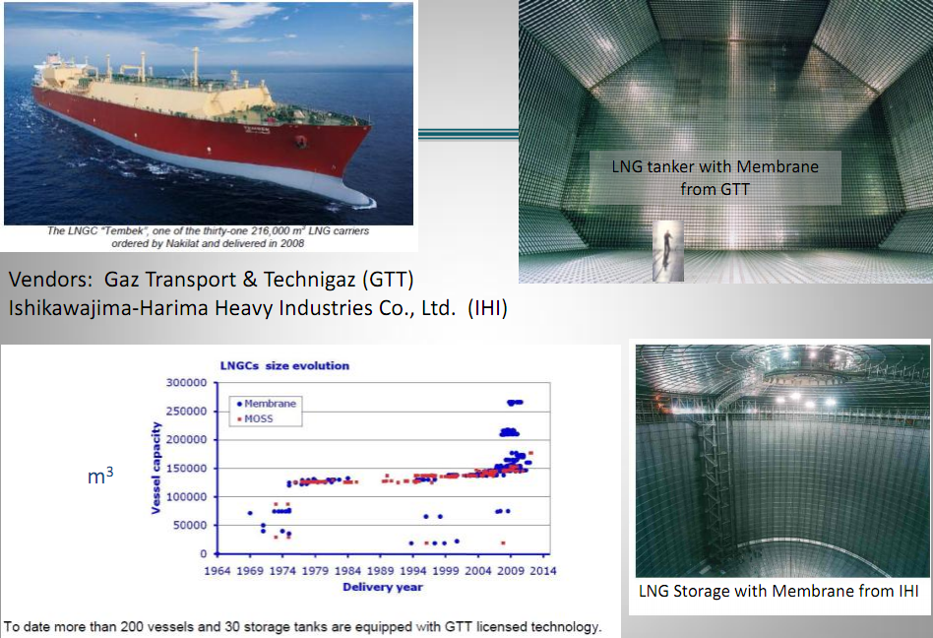
Membrane Cryostat Technology
Each LBNE cryostat
is 7,100 m3
Notes:
Here we have photos of two examples of the technology:
An LNG Ship tanker from GTT
A land base storage tank from IHI
Both are quite bigger than what LBNE plans to do.

Slide 32
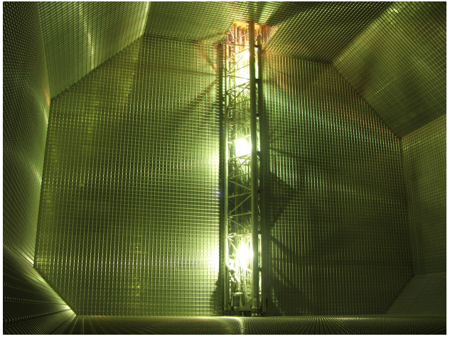
LAr pump (GTT tank)
Removable pump at the bottom of the vessel
Notes:
A removable pump installed inside the ship tanker.

Slide 33
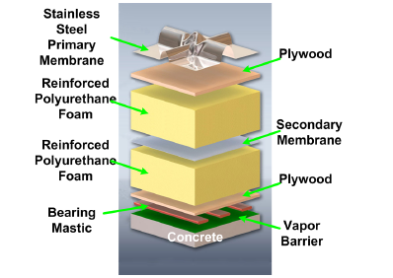
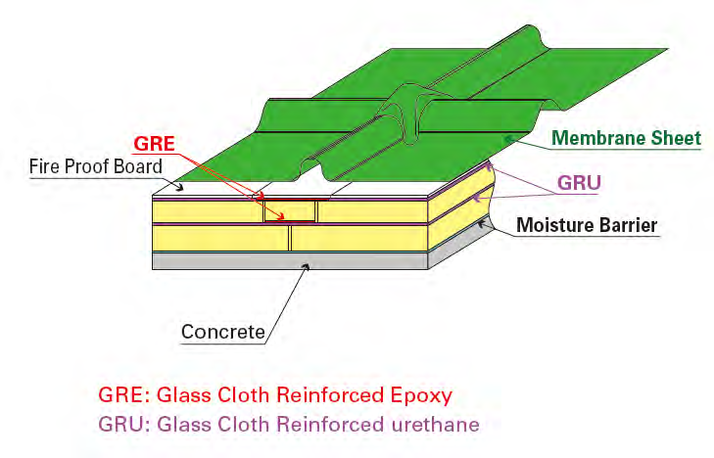
Membrane Cryostat Design
IHI Membrane Technology
(used in 35 ton prototype)
GTT Membrane Technology
Nominal Panel Size
1m x 3m x 1.2 mm thickness
Nominal Panel Size
3m x 8m x 2 mm thickness
ES&H Comment: Foam layers are fire retardant. Plywood or calcium silicate board protects foam from
heat during primary membrane welding.
Note: IHI has only tested the secondary barrier containment and implemented it in the LBNE 35 ton prototype.
Notes:
How does a membrane cryostat works??
We have two known vendors: GTT and IHI.
Their products are different, but the concept is very similar.
We have:
A stainless steel membrane (1.2 mm for GTT , 2.0 mm for IHI)
A fireproof board (plywood with GTT, Calcium Silicate with IHI)
A first layer of insulation (Polyurethane foam)
A secondary barrier to protect the insulation from potential spills of liquid from the inside (metallic for GTT, epoxy for IHI)
A second layer of insulation (Polyurethane foam)
Concrete

Slide 34
Design Parameter | Value for 35 ton | Value FD (One Cryostat)
Cryostat volume | 29.16 m³ | 7134 m³
Liquid argon total mass | 38,600 kg | 9,443,497 kg
Inner dimensions of the cryostat | 4.0 m (L) x 2.7 m (W) x 2.7 m (H) | 28.5 m (L) x 15.6 m (W) x 16 m (H)
Depth of liquid argon | 2.565 m (5% ullage) | 5% of total
Insulation | 0.4 m Polyurethane foam | 0.8 m Polyurethane foam
Primary membrane | 2.0 mm thick SS 304 corrugated stainless steel | Based on vendor design
Secondary barrier system | 0.1 mm thick fiberglass | 0.1 mm thick fiberglass
Vapor barrier | 1.2 mm thick carbon steel | Based on vendor design
Reinforced outer concrete layer | 0.3 m thick | 0.5 m thick
Liquid argon temperature | 89 K +/- 1 K | 89 K +/- 1 K
Operating gas pressure | 70 mbar | 130 mbar
Vacuum | No vacuum | No vacuum
Design pressure | 207 mbar | 350 mbar
Leak tightness | 1E-06 mbar*l/sec | 1E-06 mbar*l/sec
Heat leak | < 13 W/m² | < 7.5 W/m²
Duration | 10 years | 20 years
Thermal cycles | 50 complete cycles (cool down and total warm up) | 10 complete cycles (cool down and total warm up)
Design codes | Fermilab ES&H Applicable parts of JGA RP-107-02 ACI 318 | Membrane cryostat standard relative to vendor’s country of origin

Slide 35
We have begun the contractual strategy…
Competitive procurement among all potential vendors, including IHI and GTT.
  Contract will be adjudicated based on “Best Value to FRA (Government)”.
  Proposals will be evaluated and scored based on technical/business/quality and cost considerations with specific evaluation factors.
A Single contract will be issued to a vendor for Preliminary Design with unilateral options for Final Design, Procurement of Materials, Technical Training and Supervision during the Installation.
  Firm Fixed Price contract with escalation for Procurement of Materials and Technical Training and Supervision during the Installation only.
  Phase funded: initial subcontract will include the scope of work for the Preliminary Design. Each additional phase released as funding becomes available.
Note: Once we select the vendor, we must procure the materials and the technical training and supervision from the same vendor that performed the design. The value of the contract will be too large to sole source the procurement/training as a separate contract after the design is made.

Slide 36
Our Proposed Cryogenic System Process

Slide 37
Opening Assumption for 4850
Cryogenic System’s Design
Our cryogenic systems design strategy must take into consideration that the long range goal for the LBNE endeavor is to provide refrigeration capabilities for 34 kton fiducial mass detector arrangement (assuming ~ 50 kton total mass) whereas the initial minimum cryogenic system investment must support a 5 kton fiducial detector and probably two detectors for a 10 kton system
(~ 19 kton mass).

Slide 38
With the Opening Assumption in Mind…
We propose to design a centralized cryogenic facility where the GN2 compressors are on the surface and cold boxes are in cavern(s) supporting both 10 and 24 kton detectors.
  Note: Refrigeration cycle has been approximated based on heat loads for the LBNE Membrane cryostat design.
Propose to provide ‘Plug & Play’ concept where future required cooling capacity is accomplished by adding warm compressor(s) and cold box(es) as needed to an already existing piping infrastructure.
  All necessary CF infrastructure in place for full scale implementation
  All piping installed from surface to cavern for full scale implementation
  All power and cooling requirements installed for full scale implementation
Propose to have LN2 system work like a utility for future Users (detectors) such that a distributed piping system will be installed to deliver to future detectors the cooling needed.
  Primary equipment located in 10 kton cavern (cold boxes, dewars)
  Transfer line and piping will connect to 24 kton cavern from central area
  May need small LN2 or LAr dewar(s) in 24 kton cavern depending on experiment
Each future detector will potentially have its own strategies for argon condensing and filtration, offering flexibility in future detector designs. (Costs may vary as compared to initial LBNE design).

Slide 39
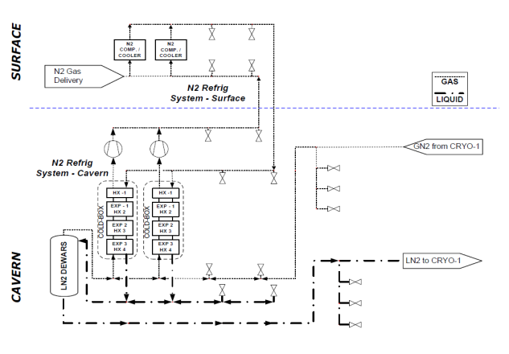
Basic Idea: Shown is Minimum Infrastructure for 9.8 metric ton total mass @ 4850’ level
(depth of 1.6 km)
Each refrigerator is 85 kW total cooling power
Entire infrastructure (piping, electrical power, water cooling, civil ) put in place to support future use of four 85 kW cooling power LN2 plants, which is the capacity required for 34 kton.
Idea is to make future expansion a type of ‘Plug & Play’ for compressors and cold boxes to create large distributed system and minimize the cost for design labor and installation.
Initial installation:
Two Cold boxes & two compressors for 9.8 kton
‘CRYO-1’ represents first 9.8-kton detector

Slide 40
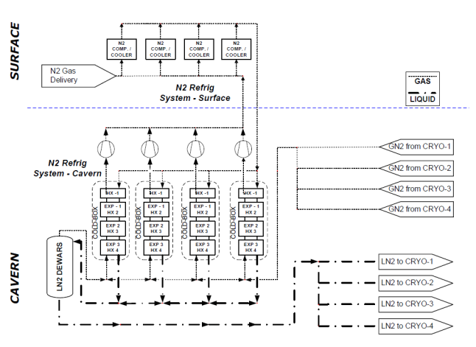
Future Expansion up to 34 kton Fiducial Mass
To increase capacity we need to add Compressors and cold boxes
Piping, electrical power, water cooling, civil required to support this expansion from day 1.
Assume CRYO-1 through CRYO-2 are 9.8 kton each
Assume CRYO-3 and CRYO-4 is any combination up to 24 kton total

Slide 41
Comment on Cold box Sizing
The four 85 kW is the refrigerator size that satisfied the following:
Maximize GN2 transfer piping in Ross Shaft utility window
Keep Refrigerator units interchangeable
Limits to four refrigerator units (qualitative limit to manage cost multiplying of installing many small units)

Slide 42
Exploring LN2 Plant Options
We have very preliminarily explored options both in the USA and internationally (including the solution used by ICARUS, Sterling Engineering) for LN2 a refrigeration plant
For this presentation we offer one solution from the company Cosmodyne, LLC.
  Cosmodyne, LLC. sells a commercial product line which is suitable for our forecasted cooling power needs. They are even willing to re-package their standard unit to meet our spatial conditions as well as maximum weight considerations via the Ross shaft.
In the long-term, there will be a Request for Proposal (RFP) process and this package will be bid.
  A Procurement strategy of ‘future cold boxes and compressors’ will need to be discussed should the Cryogenic plant be built in this ‘Plug & Play’ style.
  Any intereted vendor of cryogenic equipment will need to meet LN2 cycle parameters as well as space and utility constraints

Slide 43
Standard units range from 15 – 189 kW cooling power
ELM Family can be purchased and even re-designed or re-packaged to meet our cooling and physical space needs

Slide 44
Representation of Future
Physical Arrangement
Surface
Ross Shaft
Cavern
E-Panel
These pipes
will support
four 85 kW
units
Compressor
After Cooler
Expanders
Coldbox

Slide 45
35 ton Prototype
Cryostat and Cryogenics

Slide 46
Comment on 35 ton Cryogenic Papers
See: CEC 2013 in Anchorage, Alaska, USA.
Title: “First Scientific Application of the Membrane Cryostat Technology”
See: CRYOGENICS 2014 at Prague, Czech Republic
Title: “Results from the Commissioning of a LAr Membrane Cryostat Prototype for LBNE”

Slide 47
Our Prototype Goals
To test and satisfy the scientific and engineering requirements of the future FD, our technical goals in building this prototype were:
to demonstrate the membrane cryostat technology in terms of thermal performance,
feasibility for liquid argon, and leak tightness;
to demonstrate that we can remove the impurities from the vessel and achieve the purity requirements in a membrane cryostat without evacuation and using only a controlled gaseous argon purge;
to demonstrate that we can achieve and maintain the purity requirements of the liquid argon during filling, purification, and maintenance mode using mole sieve and copper filters.

Slide 48
Design Parameter | Value for 35 ton | Value FD (One Cryostat)
Cryostat volume | 29.16 m³ | 7134 m³
Liquid argon total mass | 38,600 kg | 9,443,497 kg
Inner dimensions of the cryostat | 4.0 m (L) x 2.7 m (W) x 2.7 m (H) | 28.5 m (L) x 15.6 m (W) x 16 m (H)
Depth of liquid argon | 2.565 m (5% ullage) | 5% of total
Insulation | 0.4 m Polyurethane foam | 0.8 m Polyurethane foam
Primary membrane | 2.0 mm thick SS 304 corrugated stainless steel | Based on vendor design
Secondary barrier system | 0.1 mm thick fiberglass | 0.1 mm thick fiberglass
Vapor barrier | 1.2 mm thick carbon steel | Based on vendor design
Reinforced outer concrete layer | 0.3 m thick (free standing) | 0.5 m thick (against rock cavern)
Liquid argon temperature | 89 K +/- 1 K | 89 K +/- 1 K
Operating gas pressure | 70 mbar | 130 mbar
Vacuum | No vacuum | No vacuum
Design pressure | 207 mbar | 350 mbar
Leak tightness | 1E-06 mbar*l/sec | 1E-06 mbar*l/sec
Heat leak | < 13 W/m² | < 7.5 W/m²
Duration | 10 years | 20 years
Thermal cycles | 50 complete cycles (cool down and total warm up) | 10 complete cycles (cool down and total warm up)
Design codes | Fermilab ES&H Applicable parts of JGA RP-107-02 ACI 318 | Membrane cryostat standard relative to vendor’s country of origin

Slide 49
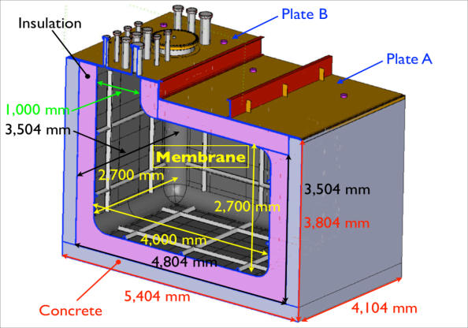
Original 3D Model
Concrete structure In support for
inner vessel and LAr
Vapor barrier installed between
concrete and foam insulation
Two layers of insulation with
fiberglass cloth barrier in between
Stainless steel membrane technology
for membrane
Top Plates A and B designed by FNAL
include penetrations

Slide 50
Pictures from Membrane Construction
Concrete structural
support
Uses two layers of
polyurethane foam
as insulation
Membrane panels
welded to assemble
cryostat

Slide 51
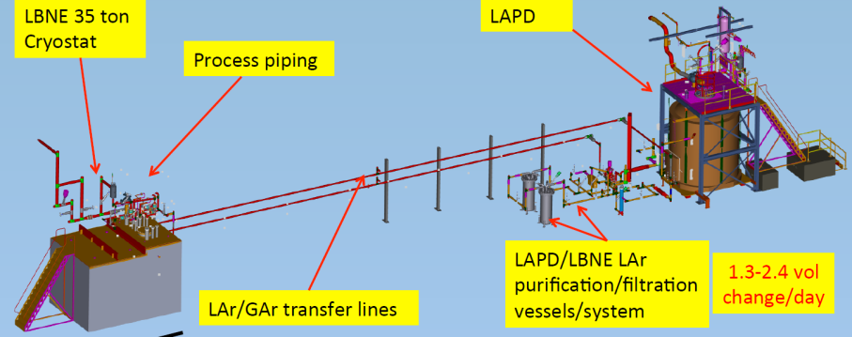
Location of 35 ton Prototype
(sharing cryogenic services with Liquid Argon Purity Demonstrator LAPD)

Slide 52
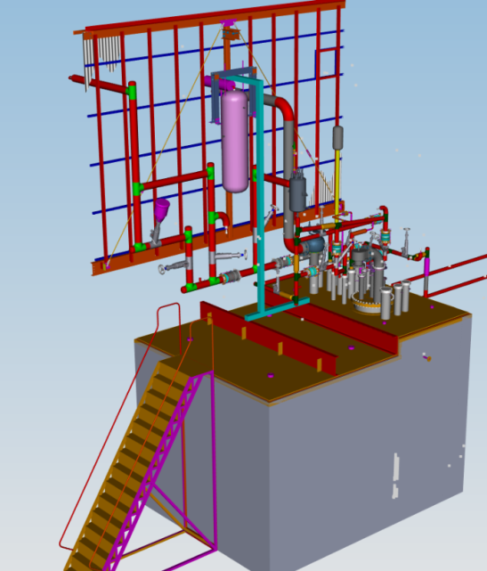
Model of
Prototype and
Piping
Components
On Vessel

Slide 53
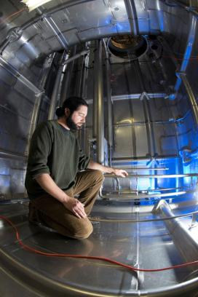
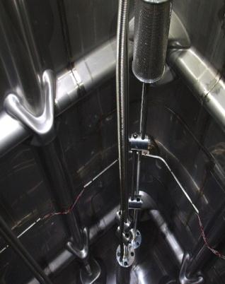
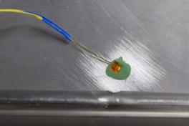
Pictures Internal to 35 ton Prototype
Purity Monitors
On
Two Different
Elevations
Submersible pumps
RTD Flush
Mount to
Cryostat Walls

Slide 54
Top Plate and Cryogenic Systems Equipment During Installation

Slide 55
Process Flow Diagram of 35 ton
1. LN2, LAr, GAr supply
2. GAr filtration
3. 35 ton Cryostat
with piping, submersible
LAr pumps
4. 8000 Watt condenser
5. LAr filtration and
regeneration
2
4
1
5
3

Slide 56
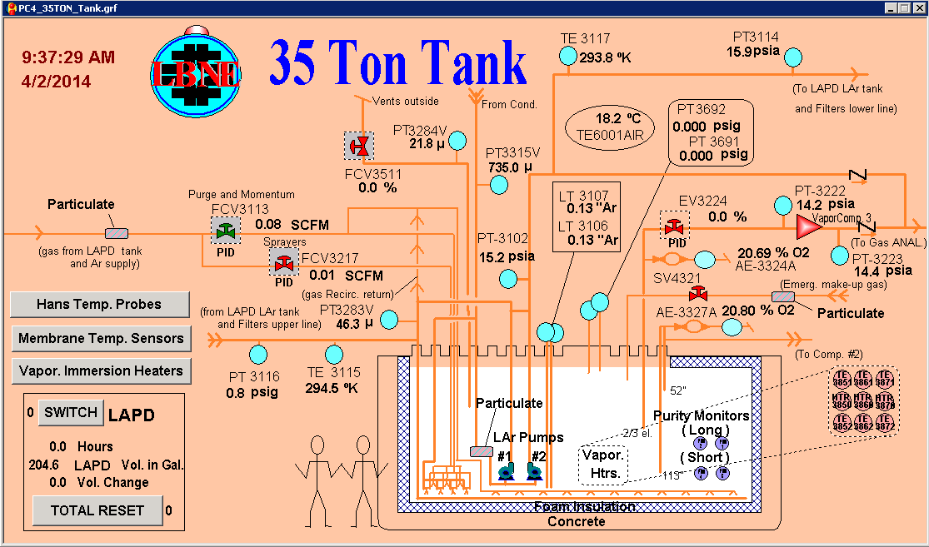
Snapshot of GE Fanuc ‘iFix’ Screen

Slide 57
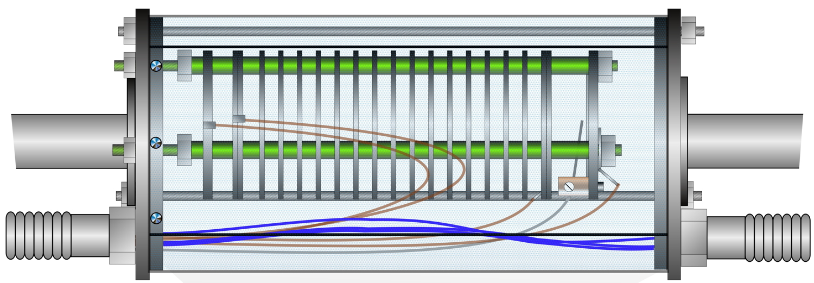
Specialized Instrumentation for LAr Requirements
Purity Monitors
  double gridded ion chambers
  the cathode to cathode grid, the cathode
grid to anode grid (the drift region), and the anode grid to anode
  cathode, a gold-plated aluminum plate, is illuminated by ultra-violet (UV) photons from a Xenon flash lamp
    photons liberate electrons from the gold layer into the LAr
    The electrons drift towards the cathode grid that is 1.8 cm from the cathode
    The electric current from this drift between the cathode and the cathode grid is integrated in external electronics and represents the electron charge Q_{c} that was emitted from the cathode.
RTD Spoolers
  Move temperature sensors thru LAr to measure small temperature gradients
  Consist of a small diameter chain and a circuit board with 3 temperature sensors in the tank moved by an external stepper motor.
Gas Sniffers
  Internal capillaries (three) at three different elevations to sample GAr during piston purge sequence. Monitors are O2 monitors (0-25% range).

Slide 58
RTD Spooler and Purity Monitors
RTD Spooler allows moving
Temperature sensors through liquid
Purity Monitors to
Measure contamination
Electron Lifetime

Slide 59
Commissioning Steps
Due to the requirement of < 200 ppt Oxygen equivalent special commissioning steps are taken to reduce O2, H20, and N2 content
Steps are:
  Piston Purge (eliminates need for evacuable vessel)
    Introduce GAr to bottom of vessel and move through vessel faster than back diffusion rate (open loop)
  Gas recirculation
    Circulate filtered GAr through membrane cryostat (closed loop)
  Cool down at < 10K/hr rate per membrane vendor using manifold system delivered to bottom of vessel
  Fill with LAr

Slide 60


Slide 61


Slide 62

Cool down and Fill Used Sprayers

Slide 63


Slide 64


Slide 65
Top off tank using D0 LAr (covers PrM4)
Switch to Pump B

Slide 66
Statement on Cryostat Heat Leak
Estimated During Design
Estimated heat leak during the design stage indicated the IHI membrane cryostat heat leak through the walls, floor, and Plate A to be on the order of 1.3 kW whereas the Plate B heat leak was ~ 50 W. (Note that Plate B has thermal radiation shields internal to the vessel rather than polyurethane foam).
Actual Measured
With the cryostat isolated from the piping system and the pumps off, our measured heat leak of cryostat is less than 1.5 kW.
  Measurements done by turning off LN2 re-condensing and measuring boil off via two methods: liquid level change as well as pressure rise in vessel
  Cryostat isolated from piping and liquid pumps off

Slide 67
Issues in Operations
Vacuum Relief valve (VRV)
  Needed because the 35T cryostat can not support either much overpressure or under pressure compared to barometric pressure.
  This cost us ~20 days due to leak of “air” into cryostat
    Confusing because N₂, O₂ ratio was not that of air.
  VRV was “bagged” with GAr --”solved” immediate problem
Dielectric Breaks
  Vessel must be isolated from ground
  Dielectric breaks leaking Ar gas into vacuum insulating sleeve around cryo piping.
  We attached vacuum pumps to compensate for the leakage.
LAr Pump Lifetime
  Apparent bearing damage as one of two pumps failed after short number of hours
  We believe similar to ICARUS failures (per Dr. C. Vignoli)
  Still need to investigate cause

Slide 68
Conclusion on Cryogenics
LBNE is moving forward in Preliminary Design phase for a detector of total LAr mass of ~ 19 kton (10 kton fiducial)
LBNE has built and operated a prototype membrane cryostat to test the thermal, leak tightness, and purity requirements of the design. Phase I was a great success.
An RFP will be issued in the months ahead and an awarding of a contract is intended at the end of CY2014.
Work continues on the cryogenic systems design which will need large LN2 capacity and infrastructure for LAr at high purity.

Slide 69
Thank You for Hosting Us

Slide 70
Back Up Slides

Slide 71
Impurity Profile
T profile verified in LAPD.
Will be verified in 35 ton prototype as well.
Notes:
Model of the Concentration of the impurity inside the cryostat, normalized to one (1).
The purity of the LAr is quite uniform.

Slide 72
Example of Cooling Power Requirements for Two 9.8 kton Cryostats

Slide 73
Trusses
Electronic Racks
Laser calibration ports
TPC Electrical feedthrus
HV Feedthrus
Service ports
Laser calibration ports
TPC Electrical feedthrus
HV Feedthru

Slide 74
Notes:
3-D Drawing of the 35 ton prototype.

Slide 75

Primary Membrane Design Requirements (from RFP)

Slide 76

Insulation Design Requirements (from RFP)

Slide 77

Concrete and Vapor Barrier Design Requirements (from RFP)

Slide 78

Cryostat Roof Design Requirements (from RFP)

Slide 79


3 D Model for 10-kton Velocity & Temperature Profile
T profile verified in LAPD and 35 ton prototype
Notes:
Models of Velocity and Temperature profile inside the cryostat:
They are both pretty uniform, with the temperature varying by less than 0.1K.

Slide 80
List of Penetrations through the Roof of each cryostat
1 Access Hatch
1 Personnel Hatch (1.2 m x 1.8 m nominal)
20 TPC Electrical feedthru ports
Laser calibration ports (4” OD tube on 6” OD CF)
Service ports (LAr pumps, LAr/GAr inlet, GAr purge inlet/outlet, LAr cool down, PSVs, VSVs, LAr/GAr return, spares).
30 lug style anchor points to hang TPCs
3 HV feedthru ports (6” OD tube on 8” OD CF)

Slide 81

Timeline for 35 ton Phase I Commissioning/Operations

Slide 82
LBNE-FD Cryostat RFP Schedule
Item | Estimated duration | Estimated Start | Estimated Completion
Drafted Request for Proposal (RFP) |  |  | Sep 2013
Draft RFP reviewed by LBNE-FD L3 Managers |  |  | Sep 2013
Draft RFP reviewed by Technical review panel |  | Oct 2013 | Jan 2014
Draft RFP reviewed by Business review panel |  | Nov 2013 | Jan 2014
Establish Source Evaluation Board (SEB) and RFP Evaluation criteria |  | Dec 2013 | Dec 2013
Draft RFP reviewed by SEB |  | Dec 2013 | Jan 2013
Draft RFP & Acquisition Plan reviewed and approved by DOE |  | Jan 2014 | Mar 2014
Issue Final RFP to known vendors and on Federal Business Opportunity |  |  | May 2014
Evaluate RFP replies |  | Jul 2014 | Aug 2014
Negotiations with offerors |  | Jul 2014 | Aug 2014
Contract to DOE for review and approval |  | Sep 2014 | Nov 2014
Award subcontract to selected vendor for Preliminary Design |  |  | Dec 2014
Notes:
READ.

Slide 83
LBNE-FD Cryostat Schedule
Item | Estimated duration | Estimated Start | Estimated Completion
Award subcontract to selected vendor for Preliminary Design |  |  | Dec 2014
Preliminary Design | 10 mo | Jan 2015 | Oct 2015
Preliminary Design review | 6 mo | Nov 2015 | Apr 2016
Issue supplemental agreement for Final Design |  |  | Jun 2016
Final Design | 14 mo | Jul 2016 | Aug 2017
Final Design review | 6 mo | Sep 2017 | Feb 2018
Issue supplemental agreement for Procurement of Materials |  |  | Dec 2018
Procurement of Materials | 14 mo | Jan 2019 | Feb 2020
Issue supplemental agreement for Technical supervision during the installation |  |  | Mar 2020
Beneficial occupancy |  | Apr 2020
Construction and testing | 16 mo | Apr 2020 | Aug 2021
Notes:
READ.

Slide 84

Figure 2. Membrane cryostat construction photos: (a) Membrane cryostat section, reprinted from IHI Corporation; (b) Membrane panel in angle with screw; (c) Inside of the tank after completion; (d) Membrane panel in corner with screw; (e) Three-way anchor; (f) One-way anchor, and (g) Flat membrane panel screw

Slide 85

Anchors
David Montanari
Notes:
This is an illustration of the anchoring system.
The Insulation is bolted to the concrete, and the membrane is screwed into membrane anchors that are bolted to the concrete.
The screw is then welded to the membrane to ensure leak tightness.
There is NOT a continuous thermal path from the membrane to the concrete.

