Slide 1
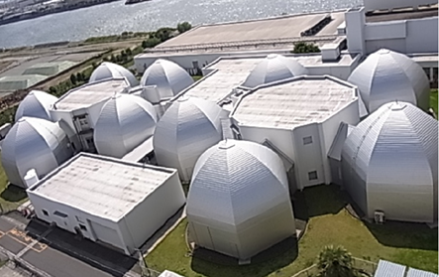
Outstanding Issues of HTS for High Quality Magnets
May 21-23, 2014
1st workshop on Accelerator magnets in HTS at DESY
H. Maeda and Y. Yanagisawa
RIKEN, Yokohama, Japan
NMR Facility
1

Slide 2
CONTENTS
Introduction
Magnetic field distortion and temporal magnetic field drift due to the screening current
Effect of screening current on the characteristic of LTS/Bi2223 NMR and LTS/REBCO NMR

Slide 3
Introduction

Slide 4
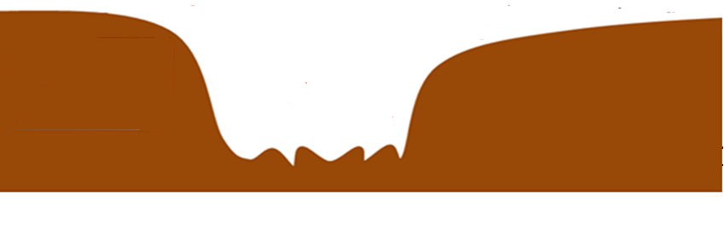
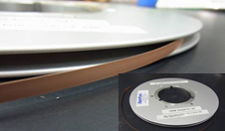
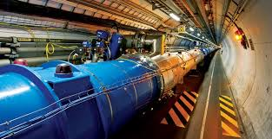
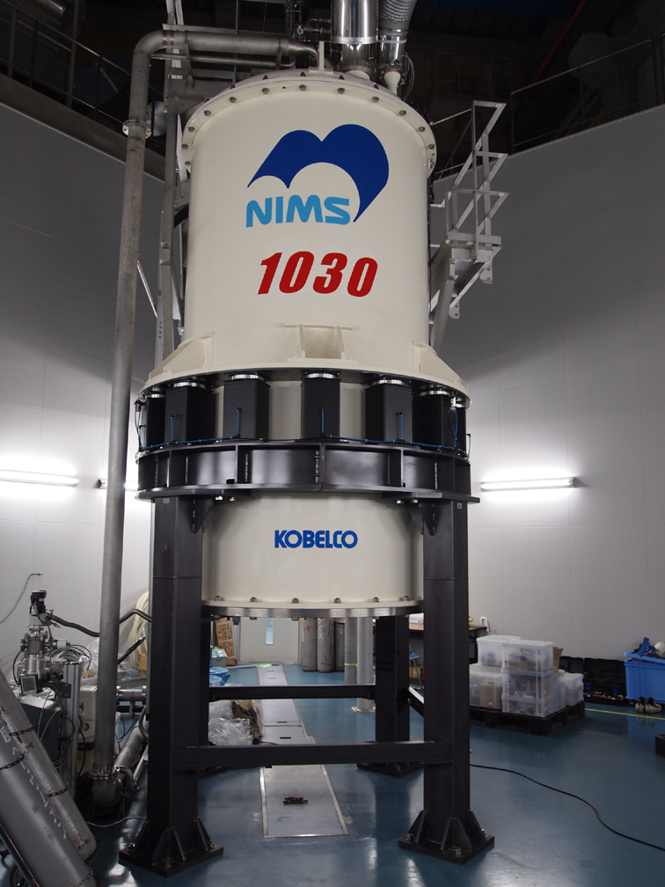
Gap between HTS conductors and HTS magnets
It is necessary to develop HTS magnet technology
HTS conductors
HTS
Magnet systems
Technological Gap
Accelerator
REBCO
NMR
4
Notes:
4

Slide 5
Magnet technology
LTS magnets
HTS magnets
Stability
AC loss
Quench protection
Structure
Magnetic field
Cryogenic engineering
Degradation in the coil performance due to delamination(REBCO)
Screening current-induced magnetic field (HTS)
Protection against thermal runaway(HTS)
Structure
Magnetic field
Cryogenic engineering

Slide 6
Magnetic field distortion and temporal magnetic field drift due to the screening current

Slide 7
Basic phenomena of the screening current-induced magnetic field

Slide 8
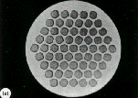
Screening current-induced magnetic field for LTS magnets
LTS mf conductor
For early LTS magnets, the screening current was enormous.
However, for modern LTS magnets, effect of screening current becomes negligible as LTS filaments are fine.
B_{z}
Axial magnetic field
Filament
Screening current
LTS Filaments
LTS Coil
Screening current-induced magnetic field, B_{s}
Net field
B₀ = B_{c} + B_{s}
Coil current magnetic field, B_{c}

Slide 9
Screening current-induced magnetic field for HTS magnet
REBCO
coil
REBCO
layer
B_{r}
Radial magnetic
field
Screening current
Screening current-induced
field, -B_{s}
Net field
B₀ = B_{c} - B_{s}
Coil current magnetic field, B_{c}
Notes:
In this slide, I want to explain the mechanism of the screening field. This is a schematic of a YBCO circular coil. During charging of the coil, radial component of the magnetic field is applied to the YBCO conductor surface and this field induces the screening current in the YBCO layer as excluding magnetic flux from superconductor. The screening current generates a screening field in the coil center in the opposite direction to the coil field. Therefore, the apparent field is composed of the coil field and screening field. Furthermore, the screening current decreases with time resulting in the long term field drift. So, the major problems for YBCO coil are reduction in the central field and field drift with time. In the following slides, I will show experimental data of screening field.

Slide 10
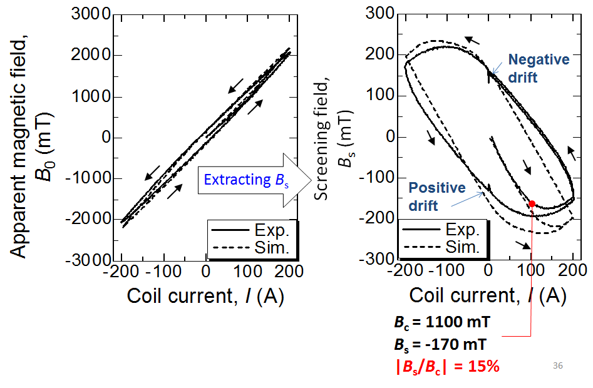
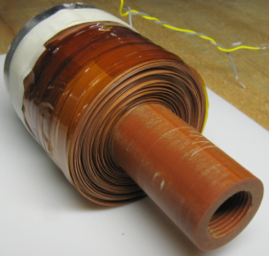
Hysteresis effect of the screening current-induced magnetic field for a REBCO magnet
@4.2K
ID 18mm
OD 45mm
L 25mm
Solenoid
Major problems:
Hysteresis effect
Reduction in the central field
Field drift with time
Y. Yanagisawa et al., IEEE Trans. Appl. Supercond. 20, 744-747(2013)
Notes:
Here you can see the central magnetic field for a small YBCO solenoid as a function of coil current. During charging and discharging process the values of the field dose not coincide. This nonlinear effect is due to screening field. You can extract the screening field from the measured data and this is the screening field as a function of coil current. For the virgin ramp the screening field decreases with coil current. Then, the field saturates, and starts to decrease in its absolute value. After that the field shows the general type of hysteresis for magnetization. The important point here is that the screening field reduces the central field. For example, when the coil current is 100 A, the central field is 1.1 T while the screening field is minus 0.17T. So the field reduction rate is as large as 15%, which is very large rate. Dashed line in both graph shows a numerical simulation result. The detail of the numerical method is described in our previous paper. So I will skip the explanation of the method and move on to the simulation results for various coils.

Slide 11
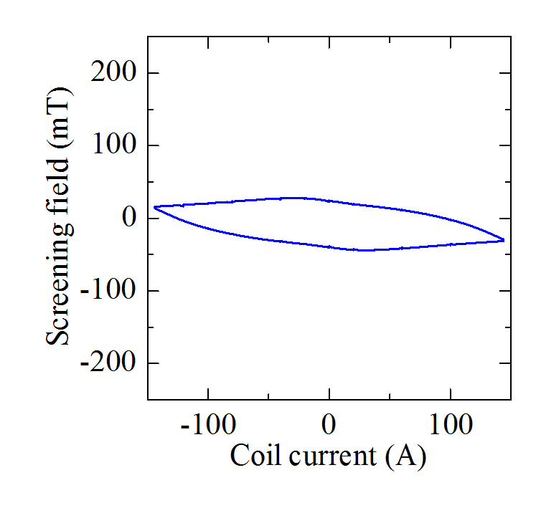
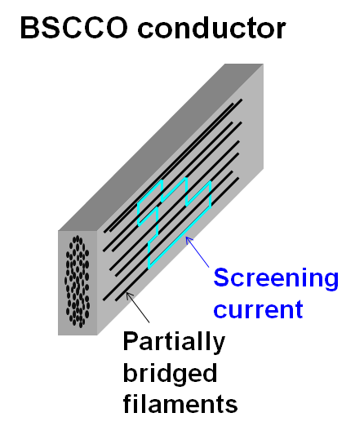
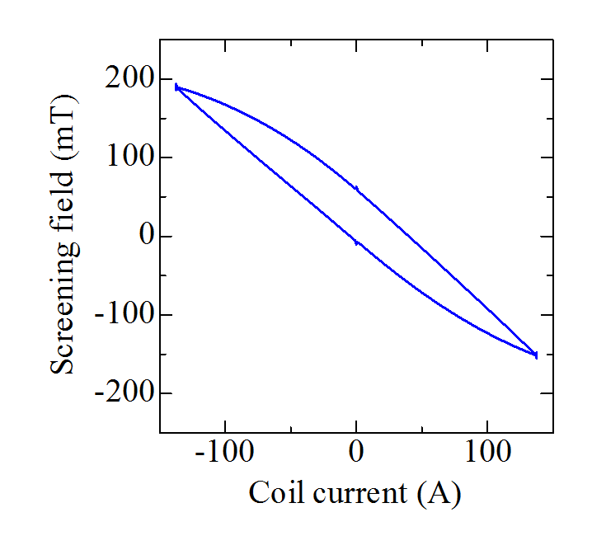
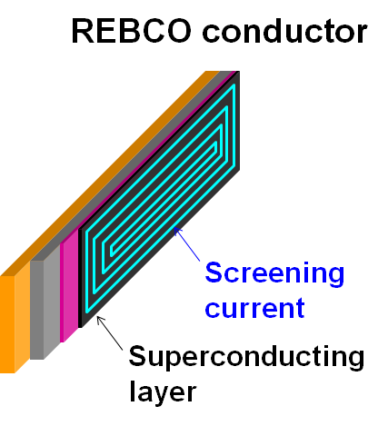
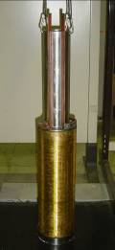
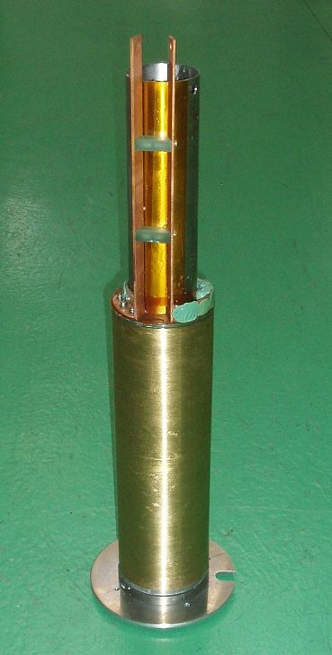
Comparison between Bi2223 and REBCO
@4.2K
Bi2223 coil
REBCO coil
-29mT
-155mT
Saturation
Unsaturation
Id 81mm
Od 121mm
L 375mm
Id 81mm
Od 119mm
L 400mm
Screening current-induced magnet field for a REBCO coil is 5-fold larger than that for a Bi2223 coil

Slide 12
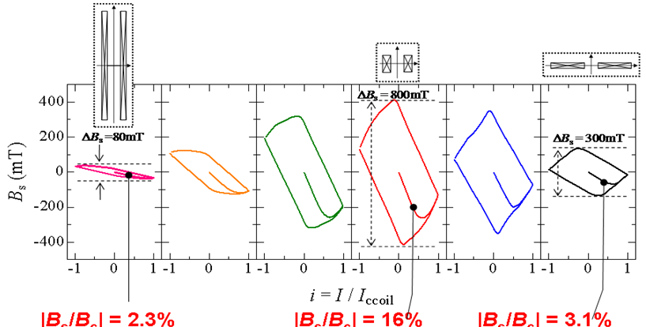
Dependence of hysteresis on the coil shape
: Shape factor of the solenoid
The central magnetic field is the same, while the shape is different
Thin cylinder
Min. volume design
Numerical simulation for REBCO
Disk
@4.2K
Notes:
Here we have hysteresis loops of screening field for the coils. Vertical axis shows screening field while horizontal axis shows coil current normalized by the critical current of the coil. This is a long and thin coil while this is a disk shape coil and this is minimum volume coil. What is interesting here is that the minimum volume designed coil shows the most apparent screening field. Let me compare the field reduction rates for these coils. For the long and thin coil, the coil field is 1.58T while the screening field is -0.0363T at this point. The field reduction rate is as small as 2.3%. For the disk shape coil, the rate is also as small as 3.1%. But, for the minimum volume coil, the field reduction rate is as large as 16%. The most important point here is that the field reduction rate shows maximum when the coil is minimum volume configuration. In other words, the minimum volume coil is effective for generating not only central field but also screening field. This rate is large problem for the practical superconducting coil. However, in the present case, the inner diameter of the coils are as small as 18mm. So we have to investigate the screening field for much larger coils.

Slide 13
Remedies for the screening current-induced magnetic field

Slide 14
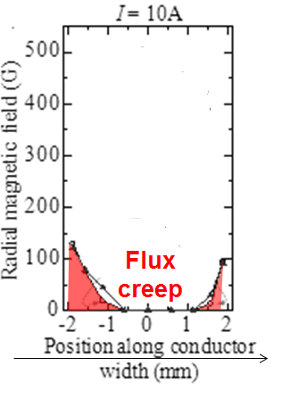
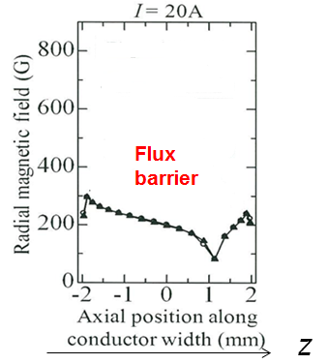
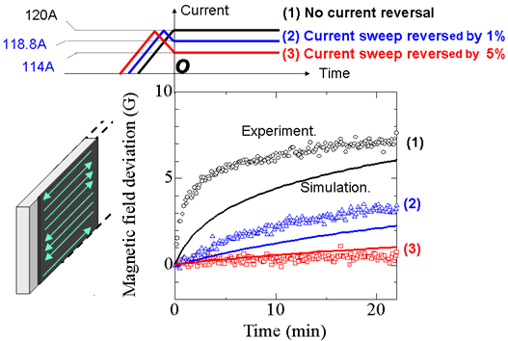
Current sweep reversal method
@4.2K
@77K
z
Flux
Flux
REBCO coil
z
Several % of current sweep reversal is necessary for HTS magnets, while 0.2-0.5% for LTS magnets.
The magnet should endure a current of 105% of the operation current
Y. Yanagisawa et al., Physica C 469, 1996-1999(2009)

Slide 15
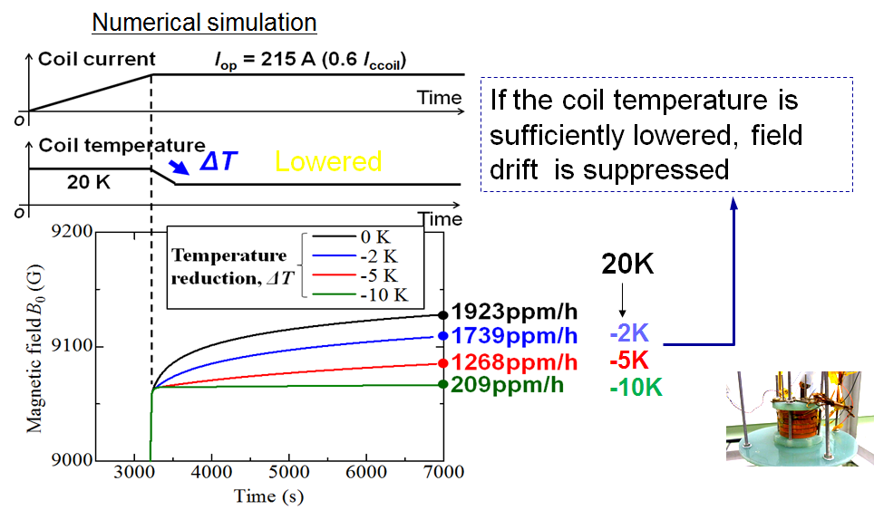
Temperature change
If the coil temperature is lowered, the critical current density is enhanced, thus flux creep is suppressed
Lowered
REBCO coil
Y. Yanagisawa et al., Adv. Cryo. Eng. 1434, 1373-1380 (2012)

Slide 16

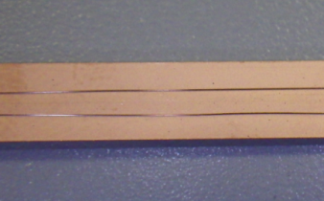
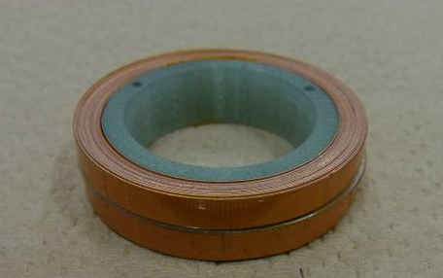
Scribed multi-filamentary REBCO conductor
Usual REBCO conductor
Mechanically scribed 3-filasment REBCO conductor
4mm
4mm
@77K
The screening current-induced field is remarkably reduced, if a scribed REBCO conductor is used

Slide 17
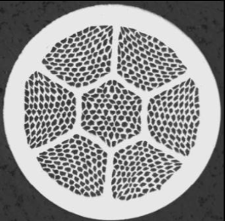
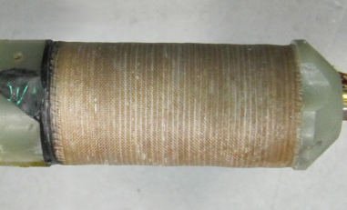
Bi2212 multi-filamentary round conductor
Bi2212 round conductor
33.8T coil, developed in NHMFL
If multi-filamentary/ twisted Bi2212 round conductor is used, the screening current-induced magnetic field will be negligible as for LTS coils.
U. P. Trociewitz, et al. Appl. Phys. Lett. 99, 202506(2011)
D. C. Larbalestier et al., “ A transformative superconducting magnet technology, 2013.

Slide 18
Effect of screening current on the characteristic of LTS/Bi2223 NMR and LTS/REBCO NMR

Slide 19
Necessity of the LTS/ HTS NMR magnet

Slide 20
History of the NMR magnetic field
RIKEN started to develop super-high field NMRs
High Temperature Superconducting (HTS) Magnets.
H_{c2}>50 T
1 GHz, 23.5 T
Low Temperature Superconducting (LTS) Magnets.
H_{c2}< 25 T
1 GHz NMR
920 MHz NMR
Notes:
20

Slide 21
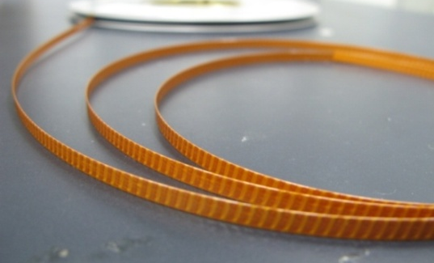
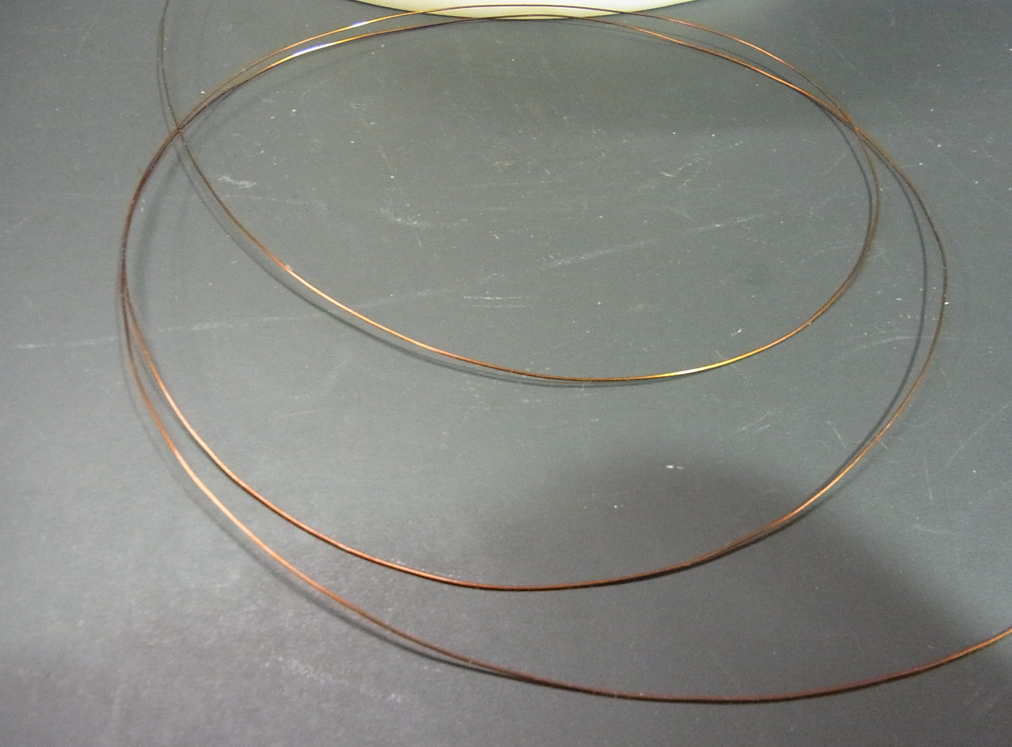
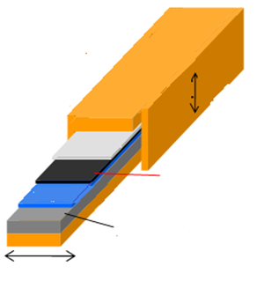
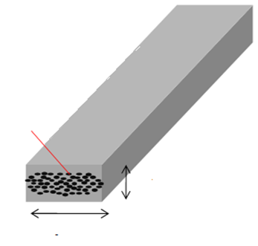
Two available HTS conductors
Bi2223 conductors
REBCO conductors
Copper
Silver matrix
0.1-0.15 mm
Buffer layer
Superconducting multi-filaments
Superconducting thin layer(1-2 μm）
0.3-0.5 mm
Hastelloy
4 mm
4-12 mm
A: Long conductor 1 km
D: Low mechanical strength →Lower current density → larger magnet
A: High mechanical strength
→High current density
→ compact size magnet
D: Shorter length 100-200m

Slide 22
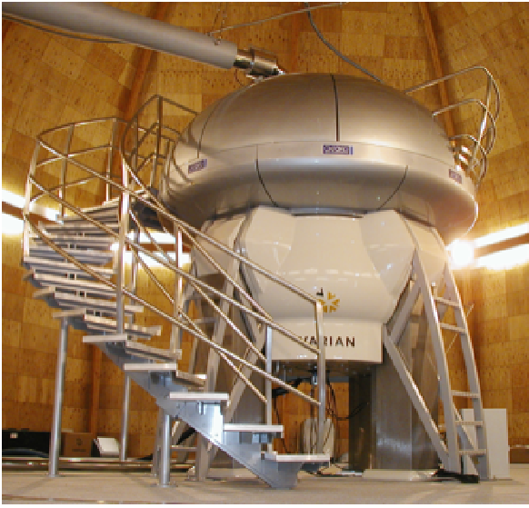
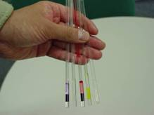
Technical problems for an NMR magnet
Strong magnetic field intensity
Spatial field homogeneity
1ppb／5mm dia. cylinder
NMR sample
NMR magnet
Temporal field stability
0.1ppb
22

Slide 23
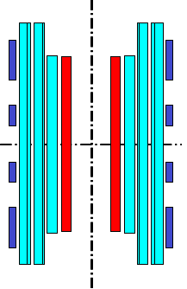
Spatial homogeneity of the magnetic field
Legendre Polynomials
Axial error component
Radial error component
Target: 1ppb
Superconducting shim coils(z,z²,x,y, zx, zy, xy,x²-y²) < 10 ppm
Room temperature shim coils & iron shims <1ppb
Field correction coils
（z² and z⁴ are canceled）
< 500ppm

Slide 24
Comparison between LTS/ Bi2223 NMR magnet and LTS/REBCO NMR magnet

Slide 25
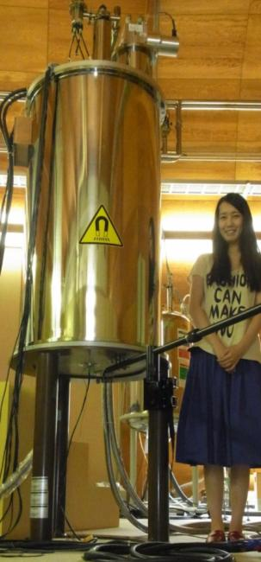
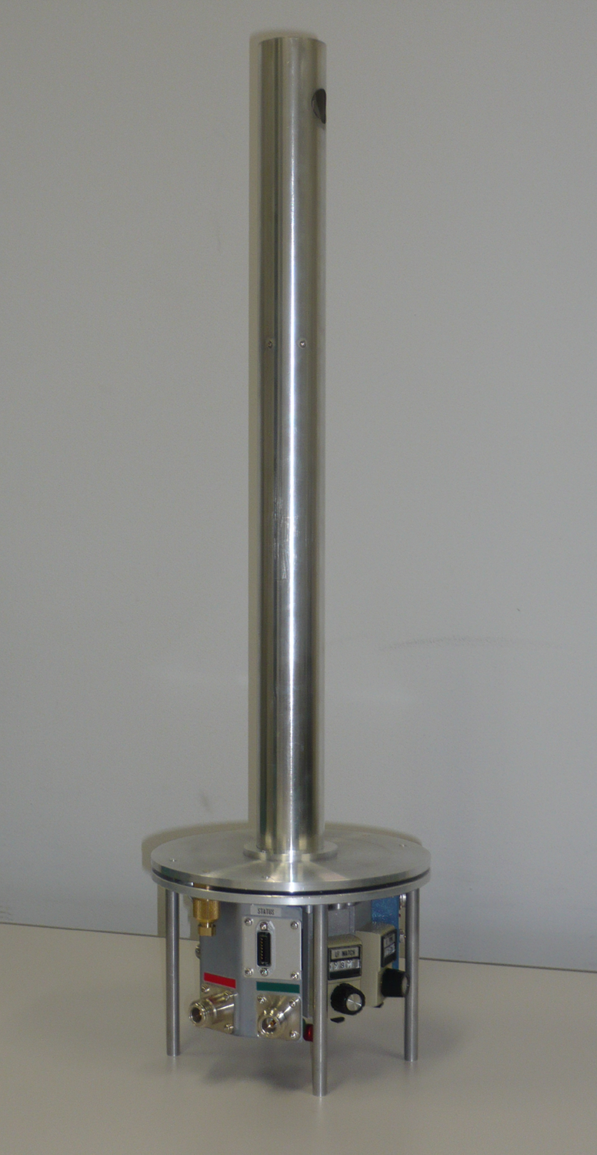
World’s first LTS/Bi2223 NMR magnet and LTS/REBCO NMR magnet(400-500MHz)
Bi2223 inner coil
)
Pulse-tube cryocooler
REBCO inner coil
Ultra-stabilized
DC-power supply
< 1ppm
(2009)
(2013)
Id 81mm
Od 121mm
L 375mm
NbTi/ Nb₃Sn outer coils
Yanagisawa et al, JMR (2010)
Kiyoshi et al, IEEE TAS (2010)
NMR probe
(¹H, ¹³C, ¹⁵N )
Notes:
We installed the REBCO coil in the conventional LTS NMR at the inner most part. The configuration of the REBCO coil is nearly equal to the Bi2223 innermost coil developed and tested in 2008. The magnet was operated in driven mode with a highly stabilized DC power supply. We have a 4K pulse tube cryocooler on the top flange of the magnet. The evaporated liquid helium due to heat leak was recondensed using pulse-tube cryocooler for helium refill free continuous operation.

Slide 26
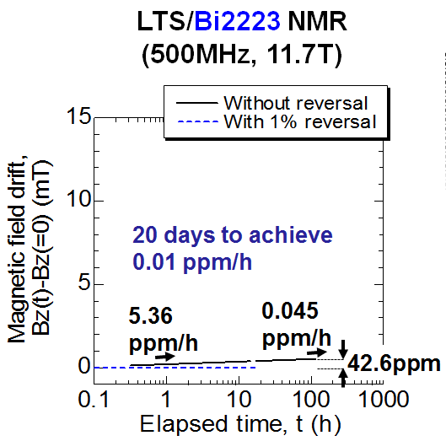
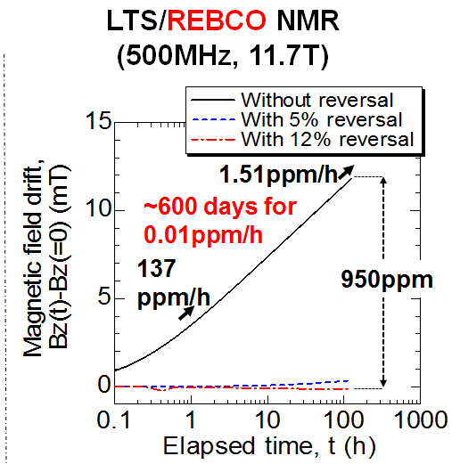
Temporal field drift after the magnet charge
Temporal field drift due to screening current for an LTS/REBCO NMR is >20-times steeper than that for an LTS/Bi2223 NMR
Notes:
I am going to show the magnetic field drift with time after magnet charging due to the relaxation of the screening current. For Bi2223 NMR, the drift is not so large and it took 20 days to obtain 0.01ppm/h which is the required stability of NMR magnets. So we just waited for 20 days. On the other hand, for the REBCO NMR, the drift was substantial. It is estimated that we require 600 days to get the rate of 0.01ppm/h. This is impractical time interval. We used current sweep reversal operation with about 10% overshooting to suppress the drift and obtained the stable magnetic field.

Slide 27
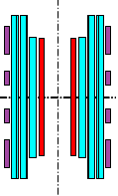
Spatial distribution of the magnetic field
LTS/Bi2223 NMR
(500MHz, 11.7T)
LTS/REBCO NMR
(500MHz, 11.7T)
Z¹: -23ppm at ±1cm
Z²: -83ppm at ±1cm
Z¹: -2.1ppm at ±1cm
Z²: -0.41ppm at ±1cm
<< superconducting shim coils(2ppm)
>> superconducting shim coils(2ppm)
Axial position (cm)
The field generated by the field correction coil is reduced by 27% due to the LTS/REBCO coil, resulting in excessive residual z² component. Therefore, additional iron shims were required.
Notes:
Next, I am going to talk about the magnetic field distribution. This is magnetic field versus coil axial position for Bi2223 NMR. There is not notable field inhomogeneity and we corrected the field error harmonics using SC shim and RT shim. On the other hand, for REBCO NMR, we found the remarkable inhomogeneity. Here you can see the notable Z2 error harmonics. This is

Slide 28


Degradation in the superconducting(SC) shim coil performance
The SC shim coil performance is remarkably degraded due to the screening current induced in the HTS coil, especially for REBCO
Axial SC shim coils
Radial SC shim coils
$$z and z2$$
$$x, y, zx, zy, xy, and x2−y2$$
LTS/Bi2223
40% of the design
LTS/REBCO
→ 20% of the design
LTS/Bi2223
20-40% of the design
LTS/REBCO
→ < 5% of the
design
Difficult to make a field correction!
Notes:
Radial shims coils generate transverse magnetic field like this. So the shim coil field is effectively shielded by the screening current. That’s why we could not correct the residual radial field error harmonics.

Slide 29
Comparison of NMR resolution and sensitivity
 | LTS NMR | LTS/Bi2223 NMR | LTS/REBCO NMR
NMR resolution | <1Hz(2ppb) | 0.7Hz(1.4ppb) | 15Hz(30ppb)
NMR sensitivity S/N | >600 | 512 | 28
20-fold lower resolution and sensitivity
The same quality
Resolution
Signal
Sensitivity(S/N)
Noise
NMR spectrum

Slide 30
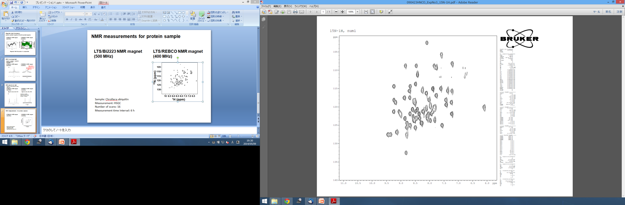
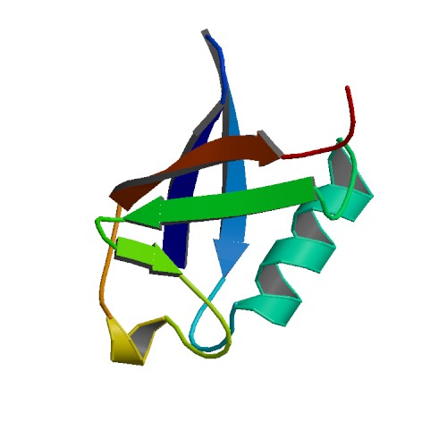
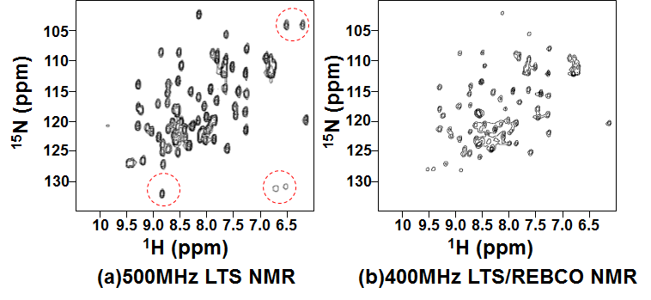
NMR spectra for a protein
LTS/Bi2223 NMR magnet
LTS/REBCO NMR magnet
2D-HNCO
HSQC
¹⁵N (ppm)
Ubiquitin (protein)
¹H (ppm)
Nearly the same quality as conventional NMRs
The number of the available NMR measurement is limited
30

Slide 31
Collaboration between NHMFL and RIKEN
on a 400 MHz LTS/Bi2212 NMR magnet
NHMFL
RIKEN
Bi2212 inner coil
Develop and evaluate an LTS/Bi2212 NMR magnet in collaboration between NHMFL, coil fabrication, and RIKEN, NMR measurement.
The experiments in RIKEN is planned to be conducted in 2015.
NMR probe

Slide 32
Comparison of NMR resolution and sensitivity
 | LTS NMR | LTS/Bi2223 NMR | LTS/Bi2212 NMR | LTS/REBCO NMR
NMR resolution | <1Hz(2ppb) | 0.7Hz(1.4ppb) | XXX | 15Hz(30ppb)
NMR sensitivity S/N | >600 | 512 | XXX | 28
Resolution
Signal
Sensitivity(S/N)
Noise
NMR spectrum

Slide 33
Summary
Effect of screening current induced magnetic field on the performance of high quality magnet such as NMR, MRI and accelerator is enormous.
It can be effectively suppressed by current sweep cycling and temperature change cycle, in addition to using adequate conductor.
The quality of the NMR spectra achieved by LTS/Bi2223 NMR magnet is nearly the same as that by LTS NMR magnet.
NMR spectra achieved by the LTS/REBCO NMR magnet is 20-fold broader than those by LTS NMR. Therefore, available NMR measurements are rather limited.

Slide 34







Acknowledgement
This work is partially supported by JST
RIKEN
Dr. T. Yamazaki
Dr. M. Takahashi
Dr. X. Jin
JASTEC
Dr. M. Hamada
Dr. K. Kominato
NIMS
Late Dr. T. Kiyoshi
Dr. S. Matsumoto
JEOL RESONANCE
Mr. H. Suematsu
Chiba University
Prof. Hideki Nakagome
Sophia University
Prof. T. Takao
Mr. S. Iguchi

Slide 35
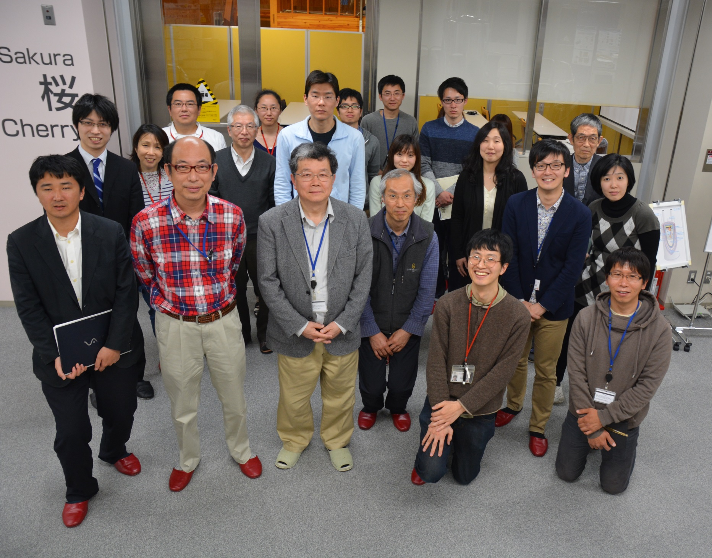
22
Thank you very much for your attention!
35

Slide 37
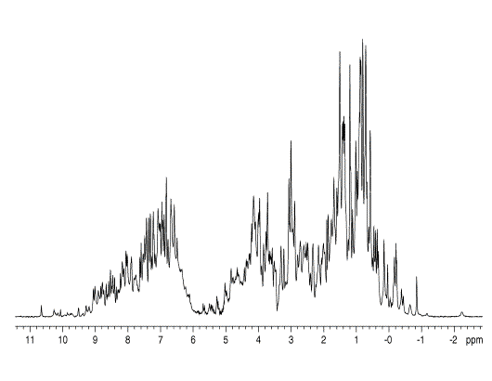
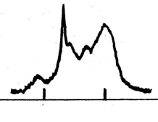
Why higher magnetic field is required in NMR ?
Protein sample
NMR magnet
NMR sample
Frequency
Frequency
0.94T (40MHz)
11.75T(500MHz)
NMR resolution and sensitivity (S/N) are remarkably enhanced with the increase of the magnetic field

Slide 38
Numerical simulation of the screening current induced magnetic field
■Current diffusion equations for each current element
■Relation between transport current and current density
■Power law E-J characteristics
■J_{c}-B characteristics
Convergence
Current element
Notes:
Here, we have numerical simulation method for calculating the screening field. The detail of the method is described in our previous paper, so I will skip the detail and show simulation result in the next slide.

Slide 39
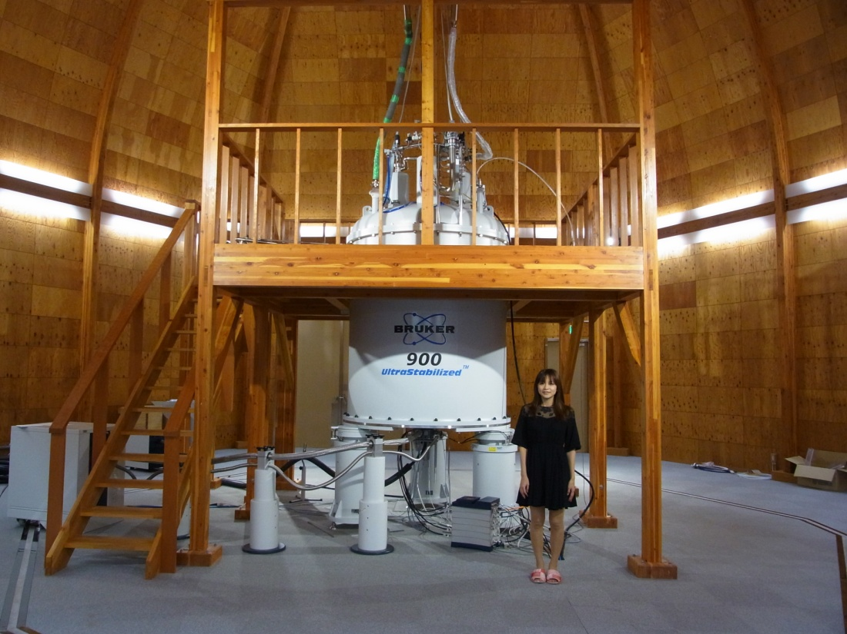
Bottleneck of high-field NMR magnets
LTS/Bi2223 NMR magnet
LTS/REBCO NMR magnet
LTS NMR magnet
930
700
800
1200
600
600MHz
(14.1T)
700 MHz
(16.5T)
800 MHz
(18.8T)
930MHz
(21.9T)
1.2GHz
(21.8T)
Notes:
By using this kind of technology, we want to make this kind of paradigm shift for NMR magnets. We are thinking about the 1.1GHz NMR magnet with the size of 700MHz magnet.

Slide 40
Temporal stabilization of the magnetic field
High temporal stability of the local magnetic field is achieved by using a ²H field-frequency lock system <1ppb
Target: 0.1ppb
Current
Ultra-stabilized DC current supply <1ppm

