Slide 1
Roebel cable industrial optimization - General Cable Superconductors
Dr Nick Long, Robinson Research Institute,
Victoria University of Wellington, New Zealand
WAMHTS-1, February 2014
Acknowledgements: Rod Badcock, Kent Hamilton, Chris Bumby, Marc Mulholland, Zhenan Jiang

Slide 2
Contents
Introduction to Roebel
Design of strands
Punching strands
Testing I_{c}
Cable assembly
Cable I_{c}
Mechanical properties
Insulation and reinforcement

Slide 3
Cable attributes for magnet applications
High current; uniform I_{c}
Available in long lengths
$/kA-m
Stability (risks of quench, equal current sharing among strands)
Mechanical behaviour
  I_{c} – stress, transverse and longitudinal
  Bending radii
  Coil manufacture; potting
Manageable AC losses

Slide 4

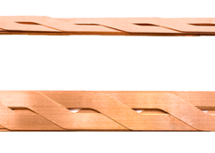
HTS Roebel cable
Started R&D at IRL in 2004
Commercialised through General Cable Superconductors
Goals
Develop long length Roebel cable manufacture
Prove applications in high current and/or AC machines
  150 MW generator (Siemens)
  1 MVA Transformer (Robinson Research Institute (ex IRL))

Slide 5
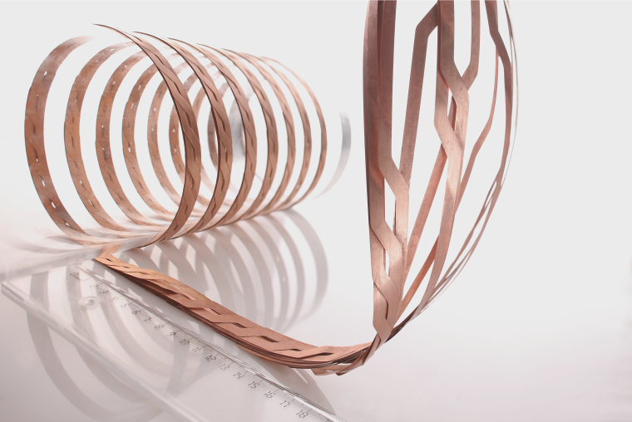


What is HTS Roebel Cable?
A high capacity winding cable from coated conductor
Continuously transposed
Photo courtesy of Siemens
Cables are labelled (no. of strands) / (strand width)

Slide 6
Design of strands/cable
Existing designs are a compromise
  Use the wire which was available
    12 mm SuperPower
    10 mm Fujikura and STI (from 2013)
  Keep tool piece manufacture simple
  Minimise problems in automated winding
  Minimise mechanical problems

Slide 7
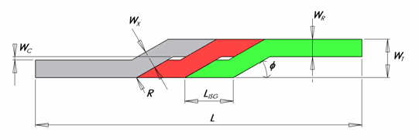
Design of strands
Figure – Roebel strand
“15/5”
300 mm
2 mm
6.0 mm
5 mm
12 mm
30°
Figure – Strands wound together and geometric parameters
Parameter | Name | 2 mm Cable | 4.5 mm Cable | 5 mm Cable
L_{TRANS} (=2L) | Transposition length | 90 mm | 300 mm | 300 mm
W_{R} | Strand width | 2 mm | 4.5 mm | 5 mm
W_{X} | Crossover width | 1.7 mm | 5.0 mm | 6.0 mm

Slide 8
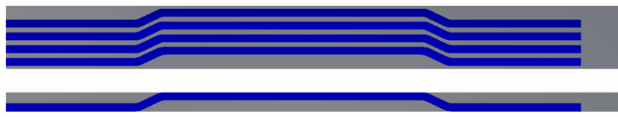
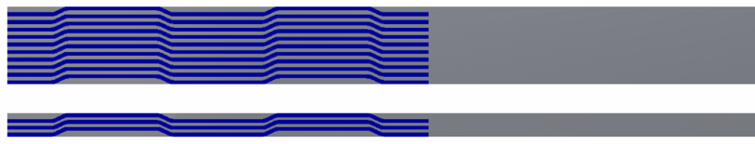
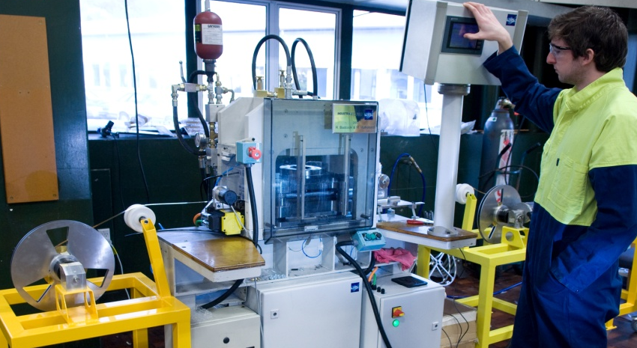
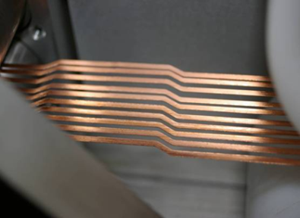
Strand manufacture
(a)
(b)
Punching
(c)
(d)
Formation of Roebel punched strands in 40 mm and 12 mm wide feedstock material.
4 x 5 mm strands in 40 mm wide material,
1 x 5 mm wide strand in 12 mm wide material,
10 x 2 mm strands in 40 mm wide material,
3 x 2 mm wide strands in 12 mm wide material.
Automated multi-strand production
Wire demonstrated: AMSC, SuperPower, Fujikura, STI

Slide 9
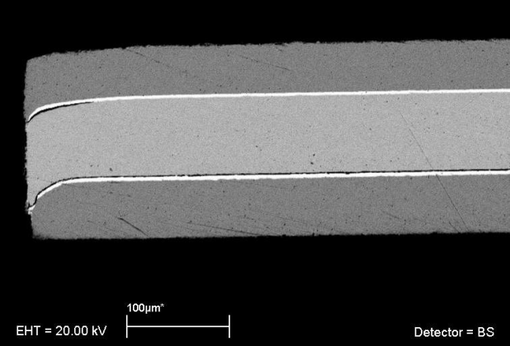
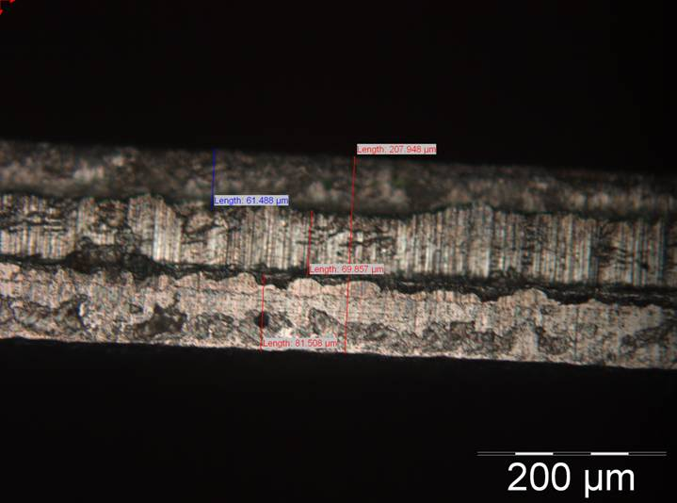
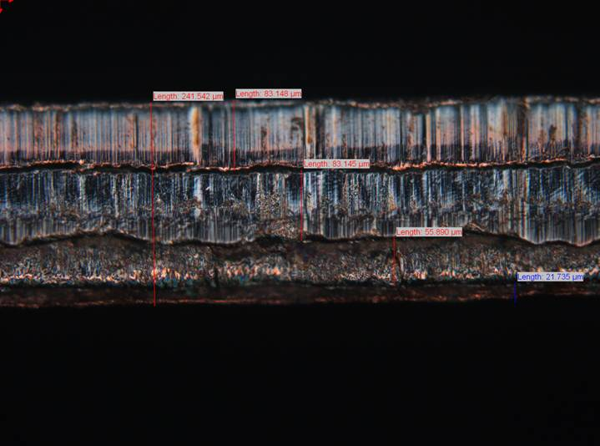
Quality of punching: AMSC wire
Electroplated copper/NiW
Electroplated copper/NiW
AMSC 3 ply SS/NiW/SS
AMSC 4 ply Cu/2x NiW/Cu

Slide 10
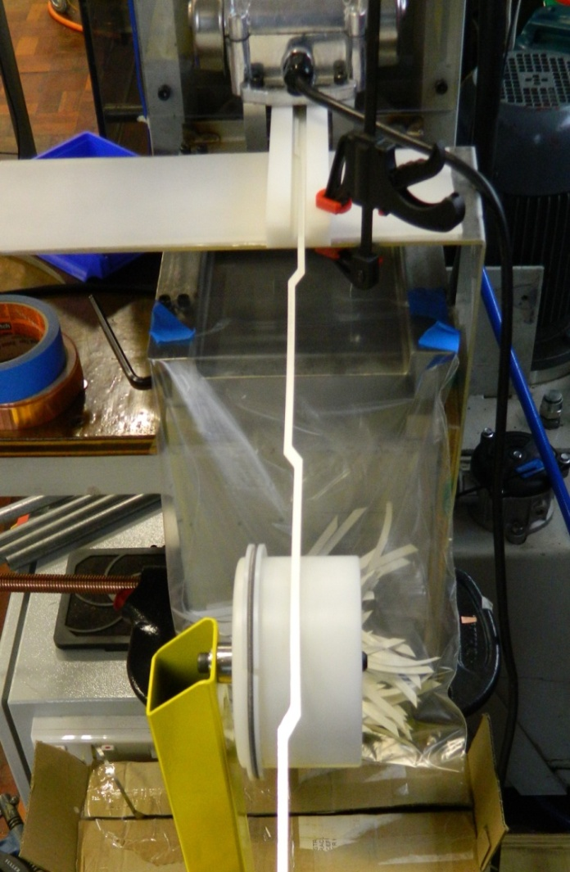
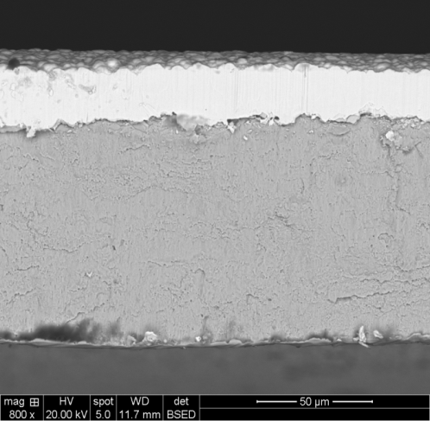
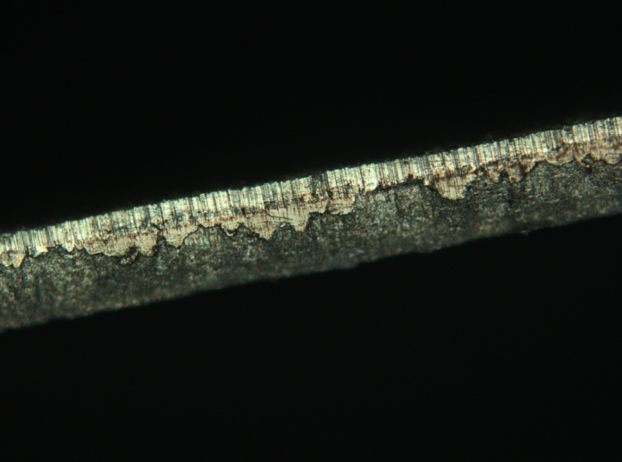
Fujikura: Silver-stabilised punched strand
Ag capping layer
Ceramic layers
Hastelloy substrate
Ag “smearing” occurs over punched edge

Slide 11
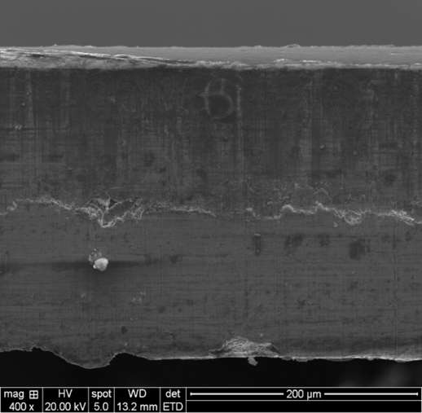
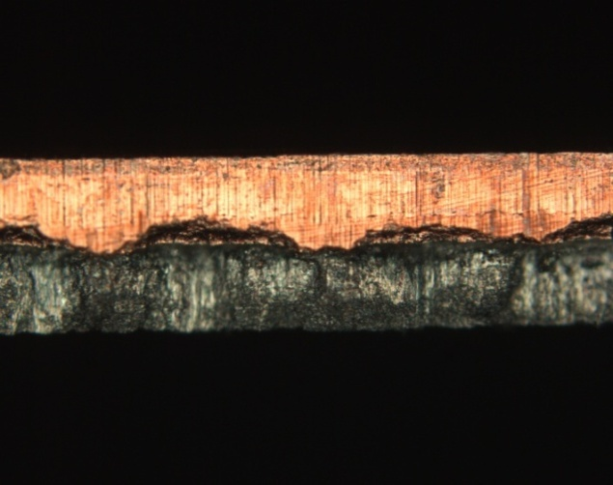
Fujikura Cu-laminated wire – punched strand
Cross section of punched edge from
Cu-laminate stabilised wire (GCS00048):
Copper laminate (stabilizer)
Ceramic layers
Hastelloy substrate
Total thickness: ~200µm

Slide 12
Wire qualification
defect
Current flow in a wire
Current flow in a Roebel strand
!

Slide 13
Wire qualification
(a)
(a)
0.023 T
Scan wire magnetically (penetrated or remanent field)
Quantify uniformity using statistical correlation with an ideal magnetic profile
200mm
(b)
0.000 T
We use continuous scanning of the Remanent magnetic field to assess tape quality (a) tape with a known defect, and (b) tape with only small scale variability.
Where |Correl | ≤ 1 X is a dataset representing calculated field
Y{y₁…y_{j}} is magnetic data across tape
Some wire is extremely good !
Correlation along a length of YBCO wire, a minimum Correl can be specified for input wire

Slide 14
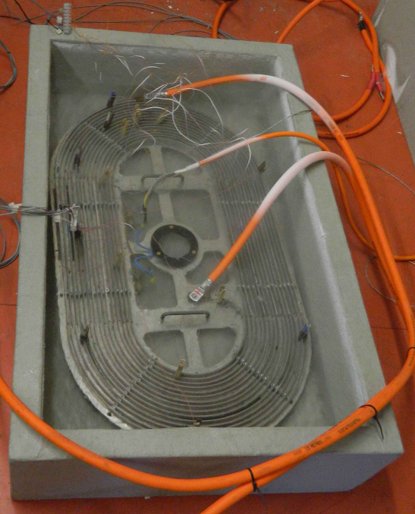
I_{c} measurement of strands
Spiral racetrack former for testing strands up to length 30 m.
Punched strands are moisture sensitive
Heat in dry nitrogen only

Slide 15
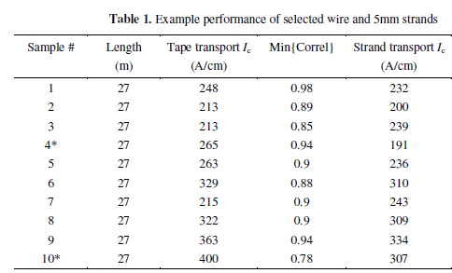

Slide 16
Summary of strand performance
(J_{e} strand) / (J_{e} wire) ~ 90-95%
High minimum value of Correl is necessary but not sufficient condition
→ ΔI_{c} also needs to be considered
→ Length of defect important
→ Scaling to low T, defects look like a cross sectional loss of conductor
Can we mitigate low Correl values?
  Probably not!

Slide 17
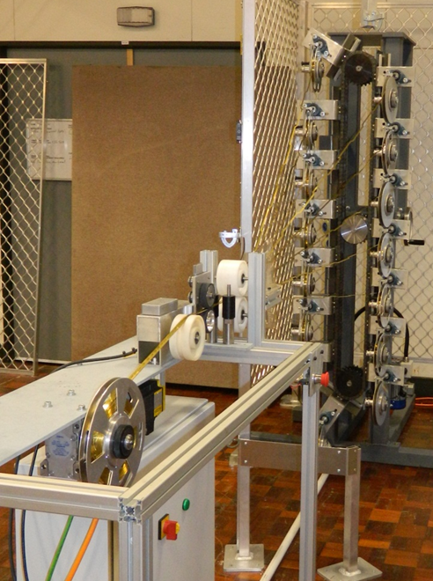
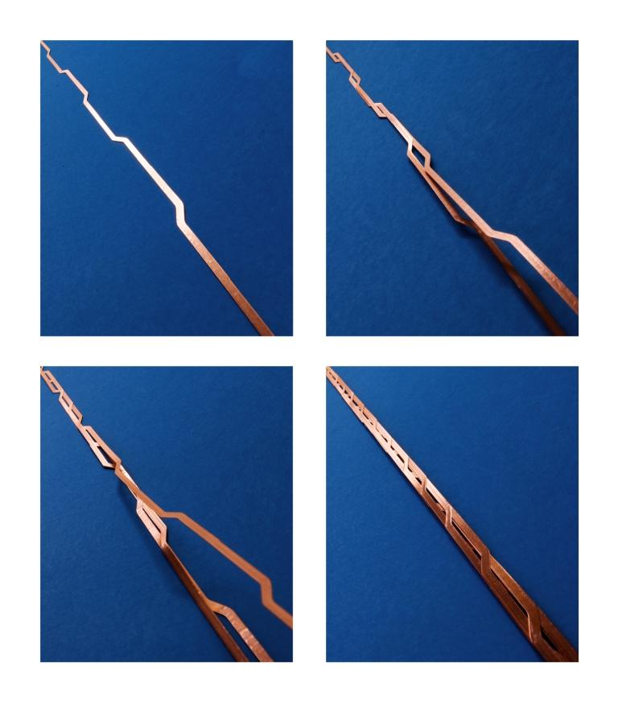
Cable assembly
Illustration of the assembly process
Automated planetary wind system for 15/5 cable

Slide 18
Assembly issues
Long length registration of crossovers
  Need high precision for each transposition length in the punching process
  Need tension control on strands in winding
  Difficult to simulate (relevantly) with low cost dummy cables
    Mechanical properties
    Camber

Slide 19
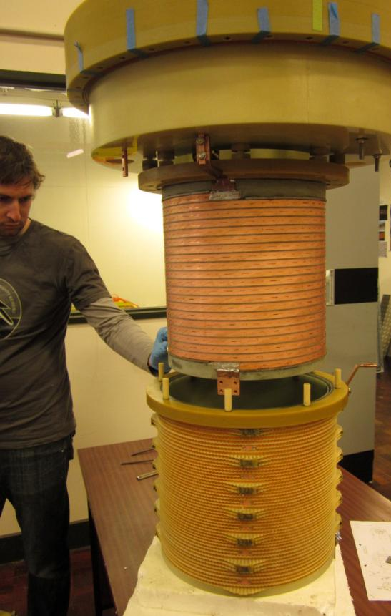
I_{c} measurement of cables @ 77 K
Cable details | Cable I_{c} (A)
 | Design I_{c} | Measured | Computed
5/2 | 252 | 203 | 220.1
9/2 | 426 | 318.8 | 339.1
9/2 | 426 | 341.9 | 359.1
15/5 | 1454 | 1100 | 1033
15/5 SRC0024 | 1616 | 1010 | 1109
15/5 SRC0027 | 2093 | 1410 | 1372
15/5 cable from SuperPower wire
RRI – 1 MVA Transformer
Measured I_{c} has been close to expected I_{c}
For short length cables accurate I_{c} measurement is difficult
At 77 K there are strong self-field effects

Slide 20
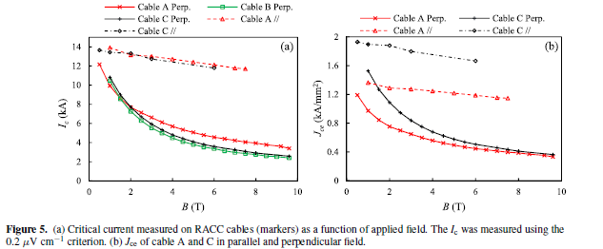
I_{c} measurement of cables @ 4.2 K
J. Fleiter et al, Supercond. Sci. Technol. 26 (2013) 065014
15/5 cable from SuperPower wire
From manufacturing perspective cables work as advertised
Measured I_{c} close to expected I_{c} (taking into account self-field)
These cables used both ‘CF’ (Cable A) and ‘AP’ (B + C) Superpower wire
Actual strand I_{c} @ 4 K values were not measured

Slide 21
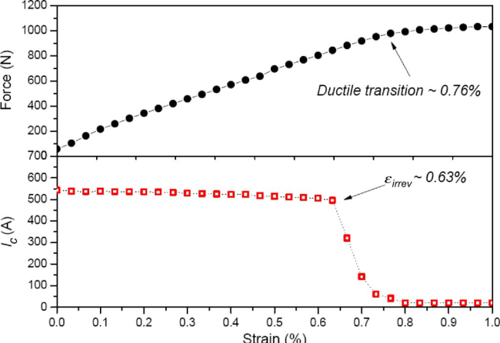
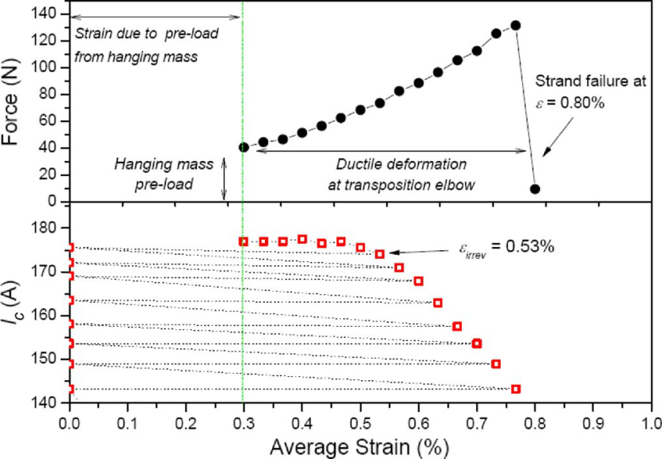
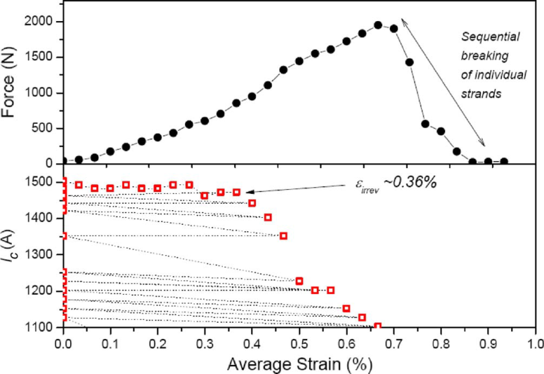
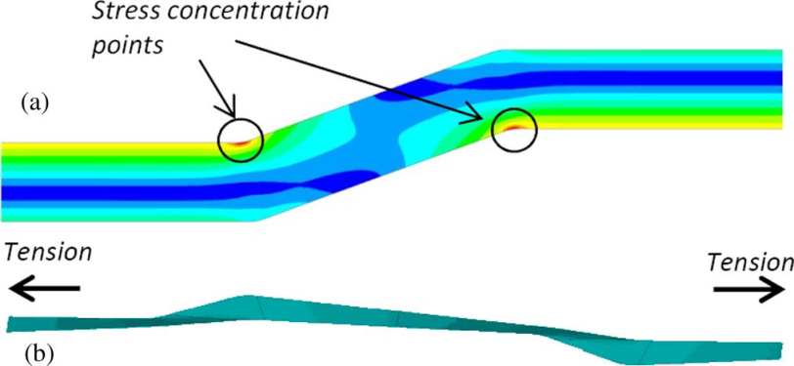
Mechanical properties – longitudinal stress-strain
SuperPower 12 mm wire
Irreversible change @ 840 N (700 MPa).
Roebel 5 mm strand (146 MPa)
Von Mises stress @ 0.4% strain
15/5 Roebel cable
Irreversible change @ 850 N (113 MPa).

Slide 22
Mechanical properties
Roebel shape weakens structure
  1/6 reversible strain limit of straight wire
Mitigate through
  Potting
  Reinforcement and wrapping
Transverse stress effects
  Again get stress concentration
  Up to 45 MPa without I_{c} degradation (15/5 cable - CERN)
  Degradation at 10 MPa, (10/2 cable with insulated strands - EPFL)

Slide 23
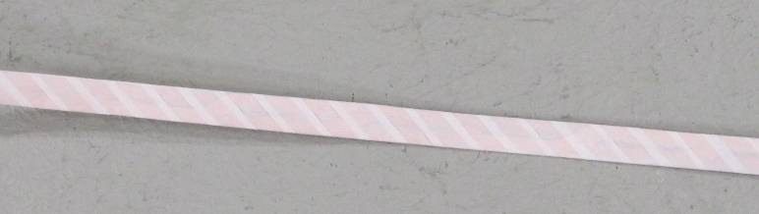
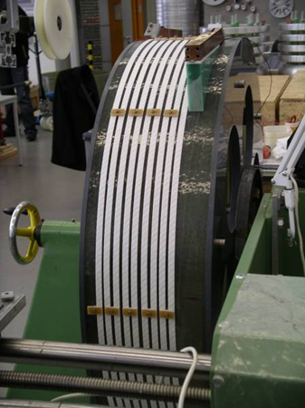
Wrapped insulation
Nomex wrapped 12 mm wide cable
Need to include a reinforcing Hastelloy or stainless steel tape
Nomex adds 200 microns total thickness
Roebel cable ready for testing at Siemens Corporate Technology, Germany.

Slide 24
Winding and Potting coils
Strands need to move during coil winding
  Tight insulation wrapping not advisable
Coated conductor has known interfacial mechanical weakness which can cause problems in potting
  This applies to Roebel as well
  We have damaged cable by using Stycast
Getting complete void filling needs consideration for large coils

Slide 25
Conclusions
Manufacturing procedures in place for long lengths
I_{c} performance
  Cables preserve tape performance (~90%)
Quality control
  Measuring magnetic Correl is relatively easy
  Measuring strand I_{c} is time consuming and adds risk
Cables up to 25 m (15/5 cables) delivered to customers
  We have wound up to 40 m length
Cost ultimately dominated by wire cost
AC loss well characterised (not discussed here)

Slide 26
Thank you for your attention!

