Slide 1
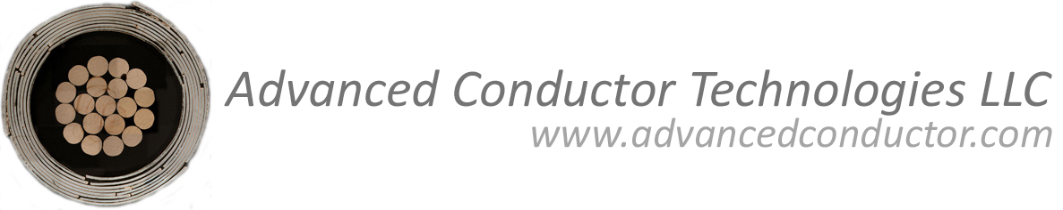

Conductor on Round Core (CORC) cable development for accelerator magnets
Danko van der Laan
Advanced Conductor Technologies & University of Colorado
Boulder, Colorado, USA
Fraser Douglas
Advanced Conductor Technologies, Boulder, Colorado, USA
Xifeng Lu
University of Colorado,Boulder, Colorado, USA
Ulf Trociewitz and David Larbalestier
Applied Superconductivity Center, National High Magnetic Field Laboratory, Florida State University, FL 32301, USA
WAMHTS-1, Hamburg, Germany, May 22, 2014

Slide 2
Outline
1. Introduction to ACT and CORC cables.
2. CORC cables for fusion magnets.
3. Mechanical properties of CORC cables.
4. CORC cables for high-energy physics magnets.
5. Production of long, high-quality CORC cables.
6. CORC cable performance projections.

Slide 3
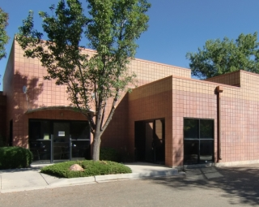
Advanced Conductor Technologies LLC (ACT)
Founded in June 2011 as a spin-off from the University of Colorado and the National Institute of Standards and Technology (NIST)
Advanced Conductor Technologies focuses on the commercialization of high-temperature superconducting Conductor on Round Core (CORC) cables for high-density power transmission and high-field magnets.
Personnel at ACT:
1. Danko van der Laan, Ph.D.
2. Annemiek Kamphuis, M.Sc.
3. Fraser Douglas Ph.D.
New location:
3082 Sterling Circle Unit B, Boulder, CO 80301 (2851 SF)

Slide 4
Programs supporting CORC cable development
Advanced Conductor Technologies:
1. Department of Energy – Office of Fusion Energy Sciences
- CORC cable for fusion magnets
- Phase II STTR (2 years – April 2013 to April 2015)
- Subcontractor is MIT (Joe Minervini, Phil Michael and Leslie Bromberg)
2. Department of Energy – Office of High Energy Physics
- CORC cables for accelerator magnets
- Phase II SBIR (2 years – April 2014 to April 2016)
- Subcontractor: NHMFL (David Larbalestier and Ulf Trociewitz)
3. Navy
- He-gas cooled CORC power transmission cables
- Phase II STTR (2 years – February 2014 to January 2016)
- Subcontractor is CAPS (Sastry Pamidi and Chul Kim)
University of Colorado:
1. Department of Energy – Office of High Energy Physics
- support for high-J_{e} CORC cable development
- Base program (3 years – April 2012 to March 2015)

Slide 5

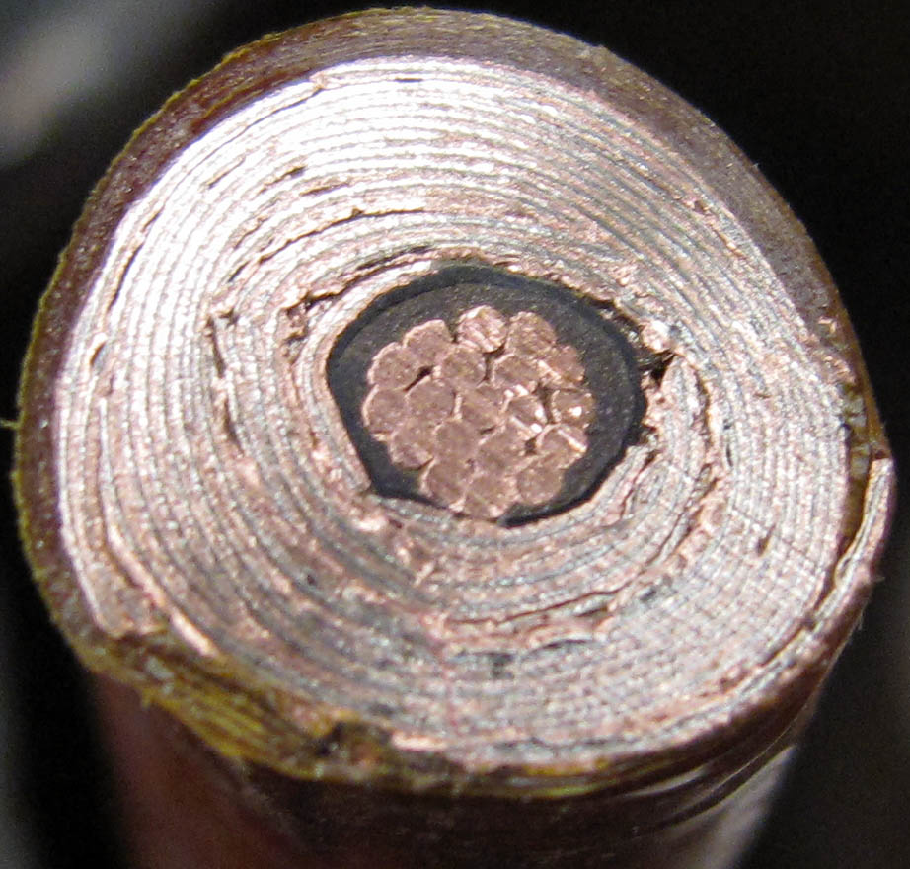
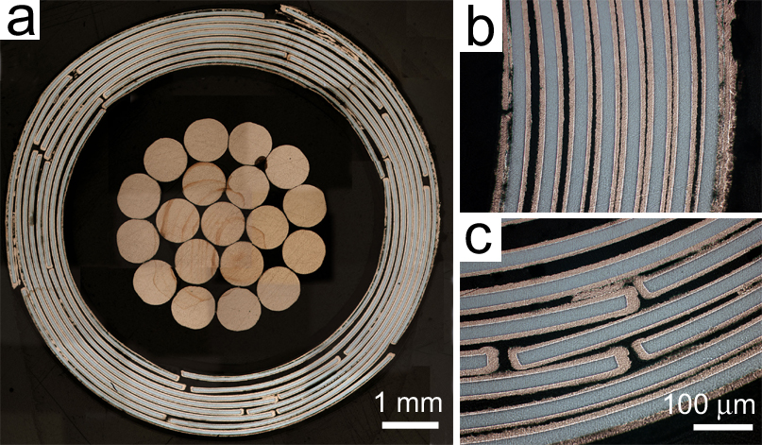
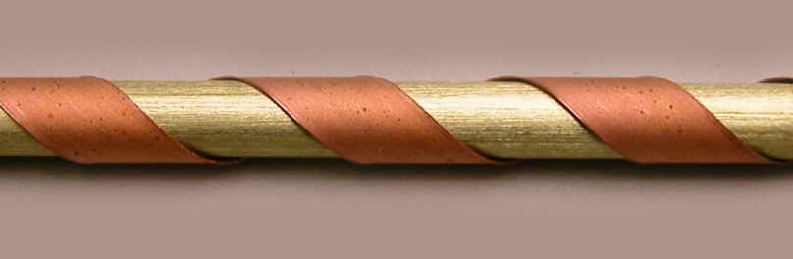
Conductor on Round Core cables
CORC cable principle:
Winding many high-temperature superconducting YBCO coated conductors from SuperPower in a helical fashion with the YBCO under compression around a small former.
D.C. van der Laan, SUST 22, 065013 (2009).
Benefits:
- Very flexible
- Very high currents and current densities
- Mechanically very strong
- Minimum degradation from cabling (< 10 %)
- Current sharing between tapes possible

Slide 6


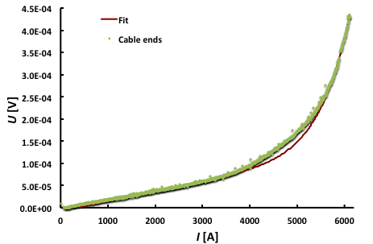
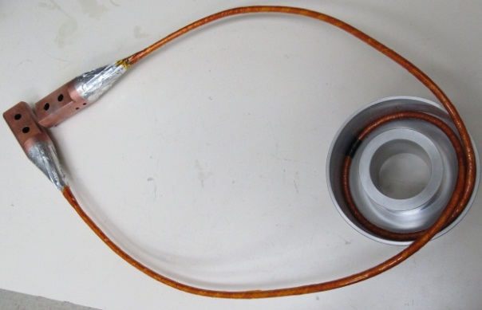
CORC cables for fusion magnets
Goal is to reach a cable current >30 kA at 4.2 K and B > 12 T.
Cables tested at the NHMFL in 19.8 T background field:
52 YBCO coated conductors, 17 layers, cable O.D. 7.5 mm:
I_{quench} = 6000 A @ 4.2 K, 19 T
I_{c} = 5021 A @ 4.2 K, 19 T, 1 μV/cm
J_{e} = 114 A/mm² @ 4.2 K, 19.0 T
ACT: DOE – Office of Fusion Energy Sciences Award DE-SC0007660,
NHMFL: DOE, NSF, agreement DMR-0654118, and the State of Florida

Slide 7
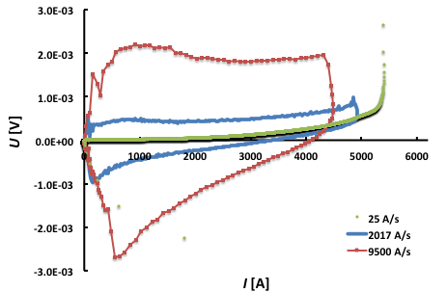
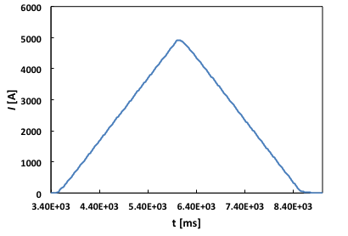
High-current ramp rates at 19 T
Will current distribution become inhomogeneous in
cables with many layers at high current ramp rates?
Cable: 52 CC in 17 layers.
Current ramp rates at
4.2 K, 19 T to 90 % of I_{quench}:
- 2017 A/s
- 9500 A/s
No effect of high current ramp rates!
Phase I STTR DOE - Fusion Energy Sciences Award DE-SC0007660

Slide 8
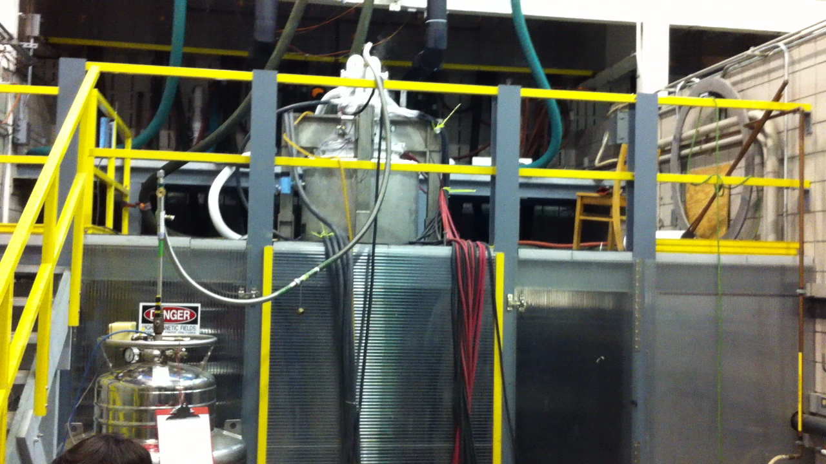
Ramp rates of 68,000 A/s at 19 T
ACT: DOE – Office of Fusion Energy Sciences Award DE-SC0007660,
NHMFL: DOE, NSF, agreement DMR-0654118, and the State of Florida

Slide 9
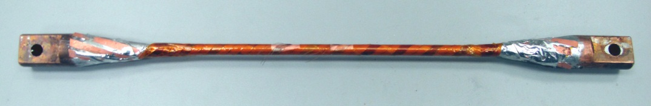
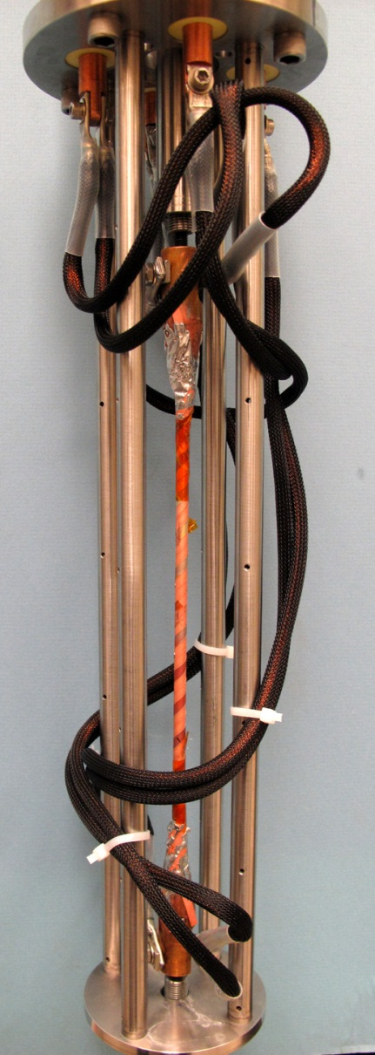
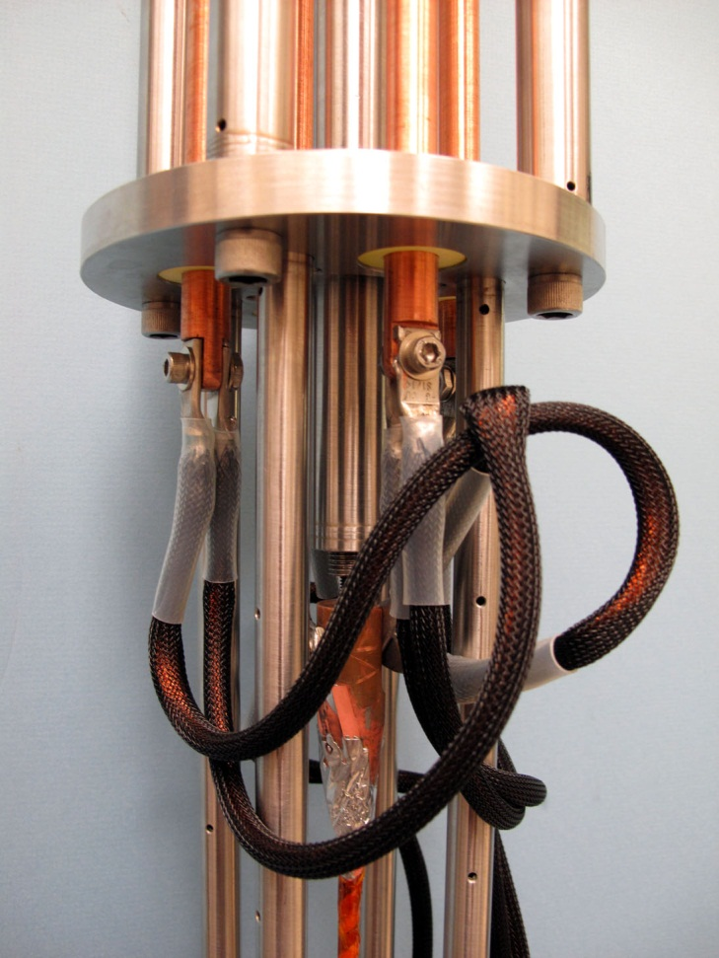
Testing of CORC cables under axial stress
σ
Cable installed with flexible current leads:
Current leads can handle >1500 A at 76 K.

Slide 10
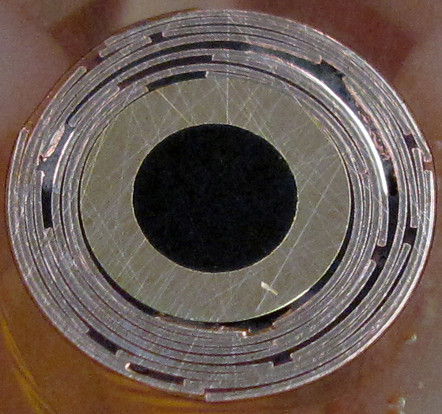
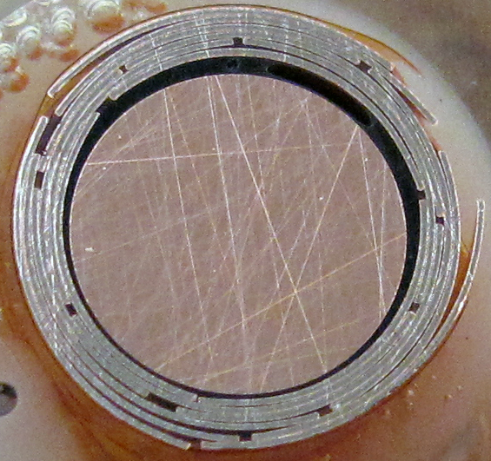
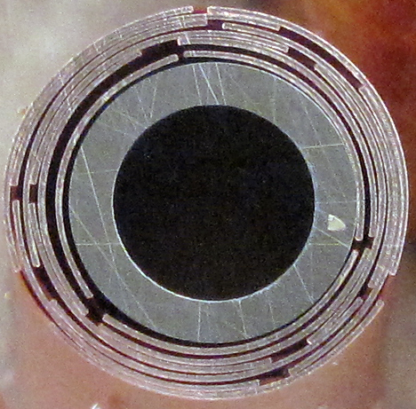
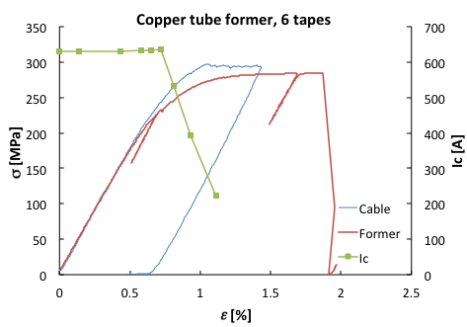
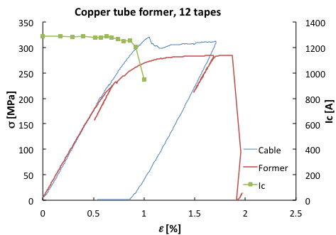
Testing of CORC cables under axial stress
Various options:
3/16” O.D. Cu former, 0.032” wall:
6 tapes in 2 layers:
σ_{irr} = 228 MPa
12 tapes in 4 layers:
σ_{irr} = 277 MPa

Slide 11
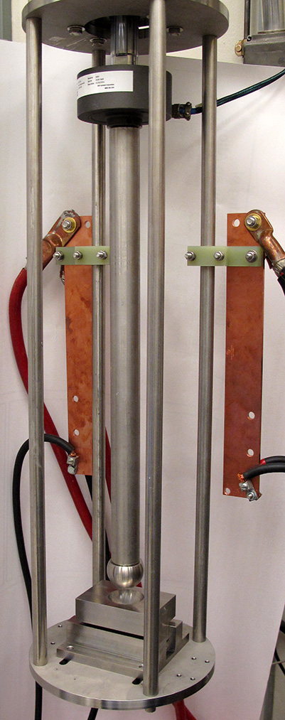
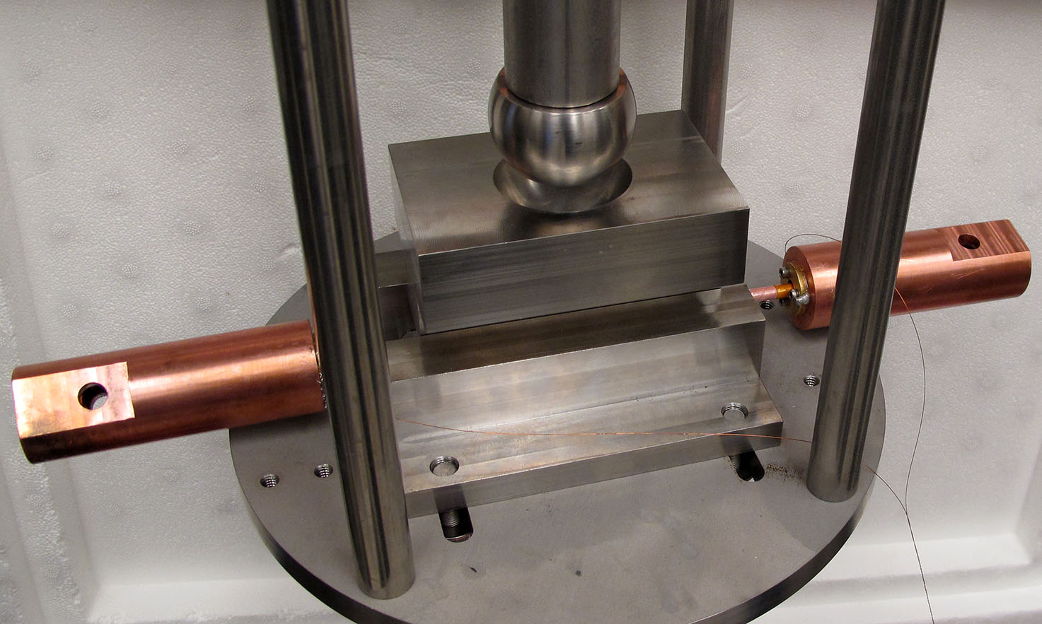
Testing CORC cables under transverse compression
Compressive stress test facility:
maximum load 10,000 lbs, or 44.5 kN.
anvil lengths 50 mm or 100 mm.
testing at room temperature and 76 K.
sample current exceeding 2 kA.
Phase II STTR DOE - Fusion Energy Sciences Award DE-SC0007660

Slide 12
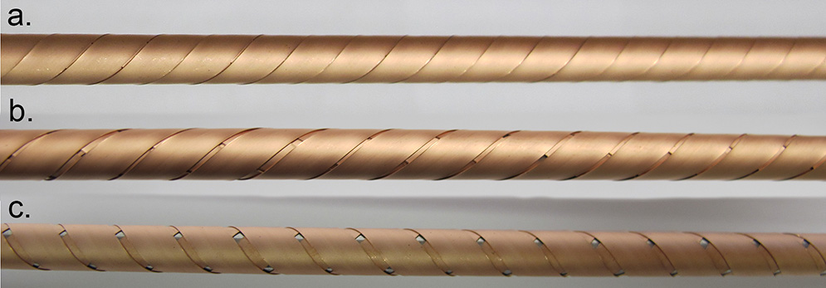
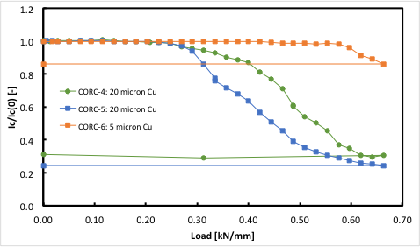
Transverse compression test results (Cont.)
CORC cables:
solid stainless steel former
former O.D. 4.8 mm
3 layers
Anvil length: 5 cm.
CORC-4:
9 tapes, 0 mm gap, 20 μm Cu
CORC-5:
9 tapes, 0.5 mm gap, 20 μm Cu
CORC-6:
9 tapes, 0 mm gap, 5 μm Cu
Decrease in I_{c} depends on gap size and copper thickness.
Phase II STTR DOE - Fusion Energy Sciences Award DE-SC0007660

Slide 13
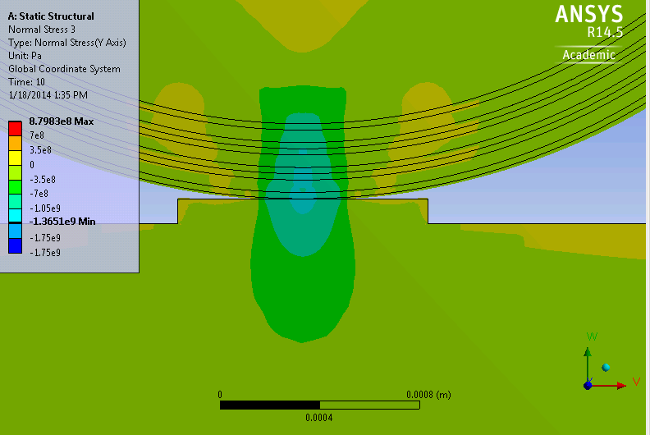
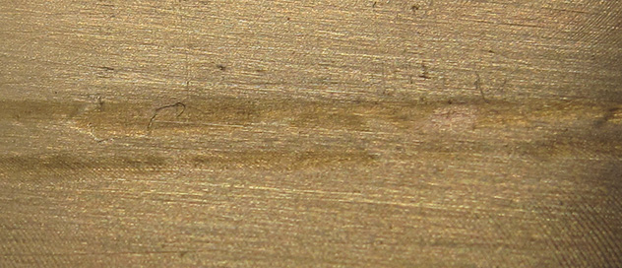
Modeling of transverse compressive stress
Maximum compressive stress at 7,500 lbs with 5 cm anvil: 1340 MPa
0.5 mm-wide imprint in 5 cm long brass anvil after 7,500 lbs load suggests a stress of 1.3 GPa!
Phase II STTR DOE - Fusion Energy Sciences Award DE-SC0007660

Slide 14
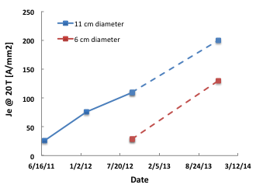
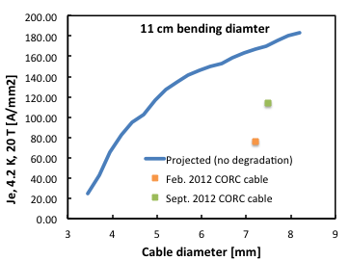
CORC cables for accelerator magnets
Collaborators: David Larbalestier and Ulf Trociewitz (NHMFL)
Goal 1: J_{e} of > 300 A/mm² at 20 T at 11 cm bending diameter using basic tape.
Goal 2: improve CORC flexibility : J_{e} > 200 A/mm² at 20 T and at 6 cm bending diameter.
Status at beginning of program (2013):
DOE-High Energy Physics Award DE-SC0009545

Slide 15
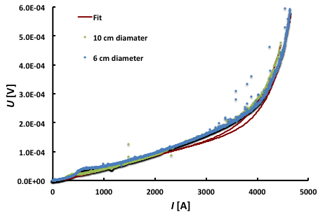
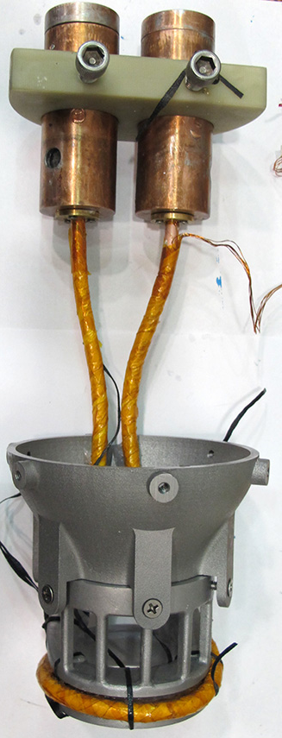
CORC J_{e}>100 A/mm² at 20 T and 6 cm diameter
Cable:
- 37 YBCO CC, 14 layers
- cable O.D. 6.4 mm
I_{c} = 3989 A (10 cm) 3967 A (6 cm)@ 4.2 K, 15 T (J_{e}=122 A/mm²)
Expected J_{e} = 103 A/mm² @ 4.2 K, 20 T
No degradation when bending from 10 cm to 6 cm: J_{e}(20T) = 103 A/mm²!
DOE - High Energy Physics Award DE-SC0009545

Slide 16
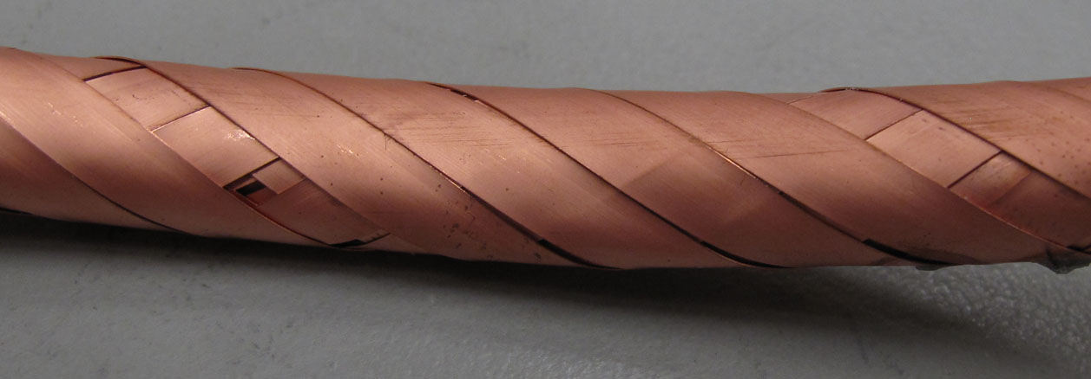
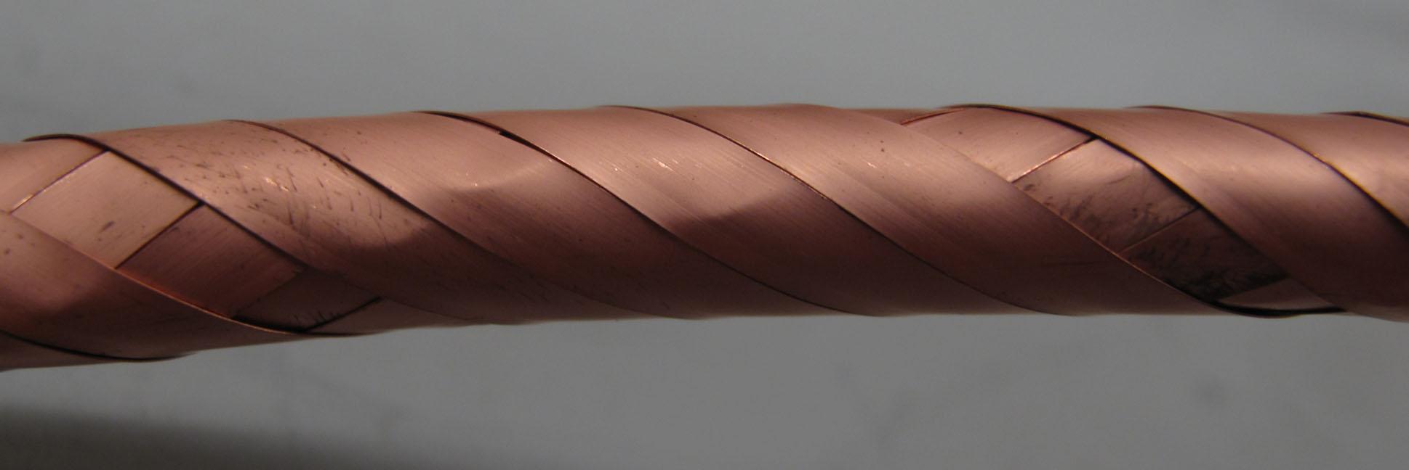
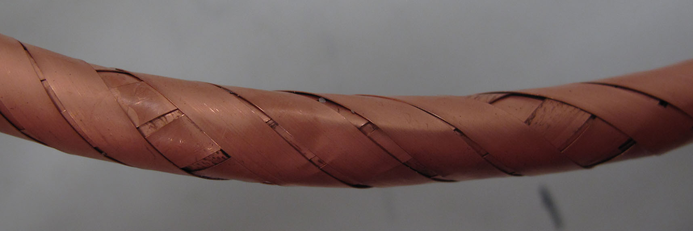
Room for improvement
I_{c} = 5021 A @ 4.2 K, 19 T
During cable inspection
after test at 19T:
Many damaged tapes in outer
layers due to cable bending!
Caused by loose winding pack.
Winding pack needs to be controlled:
=> Cabling machine is needed.
DOE - Office of High Energy Physics grant DE-FG02-12ER41801

Slide 17
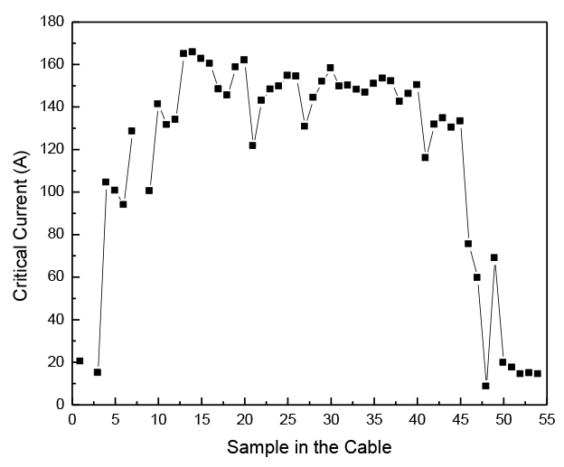
Performance of tapes extracted from CORC cables
52 tape CORC cable:
- 3 mm former
- wound into 11 cm diameter
- tested at 19 T: I_{c} was 50 % of
projected value.
- I_{c}(76 K) after test 3300 A
Extracting all tapes from cable
and measure I_{c} at 76 K:
Outer layers show degradation due to tape kinking.
Inner 4 layers show large degradation due to small former.
outside
former
About 80 % of the tapes near 100 %
Sum of tape I_{c}s 6,100 A!
Low cable performance mainly due to terminations.
DOE - Office of High Energy Physics grant DE-FG02-12ER41801

Slide 18
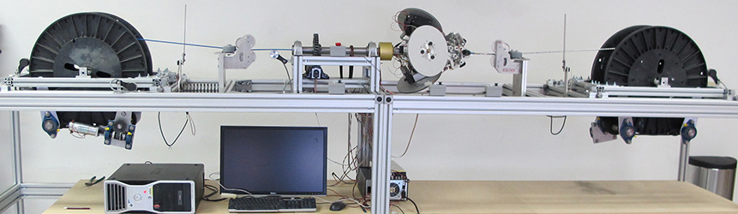
CORC cable machine
Winding of long CORC cables:
winding CORC cables layer-by-layer
accurate control of: 1. tape tension
2. winding angle
3. spacing between tapes
Long, high-quality CORC cables are now available!!!
University of Colorado program sponsored by:
DOE - Office of High Energy Physics grant DE-FG02-12ER41801

Slide 19
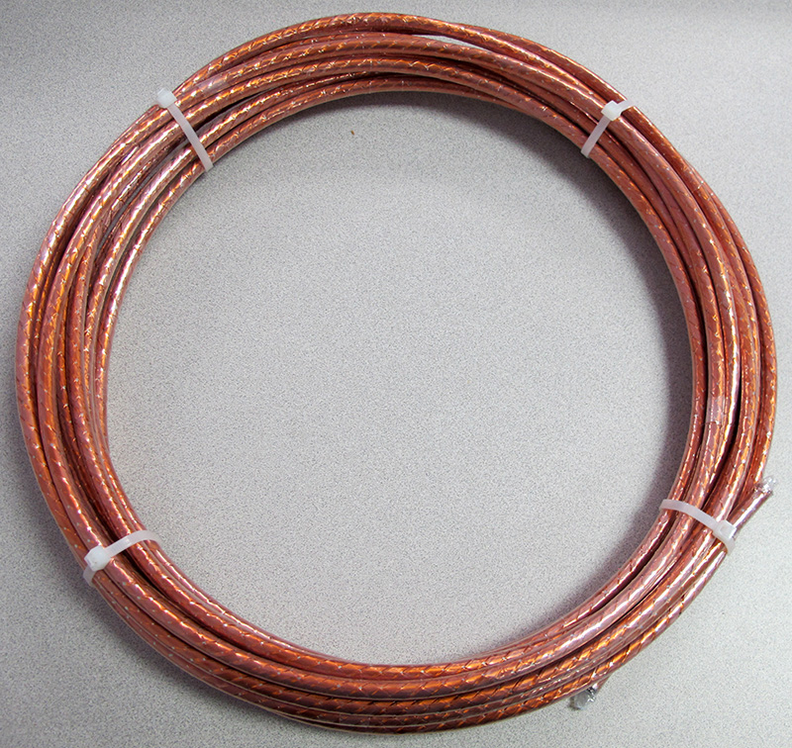
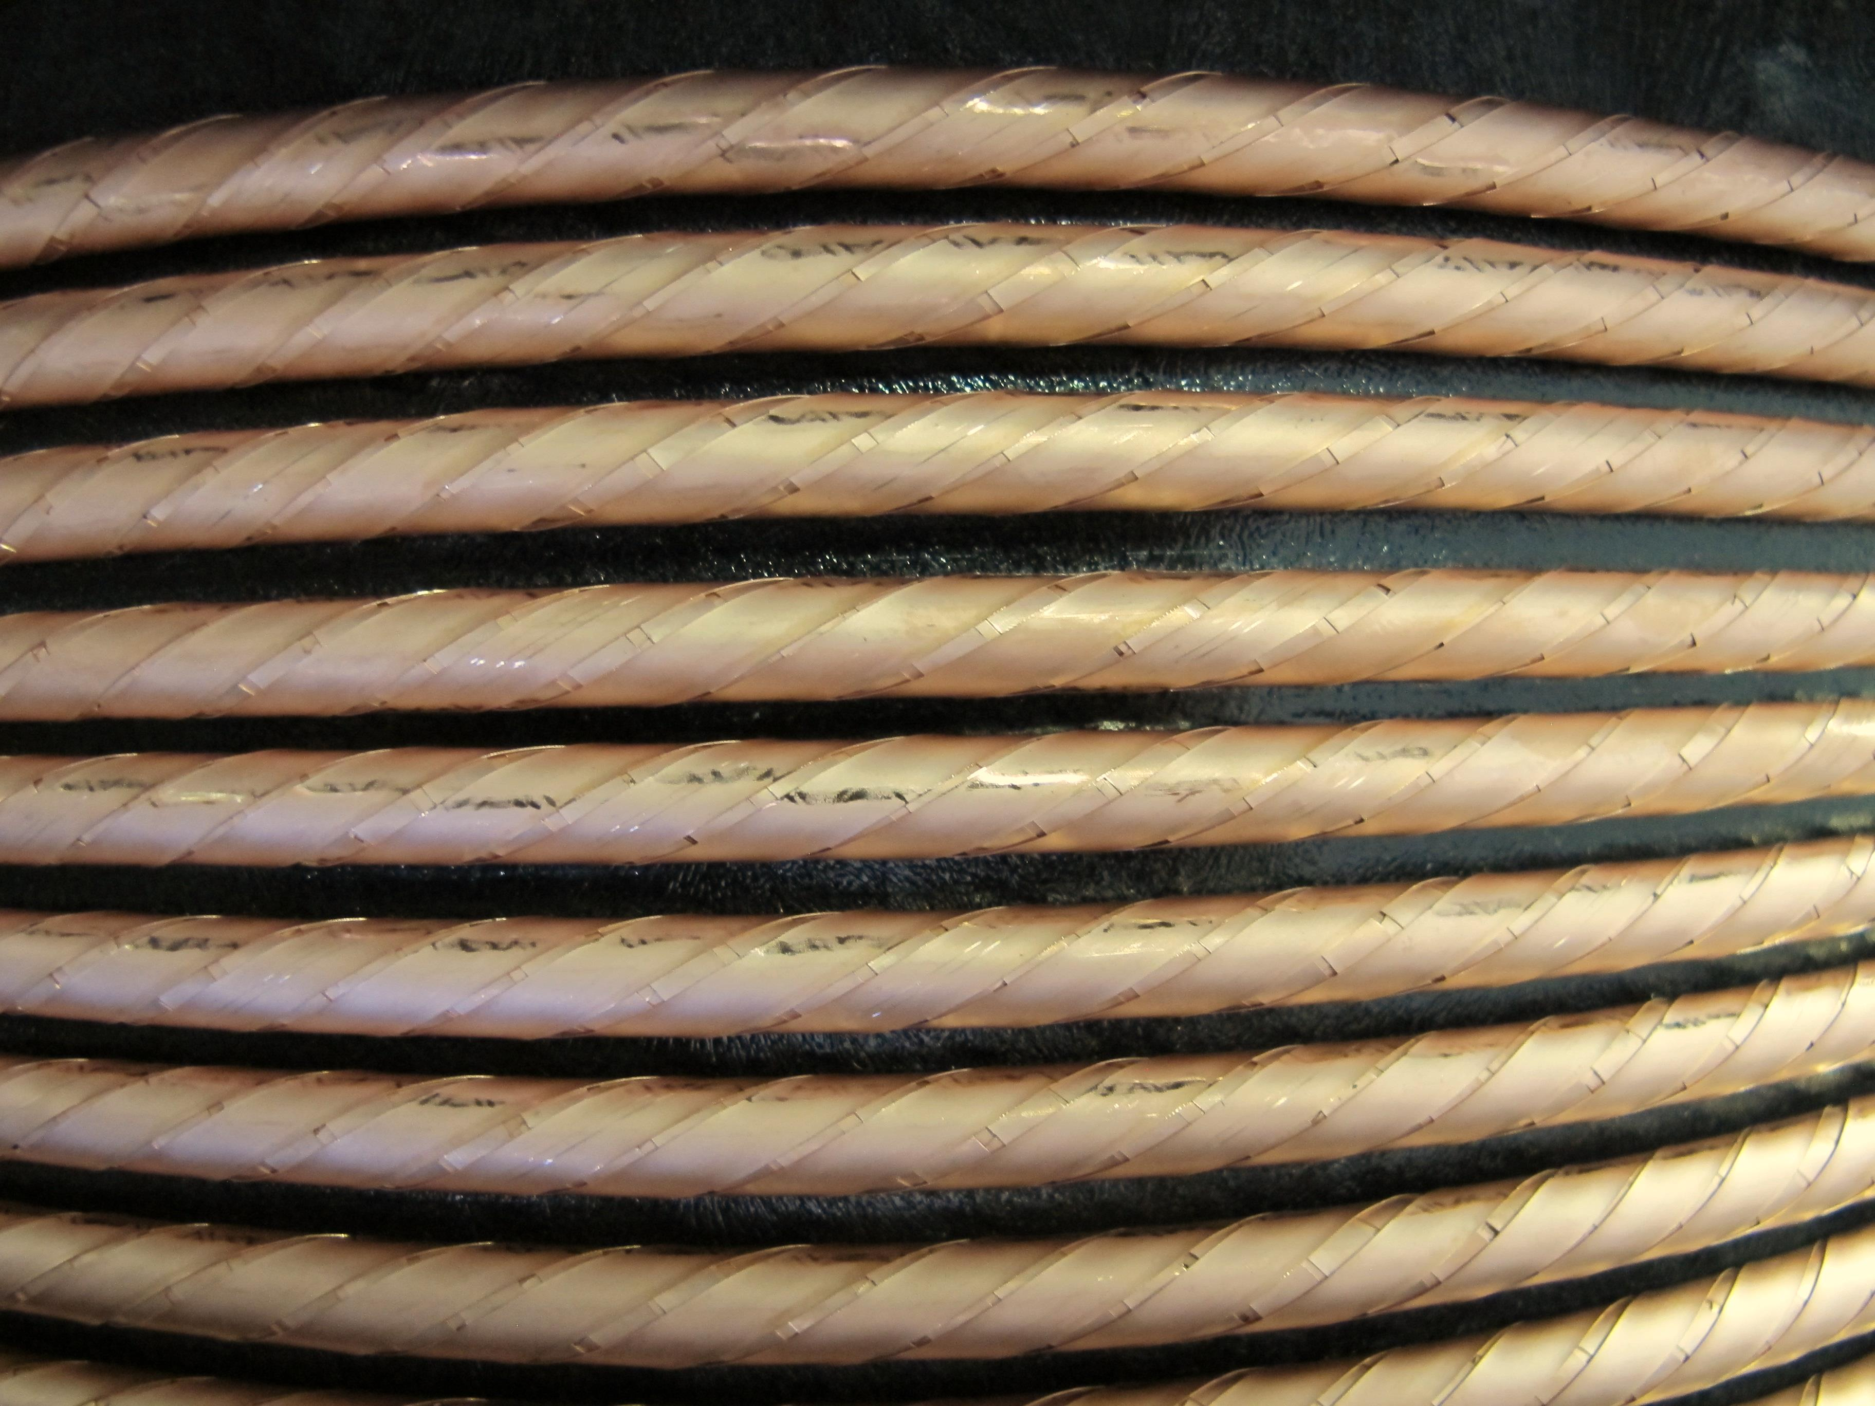
CORC cable for CERN order
Cable specification:
12 meter long
38 tapes (4 mm wide, 20 microns of copper)
5 mm diameter former (Al + Cu)
Cable finished Saturday May 17th.
Liquid nitrogen test scheduled first week of June.

Slide 20
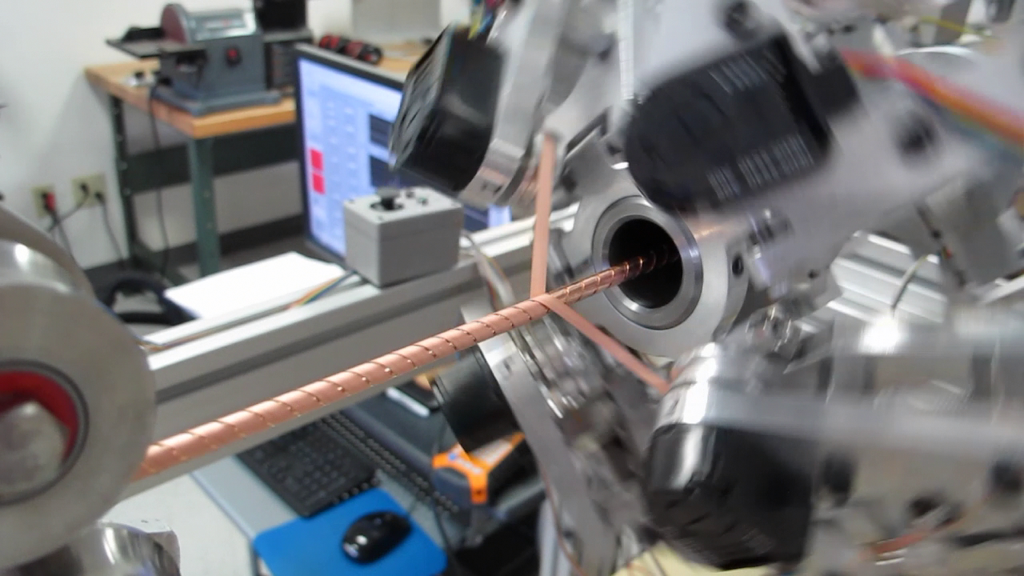
Winding the CERN CORC cable

Slide 21
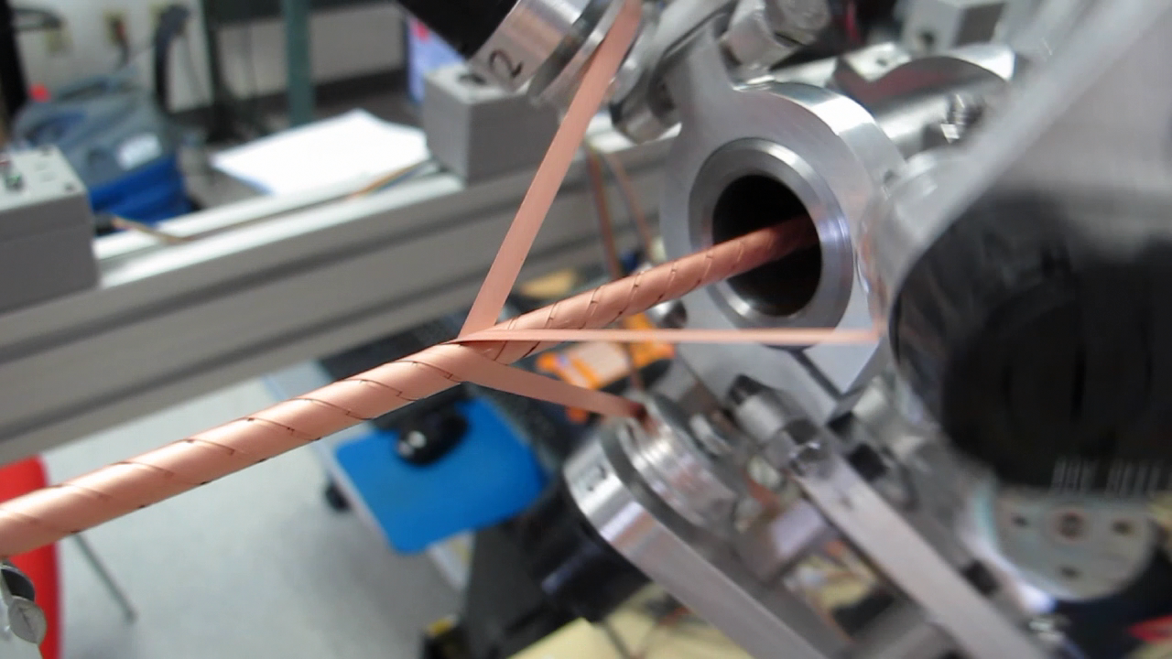
Winding the CERN CORC cable (Cont.)

Slide 22
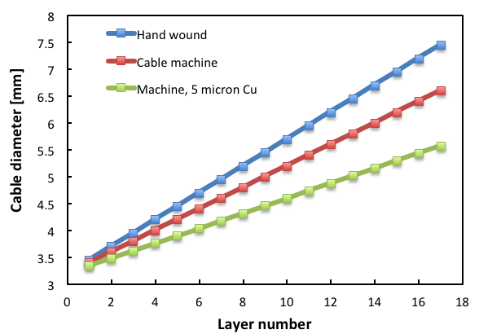
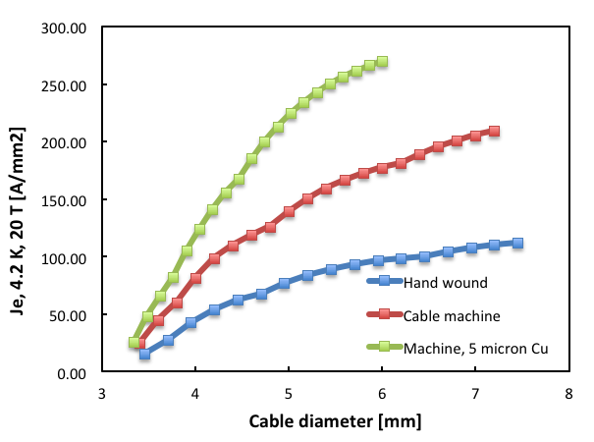
CORC cable performance projections
Improved J_{e} at 20 T due to winding machine and reduced copper thickness:
Roughly 30 % reduction in cable diameter when using 5 microns of copper and a cable machine.
Roughly 3x improvement of J_{e} at a cable diameter of 6 mm.

Slide 23
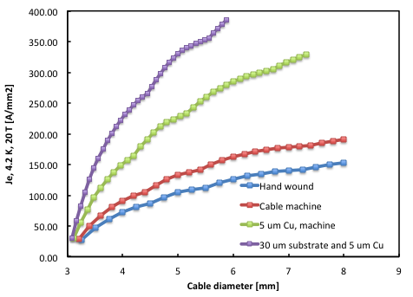
CORC cable performance projections (Cont.)
Improved J_{e} at 20 T due to reduced substrate thickness:
Roughly 50 % improvement of J_{e} when using 30 microns substrate.
CORC cable with 300 A/mm² is less than 5 mm in diameter!

Slide 24
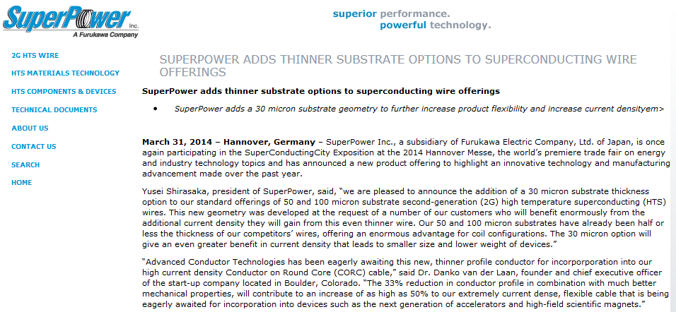
Thinner substrates are coming!
“Advanced Conductor Technologies has been eagerly awaiting this new, thinner profile conductor for incorporation into our high current density Conductor on Round Core (CORC) cable,” said Dr. Danko van der Laan, founder and chief executive officer of the start-up company located in Boulder, Colorado…”
http://superpower-inc.com/content/superpower-adds-thinner-substrate-options-superconducting-wire-offerings

Slide 25
CORC cable performance exceeding 600 A/mm² (20 T)
Based on tapes available within 6 months:
30 μm substrate, I_{c}(77 K, 4 mm) = 150 A, lift factor =2 (I_{c}(4.2 K,20 T)/I_{c}(77 K, s.f)
 | O.D. | Tape width | Gap | # tapes | Layer-Ic | Ic (77 K) | Ic (4.2 K, 20 T) | Je (4.2 K, 20 T)
Layer # | [mm] | [mm] | [mm] |  | [A] | [A] | [A] | [A/mm2]
1 | 3.08 | 3 | 0.5 | 2 | 225 | 225 | 432 | 58
2 | 3.16 | 3 | 0.5 | 2 | 225 | 450 | 864 | 110
3 | 3.24 | 3 | 0.5 | 2 | 225 | 675 | 1296 | 157
4 | 3.32 | 3 | 0.5 | 2 | 225 | 900 | 1728 | 200
5 | 3.4 | 3 | 0.5 | 3 | 338 | 1238 | 2376 | 262
6 | 3.48 | 3 | 0.5 | 2 | 225 | 1463 | 2808 | 295
7 | 3.56 | 3 | 0.5 | 2 | 225 | 1688 | 3240 | 326
8 | 3.64 | 3 | 0.5 | 2 | 225 | 1913 | 3672 | 353
9 | 3.72 | 3 | 0.5 | 2 | 225 | 2138 | 4104 | 378
10 | 3.8 | 3 | 0.5 | 2 | 225 | 2363 | 4536 | 400
11 | 3.88 | 3 | 0.5 | 2 | 225 | 2588 | 4968 | 420
12 | 3.96 | 3 | 0.5 | 2 | 225 | 2813 | 5400 | 438
13 | 4.04 | 3 | 0.5 | 2 | 225 | 3038 | 5832 | 455
14 | 4.12 | 3 | 0.5 | 2 | 225 | 3263 | 6264 | 470
15 | 4.2 | 3 | 0.5 | 2 | 225 | 3488 | 6696 | 483
16 | 4.28 | 3 | 0.5 | 3 | 338 | 3825 | 7344 | 510
17 | 4.36 | 3 | 0.5 | 3 | 338 | 4163 | 7992 | 535
18 | 4.44 | 3 | 0.5 | 3 | 338 | 4500 | 8640 | 558
19 | 4.52 | 3 | 0.5 | 3 | 338 | 4838 | 9288 | 579
20 | 4.6 | 3 | 0.5 | 3 | 338 | 5175 | 9936 | 598
J_{e} (4.2 K, 20 T) > 600 A/mm² possible in 4.5 mm diameter CORC cable!
Cable bending diameter of 10x cable diameter => 4-5 cm!

Slide 26
CORC cable performance exceeding 1300 A/mm² (20 T)
Based on tapes available within 1-3 years:
15 μm substrate, I_{c}(77 K, 4 mm) = 200 A, lift factor =3 (I_{c}(4.2 K,20 T)/I_{c}(77 K, s.f)
 | O.D. | Tape width | Gap | # tapes | Layer-Ic | Ic (77 K) | Ic (4.2 K, 20 T) | Je (4.2 K, 20 T)
Layer # | [mm] | [mm] | [mm] |  | [A] | [A] | [A] | [A/mm2]
1 | 3.05 | 3 | 0.5 | 2 | 300 | 300 | 864 | 118
2 | 3.1 | 3 | 0.5 | 2 | 300 | 600 | 1728 | 229
3 | 3.15 | 3 | 0.5 | 2 | 300 | 900 | 2592 | 333
4 | 3.2 | 3 | 0.5 | 2 | 300 | 1200 | 3456 | 430
5 | 3.25 | 3 | 0.5 | 2 | 300 | 1500 | 4320 | 521
6 | 3.3 | 3 | 0.5 | 2 | 300 | 1800 | 5184 | 606
7 | 3.35 | 3 | 0.5 | 2 | 300 | 2100 | 6048 | 686
8 | 3.4 | 3 | 0.5 | 2 | 300 | 2400 | 6912 | 761
9 | 3.45 | 3 | 0.5 | 2 | 300 | 2700 | 7776 | 832
10 | 3.5 | 3 | 0.5 | 2 | 300 | 3000 | 8640 | 898
11 | 3.55 | 3 | 0.5 | 2 | 300 | 3300 | 9504 | 960
12 | 3.6 | 3 | 0.5 | 2 | 300 | 3600 | 10368 | 1019
13 | 3.65 | 3 | 0.5 | 2 | 300 | 3900 | 11232 | 1073
14 | 3.7 | 3 | 0.5 | 2 | 300 | 4200 | 12096 | 1125
15 | 3.75 | 3 | 0.5 | 2 | 300 | 4500 | 12960 | 1173
16 | 3.8 | 3 | 0.5 | 2 | 300 | 4800 | 13824 | 1219
17 | 3.85 | 3 | 0.5 | 2 | 300 | 5100 | 14688 | 1262
18 | 3.9 | 3 | 0.5 | 2 | 300 | 5400 | 15552 | 1302
19 | 3.95 | 3 | 0.5 | 2 | 300 | 5700 | 16416 | 1340
20 | 4 | 3 | 0.5 | 2 | 300 | 6000 | 17280 | 1375
J_{e} (4.2 K, 20 T) > 1300 A/mm² possible in 4.0 mm diameter CORC cable!

Slide 27
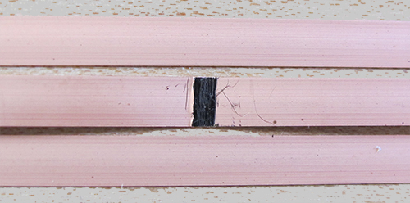
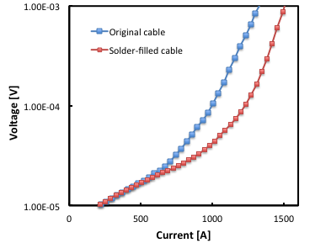
Effect of tape inhomogeneity on CORC cable performance
CORC cable with 12 tapes in 4 layers:
- two tapes with a 2 mm long interruption.
Cable with defects:
I_{c} = 991 A
n-value = 10.8
Solder-filled cable:
I_{c} = 1244 A
n-value = 16.8
Current sharing in CORC cables lowers conductor homogeneity and piece length requirements!
CORC cable performance is largely independent of tape production quality!
DOE - High Energy Physics Award DE-SC0009545

Slide 28
Summary
CORC cables are being developed for three different markets:
1. High-current magnet cables for fusion and scientific magnets.
2. Power transmission cables and magnet feeders and busbars.
3. High-current density cables for HEP magnets:
Cable concept | Achieved |  | Potential |  | M | σ_{transverse} | ε_{longitudinal}
 | I_{op} | J_{cable} | I_{op} | J_{cable}
 | (kA) | (A/mm²) | (kA) | (A/mm²) | (mT) | (MPa) | (%)
CORC | 5 | 114 (19 T) | >10 | >1300 (20 T) | ? | 1000 | 0.6
CORC cable performance improvements:
J_{e} > 300 A/mm² possible with standard conductor (I_{c,tape}(20 T) = 150 A
J_{e} > 600 A/mm² using 30 μm substrate and improved pinning (I_{c,tape}(20 T) = 300 A
J_{e} > 1300 A/mm² using 15 μm substrate and improved pinning (I_{c,tape}(20 T) = 600 A
High-quality CORC cables can now be delivered in long lengths!
danko@advancedconductor.com +1-720-933-5674

