Slide 1
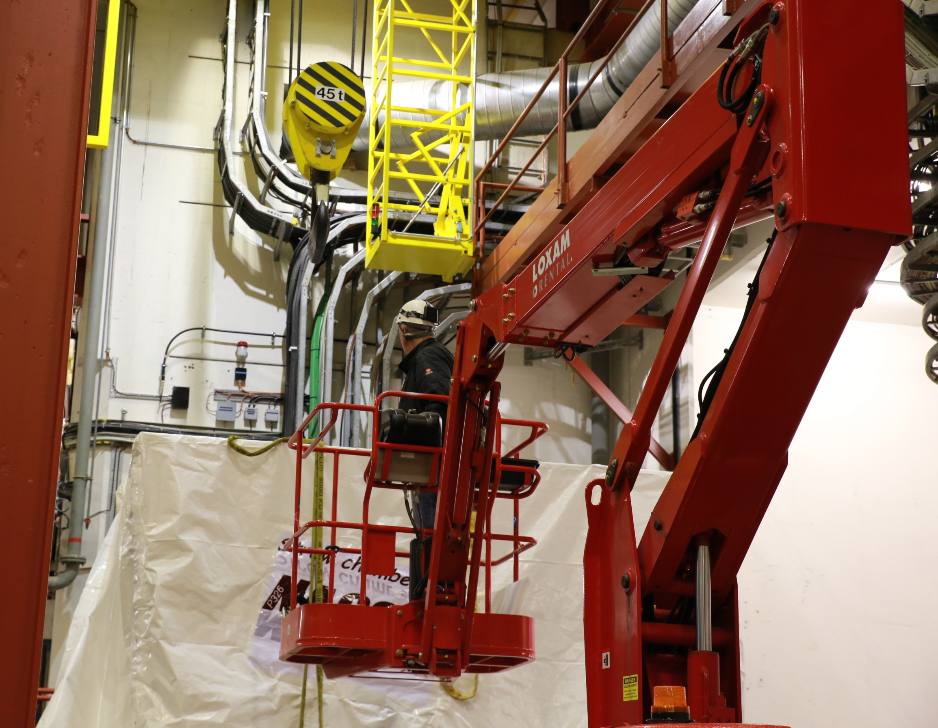


Slide 2
The NA62 Collaboration
Birmingham
Bristol
Glasgow
Liverpool
IHEP
INR
JINR
Mainz
Prague
UC Louvain
Bratislava
CERN
Bucharest
George Mason
SLAC
UC Merced
Ferrara
Florence
LNF
Naples
Perugia
Pisa
Rome I
Rome II
Turin
Sofia
San Luis Potosi
National Institute for Physics and Nuclear Engineering
IFIN-HH Bucharest-Magurele
joint in 2014

Slide 3
NA62 Physics Goal
NA62 aims to measure precisely BR(K⁺ → π⁺ν ν) exploiting a novel in-flight technique based on:
Calorimetry to veto extra particles
Very light trackers to reconstruct the K⁺ and the π⁺ momenta
Full particle identification
State of the art:
[1] J.Brod, M.Gorbahn, PRD78, arXiv:0805.4119
[2] AGS-E787/E949 PRL101, arXiv:0808.2459
[3] M. Gorbahn, arXiv:0909.2221
[4] KEK-E391a, arXiv:0911.4789v1
[5] A.J. Buras et al., EPJ C72, arXiv:1208.0934
[6] CMS PAS BPH-13-007; LHCb-CONF-2013-012

Slide 4

2014 Physics Goal
Assumptions:
  60 days of data taking
  10% of the nominal Intensity x data taking efficiency
$$N_{K}=0.06∙4.5×{10}^{12}=2.7×{10}^{11}$$
$$N_{πνν}^{selected}=N_{K}∙BR\left(πνν\right)∙𝓐_{πνν}=\left(2.7×{10}^{11}\right)∙\left(0.8×{10}^{−10}\right)∙0.1$$
Aiming to reach the required sensitivity:
  To provide an observation of K⁺ → π⁺ν ν...
  ...or find out what is still missing to do so...

Slide 5

Present Installation Status
Straw1
SAC
CHOD
Target
CHANTI
KTAG
GTK
Beam Pipe
RICH
LKr
MUV
IRC
9 LAV installed
Straw Tracker
NA62 / 2014 Layout
SAC
CHOD
Target
CHANTI
KTAG
GTK
Beam Pipe
RICH
LKr
MUV
IRC
11 LAV in vacuum tank
5

Slide 6
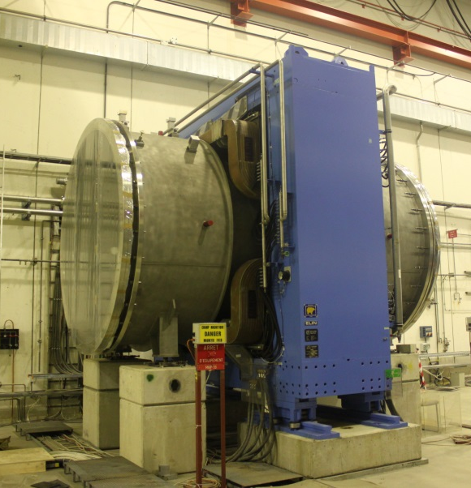
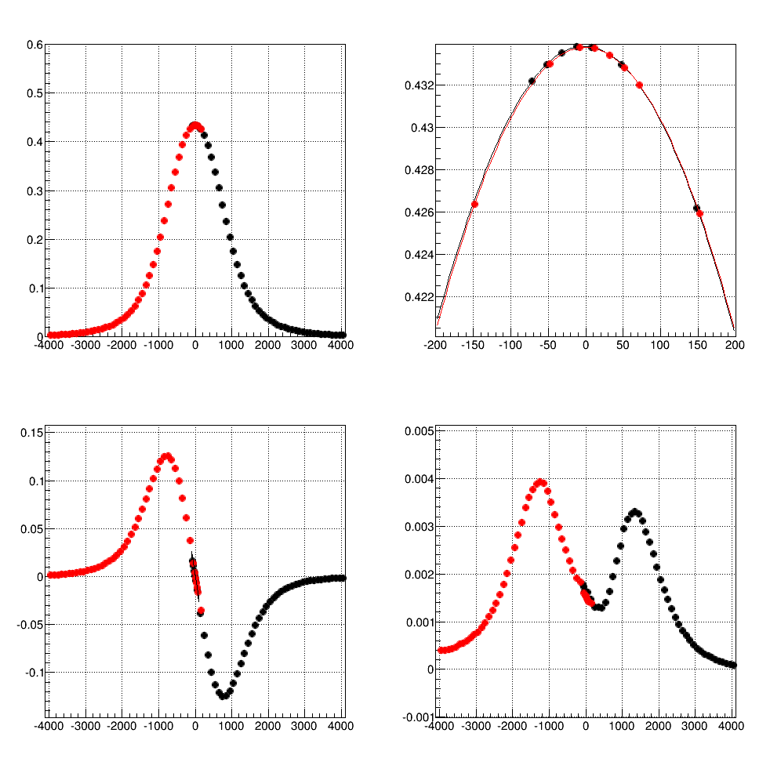
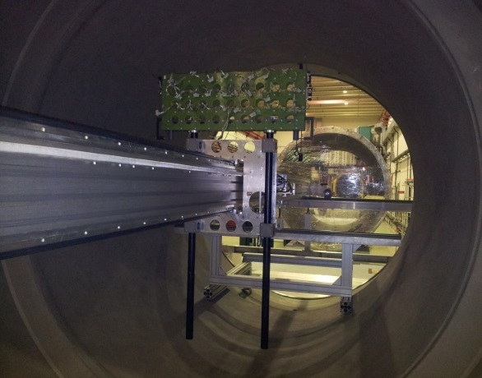
Magnetic Field Map
B_{y} (T)
B_{y} (T)
Z (mm)
Z (mm)
B_{Z} (T)
B_{X} (T)
Z (mm)
Z (mm)
F. Bergsma et al.

Slide 7
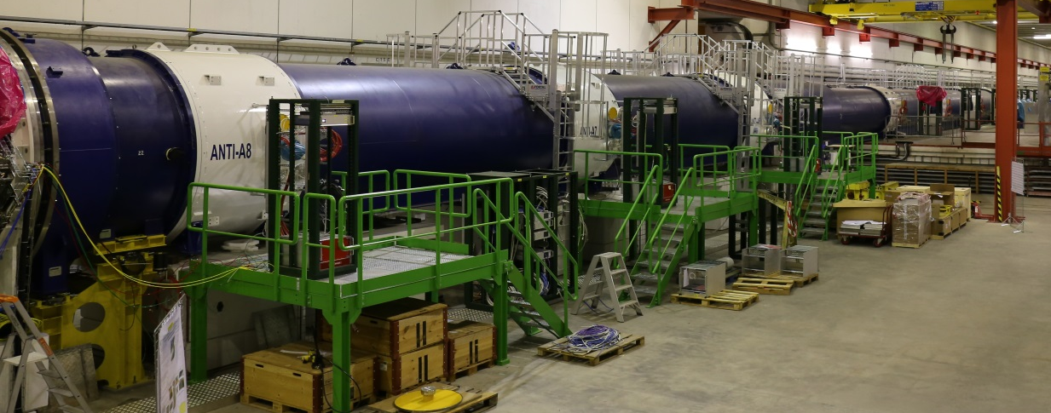
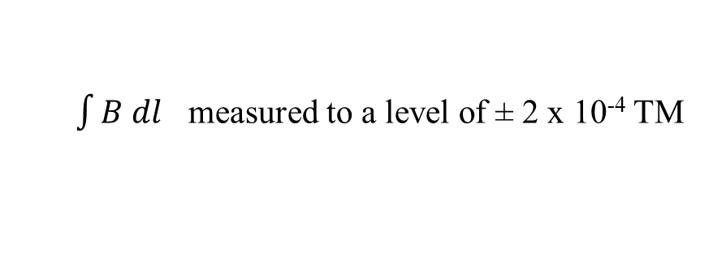
Residual B-Field in Decay Tank
$\int{B dl}$ measured to a level of ± 2 x 10⁻⁴ TM
B (μT)
Z (mm)

Slide 8
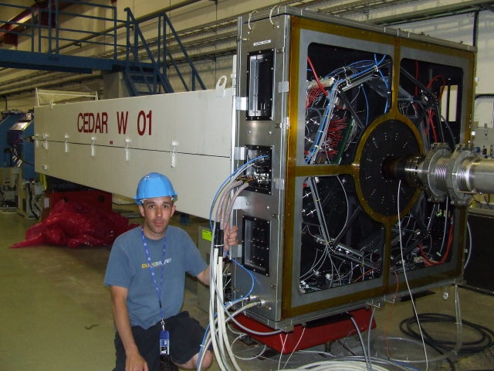
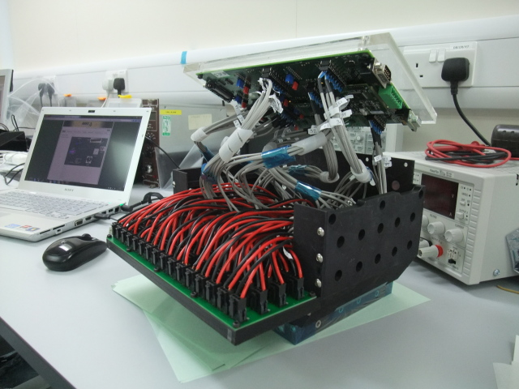
KTAG - CEDAR
PMTs: Hamamatsu replaced R7400 by R9980 (better in some respect higher gain and QE)
Hybrid solution 16x R7400 and 32x R9980 per octant
Use increased number of HPTDC boards to optimize rate capabilities.

Slide 9
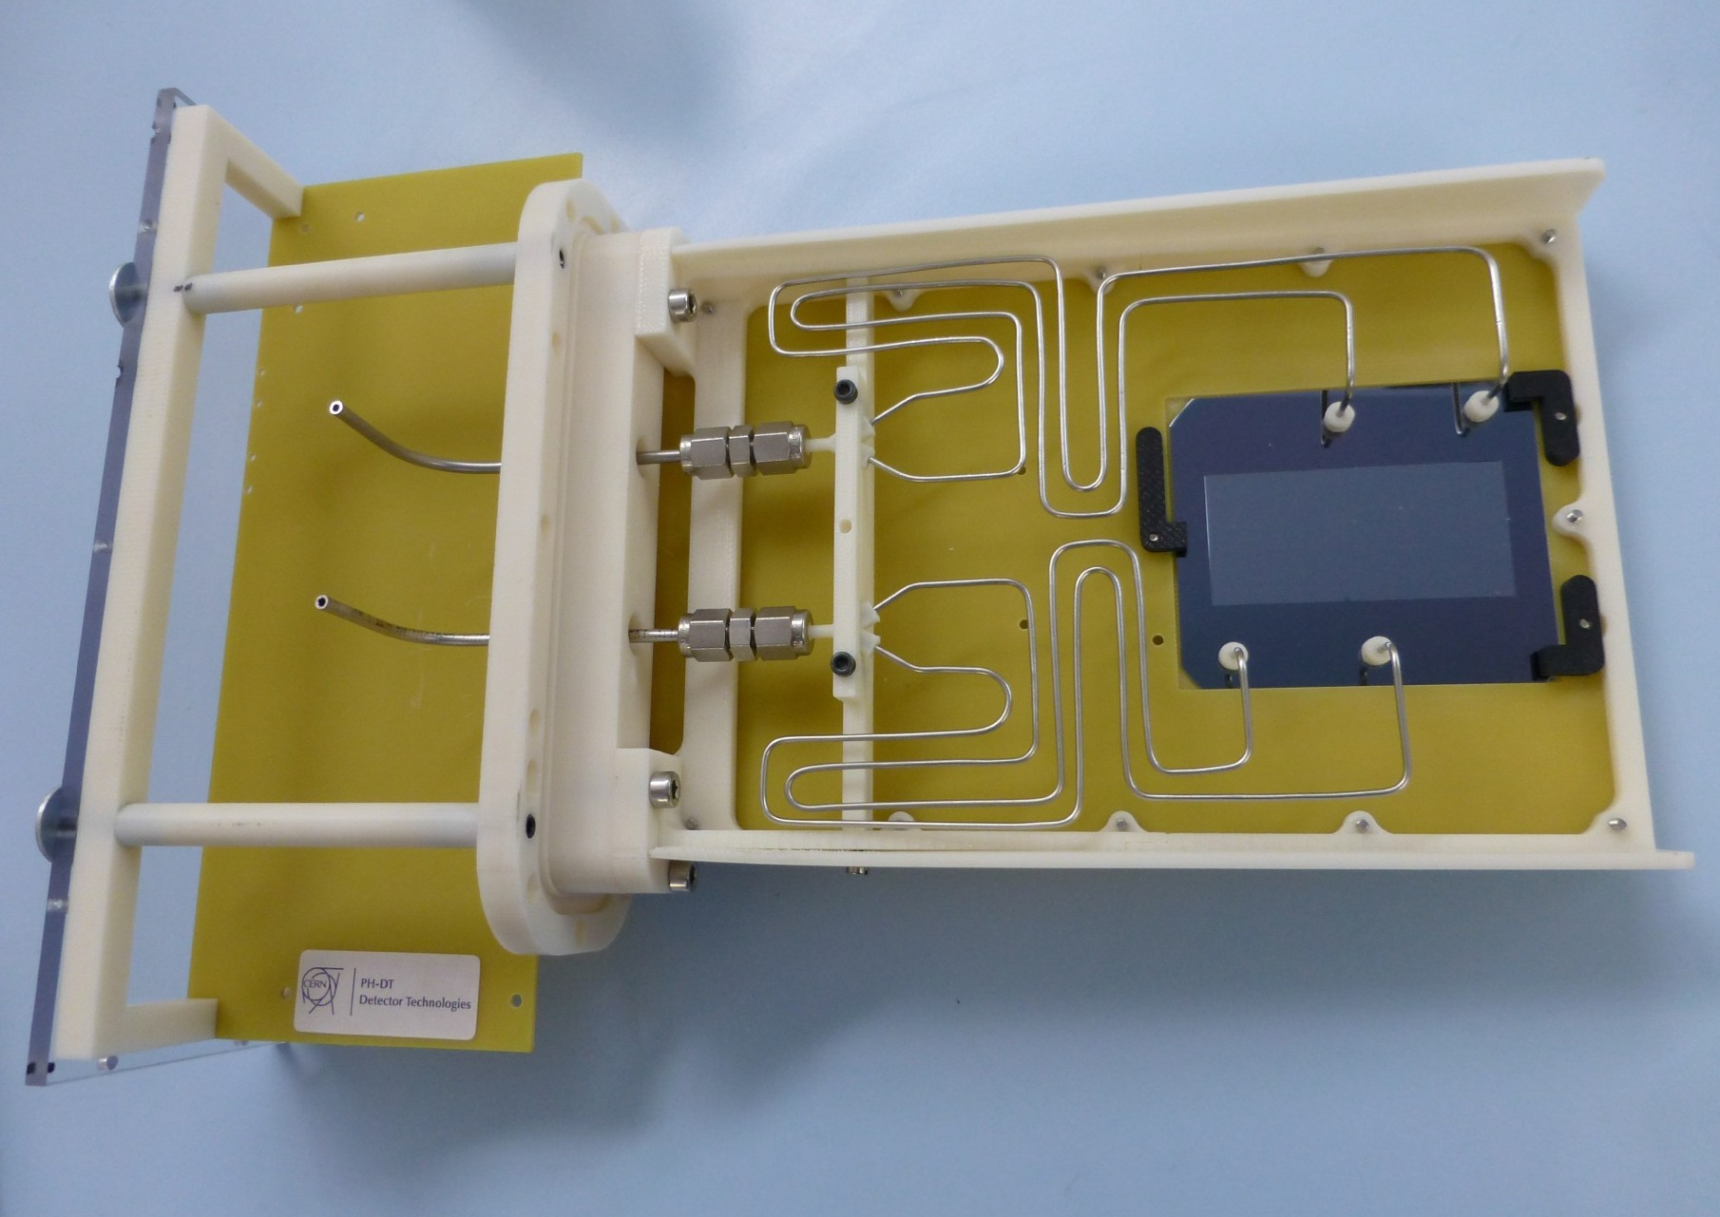
GigaTracker

Slide 10
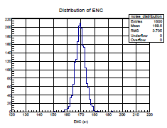
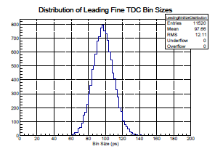
GigaTracker / ASIC Tests
The ASIC tests show that the chip is working as expected.
GTK carrier board designed and ordered
The chip thinning and bump bonding has been successfully tested on dummy chips.
Equivalent Noise Charge
all 1’800 channels work
ENC ≈ 170 e⁻
The remaining work is on a tight time plan, but the most difficult technical issues have been mastered
=> σ_{t} ≈ 50 ps RMS

Slide 11
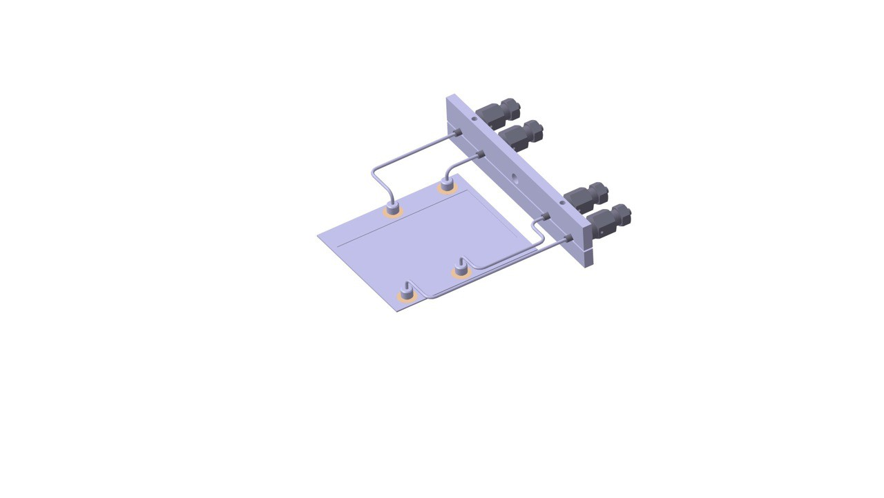

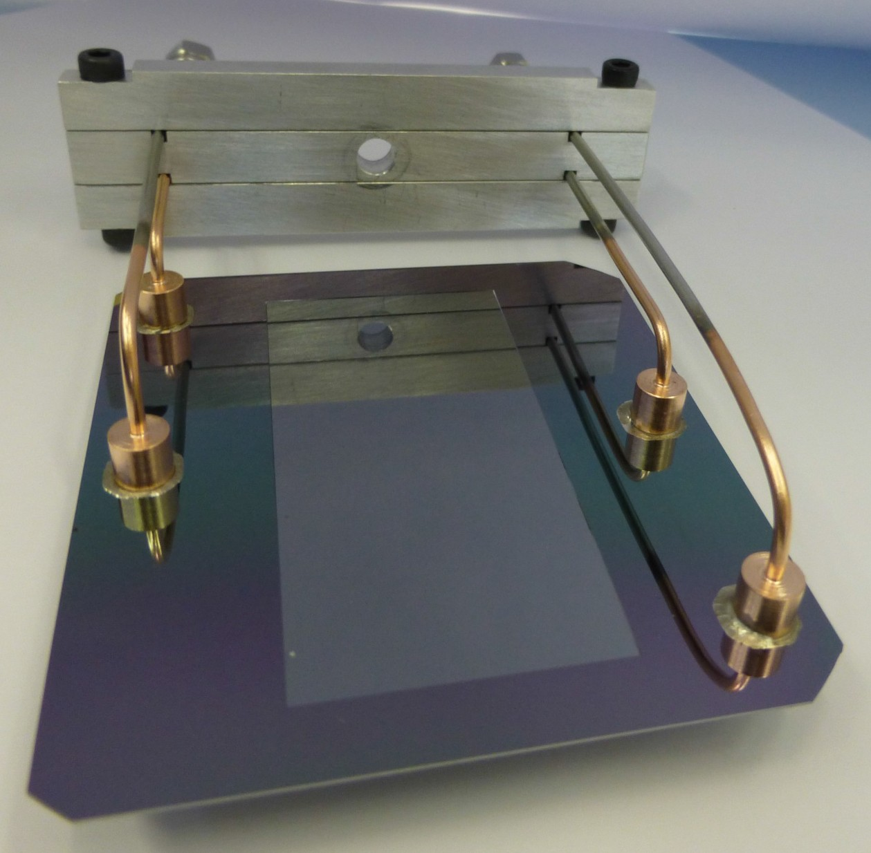
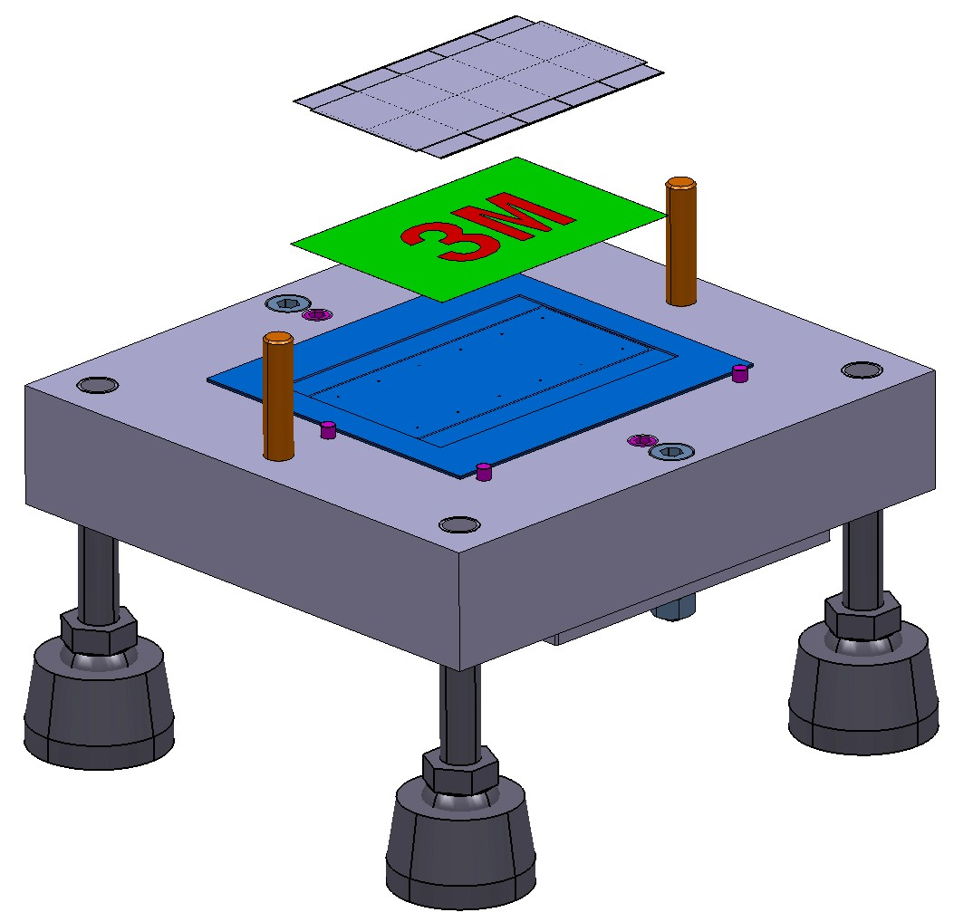

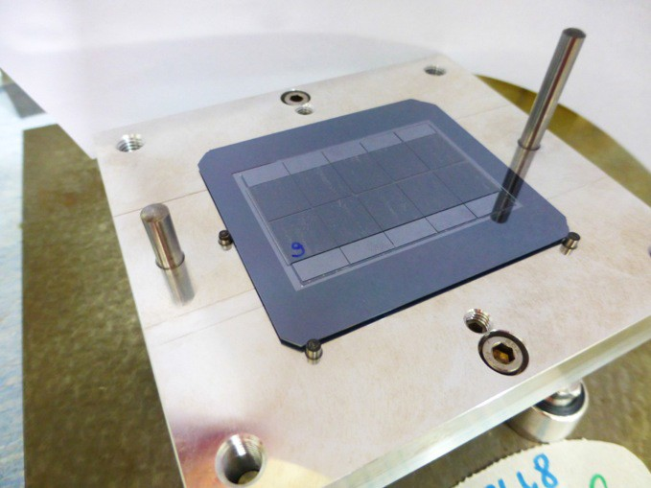
GTK Assembly Steps (1)
Soldered
fluid
connectors
Thermal
Interface

Slide 12
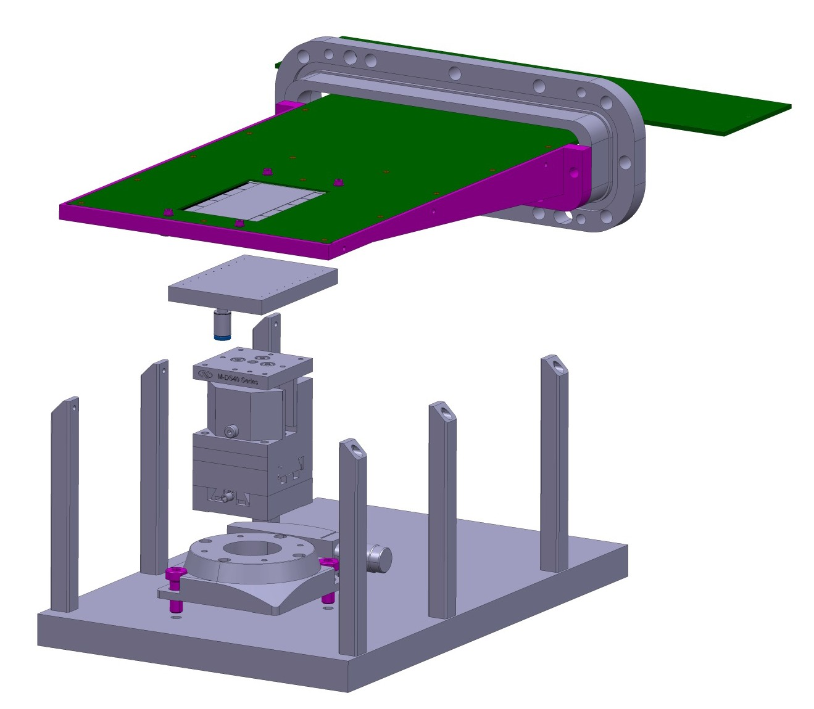

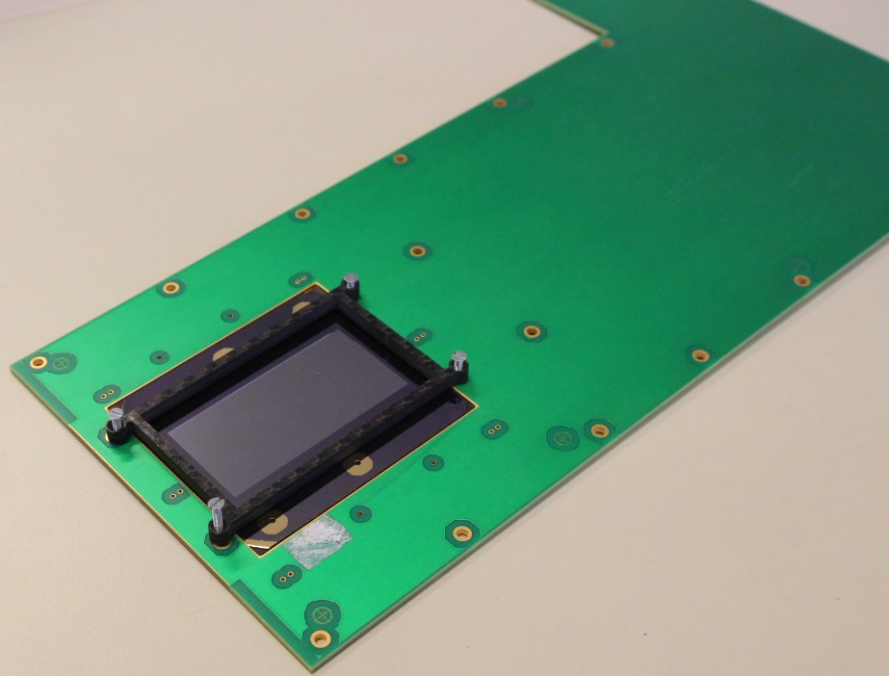
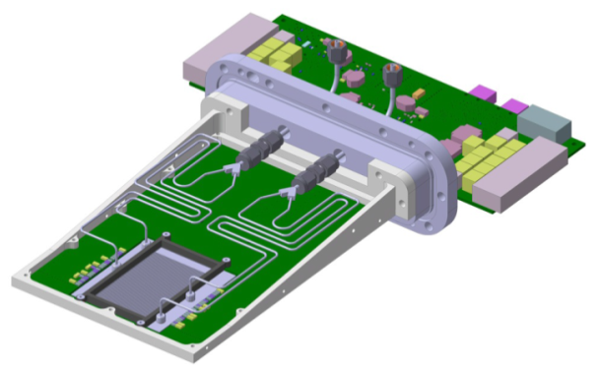
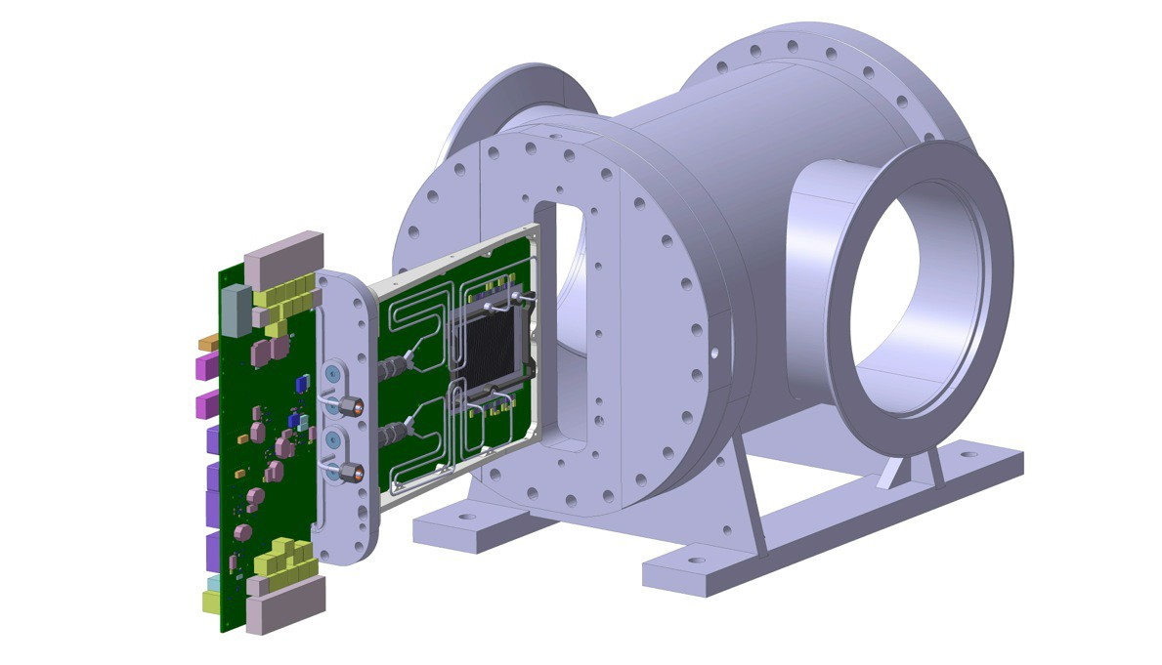
GTK Assembly Steps (2)
Mounting to Carrier Board
Installation

Slide 13
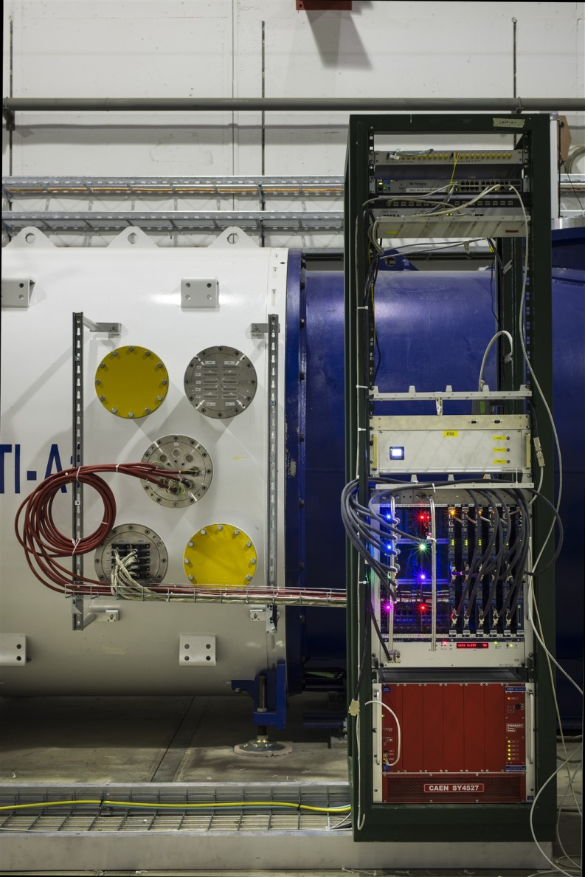
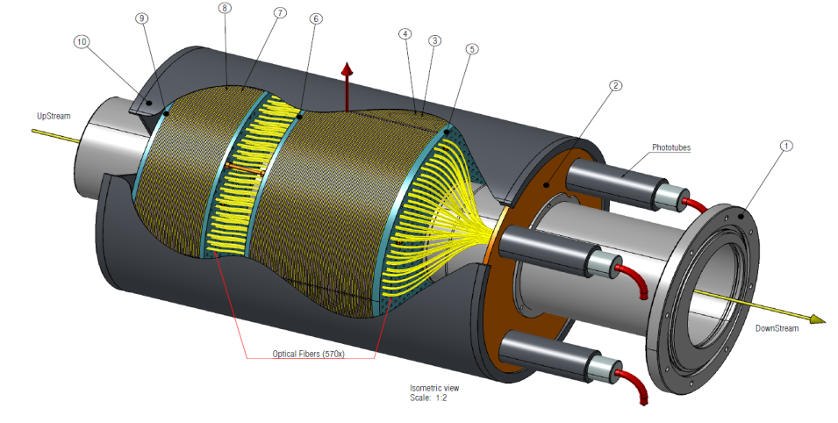
Photon Vetos
LAV 1 to 9 are installed
LAV 10 + 11
LAV 12 is in construction
SAC is installed
IRC
… in construction installation in July

Slide 14
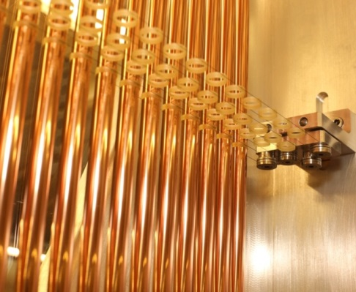
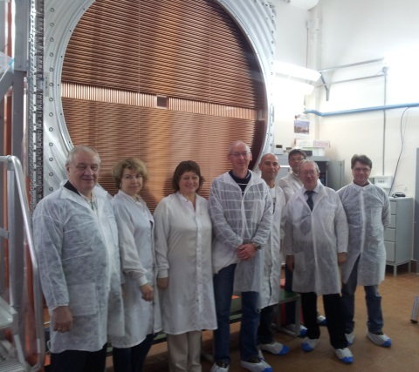
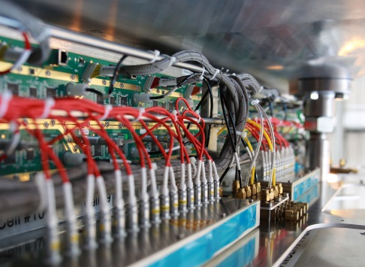
Straw Chambers
Straw Module Assembly:
  At CERN: 4/4 modules are completed
  AT JINR: 3/4 modules completed, the last module will be finished in June).
Dressing and Stacking of Modules:
  i.e. attaching all services (HV,LV and gas patch panels) to the chambers is in full swing.
Electronics:
  The frontend electronics were all produced and successfully tested.
  The SRB (back-end electronics) development is coming to the end and the production of a pre-series is expected to be available in June 2014

Slide 15
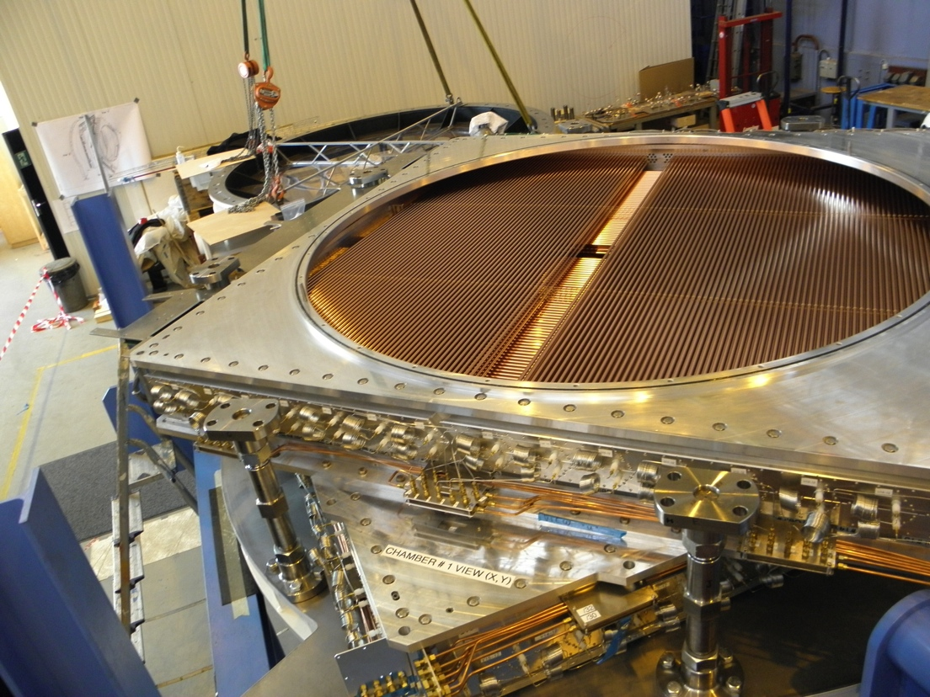
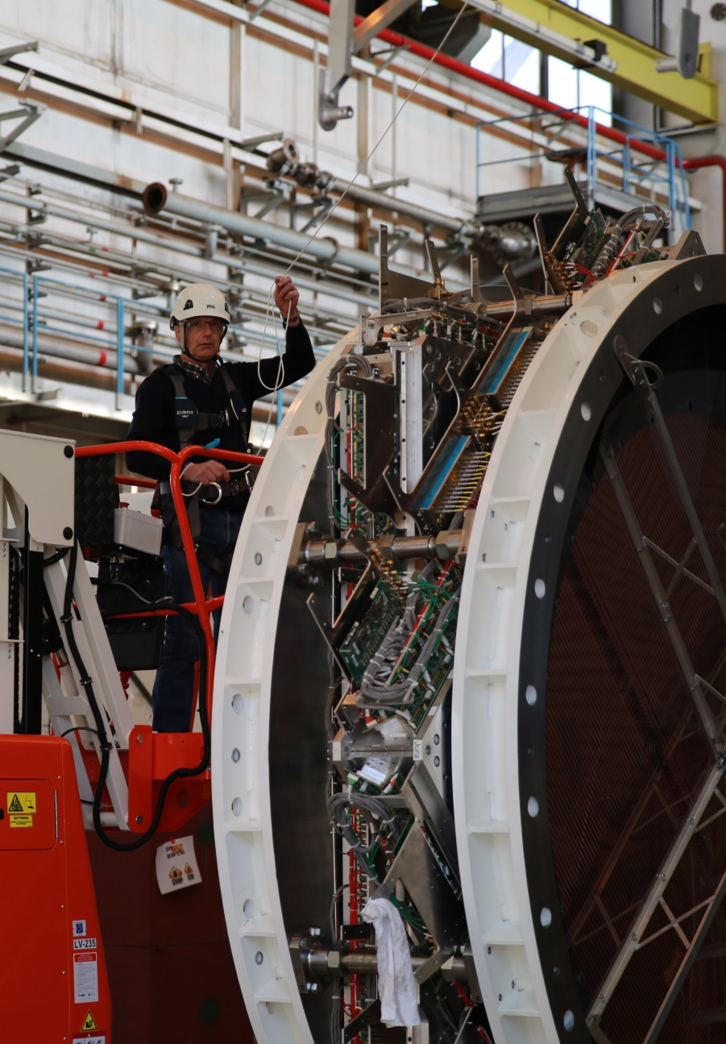
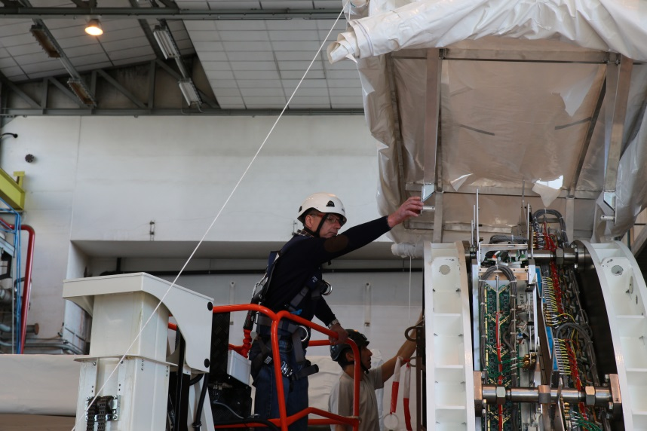
STRAW1 / Stacking in B156

Slide 16
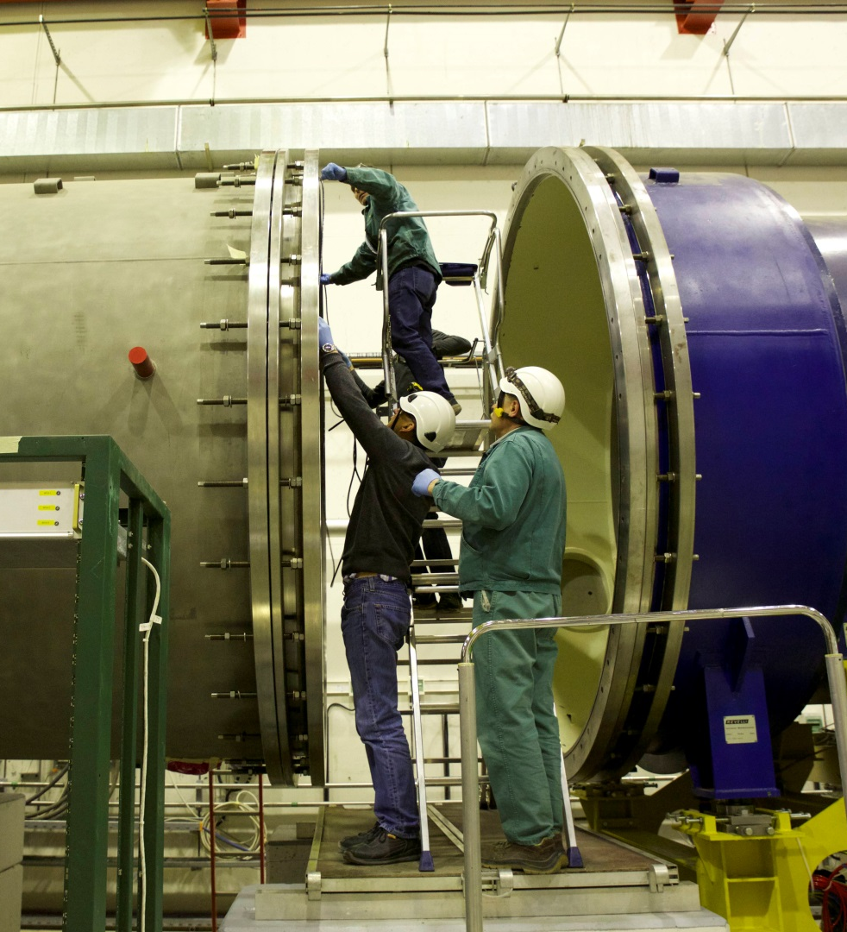
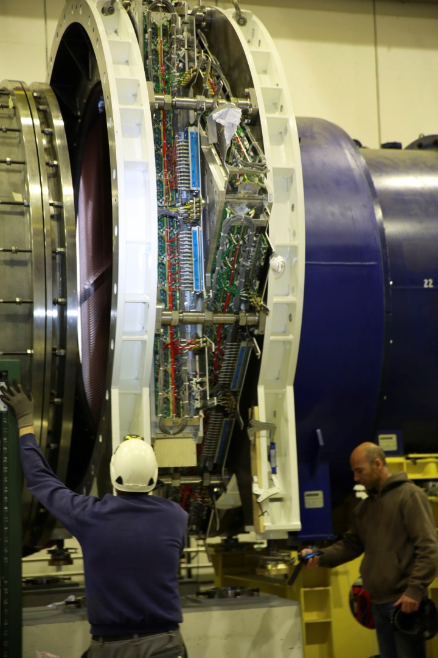
STRAW 1 Installation

Slide 17
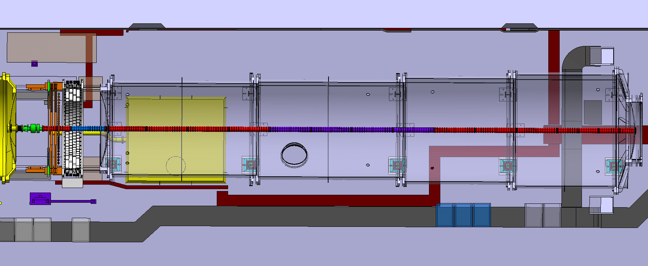
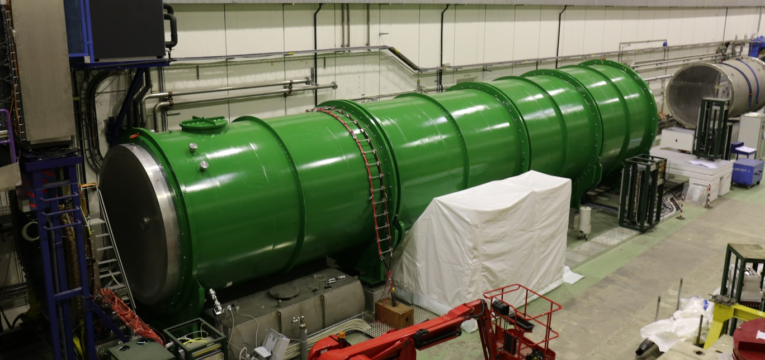
RICH Vessel Installation
Air lock
for access

Slide 18
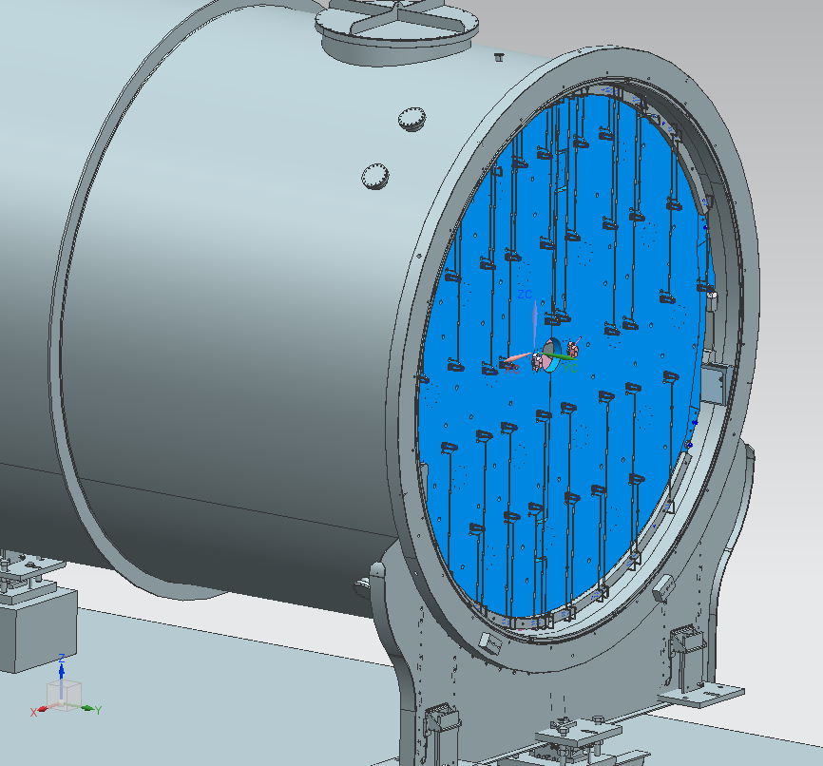
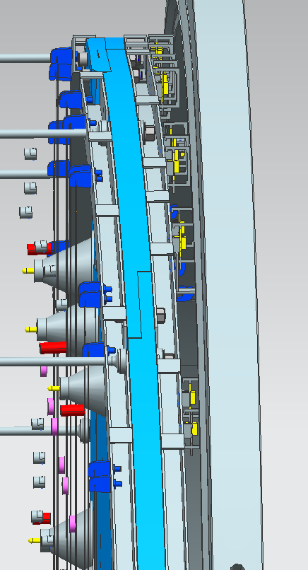
RICH Mirror Panel
Rich Mirror Panel delivery expected end of April

Slide 19
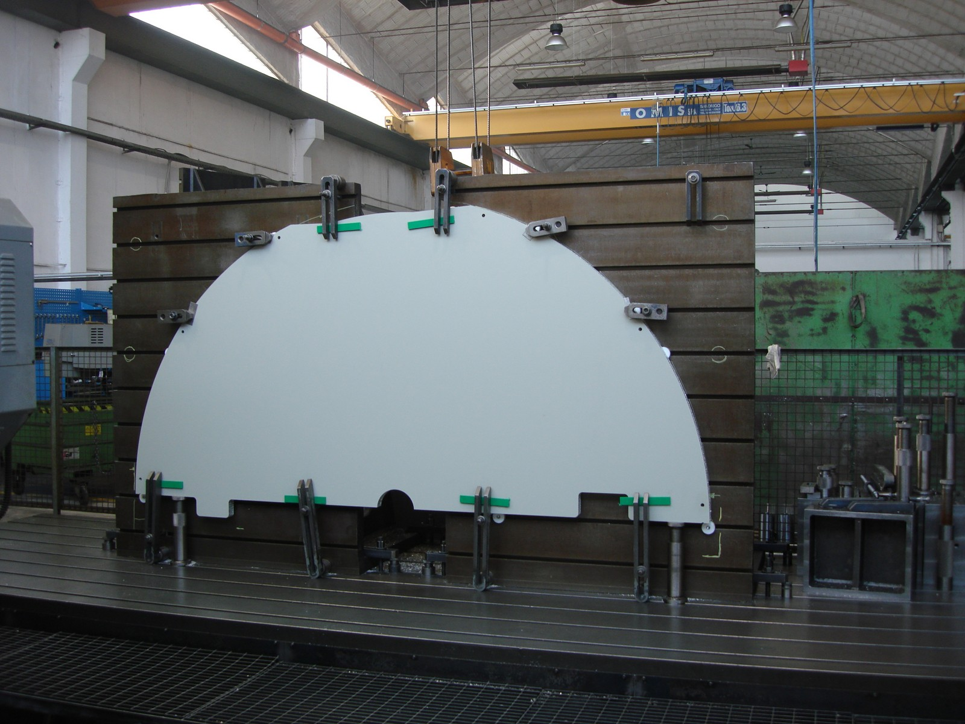

Slide 20
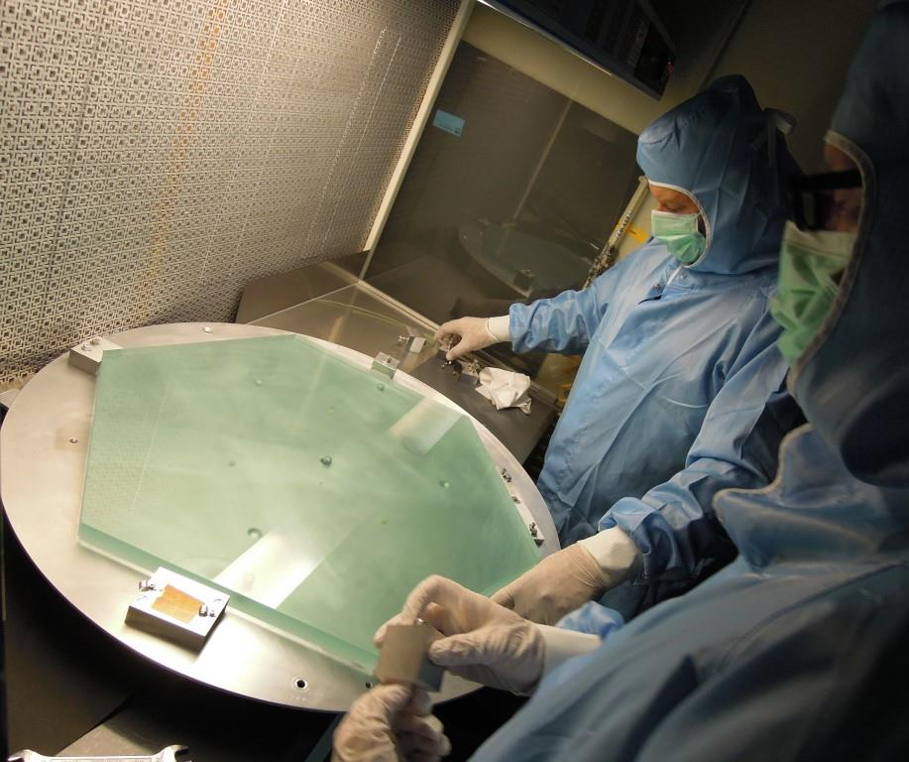
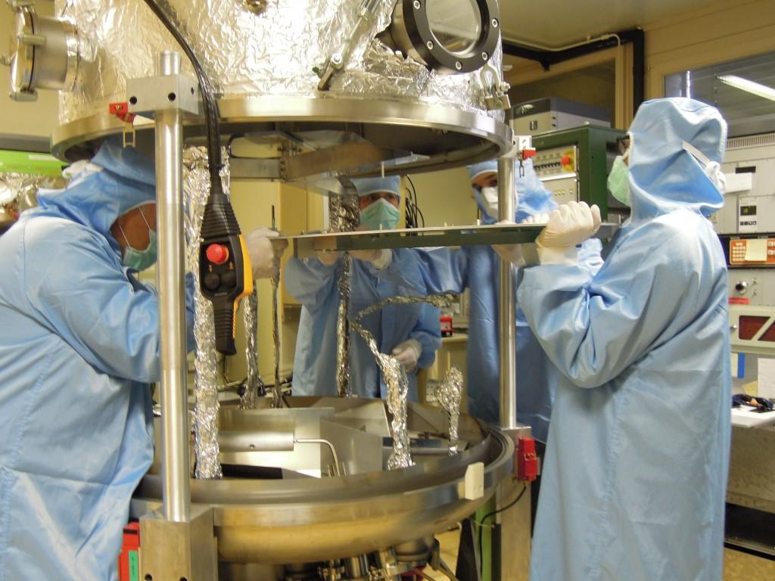
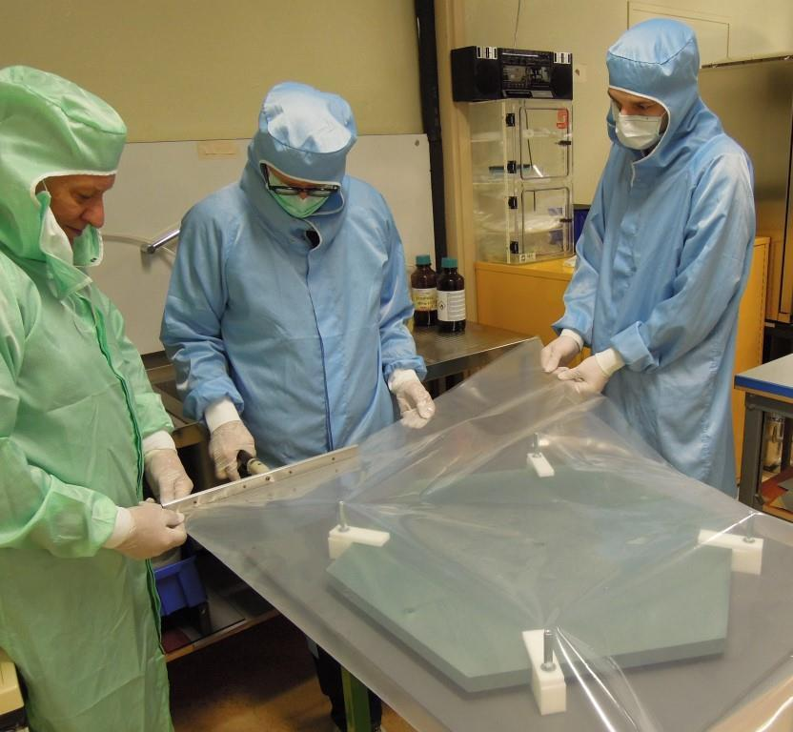
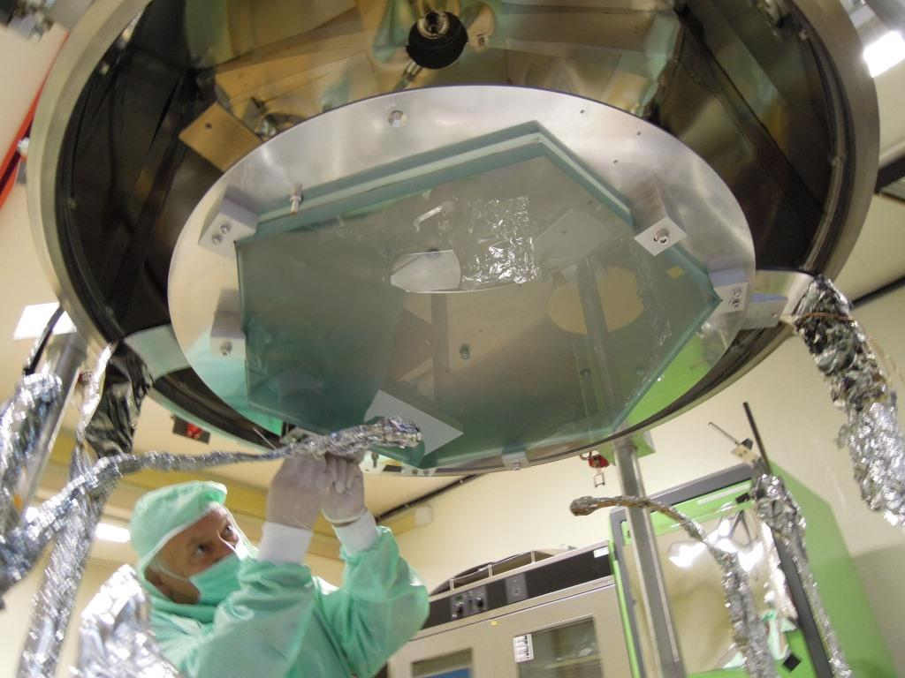
PH-DT Thomas Schneider et al.
13/18 hexagonal mirrors are coated

Slide 21
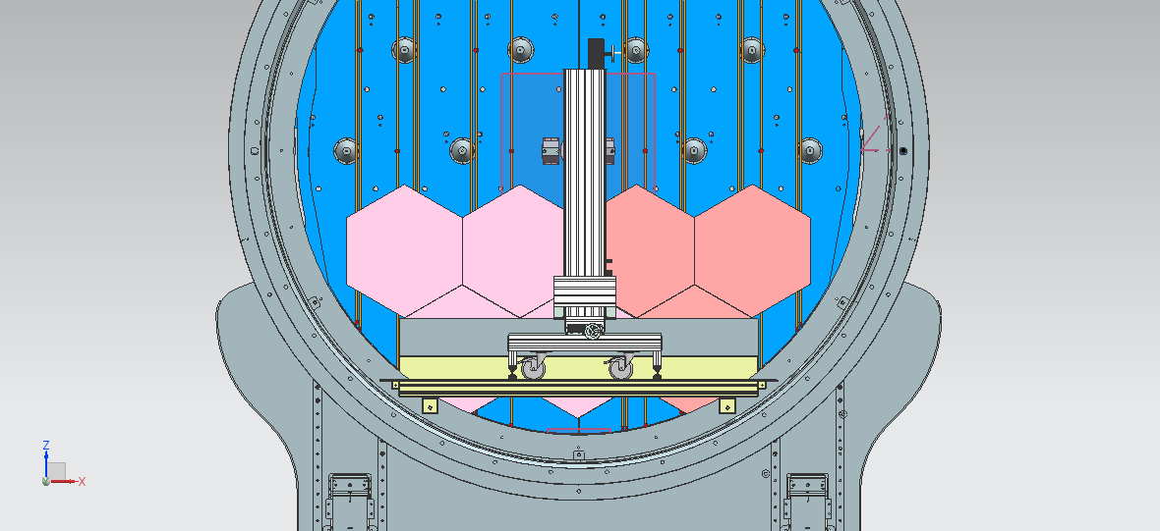
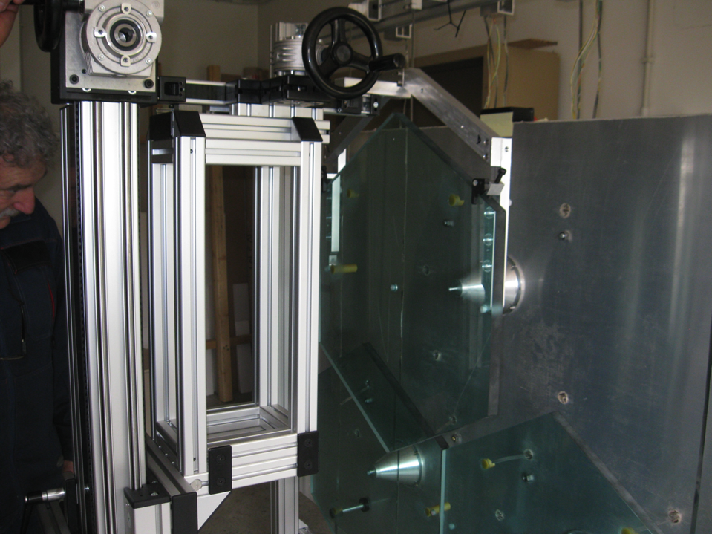
RICH Mirror Installation
Starting in May…
Installation sequence tested in Perugia on prototype

Slide 22
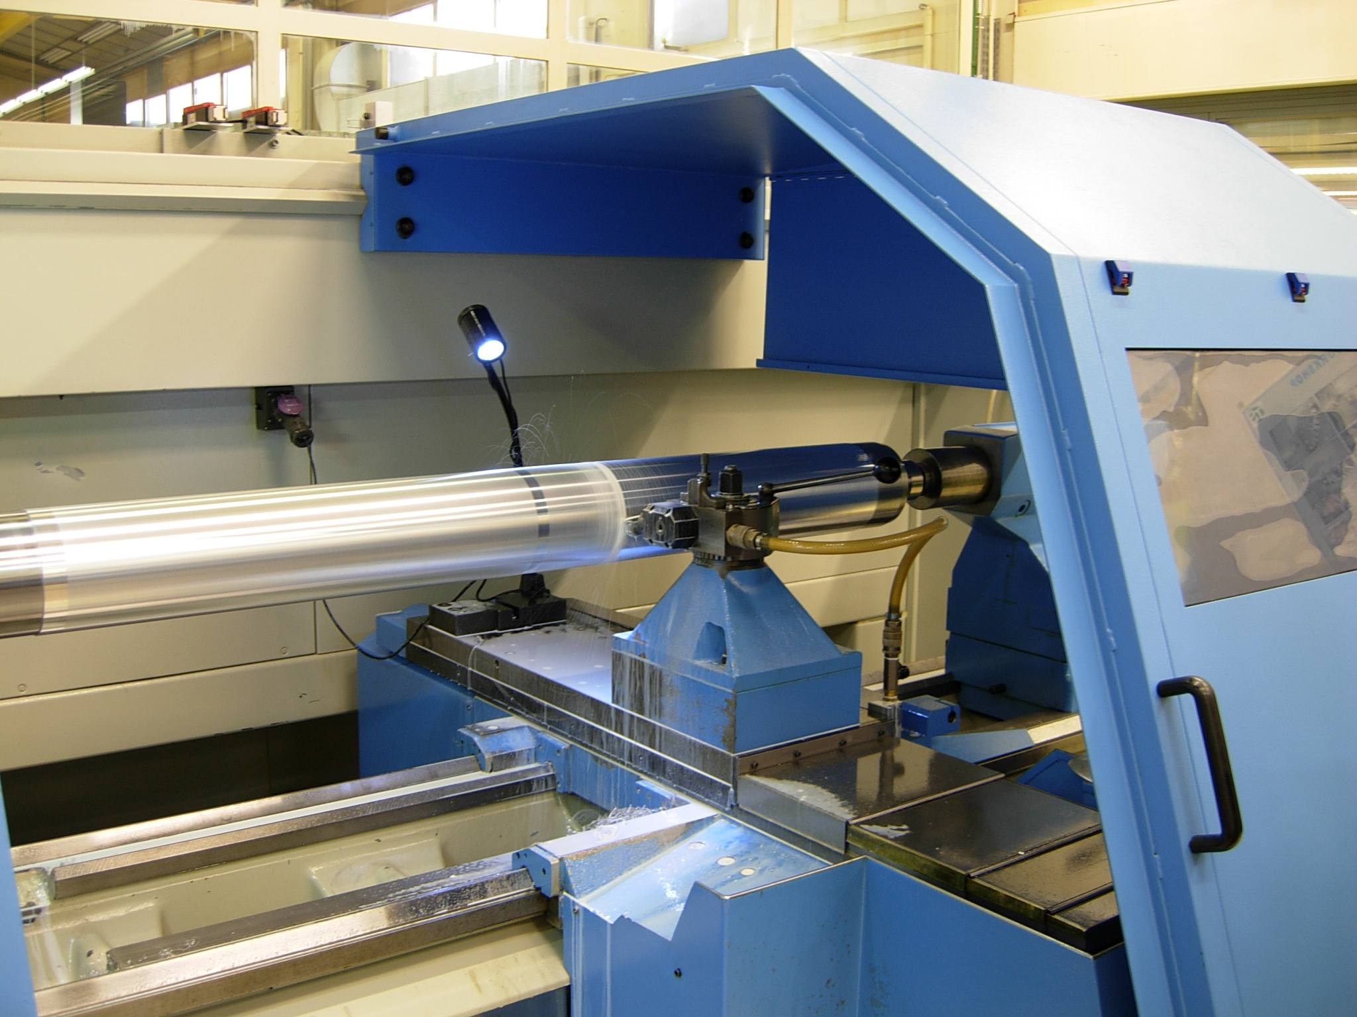

Slide 23
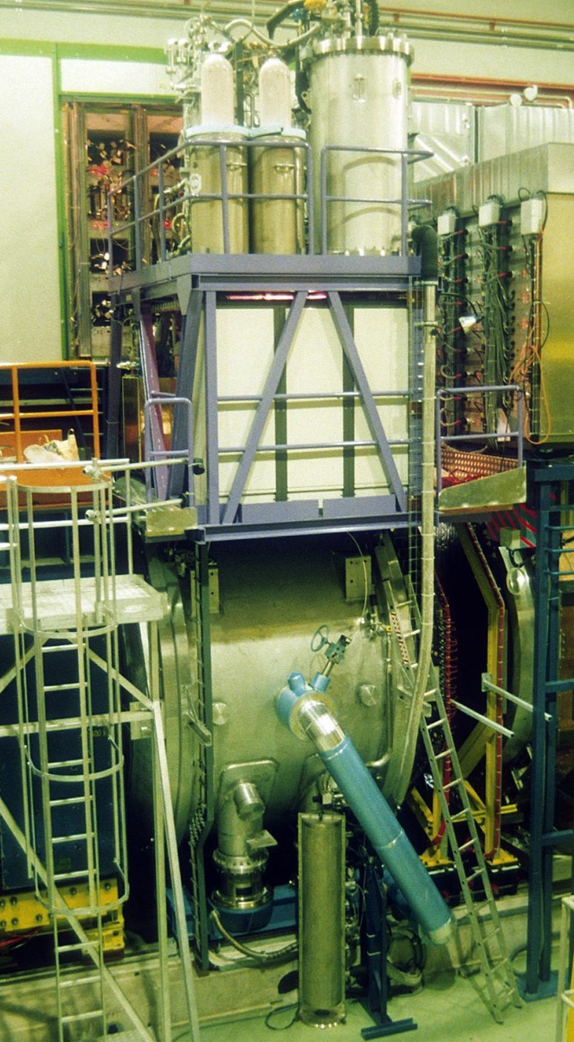
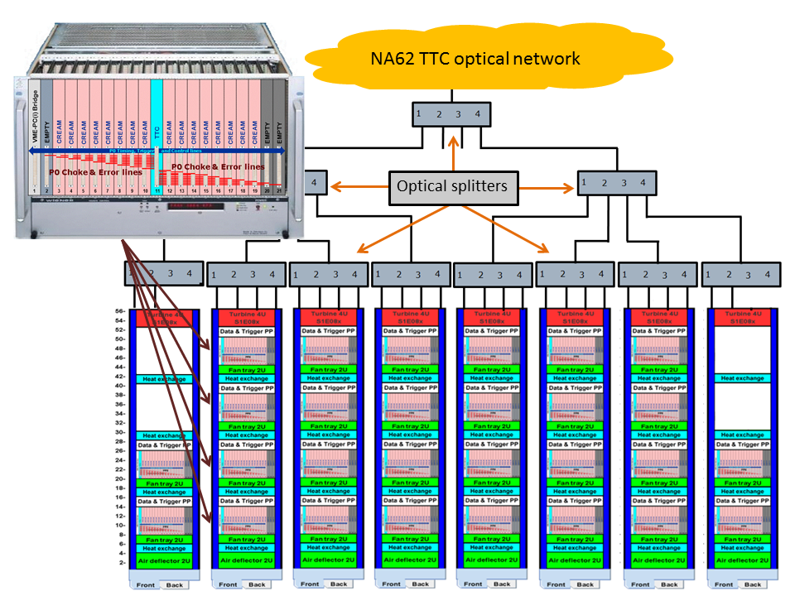
Liquid Krypton Calorimeter
CREAM
Notes:
Quasi homogeneous Cal.
Active 125cm thickness = 27 radiation lengths
10m3 bath of liquide Krypton at 120K (-150deg C)
Excellent Energy, space and time resolution
Diamter 160 mm beam tube in the center
13248 cell 2x2cm
Central anode (kept at HV) in the middle of two cathodes (at ground)

Slide 24
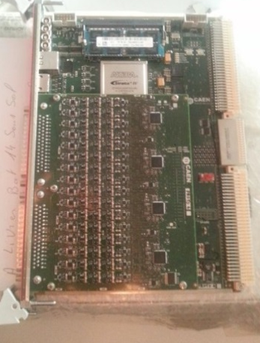
LKR CREAM Read-Out
1M x
256bits
255M x
256bits
13’248
channels
14bit ADC
@ 40 MHz
PC Farm
optional
Analog
Inputs
Zero
Suppress
ADC
Circular Buffer
L0 Buffer
L0 Event
Builder
L1 accept
LKR L0
Trigger
Sums
L0 accept
(fixed latency)
L0
Trigger Processor
Other
Inputs
Notes:
Data rate (non Zero suppressed):
40 MHz x 14 bits x 13248 Channels = 930 GB/s
Circular buffer size:
256Mbits = 32 MB
8 samples x 14 bit x 13248 = 1.5 Mbit for 1 time
1.5Mbit x 300 time slices = 450 Mbit => 56 Mbyte for 10ms
Upon receipt of L0 the Event builder ships the corresponding 8 time slices of all channels into the L0 buffer.
L0 Buffer size:
(255M x 256 bit words wide = 16M samples if 8 samples/trigger = 16 seconds
buffer @ 1 MHz L0 rate)
8 samples x 14 bits x 13248 channels x 1MHz x 10s = 1’850GByte
The L0 event buffer is able to keep 1MHz L0 rate for 10s (spill length)
The acquisition process is dead time less: while emptying the buffers CREAM can receive new data simultaneously.
Zero suppression is optional. A simple mechanism foresees to suppress channels which read only pedestals.
Trigger sums:
4x4 or 2x8 channels energy add up (pedestals subtracted) 16bit/Super-Cell (including clock bits)
Up to 4 links effective bandwidth 720 Mb/s

Slide 25
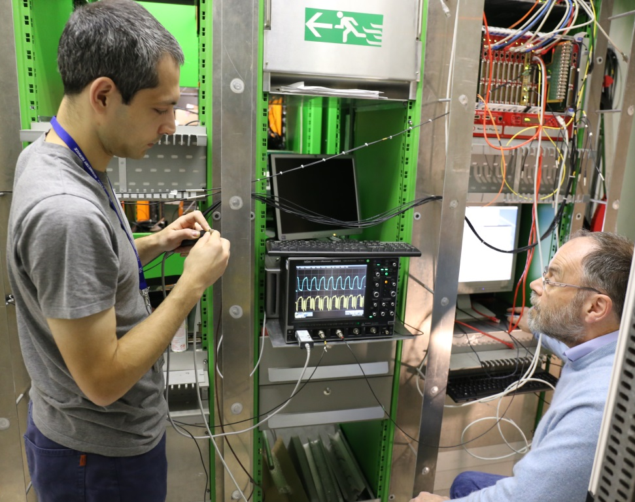
CREAM Status
CAEN Deliverables:
Pre-series (16 modules) successfully tested
serial production (11 modules received)
Expect to receive all modules by mid-June
Ongoing Tests at CERN:
Tested CREAM read-out chain, .i.e
  L0 trigger from TEL62 -> PC-Farm read L0 data from TEL62 -> L1 request to CREAM -> read CREAM data – event building -> write to disk

Slide 26
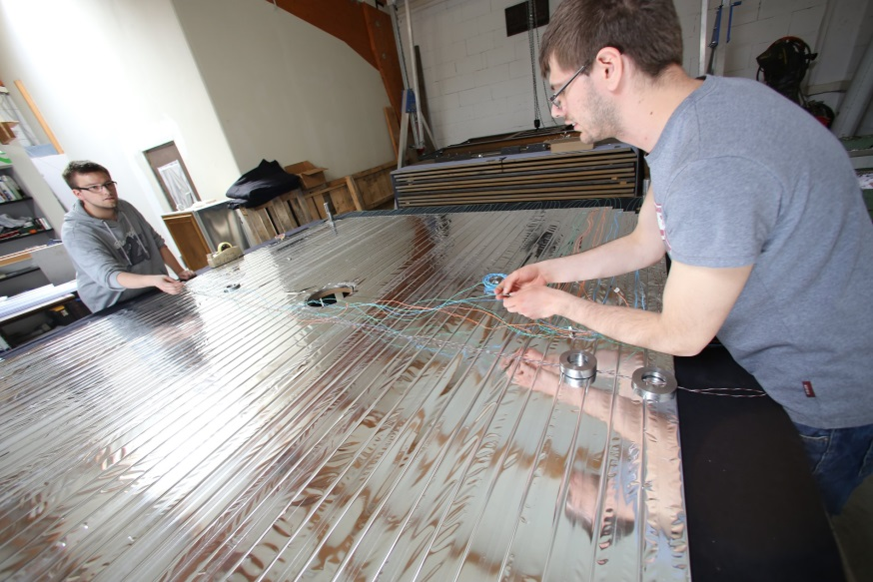
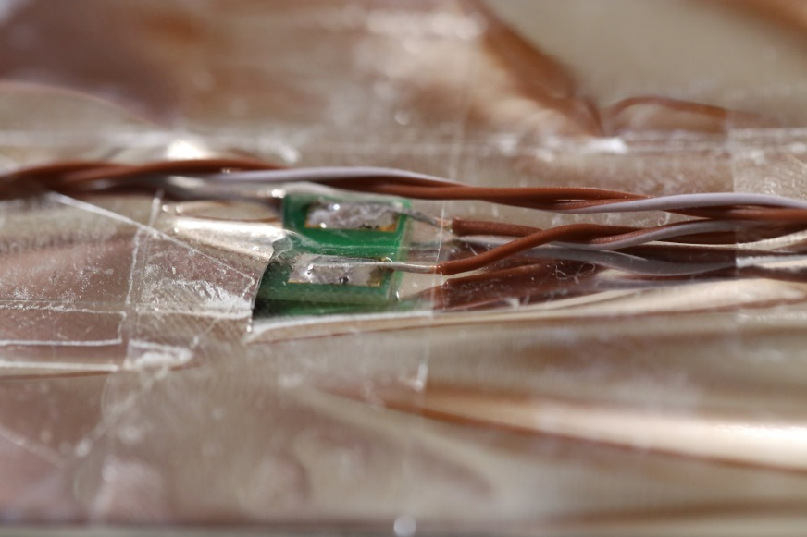
Muon Vetos
MUV2 + 3 are installed
MUV1 is being assembled in Mainz
Problems with scintillators and fibers caused delay in construction.
MUV1 installation shifted to summer.

Slide 27
TDAQ General Status
Integration of sub-systems, i.e. phase of iterative and incremental testing
two coordinated Dry-Runs in July and Nov. 2013
  Lessons:
    These tests are extremely useful for debugging
    To increase efficiency further: Test sub-systems in more complex and realistic laboratory set-ups beforehand.
In 2014:
  Switch to continuous test mode for testing of individual sub-systems or individual functionalities for several sub-systems
  In addition, special dry-runs, for example:
    common L0 trigger primitive test is in June
    Others will follow…

Slide 28
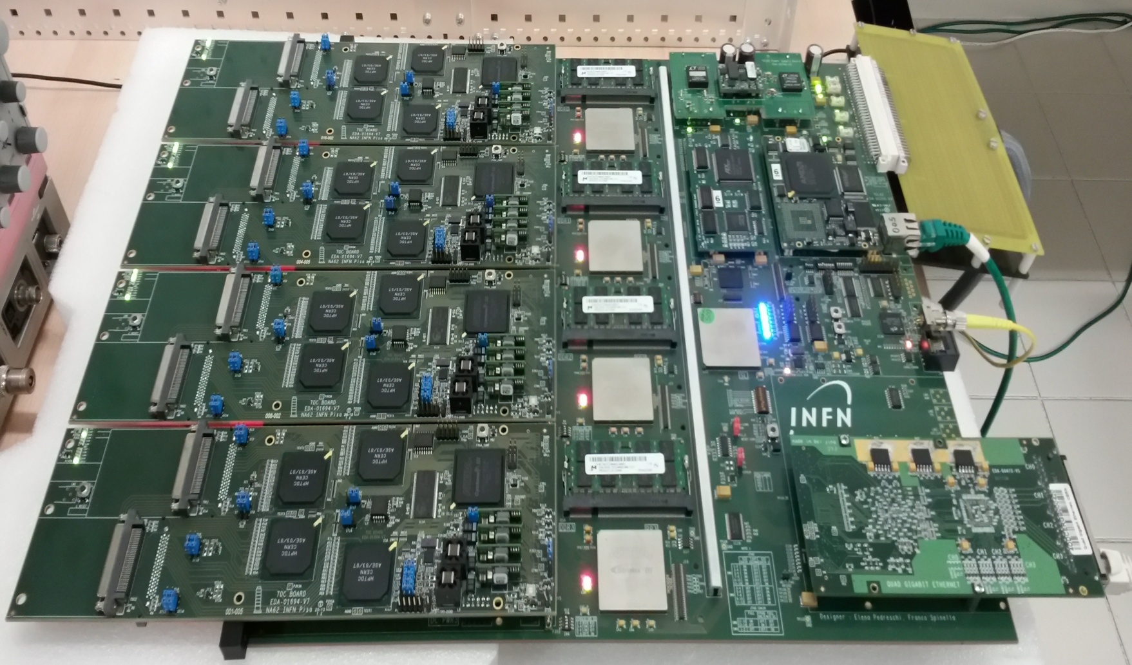
TEL62 Board
4 x TDCB Mezzanine

Slide 29
TDAQ Read-Out
common components
TEL62 boards:
  TEL62 Firmware:
    RO-firmware improvements: data storage handling far superior now; rate increase from 100kHz to 1 MHz (matching design value)
    Trigger firmware: in progress for CHOD, LAV, MUV and RICH
  TEL62 V3 Hardware:
    upgrade of pin-compatible FPGA enhancing memory contingency for further developments.
    hardware design final and frozen, some issues of assembly quality of prototype boards are being addressed
    production has started; pre-series available this months
TDCB boards :
    Are under production; delivery soon

Slide 30
TDAQ - Trigger Status
L0 Trigger:
  L0 Trigger Processor: two versions (one PC based the other FPGA based) under test;
    most of the infrastructure is common.
    Hardware for both versions exist; firmware writing and testing are ongoing
  Dispatching of L0 primitives from sub-detectors is being tested
  Intercommunication of TEL62 in preparation (RICH and LAV).
  LKR-L0: new board (TELDES) interfacing TEL62’s developed and tested.
  NIM Trigger (as used in 2012) is kept up to date as back-up.
L1/L2 Triggers:
  L0 selected data is sent to PC-Farm, except LKR data are merged after L1.
  L1 (software) trigger on sub-detector level
  L2 software trigger on assembled and partially reconstructed events
Notes:
Choice criteria:
Flexibility in handling L0 trigger conditions
Rate capability
Synchronous (or non-synchronous) trigger primitives (periodic primitives Dt=12.8 musec)

Slide 31
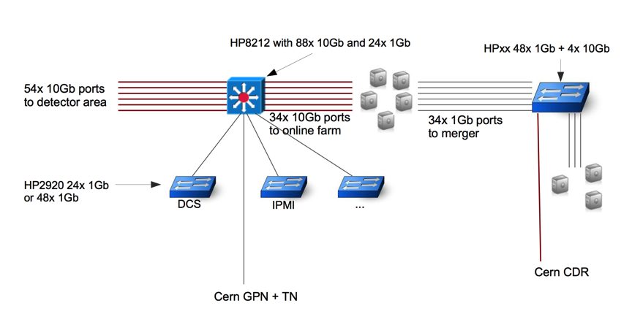
Data Handling / PC Farm
PC-farm will include about 30 PC’s
2-3 merger PC’s (interface to CDR)
installation
in June

Slide 32
RICH

Slide 33
STRAW
GTK

Slide 34
Summary
Detailed report: CERN-SPSC-2014-009 (SPSC-SR-134)
During the last 12 months we have made a lot of progress towards the completion of NA62, particular high-lights were the:
  GTK ASIC
  CREAM readout been successfully tested
  Straw Chamber production
  …
However, a lot remains to be done…
We are confident that the successful work continues
and that we will be ready to take data in October.

Slide 35
Thanks
We warmly thank the referees and the SPS Committee for the time they spent analyzing our work and for their valuable feedback they give to us.
We are grateful for the strong support of the Funding Agencies.
The collaboration wishes to acknowledge the invaluable support provided by CERN and thanks in particular the Support, Technical and Administrative teams.

