Slide 1



MAPS are for amateurs, professionals do 3D
G. Deptuch
Fermilab Batavia IL USA,
CPIX 2014
September 15 – September 17, 2014,
Bonn University, Bonn, Germany

Slide 2
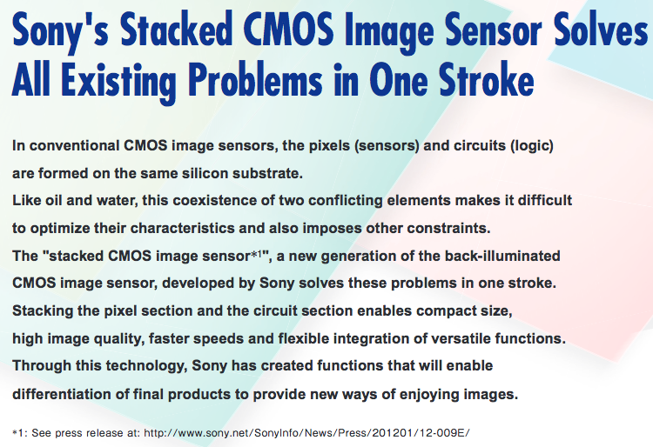
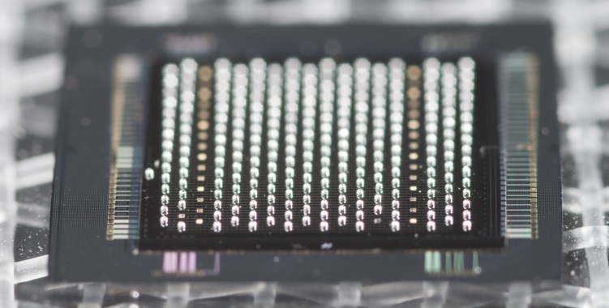
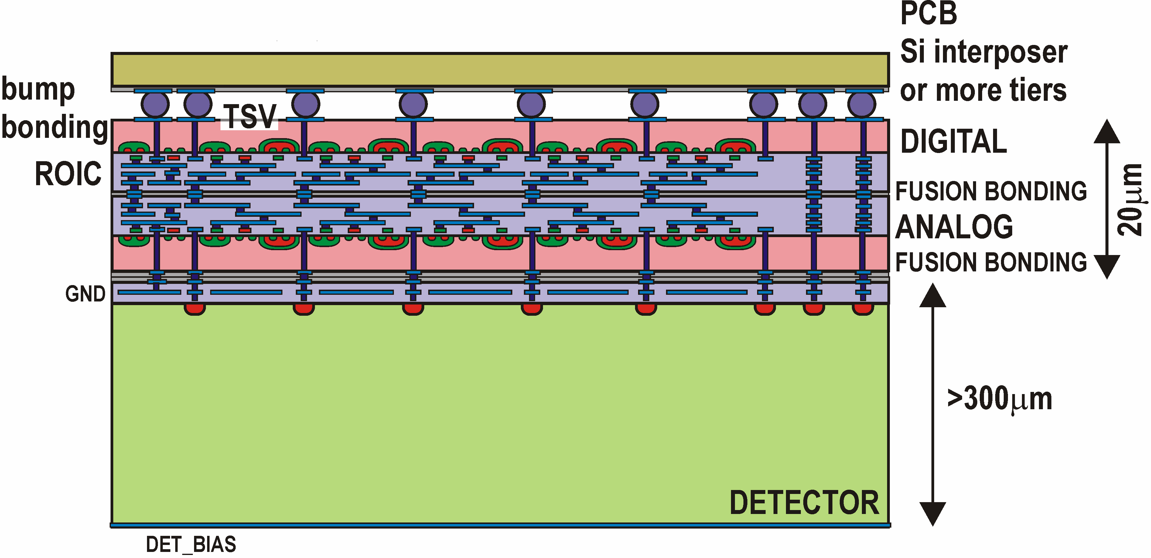
Genesis of the title
Observations of the leading industry trends
Observations and gained experience
on own efforts
Igniting discussions with Wojtek Dulinski

Slide 3
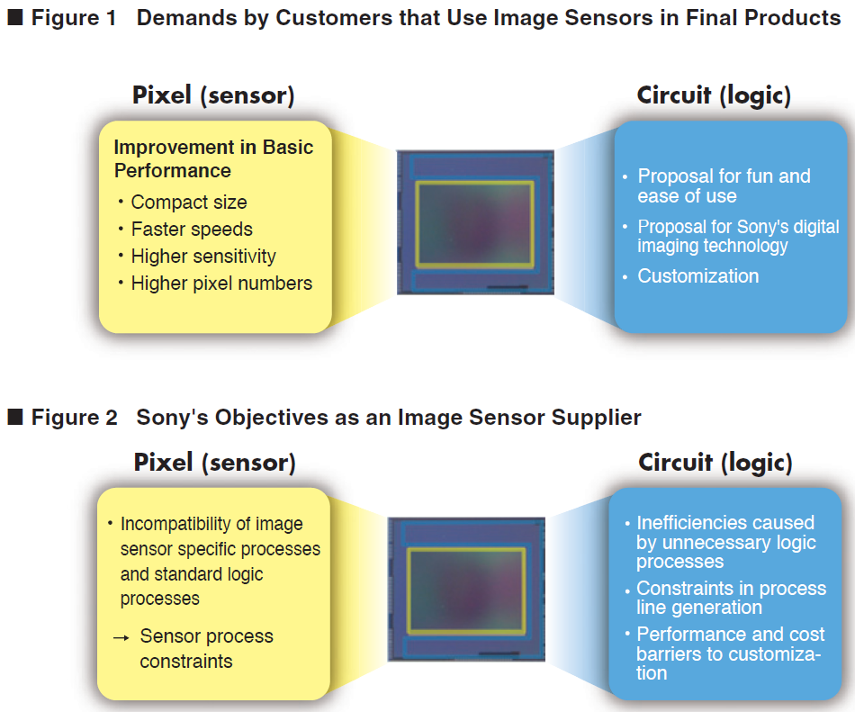
How does see it industry?
The expectations that customers have of a final product containing an image sensor can be categorized into expectations regarding pixels and those regarding circuits.
When it comes to pixels, customers are looking for improvements in basic performance such as pixel size, speed, sensitivity and high pixel numbers. For example, smaller pixel sizes make it difficult to obtain greater sensitivity.
However, Sony thinks that image sensors should capture images at 1 lx (moonlight). It is often said that customers demand a new approach from image sensors that will allow differentiation in the design of the final product, for example, fun and ease of use.
http://www.sony.net/Products/SC-HP/cx_news/vol68/pdf/sideview_vol68.pdf#page=1
What is the situation in X-ray and charged particle detection?

Slide 4
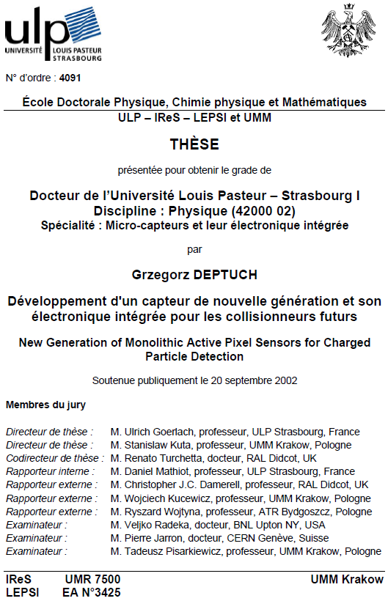
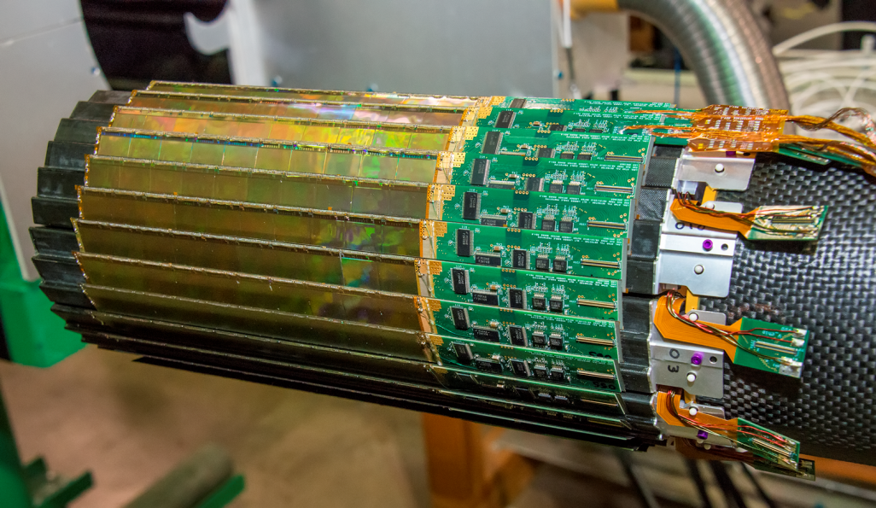
Situation in X-ray and charged particle detection?
Monolithic Active Pixel Sensors (MAPS) discovered for soft X-ray and charged particle detection about 15 years ago.
I was, with many among those sitting in this room, excited that building a highly granular particle detector of descent parameters (noise, spatial resolution, detection efficiency, cost, ect.) became possible using a standard, relatively modern CMOS process and following a typical IC design flow! – this was new!
It seemed that pixel detectors democritized – everyone could (with not significant resources: money and manpower) could build own pixel detector and obtain devices with parameters suitable for some ranges of applications.
The crowning of the successful story is the first Vertex Detector based on MAPS installed in the STAR experiment at RHIC !!!
Universality of the MAPS technology turned out to be their disadvantage:
- good detection Æ modified processes
- large forms Æ modified processes
- yield, radiation hardness Æ modified processes
- flexible applications Æ hybridizing again
Leo Greiner, FEE2014 (IPHC, LBL)
What is the conclusion?

Slide 5
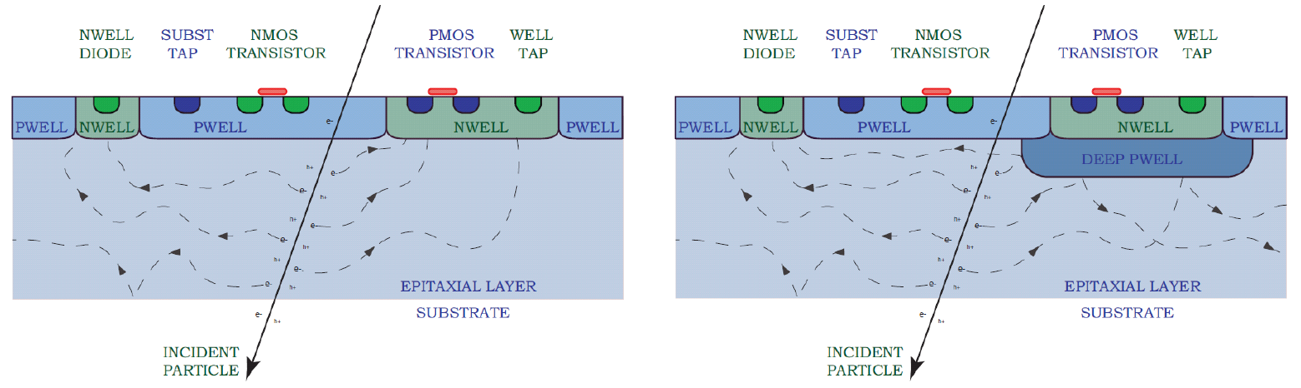
Important directions in MAPS technology - 1
QUADRUPLE WELL MAPS
QUADRUPLE WELL MAPS pixel = isolation of electronics (water) from detector (oil),
(potentially thicker active layer and operation in depletion),
Attempt of:
- increasing collection efficiency and collection speed Æ radiation hardness
- making detector ”active” – processing of signals in situ Æ being able to cope with required timings
Large area with stitching, but fetaures: radiation hardness, collection efficiency are not perfect
technology of classical MAPS
technology of quadruple WELL MAPS
(nwell, pwell, dnwell, dpwell)
Good for 3T pixel design, no processing in pixel, uncomplicated pixel = good for yield of large devices,
Renato Turchetta 2010 IEEE NSS&MIC (RAL),
Ping Yang Pixel2014 (CCNU, CERN)

Slide 6
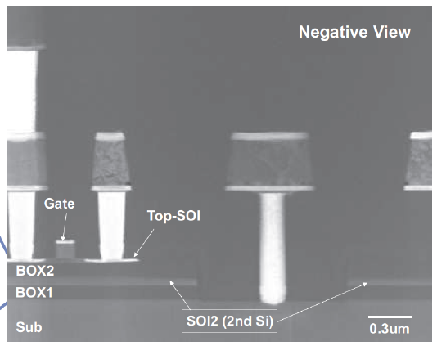
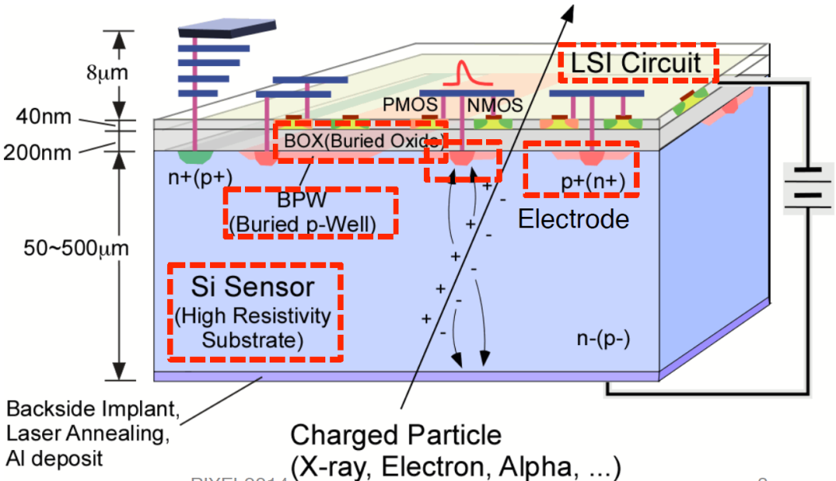
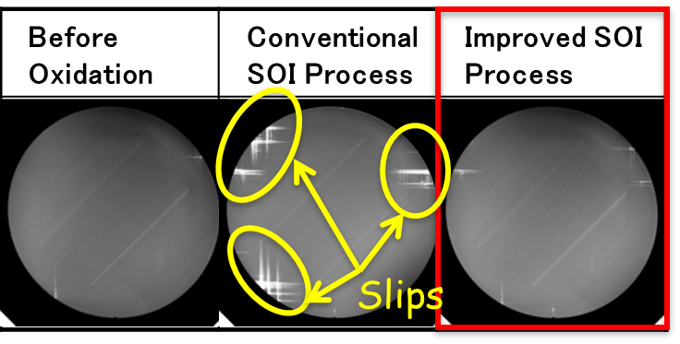
Important directions in MAPS technology - 2
SOI MAPS
SOI MAPS pixel = full depletion, but detector (oil) does not like electronics (water)
Attempt of:
- overcoming sensitivity problems of MAPS for X-rays
- overcoming limited in-situ electronics of MAPS
- building large area detectors
Technology is still searching for its fully reliable form
despite of almost decade long significant investments
double SOI for shielding and radiation hardness
defects in the sensors layer
Yasuo Arai, PIXEL2014 (KEK)
other, like thick SOI (HV SOI), also possible, Tomasz Hemperek, FEE2014 (U.Bonn)

Slide 7
Important directions in MAPS technology - 3
HVCMOS MAPS and CCPD
HVCMOS MAPS pixel = full depletion but minimum of electronics (water)
CCPD = not MAPS, no bump-bonding but hybrid (oil)
Architecture optimized for application ”CLIC style” or ”ATLAS style”
Not clear how to achieve large area seamless coverage + yield, uniformity, technology perennity
Size: 50 µm x 250 µm
ATLAS-style
Size: 25 µm x 25 µm
CLIC-style
Readout pixel
Readout pixel
1fF
TOT = sub pixel address
Different logic 1 levels (~1V)
+
Size: 33 µm x 125 µm
Size: 25 µm x 25 µm
Ivan Peric, FEE2014 (KIT)
Leo Greiner, FEE2014 (IPHC, LBL)

Slide 8
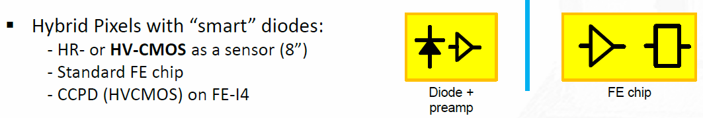
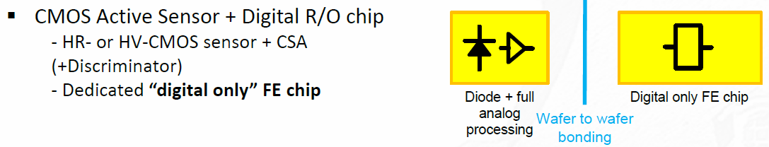
Converging ideas
Best sensors are such that the sensor material is subject to minimal processing (T, Fs, environment)
Best charge collection achieved on large, unobstructed electrodes from fully depleted volume
Best yields achieved for dense ICs on medium size chips not on multi-reticle size chips
Best active area coverage when chips have no peripheries, no tilling and no wire bonding are used
Æ MAPS don’t meet these conditions
Highest S/N with pixels possessing smallest input capacitance and capable of in-situ Q-to-V or Q-to-I conversion
Best particle tracking with lightweight and thin detectors
Æ MAPS meet these conditions
Best chances with funding agencies with inexpensive technologies Æ HQ MAPS are not inexpensive
Ideas are already appearing, e.g. Tomasz Hemperek FEE2014 (U.Bonn)

Slide 9
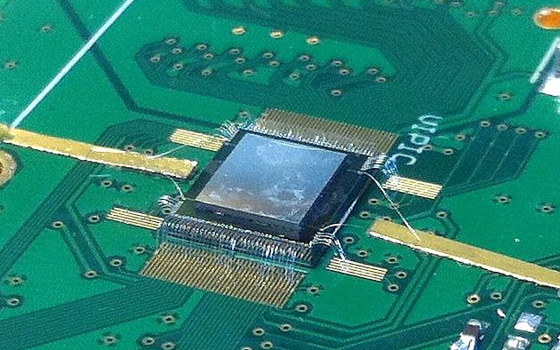
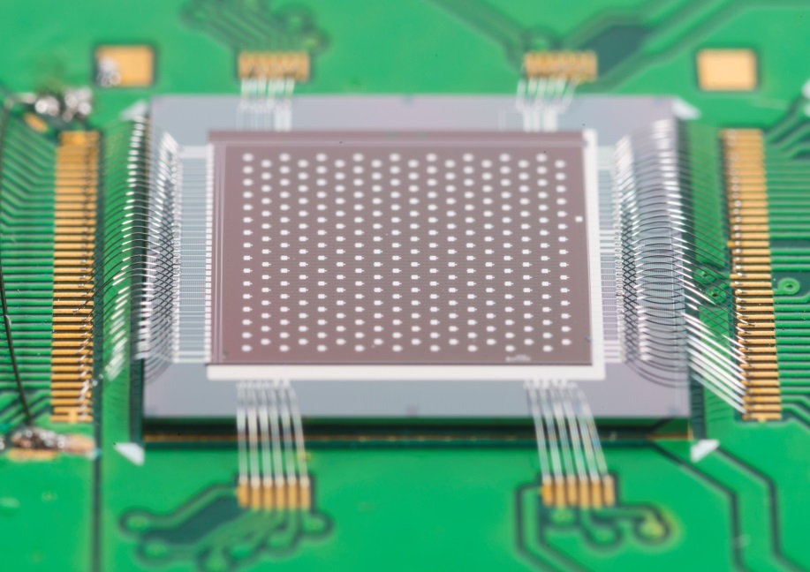
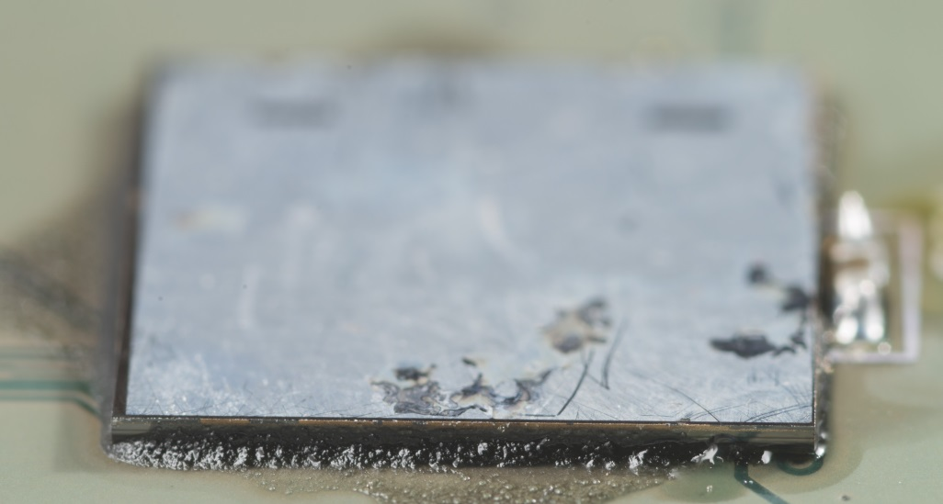


Proofs of 3D concept
5.4×6.5 mm² VIPIC1
with 32×38 pixels detector
bump bonded
3D-integrated pixel ROIC (VIPIC1chip)
results of tests in configuration with:
- bump-bonded sensor
- fusion-bonded sensor
34 μm thick VIPIC1
DBI bonded to 64×64 with pads on its back
VIPIC1 with DBI bonded sensor Sn-Pb bump-bonded on PCB
Results achieved through the efforts of collaborators.
Tezzaron and Ziptronix, as the current 3D technology providers.

Slide 10
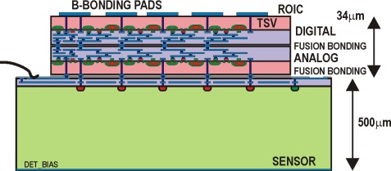
Demonstrator of 3D integration
Vertically Integrated Photon Imaging Chip (VIPIC)
detector: Si d=500 μm, pitch 80×80 μm², soft 8keV X-rays
application: XPCS
Fusion D2W bonded 3D chip on sensor wafer
VIPIC bonded to sensor can be tested through wire bonded and bump-bonded connections
10

Slide 11
Can 3D integrated compete with MAPS?
NOISE
an analytical plot:
measurement on fused sensor-ROIC assembly:
Sum of two Gaussian functions with:
x₀₁=1640 and σ₁=40
x₀₂=1800 and σ₂=40
Spectrum of ⁵⁵Fe with 500 μm thick, fully depleted (V_{dep}=170V) Si sensor,
(VIPIC1: 80×80 μm² pixel pitch, 64×64 pixels, with 150-200 ns shaping time
11

Slide 12
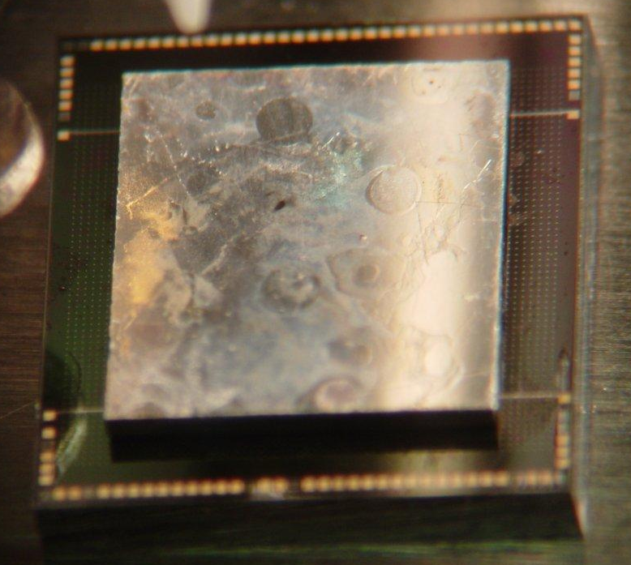
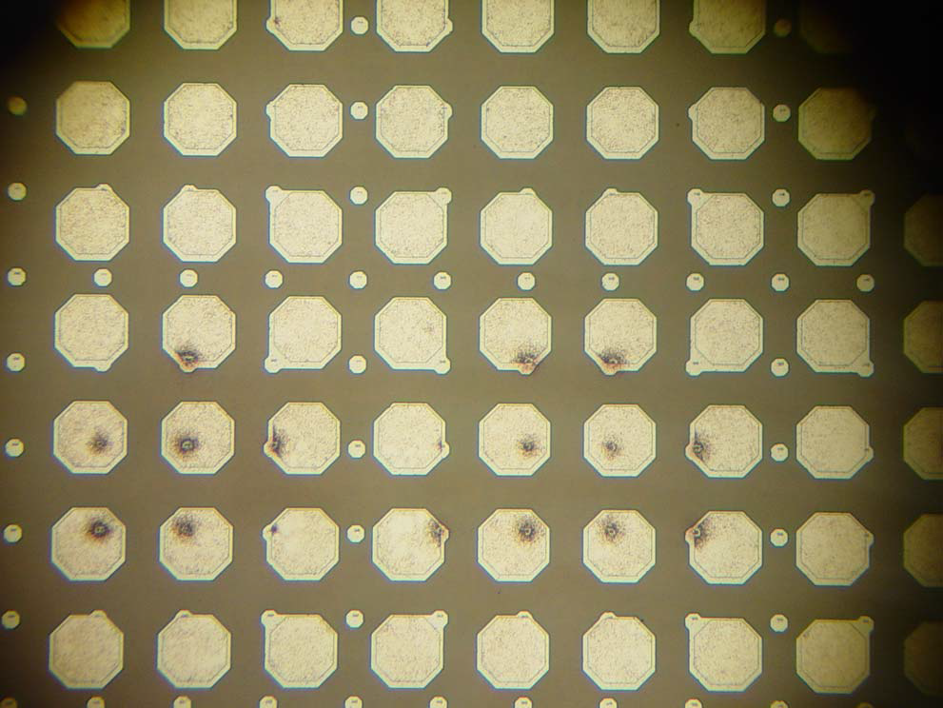
Comparison with bump bonded -1
80 μm pitch
100 μm pitch
back-side of sensor
Wire bonding pads
4 d=300 mm, p=100 μm Hamamatsu sensor Sn-Pb bump-bonded on VIPIC (75 μm bump, post reflow gap at 45−50 μm and underfill)
4 deposition technique on a single die with ENIG UBM on Al substrate pads by (CVInc.) – pads φ=60 μm
4Optimization of the Ni-Au deposition
Æ ~100% of pads retaining UBM and bumps
skipped row
skipped column
Adapting layout of pads on VIPIC1
original 80 μm - pitch pads for BNL sensors overlaid with 100 μm pitch pads for Hamamatsu sensors
In tests detector biased at 120 V
(full depletion) ¹⁰⁹Cd and ⁵⁵Fe used
12

Slide 13
Comparison with bump bonded -2
SIGNAL AMPLITUDE = GAIN
32×38 =1216 pixels
bump-bonded
64×64 =4096 pixels
fusion-bonded
Amplitude for bump-bonded VIPIC1
Amplitude for fusion bonded VIPIC1
Gain is higher and more uniform for fusion bonded device
13

Slide 14
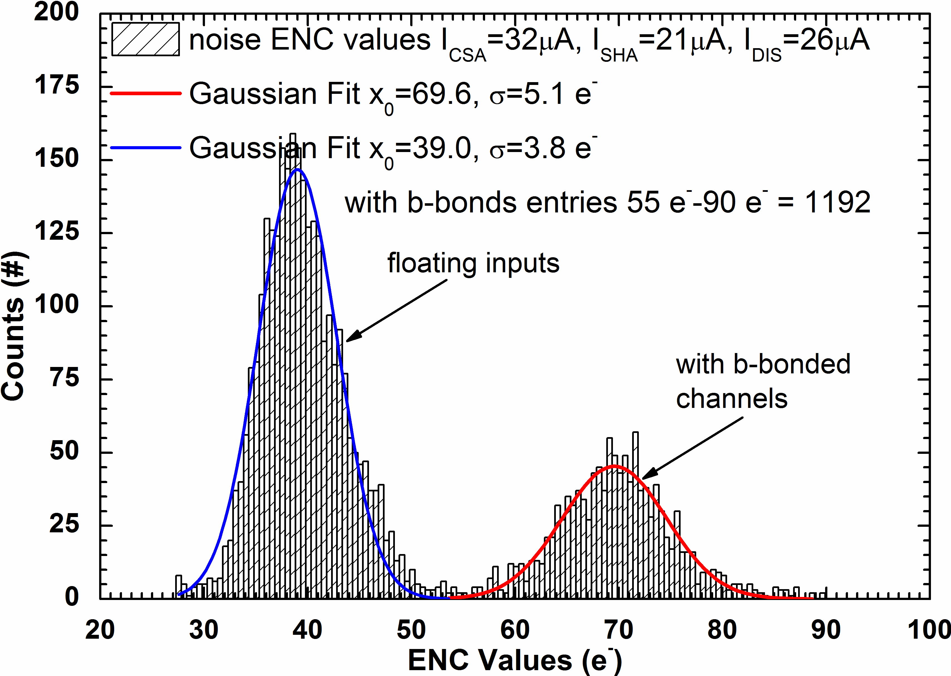
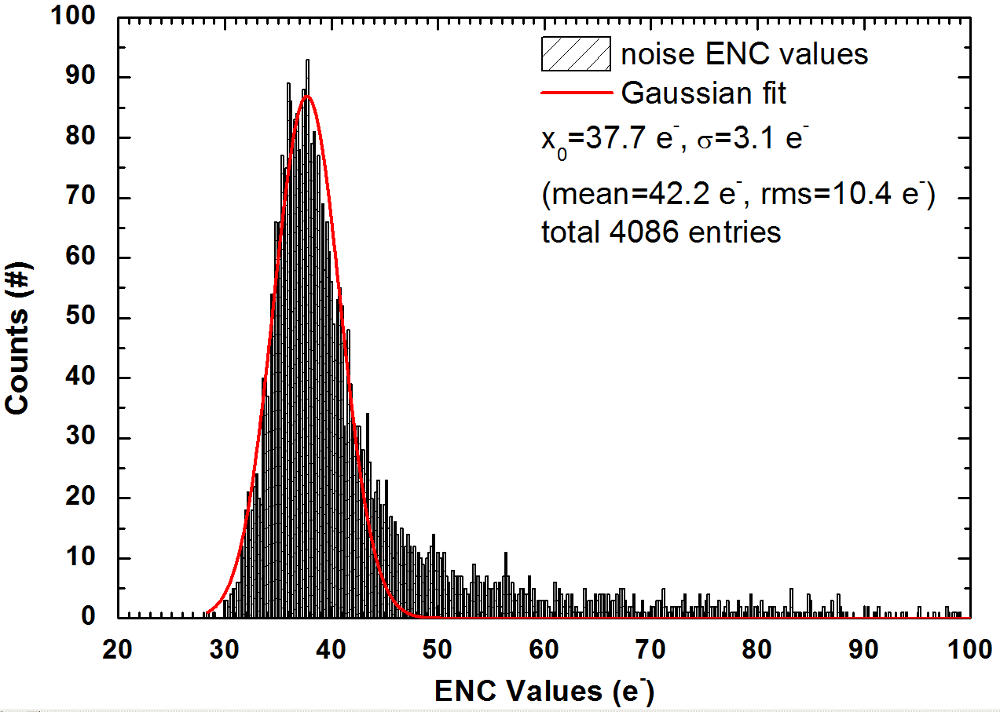
Comparison with bump bonded - 4
NOISE
Noise for bump-bonded VIPIC1
Noise for fusion bonded VIPIC1
Behind the results is lower input capacitance in the fusion-bonded version
ENC on fusion bonded device is close to that measured for floating inputs!
ENC=40e⁻ C_{in}<20fF, ENC=70e⁻ C_{in}>80fF
14

Slide 15
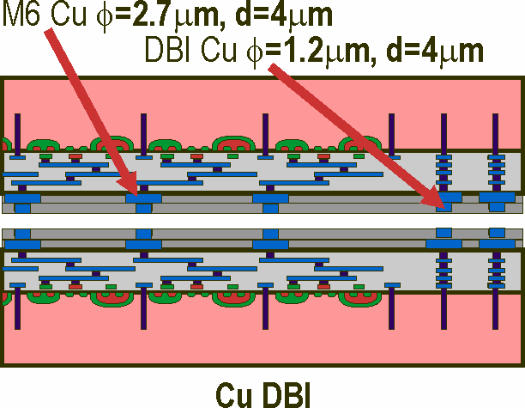
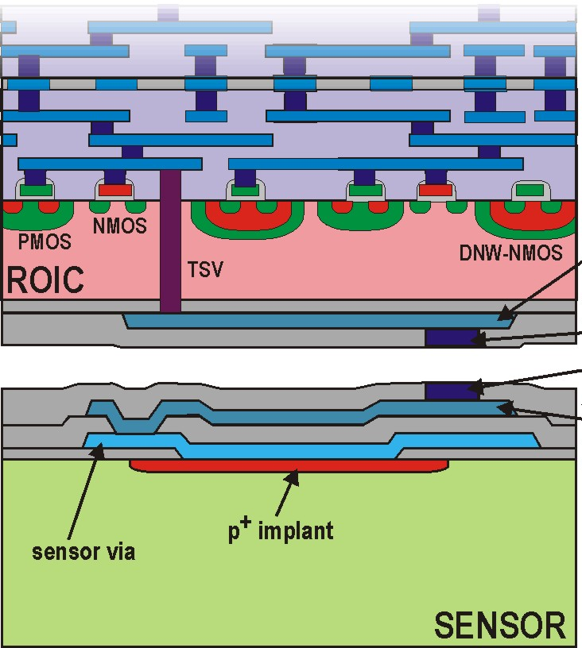
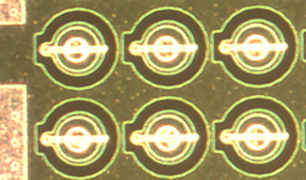
Comparison with bump bonded - 5
4 Cu-DBI (oxide-oxide fusion bonding) used for bonding tiers of 3D VIPIC
4 Ni-DBI (oxide-oxide fusion bonding) with 5μm diameter DBI post used for bonding of processed VIPIC die to sensor wafers
4actually 3 chips bonded to sensor wafers: VICTR, VIP2B and VIPIC
Must be extremely planar
15

Slide 16
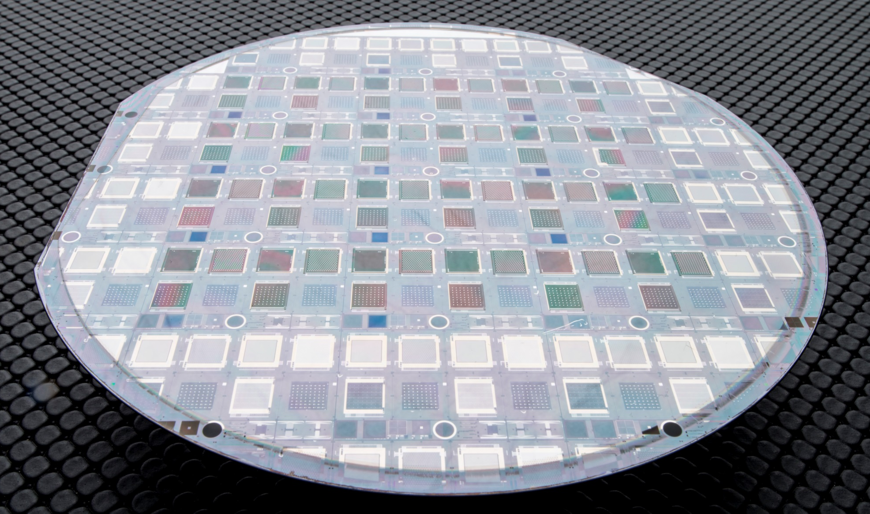
Some „propaganda” pictures - 1
VIPIC
VIP2B
VICTR
Fusion D2W bonded chips on sensor wafer …
500μm 5kΩcm p-on-n Si 6” sensor wafer (fabricated by BNL)
16

Slide 17
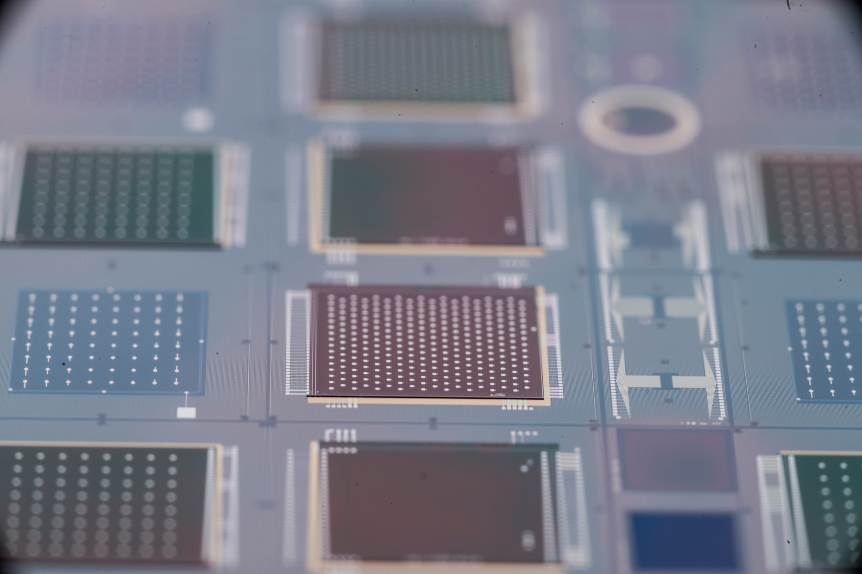
Some „propaganda” pictures - 2
VIPIC
VIPIC is 34μm thick and has b-bonding pads on its back
17

Slide 18
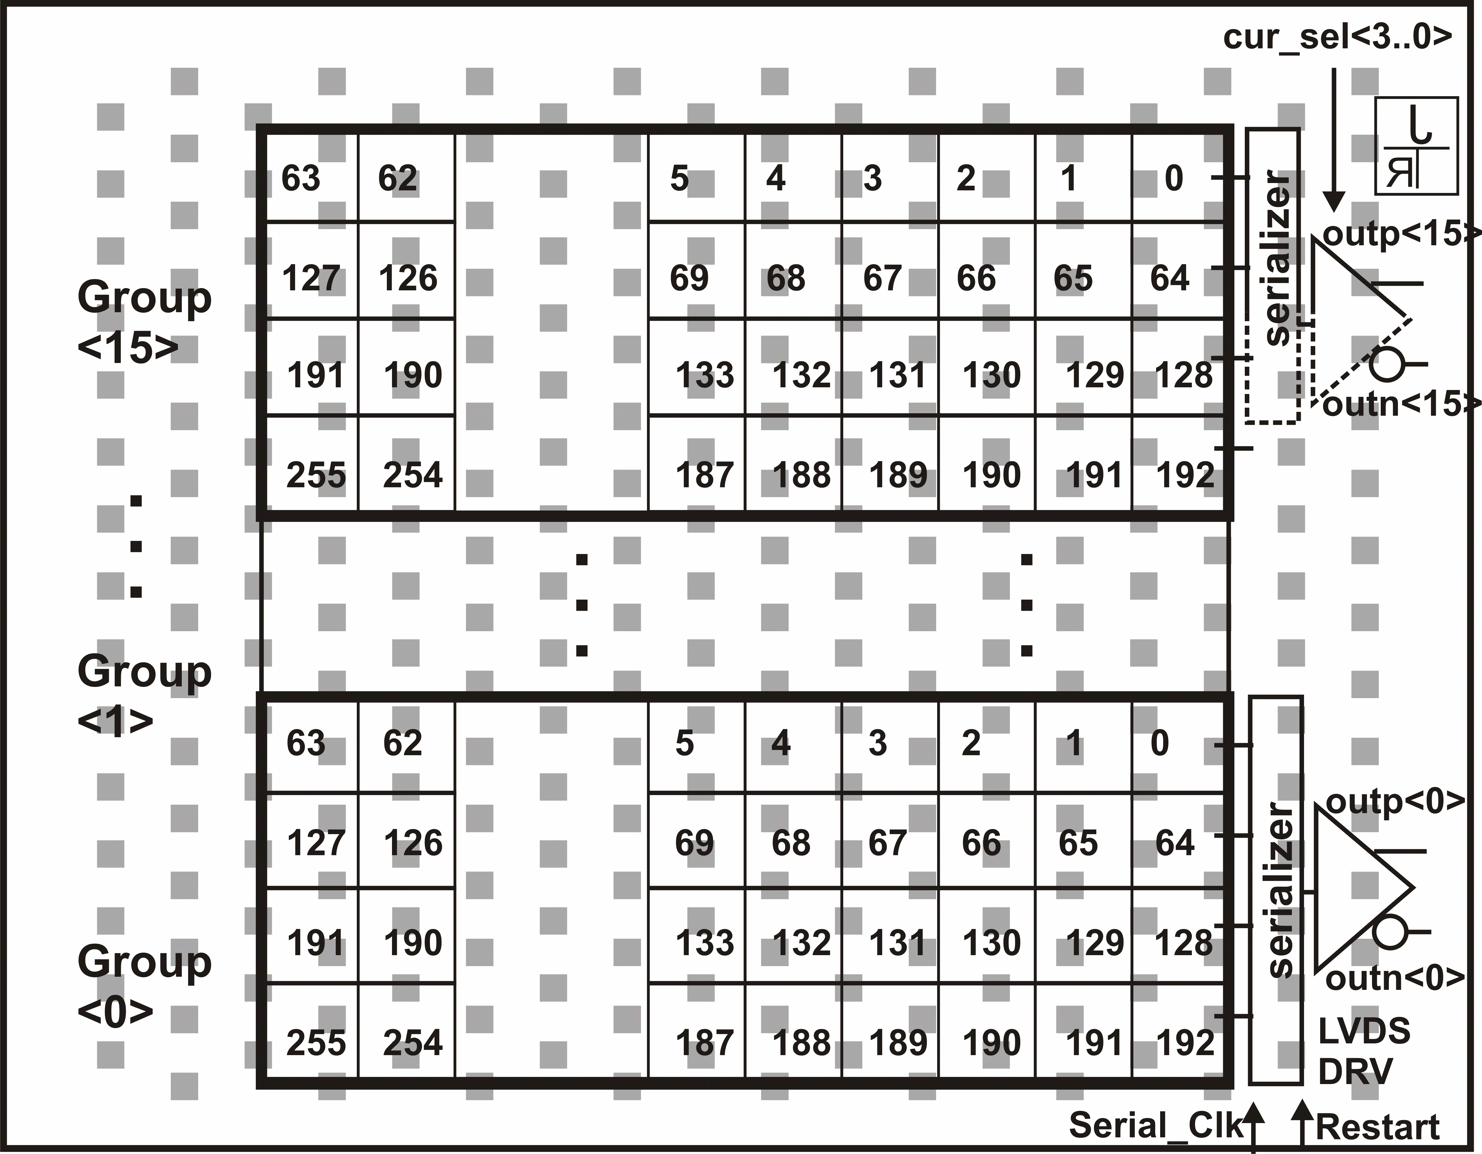
Some details of VIPIC1 - 1
VIPIC1 (Prototype) counts the number of hits in every pixel and read out the # of hits, and addresses in a dead timeless manner,
Active area: 5120×5120 μm², chip:
6.3×5.5 mm²
Matrix of 64×64 pixels divided into 16 group of 4×64 pixels read through one LVDS buffer
Sparsification engine selects hit pixels in every group for readout
Only digital information read out (160 ns /hit pixel)
more details:
G.Deptuch, M.Demarteau, J.Hoff, R.Lipton, A.Shenai, M.Trimpl, et al., “Vertically Integrated Circuits at Fermilab“, IEEE Transaction on Nuclear Science, vol. 57, no. 4, (2010), pp. 2178-2186
G.Deptuch, M.Trimpl, R.Yarema, D.P.Siddons, G.Carini, R.Szczygieł, P.Grybos, P.Maj, “VIPIC IC - Design and Test Aspects of the 3D Pixel Chip”, Proceedings of Nuclear Science Symposium, Knoxville, USA, October 2010
G.Deptuch, G.Carini, P.Gryboś, P.Kmon, P.Maj, M.Trimpl, D.P.Siddons, R.Szczygieł, R.Yarema, „Design and Tests of the Vertically Integrated Photon Imaging Chip”, IEEE Transaction on Nuclear Science, vol. 61, no. 1, (2014), pp. 663-674
18

Slide 19
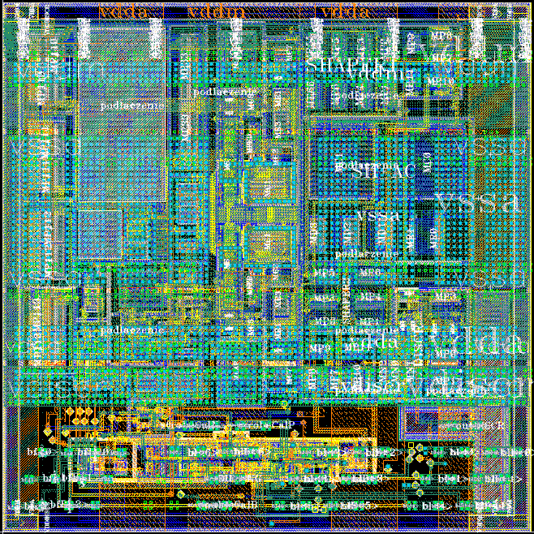
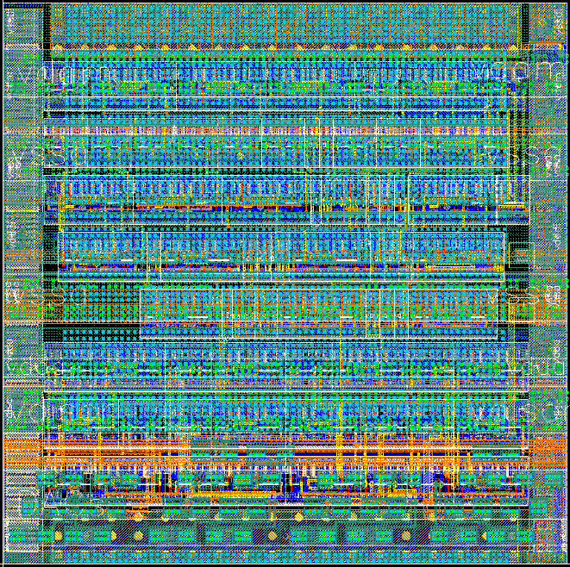
Design of VIPIC1 - 2
Analog: 280 transistors
Digital:1400 transistors
4Single ended or pseudo-differential CSA-shaping filter-discriminator: shaping time τ_{p}=250 ns, power ~25 μW / analog pixel, noise <150 e⁻ ENC, gain(C_{feed}=8fF) = ~115mV/8keV (optimized for 8 keV in Si - linearity up to 3×8 keV)
41 threshold discriminator
410 bit/pixel DAC adjustments
12-bit for configuration
7-bit trim offset, 3-bit trim R_{f},
single/dif mode, CAL enable
4in-pixel 1-stage pipe-line logic
4disributed sparsifier: 8 bit priority encoder, pixel readout selector, pixel address generator and counter output
42×5-bit long counters
4configuration registers: single bit / pixel (pixel SET, pixel RESET) and 12 bit DAC and configuration (calib., singl./diff.)
2-lines for CAL circuits
discriminator output
Doubled bond pads
for each signal
19
Power suplies tied between tiers

Slide 20
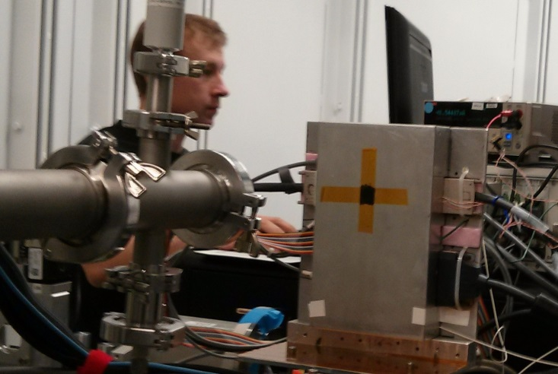
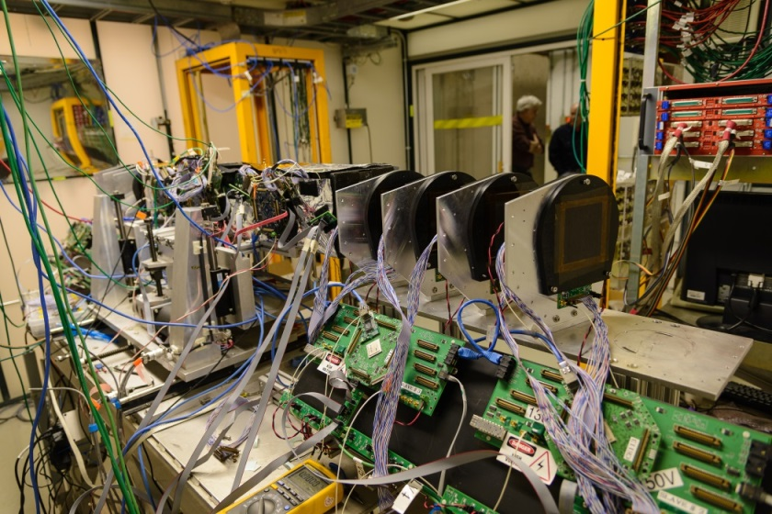
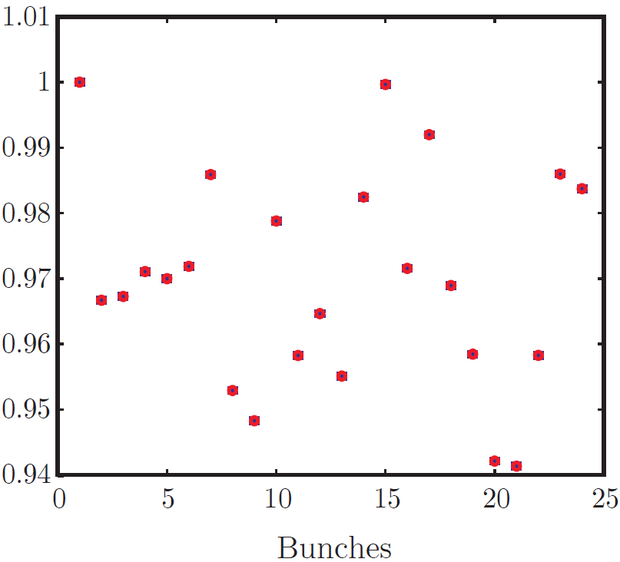
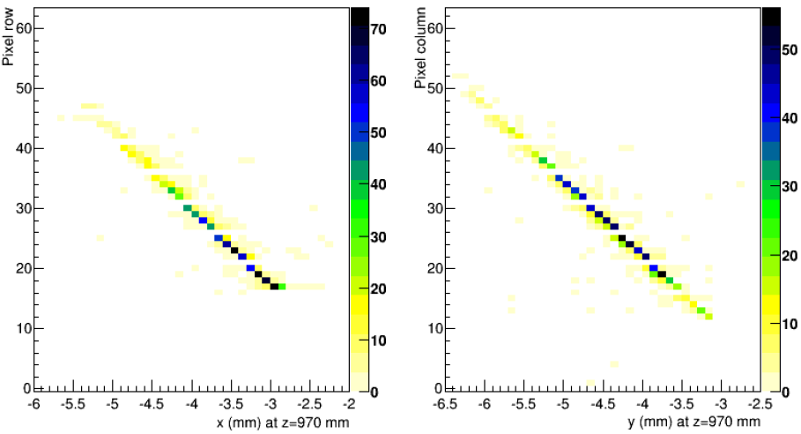
Results of VIPIC in applications
APS 10keV X-ray beam
Agonne
120GeV/C p beam
Fermilab
bunch1
bunch24
bunch2
bunch3
Normalized b-to-b current dispersions
in sparsified readout mode with Δt<153ns
Preliminary residuals Δx and Δy on the VIPIC plane
from extrapolated tracks is sparisfied readout mode
20

Slide 21
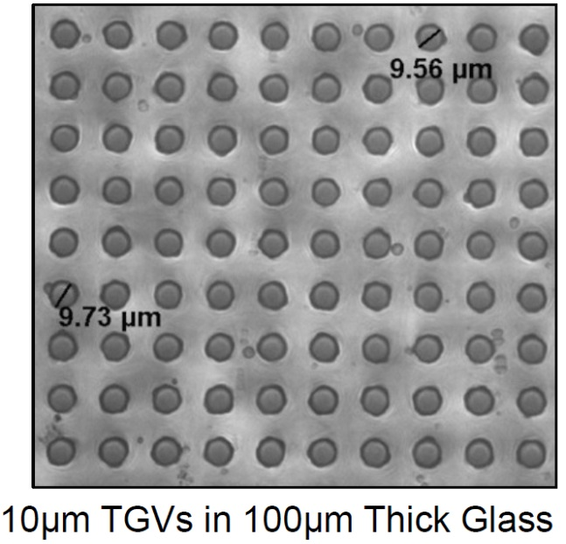
3D-based technological means - 1
Glass or Silicon interposers with through vias
A pixel detector should be seen as a module (large):
  a sensor with a structure as simple as possible (yield)
  pitch rerouting interposer fused with a sensor (seamlessness)
  medium size ASICs (not necessarily multi-stack) fused or bump bonded on interposer (modularity and yield)
  μconnectors soldered on interposer (modularity)
X-ray back-side illumination
FASPAX large area and large dynamic range
detector project - Fermilab-Argonne
21

Slide 22
3D-based technological means - 2
interposers
courtesy of 3D Glass Solutions
22

Slide 23
3D-based technological means - 2
Single module X-ray camera
Very aggressive approach
  LTCC hosts FPGA based processing units
  requires identification of KGD before stacking
X-ray back-side illumination
VIPIC-Large BES detector project - BNL-Fermilab-Argonne
submission of 3D chip run in Q1 CY2015
TSVs done in postprocessing after 3D stacking
23

Slide 24
3D-based technological means - 3
Integration with MAPS-type sensors
With 2D ASICs
BEOL can
do pitch
rerouting
With 3D ASICs
24

Slide 25
Summary
The leitmotiv of my presentation was an attempt to focus the attention on the most effective solution of problems of pixel detectors.
A wish would be that the most effective solutions are the most monolithic, but it does not always work
Using techniques of 3D integration supports solutions to the fundamental problems:
  coverage of large area,
  seamlessness
  leightweigness
  simplification of support structures
  integration of in-situ processing power
  radiation hardness
  yield
Costs: there is no free lunch, but exploration and implementation of improvements to monolithic processes to remove imperfections have been absorbing significant resources,
Access: 3D components becoming available, 3D-IC a single vendor yet
Future: Intelligent pixels = much higher level of in-situ processing in small footprint; direction to resolve water and oil problem seems to be not monolithic
25

Slide 26




Acknowledgments
J. Hoff¹, S. Holm¹, R. Lipton¹, R. Rivera¹, A. Shenai¹,
M. Trimpl¹, L. Uppleger¹, R. Yarema¹, T. Zimmerman¹
P. Gryboś², P. Maj², P. Kmon², R. Szczygieł²,
D.P. Siddons³,
G. Carini⁴,
R. Bradford⁵, E. Dufresne⁵, S. Narayanan⁵, A. Sandy⁵,
M. Jones⁶,
¹Fermilab Batavia IL USA, ²AGH-UST Kraków Poland, ³BNL Upton NY USA, ⁴SLAC Menlo Park CA USA, ⁵ANL Lemont, IL, USA, ⁶Perdue University, Perdue, IN, USA

Slide 27
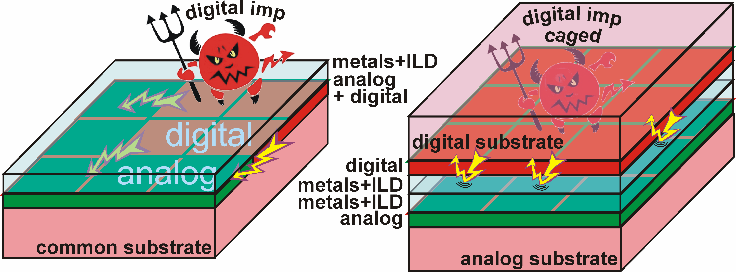
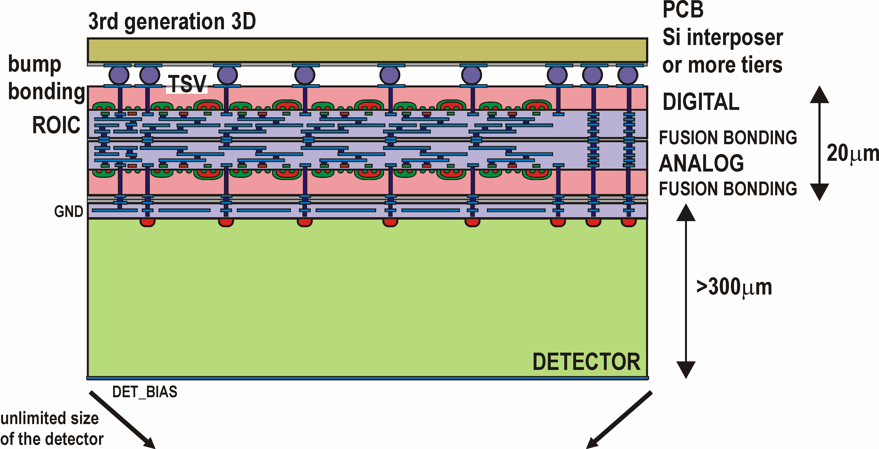
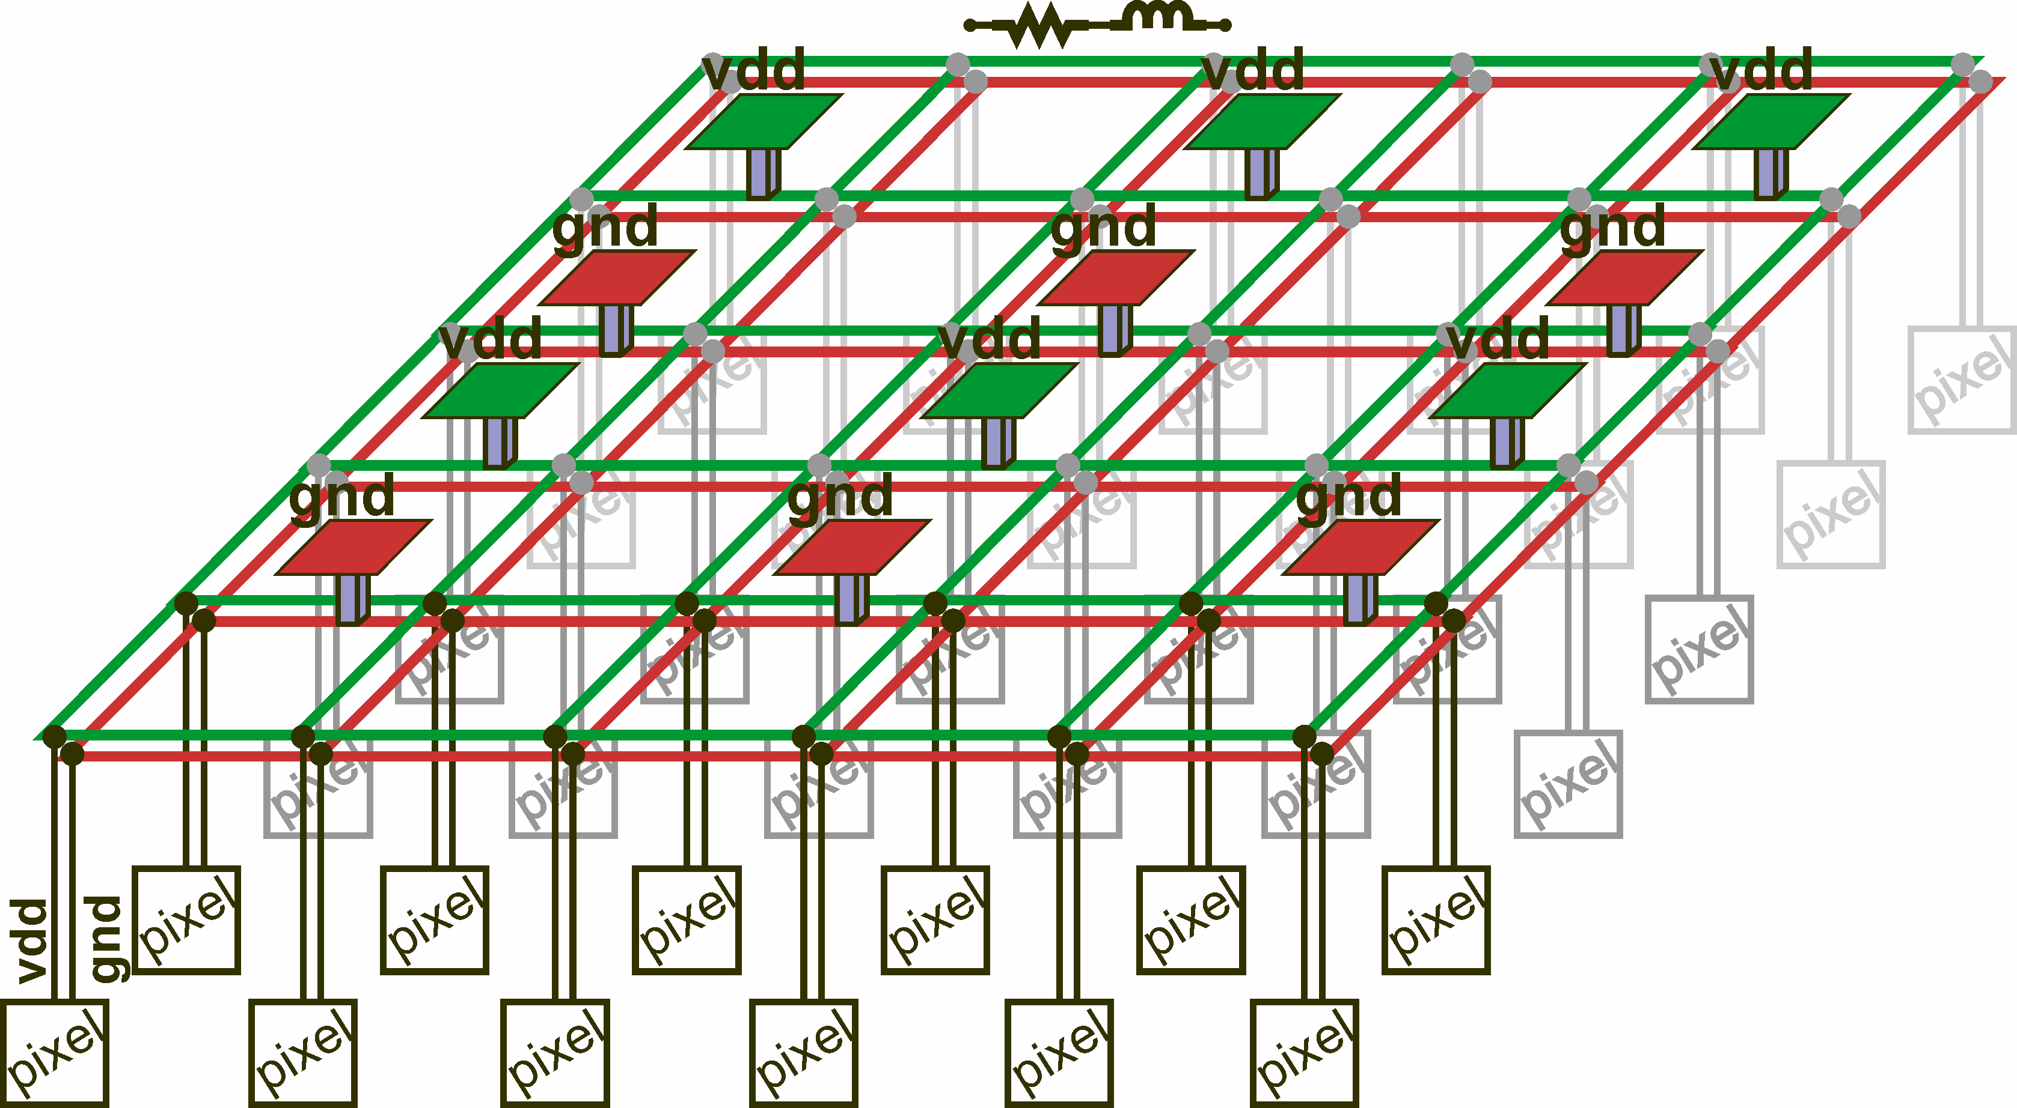
Backup: advantages of 3D integration
transformational change addressing roadblocks in advancing pixel detectors
3D ROICs
1st
  complete separation of digital activity from low-noise analog parts
uniform distribution of power supplies and I/O pads on the back side
ROICs can be integrated with sensors without bump-bonds
2D
3D-IC
2nd
3rd
goal for VIPIC
sensor
Strategy for 4 side buttable, dead-area-free detectors for use from X-ray, visible, IR imaging to classical tracking

