Slide 1


APSEL Deep n-well and Deep p-well CMOS Sensors with ST and TowerJazz Technologies
Gianluca Traversi^{a,b}
OUTLINE
Introduction
Deep n-well CMOS MAPS with ST technology
  APSEL Sensor
  SDR0 Sensor
Deep n-well CMOS MAPS with IBM technology
Deep p-well CMOS MAPS with TJ technology
ªUniversità degli Studi di Bergamo
^{b}INFN
Workshop on CMOS Active Pixel Sensors for Particle Tracking (CPIX14)
15th – 17th September 2014, Bonn, Germany

Slide 2
Motivations
Experiments at the future high luminosity colliders and B-factories (ILC, SuperB) need fast, highly granular, low material budget particle trackers
CMOS monolithic active pixel sensors (MAPS) may provide improved position and momentum resolution
  based on collection of diffusing charge → may be thinned to a few tens of μm, low multiple scattering
  minimal readout electronics → small pitch, high spatial resolution but no PMOS transistors
Modern VLSI CMOS processes (180 nm and below) could be exploited to increase the functionality in the elementary cell -> design of MAPS with similar readout functionalities as in hybrid pixels (sparsification, time stamping)
  A readout architecture with data sparsification could give some advantages with respect to standard, CIS-like MAPS implementations
MAPS approach takes advantage of CMOS triple well structures to improve the readout speed of MAPS sensors through pixel level sparsification -> APSEL family and SDR0 chip
A step toward full compliance with the experiment specs may be represented by vertical integration techniques → 3D DNW MAPS integrated in the first run of the 3D-IC collaboration
Depending on the experiment characteristics, MAPS may be required to withstand a total ionizing dose from a few 10 krad to a few Mrad per year (e.g.: SuperB SVT Layer0 specs: 3 Mrad/yr and 5∙10¹² 1 MeV neutron equivalent/cm²/yr, challenging for CMOS MAPS)
CMOS MAPS with sparsified readout in a high-resistivity epitaxial layer, deep p-well technology (INMAPS process provided by TowerJazz) -> APSEL4WELL chip
Talk V. Re this morning
Talk L. Ratti on Wednesday

Slide 3
Deep n-well MAPS with the 130nm CMOS STMicroelectronics technology

Slide 4
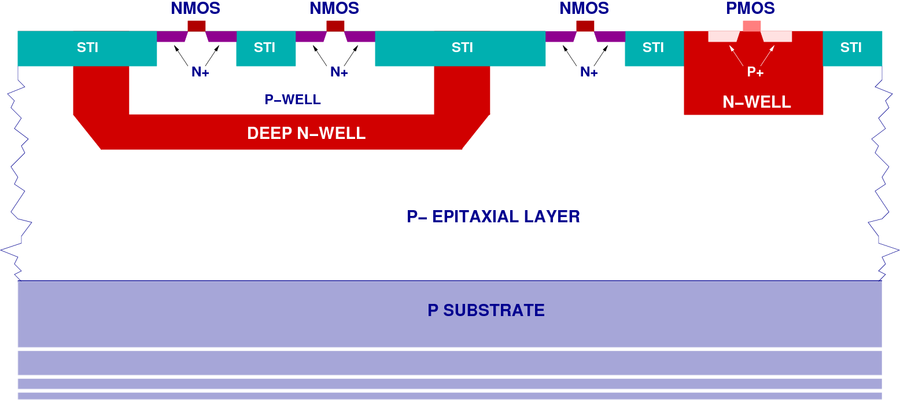
Deep n-well (Triple Well) Process
In triple-well CMOS processes a deep N-well is used to shield N-channel devices from substrate noise in mixed-signal circuits
DNW MAPS is based on the same working principle as standard MAPS
Classical optimum signal processing chain for capacitive detector can be implemented at pixel level
The collecting electrode (DNW) can be exploited to obtain higher single pixel collected charge
A charge preamplifier is used for Q-V conversion → gain decoupled from electrode capacitance
DNW may house NMOS transistors and using a large detector area, PMOS devices may be included in the front-end design → charge collection efficiency depends on the ratio between the DNW area and the area of all the N-wells (deep and standard)

Slide 5
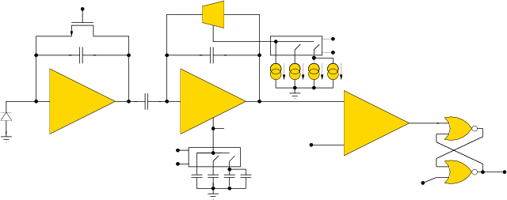
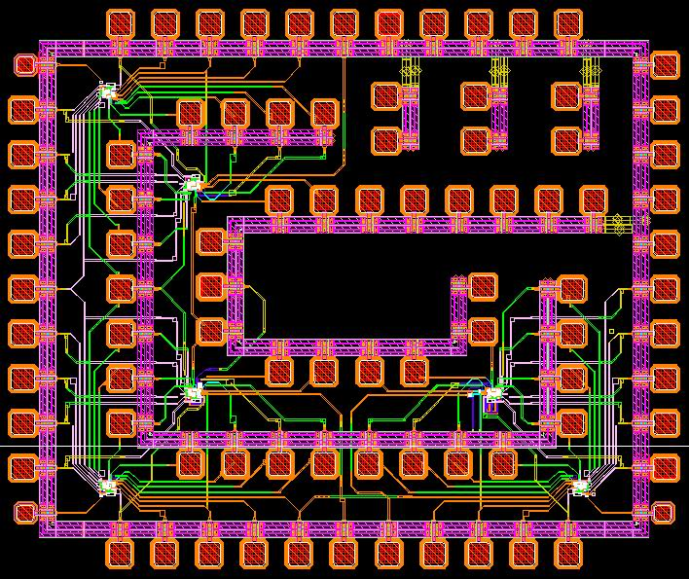
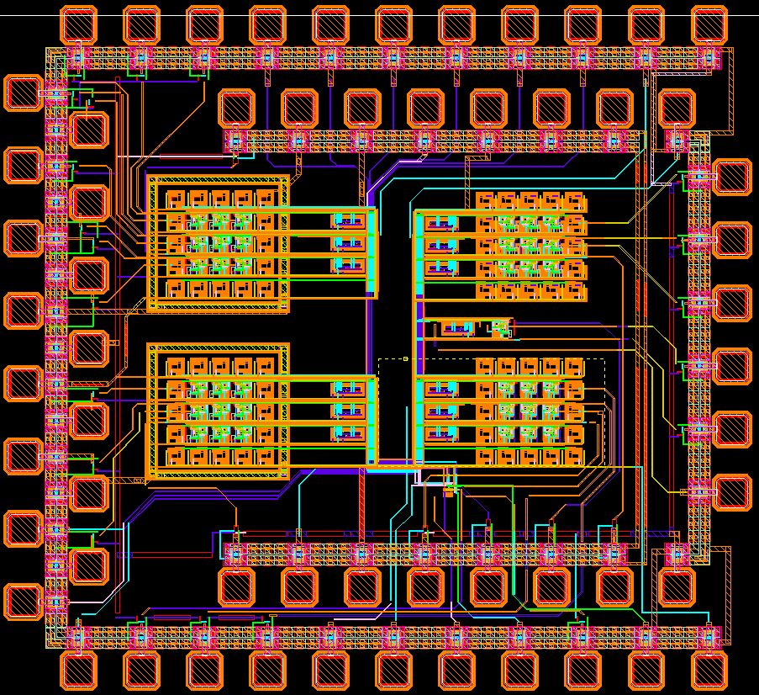
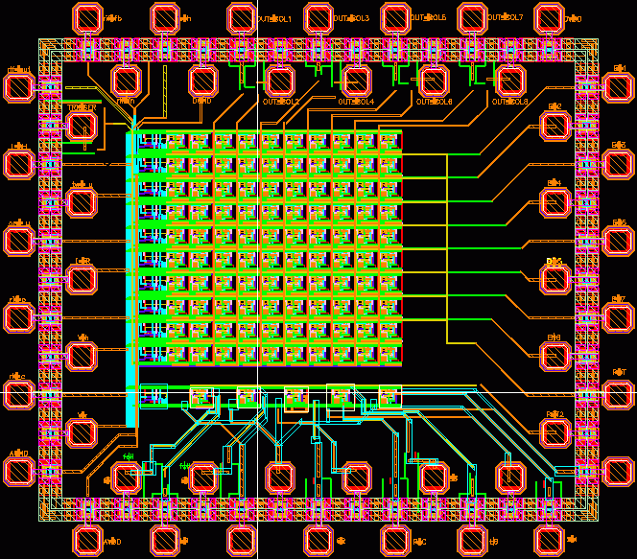
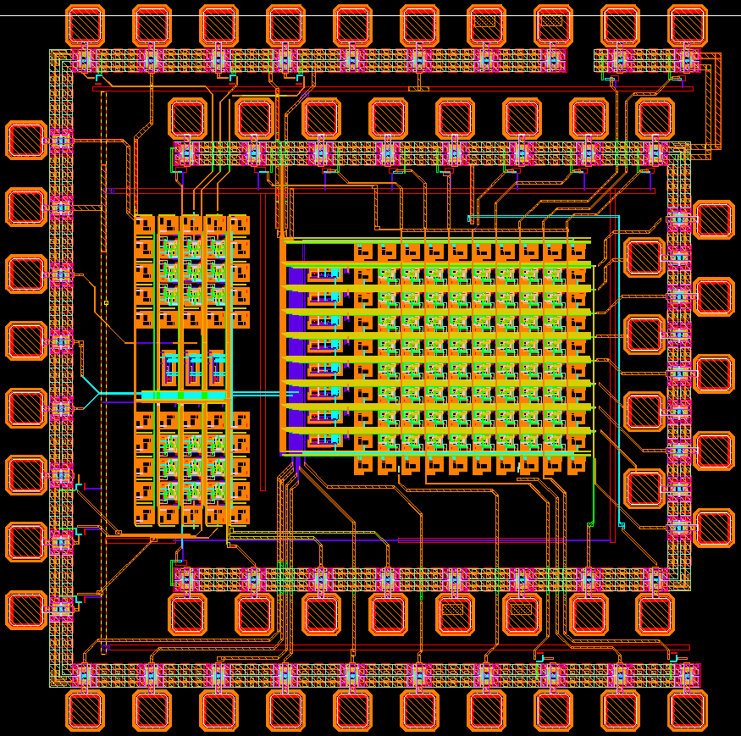
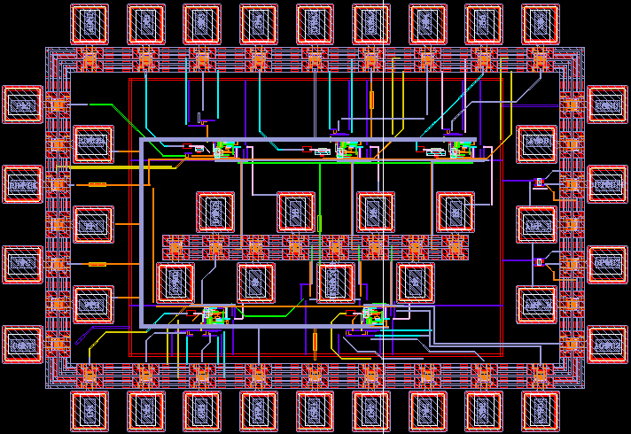
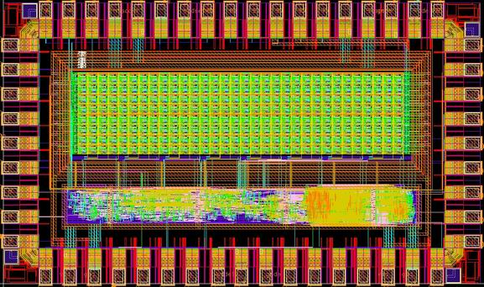
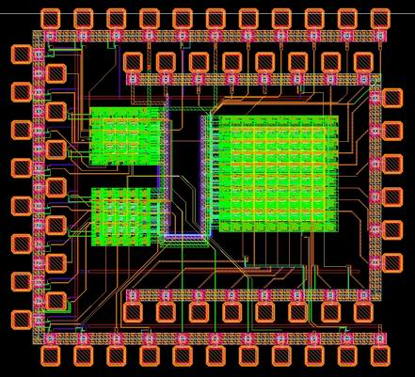
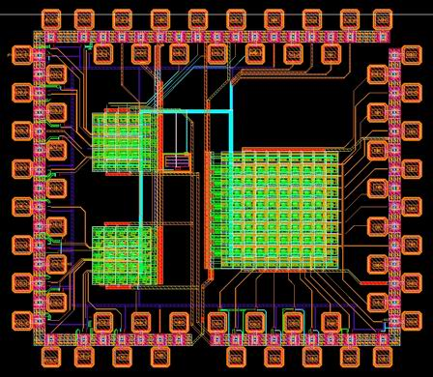
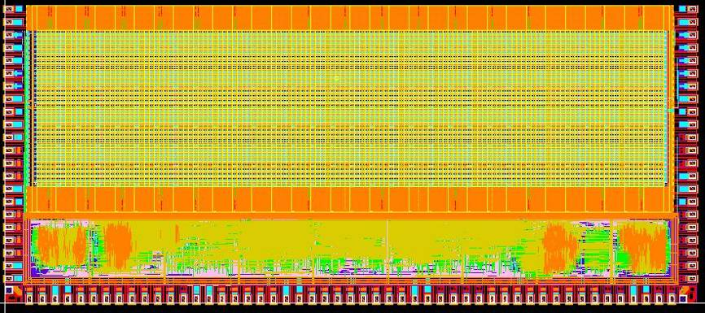

APSEL series chips
Sub. 2004
Sub. 2006
Sub. 2005
Sub. 2006
Sub. 2006
Sub. 2007
Full in-pixel signal processing: PA + shaper + comparator + latch
Prototypes fabricated with the STMicroelectronics 130nm triple-well technology
High sensitivity charge preamplifier with continuous reset + RC-CR shaper with programmable peaking time
A threshold discriminator is used to drive a NOR latch featuring an external reset
Pixel size: 50um x 50um
The first prototypes proved the capability of the sensor to collect charge from the substrate
Sub. 2006
Sub. 2007
Sub. 2007
Sub. 2007
SLIM5

Slide 6
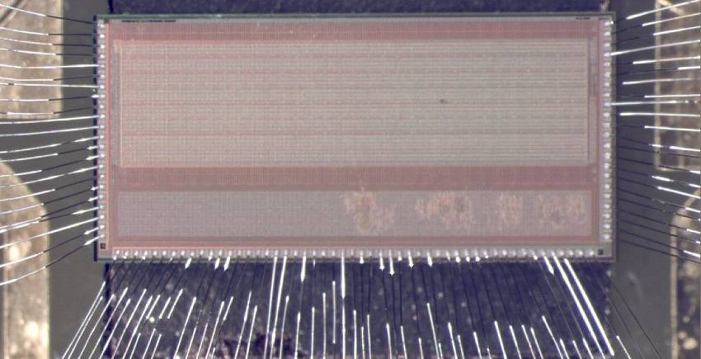
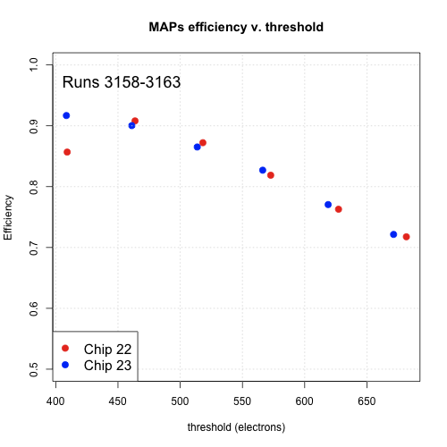
APSEL4D
4K(32x128) 50x50 μm² matrix subdivided in MacroPixel (MP=4x4) with in-pixel data sparsification and time stamping, continuous readout, tested with beams in September 2008
32x128 pix - 50 mm pitch
perif & spars logic
MAPS hit efficiency up to 92 % @ 400 e- thr.
300 and 100 um thick chips give similar results
Intrinsic resolution ~ 14 um compatible with binary readout
Efficiency vs. threshold
Competitive N-wells (PMOS) in pixel cell steal charge reducing the hit efficiency: fill factor (DNW/tot N-well) ~90%
  efficiency can be improved by optimizing the sensor layout -> APSEL5
  even better using a deep p-well process (INMAPS) -> APSEL4WELL
  MAPS in a vertically integrated technology -> APSEL5TC
100
µ
m thick
300
µ
m thick
0.5 0.6 0.7 0.8 0.9 1.0
400 450 500 550 600 650 (e-)
Test Beam results results in: S. Bettarini, et al., Nucl. Instr. and Meth. A (2010), doi:10.1016/j.nima.2010.08.026

Slide 7
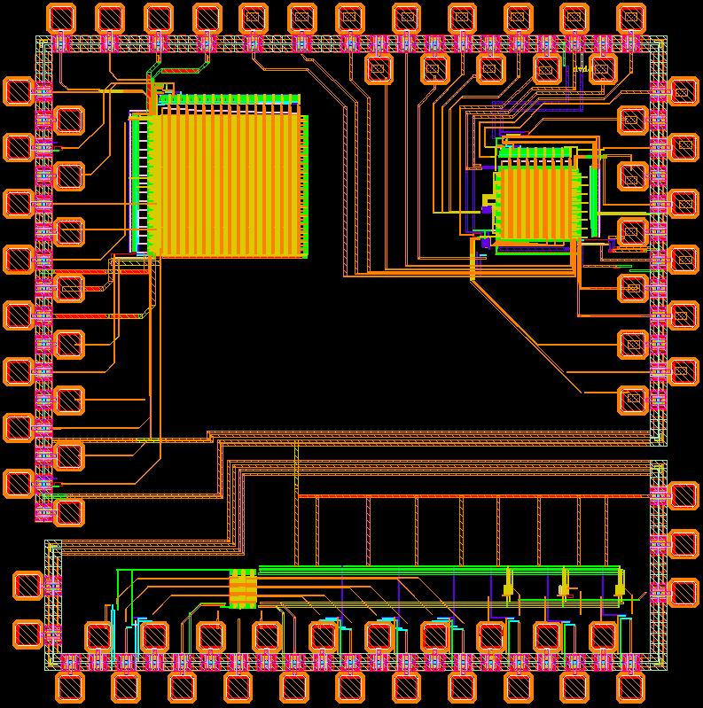
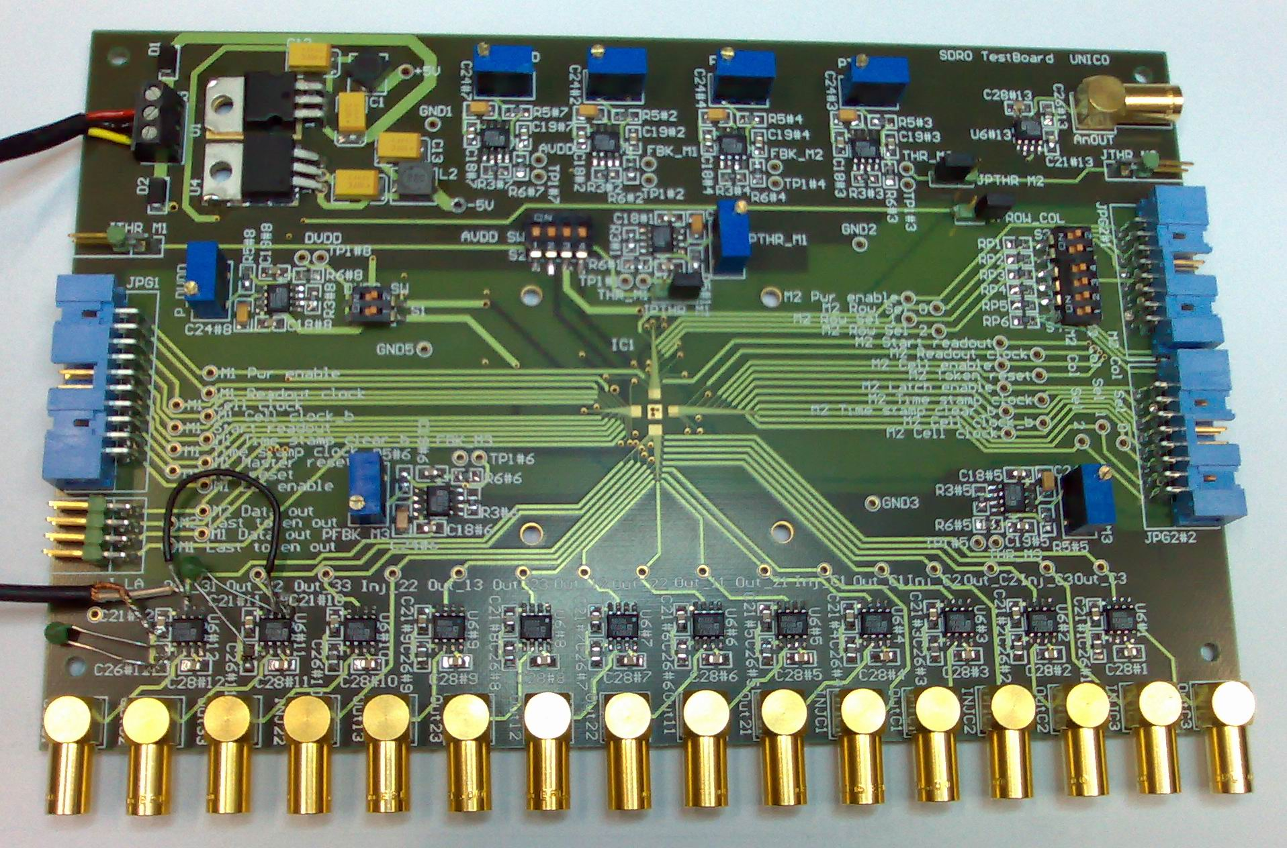
130nm CMOS DNW MAPS for the ILC vertex detector
INFN program (Milano, Pavia) started in 2006; design DNW MAPS according to ILC specifications
Same concept as in the APSEL chips, but reduced pixel pitch and power dissipation
Digital readout architecture with in-pixel sparsification logic and time stamping, taking into account the beam structure of ILC
The SDR0 chip includes:
a 16 by 16 MAPS matrix (25 μm pitch) with digital sparsified readout
an 8 by 8 MAPS matrix (25 μm pitch) with digital sparsified readout and selectable access to the output of the PA in each cell
a 3 by 3 MAPS matrix (25 μm pitch) with all of the PA output accessible at the same time
3 standalone readout channels with different C_{D} (detector simulating capacitance)
Delivered end of July 2007

Slide 8
Design specifications for the ILC vertex detector
The beam structure of ILC will feature 2820 crossings in a 1 ms bunch train, with a DC of 0.5%.
Assuming:
  maximum hit occupancy 0.03 part./Xing/mm²
  3 pixels fire for every particle hitting → hit rate ≈ 250 hits/train/mm²
  digital readout adopted: 5um resolution requires 17.3 um pixel pitch
0.95 ms
337 ns
0.2 s
Digital readout
x2820
bunch train interval
intertrain interval
15 um pixel pitch → O_{c} ≈ 0.056 hits/train → the probability of a pixel being hit at least twice in a bunch train period ≈ 0.0016 → there is no need to include a pipeline for storing more than one hit per pixel (more than 99% of events recorded without ambiguity)
MAPS sensor operation is tailored on the structure of ILC beam
  Detection phase (corresponding to the bunch train interval)
  Readout phase (corresponding to the intertrain interval)
Data readout in the intertrain interval → system EMI insensitive
Sparsified readout based on the token passing scheme. This architecture was first implemented in the VIP1 chip (3-D MIT LL technology) by the ILC pixel design group at Fermilab

Slide 9
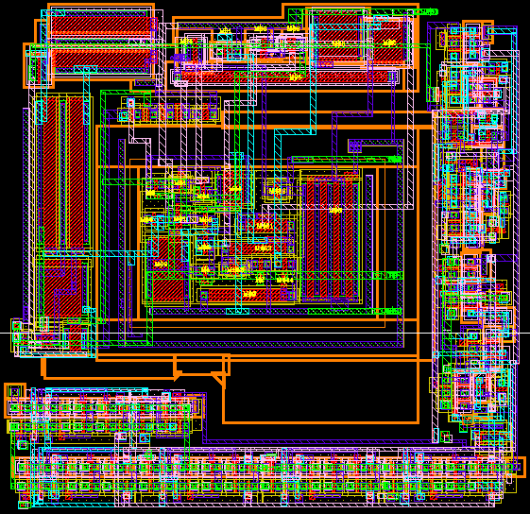
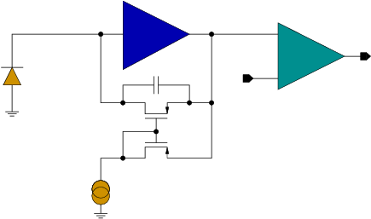
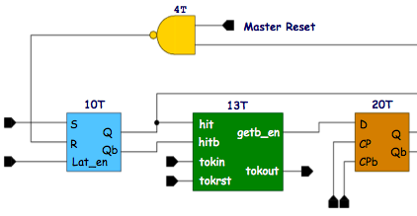
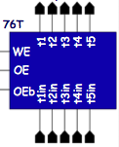
SDR0 prototype elementary cell
Preamplifier
analog front-end
22T
-G(s)
14T
+
V_{t}
digital section
C_{F}
Discriminator
DNW sensor
164 transistors
P_{TOT} ≈ 5uW
Power cyc. 1% DC
DNW sensor
25 μm
i_{F}
Sparsification logic
Time stamp register
25 μm

Slide 10
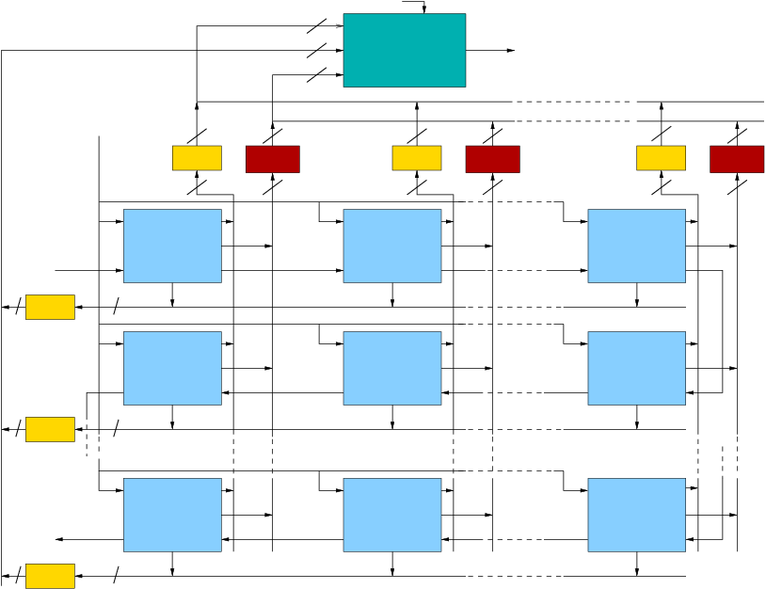
Digital readout scheme
Readout CK
4
X
Readout phase:
4
Y
MUX
5
Serial data output
token is sent
T
token scans the matrix and
Cell CK
gets caught by the first hit pixel
4
5
4
5
4
5
Time Stamp Buffer 1
Time Stamp Buffer 2
Time Stamp Buffer 16
X=1
X=2
X=16
the pixel points to the X and Y registers at the periphery and
1
1
1
Cell (1,1)
5
Cell (1,2)
5
Cell (1,16)
5
gXb
gXb
gXb
gXb=get_X_bus
gYb=get_Y_bus
TS=Time_Stamp
Tkin=token_in
Tkout=Token_out
First token in
TS
TS
Hit pixel
TS
sends off the time stamp register content
Tkin
Tkout
Tkin
Tkout
Tkin
Tkout
4
1
gYb
gYb
gYb
data are serialized and token scans ahead
Y=1
Cell (2,1)
Cell (2,2)
Cell (2,16)
gXb
gXb
gXb
TS
TS
TS
Tkout
Tkin
Tkout
Tkin
Tkout
Tkin
4
1
gYb
gYb
gYb
The number of elements may be increased without changing the pixel logic (just larger X- and Y-registers and serializer will be required)
Y=2
Cell (16,1)
Cell (16,2)
Cell (16,16)
Last token out
gXb
gXb
gXb
TS
TS
TS
Tkout
Tkin
Tkout
Tkin
Tkout
Tkin
4
1
gYb
gYb
gYb
Y=16

Slide 11
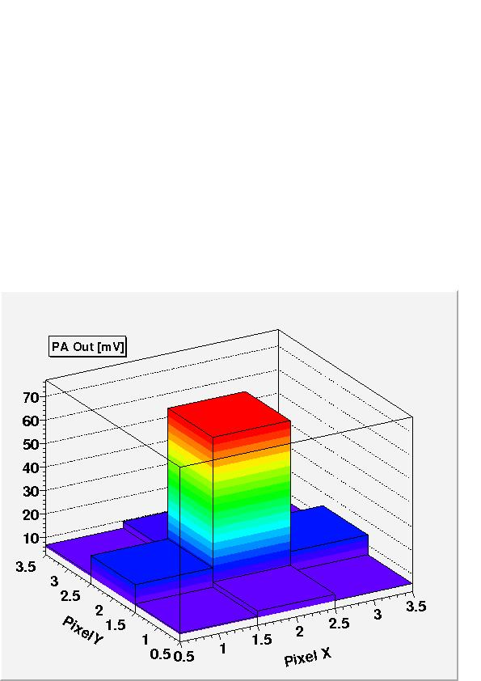
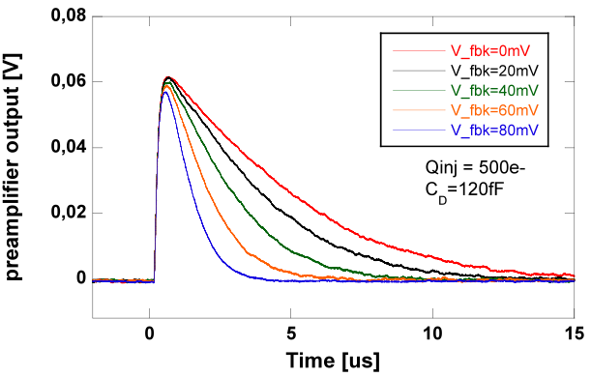
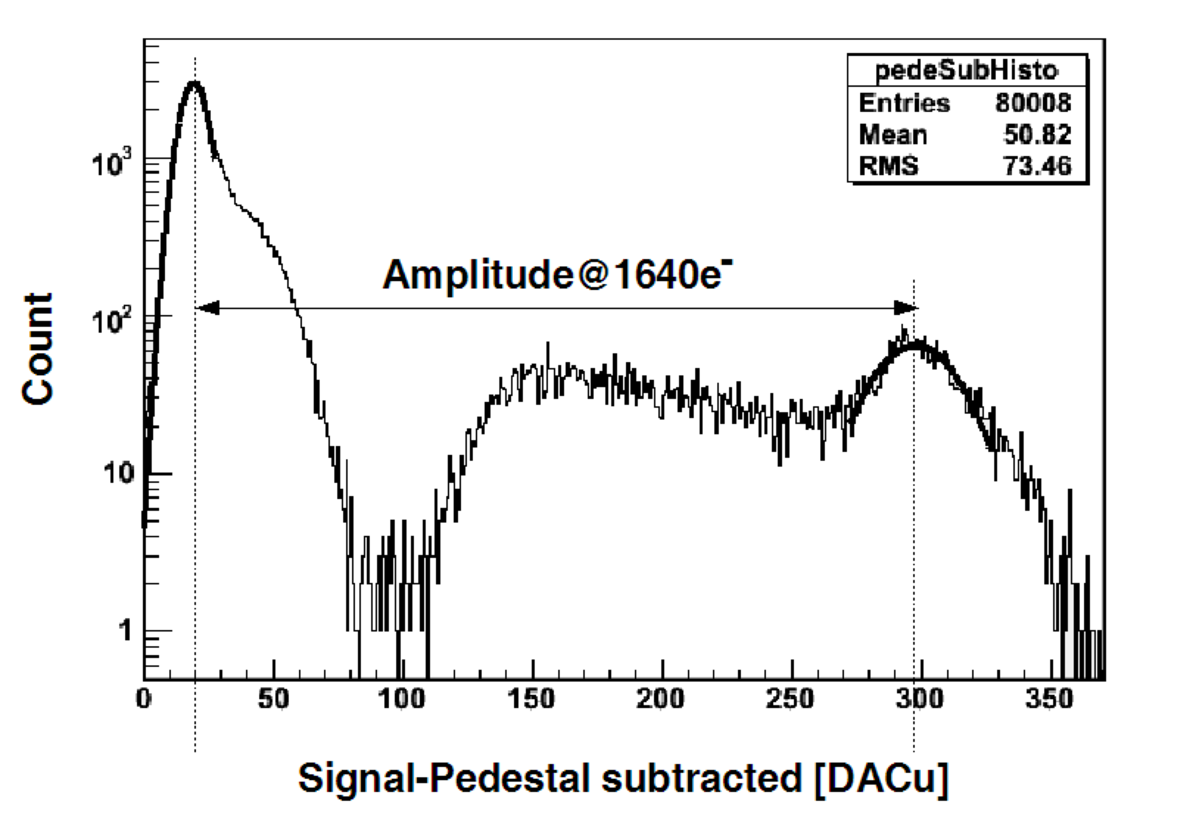
SDR0 experimental results
Tests on the analog section with injection of external calibration signals, with ⁵⁵Fe, and with an infrared laser scan (single channels, 3x3 pixel matrix)
Charge sensitivity: 650mV/fC (mean value with ⁵⁵Fe)
ENC ≈ 60 e- rms
(PA input device: I_{D} = 1 uA, W/L= 22/0.25)
Threshold dispersion ≈ 60 e-
Matrix response to infrared laser
Laser on rear of sensor
λ=1064nm
(σ_{XY} ≈ 1.5 μm)
Laser focussed on the central pixel
Limited charge spreading
Preamplifier response to an external calibration signal
Test with ⁵⁵Fe
Time [us]

Slide 12
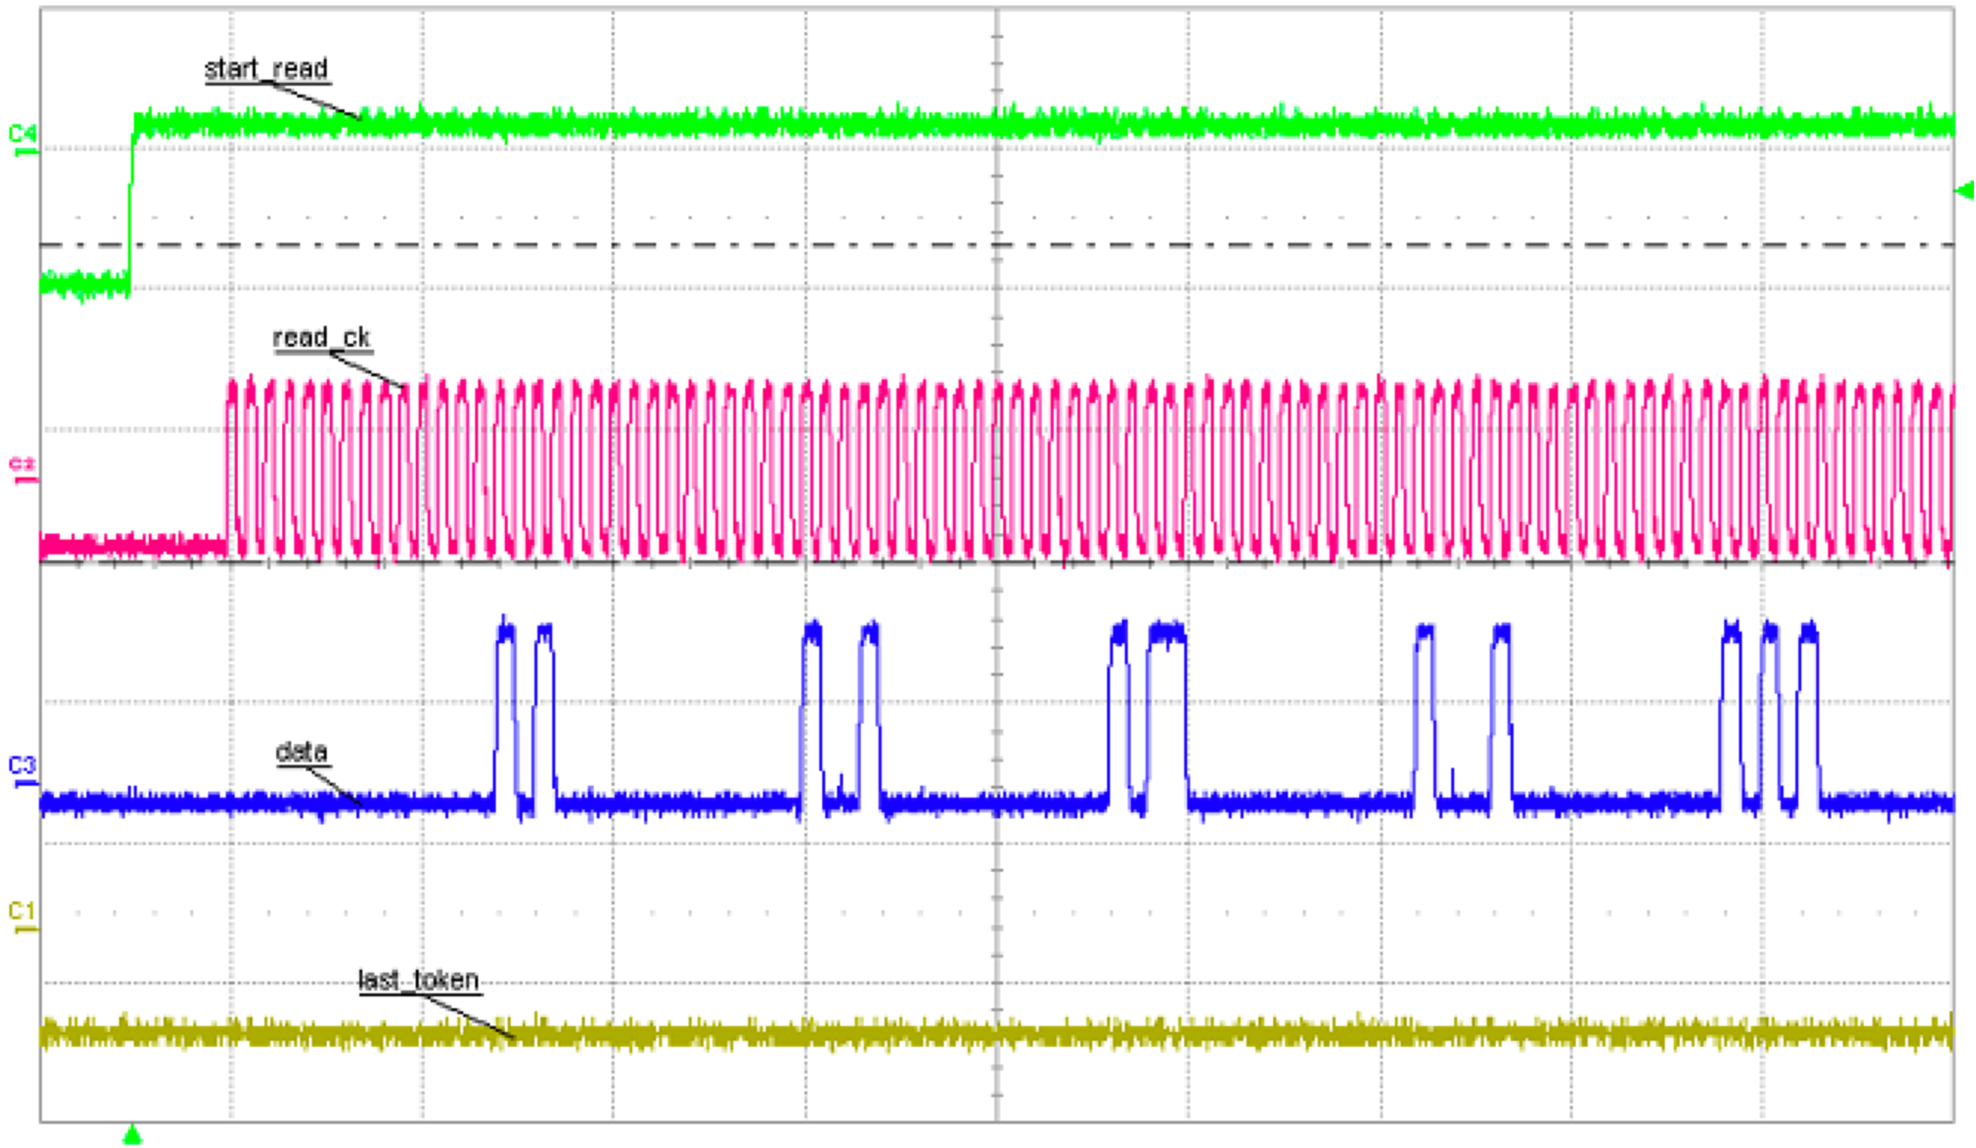
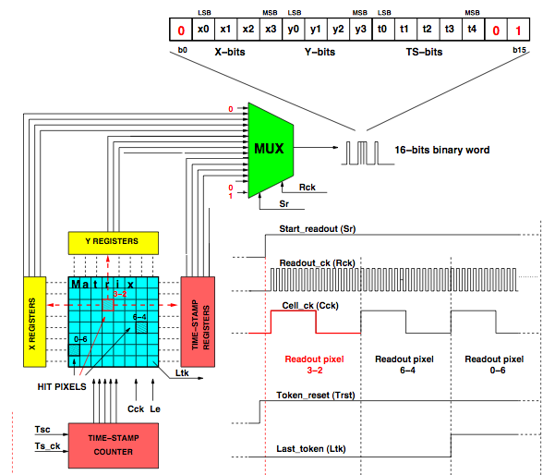
Digital readout test: pixel address
Vth < PA output DC level ⎝ all the pixels are readout
Start readout
Spare bits
Readout CLK
Data out
X=0
Y=0
TS=0
X=1
Y=0
TS=0
X=2
Y=0
TS=0
X=3
Y=0
TS=0
X=4
Y=0
TS=0

Slide 13
Deep n-well MAPS with 65nm CMOS IBM technology

Slide 14
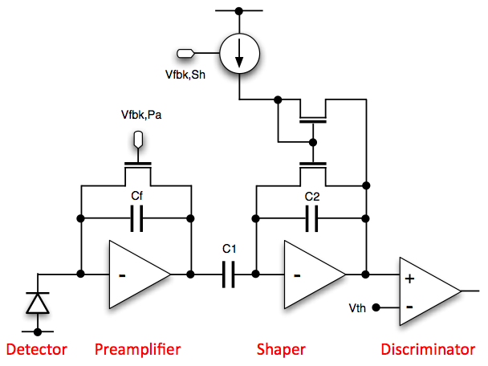
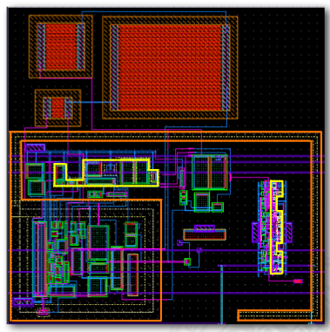
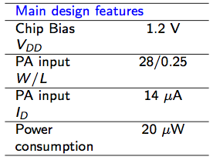
APSEL65: a prototype DNW MAPS in 65nm
Area: 40um x 40um
DNW collecting electrode (orange)
  Area: 360um²
  Capacitance: 340fF (estimated)
  99% efficiency @ 400 e- thr. (simulated)
In this prototype the digital section is kept to the minimum (latch, OR gate, tri-state buffer)
Sparsification and time-stamping logic at the pixel level in more advanced versions (room for this is available)

Slide 15
Deep p-well MAPS with 180nm CMOS TowerJazz technology

Slide 16
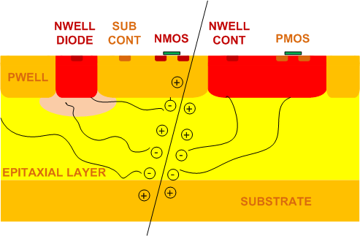
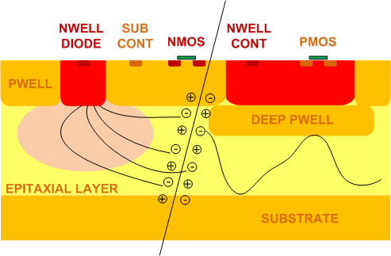
Deep p-well (180 nm CMOS INMAPS) process
Charge collection efficiency of MAPS structures developed in a standard CMOS process can be affected by the presence of competitive N-wells needed for in-pixel logic suited for a fast readout
To overcome this issue a planar 180 nm CMOS process with quadruple well (INMAPS) has been considered
An additional processing step deposits a deep P-well layer
Advantages of a high resistivity epitaxial layer (featuring a resistivity higher than both the deep P-well and the substrate):
  better charge collection properties (higher collected charge, charge collection speed)
  higher bulk damage hardness expected
The foundry provides different typologies of epitaxial layers. Three different versions of Apsel4well have been fabricated:
  5 μm standard resistivity (≈10 Ω∙cm) epitaxial layer
  12 μm standard resistivity epitaxial layer
  12 μm high resistivity (≈1 kΩ∙cm) epitaxial layer
Standard CMOS process
INMAPS process

Slide 17
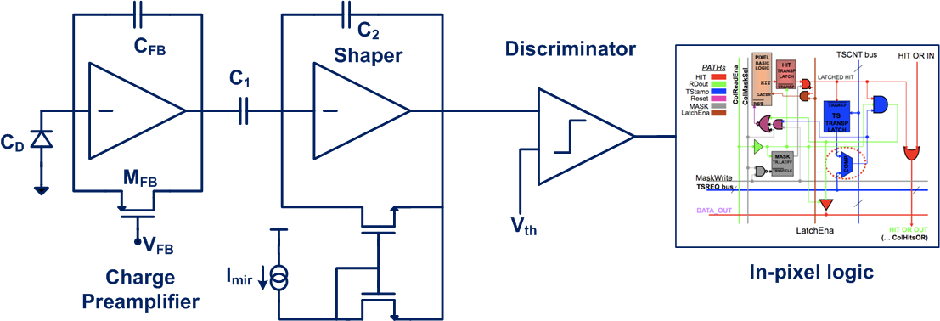

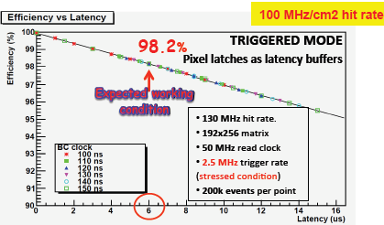

Apsel4well front-end architecture
*F. Giorgi et al. “2D and 3D Thin Pixel Technologies for the Layer0 of the SuperB Silicon Vertex Tracker”, NSS-MIC 2011
4 interconnected N-well diffusions as collecting electrode
Charge PA, shaper and threshold discriminator
In-pixel logic with time stamping capabilities, readout can be data-push or triggered
Readout efficiency >98% (triggered) and TS granularity down to 100 ns with 100 MHz/cm² target hit rate*

Slide 18
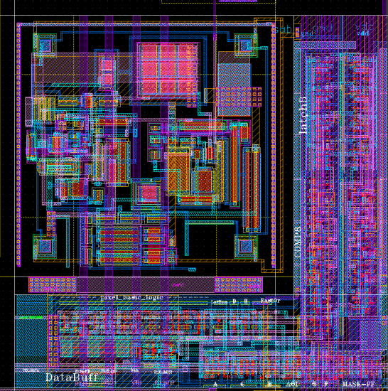
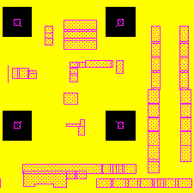
Apsel4well pixel layout
Pixel layout w/o DPW layer
DPW (yellow) and NW (pink) layers
D
L
SENSORS
W
Analog front-end section
Digital front-end section
50 μm
W=8 μm L=1.5 μm D=27 μm

Slide 19
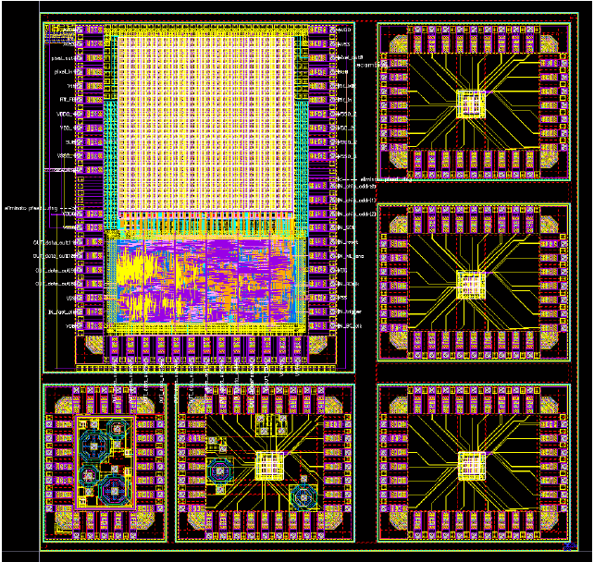
Apsel4well chip layout
Four 3x3 test analog matrices:
Enclosed layout PA input transistor, 4 collecting electrodes, DPW
Open layout PA input transistor, 4 collecting electrodes, DPW
EL PA input transistor, 2 collecting electrodes, DPW
EL PA input transistor, 4 collecting electrodes, no DPW
5 mm
Test structures:
Octagonal pn diodes
Accumulation capacitors
Single analog channels
32x32 matrix with peripheral readout logic
5 mm

Slide 20
Apsel4well analog FE performance
Performance | 3x3 matrix
Charge sensitivity | 900-1100 mV/fC
t_{p} @ 800 injected electrons | 290 ns
ENC (C_{D} = 30 fF) | 38 e-
INL (@ 2000e-) | 2%
Current consumption* | 10 μA/pixel
Analog Power consumption* | 18 μW/pixel 0.7 W/cm²
Pixel pitch | 50 μm
* Data from simulations
Data in fair agreement with simulation results

Slide 21
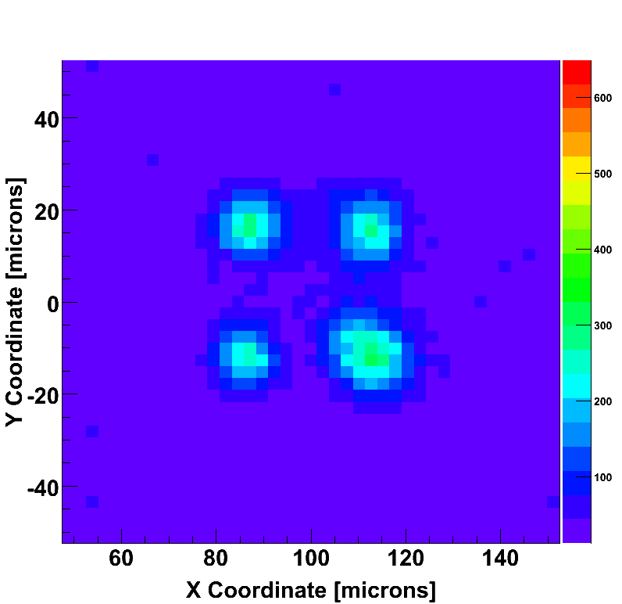
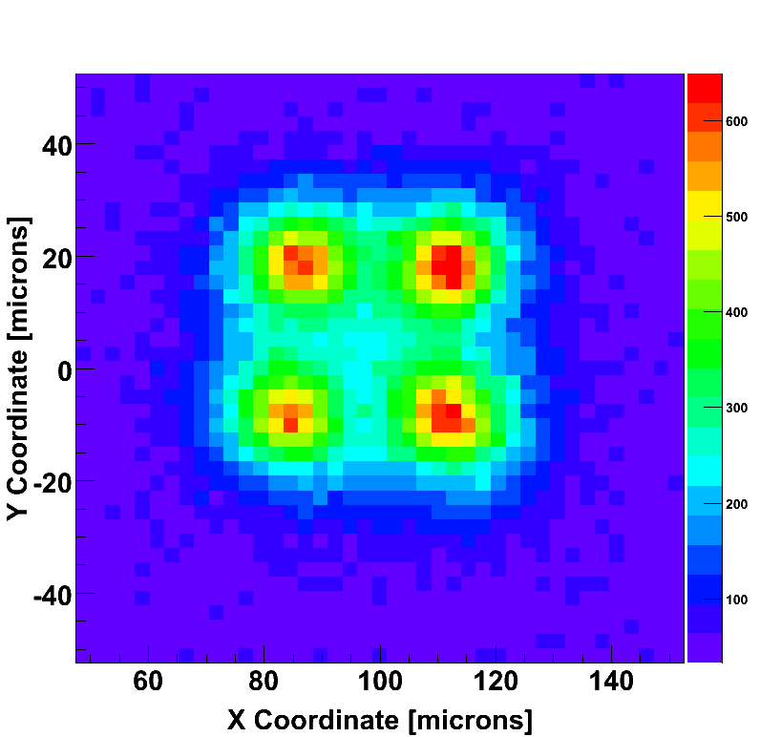
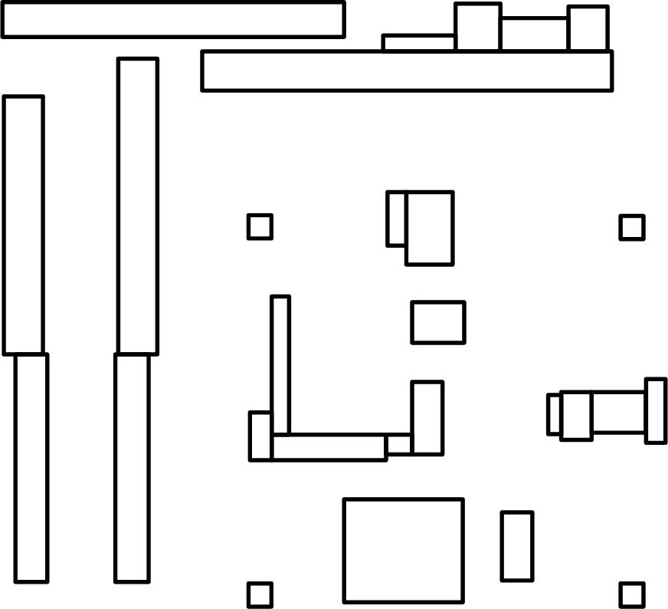
Advantages of deep P-well
Comparison of charge collection properties performed by means of IR laser
N-wells from layout have been superimposed to the charge collection plot
No Deep P-well, 5 μm std. res. epi layer
With deep P-well, 5 μm std. res. epi layer
600
600
400
400
Collected Charge (electrons)
Collected Charge (electrons)
200
200
In the pixel without DPW the charge is collected only around the electrodes.

Slide 22
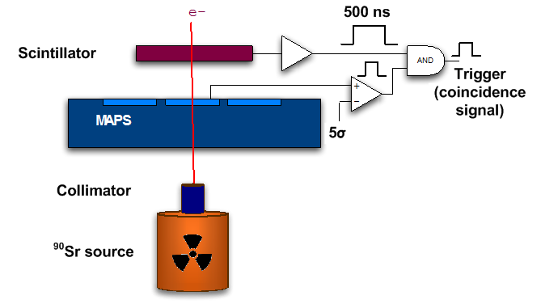
Advantages of a high resistivity epitaxial layer
Charge collection measurements performed by means of a ⁹⁰Sr radioactive source
A waveform is acquired when the pixel analog output exceeds a given threshold (5σ) within a 500 ns gate signal from the scintillator
The charge collected by adopting a high resistivity epitaxial layer (MPV≈800 e⁻) is about 35% higher than in the case of the standard resistivity option (MPV≈600 e⁻)

Slide 23
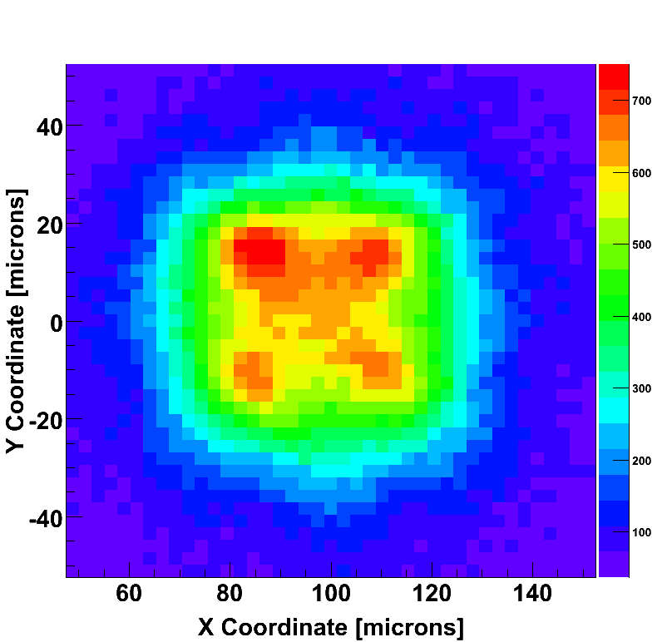
High resistivity epitaxial layer
Pixel with 12 μm thick high resistivity epitaxial layer: higher charge collected and better uniformity
With deep P-well, 12 μm std. res. epi layer
With deep P-well, 5 μm std. res. epi layer
400
Collected Charge (electrons)
Good matching between TCAD simulations and measurement results

Slide 24
Charge collection performance of thinned Apsel4well
Analog readout performance of thinned Apsel4well samples are similar to non-thinned chip ones -> all the discrepancies are in the range of statistical variations already observed in the measurements results relevant to non-thinned chips.
Analog readout performance of thinned Apsel4well samples are similar to non-thinned chip ones -> all the discrepancies are in the range of statistical variations already observed in the measurements results relevant to non-thinned chips
Measurements performed with ⁹⁰Sr do not exhibit any significant variation in terms of the amount of charge collected by the 3x3 cluster
Charge collection measurements performed by means of IR laser and ⁹⁰Sr on Apsel4well samples 25μm and 400μm thick, both of them featuring the high resistivity epitaxial layer option
Comparison of the analog front-end performance
Performance | 25 um thick | 400 um thick
Charge sensitivity (C_{inj}) | 1120 mV/fC | 1100 mV/fC
Charge sensitivity (⁵⁵Fe) | 775-850 mV/fC | 850-950 mV/fC
ENC (C_{T} = 42 fF) | 43e- | 38 e-
Analog Power consumption | 18 μW/pixel | 18 μW/pixel
S. Zucca et al., “Effects of Substrate Thinning on the Properties of Quadruple Well CMOS MAPS”, IEEE Trans. On Nucl. Sci., Vol. 61, (2) pp. 1039-1046.

Slide 25
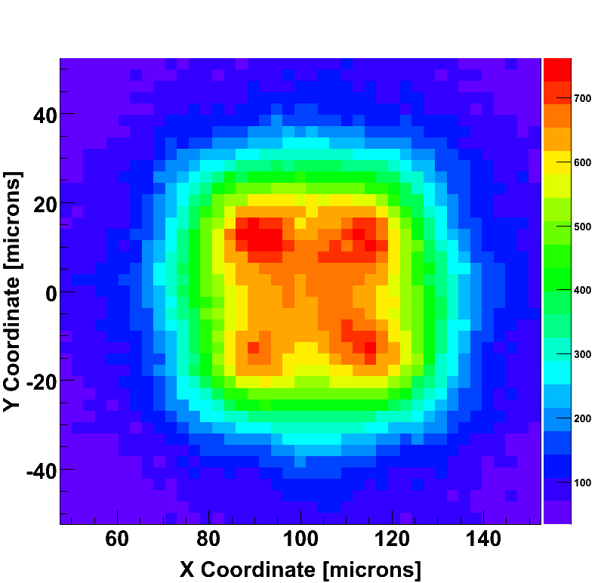

Charge collection performance of thinned Apsel4well
25 μm thick sample (chip 96)
700e-
Results from IR laser measurements show no significant changes in terms of charge collection uniformity
1
500e-
2
300e-
100e-
400 μm thick sample (chip 41)
700e-
1
500e-
2
300e-
100e-

Slide 26
Conclusions
Several deep n-well MAPS chip have been fabricated and tested with the 130nm CMOS ST technology
  APSEL4D (4096 pixels, 50um pitch) featuring in-pixel sparsification and time-stamp information has been characterized in laboratory and tested with beams
  SDR0, a monolithic active pixel sensor for vertexing applications at the ILC has been fabricated and tested. Several issues (pitch, digital functionality, detection efficiency) had to be addressed in order to meet the ILC requirement -> SDR1 in 3D Tezzaron-GlobalFoundries process
A test chip including deep n-well MAPS has been fabricated and tested in the 65nm CMOS IBM process
MAPS devices developed in the 180nm CMOS INMAPS process (deep p-well) can significantly improve the charge collection efficiency of DNW MAPS by preventing the parasitic collection action of n-well diffusions
The high resistivity epitaxial layer option improves both the charge collection properties of the sensor and its bulk damage tolerance
APSEL4WELL sensor was fully characterized by means of charge injection, infrared laser scan and radiation sources
  Sensors fabricated in a 12um thick HR epi layer have been proven to be by far the best solution among the different available options in terms both of the amount of collected charge and of charge collection uniformity
APSEL4WELL MAPS thinned down to about 25um have been tested and no significant changes in the performance of the thinned sensors have been detected with respect to non-thinned chips

Slide 27
Acknowledgments
L. Gaioni, M. Manghisoni, V. Re
Università di Bergamo and INFN Pavia
G. Bruni, M. Bruschi, R. Di Sipio, B. Giacobbe, F.M. Giorgi, A. Gabrielli, C. Sbarra, N. Semprini, M. Villa, A. Zoccoli
Università di Bologna and INFN Bologna
M. Caccia, A. Bulgheroni, F. Risigo, M. Jastrzab
Università dell’Insubria e INFN Milano
L. Ratti, A. Manazza, V. Speziali, S. Zucca, E. Pozzati, C. Andreoli
Università di Pavia and INFN Pavia
G. Batignani, S. Bettarini, G. Casarosa, M. Dell’Orso, F. Forti, P. Giannetti, M.A. Giorgi, F. Morsani, N. Neri, E. Paoloni, M. Piendibene, G. Rizzo
Università di Pisa and INFN Pisa
L. Bissi, P. Ciampolini, A. Marras, G. Matrella, P. Placidi, E. Pilicer, D. Passeri, L. Servoli, P. Tucceri
Università di Perugia and INFN Perugia
E. Bernieri, G. Conte, M.C. Rossi, G. Assanto, L. Colace, E. Spiriti
INFN Roma III
G.F. Dalla Betta, A. Repchankova, V. Tyzhnevyi, G. Verzellesi
Università di Trento and TIFPA INFN
L. Bosisio, L. Lanceri, L. Vitale, I. Rashevskaya
Università di Trieste and INFN Trieste
R. Yarema, F. Fahim, G. Deptuch, T. Zimmerman, A. Shenai, J. Hoff, M. Trimpl
Fermi National Accelator Laboratory
R. Turchetta, J. Crooks, R. Coath
Rutherford Appleton Laboratory

Slide 28
Backup slides

Slide 29
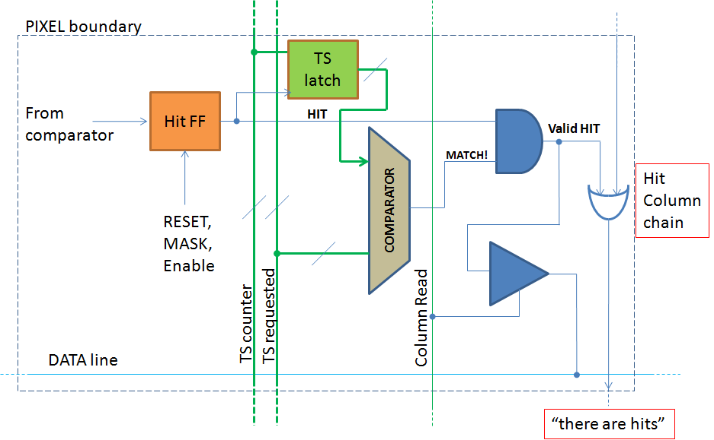
In-pixel logic
Complex in-pixel logic can be implemented without reducing the pixel collection efficiency. Readout can be data push or triggered (only selected time stamp are read out)
Timestamp (TS) is broadcast to pixels and each pixel latches the current TS when fires
Matrix readout is TS ordered
A readout TS enters the pixel and a HIT-OR-OUT is generated for columns with hits associated to that TS
A column is read only if HIT-OR-OUT=1
DATA_OUT is generated for pixels in the active columns with hits associated to that TS.

Slide 30
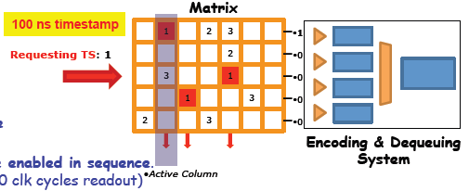
In-pixel logic
In-pixel Hit & Time Stamp Latch
TS request to the matrix
Pixel FastOR activates if:
Latched TS==TS request
1 Column sparsified in 1 clk cycle (whatever the occupancy)
Only active-FastOR columns are enabled in sequence (i.e. active column FastORs → 10 clk cycles readout)
Module area: 8 cm²
Hit rate: 100 MHz/cm²
Hit encoding: 30 bit/hit
TS: 1 μs
Trigger frequency: 150 kHz → rate/module: 3.5 Gb/s

Slide 31
Power cycling simulations
Power cycling can be used to reduce average dissipated power by switching the chip off when no events are expected
Example:
  ILC bunch structure: ~330 ns spacing, ~3000 bunches, 5Hz pulse
The analog section in the elementary cell can be switched off during the intertrain interval in order to save power (analog power is supposed to be predominant over digital)
V
Based on circuit simulations, power cycling with at least 1% duty-cycle seems feasible
0.6
Preamplifier pulse response
Preamplifier pulse response
0.4
Switch-on transient
0.2
60 μs
0.0
1.2
OFF
ON
199 ms
0.0

