Slide 1


Fully depleted MAPS:
Pegasus and MIMOSA 33
For low energy X-ray applications
Maciej Kachel, Wojciech Duliński
PICSEL group, IPHC Strasbourg

Slide 2
Motivation
Goal (success oriented):
  Low energy X-rays (< 10 keV)
  Single photon counting (with > 10⁶ ph / 100x100 µm²)
  Good spatial resolution (few µm)
Chip requirements:
          Depletion depth ~ 50-100 µm
          Low noise (sensitivity to few 100 e⁻ signal)
          Fast frame rate >> kHz
          Pixel pitch ~ 20 µm
Intermediate step ASIC:
  Counting > 10³ ph/pixel·s
  Energy range 1 keV – 10 keV
  Noise below 25 e⁻
  Pixel size 25 x 25 µm²
  Chip size ~1 cm²
How to get depletion??
maciej.kachel@iphc.cnrs.fr

Slide 3
MAPS
maciej.kachel@iphc.cnrs.fr
Notes:
Thin sensitive area – only few um of depletion… - limited in Xray appications, but work with indirect detection

Slide 4
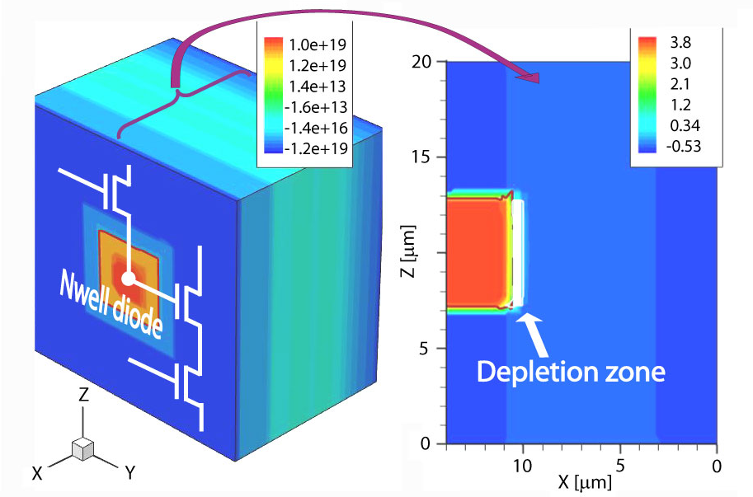
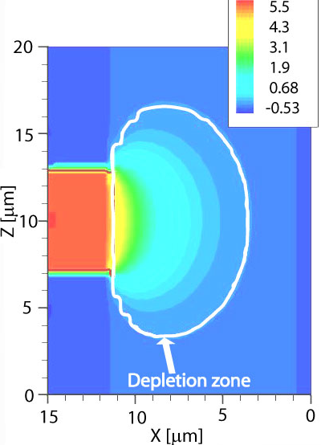
Detection with MAPS
Standard low resistivity epi (few Ω cm)
High resistivity epi (k Ω cm)
With the same electronics you gain the depletion zone depth
But this is not enough!!
Diode
Provided by A. Dorokhov
maciej.kachel@iphc.cnrs.fr

Slide 5
Absorption efficiency of Si
Si - 10 µm
Si - 50 µm
Si - 300 µm
maciej.kachel@iphc.cnrs.fr

Slide 6
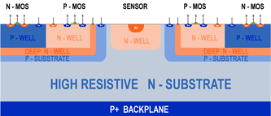
Technology choice
TOWER (0.18 um)
ESPROS (0.15 um)
Quadruple well technology
P substrate
Used by CERN
Fully depleted 50 μm
Post processing included
N substrate (detector grade)
„Out of the box solution” ?
Test structures (collecting diodes and amplifiers) were made in both technologies
maciej.kachel@iphc.cnrs.fr

Slide 7
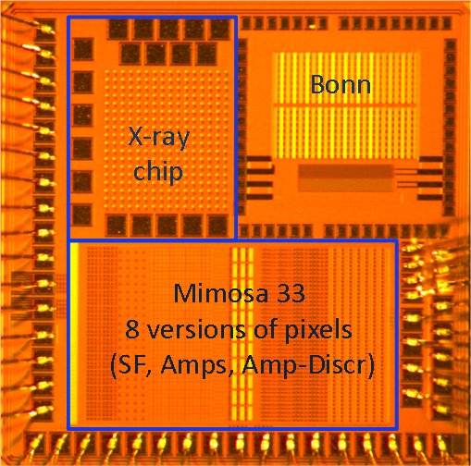
Mimosa 33 submission
ESPROS technology
Study different biasing approches
  - Bias the diode from bottom
  - Bias from the top – DC coupling
Study the charge collection with different pixel pitch
Prototype of a simple X-ray counter
maciej.kachel@iphc.cnrs.fr

Slide 8
M33: Standard SF pixel
Isolated NMOS transistors (but used with std voltage)
Diode biased from the anode side with negative voltage
SF bias - self biased solution
maciej.kachel@iphc.cnrs.fr

Slide 9
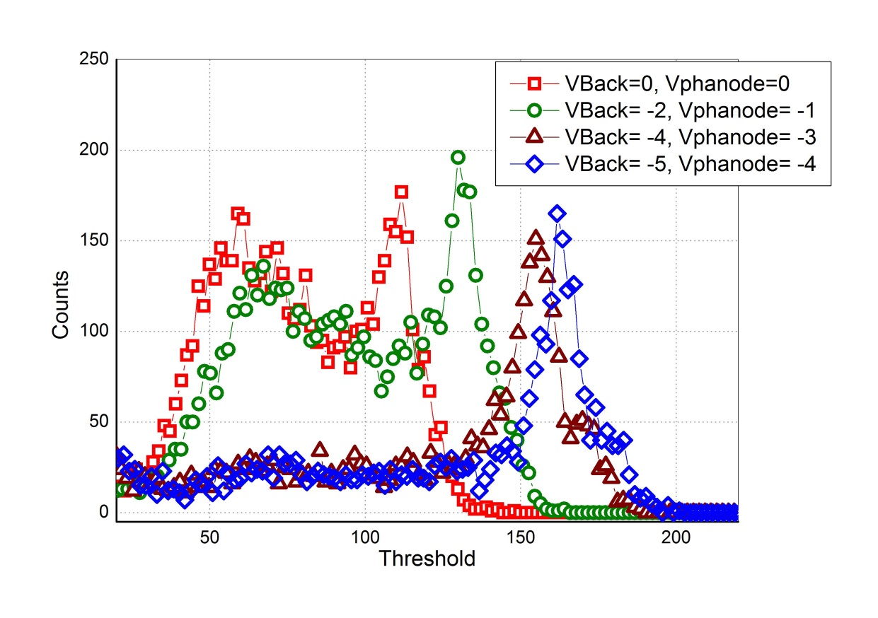
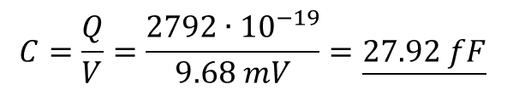
M33: Standard SF mesurements
Fe55 measurements with different biasing(Vback, Vphanode)
Seed pixel
Increasing the Vphanode improves the charge collection
High noise ~ 50 e⁻ rms ?
Low gain because of the large capacitance at the input node ??
$$C=\frac{Q}{V}=\frac{2792∙{10}^{−19}}{9.68 mV}=\underline{27.92 fF}$$
where the extracted capacitance at the gate of input transistor ~ 1-2fF
maciej.kachel@iphc.cnrs.fr

Slide 10
M33: Standard SF mesurements (I) depletion depth
Mimosa 33 was tested with Sr beta source
Seed pixel
Beta particle leave ~80 e⁻ / µm of detector
1200 e⁻ -> 15um of depleted substrate ??
It looks like there is only 15µm of depleted detector (out of 50)
Apart from that – good charge collection -> most of the charge is collected by the single pixel
maciej.kachel@iphc.cnrs.fr

Slide 11
M33: bias the diode from the top
First stage of the pixel can be supplied from higher voltages (i.e. 3.2 V – 5.0 V)
~4V at the diode
With vback=-3V (or even 0V) response from beta particles is similar to the previous case
Seed pixel
maciej.kachel@iphc.cnrs.fr

Slide 12
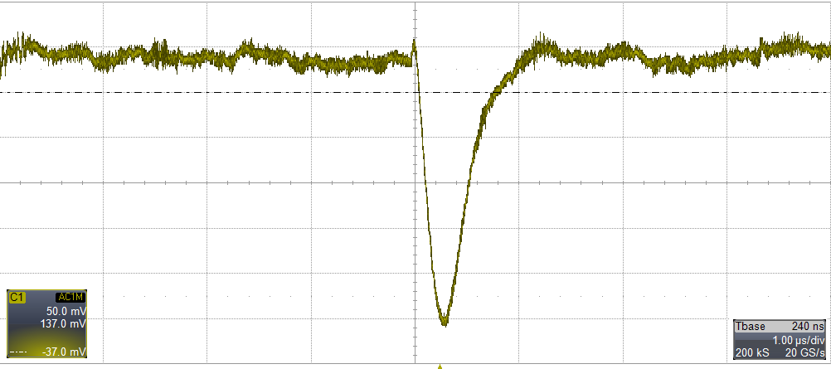
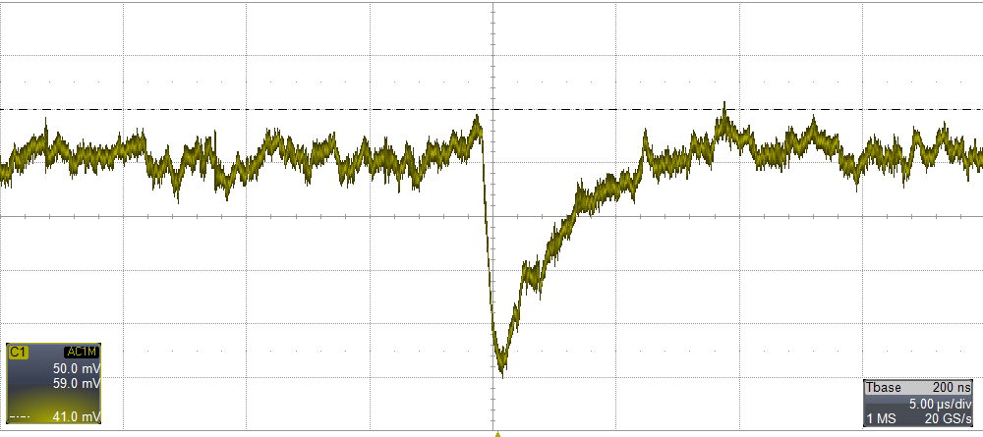
M33: X-ray counter
Developed as a proof of concept
16 x 18 pixels – 50 um pitch
In pixel:
CSA, shaper, comparator , 4bit counter and 4bit DC correction
SR⁹⁰ beta source
Fe⁵⁵ X-ray source
Chip is responsive
Due to the low gain problem the chip was not tested extensively
maciej.kachel@iphc.cnrs.fr
SR⁹⁰ beta source
Fe⁵⁵ X-ray source

Slide 13
M33: problem & second submission
The reason for the low gain/high noise was the wrong sensing element placed by the foundry
  Corrected version of chip was resubmitted and is expected in November 2014.
Foreseen tests
  Study the charge collection with different pixel pitch (25 um, 50um)
  Custom made sensing elements inserted
  Pixel designs modified, with AC coupled diode
maciej.kachel@iphc.cnrs.fr

Slide 14
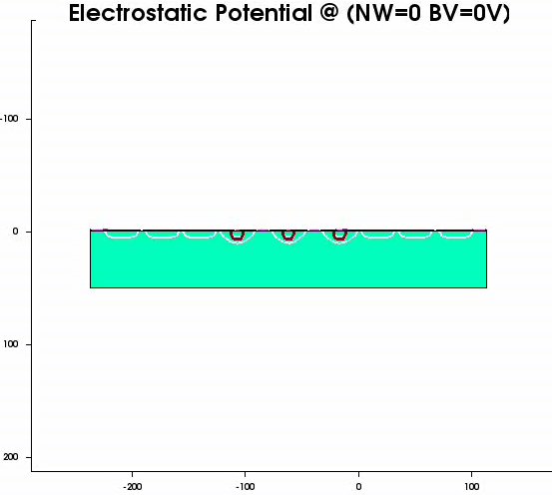
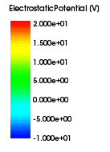
Use standard CMOS technology
Courtesy of T. Hemperek
Bonn University
maciej.kachel@iphc.cnrs.fr

Slide 15
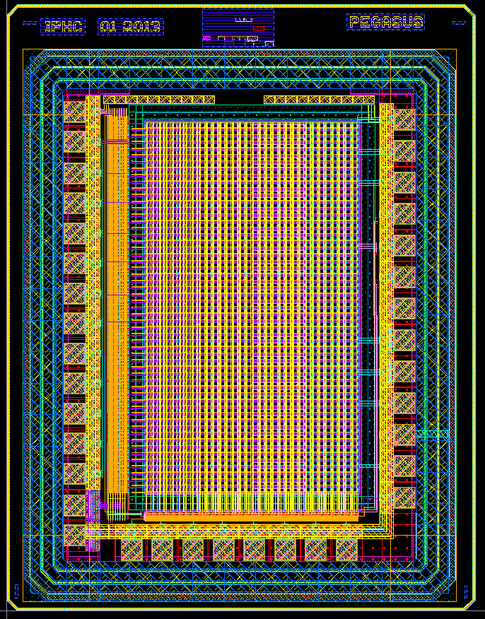
Pegasus
180nm CMOS (Tower)
Various types of epi in submission
25 x 25µm² pixels
Matrix - 56x32 with 4 versions of pixels
  Two source followers
  Two amplifiers
Amplifier
Input diode AC coupled with amplifier
Based on inverter
No bias needed
maciej.kachel@iphc.cnrs.fr

Slide 16
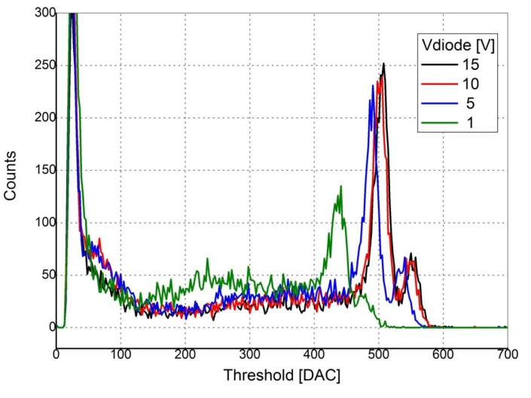
Pegasus – measurements results
Tests performed on the chips with a 18 µm thick epitaxial layer
Fe⁵⁵ spectrum with different diode voltage (seed pixel)
ENC ~25 e⁻
maciej.kachel@iphc.cnrs.fr

Slide 17
Pegasus depletion depth estimation
Pegasus chip (in-pixel amplifier)
Seed pixel
1400 e⁻ -> substrate with 18μm epi
maciej.kachel@iphc.cnrs.fr

Slide 18
Pegasus 2
Similar to Pegasus 1 (also 4 versions of pixels)
Problems with high frame rate in first submission
pixels optimized
  Rolling shutter readout -> 150ns per row
Tests just started
maciej.kachel@iphc.cnrs.fr

Slide 19
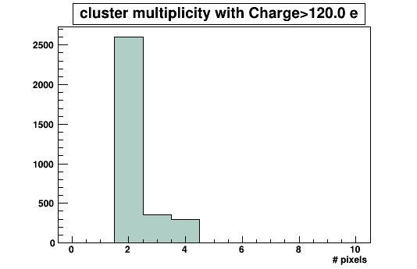
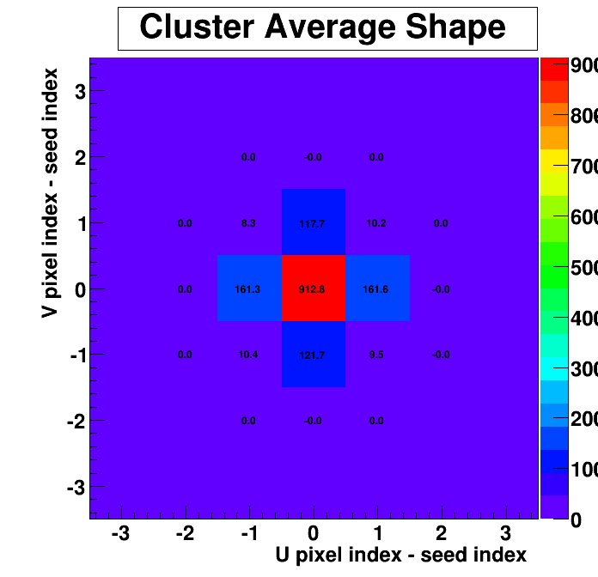
Pegasus 2
Cluster shape
maciej.kachel@iphc.cnrs.fr

Slide 20
Pegasus 2 preliminary measurements
Source follower:
Gain 17 uV/e- => C_{in} = 9.38 fF
ENC 17 e- (base)
28 e- (Fe peak)
Amplifier:
Gain 70 uV/e-
ENC 16 e- (base)
30e- (Fe peak)
Seed pixel
Seed pixel
maciej.kachel@iphc.cnrs.fr

Slide 21
Conclusions
With those „new” technologies MAPS looks promising for wide variety of low energy X-ray applications
Both approaches are promissing
  Charge collection – TOWER – full depletion of epi - most of the events in 1-2 pixels
  Small noise – 100 eV resolution at 6 keV
  Frame rate – to achieve the high frame rate goal -> 3D approach like professionals do
Study of the charge collection and depletion capabilities will be performed
  Charge collection with different pixel pitch (4µ, 25µ, 50µ)
  Response linearity with energy
  Sensitivity to 1 keV photons
  Depletion uniformity– Sr source, Edge TCT studies
  Neutron irradiated samples
maciej.kachel@iphc.cnrs.fr

Slide 22
Thank you for your attention

Slide 24
Motivation
Hybrids
Monolithic sensor
Advantages :
Different materials of detectors
Thick detectors for higher energies available
Radiation hardness
Disadvantages:
Pixel pitch
Hard to set the threshold low
Costs: Detectors, Bonding
Advantages :
Smaller pixels
Standard CMOS technology ($)
No bump bonding needed
Noise lower than in hybrid det. Due to small capacitance at the input
Disadvantages:
Low energy X-rays only ( < 20 keV )
Radiation tolerance smaller than in hybrids
Maciej Kachel

Slide 25
MAPS
Standard MAPS
Introduced at the end of the XXth century for digital cameras
Only NMOS transistors in pixels (PMOS would take part in charge collection)
Charge collection mainly through diffusion (low efficiency, no depletion)
Thin sensitive area – limited in Xray applications, but work with indirect detection
Used in various charge particle detection applications
Maciej Kachel
Notes:
Thin sensitive area – only few um of depletion… - limited in Xray appications, but work with indirect detection

