Slide 1
Endoscopic TOFPET
(Time of Flight Positron Emission Tomography)
& Ultrasound
Inna gertsenshteyn
March 24, 2014
Working with: Giacomo Cucciati and Marco Pizzichemi
Head of Project: Etiennette Auffray

Slide 2
Overall Projects and Goals

Slide 3
Focus
Pancreatic Cancer
Prostate Cancer
5-year survival rate: 6%
4th leading cause for cancer-related death in Western countries
No reliable method for early detection (yet)
Standard procedures: Ultrasound and CT scans
  Lack metabolic information
6th leading cause for cancer-related death amongst male population worldwide
Good prognosis if cancer confined to prostate and treated aggressively
Standard procedures: Ultrasound and MRI
  Lack metabolic information

Slide 4
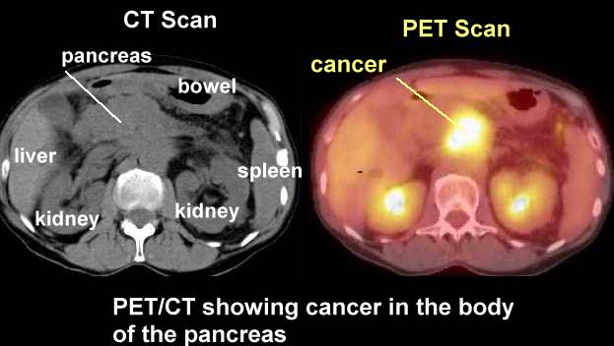
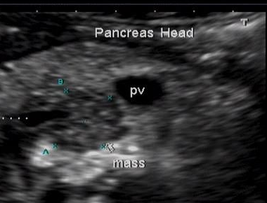
Ultrasound
Ultrasound
Ultrasound

Slide 5
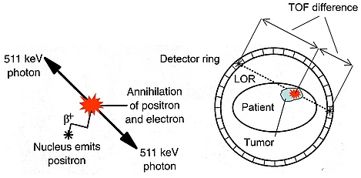
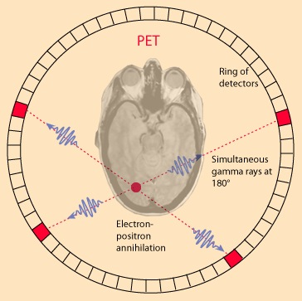
Typical Full-Body PET Scan
Fluorodeoxyglucose (FDG) injected into body
FDG is basically radioactive glucose
Cancerous cells process glucose differently to normal cells
FDG releases positrons, which break down and release gamma waves
PET scanner detects gammas
Images from scan highlight how FDG is broken down in body, giving insight into tumors’ metabolism
TOF = Time of Flight
LOR = Line of Response

Slide 6
Endoscopic PET probe

Slide 7
Close-up of probe
Ultrasound

Slide 8
What I Do
Currently working on simulation of phantom pancreas and surrounding organs/bones
(just in case, here is the pancreas)

Slide 9
Preliminary phantom prostate created on GAMOS 5.0.0
(to be used in future simulations)
Spine
Detector Plate
Bladder
Prostate
PET
Colon

Slide 10
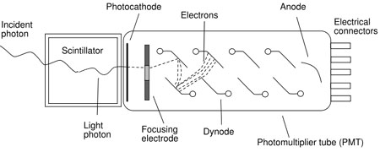
What I Do
Testing physical and scintillation properties of various crystals

