Slide 1
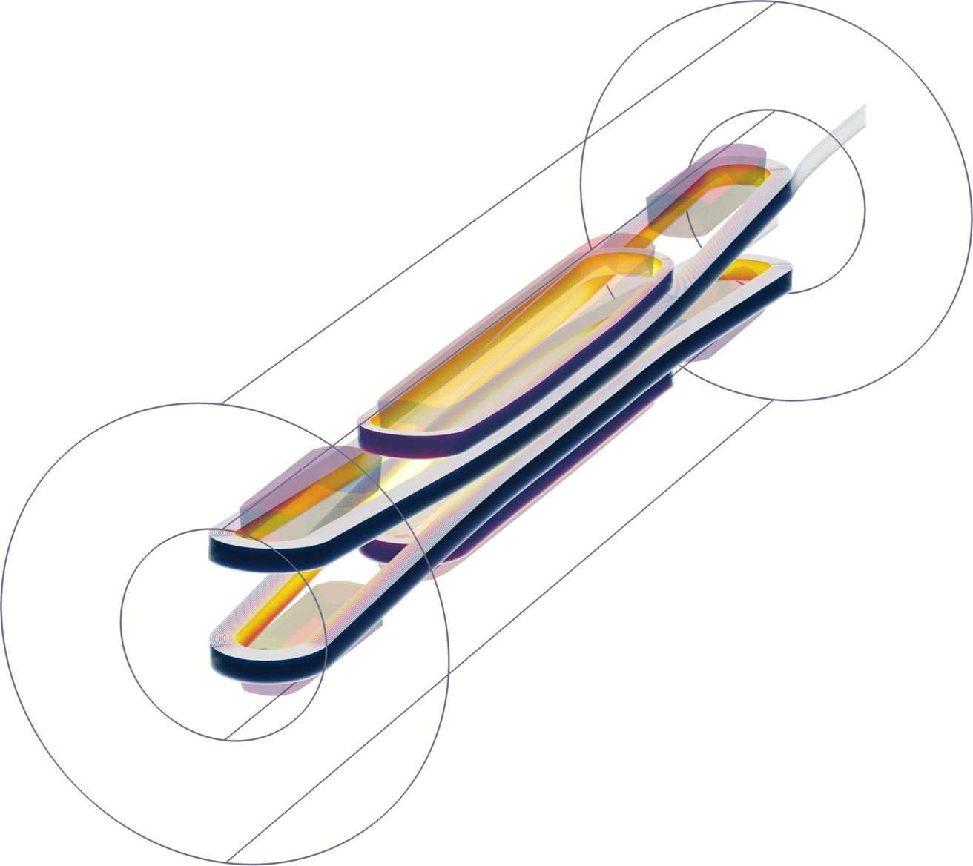

EuCARD-2 WP10.3
Update on progress CERN
Glyn Kirby
Jeroen Van Nugteren
Nabil Chouika

Slide 2
Overview
New student Nabil, progress with the three-dimensional COMSOL model of the Roebel cable,
Assembly of the next dummy Roebel cable, (stainless steel 100 microns copper plated 4 to 5 microns).
CTD Resin’s, Matrix of tests for resin impregnation system, selection, and discussion with KIT
Quench detection electronics overview of specification.
Feather zero small coil impregnation mould progress with drawings.
Visit report visit to CERN of Erkki and Antti ,
CCT 3D printed coil.

Slide 3
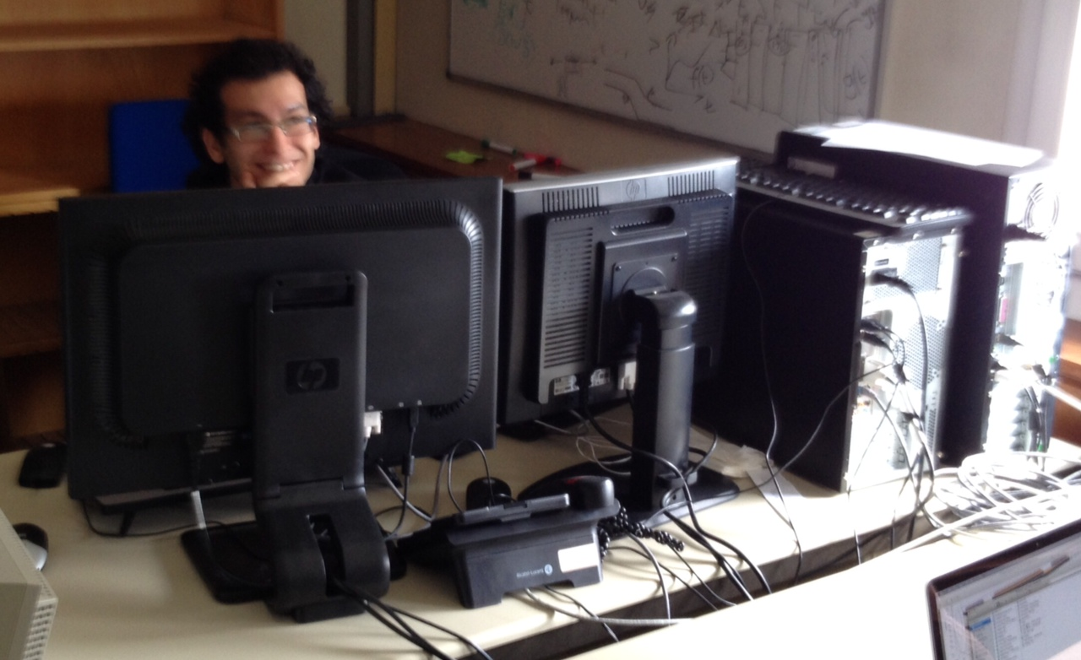
Nabil Chouika
Nabil Chouika arrived at the start of March for 6 months, Nabilnabil.chouika@cern.ch
He has made a good start on the Roebel cable mechanical model.

Slide 4
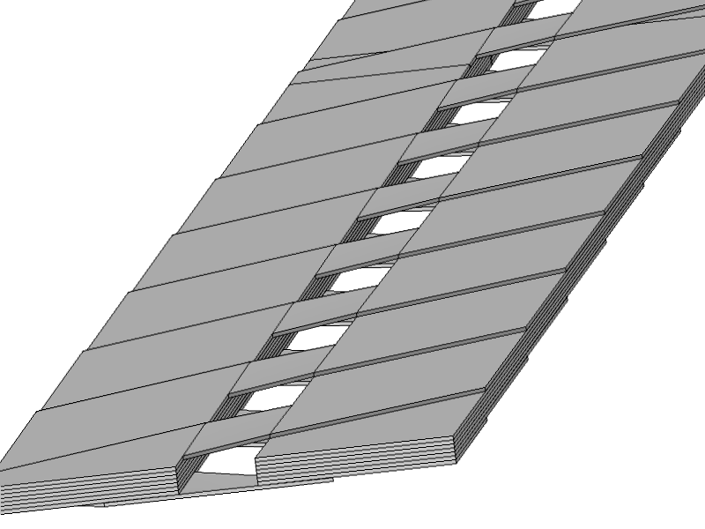
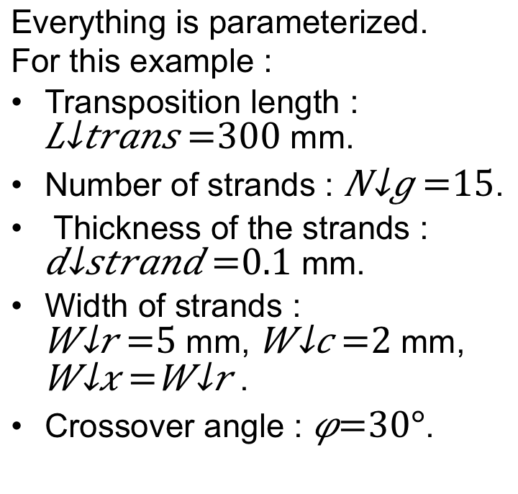
Geometry on Comsol
Everything is parameterized.
For this example :
Transposition length :
mm.
Number of strands : .
Thickness of the strands :
mm.
Width of strands :
mm, mm, .
Crossover angle : .

Slide 5
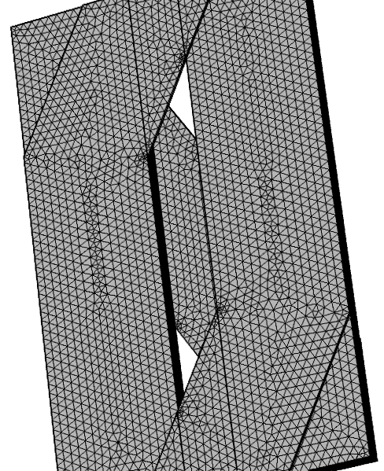
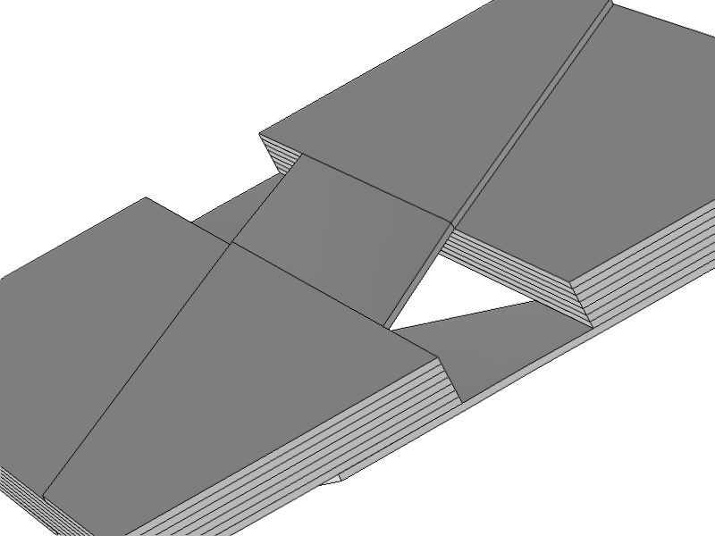
Geometry on Comsol
Easier to mesh
One unit cell (with symmetrical boundary conditions)

Slide 6
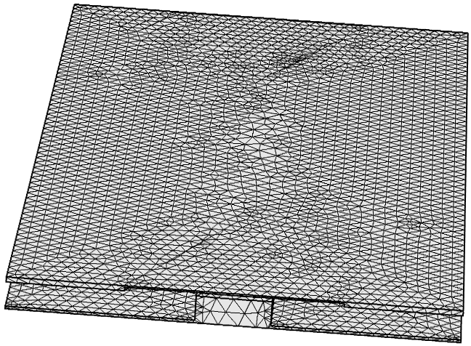
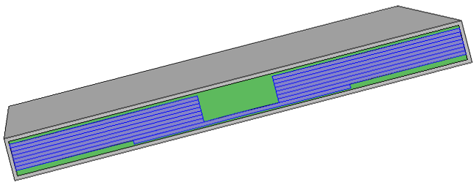
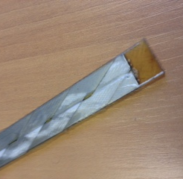
Geometry in Comsol
Mesh of the Resin
Resin (green) filling the gaps around and between
The YBCO tape-strands (purple)
Turn to turn insulation glass rap (grey)

Slide 7
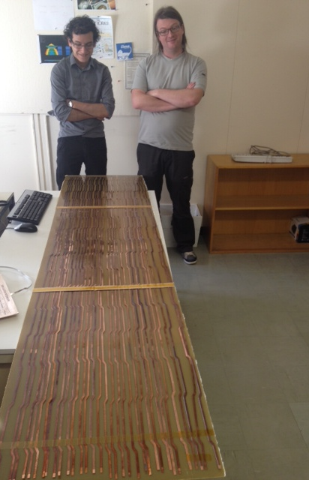
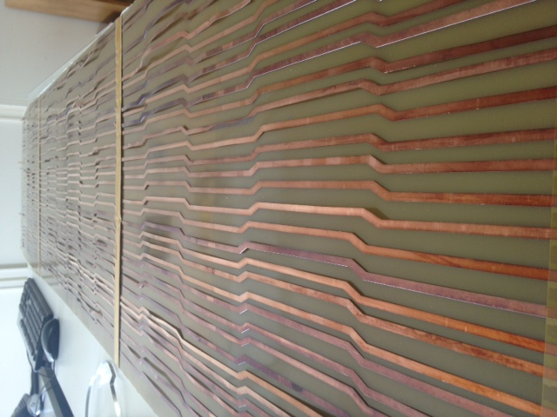
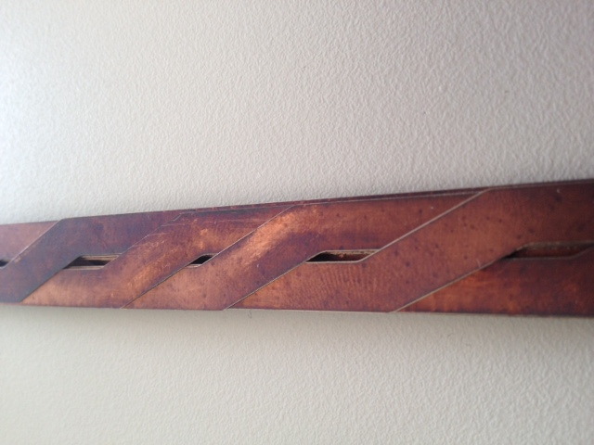
Dummy Roebel cable assembly

Slide 8
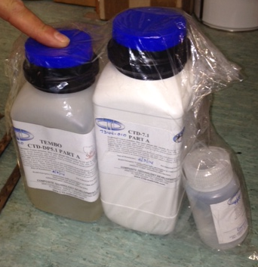
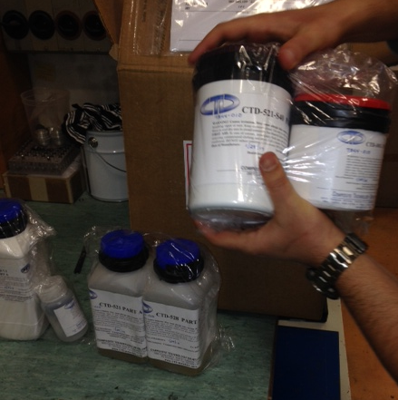
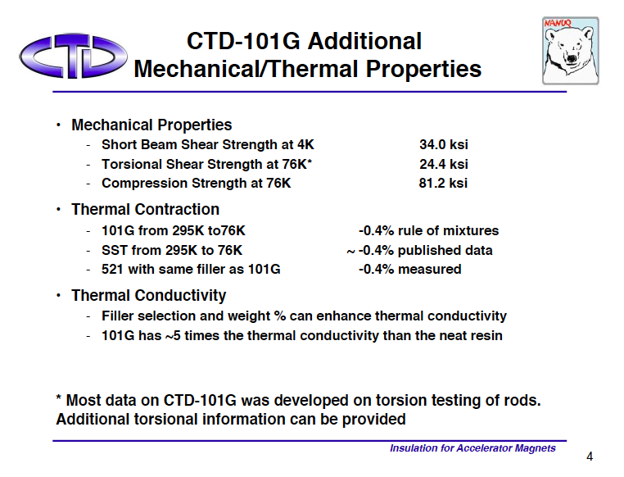
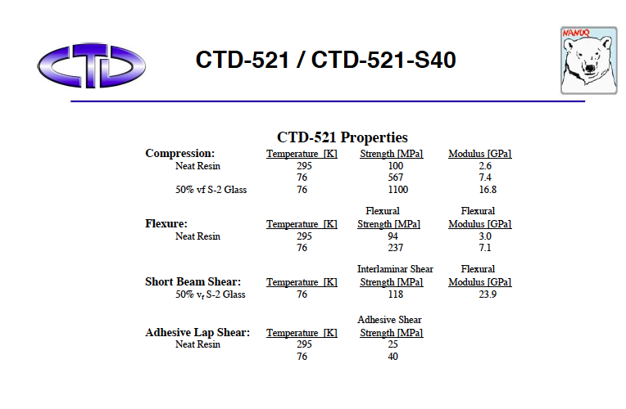
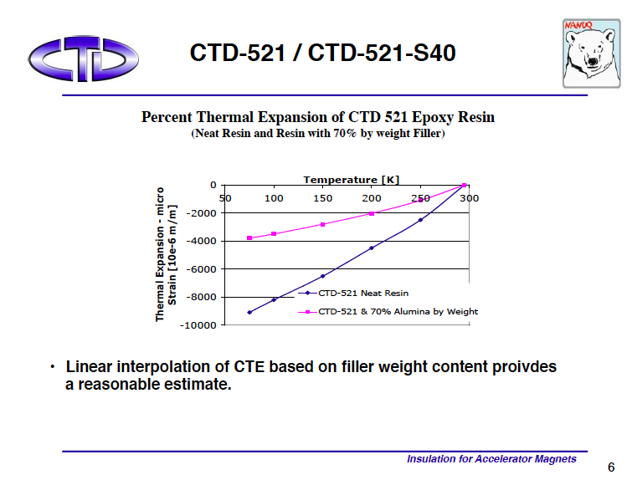
CTD Resin’s.
We ordered and have received the following set of resins: CTD521, CTD528, CTD101(G/K) CTD7.1, CTD-DP5.1.
One kg of each.
Compressive Stress limit 558 MPa,
-0.4% thermal contraction.

Slide 9
List of Resin test ideas
We need to examine compatibility of:
(a) basic material (tape),
(b) punched material,
(c) punched striated material, and
(d) cables
with the insulation system:
(i) Resin,
(ii) Charged resin,
(iii) Composite of resin/charged resin and glass fiber, or a kapton wrap may be).
The potential issues are:
1. ability to impregnate/insulate (resin flow, adhesion)
2. chemical compatibility
3. influence on Jc of curing cycle
4. effect on tape of thermal stresses during polymerization and cooldown

Slide 10
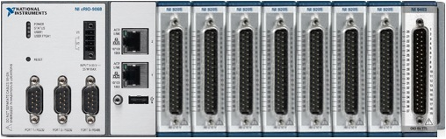
HTS Quench DAQ
NI-CompactRIO
Received at CERN 14 March
7 modules: 16 differential analog inputs each
+/- 200 mV till +/- 10 V input range
16 bits
7.8 kS/s per channel
1 module: 32 digital outputs
5 V TTL
7 µs response time
Also available: high speed module
4 differential analog inputs
16 bits
1 MS/s, simultaneous sampling
30 cm
Processor:
667 MHz dual-core ARM
512 MB RAM
1 GB storage
NI Linux Real-Time OS
FPGA:
Xilinx Artix-7
2 M cells
A similar system is used by the EL group to capture voltage transients on the electrical network caused by EDF switching, thunderstorms and internal load changes.

Slide 11
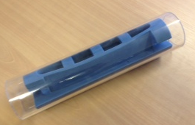
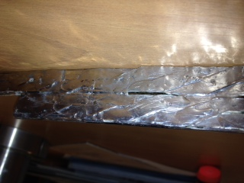
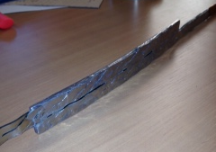
Soldered layer jump,
This was our initial design for feather zero version 1.
We soldered two lengths of dummy Roebel cable to a copper backing plate. But later we realised the quench detection system would be vulnerable to the varying current position that we anticipate in this design of layer jump.
Hence we moved to a “S” shaped layer jump

Slide 12
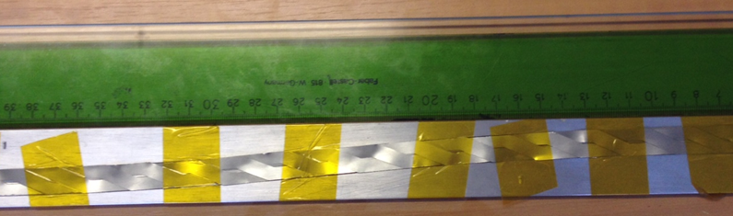
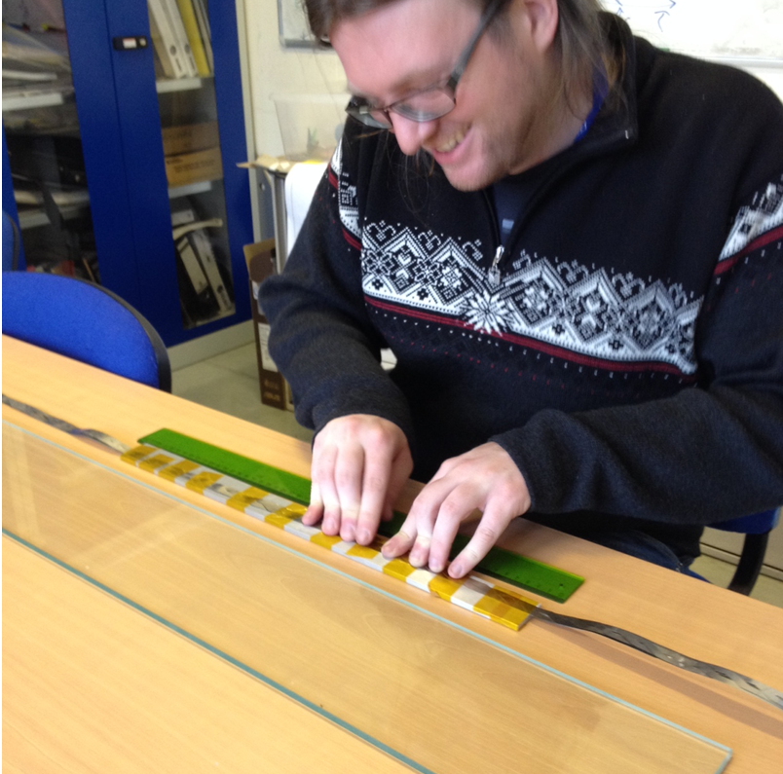
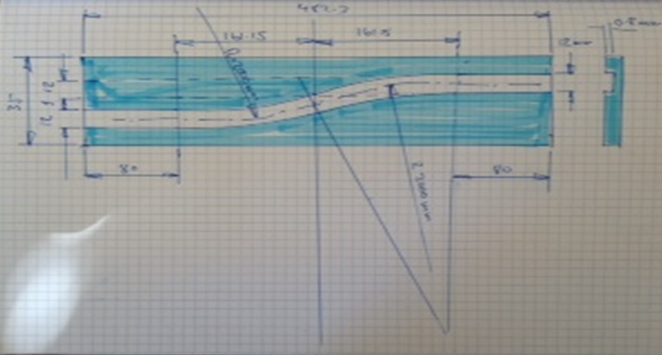
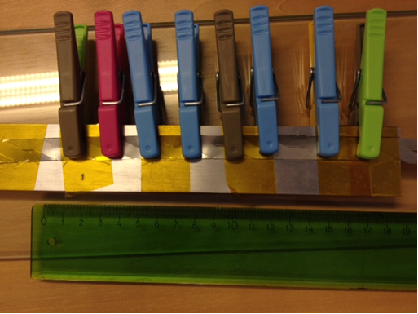
Machine groove in aluminium bar used to test if it is possible to deform the cable to that shape.
We may want to cold test this individually to see if the superconductor is damaged after fixing into the layer jump.
Layer Jump testing

Slide 13
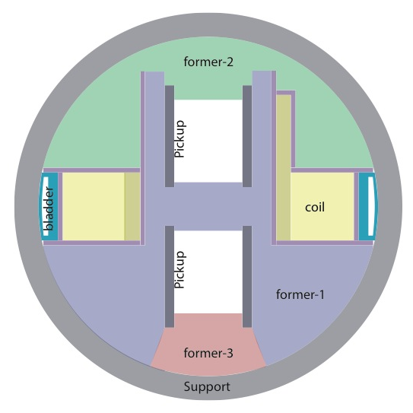
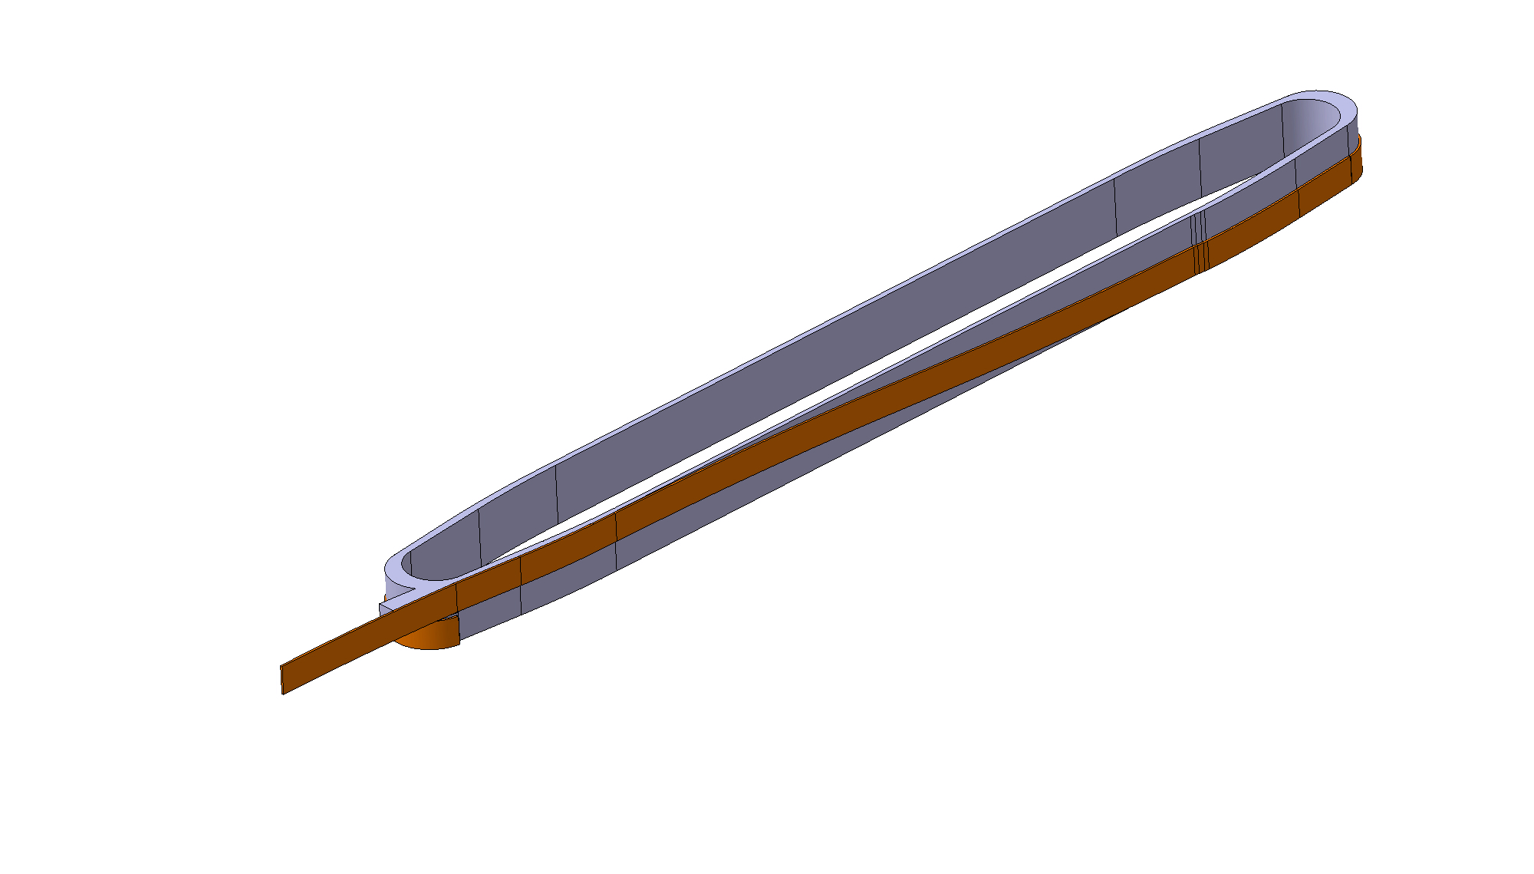
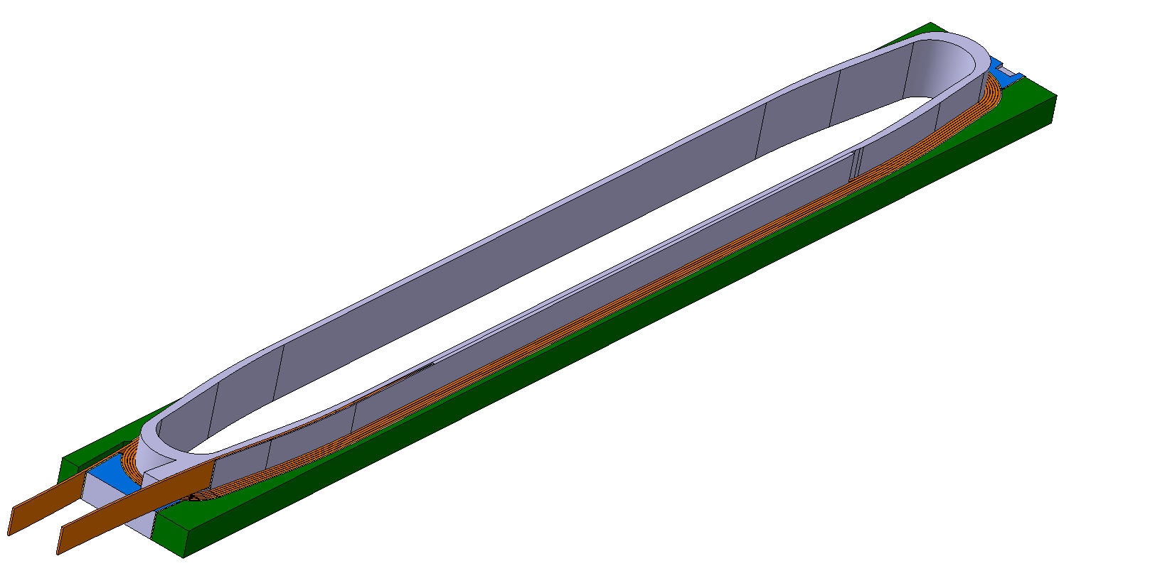
Feather former cross section.
Coil impregnated with central former and pads
Not to scale

Slide 14
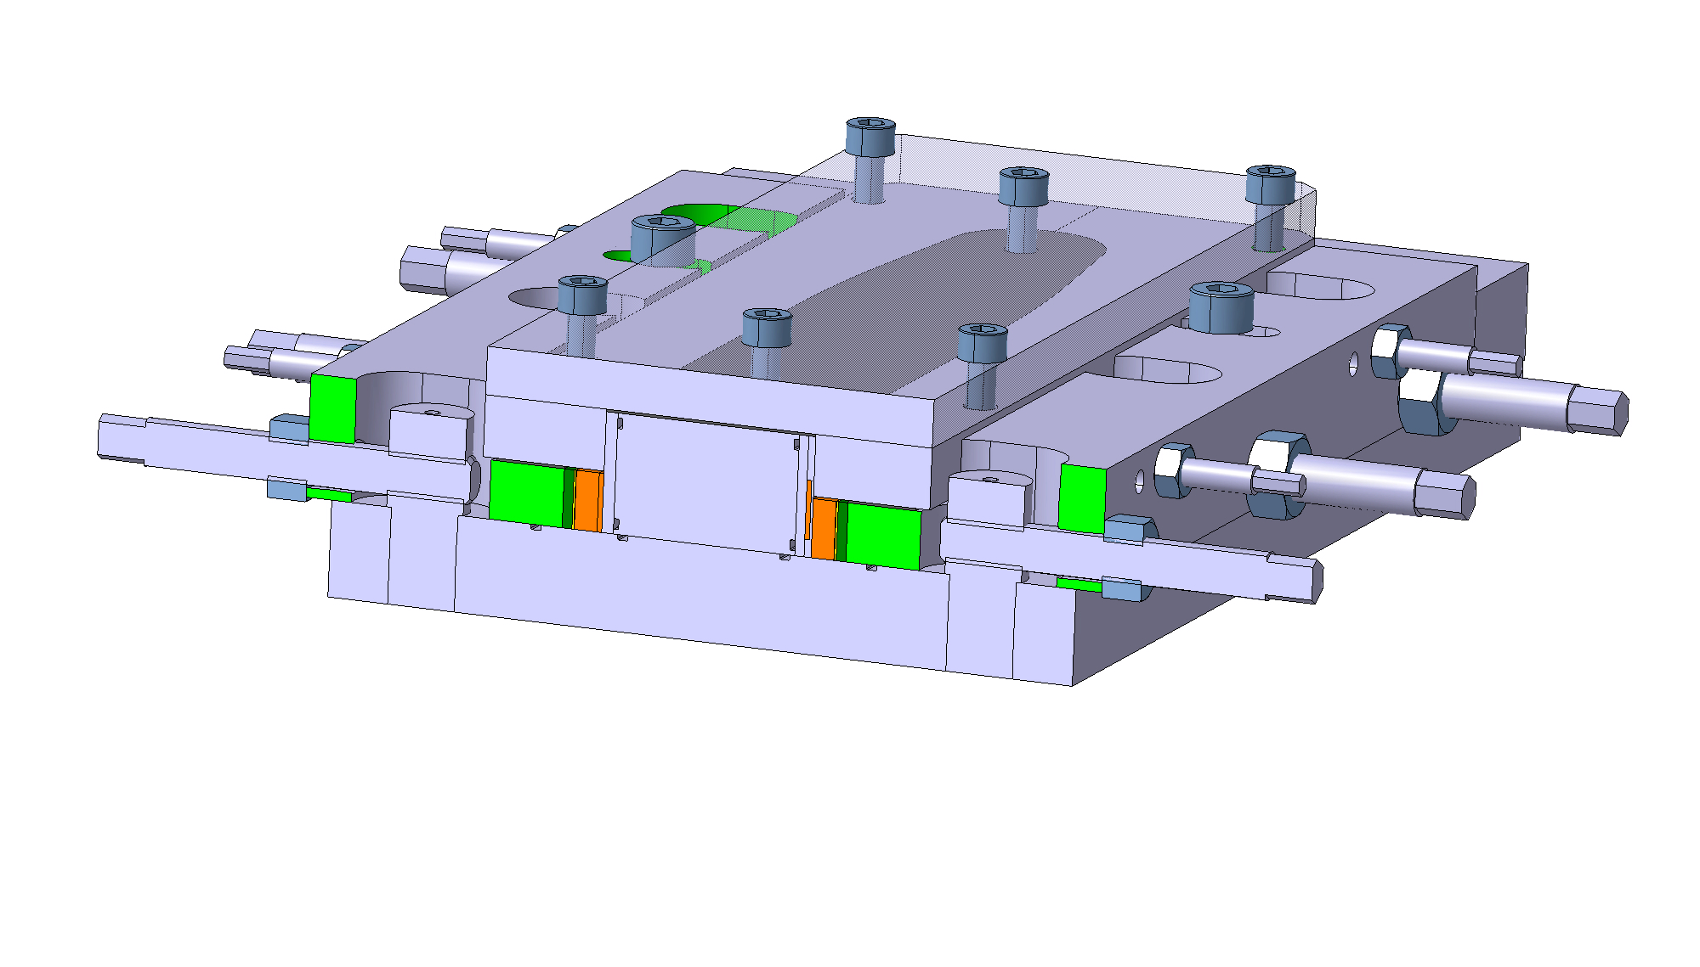
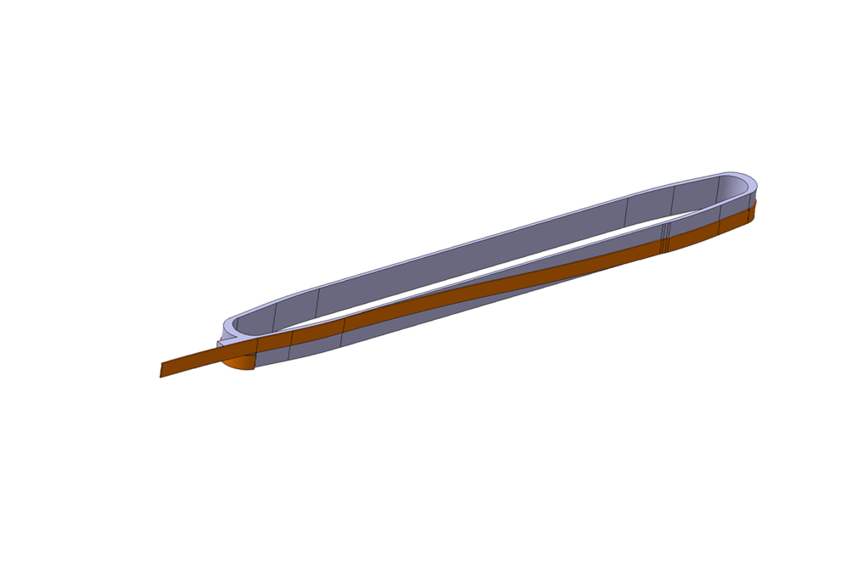
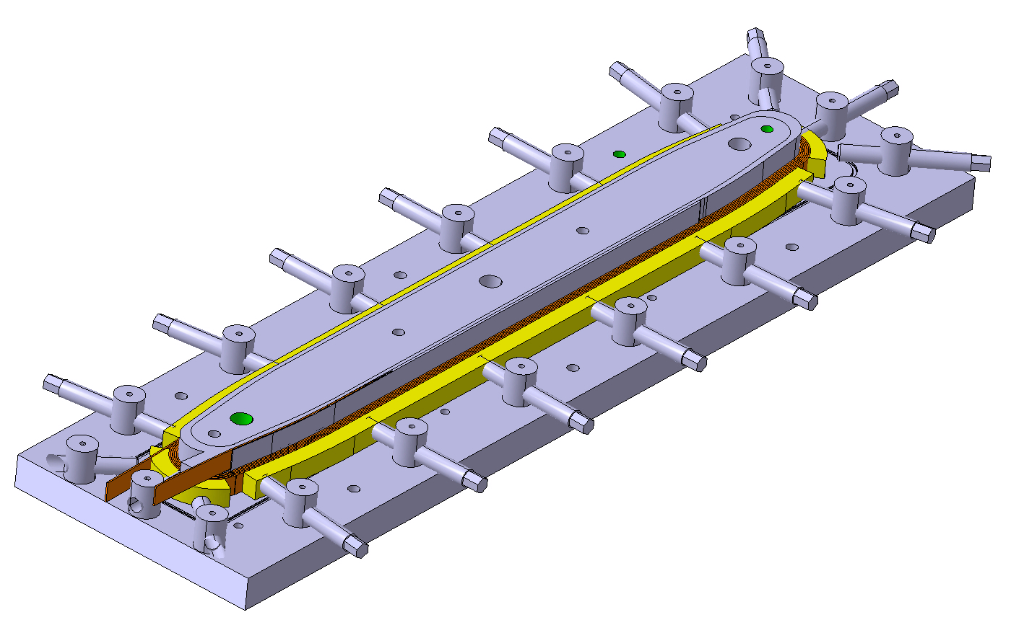
We are starting to work on the impregnation mould for
feather zero

Slide 15
Meeting Tampere-CERN
Location and Time
  CERN, at Glyn’s office, cafeteria, and visits to workshops
  10-13.03.2014 (Antti left 11.03. to teach)
Attendants
  Erkki Haro
  Glyn Kirby
  Jeroen van Nugteren
  Antti Stenvall
Discussed
  Numerical tooling for the calculation of quenches
  The construction of small scale test coils and their modelling
  Problems related to constructing YBCO coils from Roebel
  Need for geometry/mesh exchange
  Erkki, will come to CERN Sep. to Dec. 2014

Slide 16
Mesh Generation
For Finite Element Calculations it is necessary to have a mesh on which the differential equations are solved
Steps for acquiring the mesh were:
  generate a CAD model
  Import geometry in COMSOL
  Mesh domains
  Export mesh
There are three problems
  It takes a lot of time for each mesh
  No information on the conductor orientation were available
  Possible to calculate current direction in COMSOL but not very nice interface
Idea: implement mesh generation in Field 2014

Slide 17
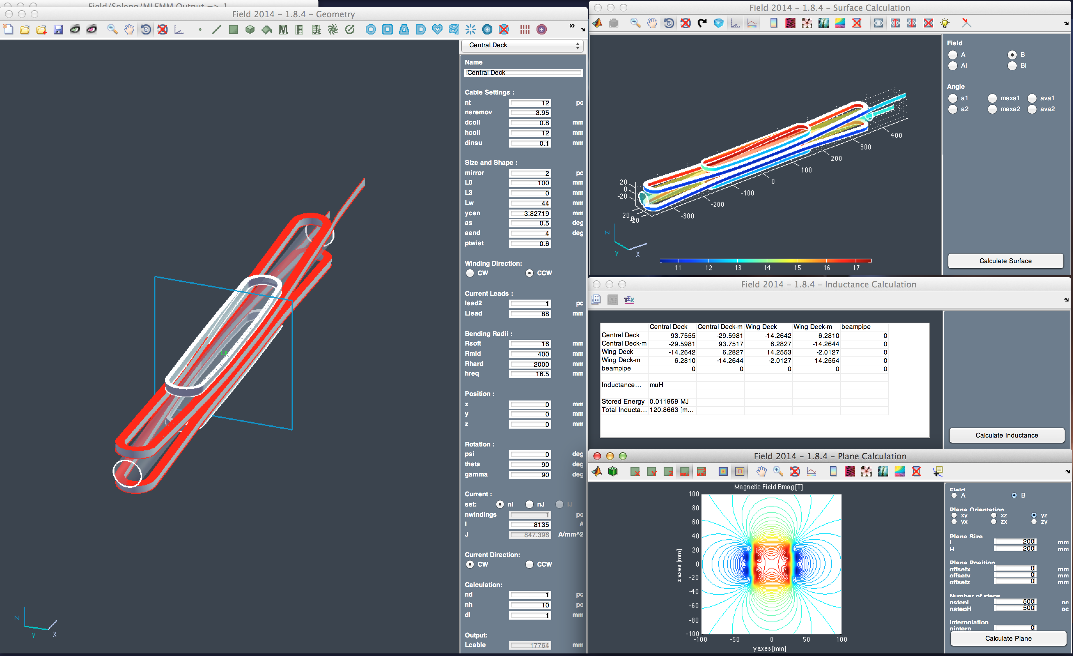
Field 2014

Slide 18
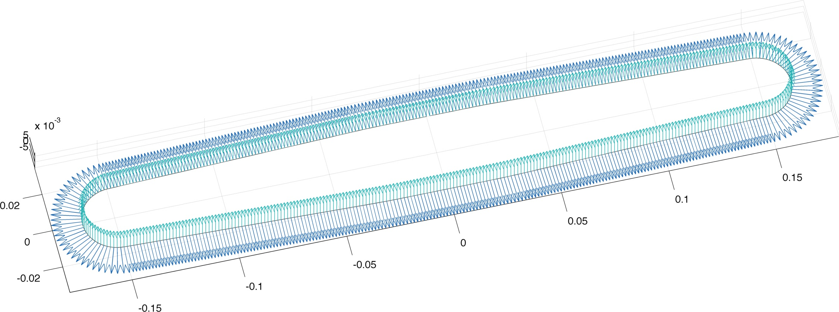
Coordinates in Field
Directly generate mesh from conductor coordinates
Coordinates as stored in Field 2014
  Coordinate of inner edge X
  Normal vector Xn
  Radial vector Xr
  Direction vector Xl
Xn
  Xr

Slide 19
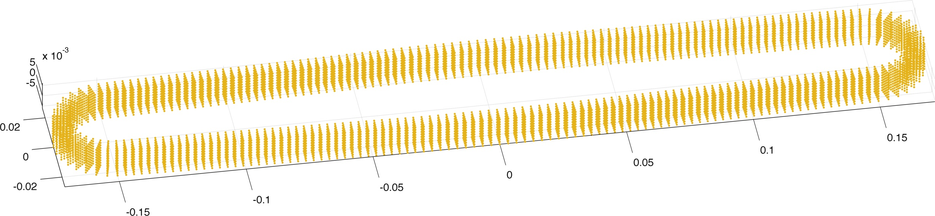
Nodes and Elements
The coordinates are copied
  in the normal direction
  in the radial direction
The elements are formed by splitting the cubes into five tetrahedrons
3
5
1
4
2

Slide 20
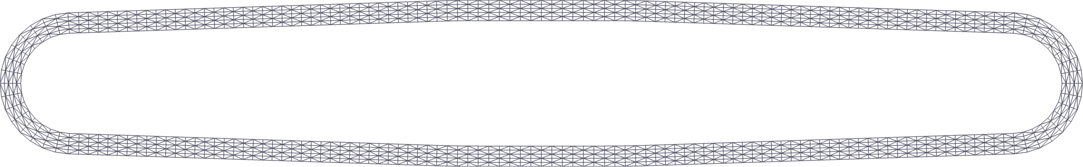
Field Output
The resulting mesh in Field 2014
The mesh is then written to .msh format native to GMSH
Also stored are data files with
  The magnetic field contribution of each coil on each node (no longer need air domain)
  The orientation of the conductor on each node
  Information on the system such as number of windings, current and the inductance matrix
All steps are fully automated and can be used on any geometry that can be modeled with Field 2014
Now awaiting first results from Tampere side (=

Slide 21
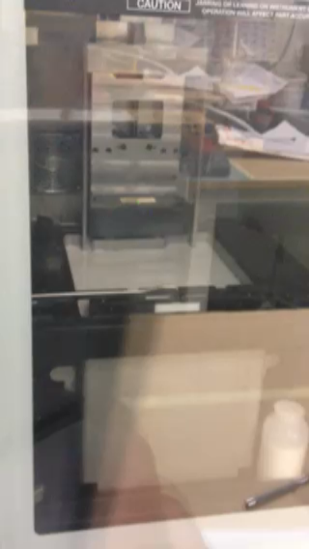
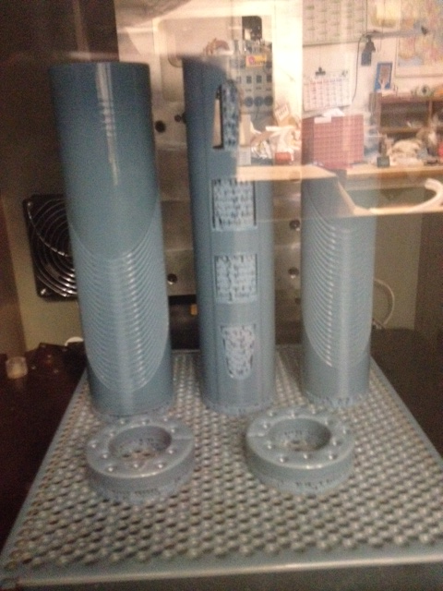
Video of 3D printing at CERN

Slide 22
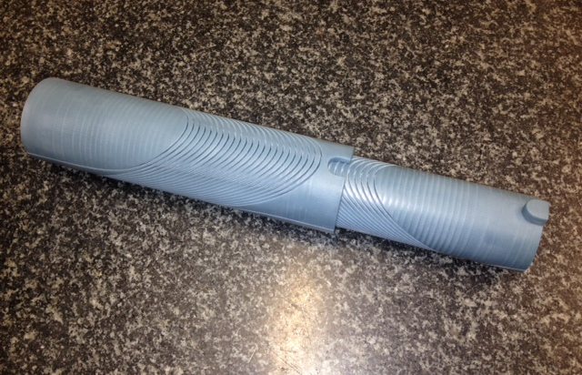
BSCCO coil ideas, CCT 3D printed coil former

Slide 23
Thank you for your attention

