Slide 1
Vacuum activities during LS1
Jose A. Ferreira Somoza on behalf of TE-VSC-IVM team

Slide 2
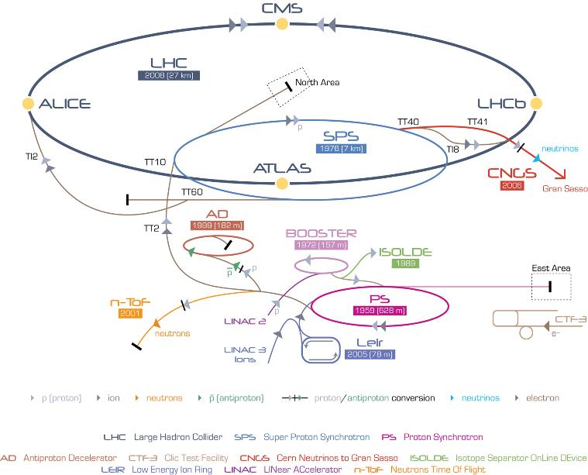

Slide 3
LS1 works: few numbers
Equipment | #
Ion Pumps | 160
Valves | 15
Gauges | 40
Ti sublimators | 100
TMP pumping groups | 5

Slide 4
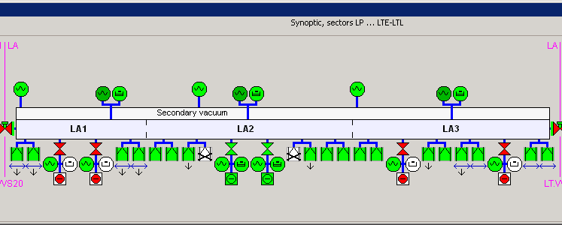
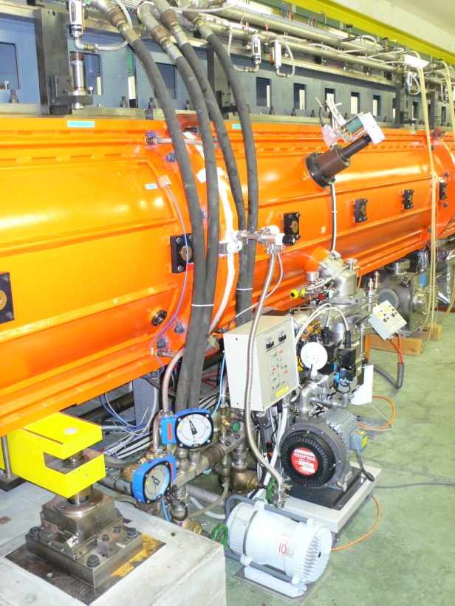
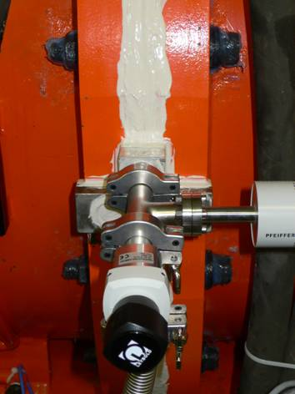
Problems found during LS1
2xVPIs in tank2 of LINAC2 lost
Fixed pumping groups: 3e-7 mbar

Slide 5
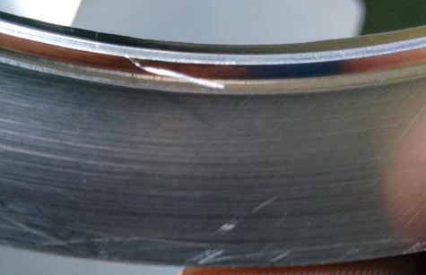
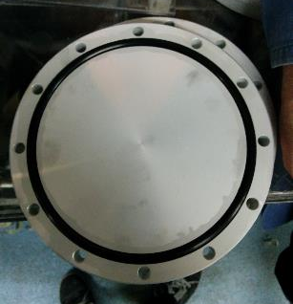
Problems found during LS1: Seals
PS195 seal
Low quality o-ring
Dust from fiber glass (insulation)

Slide 6
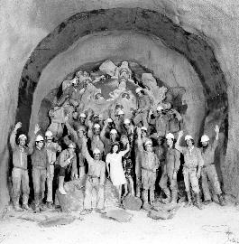
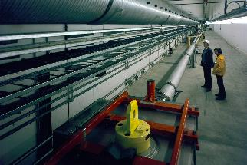

LS1 works: Work in hot areas
1974
Recabling LSS1 (SPS). 120 m of beam line dismantled (reduction of ambient dose) in summer 2013. Reinstallation spring 2014.
Vacuum consolidation north area of SPS
1978
>5 mSv/h

Slide 7
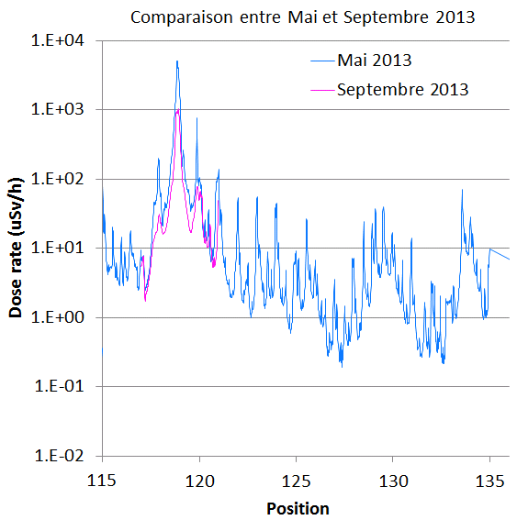
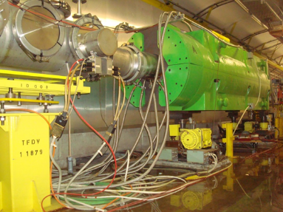
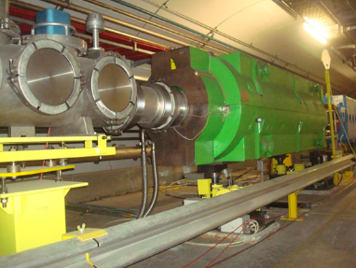
Recabling LSS1 of SPS
5 mSv/h
10 mSv/h
2 mSv/h
4 mSv/h
TIDVG
TIDH
  Peak dose rate reduction factor ≈ 5 (initial estimation ≈ 2)
  Average dose rate reduction factor in LSS1+ ≈ 3.2

Slide 8
Interventions in hot areas: steps
Gather information
Define steps
Tooling and training
Action
Lessons learned
Any discussion in the field has to be avoided!

Slide 9
Sources of information
Drawings and pictures (2D, 3D)
Immersive 3D
  High-Definition Surveying (Laser scans)
  360º cameras
Robot inspections

Slide 10
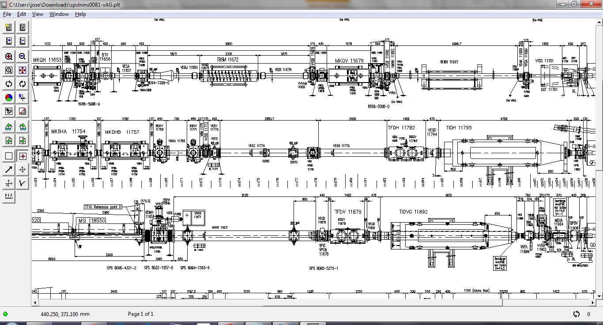
Drawings
Portable (paper)
2D

Slide 11
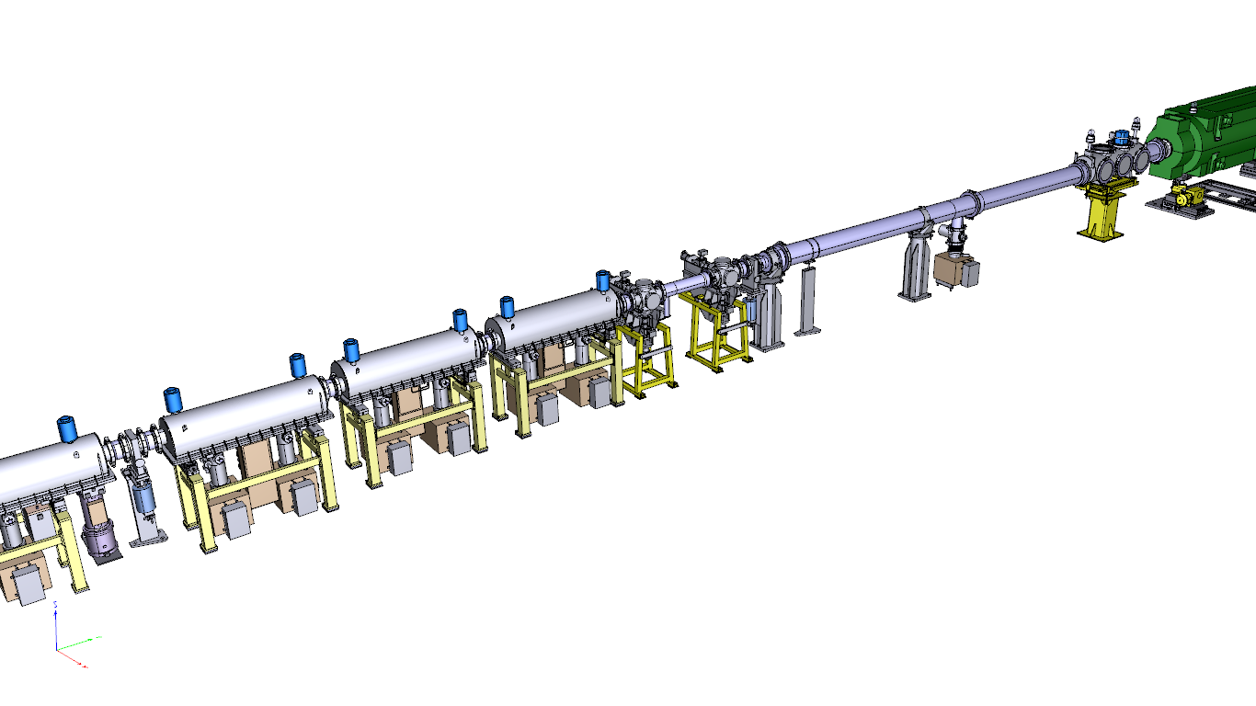
Drawings
3D
Easy manipulation of virtual world

Slide 12
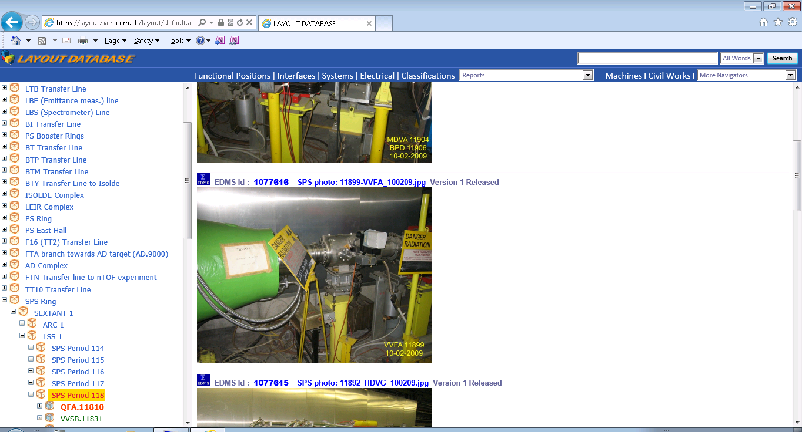
Pictures

Slide 13
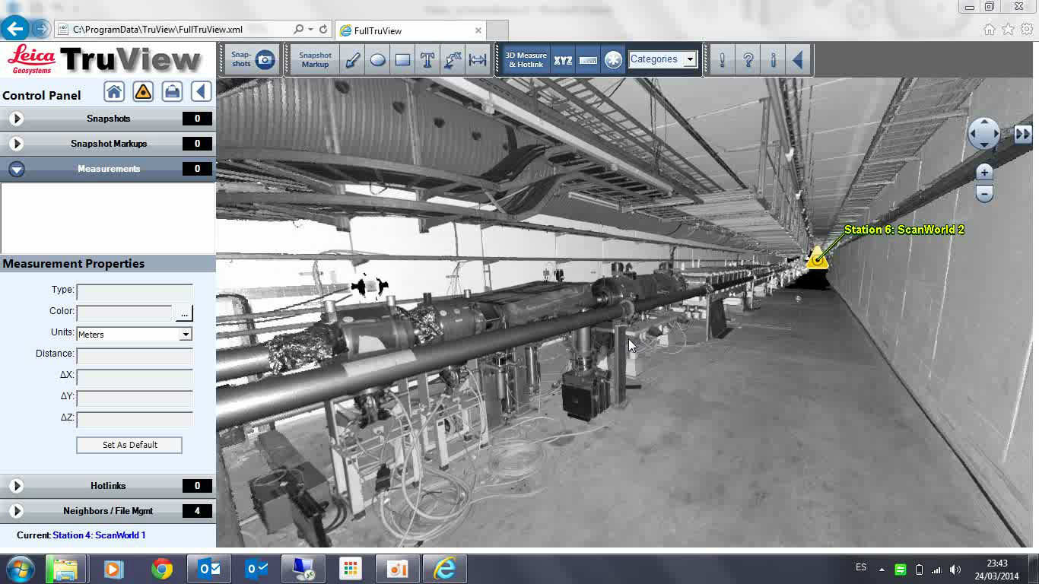
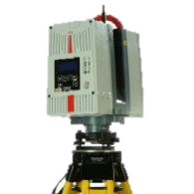
Immersive 3D (High Definition Survey)

Slide 14
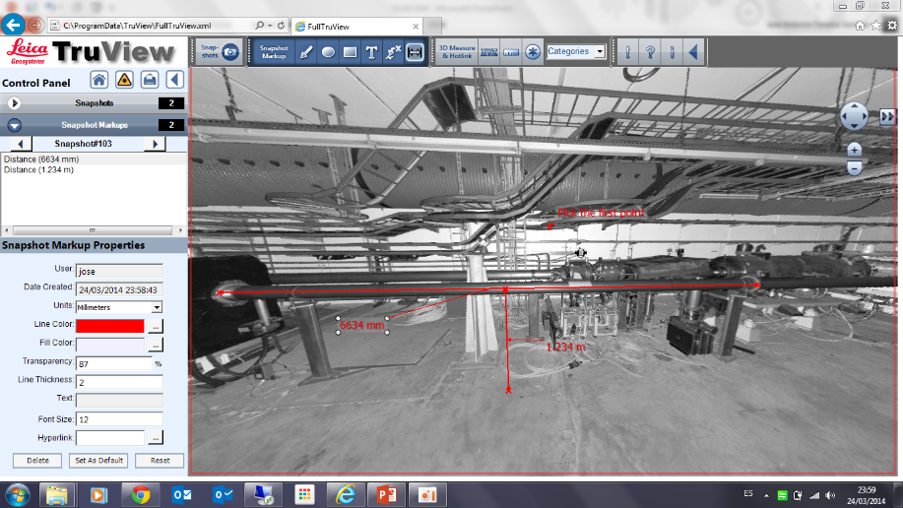
Immersive 3D (High Definition Survey)
Real 3D model
Exportable to CAD
Measure

Slide 15
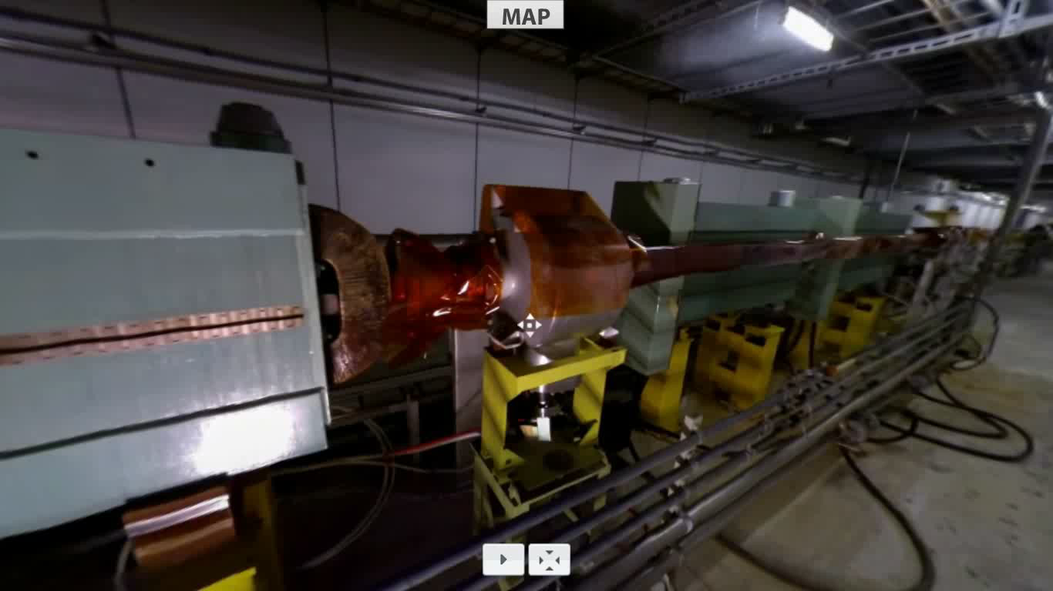
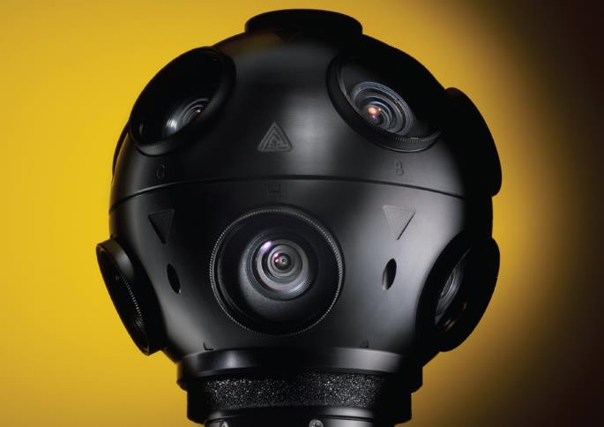
Immersive 3D (360º video)

Slide 16
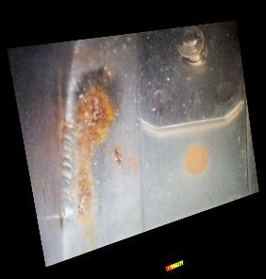
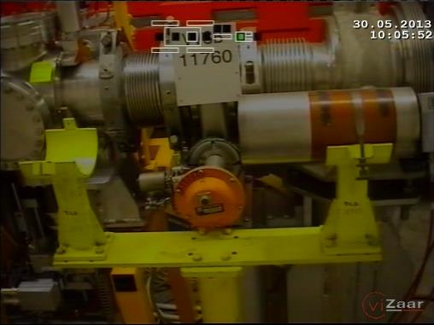
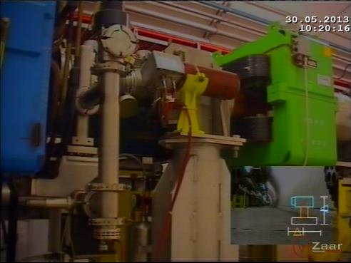
Robot Inspections

Slide 17
Outcome: Work Dose Planning

Slide 18
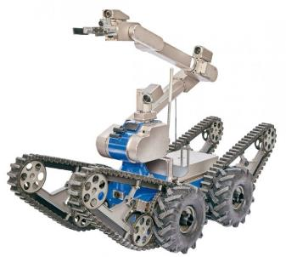
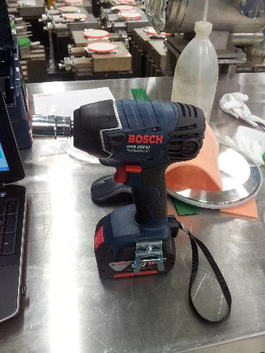
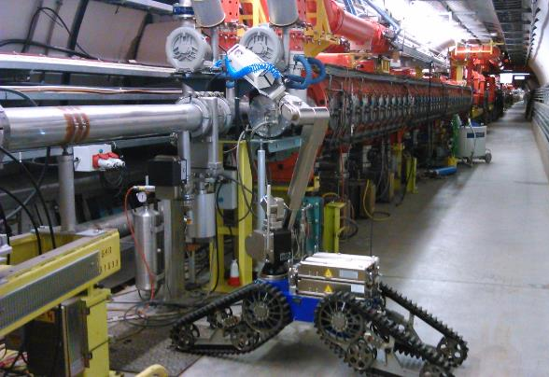
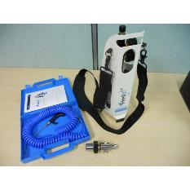
Tooling
Telemax
Leak detection with remote operated robot
HeliJet

Slide 19
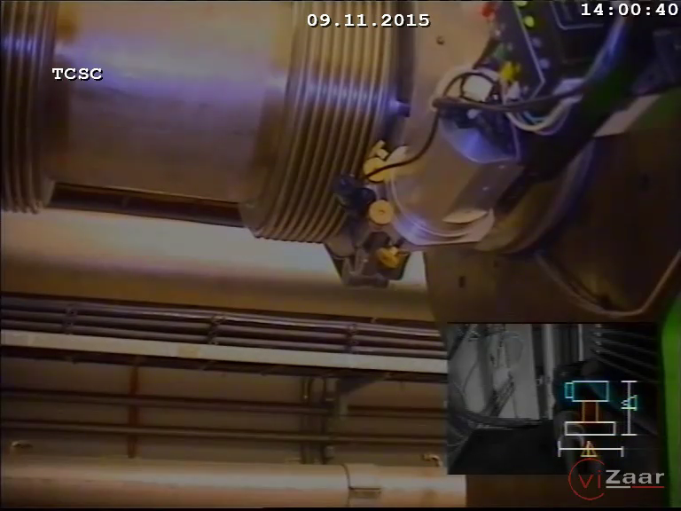
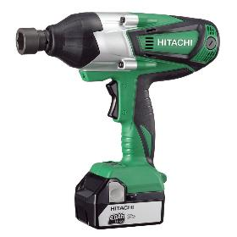
Tooling
Telemax
Impact wrench

Slide 20
Robot vs Human
Costs
Difficult operation (trained personnel)
Time consuming
Remote operation → 0 dose
Remove 1 clamp
Torque wrench: 2-3 minutes
Cordless impact wrench: 20-30 seconds
Robot: 15-30 minutes

Slide 21
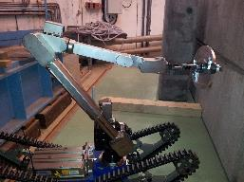
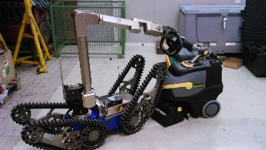
Interventions during LS1
Robot:
  Inspection
  Leak detection
  Removal of clamps
  Cleaning
  Install 1 flange (12 mSv/h)
>60% reduction of the collective dose

Slide 22
Conclusions
An important period is coming to an end
Objectives during this period: consolidation + support other activities
Some complex tasks in very hot areas
The use of new techniques are extremely helpful to reduce the collective dose

Slide 23
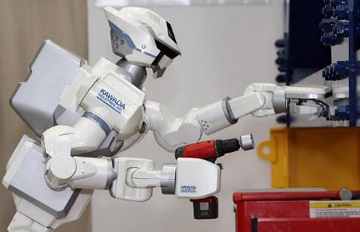
Thank you for your attention!

